Slide 1
AWS Elastic Kubernetes Service (EKS) with Fargate QuickStart
Kirk Kalvar
Senior Software Engineer/Principal
KAL Technology
kirk.kalvar@kal.technology
@kskalvar

Slide 2
So How Did I Get Here?
Use Docker for development but quickly realized if you want to do anything serious with containers in production you need orchestration
Wasted way too much time on orchestration engines
Highly Desirable: Production grade development environment
Highly Desirable : Something that would scale easily
Highly Desirable : Something for developers to use without all the drama, tool fatigue, etc.
Highly Desirable: On demand

Slide 3
Introduction
So Kubernetes has established itself as the leading platform for managing containerized workloads and services.
Run Anywhere
63% of Kubernetes workloads run on AWS today – Cloud Native Computing Foundation (AWS News Blog by Jeff Barr, 29 November 2017)

Slide 4
Why AWS EKS Fargate?
AWS Managed Services enables you to quickly and easily deploy your cloud infrastructure
Amazon EKS is already integrated with many AWS services to provide scalability and security for your applications, including the following
Load Balancing for load distribution
IAM for authentication
VPC for isolation
Amazon EKS runs up-to-date versions of the open-source Kubernetes software. Currently 1.14
You can easily migrate standard Kubernetes applications to Amazon EKS
On Demand

Slide 5
Requirements
AWS Account (root)
An EC2 Instance in which to install eksctl, kubectl, aws-iam-authenticator, and AWS CLI version 1.15.x or greater
Installation time about 15 minutes based on presentation artifacts

Slide 6
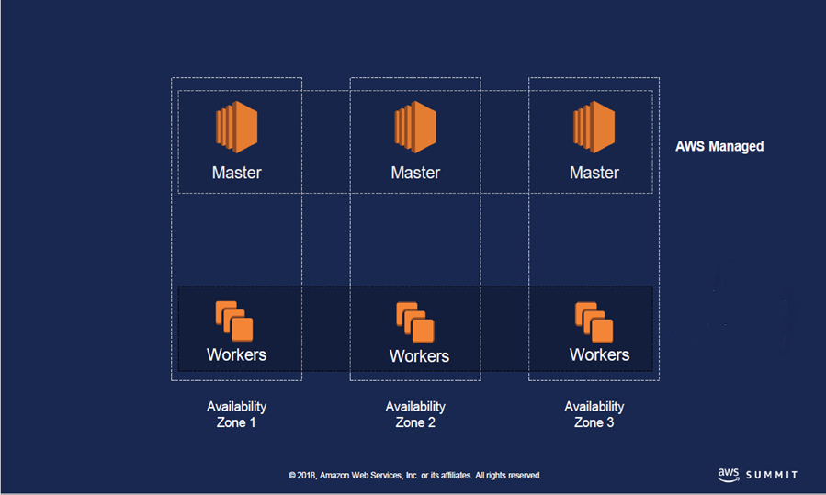
Architecture
Amazon EKS with Fargate
AWS Managed Fargate Nodes

Slide 7
AWS Fargate Profile
The Fargate Profile under defined under AWS EKS is responsible for setting up and managing the serverless worker nodes based on a namespace
Each profile can have up to five namespaces
Pods that match a namespace are scheduled on the Fargate Profile with matching namespace

Slide 8
Installation Steps
Create an EC2 Instance to be used as a eks_cloud_shell
Create an EKS Cluster
Create an IAM OIDC Provider
Create a Kubernetes ALB Ingress Controller
Create a Fargate Profile with an Associated Namespace
Deploy Simple WebApp to Your Cluster (Using the Namespace define in the Fargate Profile above)
Run manual and automated scaling of the WebApp
Configure the Kubernetes Dashboard (Optional)
Remove AWS EKS Cluster

Slide 9
Quick Demo
To save time an AWS EKS Cluster with a Fargate Profile called “web-namespace” has already been configured using eksctl
We’ll:
Create and deploy an Ingress Controller
Create a deployment and service for a simple webapp
Scale the webapp to show Fargate scaling nodes dynamically
Show an unique ip as it is load balanced across the webapp containers
Configure the Kubernetes Dashboard (optional)

Slide 10
Notes
Fargate is limited to 100 Nodes per account initially. This limit is adjustable and you can request a Quota increase to a higher value based on the requirement.
When deleting Fargate Profiles you must delete one at a time or you can delete the entire cluster and all Fargate Profiles will be deleted at once.

Slide 11
Conclusions
Cons
Configuring AWS EKS with Fargate requires the use of eksctl right now. Not what I would expect for a AWS Managed Service
Still requires more manual configuration then I would normally want.
We used cloud-init and shell scripts to speed the configuration process
Pros
Provision Kubernetes across AWS Availability Zones
No need to provision node groups
Scales up and down very quickly
On Demand

Slide 12
Questions?

Slide 13
References
AWS EKS Fargate QuickStart
https://github.com/kskalvar/aws-eks-cluster-fargate-quickstart
AWS Fargate
https://docs.aws.amazon.com/eks/latest/userguide/fargate
How do I set up the ALB Ingress Controller on an Amazon EKS cluster for Fargate?
https://aws.amazon.com/premiumsupport/knowledge-center/eks-alb-ingress-controller-fargate

