Slide 1
4 ME Project
BLT Development

Slide 2
BLT
Client: Malcam Trust Foundation
Value Statement:
“BLT has addressed the problem of our clients lack of knowledge in the modern technology field.”
The foundation was established early in 2014 and currently they are rolling out a their 4ME project which engages the youth using modern technology.

Slide 3
Functional Requirements – System
The System shall:
have physical interactions
have community involvement
allow modifications
provide career information through multimedia

Slide 4
Functional Requirements – User
As a User I:
can gain knowledge for a particular career
want to see other similar career paths
want to see different careers in the same category

Slide 5
Software Interaction
No current end goal for software.
Client is unfamiliar with current generation, and are unsure on what they need developed.

Slide 6
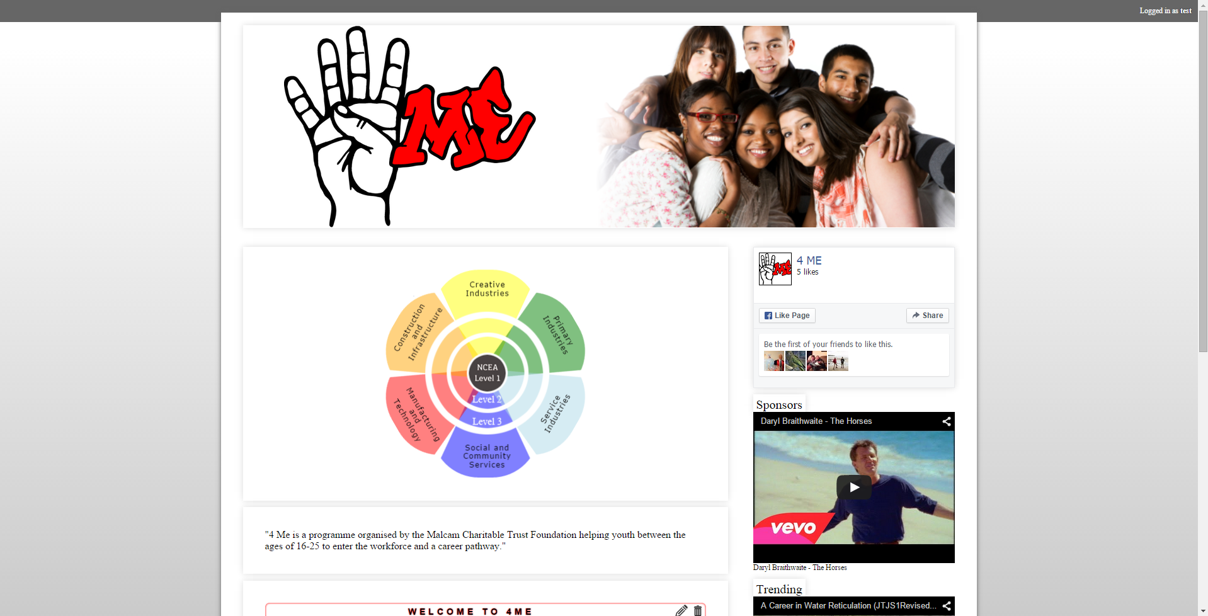
Software we’re working on.
Website
PHP – Fastest Option
MySQL Database
Videos are hosted externally

Slide 7
Future Software
Malcam Trust Foundation are somewhat unfamiliar with technology.
Working with Cyclone to figure out exactly what client needs.
A system to measure success.
Finding ways of improving current systems.

Slide 8
Social Aspect
Development role
Ethnography
Social processes
Developing User stories

Slide 9
Development Pathway
Minimum Viable Product
Work alongside Cyclone
Interact with users to gain a better understanding of what the clients needs
Measure success
Investigate more technical solutions for client that will help achieve their goals.

Slide 10

Questions

