Slide 1
Music Generation
Soheil Rastegar
Moein Mirzaei

Slide 2
Introduction
Music generation. Why?
Humans love arts
Financial outcomes
Can help musicians and song makers
Improving already made music
Give ideas

Slide 3
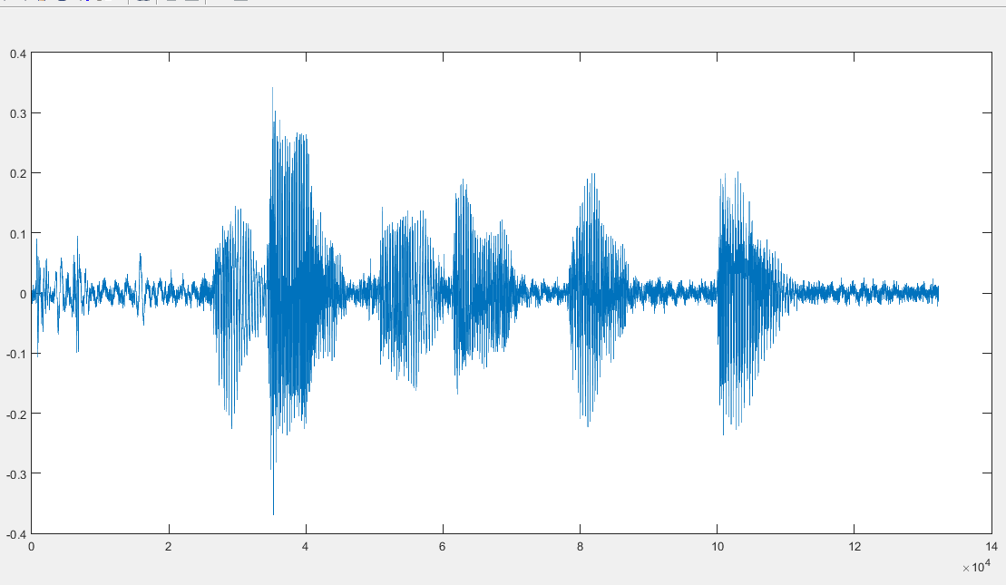
Data
Simple Raw Sound Signal
Too complicated
Heavy
Noisy
We must use other methods

Slide 4
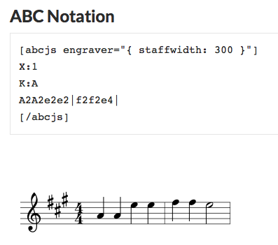
Data
ABC Notation

Slide 5
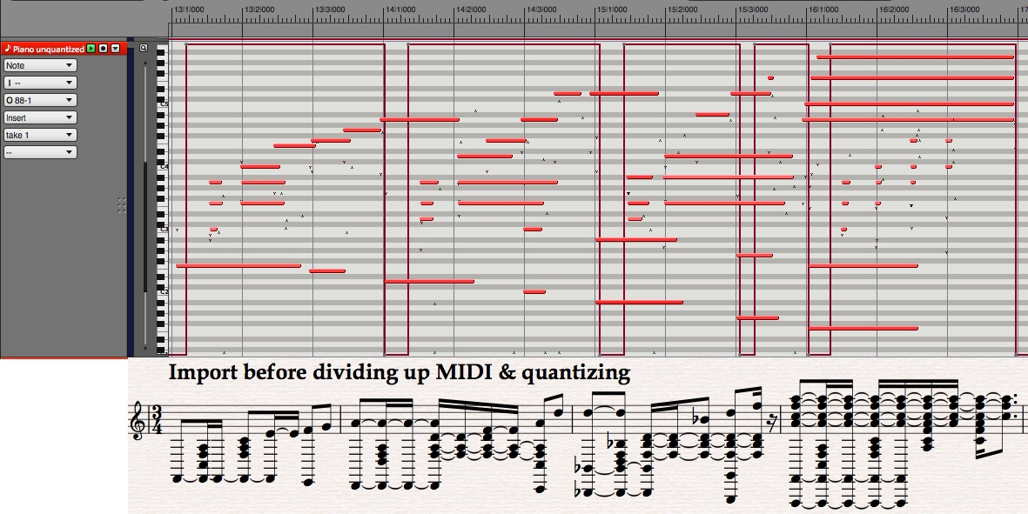
Data
MIDI

Slide 6
Data
Iranian Music
Challenges
Not Supported by MIDI
Have Extra Notes
No Note-Database as For western Music
No Simple interface for getting output

Slide 7
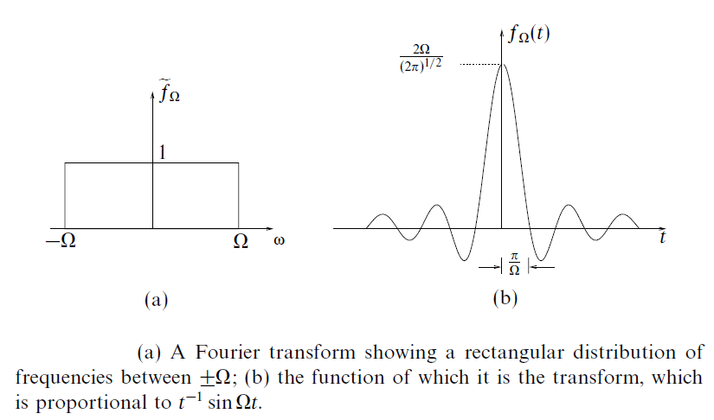

Suggestions
Use Fourier Transform
Break Signal into short chunks
Calculate each chunk Fourier Transform
Calculate each note Frequency
Keep maximum of a frequency range around each note’s frequency
Find the range with bigger maximum
It’s possibly this chunk note

Slide 8
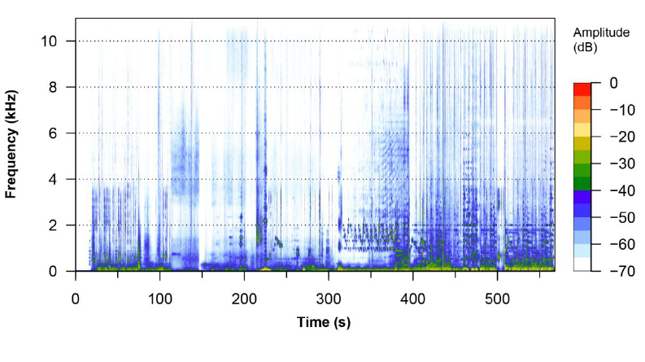
Suggestions
Use Fourier Transform
Challenges
Signal is probably noisy
How to determine chunk length when we have different length notes
How to determine that a note is continued between 2 adjacent chunks

Slide 9
Suggestions
Pre learn on Classical music data
Then learn on few Iranian data with western scales
Generate music
Put Iranian musical instrument sound on suggested notes

Slide 10
Model Input
Input data is a sequence of characters
Each character denotes a note
We should try to learn patterns in sequence of characters
So RNN is our choice!

Slide 11
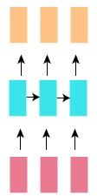
Model Architecture
We will feed the characters of a sequence one after the other
And we expect the model to output the next character in the sequence
Hence, we will be using Many-To-Many RNN where number of outputs is equal to the number of input

Slide 12
Model Loss Function
Our problem can be thought of as Multi-class classification because input is a combination of many characters and the output is one of characters in dataset
So, we will use Categorical Cross-Entropy as loss function
We will pass the outputs of RNN to a dense layer with softmax activation
The number of cells in dense layer will be equal to the number of unique characters

Slide 13
Model Layers
model = Sequential()
model.add(LSTM(256, return_sequences = True, stateful = True))
model.add(Dropout(0.2))
model.add(LSTM(256, return_sequences = True, stateful = True))
model.add(Dropout(0.2))
model.add(LSTM(256, return_sequences = True, stateful = True))
model.add(Dropout(0.2))
model.add(TimeDistributed(Dense(num_of_unique_chars)))
model.add(Activation("softmax"))

Slide 14
Model Training
We split the data into batches
If the length of data L = 128 & batch_size = 4 & sequence_len = 8 then we split the data as follows:
Batch 1 | Batch 2 | Batch 3 | Batch 4
0…7 | 8…15 | 16…23 | 24…31
32…39 | 40…47 | 48…55 | 56…63
… | … | … | …
96…103 | 104…111 | 112…119 | 120…127
epoch_loss, epoch_accuracy = model.train_on_batch(x, y)

Slide 15
Sampling
After training the model we will feed any character in dataset to model
A set of probabilities will be generated and from this set we will chose the next character probabilistically and feed it back to network and so on …
Dense
LSTM
LSTM
LSTM

Slide 16
Thank You

