Slide 1
캡스톤 디자인 2학기 - A* Algorithm
A6 Blue
2022/9/6

Slide 2
Path Planning
A6 Blue
Search-based
Dijkstra
A* - Dijkstra + heuristic cost
D* - Dynamic A*
Sampling-based
RRT – Random Tree
RRT* - RRT + rewire
Artificial Intelligence
ANN – Artificial Neural Network
GA – Genetic Algorithm
2022/9/13

Slide 3
Our Algorithm
A6 Blue
Design own algorithm
- D*(A*) 기반 : 장애물 회피
Using drone
- 3D path planning
- Safety distance
- Cost function optimization
: Distance(Euclidean) + Power(battery) + Stability(?)
Using python & ROS
- Simulation & 실제 비행
2022/9/13

Slide 4
A* Algorithm
A6 Blue
Search-based algorithm
Dijkstra + heuristic cost
Cost function : f(n) = g(n) + h(n)
g(n) : 현재 node까지의 cost
h(n) : 현재 node부터 목표 node
까지의 heuristic cost
2022/9/13

Slide 5
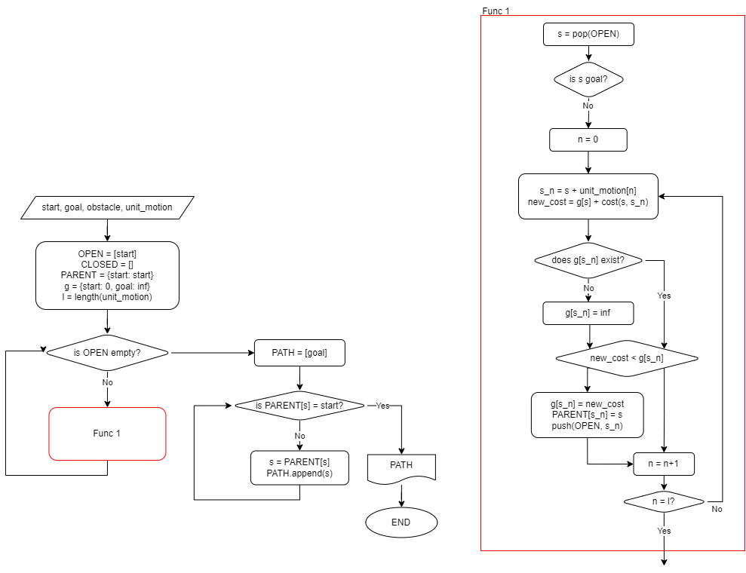
A* Algorithm
A6 Blue
Flowchart
2022/9/13

Slide 6
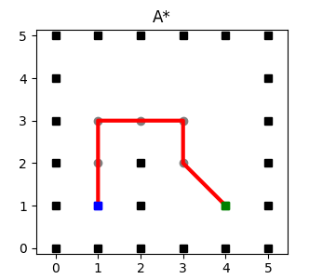
A* Algorithm
A6 Blue
Start = (1,1)
Goal = (4,1)
Unit_motion (이동할 수 있는 단위)
[(-1, 0), (-1, 1), (0, 1), (1, 1), (1, 0), (1, -1), (0, -1), (-1, -1)]
obstacle (장애물)
{(4, 0), (3, 1), (5, 4), (5, 1), (0, 2), (0, 5), (1, 0), (2, 5), (3, 0), (4, 5), (5, 0), (5, 3), (0, 1), (0, 4), (1, 5), (3, 2), (3, 5), (5, 2), (5, 5), (0, 0), (0, 3), (2, 0)}
2022/9/13

Slide 7
A* Algorithm
A6 Blue
Flowchart
2022/9/13

Slide 8
D* Algorithm
A6 Blue
Search-based algorithm
Dynamic A* algorithm
주어진 지도가 틀릴 경우, Local path를
수정하여 real-time path planning.
2022/9/13

