Slide 1
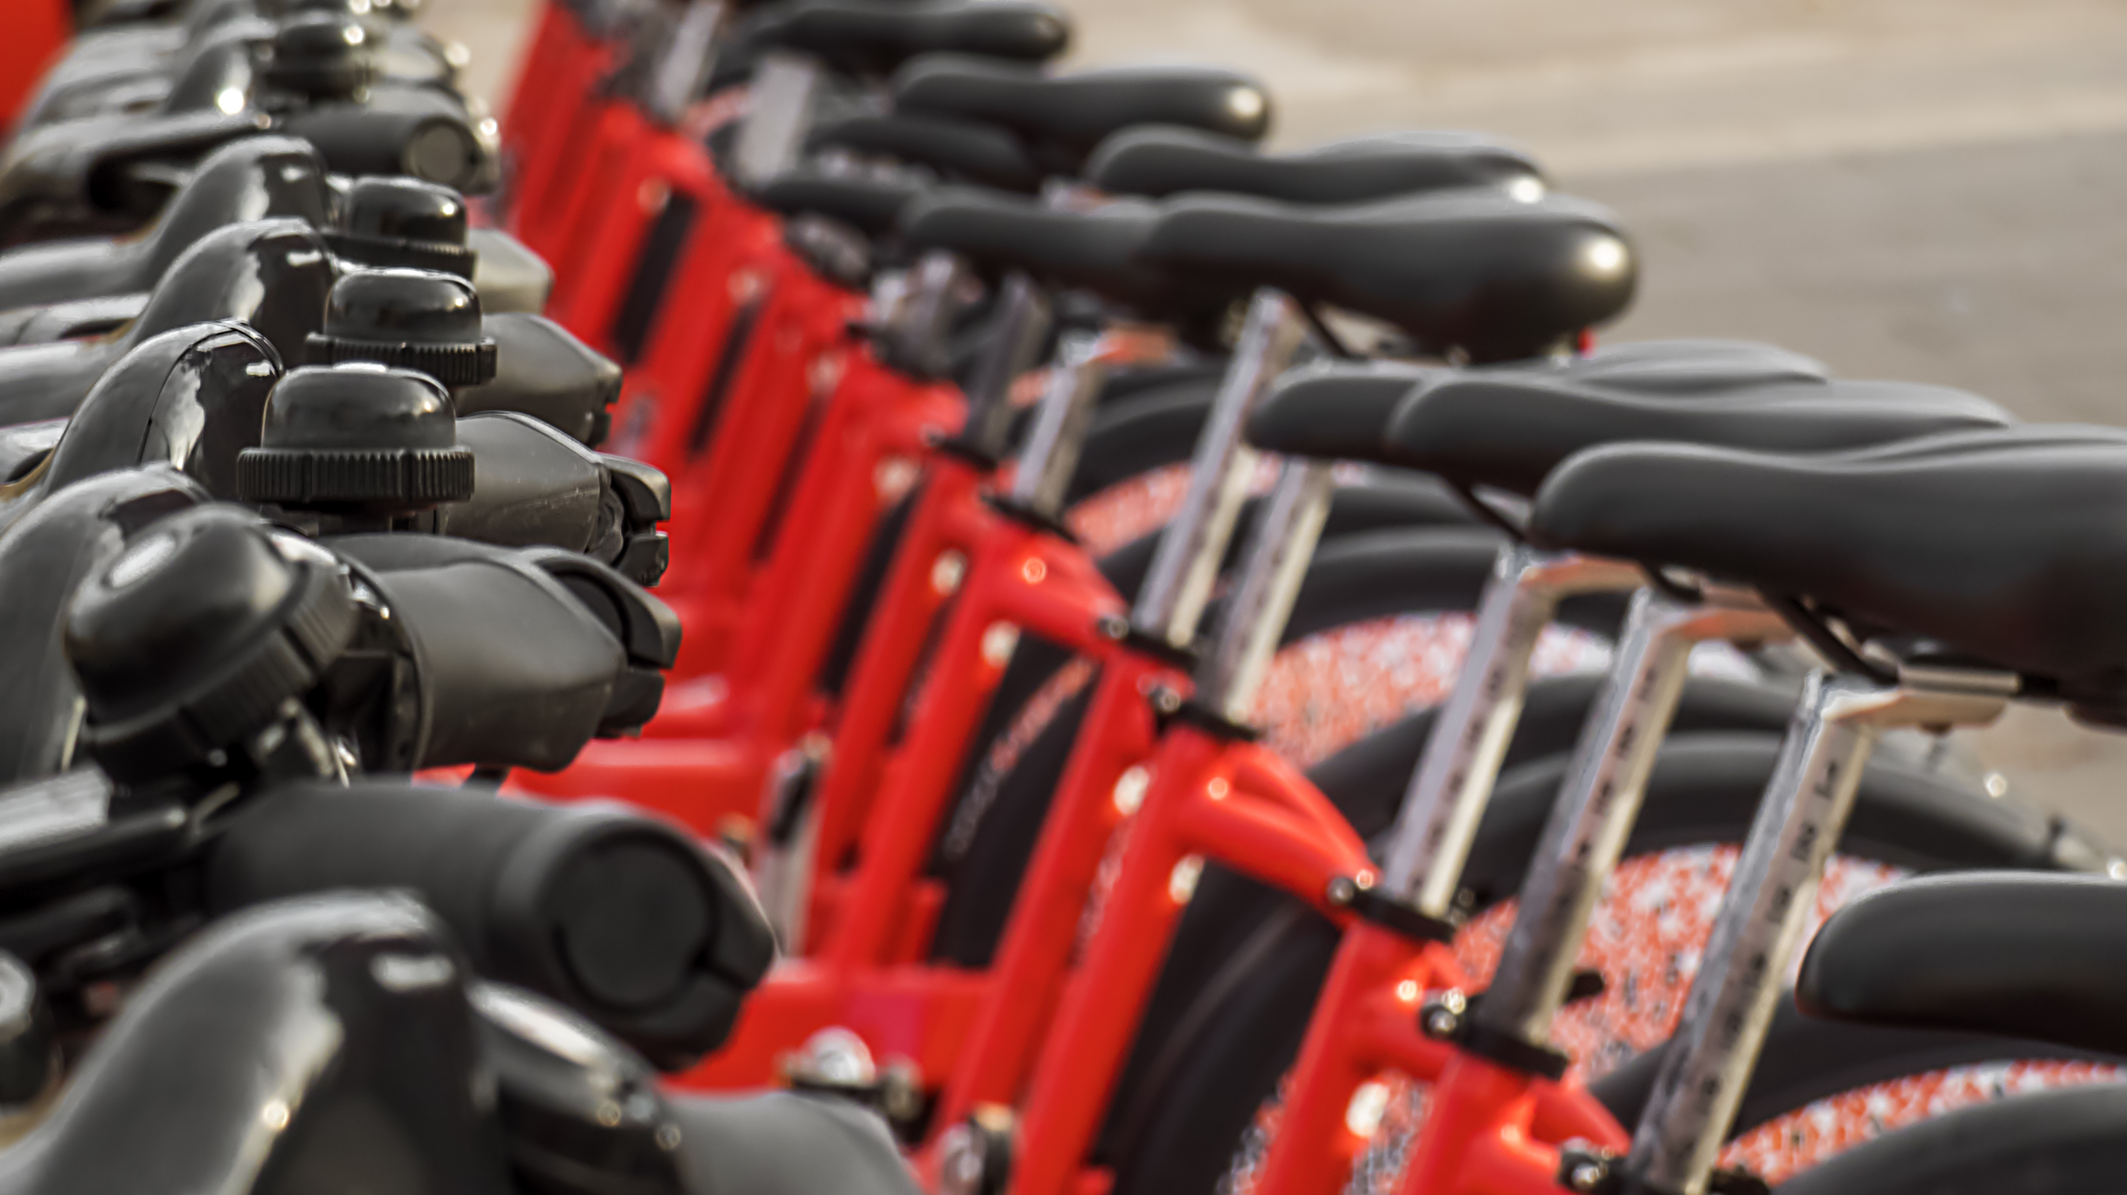
How do annual members and casual riders use Cyclistic bikes differently?
Crystal Aguilar

Slide 2
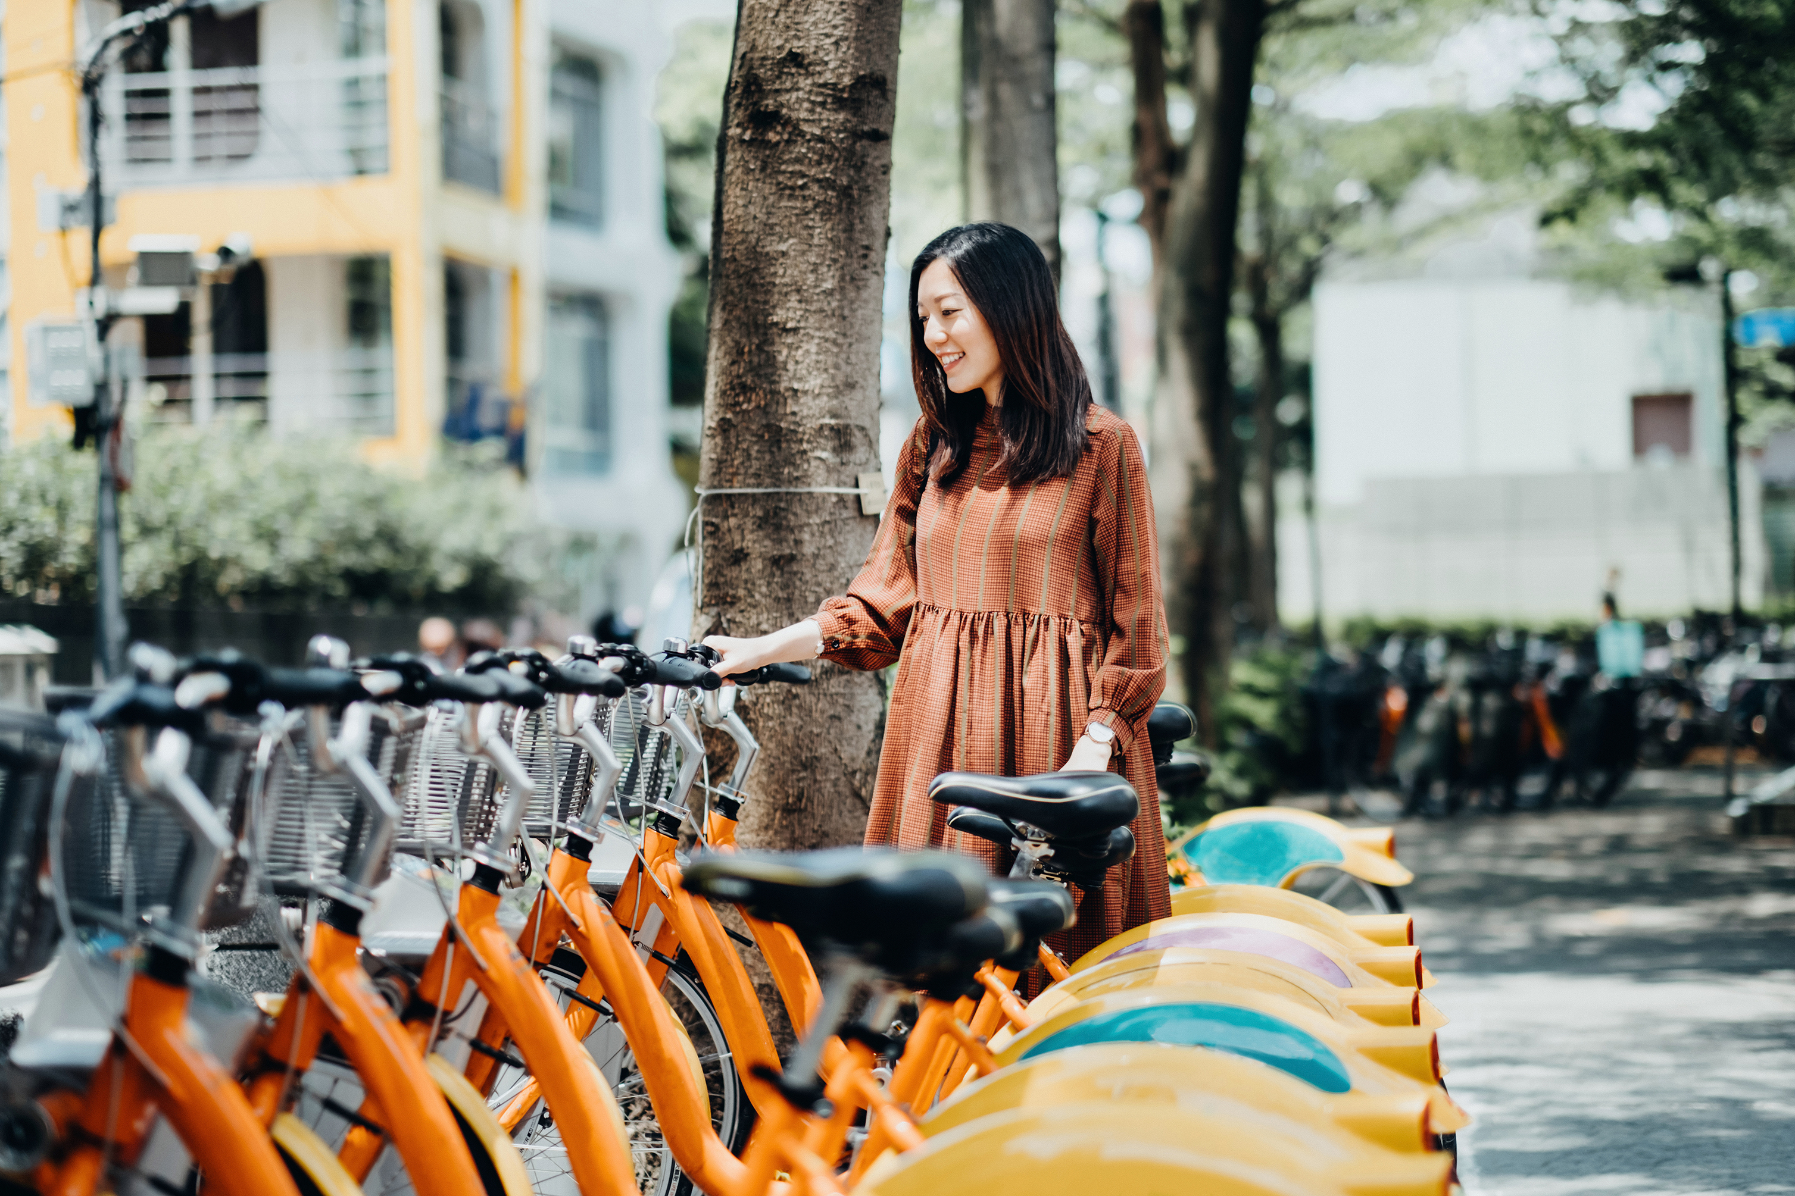
Business Task
TASK
Analyze data to draw conclusions on how annual members and casual riders use Cyclistic bikes differently?

Slide 3

WHY
WHY
Data referencing
The data has been made available by Motivate International Inc. under this license
We are analyzing data to see how differently members and casual users use the bikes in different seasons.

Slide 4
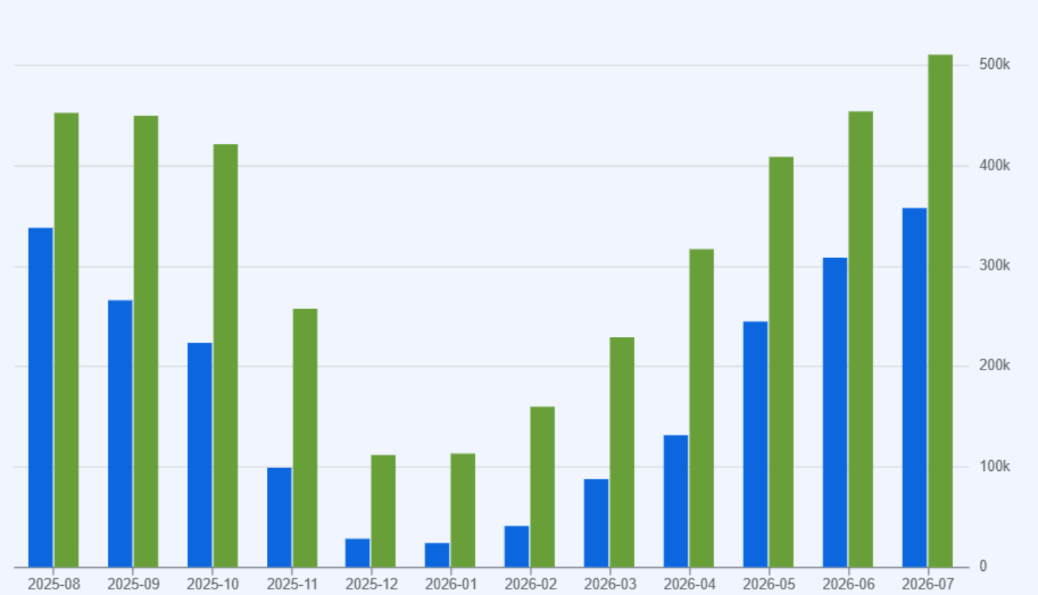
RESULTS
Blue = Casual riders
Green = Member riders
Our results turned out that members use the bicycles more than casual riders.
Ridership goes down in the winter months from Dec – Feb and total ridership has the best ridership during summer months.

Slide 5

SUMMARY
Members use the bicycles more than casual members and total ridership use goes down in the winter months.
summary

Slide 6

Thank You
Crystal Aguilar
crystal0688@gmail.com
https://github.com/blu3bloodedcod3r

