Slide 1
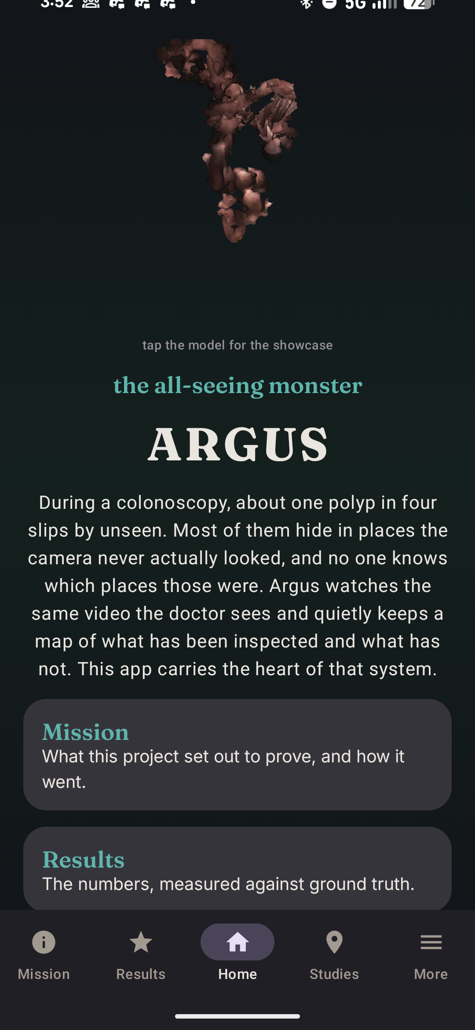
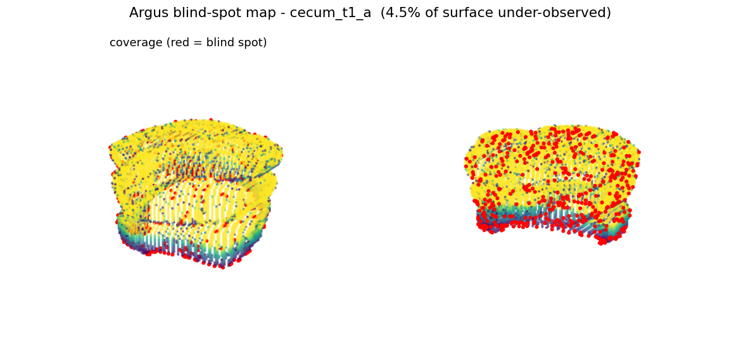
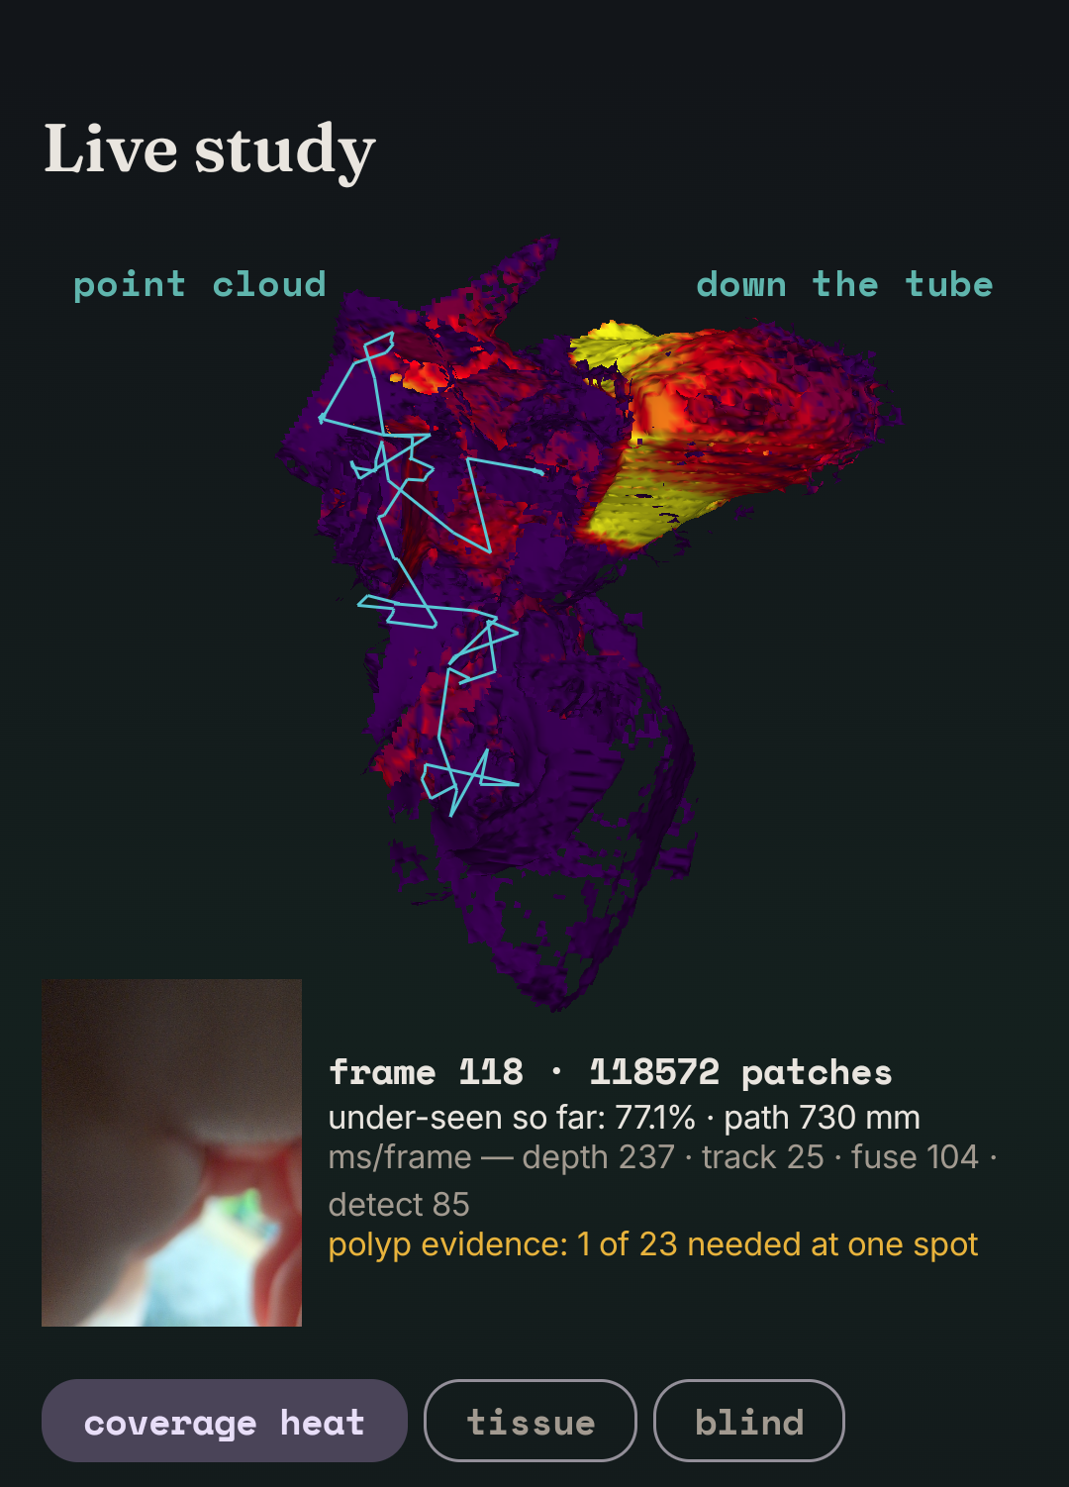
Argus: Monocular 3D Coverage Mapping to Reveal Blind Spots in Colonoscopy
Biomedical/Health Sciences, and Biomedical Engineering
Kathleen Wang, 11th Grade
A reconstructed colon segment with its blind-spot map: patches seen fewer than three times are flagged (my figure).
Argus Lite, the phone app (my screenshot)
a live camera study in the app (my screenshot)

Slide 2
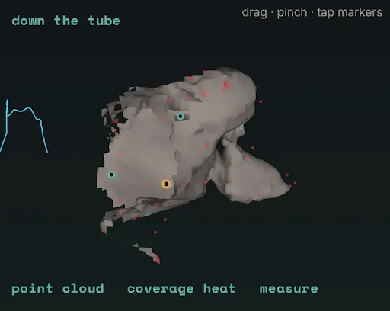
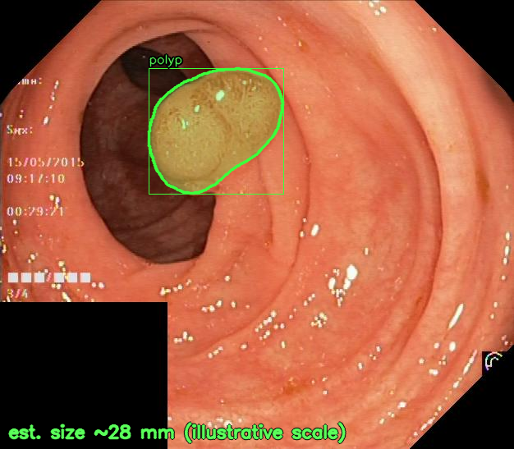
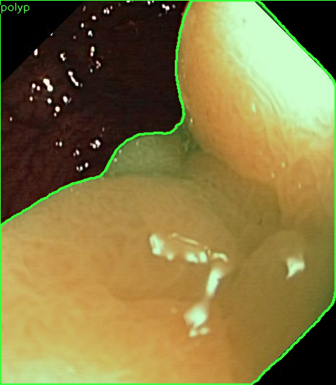
ABSTRACT
Colonoscopy misses roughly one in four precancerous polyps, largely because parts of the colon wall are never brought into view and no standard instrument tells the endoscopist which parts those were. This project developed Argus, a system that answers that question using only the video of a standard, unmodified endoscope. The pipeline chains a fine-tuned monocular depth network, a visual odometry tracker written from scratch, 3D surface fusion, per-patch view counting, and a cascaded polyp detector, and the whole system runs on one workstation and an ordinary Android phone. Development went through 23 design iterations, each judged against pass or fail criteria committed to a public git record before the test ran; only 2 passed their gates and were adopted. Against phantom ground truth, the final pipeline tracks the camera to 0.42 mm mean error and reconstructs the surface to about 2 mm, and fine-tuning the depth network cut false blind-spot alarms from up to 41% of the wall to under 4%. The same pattern repeated in detection, where a redesigned sampling protocol raised detection on unseen clinical footage from 13 of 25 to 19 of 25 polyp clips. Head to head, the tracker ties the standard tool ORB-SLAM3 on accuracy while posing every frame of video. These results show that inspection coverage can be measured from the video a doctor already has, and that generic AI fails inside the body until it is specifically adapted to it.
the app's 3D map with blind spots (my screenshot)
automatic polyp find-and-size (my figure)
segmentation vs expert outline (my figure)
Notes:
The purpose of the video is for Professional Societies to choose the projects they want to interview and for category judges to preview. Both types of judges will formulate question to ask you in the in person interview judging portion of the fair.

Slide 3
INTRODUCTION
Problem. Colonoscopy is the gold standard for preventing colorectal cancer, but tandem studies estimate that about a quarter of adenomas are missed, and a major mechanism is simple: parts of the colon wall are hidden behind folds, passed too quickly, or seen only at a glancing angle, and the endoscopist has no record of which parts those were. Procedure quality is currently measured by proxies such as adenoma detection rate and withdrawal time, which describe the doctor on average but say nothing about the wall of this patient's procedure.
What is already known. Commercial AI for colonoscopy (computer-aided detection) highlights polyps that appear on screen; by construction it cannot see wall that never appears. General-purpose visual SLAM such as ORB-SLAM3 is mature, and monocular depth networks such as Depth Anything V2 are strong on everyday scenes, but the colon violates their assumptions with weak texture, specular glare, and deforming tissue. Research reconstruction systems typically need added hardware or offline processing, and the C3VD phantom datasets are the only public source of trajectory ground truth.
Engineering goal. The goal was to build and honestly validate a system that turns a standard, unmodified endoscope's video into a 3D reconstruction with a per-patch coverage map showing what was examined, what was only glanced at, and where the map has holes, running on consumer hardware, with every stage measured against ground truth and every claim carrying its trivial baseline.
Origin and hypothesis evolution. The project began with the hypothesis that specular glare breaks endoscopic SLAM and that removing it would help. Controlled experiments largely disproved this: feature-based tracking is already glare-robust, and naive glare inpainting actively hurt. That disproof produced the from-scratch tracker and pivoted the project to the coverage question.
Research question and hypothesis. The final research question was whether a per-patch inspection coverage map, accurate enough to be clinically meaningful, can be computed from monocular endoscope video alone on consumer hardware. The working hypothesis was that tracking accuracy would be the limiting factor; a staged ablation proved this wrong by isolating learned depth as the actual bottleneck.
Notes:
Hints and Help/ Research/Information (Include ANY of these questions)
How did you choose this project ?
What is your interest in the topic?
What is already known about this research question?
Is this a continuation of a previous science fair project? How is it different?
What did you find out about this research topic?
What motivated you to study this topic, investigate your question and/or solve this problem?
Is this project/research important?

Slide 4
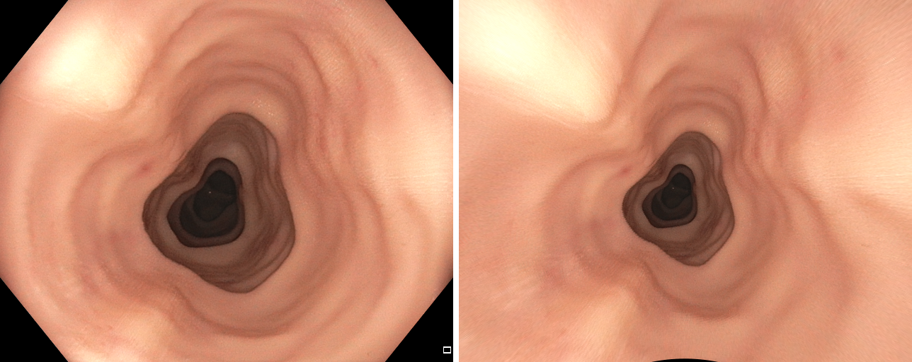
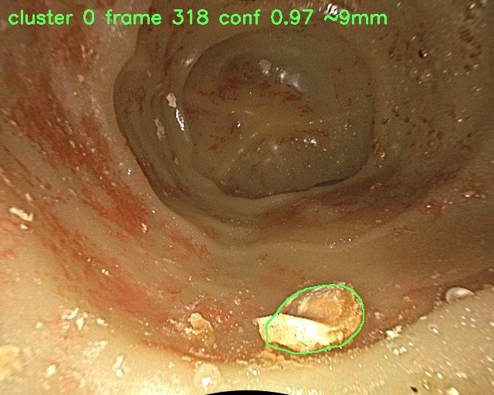
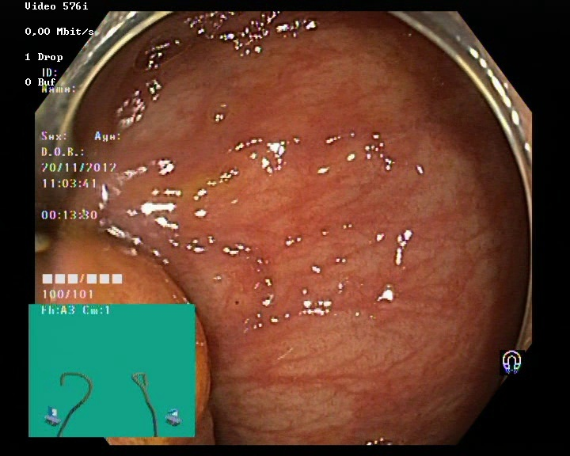
MATERIALS
Datasets. I validated all trajectories and reconstructions on C3VD and C3VDv2, silicone colon phantoms filmed with a real endoscope that come with 6-degree-of-freedom camera ground truth, using 5 headline sequences plus full screening withdrawals. For real tissue I used EndoSLAM, an ex-vivo porcine colon with OptiTrack camera ground truth, across 5 trajectories of 457 to 942 frames. The two frozen detection tests used unseen human footage from HyperKvasir and public clinical clips (n = 41 and n = 48).
Hardware. Everything ran on one Windows workstation with a single NVIDIA RTX A1000 graphics card (8 GB), which also performed all of the neural-network fine-tuning, plus one ordinary Android phone that runs the complete pipeline on-device, including from its own live camera.
Software and models. I wrote the pipeline in Python with PyTorch, OpenCV, and Open3D. Depth comes from Depth Anything V2, which I fine-tuned on phantom data; tracking comes from a visual odometry tracker I wrote from scratch; polyp segmentation uses a DeepLabV3+ model (EfficientNet-B4 backbone) that I fine-tuned; the phone app is written in Kotlin; and a containerized ORB-SLAM3 build served as the comparison baseline.
The record. A public git repository holds every pre-registered pass or fail criterion, committed before each test ran, along with all raw result artifacts and the audit scripts that reproduce every published number.
the ground-truth phantom (C3VD)
a screening-pace withdrawal frame
unseen clinical footage

Slide 5
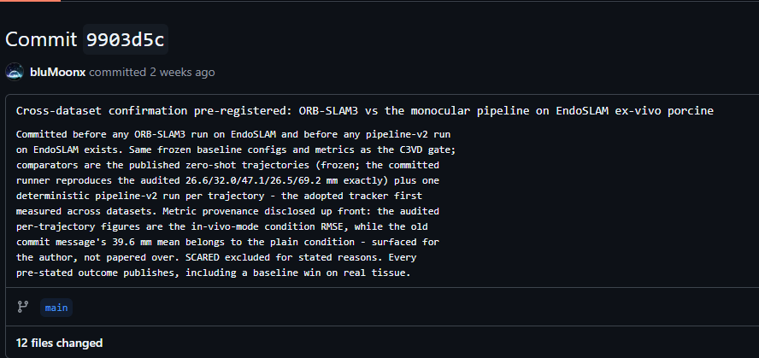
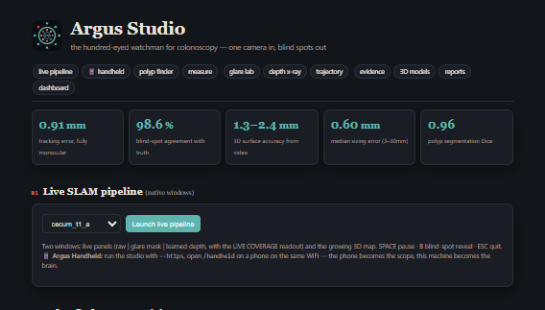
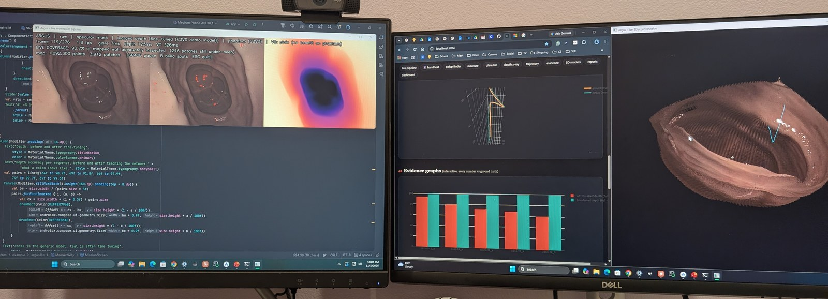
METHODS/PROCEDURE
Raw video
standard endoscope, no added hardware
Learned depth
fine-tuned Depth Anything V2
Tracking
from-scratch direct visual odometry
3D fusion
depth maps merged into a surface
Coverage map
views counted per wall patch
Polyp detection cascade
fast student screens every frame, teacher confirms; findings pinned and sized in the 3D map
Block diagram of the full program, drawn by me. The detection branch is a cascade: a fast student screens every frame (3.2 to 3.7x faster on-device) and the teacher confirms what it flags, so findings stay teacher-grade.
Validation by staged ablation. On phantom ground truth I swapped each estimated input for its ground-truth version to isolate error sources, running ground-truth depth with estimated poses, estimated depth with ground-truth poses, and so on, so that every error is attributed to a stage instead of guessed at. All measurements are metric, in millimeters.
Pre-registration. Before each test ran I committed its pass or fail criteria, data lists, and planned outcomes to the public git record, and never changed them afterward; testing stops at the first failed gate, and failures are published with their mechanisms. I also print every trajectory error beside the same sequence's trivial constant-point baseline so a flattering but meaningless number cannot hide.
a gate committed to GitHub before the run (my screenshot)
the Argus Studio console (my screenshot)
the live pipeline at my workstation (my photo)
Notes:
Hints /Help:
Your scientific procedure must contain detail sufficient to allow another person to repeat your experiment or produce your engineering design.
Control and experimental groups clearly defined/ engineering design and redesign clearly described.
Explain how you completed your project
What did you do, when, where, how?
Written by you—No copied procedures from the internet or other sources.

Slide 6
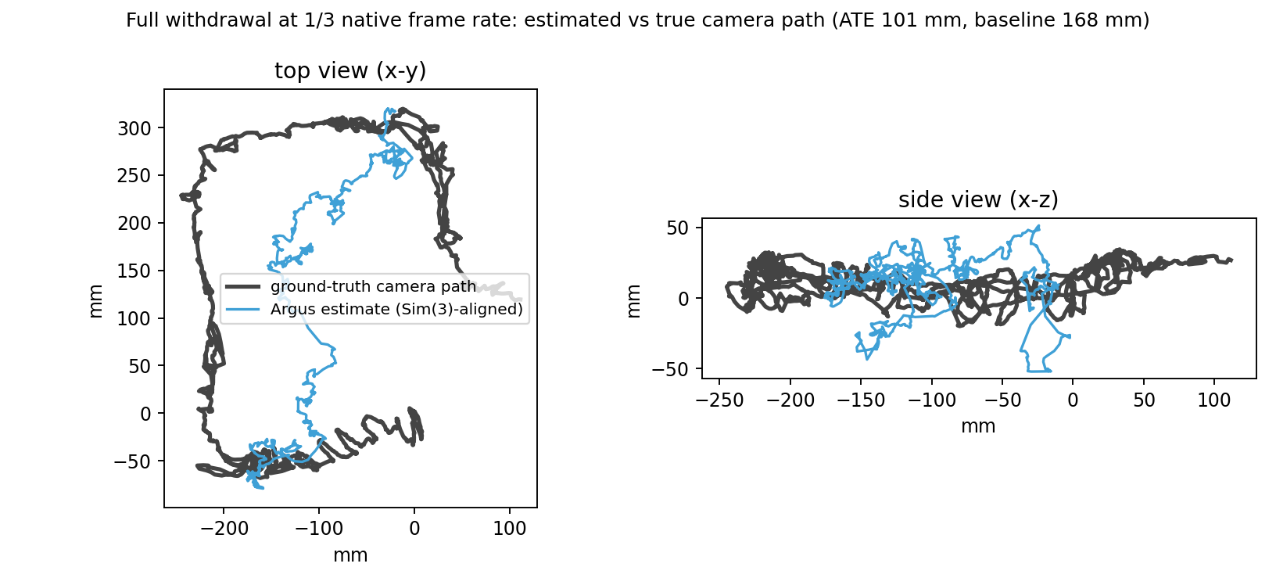
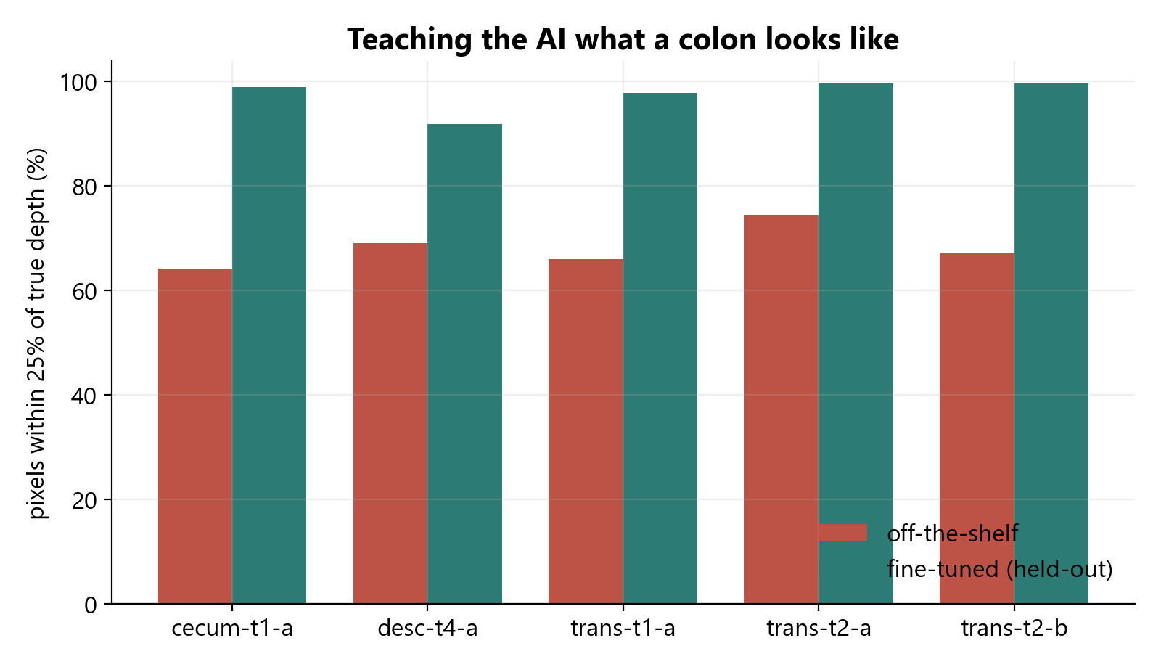
METHODS/PROCEDURE (Con’d)
Design, test, redesign. I ran 23 pre-registered design iterations, and only 2 passed their gates and were adopted; the rest were rejected by their own pre-stated criteria and published anyway. The first adoption was an improved tracking kernel with robust in-loop weighting, which I adopted only after re-validating every tracking benchmark in stages, and it cut mean trajectory error from 0.91 to 0.42 mm. The second was a dense frame-sampling protocol for detection, adopted only after it passed three gates on a second frozen test of 48 fresh clinical clips.
Redesigns the evidence rejected. The failures outnumber the successes, and each was judged against its own committed bar: glare removal as a tracking aid, two inpainting methods, six deformation compensations, three generations of loop closure, keyframe tracking, two depth-resolution speedups, and the attempt to port the first adoption to the phone's tracker, which failed its gate, so the phone kept its own kernel. An adoption is validated per configuration, never assumed to generalize.
Self-audit. A 35-figure audit reproduces every published number from raw artifacts, and a red-team audit re-derives the headline results with independently written code, passing 15 of 15 checks. I also caught two of my own metrics flattering the system and retracted them; the retractions are reported as results.
estimated camera path vs phantom ground truth (my figure)
off-the-shelf vs fine-tuned depth, the central redesign (my figure)

Slide 7
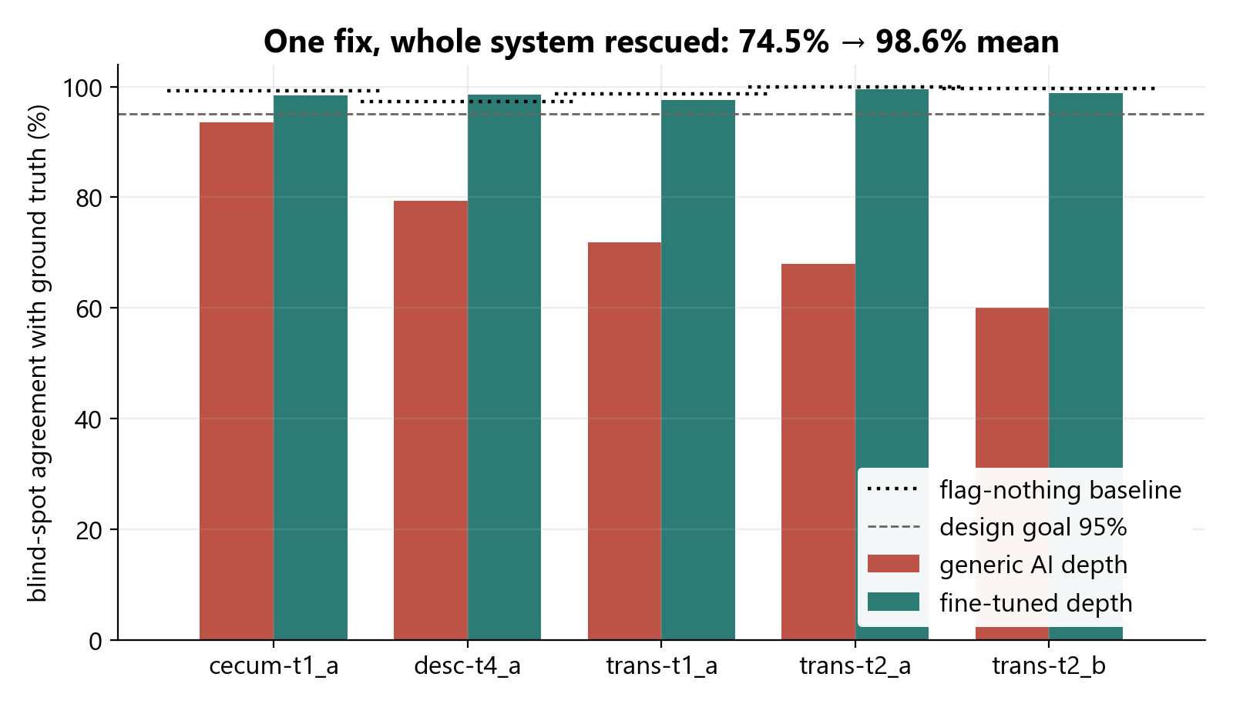
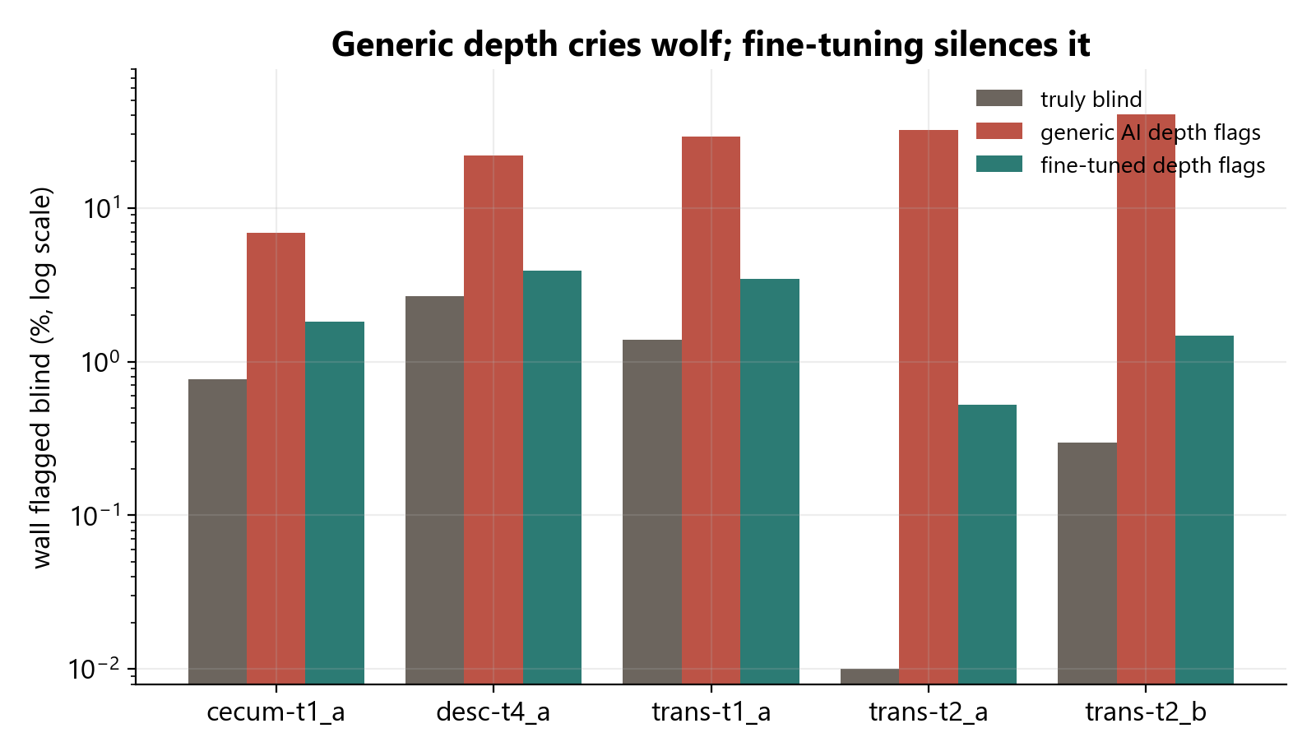
RESULTS
All results below are against phantom ground truth; n = 5 sequences unless stated; every trajectory error is reported beside its sequence's constant-point trivial baseline.
Stage (what was measured) | Result | Baseline / sample size
Camera tracking, mean trajectory error | 0.42 mm (v1: 0.91 mm) | constant-point baselines 33 to 74 mm; n = 5 sequences, every frame posed
Depth accuracy, held-out (leave-one-sequence-out) | 68% off-the-shelf to 92 to 99.7% fine-tuned | n = 5 held-out sequences
3D reconstruction, median surface error | 1.3 to 2.4 mm | 4 of 5 sequences, from video alone
False blind-spot alarms (the headline) | 7 to 41% of wall, cut to 0.5 to 3.9% | same fixed metric before vs after fine-tuning
Coverage at screening pace | about 40% of mapped wall under-seen | validated against a perfect-tracking twin instrument, 3 withdrawals
Withdrawal frame-rate requirement | tracking fails at ~2 effective fps, holds at ~9 | n = 5 complete withdrawals, ~43 m of ground-truth path
the staged ablation isolating depth (my figure)
false alarms before and after fine-tuning (my figure)
Notes:
Hints/ Help:
Photographs of procedure/designs/final creation—if applicable.
Graphics- Labeled, and source cited if not produced by you.
If showing pictures of you performing the experiment/design prototypes, showing your face is okay.
No pictures of other students (participants and subjects) showing their faces are allowed.
Adults need to give permission to have their faces appear.

Slide 8
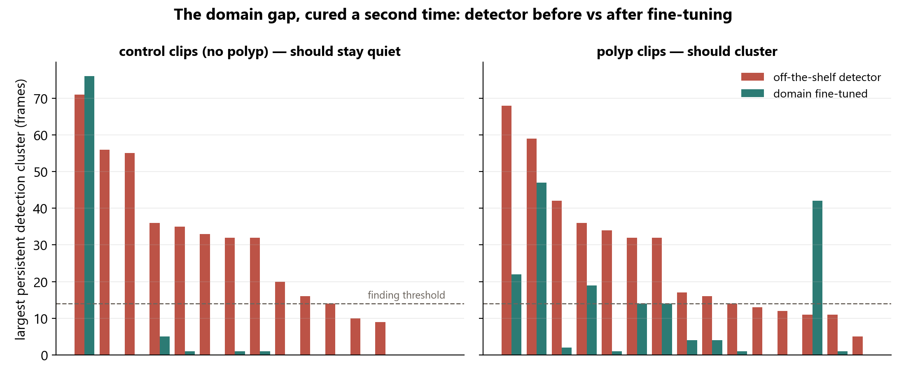
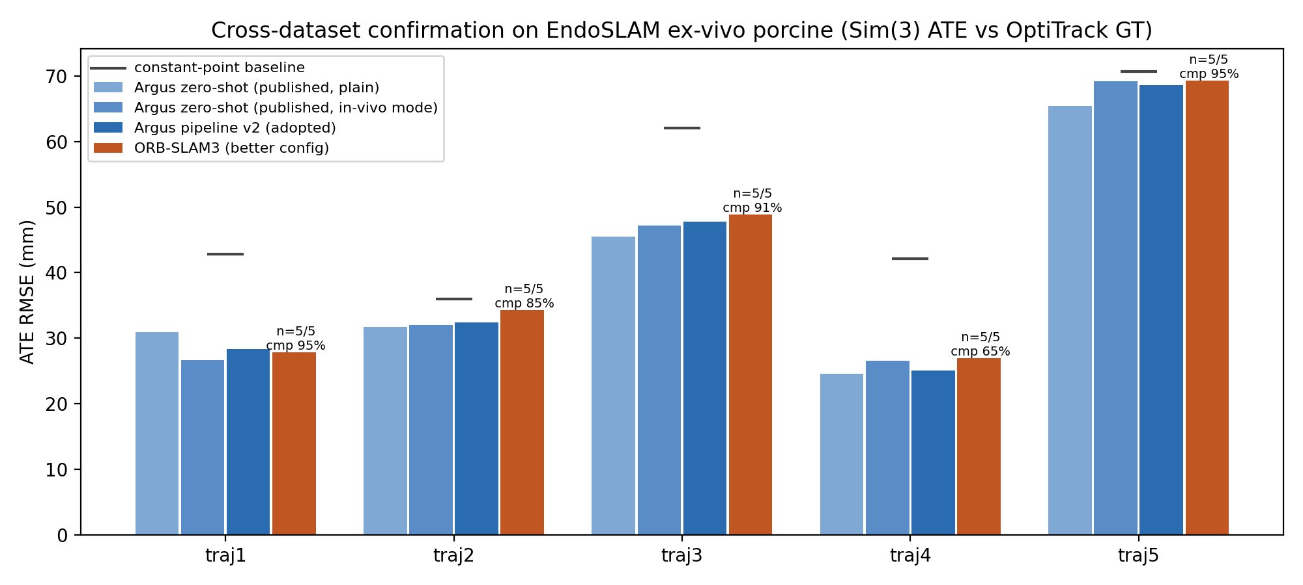
RESULTS (Con’d)
Frozen tests on unseen human clinical footage: the detector and its threshold were frozen before any test clip was downloaded, and no test clip was ever used for tuning.
Test (all pre-registered) | Result | Statistics
First frozen test, n = 41 clips | 11/21 polyp clips vs 3/20 controls; every flagged control held real labeled pathology | Fisher exact p = 0.020
Miss autopsy, then redesign | 8 of 10 misses traced to sparse frame sampling; dense protocol pre-registered | candidate frozen before new data
Second frozen test, n = 48 fresh clips | 19/25 polyp clips (76%) vs 13/25 (52%), old protocol, identical clips; 2 clean false alarms (pre-stated allowance) | paired, p = 0.0012
Head-to-head vs ORB-SLAM3 (phantom, 50 runs) | a draw on accuracy: means 0.42 vs 0.39 mm, per-sequence 2-2-1; baseline poses sparse keyframes, Argus every frame | overlapping bootstrap CIs
Cross-dataset check (real porcine tissue) | four-way statistical tie, 39.6 to 41.4 mm mean; ORB-SLAM3 completes 65 to 95% of each sequence | n = 5 trajectories, 5 runs per config
the detector's domain-gap failure and fix (my figure)
trajectory error on real tissue, all systems (my figure)
Notes:
State the facts- There is no editorializing or trying to explain the results here
What are the results of your project?
Data tables, graphs, charts– have titles and appropriate labels. The number of groups and sample size must be evident.
Engineering: evidence of design → test → redesign process → prototype.
If you have statistical analysis of numerical data show it here– mean (average) or percent change at least. This could also include standard deviation, error bars, chi-square, P-value etc.

Slide 9
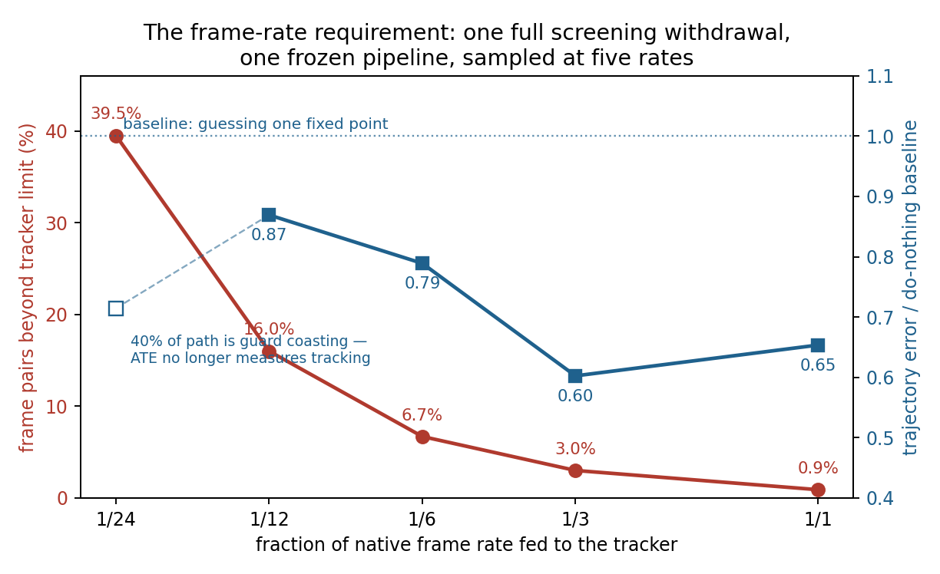
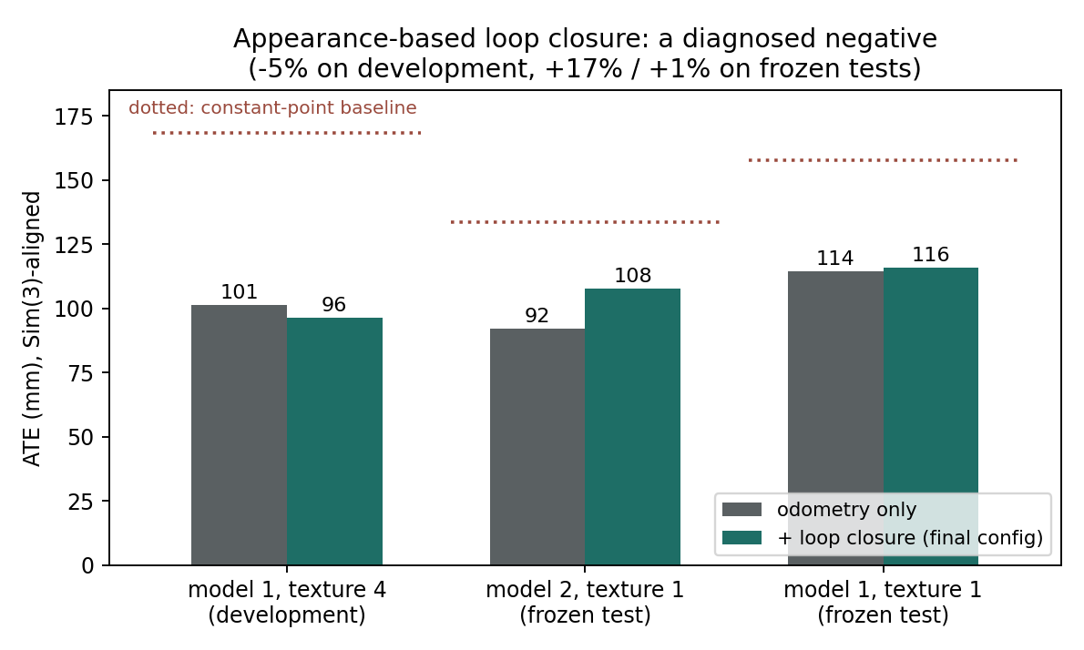
RESULTS (Con’d)
Negative results, published under their own pre-registered gates. Each failure below carries a measured mechanism; none was quietly dropped. These bound what the system can honestly claim.
Question (pre-registered gate) | Measured answer | Mechanism
Can loop closure fix whole-colon drift? | no: a ground-truth oracle recovers at most 14% on screening paths | a withdrawal is topologically a line; too few revisits
Can a site marked in one procedure be re-found in the next? (bar: 10 mm) | no: median 26.3 mm across 45 sites, discrimination 29% vs the 80% bar | per-session map error compounds across two sessions
Can tissue deformation be compensated? (6 attempts) | no: all six rejected; best miss was -18% vs a 20% bar | measured 9x cost; learned weights did not generalize
Is the phone video-rate? | no: about 3 fps on-device (depth 199 ms, track 25, fuse 50, detect 76) | depth network is the bottleneck; resolution speedup failed its accuracy gate
the frame-rate law from complete withdrawals (my figure)
the loop-closure oracle bound (my figure)
Notes:
State the facts- There is no editorializing or trying to explain the results here
What are the results of your project?
Data tables, graphs, charts– have titles and appropriate labels. The number of groups and sample size must be evident.
Engineering: evidence of design → test → redesign process → prototype.
If you have statistical analysis of numerical data show it here– mean (average) or percent change at least. This could also include standard deviation, error bars, chi-square, P-value etc.

Slide 10
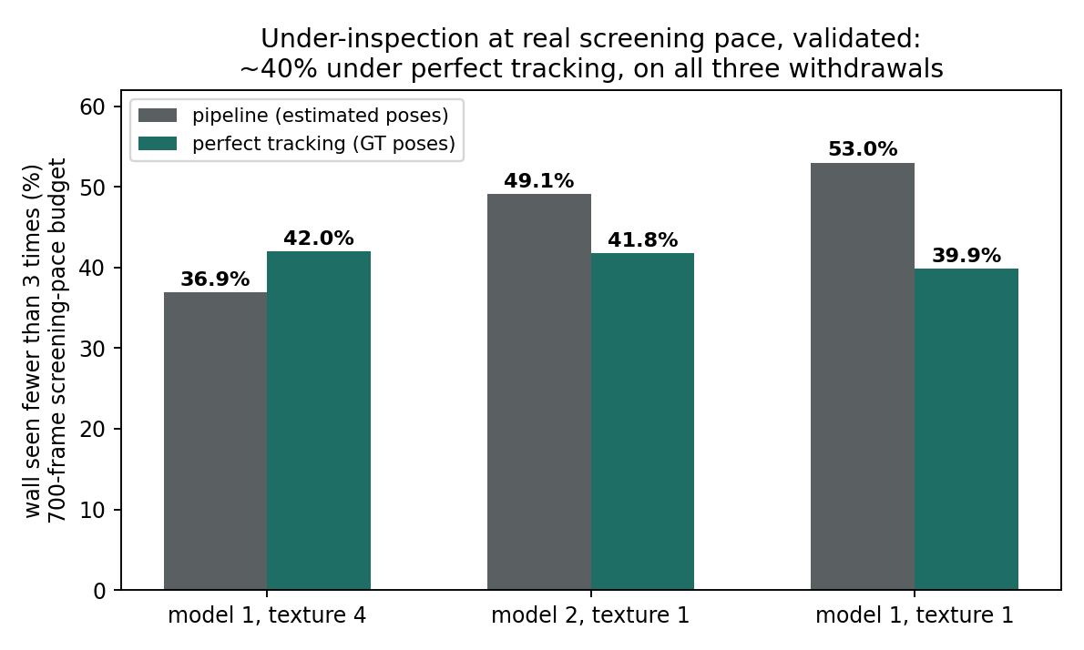
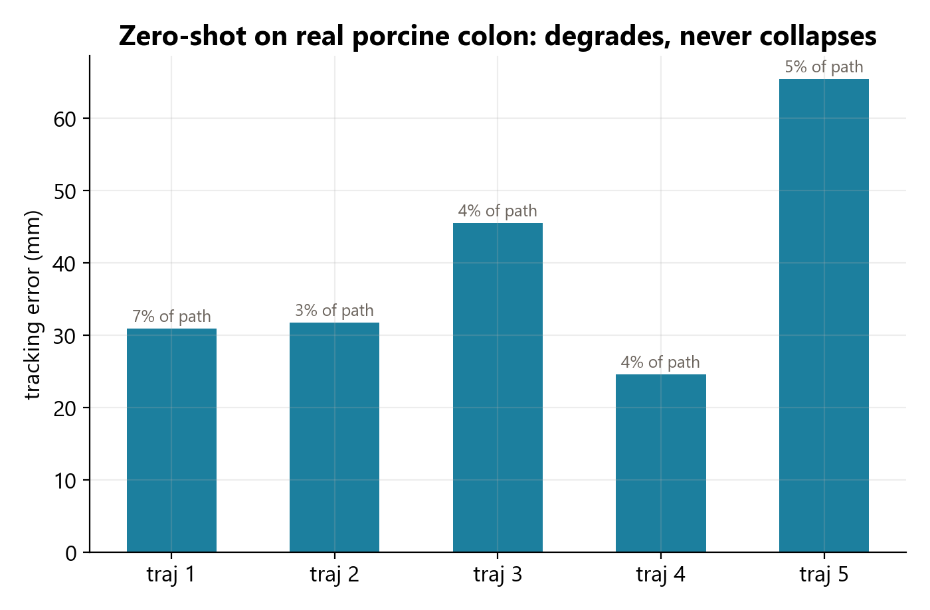
DISCUSSION
The central finding, demonstrated twice. The same disease and cure appeared in two independent AI components: the depth network and the polyp detector were both strong on their home data and failed in the colon's domain, and in both cases targeted fine-tuning or protocol redesign recovered them. Competence ends at the edge of the training data; this matches the published experience of medical AI generally and is the project's most transferable result.
What the coverage number means. A blind spot is a wall patch with fewer than three adequate views, including zero; wall never captured at all appears as visible holes in the reconstruction rather than in the percentage, so the figure is stated as a fraction of the mapped wall. The threshold was sensitivity-tested and does not drive the conclusions.
Errors and surprises. Two metrics flattered the system while measuring nothing: an agreement score inflated by class imbalance, and an aligned trajectory error that collapses under divergence. I caught and retracted both, and each produced a standing safeguard, which is why a trivial baseline sits beside every published number. The original glare hypothesis was itself largely disproven, which redirected the whole project.
Why the redesigns happened. Each redesign was forced by a measured mechanism, not taste: the detection miss autopsy traced misses to frame sampling, so the protocol was redesigned and re-frozen; the tracker upgrade failed its phone gate, so the phone kept its own kernel; drift resisted loop closure for a measured topological reason, so the claim was bounded instead of forced.
coverage validated against the twin instrument (my figure)
cross-dataset transfer to real tissue (my figure)

Slide 11
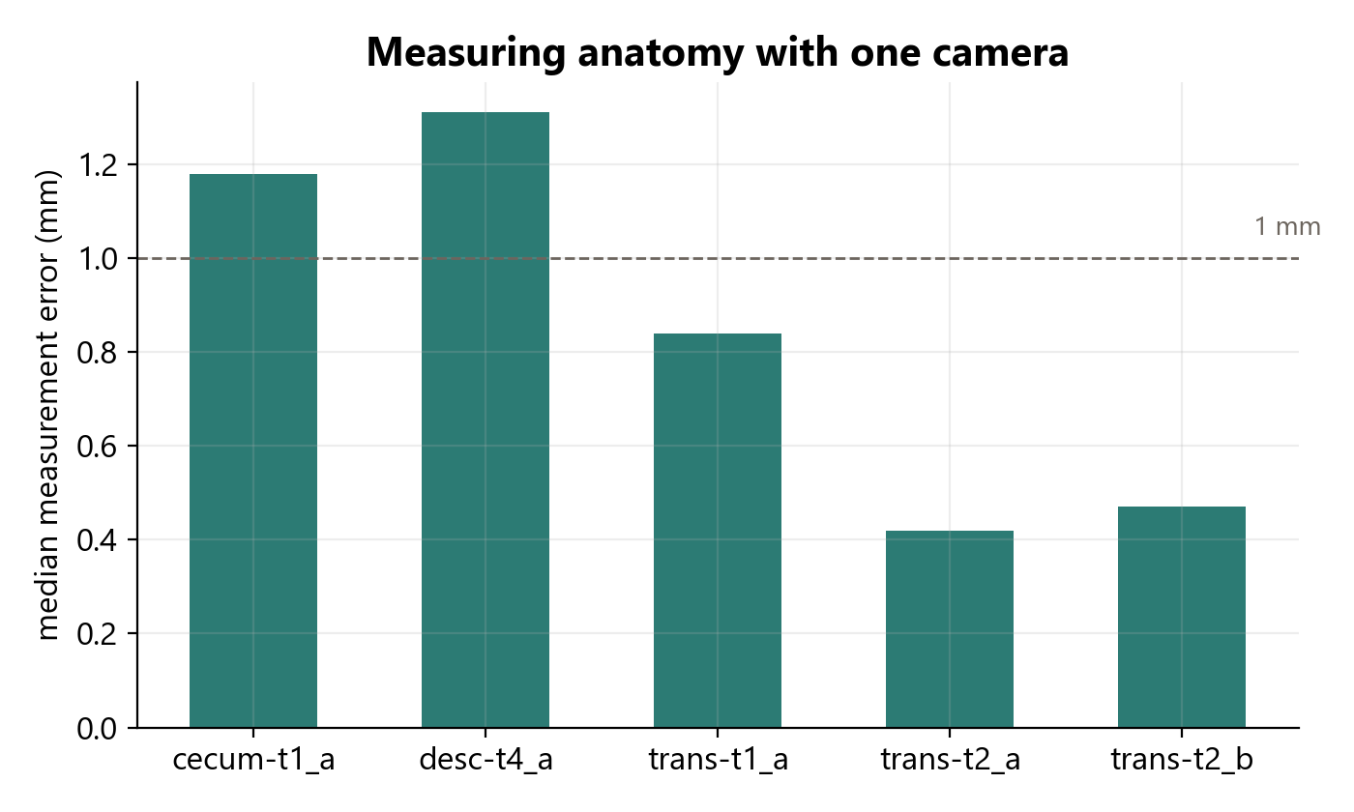
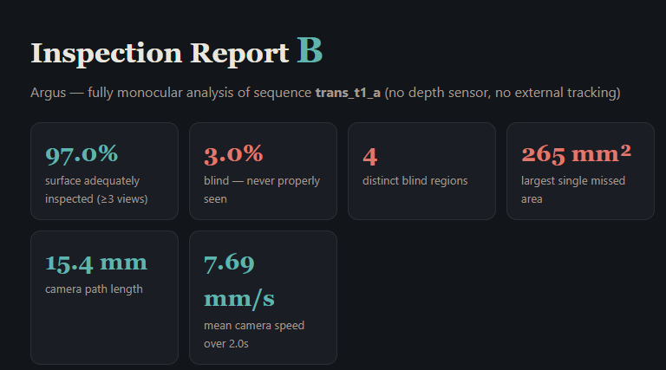
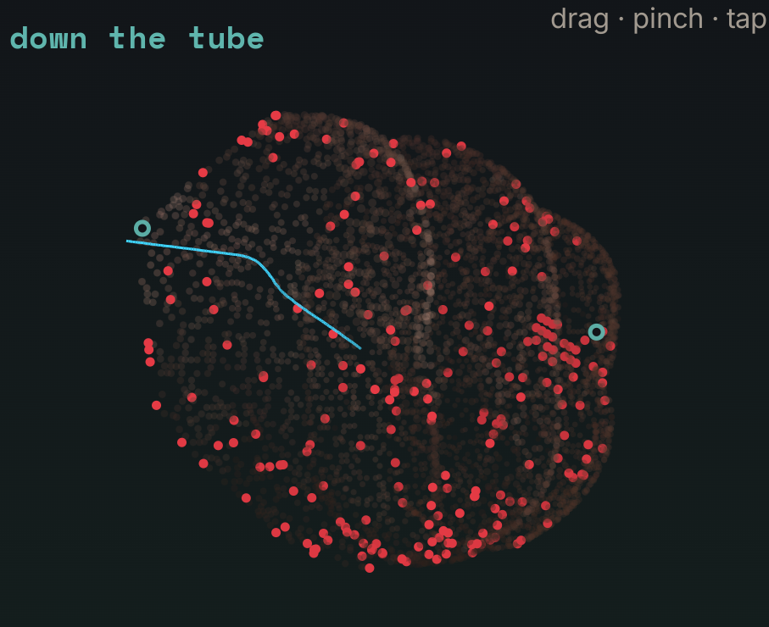
CONCLUSION
Answer to the engineering goal. A standard endoscope's video alone, processed on consumer hardware, can be turned into a 3D reconstruction accurate to about 2 mm of surface error with a validated per-patch coverage map; at screening pace about 40% of the mapped wall is genuinely under-seen, which is precisely the information no current instrument provides.
Against existing designs. Commercial computer-aided detection answers a different question (is a polyp on screen now?) and cannot see wall that never appears; Argus measures exposure itself. Against the standard open-source tracker, ORB-SLAM3, the from-scratch tracker draws on accuracy on the phantom and on real tissue while posing every frame with zero tracking loss; the honest tracking claim is density, glare handling, and a measured operating envelope, not accuracy supremacy.
Honest limits. The system is validated only where ground truth exists, on the phantom and in real-tissue cross-checks. Whole-colon drift of roughly 100 mm is proven unfixable by loop closure here, the phone runs near real time at about 3 fps against the measured 9 fps needed for live guidance, and cross-patient generalization needs data that does not publicly exist. Each limit ships with its mechanism.
Applications and next steps. Today the system produces a retrospective procedure report card with a coverage grade, blind regions in square millimeters, and camera speed, a stratification signal for quality review rather than a diagnosis. The next steps are reaching the measured 9 fps target for live guidance and a clinical study tying measured coverage to outcomes, which this project showed requires prospectively collected data.
monocular sizing, 0.60 mm median error (my figure)
a procedure report card (my screenshot)
the blind-spot map on the phone (my screenshot)
Notes:
Hints/Help:
Analysis of results.
Connect your hypothesis with the results to your conclusion.
What is your current best answer to your question or solution to your problem?
What would you do differently if you could do your project again?
Based on the results of your project, what should be studied next?
What have you learned from doing this project?

Slide 12
REFERENCES/ACKNOWLEDGEMENTS
References (one format throughout):
Shaukat A. et al. ACG Clinical Guidelines: Colorectal Cancer Screening 2021. American Journal of Gastroenterology 116(3), 2021.
Corley D.A. et al. Adenoma Detection Rate and Risk of Colorectal Cancer and Death. New England Journal of Medicine 370, 2014.
Zhao S. et al. Magnitude, Risk Factors, and Factors Associated With Adenoma Miss Rate of Tandem Colonoscopy. Gastroenterology 156(6), 2019.
Bobrow T.L. et al. Colonoscopy 3D Video Dataset with Paired Depth from 2D-3D Registration. Medical Image Analysis, 2023.
Ozyoruk K.B. et al. EndoSLAM Dataset and an Unsupervised Monocular Visual Odometry and Depth Estimation Approach for Endoscopic Videos. Medical Image Analysis 71, 2021.
Yang L. et al. Depth Anything V2. Advances in Neural Information Processing Systems (NeurIPS), 2024.
Campos C. et al. ORB-SLAM3: An Accurate Open-Source Library for Visual, Visual-Inertial, and Multimap SLAM. IEEE Transactions on Robotics 37(6), 2021.
Engel J. et al. Direct Sparse Odometry. IEEE Transactions on Pattern Analysis and Machine Intelligence 40(3), 2018.
Chen L.-C. et al. Encoder-Decoder with Atrous Separable Convolution for Semantic Image Segmentation. European Conference on Computer Vision (ECCV), 2018.
Borgli H. et al. HyperKvasir, a Comprehensive Multi-Class Image and Video Dataset for Gastrointestinal Endoscopy. Scientific Data 7, 2020.
Umeyama S. Least-Squares Estimation of Transformation Parameters Between Two Point Patterns. IEEE Transactions on Pattern Analysis and Machine Intelligence 13(4), 1991.
Acknowledgements. I thank the authors of the validation dataset for correspondence on clinical framing and evaluation priorities. I used an AI assistant (Anthropic's Claude) as an engineering collaborator for code drafting and analysis under my direction; all experiments ran on my own hardware against pass or fail criteria committed in advance, every published number is reproducible from the repository's raw artifacts, and the responsibility for all of it is mine. This project used no institutional lab and no mentorship program.
Notes:
Hints /Help:
References– Works cited (Minimum 5 for Middle School, 10 for High School)
Citation Format—Pp. 25-26 of GSDSEF Sample Notebook – 2019 revision at gsdsef.org.
Works cited from the internet must have the
complete, current url. (Judges may check
your sources.)

