Slide 1



Knowledge Discovery:
HCI Studies
Felix, Florian, Lukas, Steffen

Slide 2



Hamburger vs Swipe Navigation
Hamburger Menu: Pop-up Menu Button for Mobile devices to compensate lack of available display space.
Swipe Navigation: Perform a swipe gesture to navigate through subsequent views.

Slide 3
In the context of a survey app
On mobile devices, it makes sense to have an individual view for each question
Questions focus on testing students' knowledge => students may revise their answers frequently
User has to navigate back to the page they want to revise

Slide 4
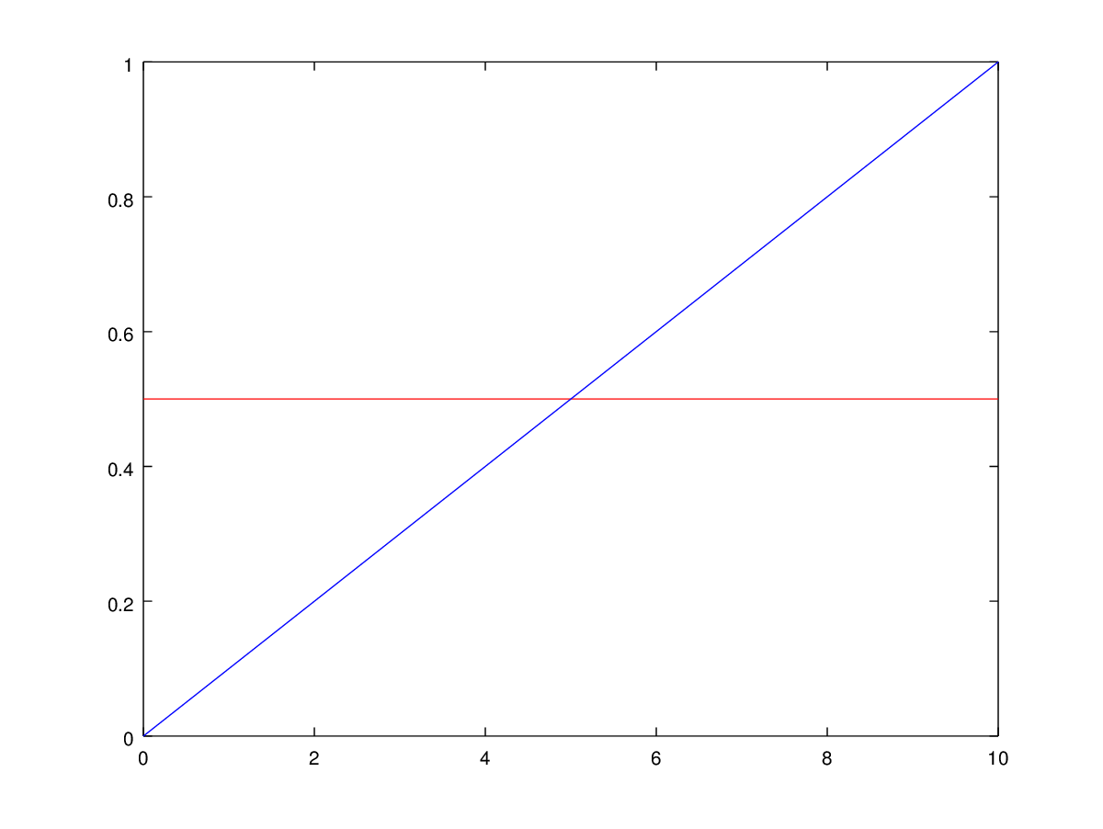
Expectation
Linear increase in required time using Swipe
Constant required time for the Hamburger
Point of Intersection

Slide 5
What do we measure?
Efficiency, the time needed to perform the task
Satisfaction, by having the users fill in a questionnaire
Effectiveness? What is the “right” answer to a question? Bias?

Slide 6
Challenges
What do tasks look like?
  Test for actual knowledge? How to reduce bias?
  Tasks that only involve navigation?
  Treasure hunt ('Schnitzeljagd') involving back and forth navigation?
Need to train the user in the different ways of navigation?
Between-Group Design or Within-Group Design?
How to estimate the point of intersection?

