Slide 1



Knowledge Discovery:
HCI Studies
Your Name

Slide 2



Hamburger vs Swipe Navigation
Hamburger Menu: Pop-up Menu Button for Mobile devices to compensate lack of available display space.
Swipe Navigation: Perform a swipe gesture to navigate through subsequent views.

Slide 3
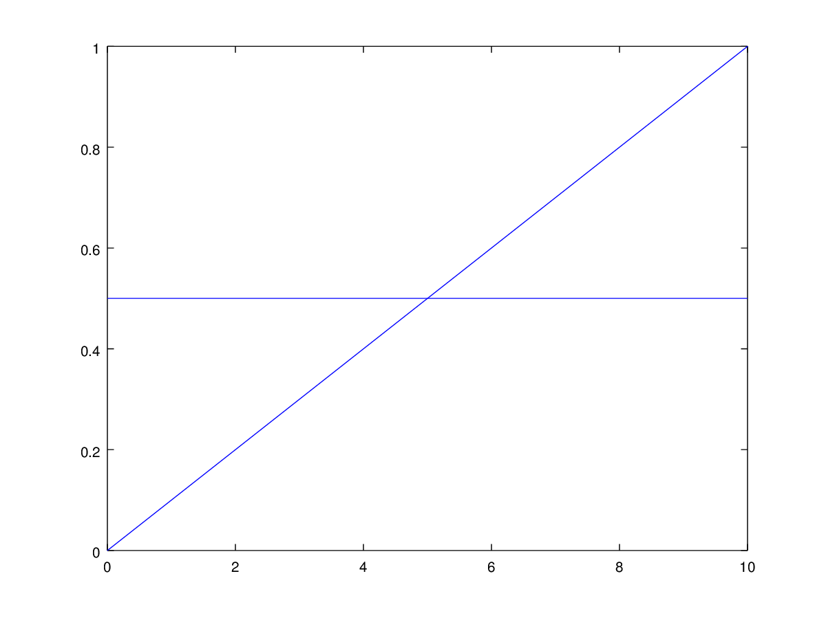
Expectation
Time required increases linear using Swipe
Time required is constant for the Hamburger

