Slide 1

Felix Schuckert
Marco Fehrenbach
Notes:
First start sbt, play and WhiteStarUML with the uml diagram.
Also open the firefox for jacoco:cover and play localhost:9000

Slide 2
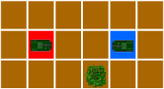
Abstract
Goal
Approach
Scala Features
Discussion
Tests and Demo

Slide 3
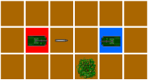
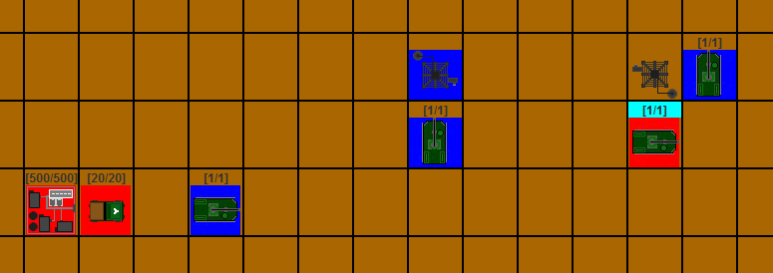
Goal
Round game for 2 – 4 player
Scala
TUI, GUI and PLAY

Slide 4
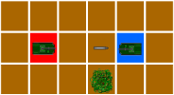
Approach
UML - Diagram
Test Driven Development
Clean Code
Model
Controller
TUI, GUI and PLAY
Notes:
Show WhiteStarUML Diagram
147 Tests and 14 Suites
Robert C. Martin – Clean Code and Clean Coder
„Programming in Scala“ from Martin Odersky, Lex Spoon, and Bill Venners the second edition.
POJOs, immutable
Mutable and Use Cases

Slide 5
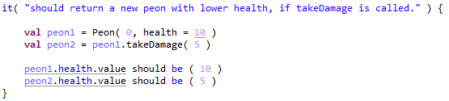
Scala Features
Test Driven Development
Notes:
FunSpec with ShouldMatchers
Tests first then source

Slide 6

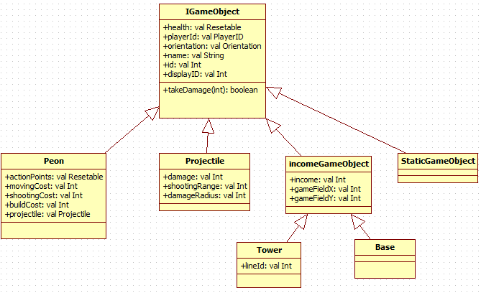
Scala Features
Inheritance

Slide 7

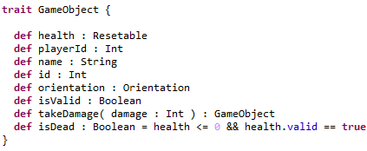
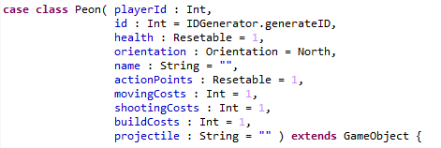
Scala Features
Inheritance

Slide 8
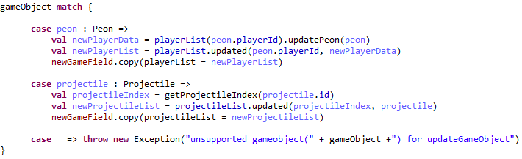
Scala Features
Match-Pattern

Slide 9
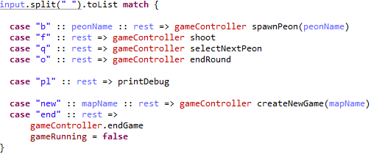
Scala Features
Match-Pattern

Slide 10
Scala Features
List and map patterns
As many values as possible
Easy file reading
Notes:
Variables only on the highest layer.
Variables only for computation.
Each set-functions return a new instance.

Slide 11
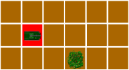
Discussion
High implementation overhead for values
Redundancy vs. Inheritance
Missing typical IDE features

Slide 12
Tests and Demo
Notes:
For tests: show jacoco:cover and code coverage
For demo: first TUI, then GUI, at least PLAY

