Slide 1

Project Name: SecureCom - AI-Powered Communication Fraud Defense Platform
Team Name: SMGyupsal
University Name: Technological Institute of the Philippines - Quezon City
Team Leader Email: qarsantos02@tip.edu.ph
Team Leader WhatsApp Contact Number: +63 911 656 1428

Slide 2

Project Overview
Overview
Project Name | SecureCom - AI-Powered Communication Fraud Defense Platform
Team Name | SMGyupsal
Contacts | qarsantos02@tip.edu.ph qhamanuel@tip.edu.ph qmjkegob@tip.edu.ph
Technical Field | AI, Machine Learning, Natural Language Processing, Cybersecurity
Technologies | BERT Transformer Models, PyTorch, Flask REST API, Flutter, Firebase, Huawei Cloud OBS (planned), Google Colab
Keywords | Fraud Detection, AI, Smishing, Vishing, NLP, Mobile Security, Transformer Models, Communication Safety
Applicable Fields | Cybersecurity, Mobile Security, Financial Protection, Digital Safety, Public Safety
Description (in 200 words) | Communication fraud through smishing (SMS phishing) and vishing (voice phishing) has emerged as a critical cybersecurity threat, with global losses exceeding USD 2.9 billion in 2023. In terms of our local considerations, the Philippines itself faces acute challenges due to high mobile penetration (170M subscriptions) and SMS-centric communication patterns (2.4B daily messages). SecureCom addresses this through AI-driven fraud detection using advanced natural language processing. We have developed core technical components including comprehensive data preprocessing pipelines, dual transformer models (BERT-tiny architecture) specialized for SMS and voice call detection, and Flask-based REST API infrastructure. Our working prototype demonstrates proof-of-concept functionality with semantic analysis that goes beyond traditional keyword-based filtering. The dual-model strategy captures channel-specific fraud patterns, while the lightweight architecture enables fast inference suitable for real-time mobile deployment. The system is architected for Huawei Cloud OBS integration for scalable model distribution in production. SecureCom targets vulnerable populations in high-risk regions, supporting UN SDG 8, 9, and 16 by enabling safe digital adoption and strengthening trust in telecommunications infrastructure.

Slide 3

Contents
1
Team Introduction
2
Project Introduction
3
Technical Architecture
4
Features
5
Innovations
6
Business Value
7
Development Status & Roadmap
8
Demo

Slide 4




Team Introduction
Mark Jeonel Kenn Gob
Hazel Aillson Manuel
Andrei Santos
University Name:
Technological Institute of the Philippines
- Quezon City
Position/Role:
Backend API Development
Background/Experience:
Undergraduate, Computer Engineering
Major in Cyber-Physical Systems
University Name:
Technological Institute of the Philippines
- Quezon City
Position/Role:
Mobile Application & System Integration
Background/Experience:
Undergraduate, Computer Engineering
Major in Systems Administration
University Name:
Technological Institute of the Philippines
- Quezon City
Position/Role:
AI Model Development & Training Lead
Background/Experience:
Undergraduate, Computer Engineering
Major in Human-Computer Interaction

Slide 5
Project Introduction
Project Background & Context
Communication fraud has evolved from crude spam into sophisticated social engineering campaigns exploiting human psychology: trust, fear, and urgency. Modern smishing and vishing attacks impersonate legitimate institutions (banks, government agencies, healthcare providers, delivery services) with alarming authenticity.
Global Crisis Statistics:
USD 2.9 billion in losses from phishing/vishing in 2023 (FBI IC3 Report)
Philippines ranks among top 5 countries for mobile fraud incidents per capita
37% of vishing attacks in 2024 used AI-generated voice cloning
65% of victims are elderly or financially vulnerable individuals
Small businesses lose average USD 75,000 per successful fraud incident
Regional Context - Philippines & Southeast Asia:
Over 170 million mobile subscriptions (population: 115 million)
2.4 billion SMS messages sent daily (highest globally)
Rapid shift to mobile banking and e-wallets creates new fraud opportunities
Mix of English, Filipino, and Tagalog complicates detection
Limited cybersecurity awareness among general population
Problems Solved:
Critical Gaps in Existing Solutions:
Target Users
Primary Users: Individuals in high-risk social settings - primarily young adults vulnerable to communication fraud
Secondary Users: Law enforcement, organizations, and public health groups requiring reliable, aggregated data to improve policy and resource allocation
Enterprise Users: Businesses seeking to protect employees and customers from fraud attacks
Telecom Providers: Network operators looking to enhance security offerings
Current Approach | Why It Fails
Keyword blacklists and pattern matching | Cannot understand context, intent, or semantic manipulation
Crowdsourced phone number blacklists | Scammers change numbers instantly; reactive not proactive
No voice call analysis | Vishing attacks go undetected until damage is done
Network-level filtering after delivery | Users already exposed to fraudulent content before analysis

Slide 6
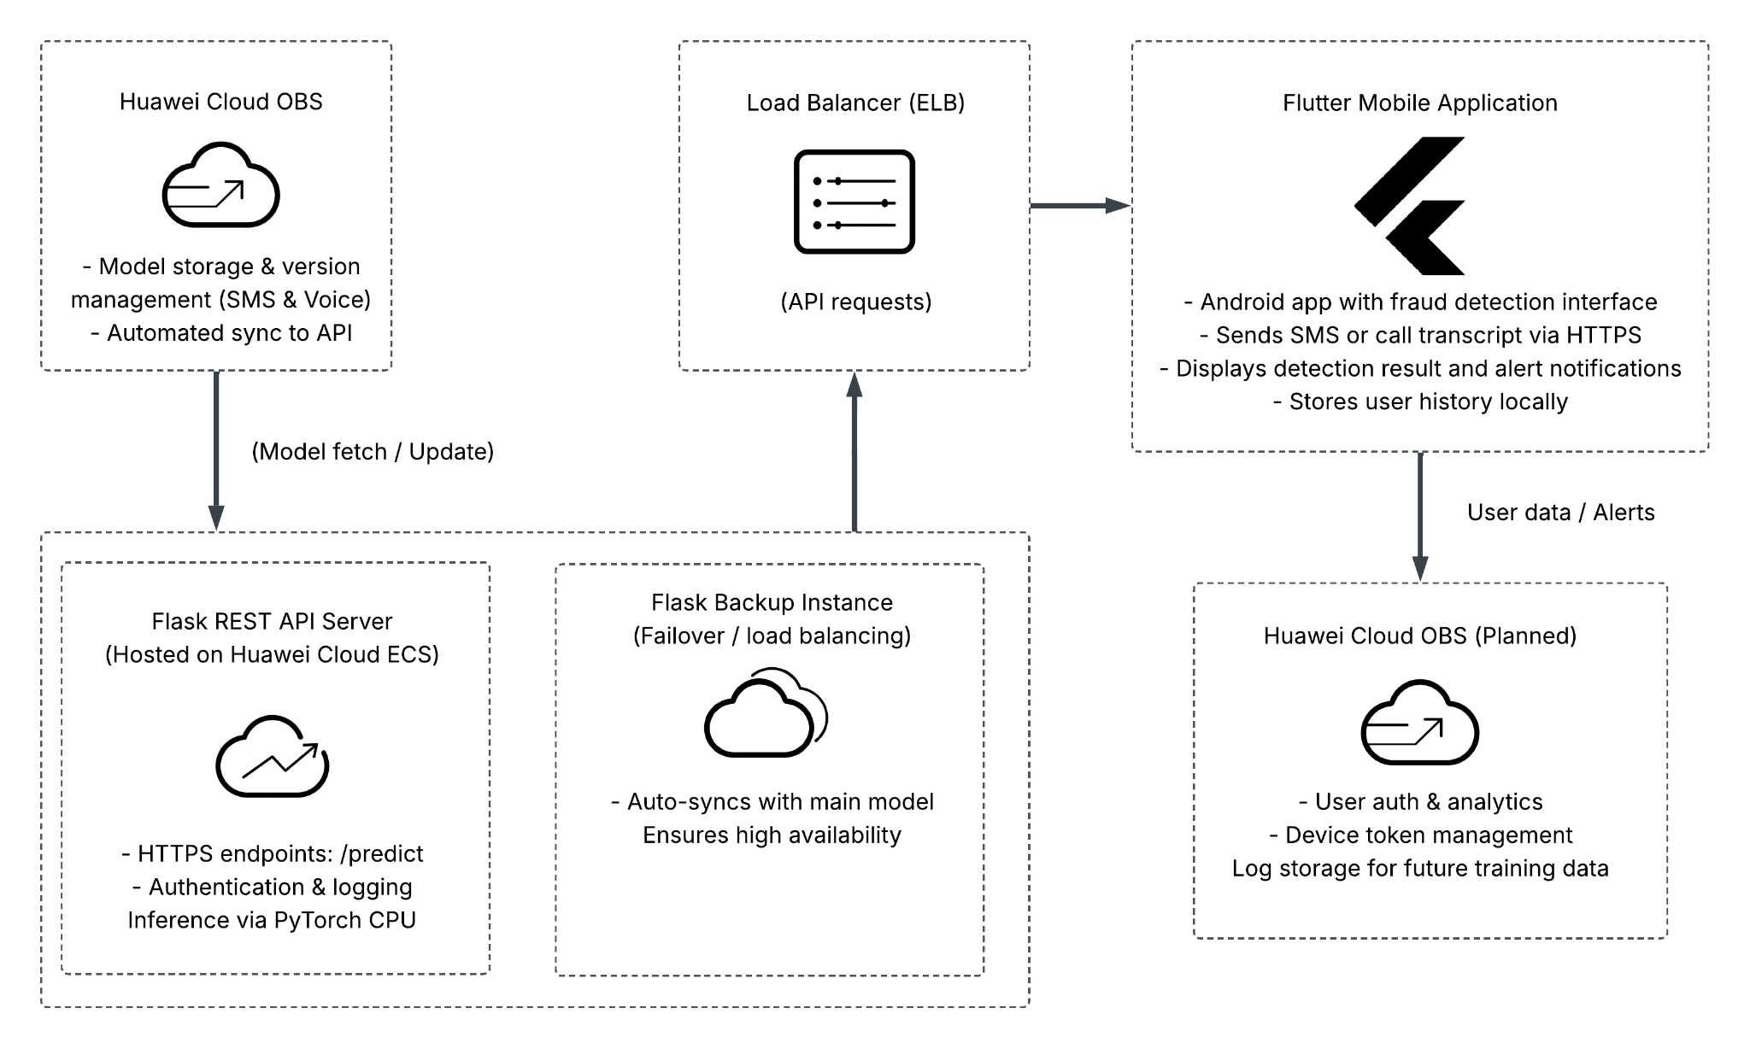
Technical Architectures
Service Description
SecureCom deploys dual AI fraud detection models using Huawei Cloud OBS and Flask-based APIs to analyze SMS and voice transcripts. The system ensures secure, scalable, and real-time protection against communication fraud.
The latest SMS and voice models are stored and versioned in Huawei Cloud OBS, automatically synced to Flask API servers hosted on Huawei ECS.
The Load Balancer (ELB) distributes incoming HTTPS prediction requests from the Flutter mobile app to available Flask instances.
The mobile app authenticates users via Firebase, then submits SMS or voice transcripts through secured API endpoints (/predict_sms, /predict_calls).
The Flask API verifies the request, loads the appropriate model from local cache or OBS, and performs inference using PyTorch.
The classification result (legitimate or fraudulent) is returned to the mobile app, which displays alerts and logs activity for analytics or retraining.
The system is finally planned to periodically sync with Huawei Cloud OBS to ensure both primary and backup API servers run the latest model versions, maintaining availability and accuracy.
Solution Deployment Architecture Diagram
Notes:
Overview
Key technologies you selected and their collaboration with other functional modules
Roles of the Huawei Cloud technologies you used in the project
Implementation principles
Solution deployment architecture diagram (including service flows)
Technology maturity assessment, such as whether the technical roadmap is clear and tools are mature and reliable

Slide 7
Features
SecureCom integrates transformer-based AI fraud detection with dual-channel architecture and Flask API infrastructure to provide immediate, context-aware identification of smishing and vishing attacks.
Key Features:
Provides objective AI classification beyond keyword blacklists through semantic understanding of fraud patterns, urgency manipulation, and social engineering tactics
Utilizes dual BERT-tiny models analyzing SMS and voice transcripts separately, with specialized optimization for each channel's linguistic characteristics
Processes input through preprocessing pipeline (cleaning, normalization, tokenization) then analyzes with fine-tuned transformers to classify: LEGITIMATE (0) or FRAUDULENT (1)
AI Detection Capabilities vs. Traditional Systems
Capability | Traditional Systems | SecureCom AI
Detection Method | Keyword matching | Semantic context analysis
SMS Protection | Static blacklist | BERT transformer (SMS-optimized)
Voice Protection | None | BERT transformer (voice-optimized)
Adaptation | Manual updates | Retrainable AI models
Response Time | Post-exposure | Real-time inference
Table 1. SecureCom AI-driven detection capabilities compared to traditional fraud prevention systems
SecureCom is the first platform to integrate transformer-based NLP, dual-channel specialization, and mobile-ready inference for communication fraud detection. Unlike traditional blacklist systems, SecureCom's AI model understand context, intent, and manipulation patterns, providing quantifiable fraud assessment that adapts as threats evolve, immediately enabling users to recognize sophisticated attacks without relying on constantly-updated keyword lists.

Slide 8
Innovations
SecureCom is the first fraud detection system to apply transformer neural networks to communication content analysis, moving beyond simple pattern matching to semantic understanding.
Technical Breakthroughs:
AI Semantic Detection – First BERT transformer application for communication fraud, detects manipulation patterns keyword filters miss
Dual-Channel Models – Separate SMS and voice models optimized for each channel's fraud characteristics
Mobile-Ready Inference – BERT-tiny architecture enables real-time detection with practical response times
In comparison to keyword blacklists and phone number blocking systems, SecureCom is the first platform to integrate transformer NLP, dual-channel specialization, and mobile-ready inference for communication fraud detection. The AI models understand semantic context, urgency manipulation, and social engineering language, providing quantifiable fraud assessment that adapts as threats evolve, rather than relying on static rules requiring constant manual updates.

Slide 9
Business Value
Social & Economic Impact
Protects users from smishing/vishing losses and psychological harm
Enhances telecom trust and supports secure digital participation
Contributes to UN SDGs 8, 9, and 16 by promoting safe digital economies
SDG | Contribution of SecureCom
SDG 8 – Decent Work and Economic Growth | Protects individuals and small businesses from fraud-related financial losses, enabling safer participation in the digital economy.
SDG 9 – Industry, Innovation, and Infrastructure | Strengthens the reliability of digital communication networks and promotes trust in mobile technologies through AI-driven cybersecurity innovation.
SDG 16 – Peace, Justice, and Strong Institutions | Reduces cyber-enabled crime by identifying fraudulent communications early, supporting law enforcement and public protection efforts.
SecureCom delivers both economic and social impact by protecting users and small businesses from communication fraud, fostering safer participation in the digital economy. By strengthening trust in mobile communication systems, it supports SDG 9 (Industry, Innovation, and Infrastructure) and SDG 8 (Decent Work and Economic Growth) through secure digital adoption. Additionally, by detecting scams early and potentially aiding law enforcement, it advances SDG 16 (Peace, Justice, and Strong Institutions). Overall, SecureCom positions itself as a sustainable, AI-driven solution that promotes financial safety and digital confidence.

Slide 10
Development Status & Roadmap
Current Status (Prototype Achievements)
Data Infrastructure: Complete preprocessing pipeline (cleaning, normalization, tokenization) tested on SMS and voice datasets
AI Models: Dual BERT-tiny models fine-tuned for SMS and voice fraud detection
Backend API: Flask REST API with authentication, dual endpoints
Mobile Interface: Flutter prototype developed with fraud visualization UI
Deploy models to Huawei Cloud OBS for scalable distribution
Next Steps & Expansion
May integrate FunctionGraph for automated updates, ModelArts for model lifecycle management, and Huawei Mobile Services (HMS) to enable real-time SMS and call event detection
Expand datasets to include other main and regional languages
Establish pilot partnership with telecom provider/s for real-world testing

Slide 11

Demo (For Semi-finals)
Demo
Google Drive Link: https://drive.google.com/drive/folders/15P3v2yMIQmAtSPdY8zMQgd9ZZrXyIJbc?usp=sharing

Slide 12
THANK YOU
Team SMGyupsal
- Gob, Mark Jeonel Kenn -
- Manuel, Hazel Aillson -
- Santos, Andrei -

