Slide 1

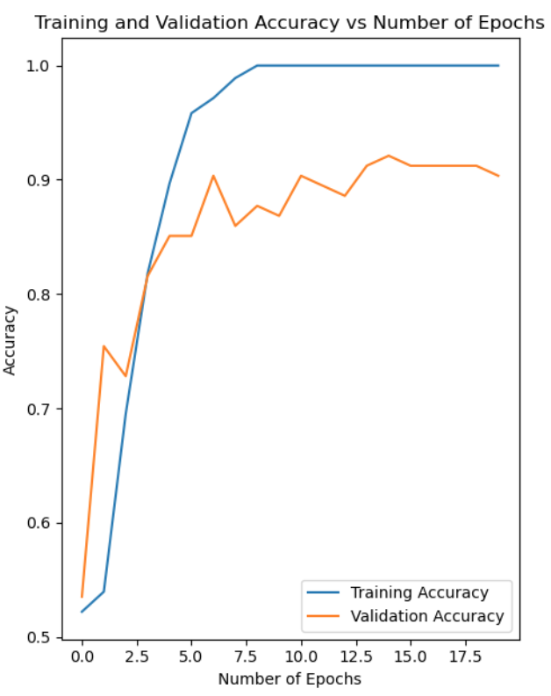
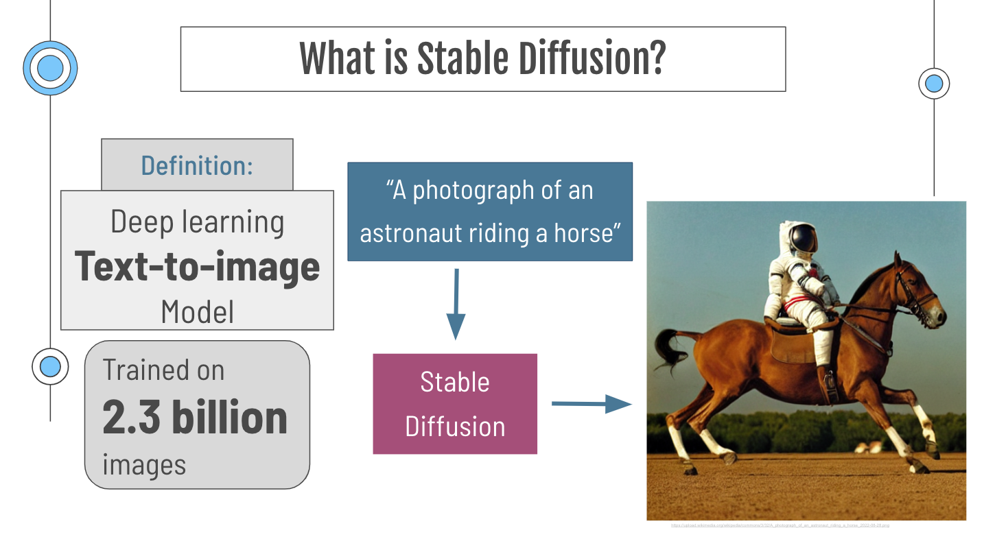
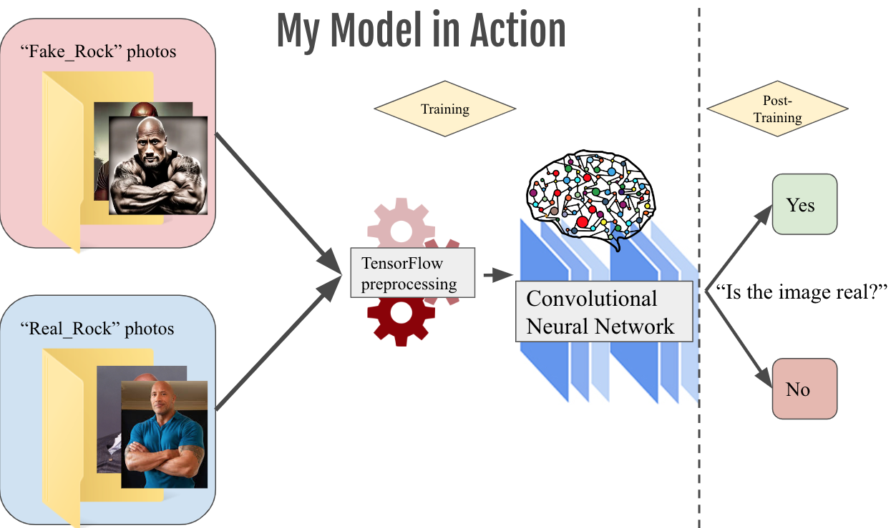
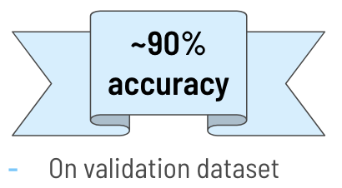
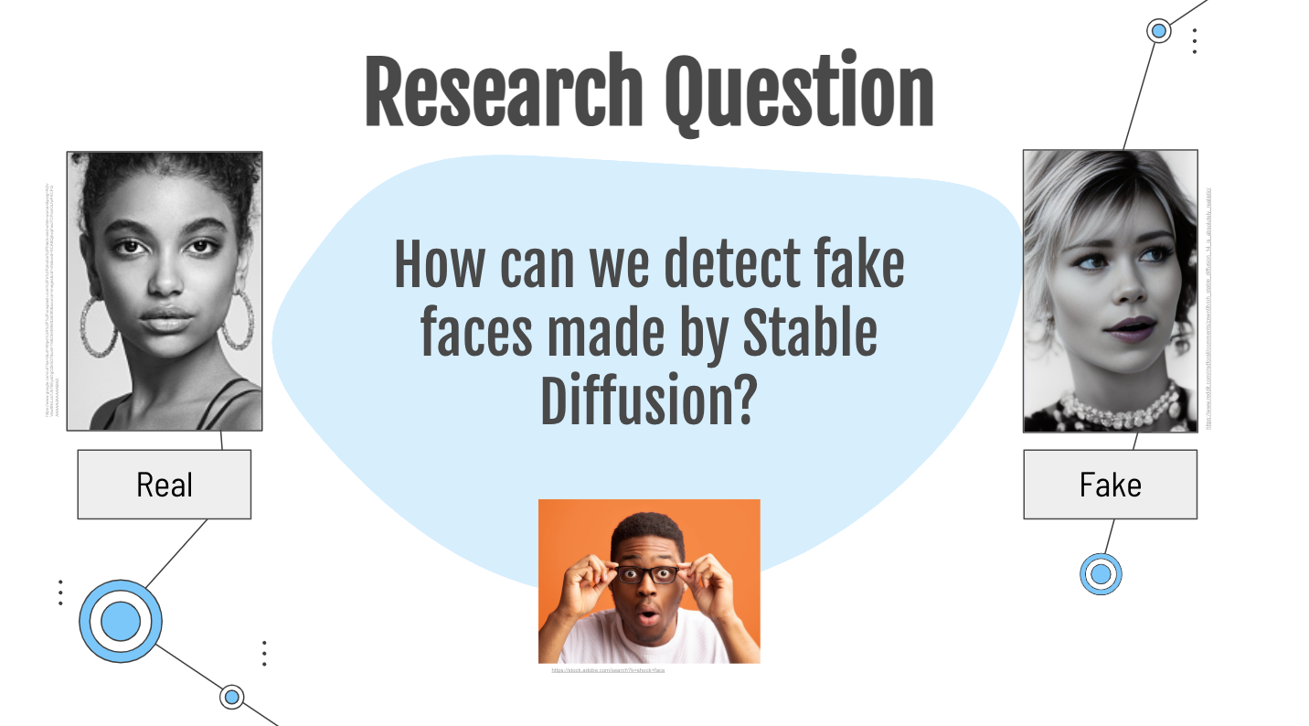
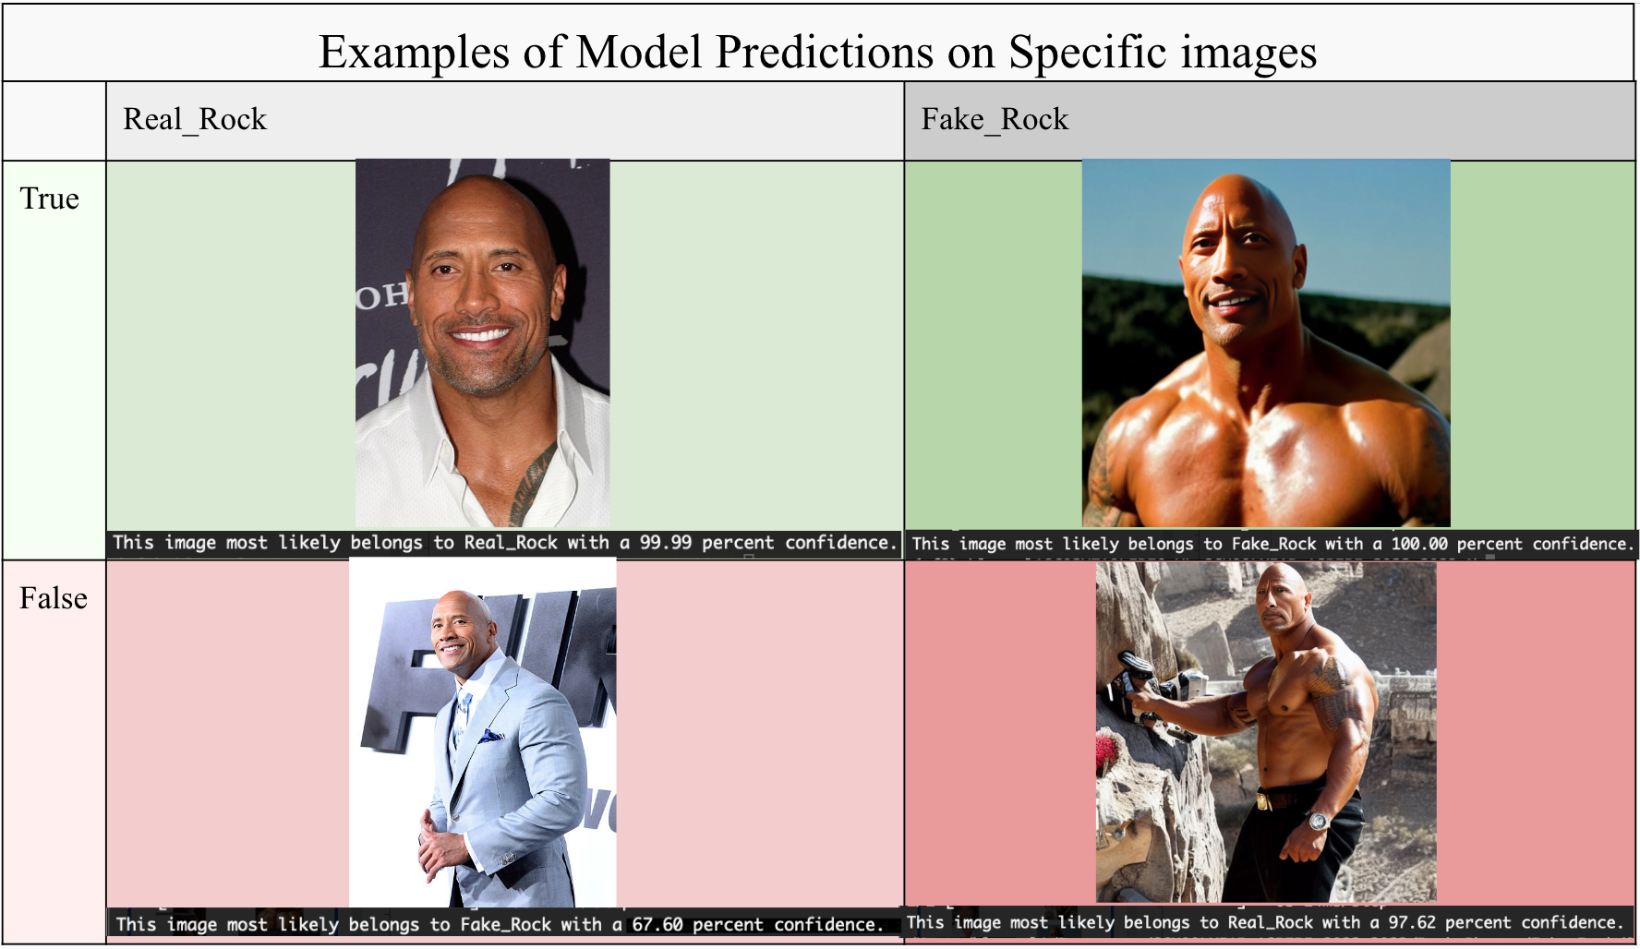

Doppelganger Detection: Identifying Fake Faces Generated by Stable Diffusion
Zachary Blumenfeld (ASPIRE Intern)
Mentors: Katie Zaback (AMDS/A4I) and Morgan Mango (AOS/QCR) at JHUAPL
Background
Proposed Solution: Convolutional Neural Network
Results
The finalized model can be expected to correctly predict at least 9 out of 10 times if a particular one of the 574 images (used for both training and validation) is real or fake.
Stable diffusion is a recent, popular text-to-image generation model. The use of Stable Diffusion is free and open source, and quality of generated photos can be photorealistic – sometime indistinguishable from reality for the human eye. The use of such image generation techniques could pose a threat in the hands of a malicious party, especially if used to create realistic fake human faces.
Two categories of photos (”Real_Rock” & “Fake_Rock”) are directed into into TensorFlow (Python library) preprocessing and then fed into a convolutional neural network until the model is successfully trained.
Conclusion
Objective
Though it is easy to be caught up in the high accuracy that the model ultimately achieved, a key issue of generalization still remains. This kind of model would need additional training on a much larger dataset in order to have a chance of adequately generalizing to the wide variety of human faces in existence (outside of just The Rock’s face).
Using convolutional neural networks in this manner may prove to be useful in identifying fake faces made by Stable Diffusion. Again, using artificial intelligence to prevent the cybersecurity and other threatening risks presented by growing technologies should be among the highest priority for the greater data science community. The next generation of AI is hopeful as research like this continues to spearhead the achievement of a secure, honest, and bright future.
Contact Info: zachb0077@gmail.com
Acknowledgements:
A HUGE “Thank You” to both of my mentors, Katie Zaback and Morgan Mango
This project would not have been possible without you, thank you.
References
https://commons.wikimedia.org/wiki/File:A_photograph_of_an_astronaut_riding_a_horse_2022-08-28.png
https://waxy.org/2022/08/exploring-12-million-of-the-images-used-to-train-stable-diffusions-image-generator/
https://cs231n.github.io/convolutional-networks/
https://developersbreach.com/convolution-neural-network-deep-learning/
https://www.youtube.com/watch?v=sDDjJRnnHao
Above are examples of predictions made by the model on specific images (e.g. true positive on top left or false positive on bottom left)

