Slide 1
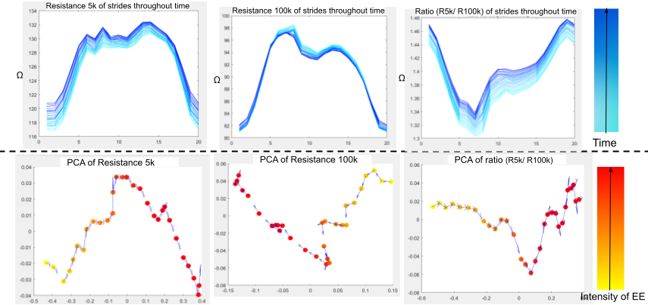
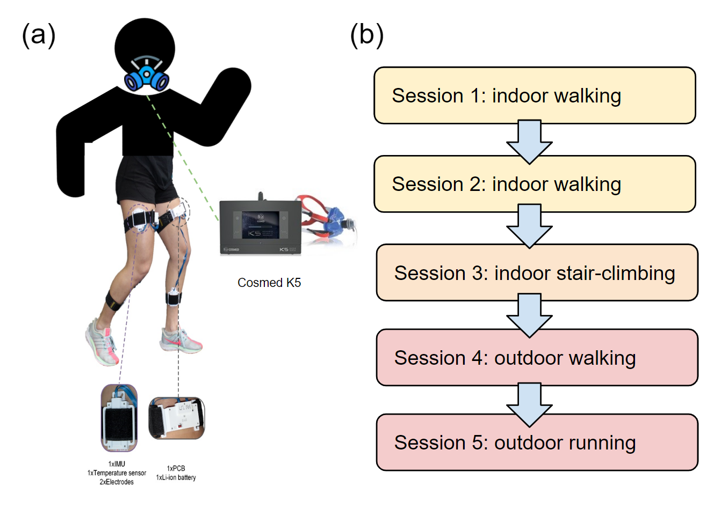
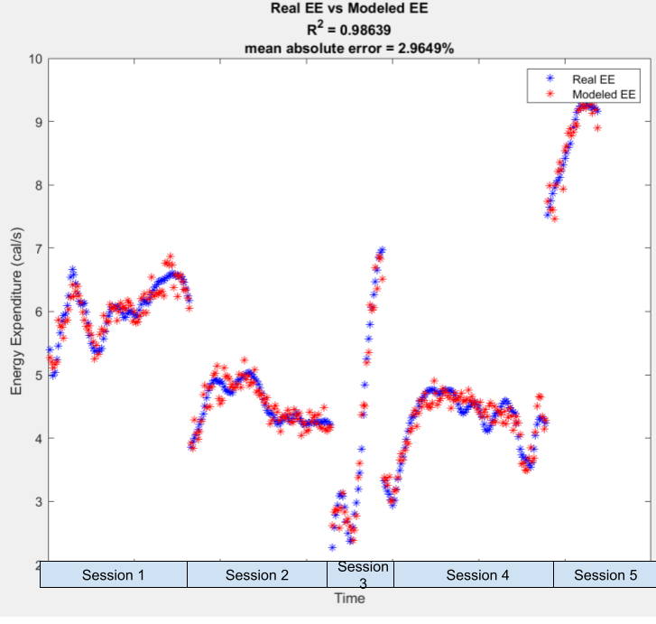
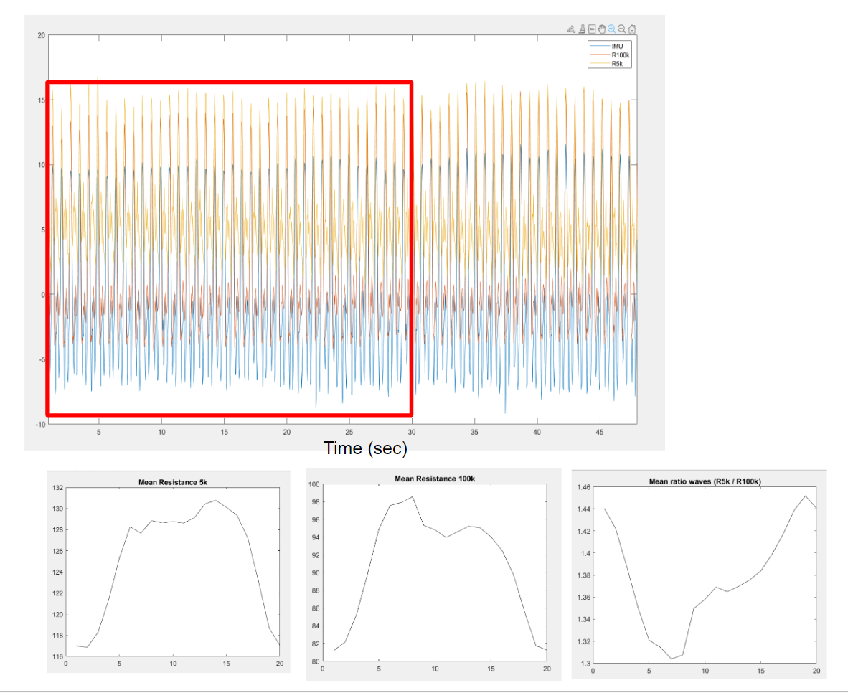
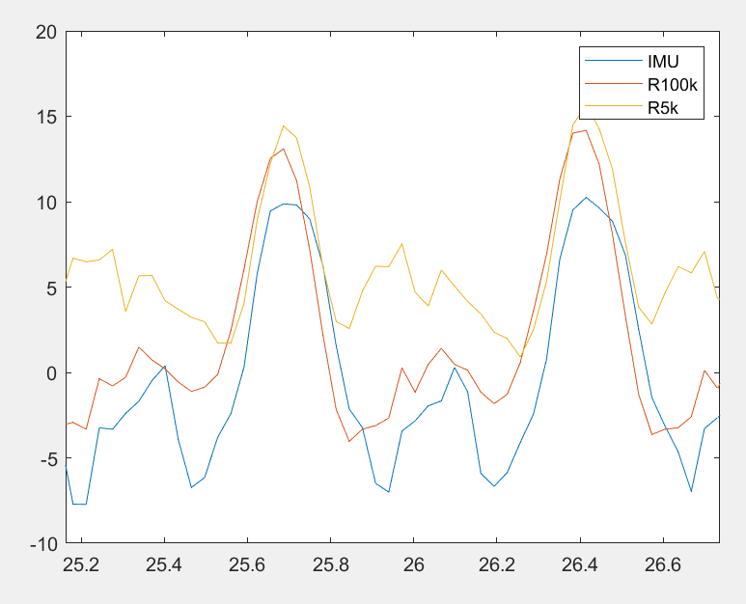
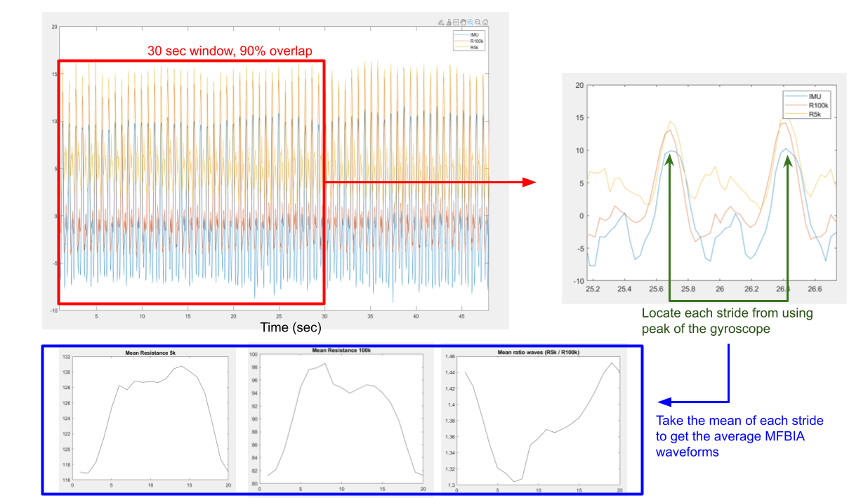
Wearable leg bioimpedance is associated with energy expenditure during dynamic activities
Lan Lan
Department of Biomedical Engineering, Georgia Institute of Technology
ABSTRACT
OBJECTIVES
RESULTS
3. Evaluate the results of subject-specific, leave-one-session out analysis using multiple regression model
Although the regression model when all impedance waveforms for all sessions were used as input had near perfect R^2 and a very low mean absolute percent error. The result of leave-one-session-out cross validation was not as promising. The mean absolute percent error for each subject -specific model with varying data input is shown below. When include all MFBIA waveforms as data input, the percent error could reach up to 68%. However, if I reduce the data input to include only 1 single type of resistance waveform, the the errors seems to be smaller and is compatible with state-of-art activity monitors, whose mean percent error also ranges from 24-42% [1].
Physical activity is necessary for better overall health. Performing physical activities has a metabolic cost on the body, which can be quantified using energy expenditure (EE). Respirometry has been shown to accurately measure (EE); however, it is not practical for everyday use. Wearable multi-frequency electrical bioimpedance analysis (MFBIA) technology has rapidly evolved in the last two decades as a noninvasive measure of local tissue fluid content. By using multiple frequencies, MFBIA can estimate the dynamic changes in intra- and extracellular fluid of tissue during activities. With activity, the increased metabolic demand of muscle results in rapid exchange of metabolites within the muscle tissue, including fluid. In this study, we hypothesized that wearable MFBIA could estimate mid-activity EE during versatile activities. To evaluate the hypothesis, we recruited three individuals and used a custom wearable MFBIA system measuring dual frequency bioimpedance (5 and 100 kHz) during two indoor and one outdoor walking, one indoor stair climbing, and one outdoor running sessions.
The VO2 and VCO2 content were also measured during these activities, which were used as ground truth calculation of EE using the Weir Formula. We observed dynamic changes both within and between gait cycles for the 5 and 100 kHz tissue resistances (R5kHz and R100kHz), as well as R5kHz/R100kHz. Using these MFBIA waveforms, we visualized the temporal trajectory of MFBIA during activity using principal component analysis. Then, by using multiple linear regression, we found a strong association between the MFBIA waveforms and EE
Demonstrate the changes in MFBIA waveforms (R5k Hz, R100k Hz, and R5k Hz/R100k Hz) throughout dynamic activities using Principal Component Analysis (PCA).
Evaluate the multiple linear regression that predicts energy expenditure while using each data point of all MFBIA waveforms as input
Evaluate the results of subject-specific, leave-one-session out analysis using multiple regression model
1. Demonstrate the changes in MFBIA waveforms throughout dynamic activities using PCA.
As each dynamic activity session showed the same pattern, the following used one indoor running session from one subject as a representative. In figure 4, The first row shows all the averaged waveforms in a 30-second window. The color gradient from cyan to blue shows the progression of time. As we can see, Resistance 5k increases, Resistance 100 k decreases, and the ratio wave decreases unidirectionally. This change in resistance over time shows that, as metabolic demand increases, the fluid providing the muscles' nutrients shifts from the extracellular fluid into the intracellular fluid throughout the exercise [5-7]. The second row shows the principal component analysis graph corresponding to each resistance waveform above. Each data point on the PCA corresponds to one averaged waveform. The blue arrows trace out the temporal trajectories. The color of each dot corresponds to its relative intensity of energy expenditure. The temporal trajectories are very clear and traceable, and the intensity of EE changes along the trajectories.
MATERIALS AND METHODS
Data Input | Subject 102 | Subject 103 | Subject 104
R5k | 27% | 45% | 25%
R100k | 41% | 25% | 39%
ratio wave | 47% | 23% | 22%
R5k, ratio | 38% | 15% | 35%
R5, R100 | 34% | 15% | 33%
R100, ratio | 35% | 14% | 33%
R5k, R100k ratiowave | 41% | 68% | 56%
Experiment Protocol
The study was approved by the Georgia Institute of Technology Institutional Review Board. Three healthy subjects were recruited. Each of them performed 2 indoor and 1 outdoor walking, one indoor stair climbing, and one outdoor running session. During those sessions, the MFBIA data was measured from thigh and shank using custom wearables designed by our lab member [4]. Meanwhile, the VO2 and VCO2 data was also measured from COSMED K5 masks (COSMED, ITALY). These respiratory data were used to calculate ground truth energy expenditure using the Weir Formula. Figure 2 (a) demonstrated the setup of the experiment and (b) demonstrate the flow of the experiment.
Table 2. Results of leave-one-session-out CV
CONCLUSIONS
INTRODUCTION
Although the multiple regression model shows strong association between MFBIA waves and energy expenditure, the reason that corresponding Leave-one-session-out CV yields weaker results is unclear. However, the percent error predicted by the LOSO-CV is comparable to state-of-the-art products.
The gold standard for calculating energy expenditure during exercise relies on breath-based, respirometry measurements, which can be inconvenient to measure in every-day use. Commercially available wearable sensors (such as smart watches) that measure energy consumption, could reach a mean absolute error of 24% - 42% [1] as most of them rely on heart rate and upper limb kinematics. Slade et al. has shown that energy expenditure predicted from IMU data of the lower limb has a mean absolute error (13%) much lower than state-of-the-art methods [2]. Therefore, this project hypothesizes the feasibility of using multi-frequency electrical bioimpedance (MFBIA) of the lower limb to estimate energy expenditure. MFBIA measures the impedance of a tissue by measuring the voltage across it after injecting a small current at two or more different frequencies. Similar to IMU data, lower limb impedance changes periodically during gait. The reason for the periodicity is because the driving force for changes in tissue impedance is fluid movement. During gait, fluid moves in tissue periodically (Figure 1.) MFBIA not only reflects the gait pattern, it also reflects the dynamic changes between intra-and extracellular fluid during exercise. At low frequency current, 5k Hz in this case, bioimpedance mainly reflects the impedance of the extracellular content. At high frequency, bioimpedance measures both the extracellular and intracellular content [3].
Figure 4 Waveform changes through course of exercise
2. Evaluate the multiple linear regression that predicts energy expenditure while using each data point of MFBIA waveforms as input
When all MFBIA waveforms are used as input to model energy expenditure. The Correlation of Coefficient (R²) for every subject-specific model is nearly 1. In addition, the mean absolute error is less than 5%. Table 1 details the R² and mean absolute error for each subject-specific model. The graph shows one representative case.
REFERENCES
1. Pope ZC, Zeng N, Li X, Liu W, Gao Z. Accuracy of Commercially Available Smartwatches in Assessing Energy Expenditure During Rest and Exercise. Journal for the Measurement of Physical Behaviour. 2(2):73-81. doi:10.1123/jmpb.2018-0037
2. Kyle UG, Bosaeus I, De Lorenzo AD, et al. Bioelectrical impedance analysis--part I: review of principles and methods. Clin Nutr. 2004;23(5):1226-1243. doi:10.1016/j.clnu.2004.06.004
3. Slade P, Kochenderfer MJ, Delp SL, Collins SH. Sensing leg movement enhances wearable monitoring of energy expenditure. Nat Commun. 2021;12(1):4312. doi:10.1038/s41467-021-24173-x
4.D. G. Allen, G. D. Lamb, H. Westerblad, Skeletal Muscle Fatigue: Cellular Mechanisms. Physiological Reviews. 88, 287–332 (2008).
5 U. Proske, D. L. Morgan, Muscle damage from eccentric exercise: mechanism, mechanical signs, adaptation and clinical applications. The Journal of Physiology. 537, 333–345 (2001).
6. H. Westerblad, D. G. Allen, Changes of myoplasmic calcium concentration during fatigue in single mouse muscle fibers. Journal of General Physiology. 98, 615–635 (1991).
Figure 2 (a) setup of the experiment ; (b) each dynamic activity session of the protocol
Signal Processing:
For each exercise session, the point average resistance waveform for each stride in each 30 second window with 90% overlap was calculated. Each stride is extracted by locating the 2 consecutive peaks in the gyroscope data. The average EE data from each 30 second window with 90% overlap was also calculated.
 | R² | Mean % Error
Subject 102 | 0.9782 | 4%
Subject 103 | 0.9864 | 3%
Subject 104 | 0.9721 | 3%
Table 1. Results of Subject Specific Multiple Regression Model
ACKNOWLEDGEMENTS
Michael Chan conducted the experiment protocol.
Figure 5 Multiple Regression model shows high association
Figure 1 Resistance Data changes periodically with each stride as IMU
Figure 3 Depiction of the signal processing workflow

