Slide 1
Rigour, Relevance and Relationships
Keeping a research career alive while making a difference in policy
Dr John McDermott CRSNZ
Executive Director, Motu Economic and Public Policy Research · Chair, IRANZ
WSBG Doctoral Colloquium · Rutherford House · 30 October 2026
Notes:
Kia ora koutou. Thank Martien and the WSBG doctoral programme for the invitation.
Framing: Martien's invitation said many of you wonder how to keep an active research career while making a difference in policy. This talk is my answer, told through three stages of my own career.
Timing guide (45 min slot from 9:30): ~30 minutes talk, ~15 minutes questions.
VISUAL SUGGESTION: a personal photo here works well, e.g. a photo from Yale (graduation or Cowles Foundation building), or a Wellington harbour shot to anchor it locally. Place it on the right third of the slide.

Slide 2



The question you asked me to answer
“How do you keep an active research career while making a difference in policy?”
ACT 1
ACT 2
ACT 3
Foundations
Policy institutions
Leading research
Yale PhD and the econometrics that underpin everything after
IMF and Reserve Bank: technical depth, and the co-authors who kept it current
Motu and IRANZ: building the conditions for other people’s research
Notes:
Read the question from the invitation. It's a good question, and it doesn't have a single answer, so I'll tell it as three acts.
Act 1: the technical foundation, my PhD at Yale.
Act 2: twenty-five years in policy institutions, at the IMF and the Reserve Bank, and how research survived there, largely through co-authors.
Act 3: leading research organisations, Motu and IRANZ.
I'll come back at the end with a few lessons. (Lessons slide to be finalised.)

Slide 3
Four decades, one thread
1986–88
1990–94
1998–2005
2007–19
BCom/BSc, MCom
University of Auckland
PhD, Yale University
Cowles Foundation
RBNZ, then Chief Economist
National Bank
Assistant Governor
Reserve Bank of NZ
1988–90
1994–98
2006–07
2019–
Economist
Reserve Bank of NZ
Economist
IMF, Washington DC
Associate Professor
Victoria University
Executive Director, Motu
Chair, IRANZ (2021–)
Academic / research
Policy institutions
Research leadership
Notes:
Quick tour of the career. The point to make: it looks like a zig-zag between research and policy, but the thread is the same throughout. Applied time-series econometrics in the service of real questions.
Also mention: Adjunct Professor at Victoria 2007–2023, IMF visiting scholar 1999–2003 and IMF short-term expert 2023–25. The academic link never fully broke, even as Assistant Governor.
VISUAL SUGGESTION: replace or supplement dots with small logos (Auckland, RBNZ, Yale, IMF, VUW, Motu). Check logo-use permissions first.

Slide 4

The technical foundation
ACT 1
Yale, the Cowles Foundation, and learning to prove that the tools we use actually work
Photo: Carol M. Highsmith Archive, Library of Congress
Notes:
Transition: Let me start in New Haven in 1990.
Photo: Sterling Memorial Library from Cross Campus (Carol M. Highsmith Archive, Library of Congress; public domain).

Slide 5
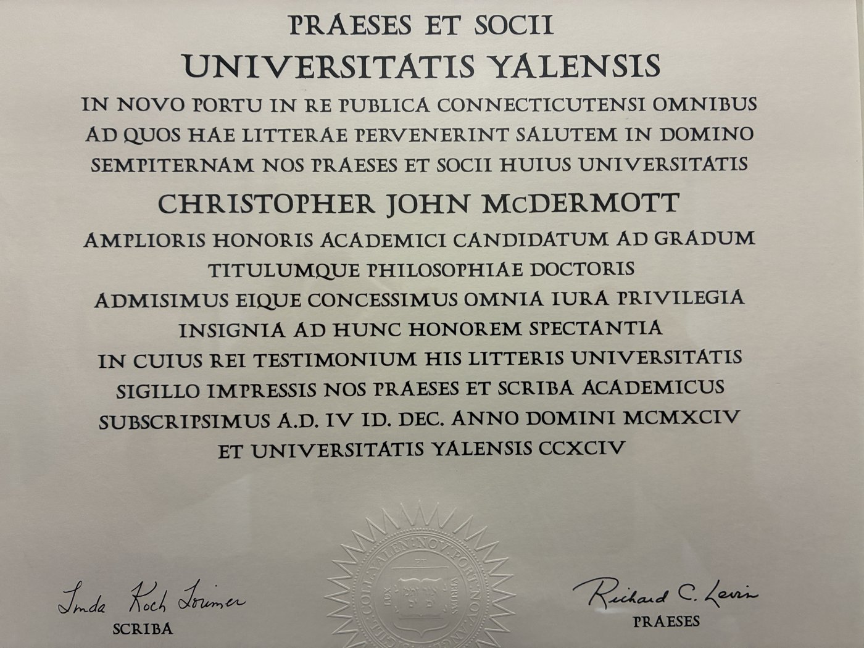
Yale: training at the frontier
1994
PhD, Yale University
Conferred Dec 1994, presented May 1995
Sloan
Dissertation Fellowship
Alfred P. Sloan Foundation, 1993/94
Bergstrom
Prize in Econometrics
A.R. Bergstrom Prize, 1995
Before Yale: Auckland MCom (first-class honours) and two years at the RBNZ. At Yale: co-authored with Donald W. K. Andrews, one of the leading econometric theorists of his generation, published in the Review of Economic Studies (1995).
Notes:
Why Yale mattered: the training was about rigour, about proving that the methods we use give the right answers, not just running them.
Working with Don Andrews taught me how theorists think: precise assumptions, clean results, and an obsession with whether approximations are actually good approximations.
Mention the 1989 NZ Young Economist Prize and the Auckland background briefly if time allows.
The diploma is in Latin: "Philosophiae Doctoris", conferred 10 December 1994 (A.D. IV Id. Dec. MCMXCIV), signed by President Richard C. Levin, and presented at Commencement in May 1995. A light moment: few of us can read our own diplomas.

Slide 6
The problem: trends in nonlinear models
Andrews and McDermott (1995), Review of Economic Studies 62, 343–360
Observed data = trend ∘ stochastic part
Why standard asymptotics struggle
As T → ∞ the trend’s magnitude explodes, so the asymptotics stop mimicking the sample we actually have
With an exponential trend in levels, the Lindeberg condition fails: no CLT, even with iid bounded shocks
Results depend on the trend for t far beyond the sample, which is irrelevant to the data in hand
Existing results (sequential asymptotics) rest on high-level conditions that are hard to verify
W_{t} = d(t, Z_{t}), t = 1, …, T*
Trend shapes economists actually use:
d(t) = bt + ct²
d(t) = exp(bt)
d(t) = bt for t ≤ G, ct for t > G
Polynomial · exponential (levels) · broken trend
Notes:
For a room of PhD students, it's worth spending two or three minutes here.
The setting: most macro and many financial variables trend. In nonlinear models (estimated by GMM, say) with trending regressors, the usual approach lets the sample size go to infinity with the trend continuing on. That causes three problems:
1. The trend gets infinitely large, which doesn't look like the finite sample we have, especially if the trend is small relative to the noise.
2. With an exponential trend in levels, the Lindeberg condition fails, so no central limit theorem, even though a normal approximation is perfectly sensible when b is small.
3. The asymptotics depend on how the trend behaves far outside the sample, and that is irrelevant to the data in hand.
The question: can we justify using the standard toolkit (normal and chi-squared) anyway?

Slide 7
The idea: a triangular array
W_{Tt} = d( (T*/T)·t , Z_{t} ), t = 1, …, T, T ≥ 1
At T = T* this is exactly the observed sample. As T grows we observe the same trend shape more densely, not a longer trend.
Illustrative: exponential trend with b = 0.02, T* = 40
Notes:
The key move. Instead of extending the sample forward in time, embed it in a triangular array: rescale time by T*/T. At T = T*, you get exactly your data. As T grows, you see the same trend shape on a finer grid.
Four properties: (i) only the trend within the sample matters; (ii) the trend's shape is mimicked in the limit; (iii) the trend's magnitude stays bounded; (iv) standard LLNs and CLTs for triangular arrays apply, so the familiar proofs go through.
Left chart: standard asymptotics. The trend runs away from what we see in a sample of 40.
Right chart: triangular array. Same range, same shape, just more points.
Note for students: the chart is illustrative, not from the paper.

Slide 8

The result: the standard toolkit is justified
For GMM / extremum estimators under the triangular array
√T ( θ_{T} − θ₀ ) →^{d} N( 0, V )
Why it mattered to me
θ_{T}: GMM estimator from a sample of size T
Wald, LM and LR-type test statistics → χ² under the null
It taught me to ask whether an approximation fits the problem actually in front of you. That question turned out to be the most useful thing I took into policy work.
V depends on the form of the trend…
…but the usual covariance estimators designed for non-trending data are still consistent
So estimation and inference proceed exactly as in the non-trending case
Notes:
The punchline of the paper: estimators are asymptotically normal and test statistics are asymptotically chi-squared, just as with non-trending variables. The covariance matrix V does depend on the trend, but you don't need to know its form, because standard covariance estimators are consistent anyway.
So the paper provides a justification for doing what applied economists were already doing, and tells them when it's safe.
Bridge to Act 2: The habit this paper built, asking whether your approximation fits the problem in front of you, is exactly what a policy institution needs. Is this shock temporary or permanent? Is this trend real? Has the economy changed?

Slide 9
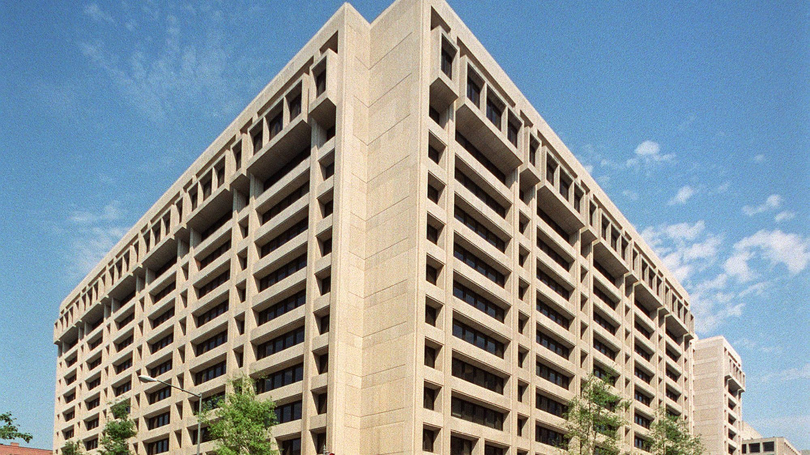
Research inside policy institutions
ACT 2
IMF 1994–98 and Reserve Bank of New Zealand: why technical depth pays, and how co-authors kept it current
Photo: IMF headquarters, Washington DC. Wikimedia Commons (VRT permission #2007052110013541)
Notes:
Transition: I left Yale for the IMF in Washington, then returned to the Reserve Bank.
Photo: IMF headquarters (HQ1), 19th Street, Washington DC. From Wikimedia Commons under a free licence (VRT ticket #2007052110013541).

Slide 10


Policy questions are econometric questions in disguise
Is this shock temporary or permanent?
Persistence decides whether to finance or adjust: smooth through it, or change course.
Is the trend real, or just noise?
A small trend can be swamped by variability. Policy should respond to what dominates.
Has the economy changed?
Structural change shifts the transmission of policy. Old rules of thumb can mislead.
Notes:
The advantage of a strong technical background in a policy institution: you can recognise the econometric question hiding inside the policy question, and you know the limits of the answer.
These three questions recur through my work at the IMF and the RBNZ, and they map onto the two bodies of work I'll describe next.
- Temporary vs permanent: commodity price shocks (Cashin).
- Trend vs noise: the long-run behaviour of commodity prices (Cashin).
- Has the economy changed: the business cycle before and after the GFC (Hall).
The credibility point: as Assistant Governor, being able to interrogate the staff's models, and to be trusted by them, came directly from having done the work myself.

Slide 11
Paul Cashin and the IMF: commodity prices
13
Small trends, big variability
Slumps outlast booms
journal articles
1998–2006
Real prices drifted down about 1% a year, but variability dwarfs the trend and rose after Bretton Woods. The trend has little practical policy relevance.
Price slumps last longer than booms, and the chance a slump ends does not depend on how long it has lasted.
140
years of real commodity
prices, 1862–1999
Shocks are persistent
Real exchange rates
~1%
Shocks are typically long-lived, so stabilisation schemes for export earnings are likely to cost more than they deliver.
Parity reversion in real exchange rates is faster for developed countries and flexible regimes. Terms-of-trade shocks shape saving and current accounts.
a year: the small long-run
decline in real prices
Notes:
The body of work with Paul Cashin, started at the IMF and continued for a decade after I returned to New Zealand.
The common thread is the same Act 1 question: what is trend, what is cycle, and how persistent are shocks?
- Long-run behaviour of commodity prices (IMF Staff Papers 2002): using The Economist's index back to 1862, real prices fell about 1% a year, with little evidence of a break. But the trend is tiny next to the variability, which increased in the early 1900s and became more frequent after the early-1970s collapse of Bretton Woods.
- Booms and slumps (J. Development Economics 2002, with Scott): slumps last longer than booms; prices fall slightly further in slumps than they recover in booms; no duration dependence.
- How persistent are shocks (IMF Staff Papers 2000, with Liang): shocks are typically long-lasting, so commodity stabilisation schemes are unlikely to pay off. That was a live policy debate for developing countries.
- PPP and real exchange rates (IMF Staff Papers 2003, 2006): support for PPP over 90 countries; faster reversion for developed countries and floating regimes.
- Current account and terms of trade: Australia, France, five industrial countries, and the 2002 Open Economies Review prize; plus Australia's dependence on wool ("Riding on the sheep's back").
Why this matters for you: this work was done alongside full-time policy jobs. The co-authorship made it possible.
VISUAL SUGGESTION: if you have the Economist commodity index data (or the IMF paper's Figure 1), a long-run chart of real commodity prices 1862–1999 would be striking here. Or use a photo of you and Paul.

Slide 12



Viv Hall and Victoria: NZ’s business cycle
2011
2016
2004–12
2020
Build the data
Date the cycle
Test policy options
Ask what changed
No official quarterly real GDP before 1977. We built a seasonally adjusted quarterly series from mid-1947 (Chow–Lin temporal disaggregation).
Bry–Boschan turning points: nine recessions in ~70 years. GDP and employment cycles coincide ~90% of the time, and recovery strength is independent of recession depth.
Region-specific cycles dominate the common Australasian cycle, which supports NZ keeping its own currency and monetary policy.
After the GFC the economy is less interest-rate sensitive, so policy must move more, and lower neutral rates have pulled down inflation and output.
Notes:
The body of work with Viv Hall: nine journal articles from 2004 to 2020, including Econometric Theory (2009) and Economic Record (2011).
The arc is a model for a research programme:
1. Build the data. You can't study NZ's post-war cycle with quarterly GDP that starts in 1977 (official chain-linked only from 1987). We built a quarterly series from 1947 by temporally disaggregating annual GDP using the Haywood–Campbell diffusion indexes (NZEP 2011).
2. Date the cycle. Classical turning points with the Bry–Boschan algorithm: nine recessions; GDP and employment cycles associated about 90% of the time; strength of recovery independent of the depth, duration or severity of the recession (NZEP 2016). Also regional cycles (Papers in Regional Science 2007) and unobserved-components cycles (Economic Record 2011).
3. Test policy options. Would NZ be better off with the Australian dollar? The region-specific cycles dominate the common cycle, which is consistent with NZ keeping its own currency and monetary policy (Economic Modelling 2004; NZEP 2012).
4. Ask what changed. A small open economy New Keynesian model pre- and post-GFC: the economy has become less interest-rate sensitive, so monetary policy needs to act more strongly, and lower neutral rates created transitional dynamics (NZEP 2020). Also post-GFC business insolvency rates (NZEP 2019).
This was directly useful at the RBNZ: turning-point dates and recession facts are inputs into forecasting and policy communication.
The next slide shows the quarterly real GDP series with recessions shaded.

Slide 13
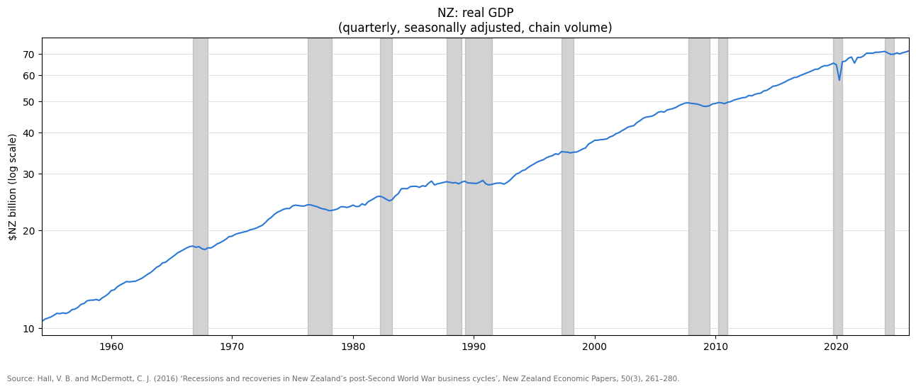
Seventy years of New Zealand recessions
Series updated by J. McDermott, 2026
Notes:
The payoff from building the data: a quarterly real GDP series long enough to date New Zealand's classical business cycles, with recessions shaded.
Points to draw out:
- Expansions are long and recessions short, which is the asymmetry that linear forecasting models struggle to capture.
- The late-1980s/early-1990s episodes during reform and disinflation.
- The GFC recession (2007–09), and how the recovery afterwards was slower.
- The series has been extended beyond the 2016 paper to include the COVID-19 contraction in 2020 and the 2023–24 recession.
Source: Hall and McDermott (2016), "Recessions and recoveries in New Zealand's post-Second World War business cycles", NZEP 50(3), 261–280, with the series updated.

Slide 14
Co-authors keep the toolkit current
Don Andrews
Yale
Paul Cashin
IMF · 13 papers
What a good co-author gives you
Continuity: the project survives your busy quarters
Currency: a partner closer to the academic frontier
Discipline: deadlines and referees outside your day job
Complementarity: policy questions meet new methods
Long horizons: relationships lasting 10–15 years
John
Renée Fry-McKibbin
ANU · inflation targeting
Viv Hall
Victoria · 9 papers
RBNZ colleagues
Karagedikli, Lewis, Drew…
Pierre-Richard Agénor
Eswar Prasad
IMF / World Bank
Notes:
The honest answer to the colloquium's question: I could not have kept publishing through 25 years of policy jobs on my own. Co-authors made it possible.
Paul Cashin: we met at the IMF and kept writing for a decade across Washington and Wellington.
Viv Hall: Victoria (and my adjunct role at VUW 2007–2023) gave a home for a 15-year business cycle programme while I was at the RBNZ.
Others: Pierre-Richard Agénor and Eswar Prasad (stylised facts of developing-country fluctuations, World Bank Economic Review 2000), RBNZ colleagues (Ozer Karagedikli, Michelle Lewis, Aaron Drew), Renée Fry-McKibbin (RBA/RBNZ inflation targeting chapter).
Advice for students: choose co-authors for complementarity and for the long run. Some of your best future co-authors are probably in this room.
VISUAL SUGGESTION: photos of Paul Cashin and Viv Hall (with permission) in place of the coloured nodes.

Slide 15
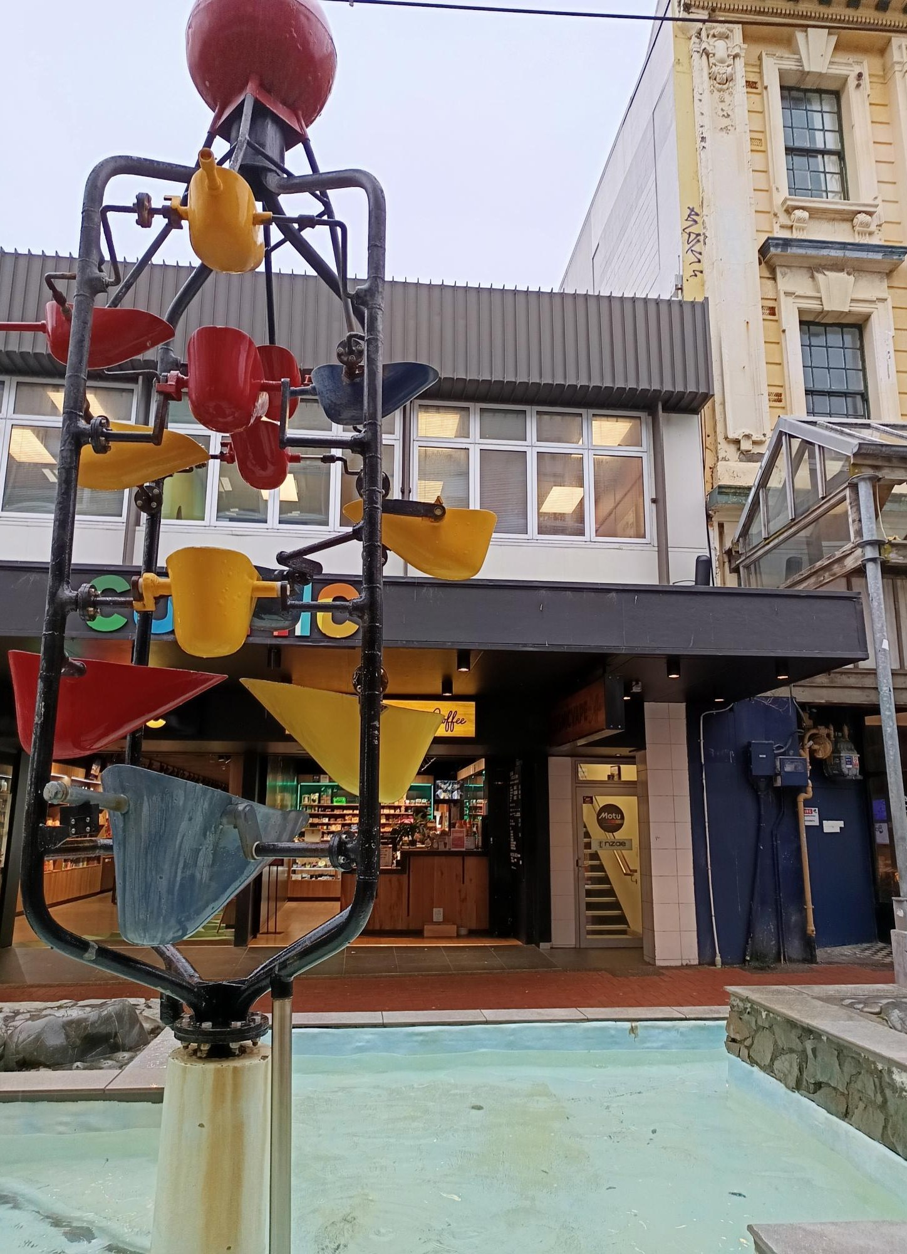
Leading research organisations
ACT 3
Motu and IRANZ: from doing the research to building the conditions for it
Photo: Hannah Griffin, Motu
Notes:
Transition: In 2019 I left the Reserve Bank to lead Motu. The job changed from doing research to making it possible for others.
Photo: Motu's office above Cuba Mall, behind Wellington's Bucket Fountain (1969). Photo by Hannah Griffin, Motu. A local landmark many students will recognise; a light opener: "If you've ever been splashed walking down Cuba Mall, you've walked past Motu."

Slide 16



Motu: independent research for public good
Research initiatives led as Executive Director
20
Climate change
Land-use change
staff, with Senior Fellows setting their own research agendas
2000
Carbon farming
Human rights
founded as an independent, charitable research trust
2019
What changes when you lead
Senior Fellows set the research agenda. My job is to lead the organisation and get its research into New Zealand’s policy debate, while securing funding and protecting independence.
became Executive Director
Notes:
Motu: founded in 2000 as an independent, non-partisan charitable trust (founding trustees included Sir Geoffrey Palmer). Areas include climate change and emissions trading, land use, productivity and innovation, wellbeing, and housing.
Motu today: 20 staff. The Senior Fellows determine their own research agendas; my role is to lead the organisation and to disseminate the research so that it improves the policy debate in New Zealand.
Leadership reflection: the shift from doing research to creating the conditions for it, including funding, independence and the translation of research into policy.
My own research hasn't stopped (e.g. the Hall 2020 paper was written from Motu, and IMF short-term expert work 2023–25), but the main contribution is now through others.
OPTIONAL: add one Motu project story with clear policy impact.

Slide 17

IRANZ: a voice for independent research
Independent Research Association of New Zealand · Chair since 2021
As Chair, I help communicate the importance of independent research to policymakers while the science and research system is under substantial review.
28
member organisations
Members build capability across
Primary processing
Food safety
Environment
Infrastructure
Society
Economy
Health and medicine
For doctoral graduates: independent research organisations are a real career path between universities and government.
Notes:
IRANZ: the association of New Zealand's 28 independent research organisations. As Chair since 2021, I help communicate the importance of independent research to policymakers, which matters especially now that the science and research system is undergoing a substantial review.
Point for students: there's a third career path between universities and government. Independent research organisations hire PhDs and offer research careers with direct impact.

Slide 18
Lessons for emerging scholars
1
2
3
Invest deeply in foundations
Co-authors are research infrastructure
Let policy and research shape each other
My PhD meant learning techniques such as cross-validation and gradient descent in depth. No one could have predicted it, but they are now central to AI models.
Foundations keep paying off: Motu is now building its own AI models.
Paul Cashin and Viv Hall kept my research alive through demanding policy jobs.
Choose co-authors for complementary skills and for the long run.
“Temporary or permanent?” and “Has the economy changed?” are policy questions and econometric questions at once.
Let the questions drive the research, and research discipline shape the policy.
Notes:
Three lessons, one from each act.
1. Invest deeply in foundations (Act 1). At Yale I had to learn techniques like cross-validation and gradient descent properly, from first principles. In the early 1990s nobody could have predicted they would become central to modern AI models. But deep foundations keep paying off in ways you can't foresee. Today Motu is building its own AI models, and knowing how these methods actually work matters. Your methods training may pay off in ways you can't foresee.
2. Co-authors are research infrastructure (Act 2). The research survived 25 years of policy jobs because of Paul Cashin and Viv Hall. Pick co-authors for complementary skills and invest in the relationship for the long run.
3. Let policy and research shape each other (Acts 2 and 3). The most useful research questions came from policy, and the most useful policy contributions came from research discipline. At Motu, this is what dissemination means: getting good research into the policy debate.
Hold for Q&A: research careers beyond academia (central banks, the IMF, independent research organisations such as the 28 IRANZ members).

Slide 19
Ngā mihi nui. Questions?
Pātai, kōrero, and good luck with your research
Dr John McDermott CRSNZ
john.mcdermott@motu.org.nz · motu.nz
Notes:
Allow ~15 minutes for questions.
Possible questions to prepare for:
- How did you protect research time as Assistant Governor?
- Would you do a PhD overseas again?
- How do you pick research questions with policy relevance?
- What do independent research organisations look for when hiring PhDs?
- Careers beyond academia: central banks, the IMF, and independent research organisations (28 IRANZ members) all hire PhDs and offer research careers with direct impact.

