Slide 1
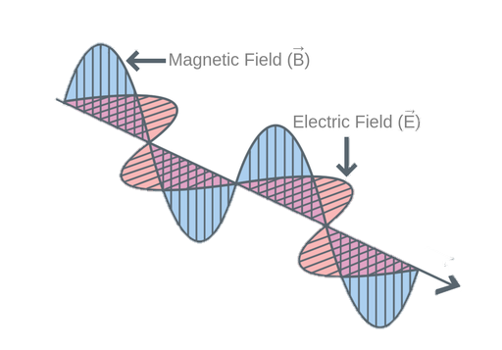
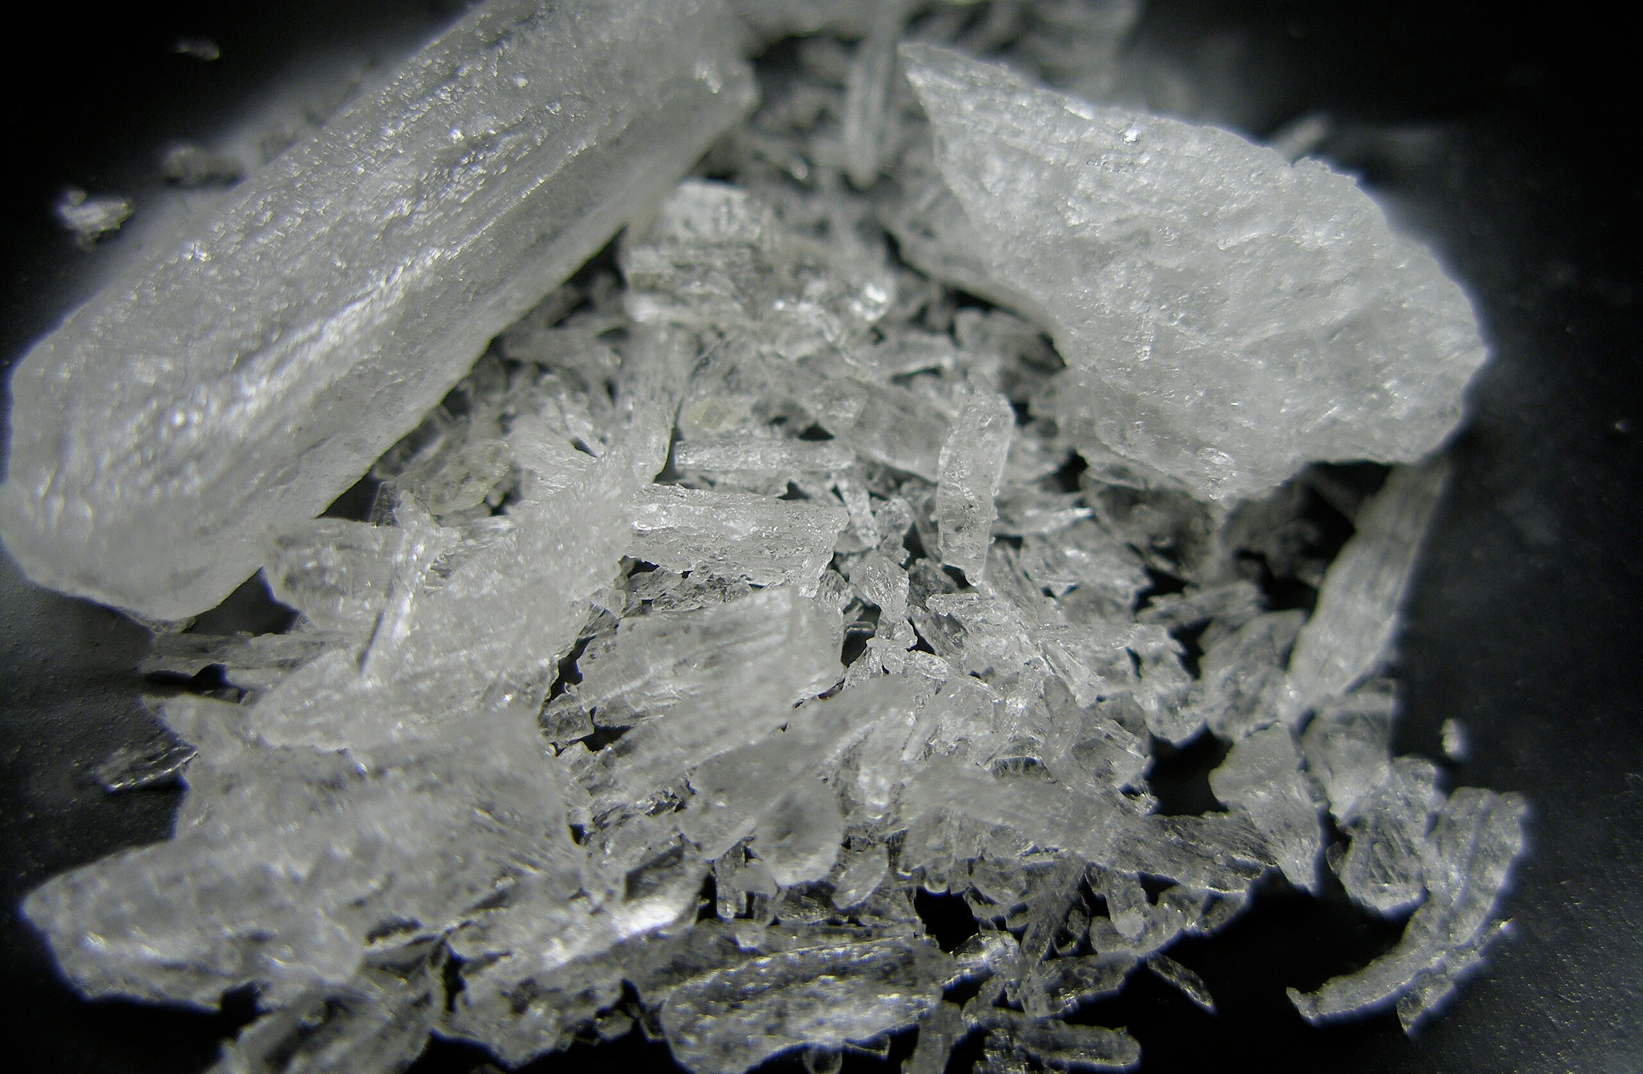
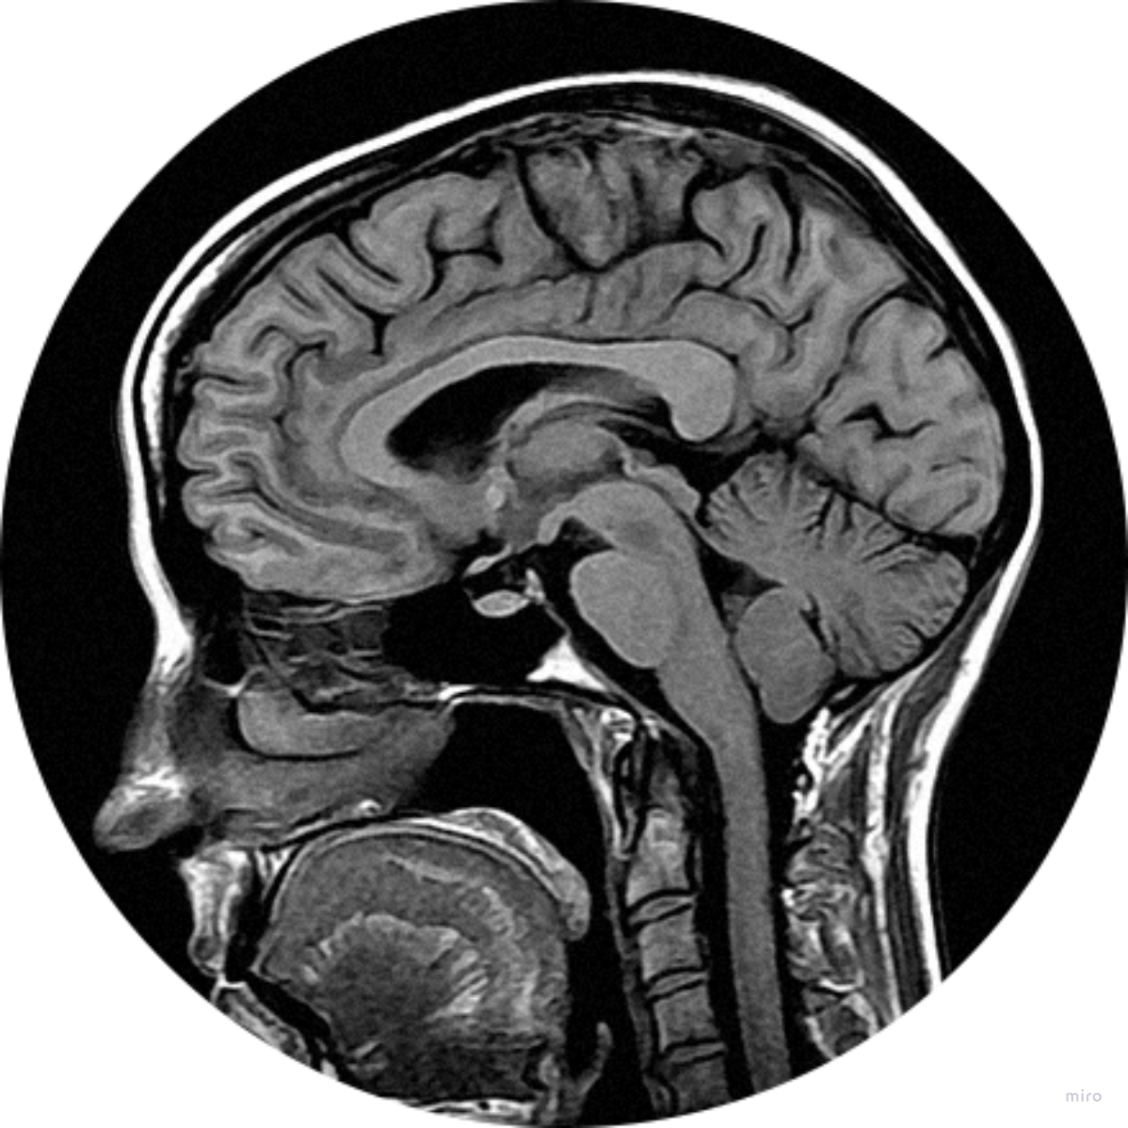
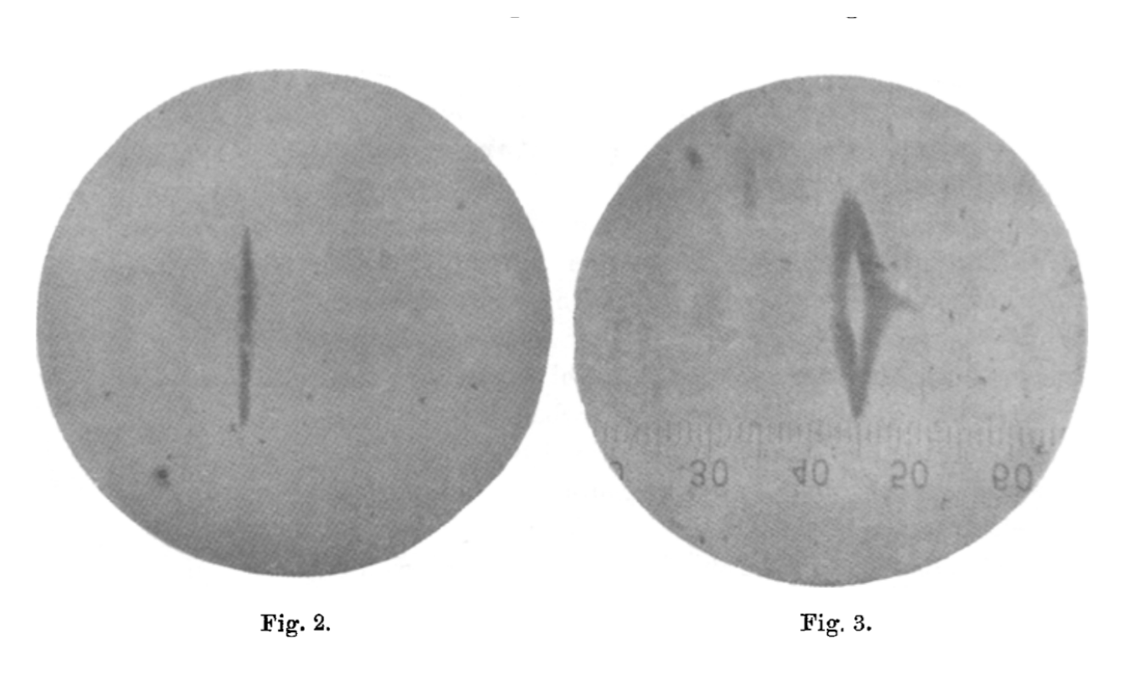
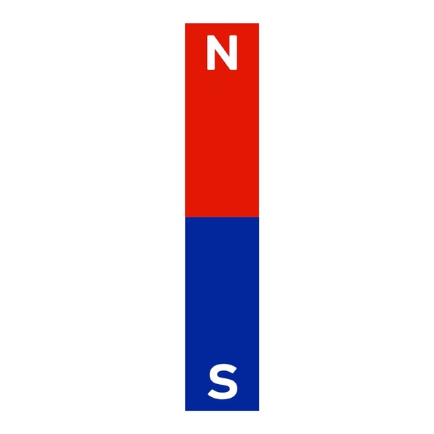
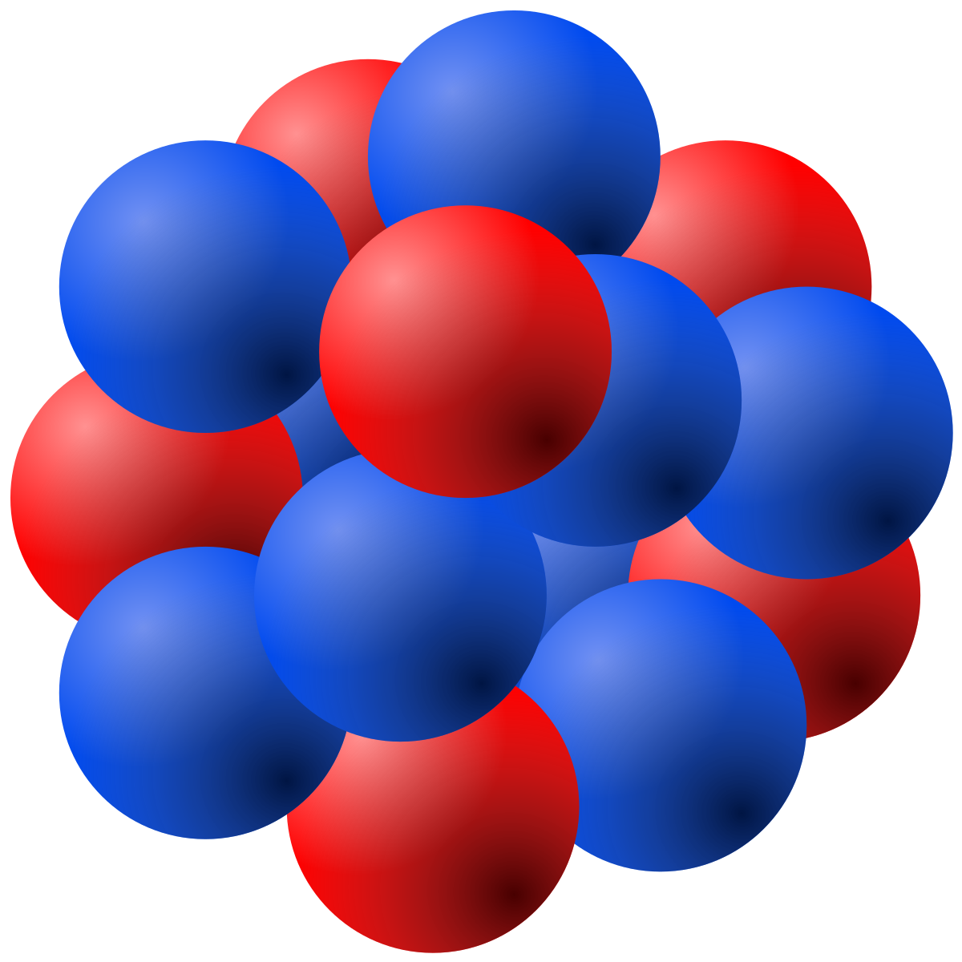
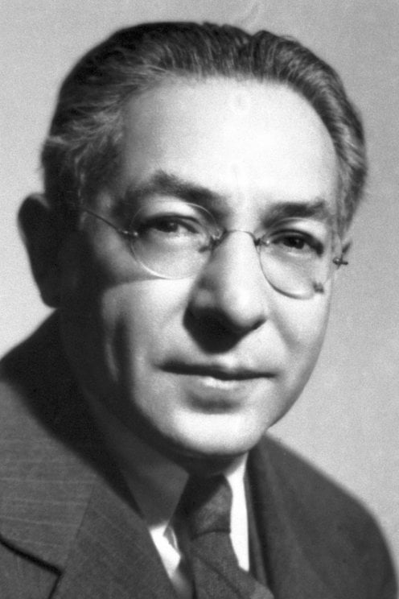
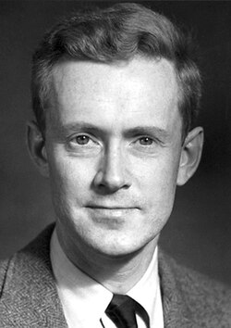
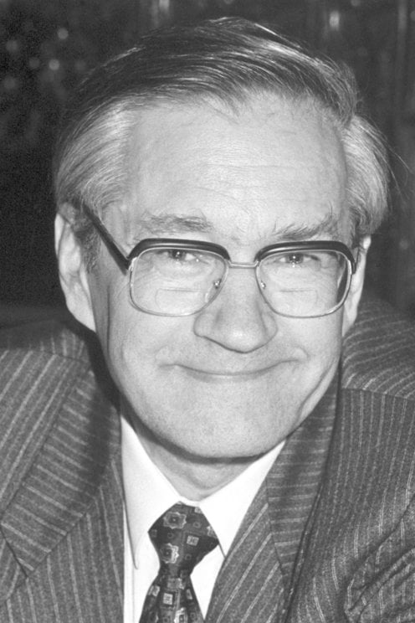
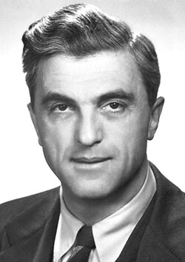
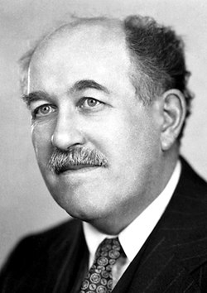
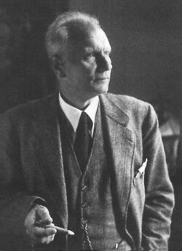
Fourier Transform-Based Nuclear Magnetic Resonance Spectroscopy

Slide 2
The Problem
When working at the atomic scale,
observation is difficult

Slide 3
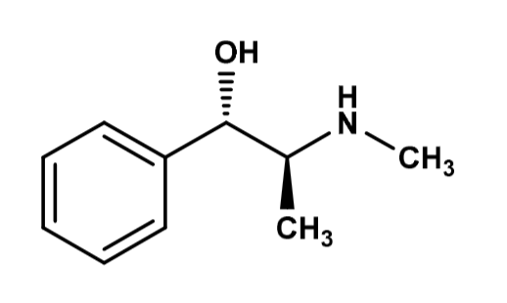
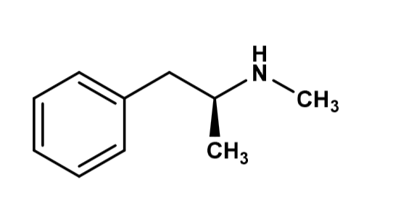
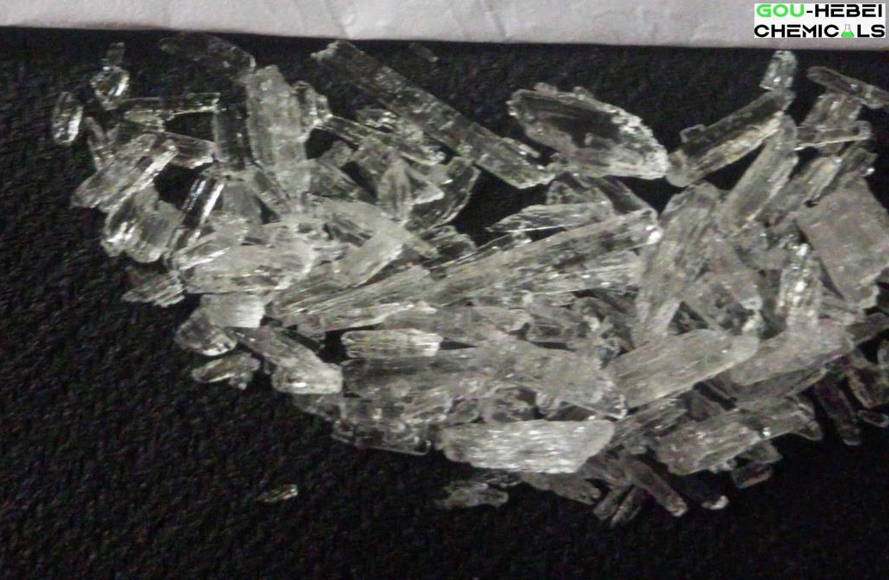
Atomic Observation is Difficult
Which is which?
Pseudoephedrine
Methamphetamine
Image Credit: SCIE001-Unit 2-Introduction to Organic Chemistry, Alcirclebiz, Wikipedia
Notes:
https://www.alcirclebiz.com//Uploads/ProductImage/17984/1688302544383.JPEG
https://canvas.ubc.ca/courses/181840/files/40250851?module_item_id=8206638
https://commons.wikimedia.org/wiki/File:Crystal_Meth.jpg

Slide 4

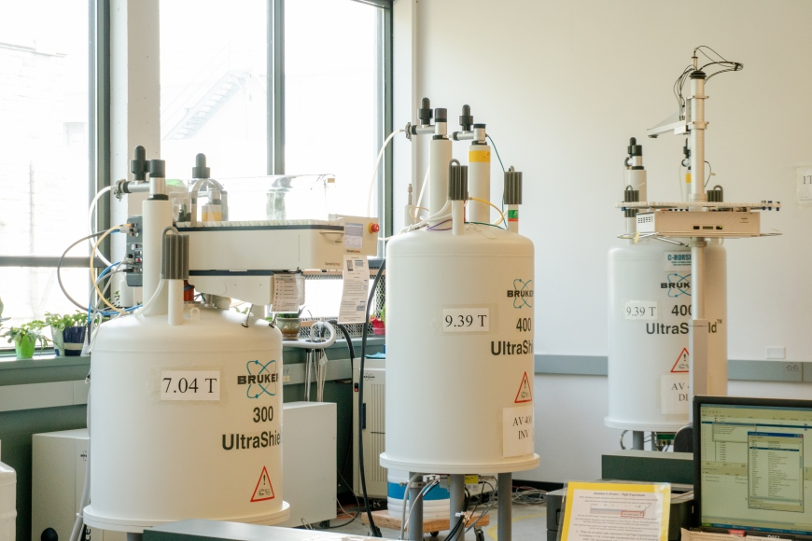
Image Credit:
UBC High Resolution NMR Spectroscopy Facility
HOW?
How?
Notes:
https://chem.ubc.ca/high-resolution-nmr-spectroscopy

Slide 5
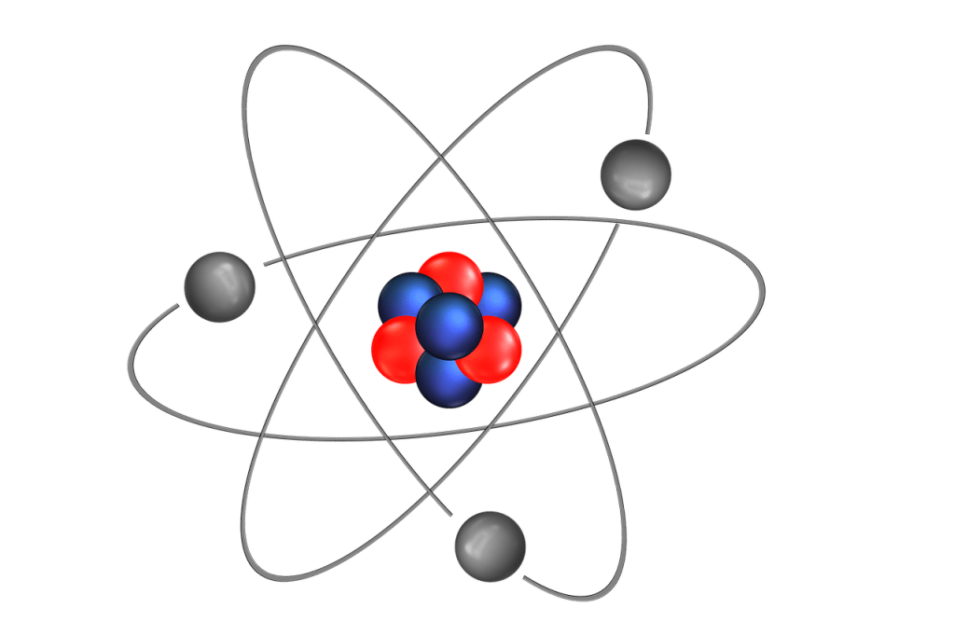
Inside the atom!
Image Credit: Hobarts
Notes:
https://hobarts.com/pages/the-ultimate-guide-to-lasers

Slide 6
At the subatomic scale, nuclei behave like bar magnets
SPIN! “property”
Nothing is actually spinning – it just looks that way

Slide 7
Properties of Magnets!

Slide 8
N
Magnets align to magnetic fields
(Magnets experience electromagnetic forces)
S

Slide 9
N
More favorable
(Lower Energy State)
Less favorable
(Higher Energy State)
S

Slide 10
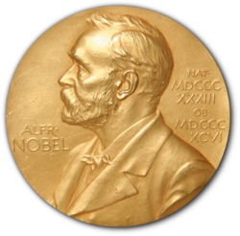
The Stern-Gerlach Experiment – Discovery of Spin
N
Beam of Silver Atoms
S
Glass Slide
Inhomogeneous Magnetic Field

Slide 11
Absorbing RF waves
Electromagnetic Radiation
(Radio Frequency Wave)
Figure reproduced without permission from Labster Theory - Electromagnetic Waves
Notes:
https://theory.labster.com/electromagnetic-waves/

Slide 12
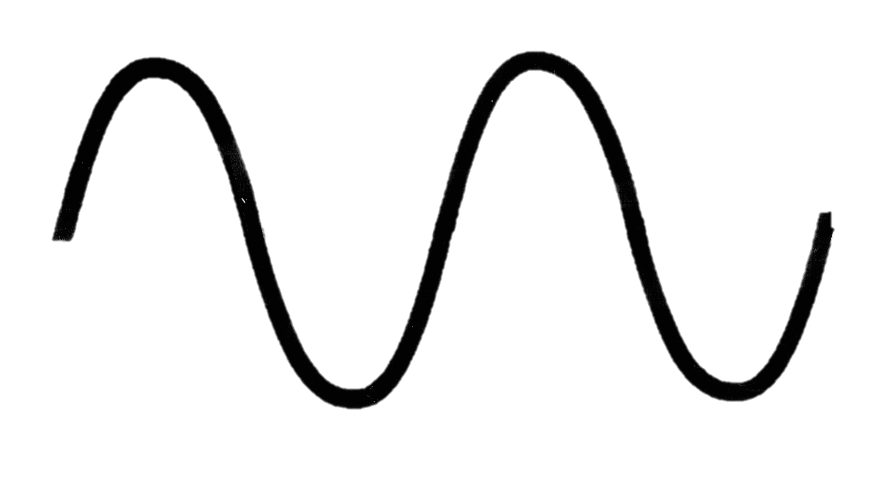
Emitting RF Waves
Electromagnetic Radiation
(Radio Frequency Wave)

Slide 13
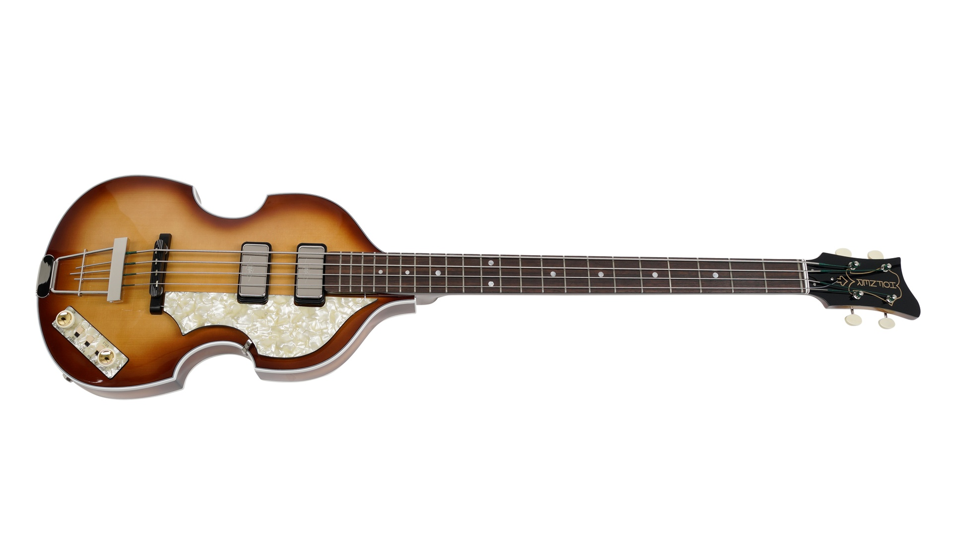
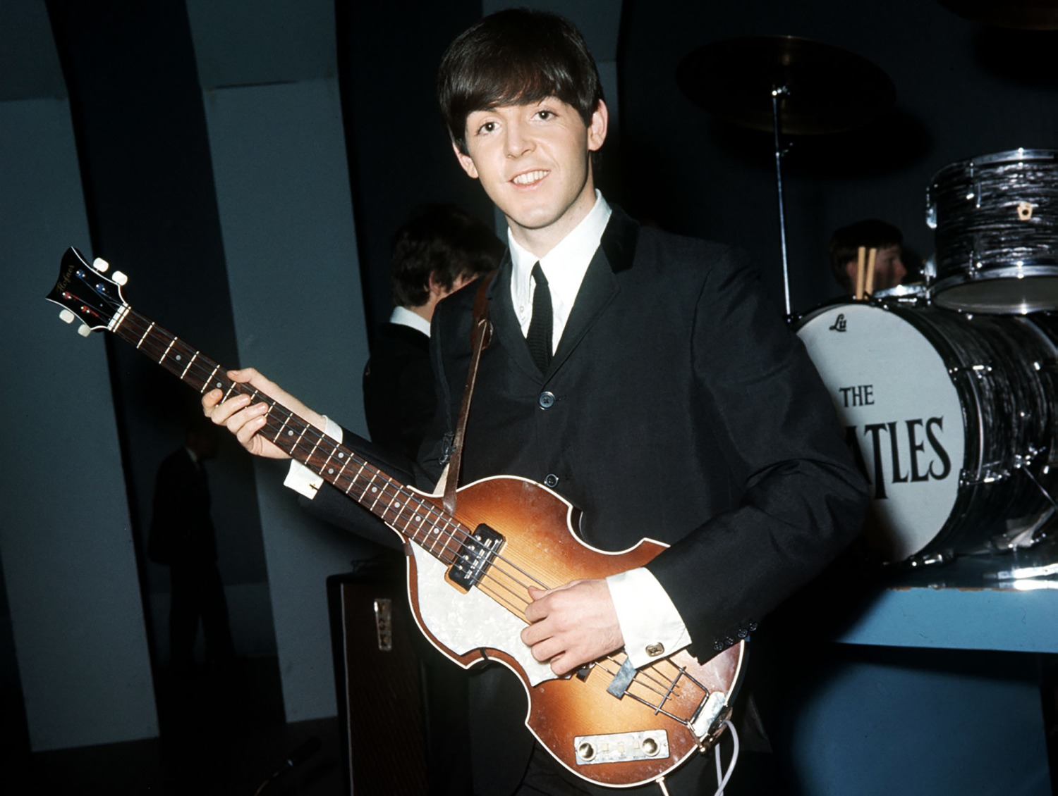
Image Credit: Honfer.com
H500/1-61-0 - Violin Bass 'Cavern'
Notes:
https://www.hofner.com/shop/h500-1-61-0-h500-1-61-0-violin-bass-cavern-3201?category=476

Slide 14
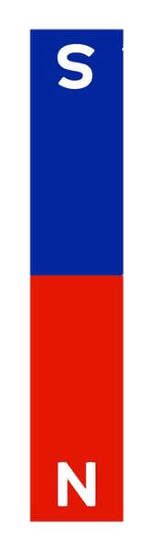
Restorative force of tension
When plucked: Sound Waves
E - ~41.2 Hz
Restorative force of tension

Slide 15
N
Restorative force (Magnetic Field)
When Excited: Electromagnetic Waves
Larmor Frequency
Radio Frequency Wave
S
Restorative force (Magnetic Field)

Slide 16
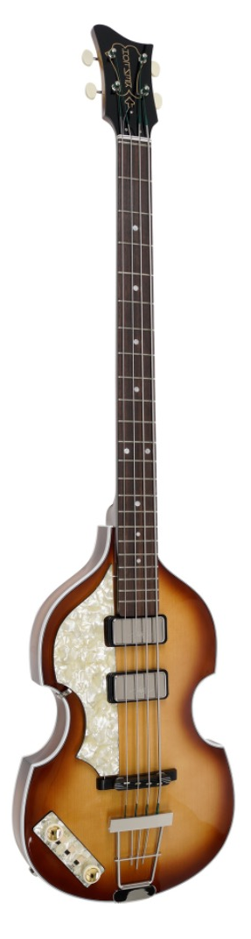
String frequency depends on tension and thickness
Restorative force (Magnetic Field)
Larmor Frequency
Larmor depends on
field strength and element
Restorative force (Magnetic Field)

Slide 17
String frequency depends on tension and thickness
Restorative force (Magnetic Field)
ω – Frequency
γ – Gyromagnetic ratio
(Specific to each element/isotope)
B – Strength of magnetic field
ω = γB
Larmor depends on
field strength and element
Restorative force (Magnetic Field)

Slide 18
Isidor Rabi
Homogenous
Magnetic Field
Radio Frequency Waves
N
N
S
Image Credit: Nobel Foundation archive
Beam of Lithium Atoms
S
S
N
Inhomogeneous
Magnetic Field
Inhomogeneous
Magnetic Field
Point Detector
Notes:
https://www.nobelprize.org/prizes/physics/1944/rabi/facts/

Slide 19
Isidor Rabi
Homogenous
Magnetic Field
Radio Frequency Waves
N
N
S
Image Credit: Nobel Foundation archive
Beam of Lithium Atoms
S
S
N
Inhomogeneous
Magnetic Field
Inhomogeneous
Magnetic Field
Point Detector
Notes:
https://www.nobelprize.org/prizes/physics/1944/rabi/facts/

Slide 20
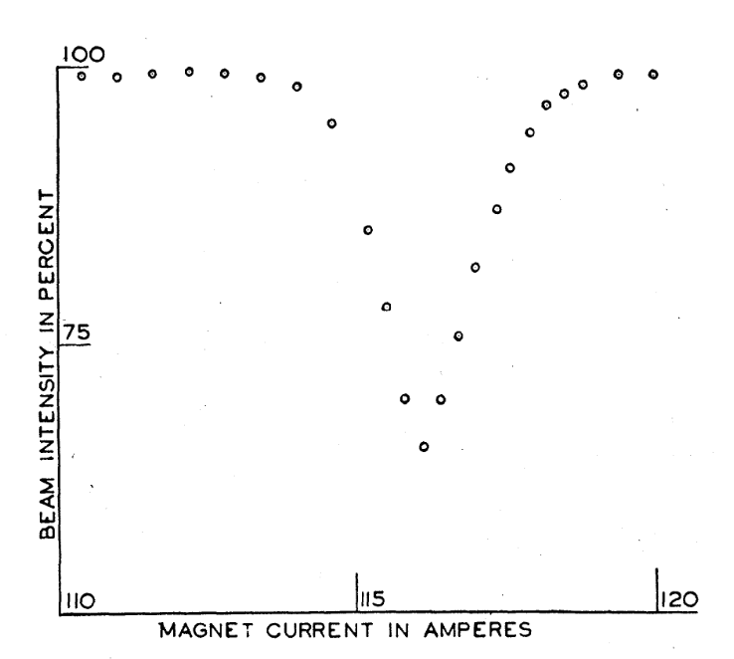
First NMR Spectrograph
Constant Radio Waves
ω = γB
Frequency =
Gyromagnetic Ratio x Magnetic Field
N
S
New Method of Measuring Nuclear Magnetic Moments
Rabi, I. I., Zacharias, J. R., Millman, S., & Kusch, P.
Reproduced without permission.

Slide 21
Edward Mills Purcell
Homogenous
Magnetic Field
N
Image Credit:
Nobel Foundation archive
Paraffin
Wax
Radio Detector
Radio Frequency Waves
S
Felix Bloch
Image Credit: Nobel Foundation archive
Notes:
https://www.nobelprize.org/prizes/physics/1952/summary/

Slide 22
Richard Ernst
Homogenous
Magnetic Field
N
Image Credit:
Nobel Foundation archive
Progesterone
Frequency
Detector
Broadband Radio Frequency Waves
S
Notes:
https://www.nobelprize.org/prizes/chemistry/1991/ernst/facts/

Slide 23
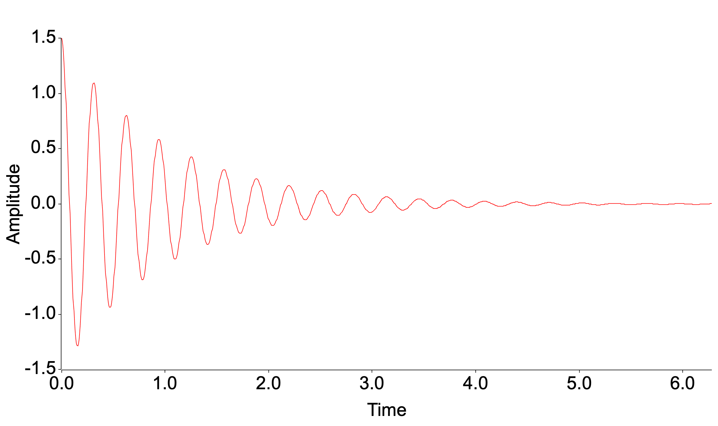
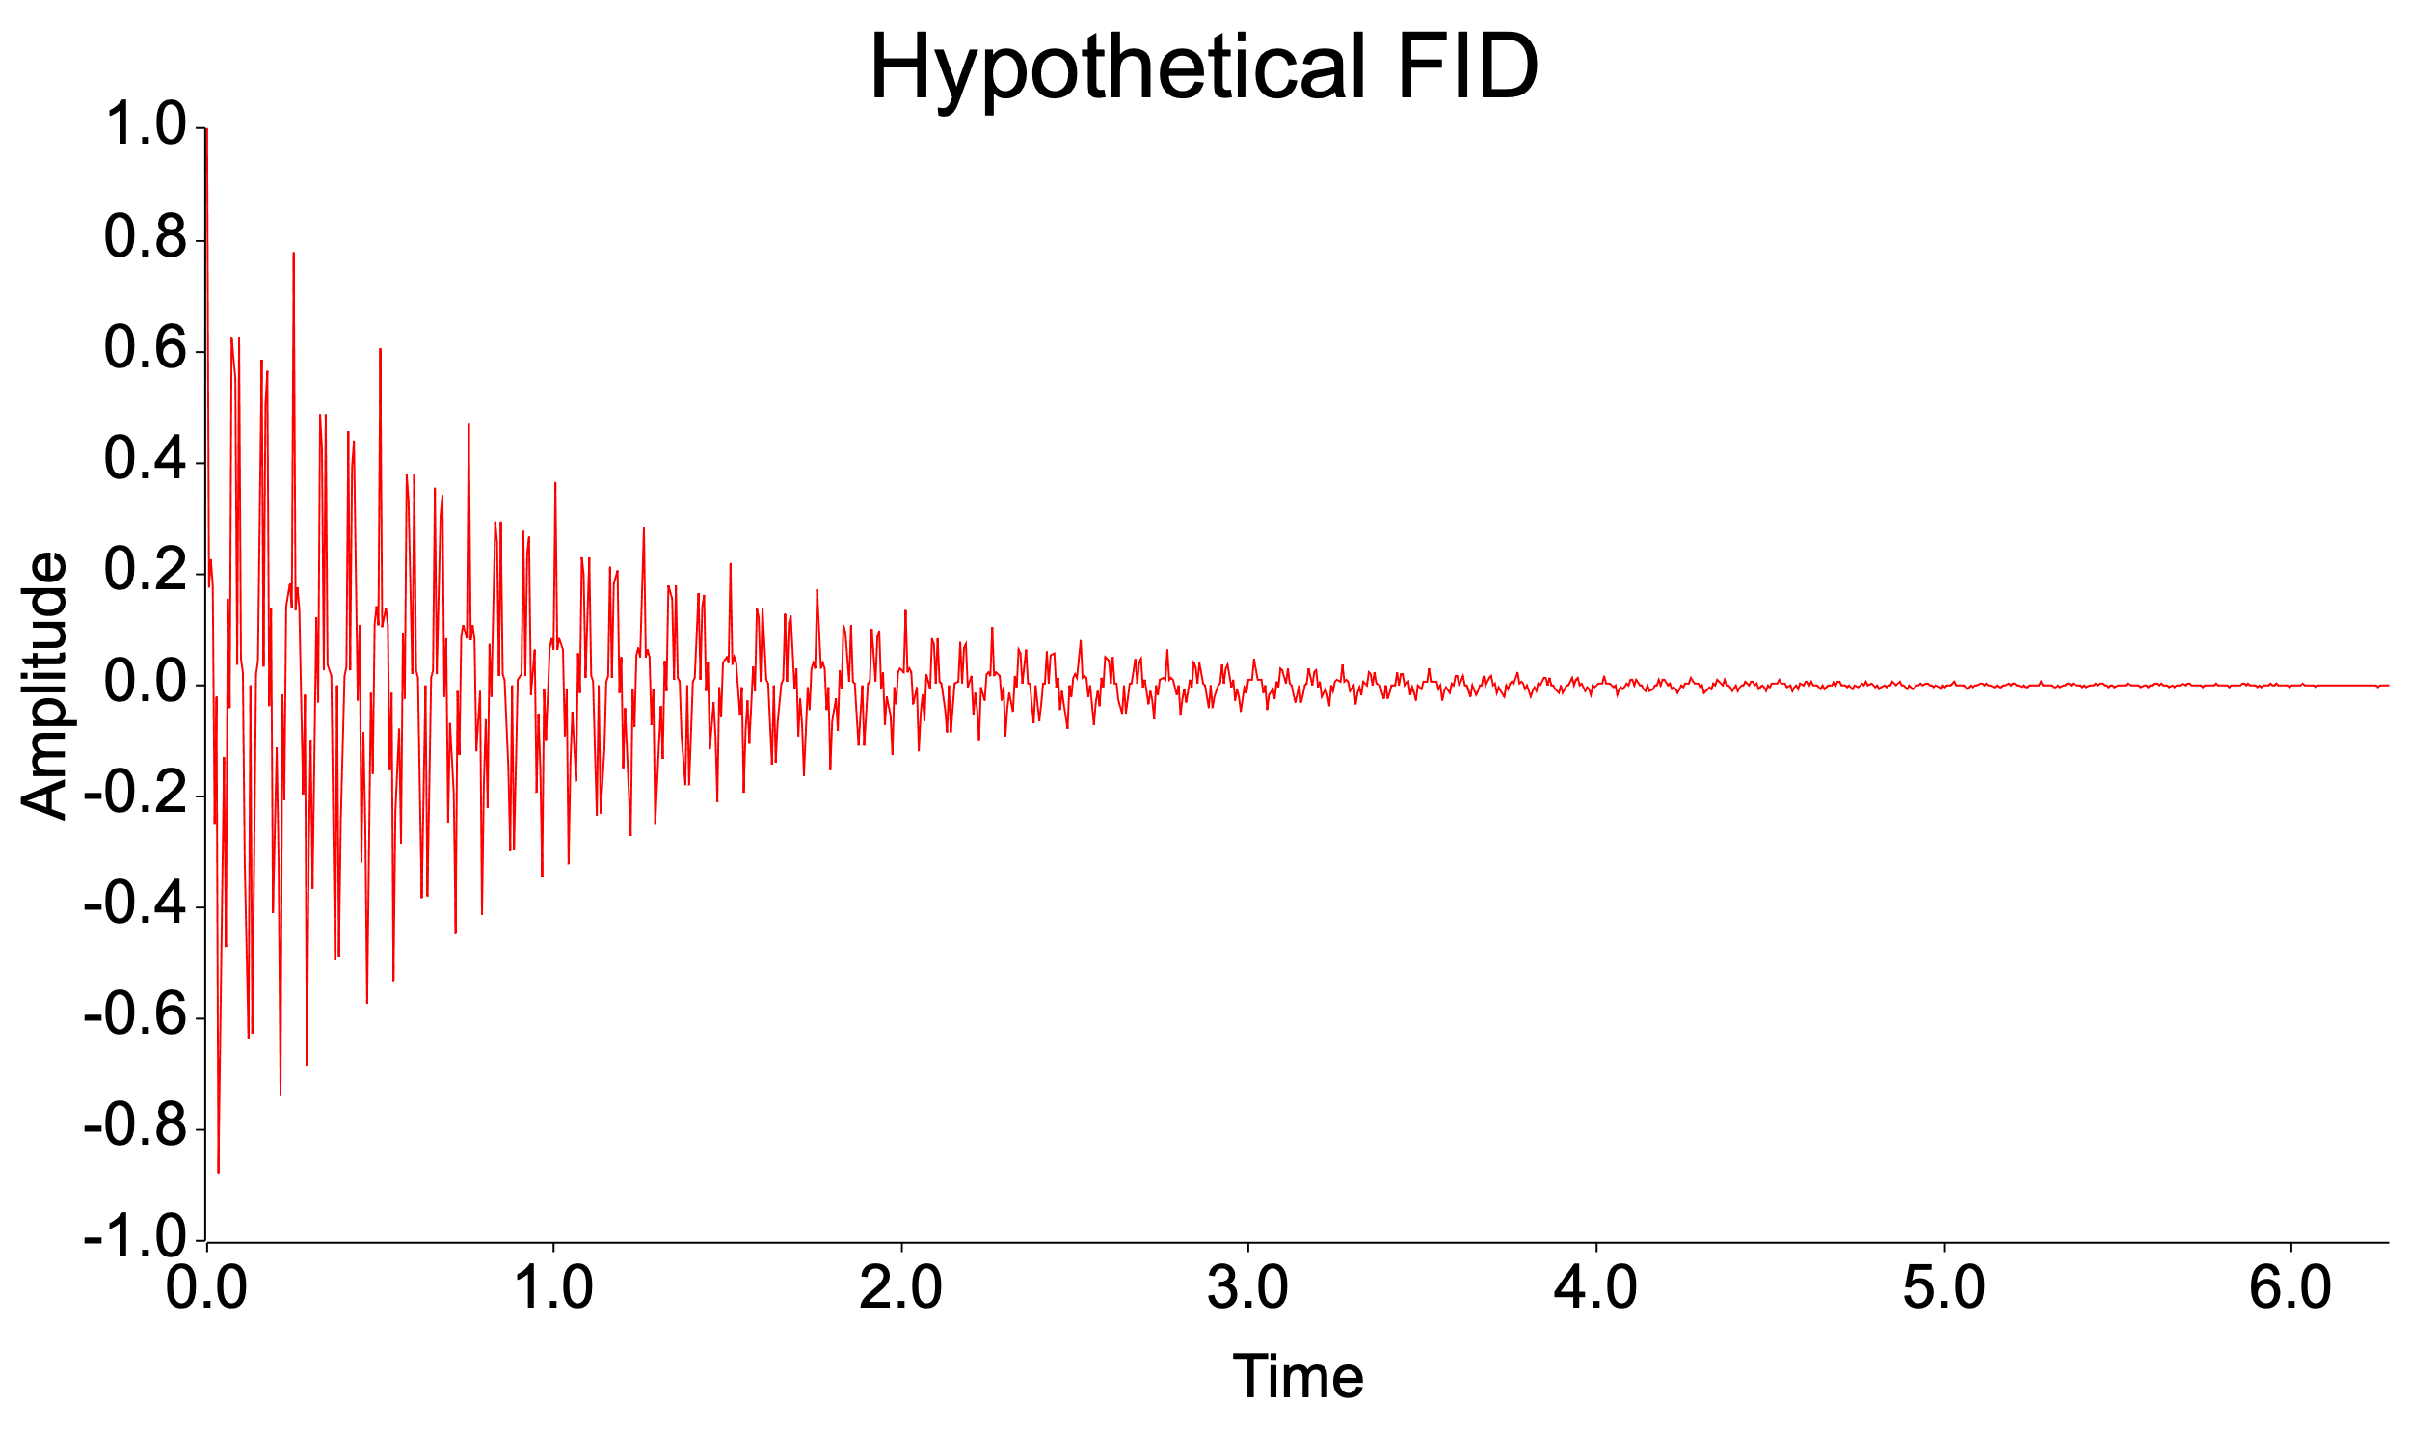
Free Induction Decay
How do we get the frequency?
Same atom
Self-produced Graph
How do we tell them apart?
Different Atoms
Self-produced Graph

Slide 24
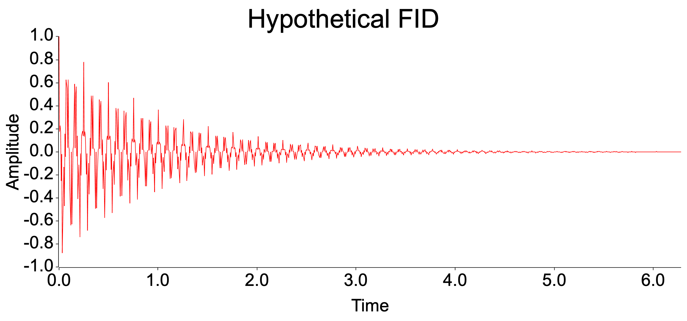
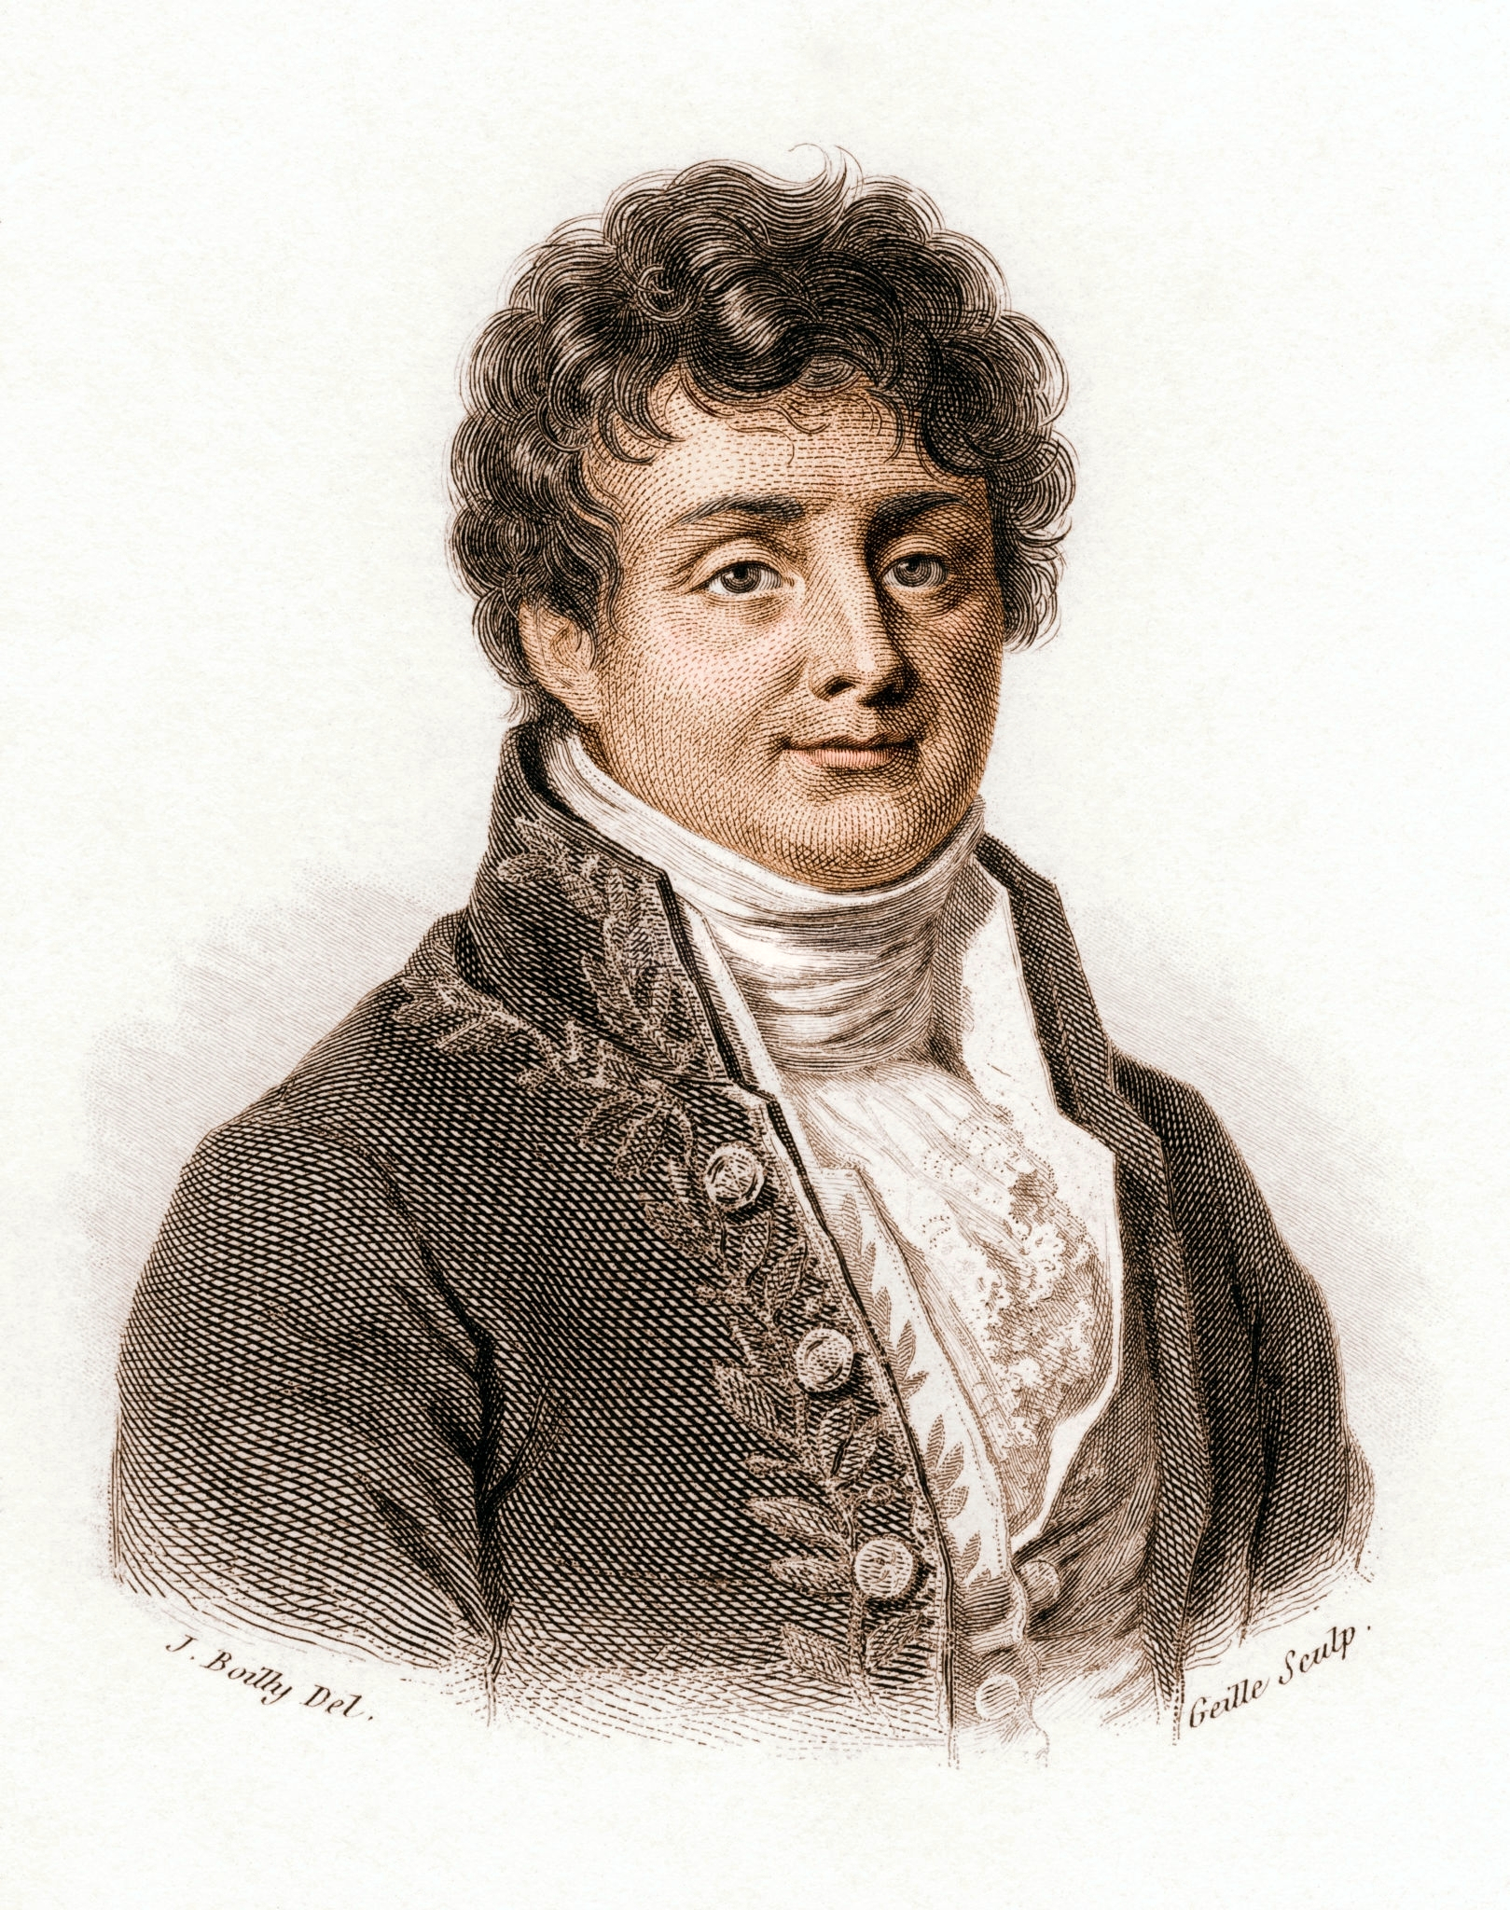
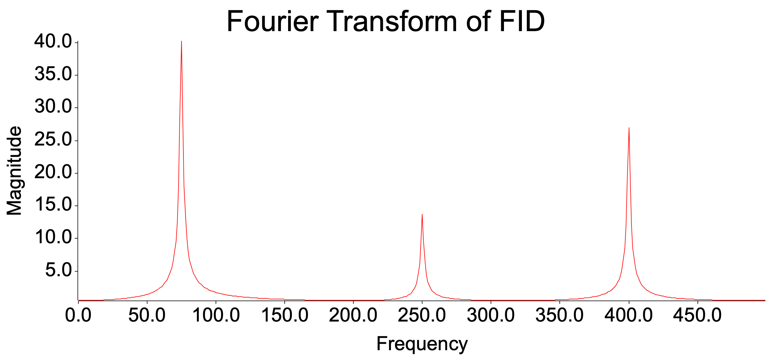
Joseph Fourier
Self-produced Graph
Fourier Transform
Public Domain Illustration
Looking at Heat
Self-produced Graph
Notes:
https://commons.wikimedia.org/wiki/File:Fourier2.jpg

Slide 25
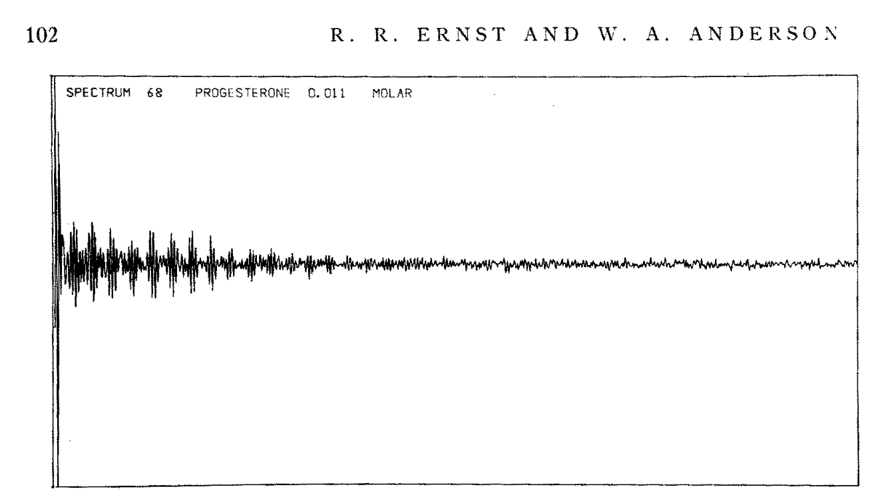
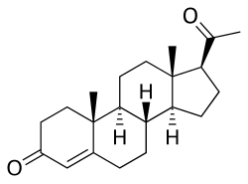
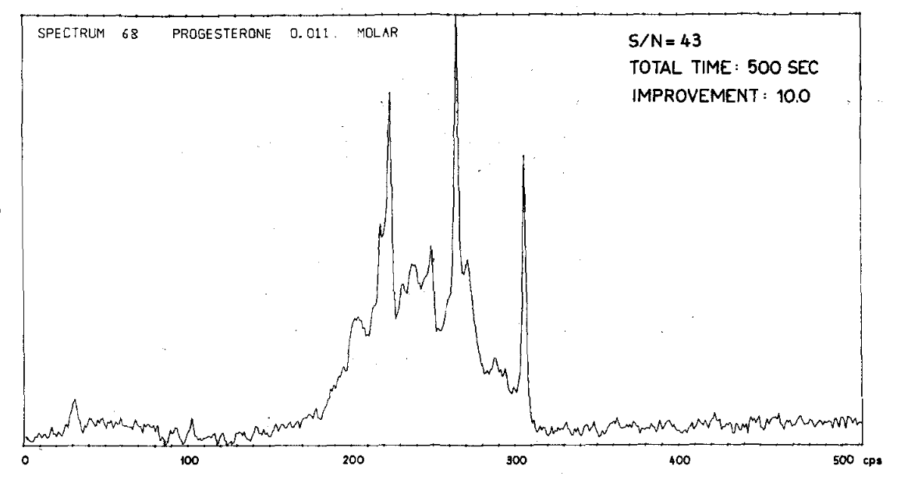
Richard Ernst
Free Induction Decay
Image Credit:
Nobel Foundation archive
Fourier Transform
Progesterone
First FT-NMR
Application of Fourier Transform Spectroscopy to Magnetic
Resonance - R. R. Ernst and W. A. Anderson. Reproduced without permission.

Slide 26
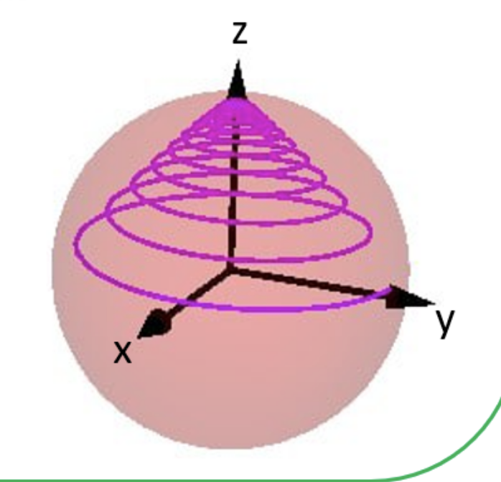

Nuance:
Gyroscopic Precession
Where Frequency?
Angular momentum causing procession
N
SPIN but not SPINNING!
S

Slide 27
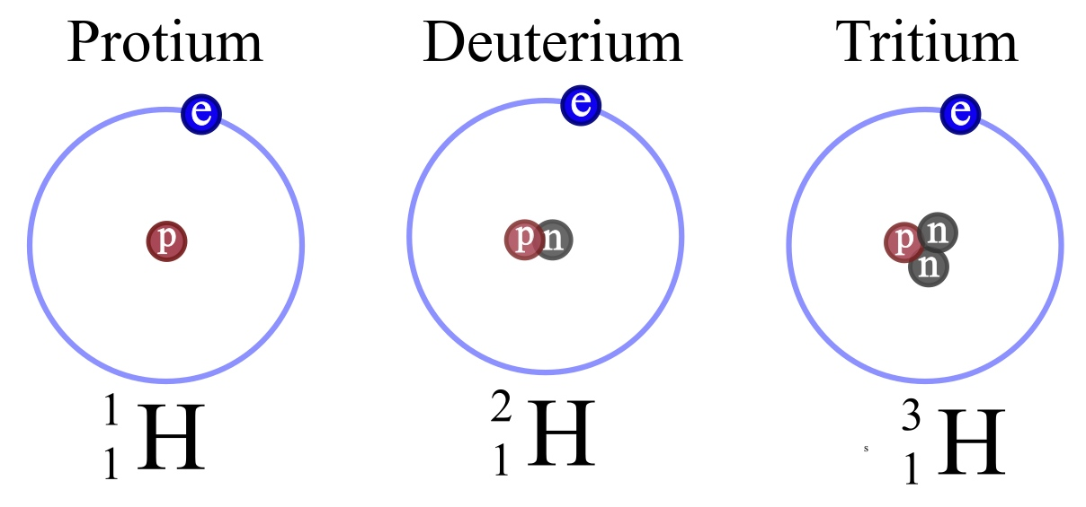
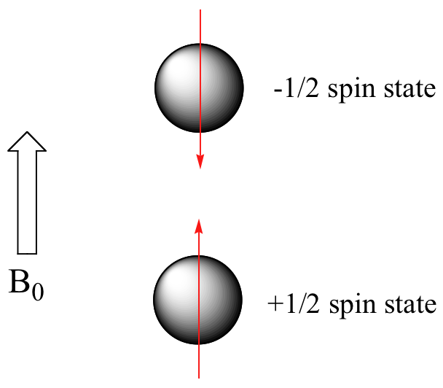
But what nuclei resonate?
Only some nuclei’s spin give signals.
Dependent on nucleons.
½ spin state

Slide 28
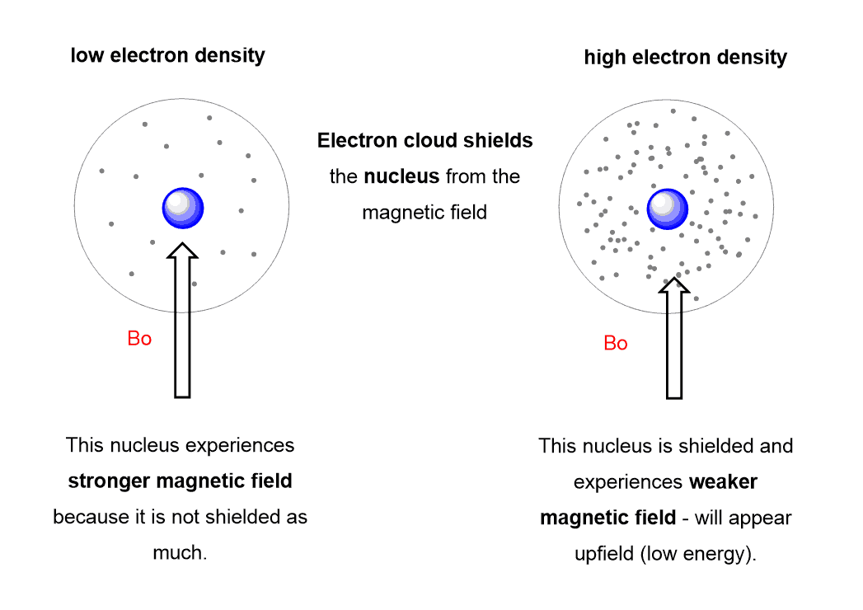



How to Differentiate the Signal 101
Larmor frequency
Dependent on shielding
Weaker magnetic field
Stronger magnetic field
Lower frequency
Higher frequency
Lower energy
Higher energy

Slide 29
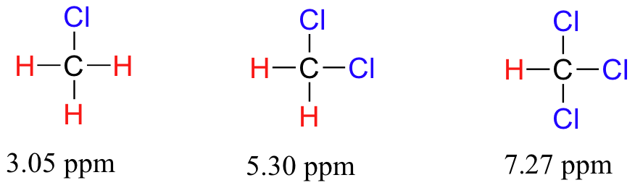
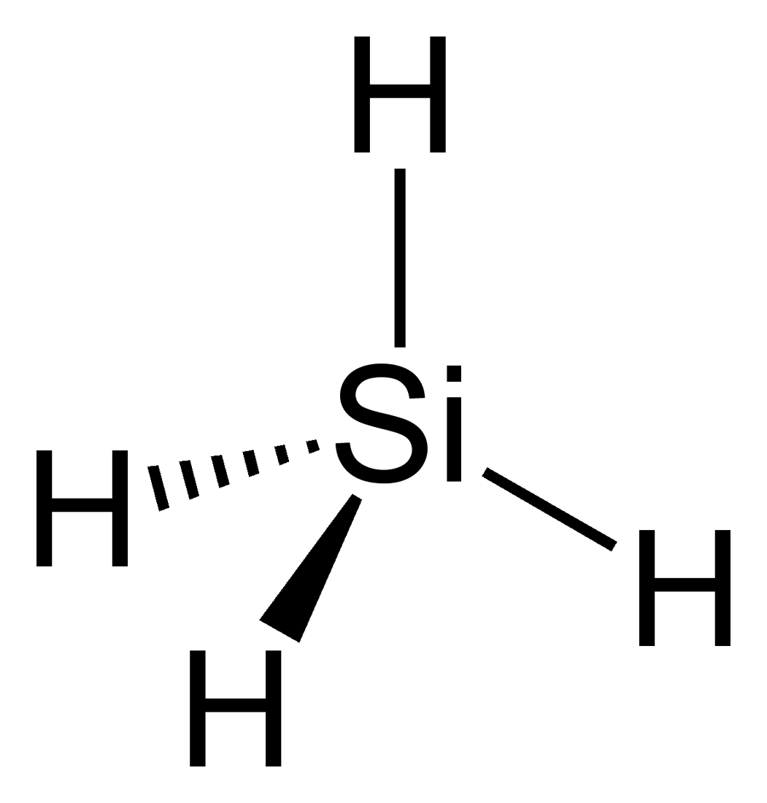
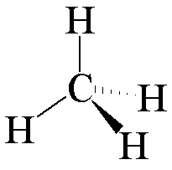
Chemical Environment and Shift
Electronegativity and quantity of electrons

Slide 30
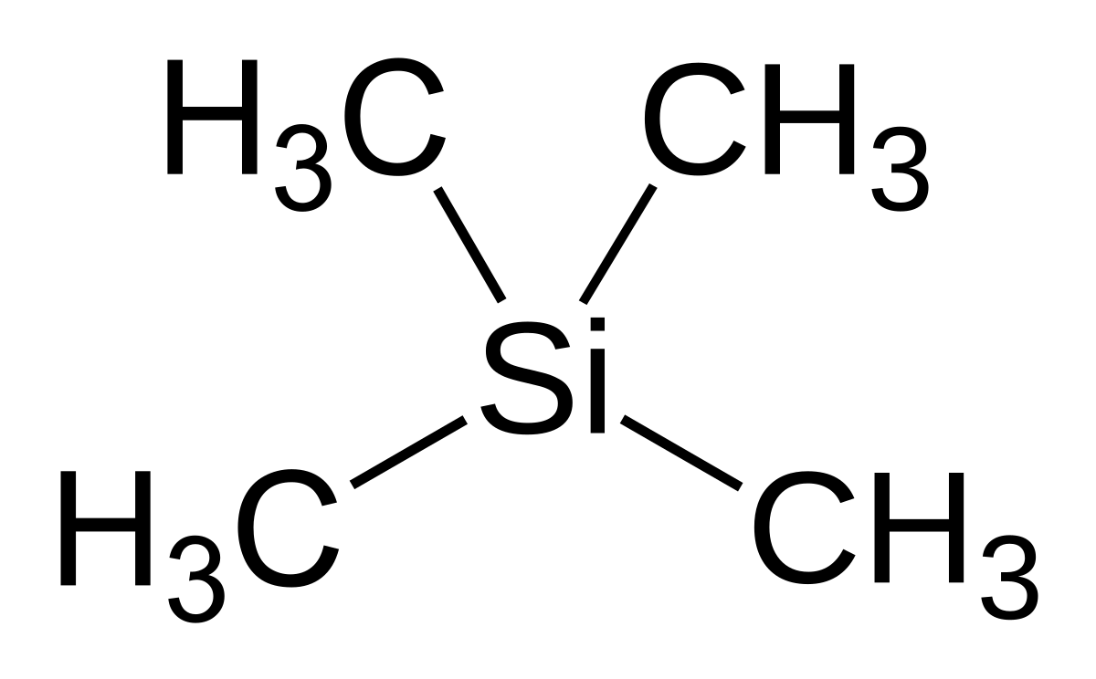


High electron density
Parts per million
Highly symmetrical
Not electronegative

Slide 31
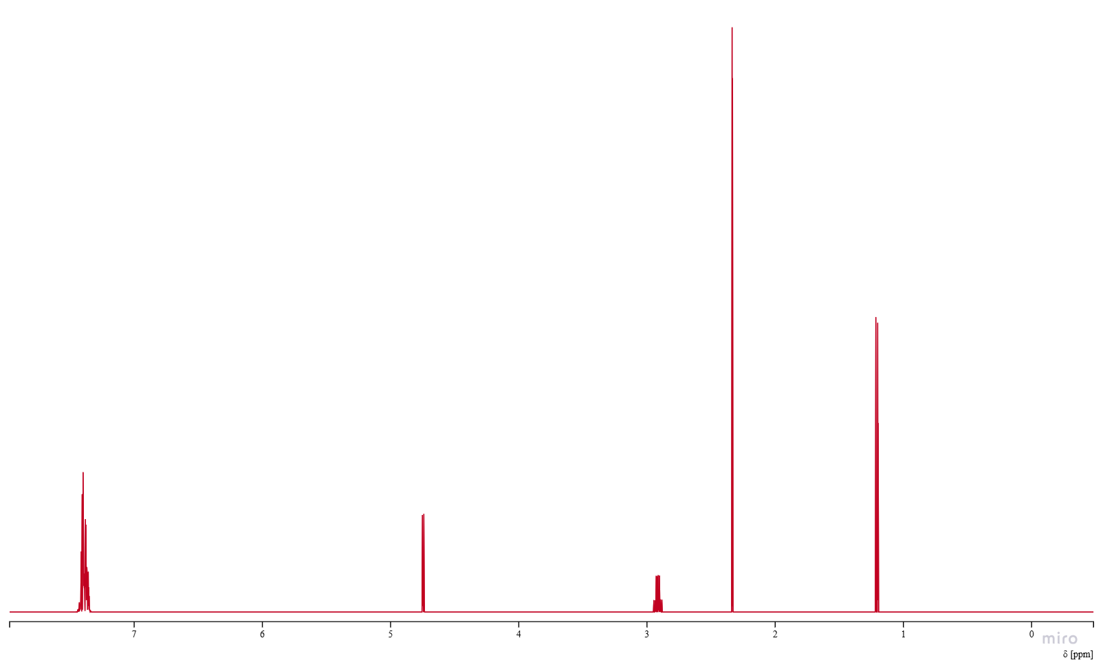
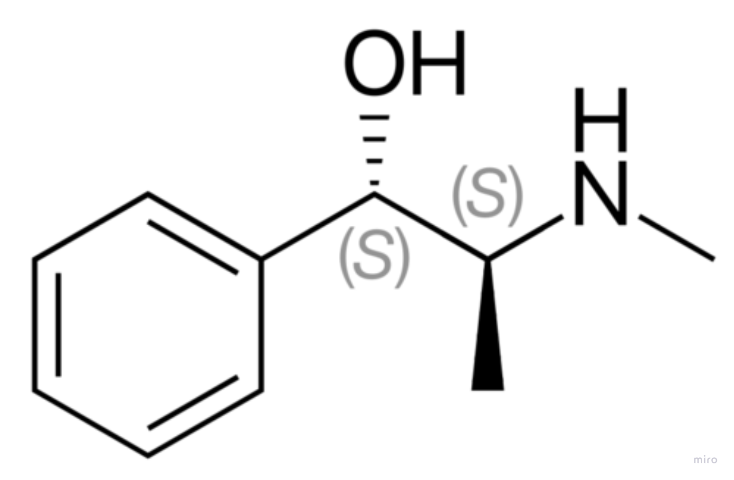
Pseudoephedrine
Self-made spectrum using nmrium.com
Notes:
https://app.nmrium.com/predict

Slide 32
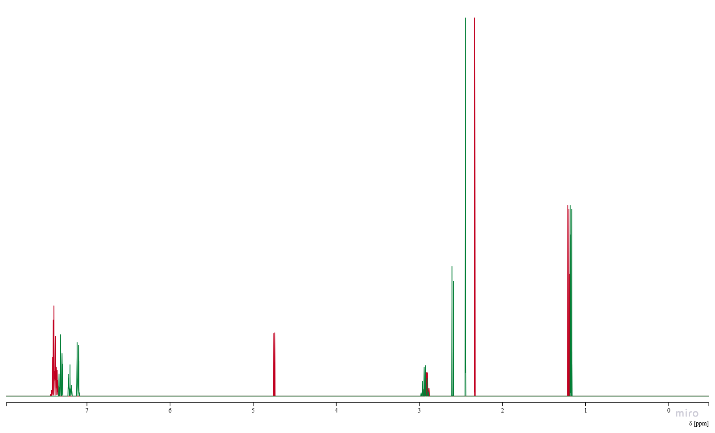
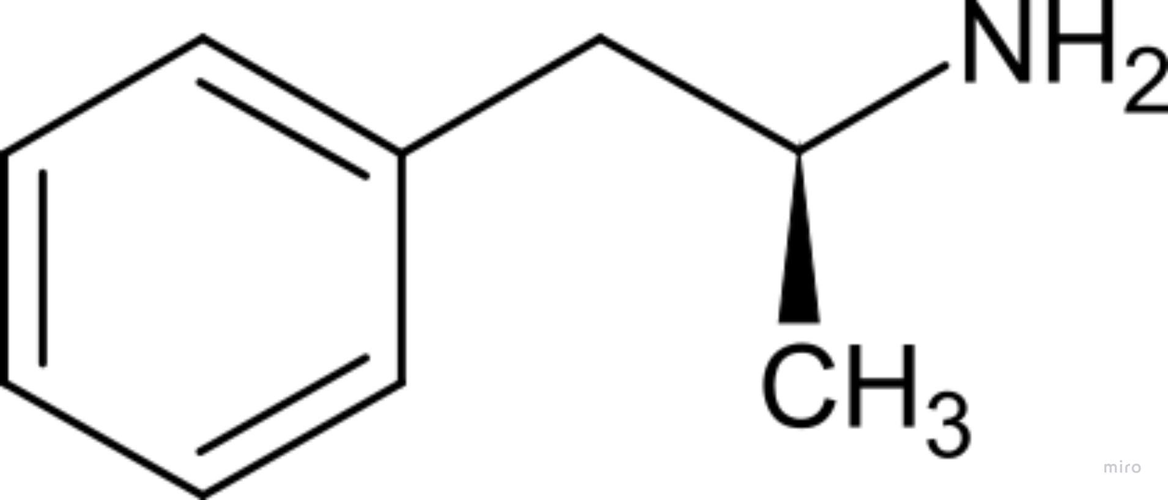
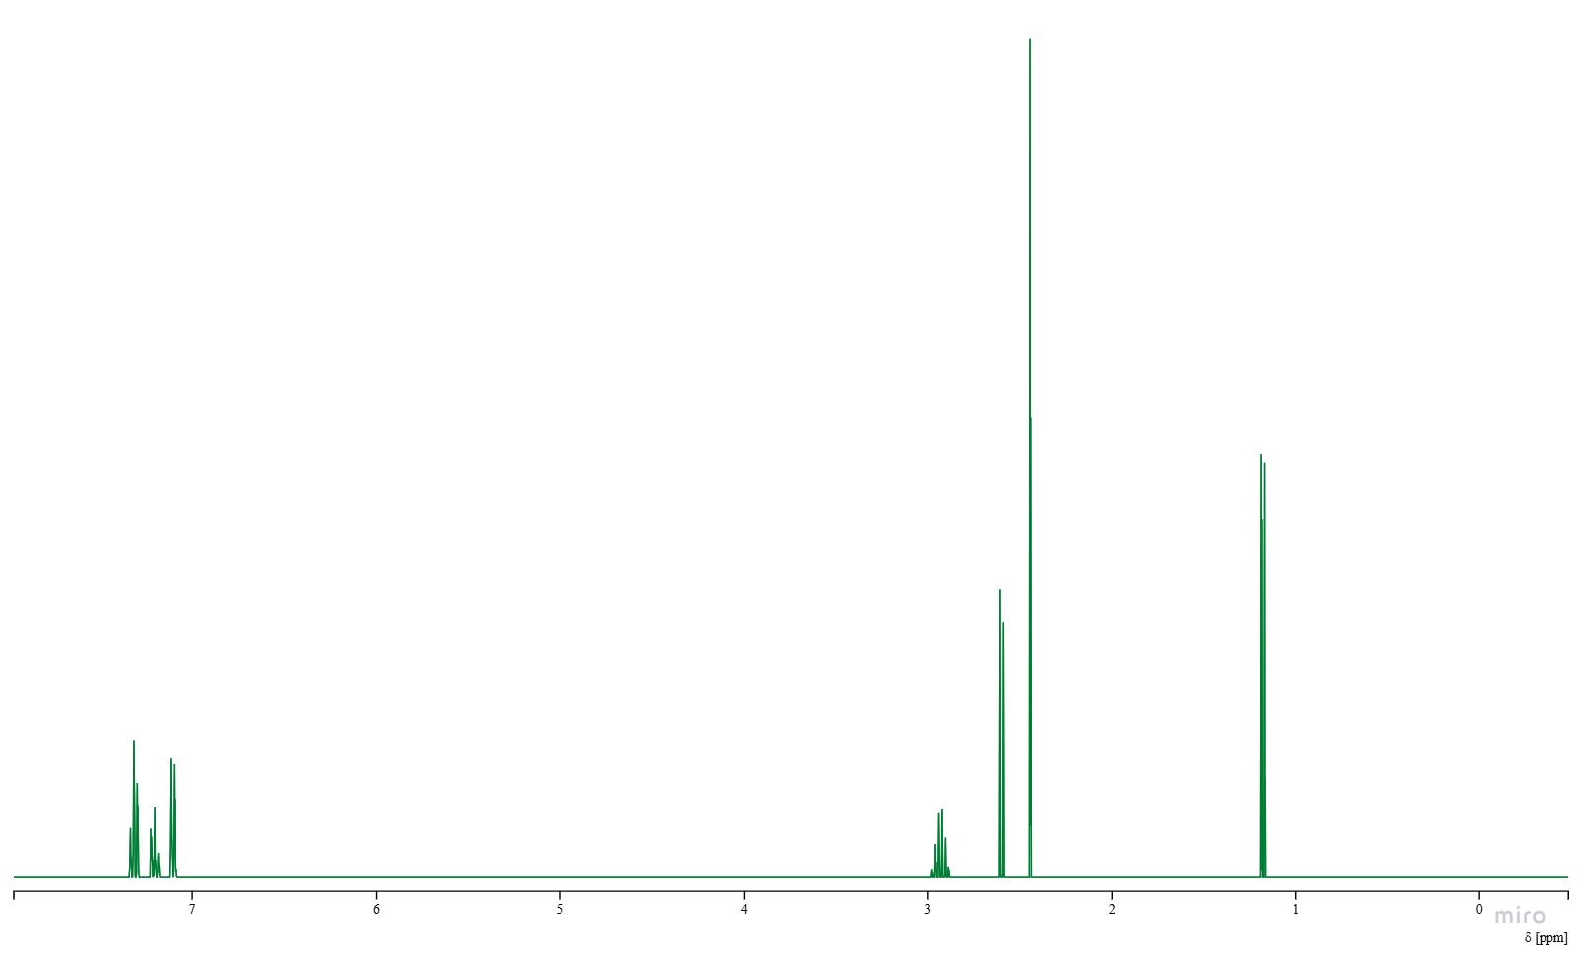

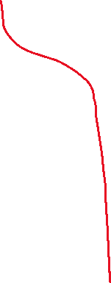
Pseudoephedrine
d-Methamphetamine
Self-made spectrum using nmrium.com

Slide 33
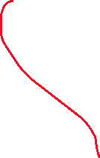
J-coupling (briefly)
Magnetic interaction between the nuclear spins
Neighboring spins influence energy levels
Self-made spectrum using nmrium.com

Slide 34
J-coupling (briefly)
Magnetic interaction between the nuclear spins
Neighboring spins influence energy levels
Self-made spectrum using nmrium.com

Slide 35
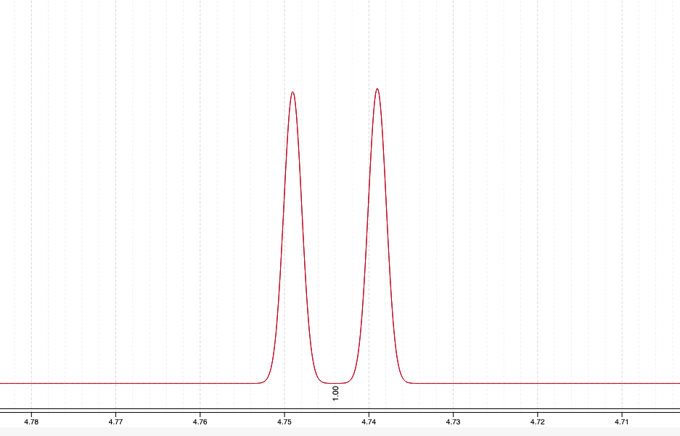
J-coupling (briefly)
Self-made spectrum using nmrium.com

Slide 36
Applications
MRI (Magnetic Resonance Imaging)
Same principle as NMR
Most active nucleus is water

Slide 37
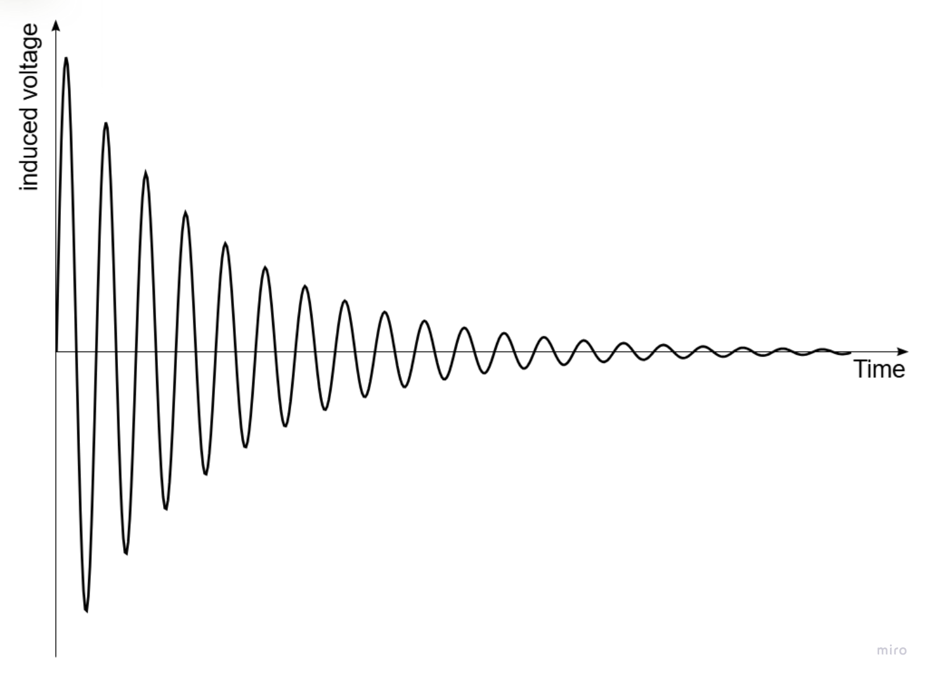
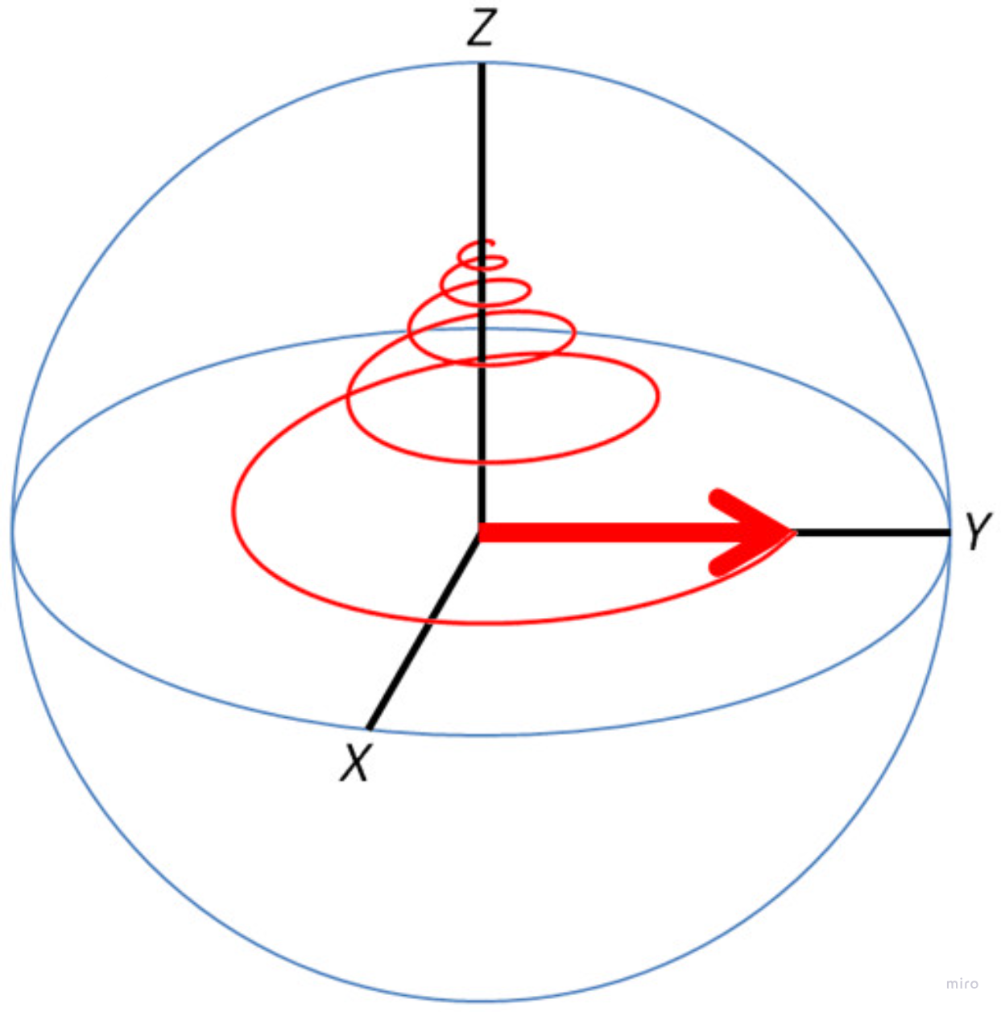

How it works
Quite a strong magnetic field is established along the scanner.
Nuclei precess around z-axis.
RF pulse is sent through, causing net magnetization to tip.
Precess back to original magnetization

Slide 38



How it differs
Gradient Coils

Slide 39

Tumors
Vary in relaxation times, unique signals
Microenvironments
Depending on MRI can show up differently.
Both malignant and benign tumors

Slide 40



Nobels
1991
Ernst
Chemistry
1944
Rabi
Physics
2003
Lauterbur and Mansfield
Physiology and medicine
1952
Bloch and Purcell
Physics
1943
Stern
Physics

Slide 41
Good Science: it takes a village
Quantum Physics
Medicine
Chemistry
Math
Computer Science
Engineering

Slide 42
Fourier Transform-Based Nuclear Magnetic Resonance Spectroscopy

Slide 43
Main References:
Bauer, M. (2023). The Stern-Gerlach Experiment, Translation of: “Der experimentelle Nachweis der Richtungsquantelung im Magnetfeld” (No. arXiv:2301.11343). arXiv. https://doi.org/10.48550/arXiv.2301.11343
Bloch, F., Hansen, W. W., & Packard, M. (1946). The Nuclear Induction Experiment. Physical Review, 70(7–8), 474–485. https://doi.org/10.1103/PhysRev.70.474
Ernst, R. R., & Anderson, W. A. (1966). Application of Fourier Transform Spectroscopy to Magnetic Resonance. Review of Scientific Instruments, 37(1), 93–102. https://doi.org/10.1063/1.1719961
Fourier, J. B. J. (2009). The Analytical Theory of Heat (A. Freeman, Trans.; 1st ed.). Cambridge University Press. https://doi.org/10.1017/CBO9780511693205
Khashami, F. (2024). A mini review of NMR and MRI (No. arXiv:2401.01389). arXiv. https://doi.org/10.48550/arXiv.2401.01389
Larmor, J. (1897). LXIII. On the theory of the magnetic influence on spectra; and on the radiation from moving ions. The London, Edinburgh, and Dublin Philosophical Magazine and Journal of Science, 44(271), 503–512. https://doi.org/10.1080/14786449708621095
Purcell, E. M., Torrey, H. C., & Pound, R. V. (1946). Resonance Absorption by Nuclear Magnetic Moments in a Solid. Physical Review, 69(1–2), 37–38. https://doi.org/10.1103/PhysRev.69.37
Rabi, I. I., Zacharias, J. R., Millman, S., & Kusch, P. (1938). A New Method of Measuring Nuclear Magnetic Moment. Physical Review, 53(4), 318–318. https://doi.org/10.1103/PhysRev.53.318

Slide 44
Image URLs in Order of Presentation:
https://www.alcirclebiz.com//Uploads/ProductImage/17984/1688302544383.JPEG
https://canvas.ubc.ca/courses/181840/files/40250851?module_item_id=8206638
https://commons.wikimedia.org/wiki/File:Crystal_Meth.jpg
https://chem.ubc.ca/high-resolution-nmr-spectroscopy
https://hobarts.com/pages/the-ultimate-guide-to-lasers
https://theory.labster.com/electromagnetic-waves/
https://www.hofner.com/shop/h500-1-61-0-h500-1-61-0-violin-bass-cavern-3201?category=476
https://www.nobelprize.org/prizes/physics/1944/rabi/facts/
https://www.nobelprize.org/prizes/physics/1952/summary/
https://www.nobelprize.org/prizes/chemistry/1991/ernst/facts/
https://commons.wikimedia.org/wiki/File:Fourier2.jpg
All NMR spectra generated using nmrium.com

