Slide 1


DesignAR
Real-time Augmented Reality Interior Design

Slide 2
Team DesignAR
Sam Friedman
Daniel Lasry
Benjamin Ludman
Anuj Sampathkumaran

Slide 3
High level goals
  AR system for interior design and architecture
  Interactive, real time furniture layout design
  Real time prototyping of proposed designs for clients
  Allow users to experiment with room configurations

Slide 4
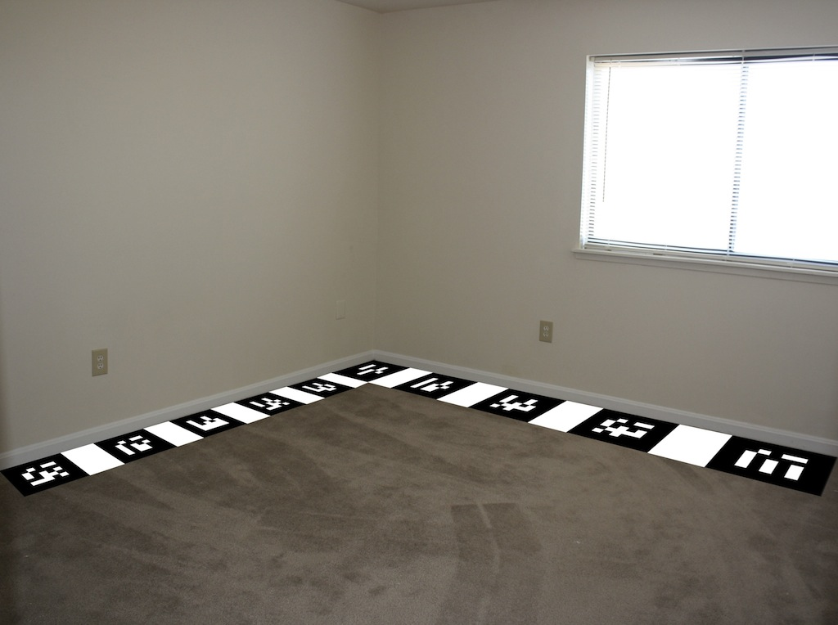
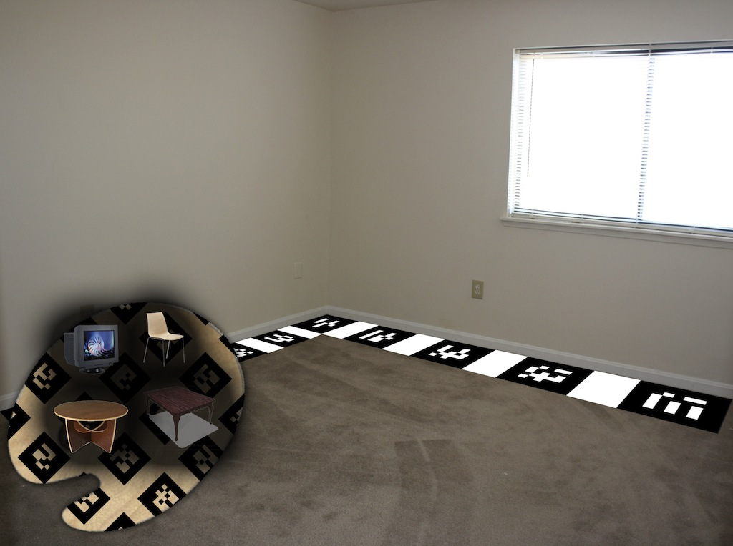
Overview of system design
  Palette displays a catalog of furniture and room items
  Item can be placed in room with a virtual pointer (wand)
  Floor and palette are tracked using Markers

Slide 5
Interaction Techniques
Selection, Manipulation, Travel, Wayfinding

Slide 6
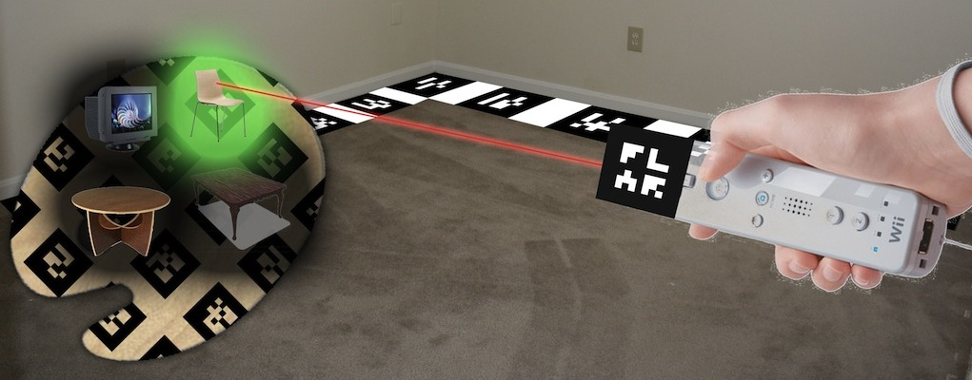
Selection
  Selection of items in catalog using a ray cast from wand
  Selection of items in room in similar fashion

Slide 7
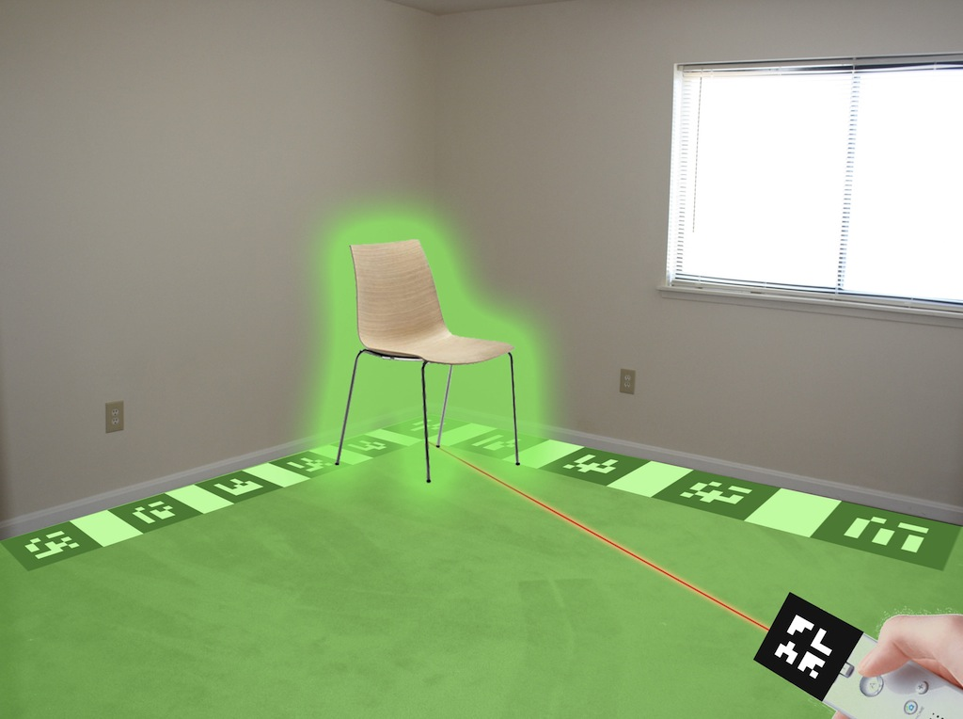
Manipulation
  Placement of items from catalog in room using pointing of wand to place
  Snapping of ray to discrete positions in the environment
  Rotation via buttons on wand
The chair is snapping to the ground

Slide 8
Travel
  Travel involves the user physically walking around the room to evaluate it as he/she makes changes using DesignAR or to make changes to the virtual items

Slide 9
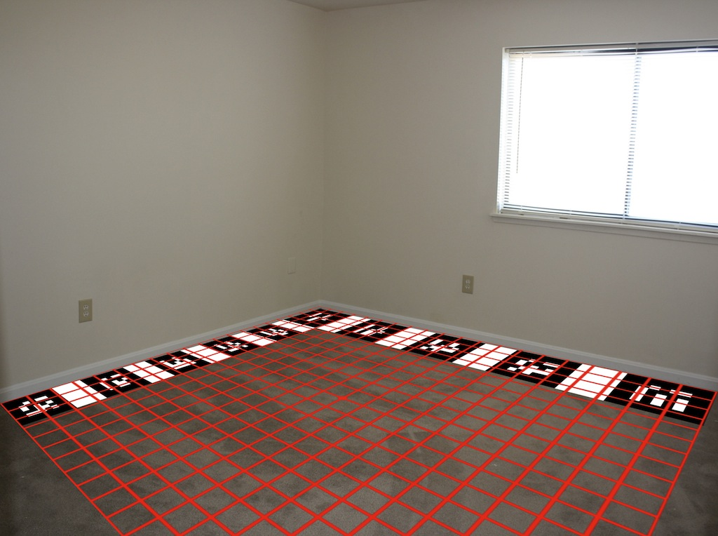
Wayfinding
  Virtual grid overlaid on floor to help with positioning of items and highlighting the position of the ray.
  We are considering placing arrows and labels to indicate the position of objects not in view, as well.

Slide 10
Personae and Use Scenarios

Slide 11
Mildred Pummelhorse
Mildred Pummelhorse just moved. She is small and elderly. She is an ardent practitioner of Feng Shui. It is difficult for her to move her furniture owing to her diminutive stature. However she desires to experiment with different possible layouts in her new place, to find the arrangement that is the most astrologically pleasing.

Slide 12
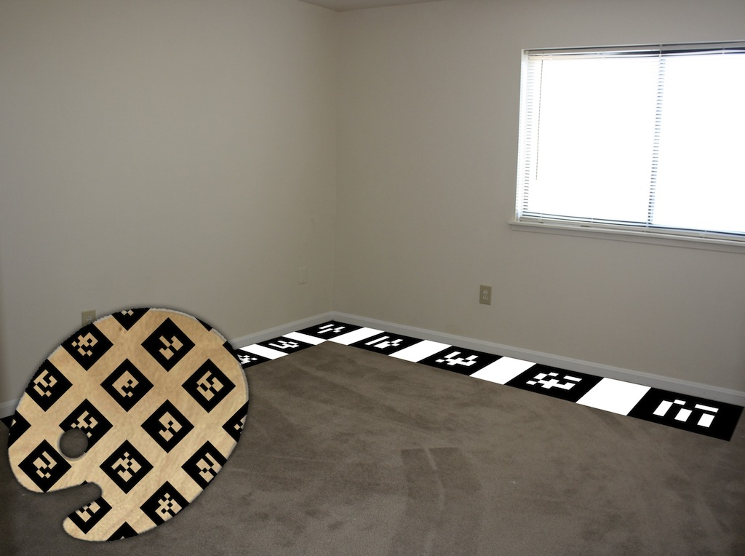
Mildred's Scenario
Mildred installs our software and prints out the marker arrays.
She places one array in the corner to detect the ground and another on her forearm like a palette.

Slide 13
Mildred's Scenario
She starts the program and sees on her palette a wide selection of furniture, posters and paintings.

Slide 14
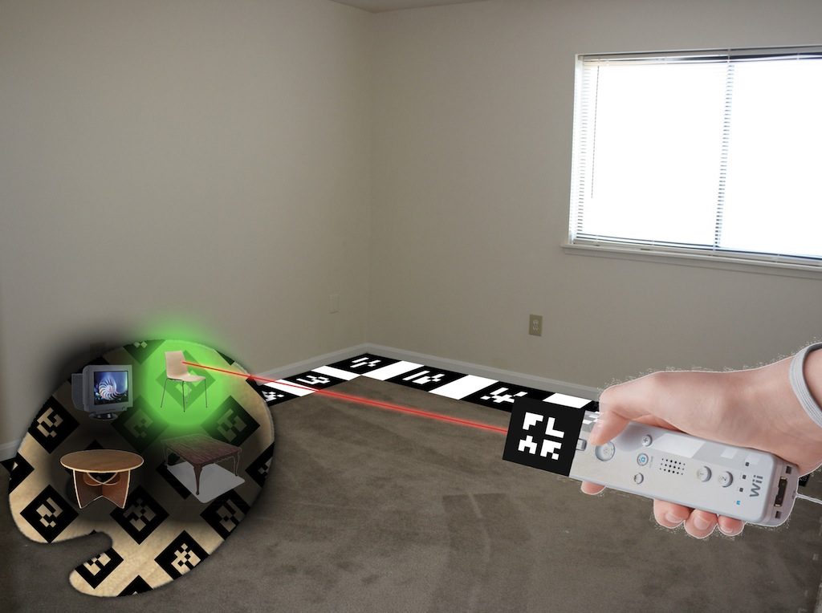
Mildred's Scenario
She moves her wand over a beautiful chair.

Slide 15
Mildred's Scenario
She points onto the northeast sun rise facing corner of her room and sees a ray extend from her wand showing where the chair will land. She finds the perfect place, presses the wand's button, and the chair is deposited.

Slide 16
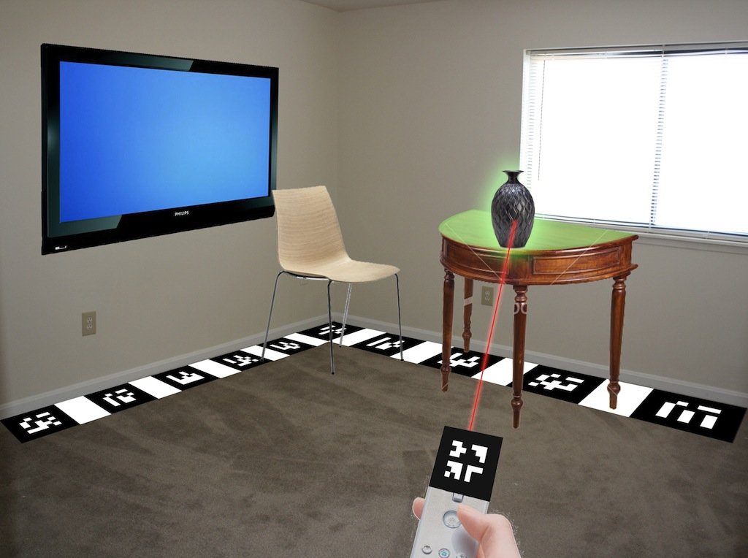
Mildred's Scenario
Using the program and this technique, she goes on to design the entire room according to her taste.

Slide 17
Kevin Smith
Kevin, 35, is an interior designer who serves an upscale clientele. He likes to use state of the art tools to make designing convenient and he is used to using a computer regularly to mock up his ideas in various 3D design programs to show to clients.

Slide 18
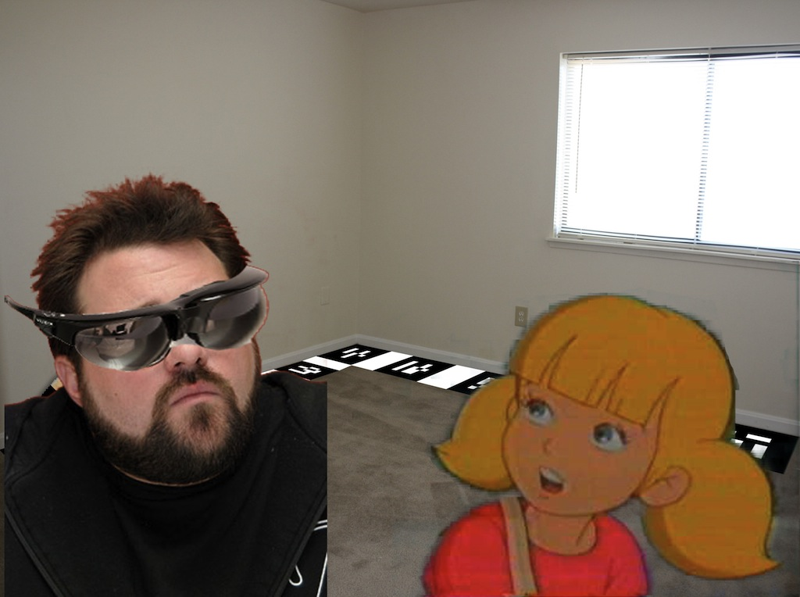
Kevin's Scenario
Kevin's client Penny, wants to re-model her room using existing furniture and new items, but isn't exactly sure what will look best. Kevin gets his supercool Vuzix eye gear and hooks it up to his laptop. He wears the glasses and has Penny look at the laptop to see what he sees.

Slide 19
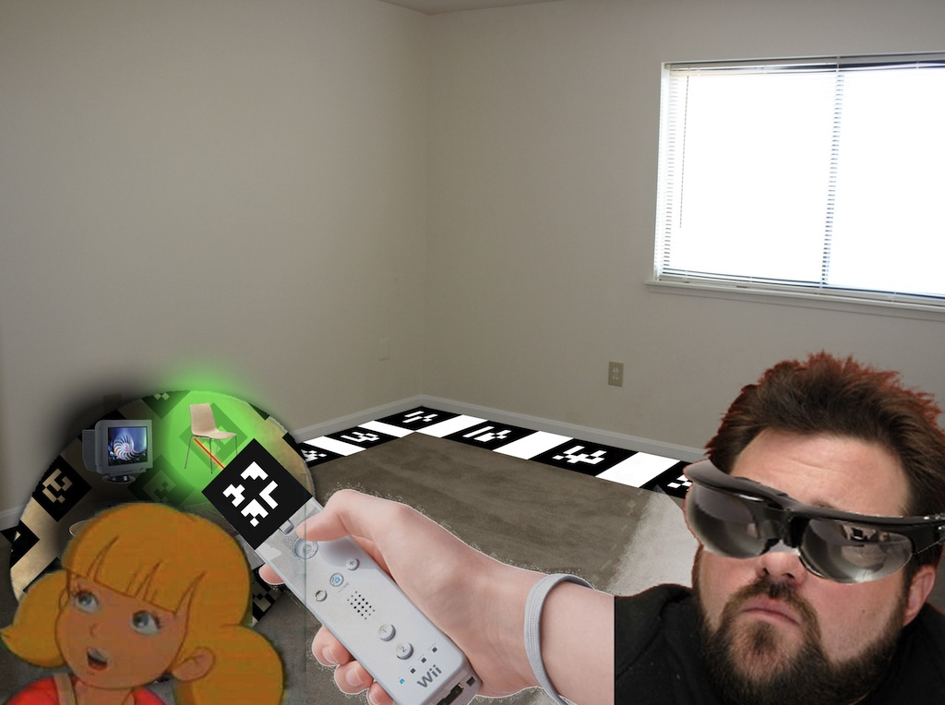
Kevin's Scenario
He then browses through the catalog overlaid on his palette and selects the furniture item that Penny chooses. Having picked an object from the catalog, Kevin points to a place in the room and has the object placed there at the click of a button.

Slide 20
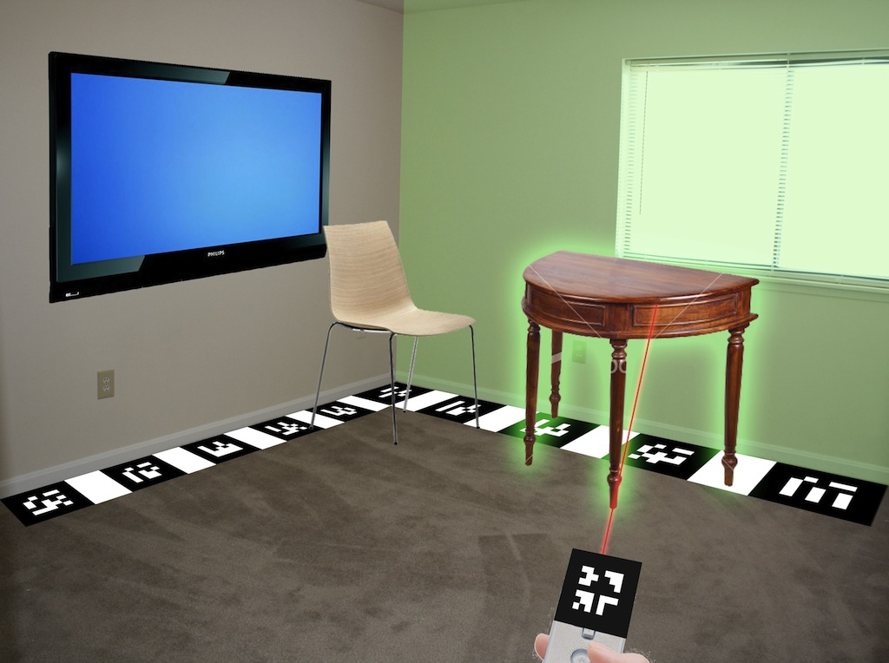
Kevin's Scenario
Using this technique, and dynamic feedback from Penny, he populates the room with furniture, orients them, and deletes furniture if Penny so wishes.

Slide 21
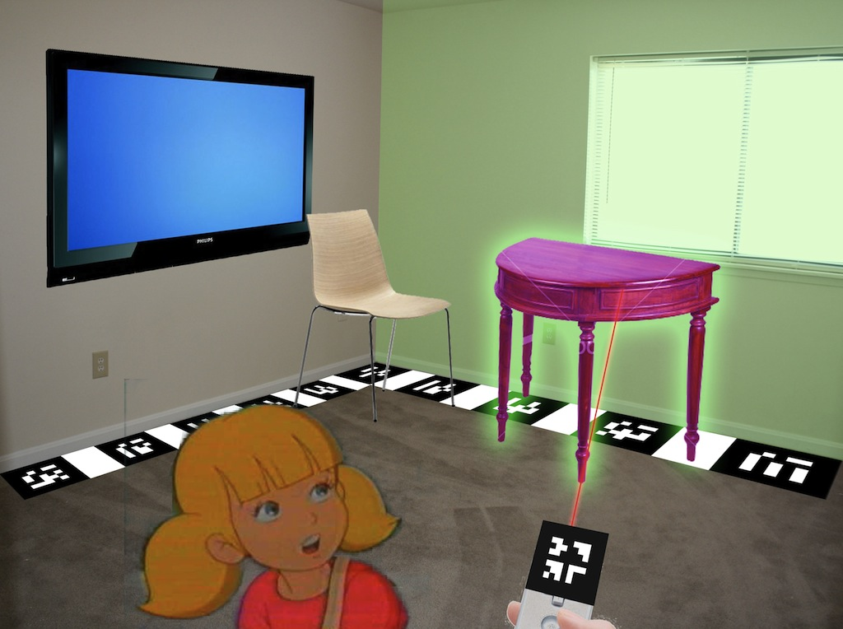
Kevin's Scenario
Penny then wears the glasses, walks around the room, to look at it from different angles and check if that is what she wants. Quite naturally, she is unhappy with the color scheme and goes on to change the color of the furniture to match her fingernails.

Slide 22
Division of labor
  Room and overall program flow
  Wand
    selection and manipulation
  Palette and Catalog
  Items and 3D Models

Slide 23
Questions needing resolving
  How do we track the whole room?
    Should we limit the tracking to one corner?
    Should we put markers on each wall and use a calibration method?
    Marker "Islands" for the different corners
  How/can we deal with overlap of real items and virtual items?
  Should we allow objects to snap to other objects? Different surfaces? Only the floor?
  Should we just change the project completely? Those saying "Yes", beware!

