Slide 1
ELE417 Embedded System Design Project
AHMET FURKAN TUNCER
FATIH KAYA

Slide 2
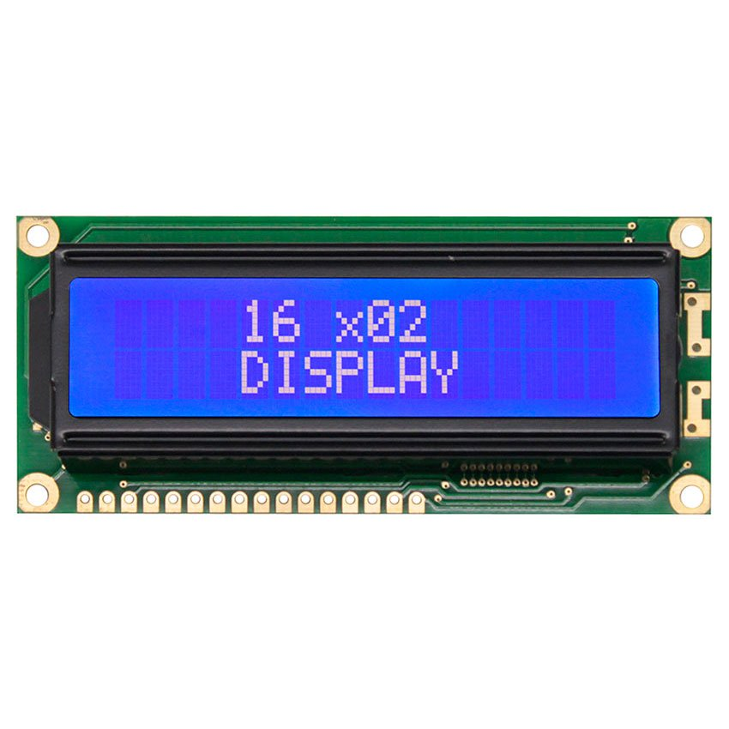

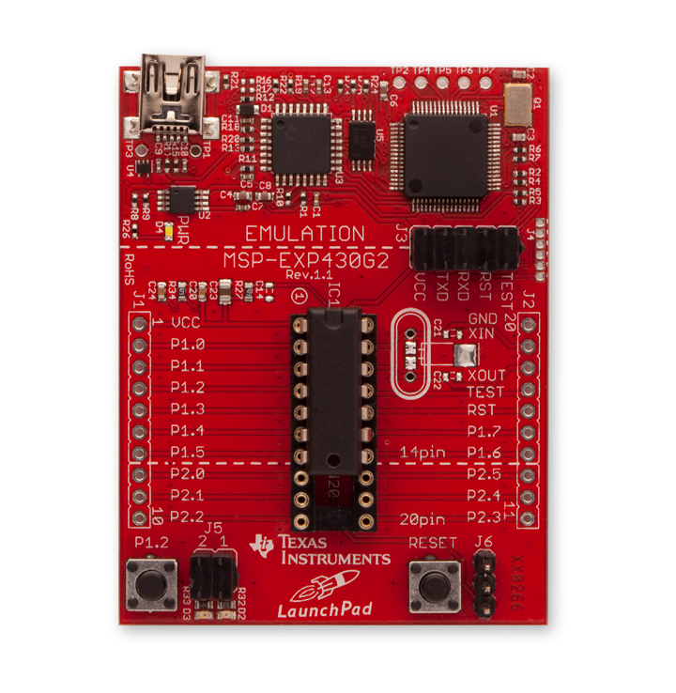

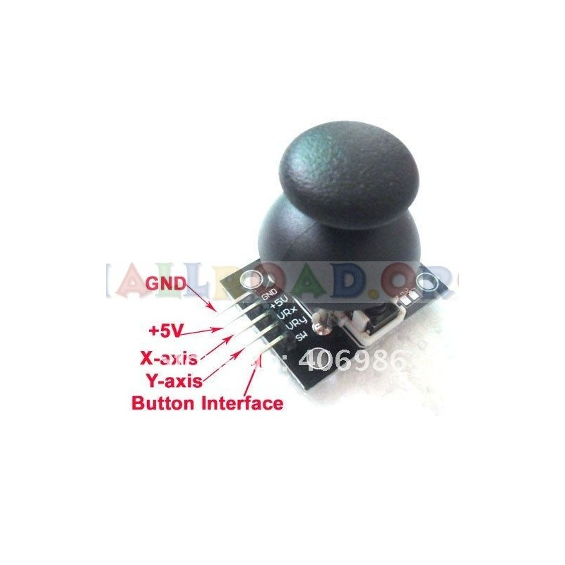

Circuit Diagram

Slide 3
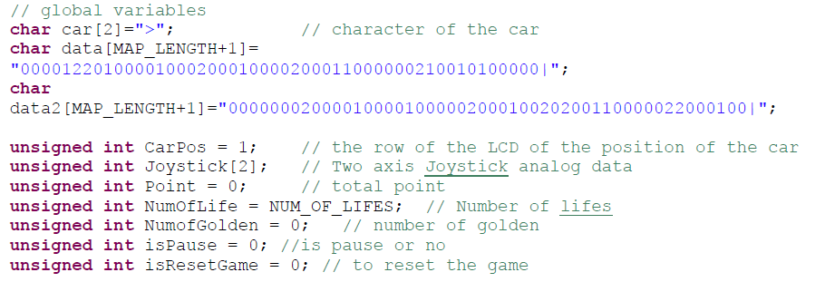
Global Variables

Slide 4
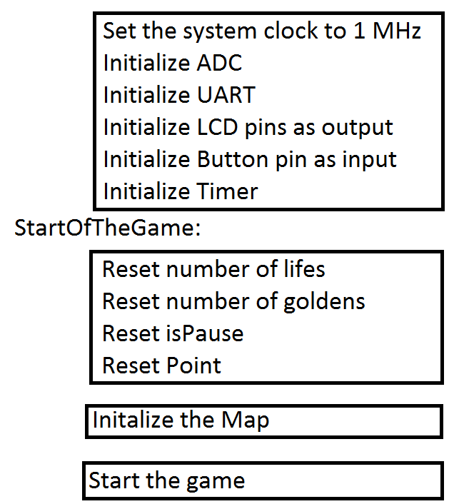
Main Program

Slide 5
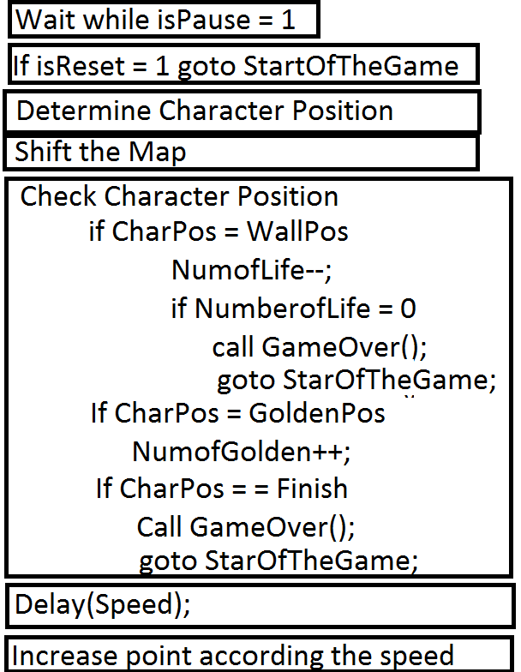
Infinite loop
isPause is toggled in Port2 ISR
isReset is set when the game is over or
when character or map is changed by sending
appropriate commands via UART.
Character Position is determined using the
one axis of the joystick.
Game Over function calculates and show the score
and also determines if the game is over or the user
win the game.
Speed is determined using the other axis of the joystick.

Slide 6
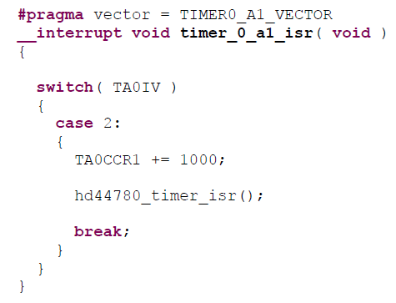
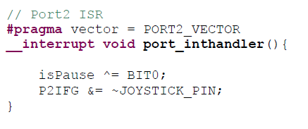
Interrupt Service Routines

Slide 7
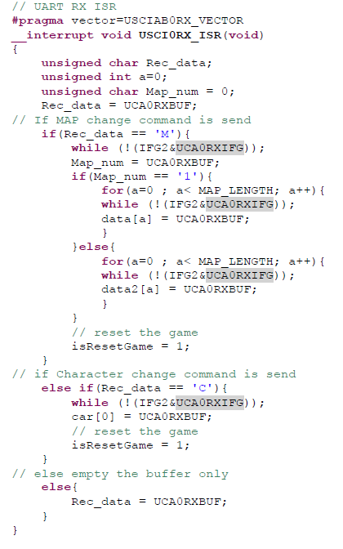
If Map Change command is received
If Character Change command is received
If none of the command is received

