Slide 1

Topic selected: Ethical Hacking
Presenter name:
your name{roll number}
team member name {roll number}
Submitted to:
Sir, ……..
subject:
Professional Practice for IT

Slide 2

Short intro to what we learn about Hacker?
Short introduction of we can learn
Who are hacker?
What is hacking?
A “hacker” is a term used by someone mean “a clever programmer” and by others, especially those in popular media to mean, “who tries to break into computer systems”
A hacker is just a person who uses computer programming or technical skills to overcome a challenge or problem.
A hacker is a person who is highly creative and dedicative to knowledge.
All hackers are not criminal that depend on there work.

Slide 3
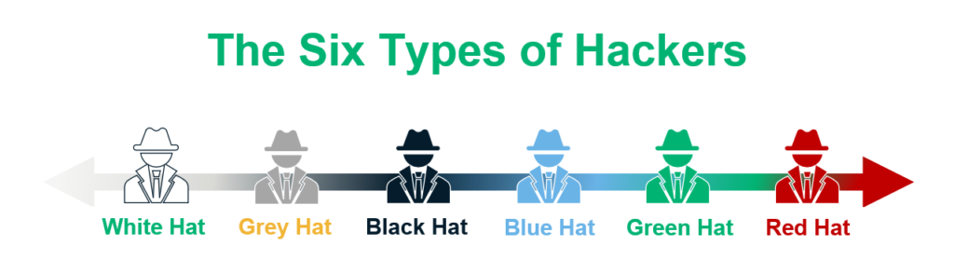


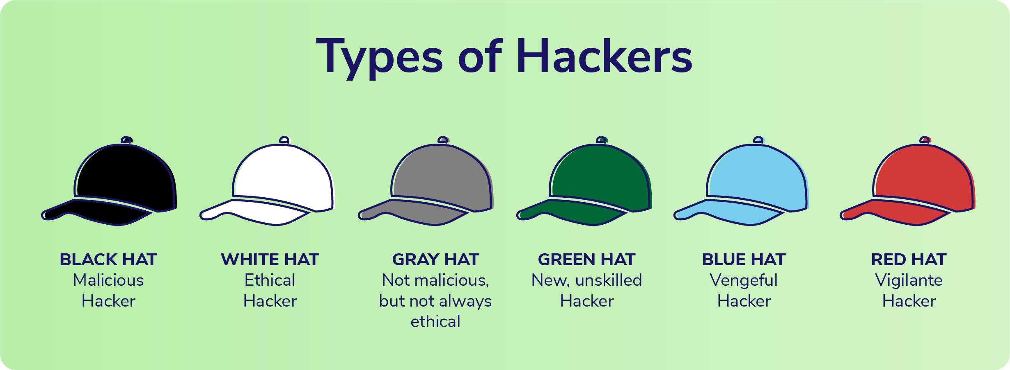

Slide 4

Ethical hacking:
Our topic is related to Ethical hacking which is also related to “White Hat hacker” .
What is Ethical hacking?
White hat hacker also called ethical hackers, these are the professional security specialists/analysts, and penetration testers who work with companies, industries, and computer systems to develop more robust security systems..
They must understand the methodologies of malicious hackers as well as the legal frameworks in place that define current security protocols.
Benefits
The primary benefit of ethical hacking is to prevent data from being stolen and misused by malicious attackers

Slide 5

Important Skills Needed for Ethical Hacking
Networking Skills
Computer Skills
Linux Skills
Programming Skills
SQL Skills
Hardware Knowledge
Knowledge in Reverse Engineering
Cryptography
Database Skills
Problem-solving Skills

Slide 6

Programming Skills:
Programming Skills are another most critical ability to become an ethical hacker.
Here is the list of programming languages.
Python
SQL C
JavaScript
PHP
C++
SQL Skills:
SQL is a Cross-platform programming language used to communicate with database. As an ethical hacker, having SQL skills will help you to hack a website for good.

Slide 7


