Slide 1

Print Instructions
Do not print the following hidden slide: 0, 24-32
Print notes: 2, 6, 7, 8, 9, 10, 11, 13, 18, 19
Print full page: 7
Notes:
Print instructions.

Slide 3

So What?
Notes:
Access to a Windows system is only the first step, credentials can be used for much more!
Windows credentials won’t get all the intel available
Credentialed access to web applications is a whole new world of access vectors (AWS management front ends, Facebook profiles, Email accounts, etc.)
Mission are enabled by credentials (vignette about Hawaii/Maryland trips)

Slide 4
32 WPS Syllabus Objectives
Describe DPAPI
Describe how Windows utilizes DPAPI to store credentials
Illustrate the DPAPI encryption/decryption process
Locate the DPAPI storage locations on Windows
Demonstrate stealing Google Chrome session using Mimikatz
Demonstrate stealing Google Chrome saved passwords using Mimikatz
Notes:
Describe DPAPI (slide 6)
Describe how Windows utilizes DPAPI to store credentials (slide 7)
Illustrate the DPAPI encryption/decryption process (slide 8)
Locate the DPAPI storage locations on Windows (slide 11)
Demonstrate stealing Google Chrome session using Mimikatz (slide 17)
Demonstrate stealing Google Chrome saved passwords using Mimikatz (slide 17)
If I want to do Credential Harvesting, what do I need to know
Separate out, “what is nice to know?”
List open-source tools used to abuse DPAPI (could be a nice to know)
List the locations of DPAPI procedures/instruction (available in classified brief) (you have to be able to find the page in order to demonstrate it)
List the two primary user function calls within DPAPI (not really necessary to understanding how DPAPI works, but nice to know)
List open-source tools used to abuse DPAPI (now more specific to the brief)
List applications that utilize DPAPI for credential storage (moved to more specific)
Demonstrate credential harvesting using Mimikatz against Windows NT5+ targets (now specific vignettes shown in brief)
Demonstrate stealing Remote Desktop saved credentials using Mimikatz (now specific vignettes shown in brief)

Slide 5
Overview
Background
Data Protection API (DPAPI) Overview
Password to Password
DPAPI Conditions
DPAPI Locations
Problem
Solution
Notes:
Review slide.

Slide 6
DPAPI Overview
Data Protection API is a Windows API which uses a pair of function calls that provide operating system-level data protection services to user and system processes
Password-based data protection service
DPAPI does not store any data, it simply protects data via BLOB
Notes:
https://docs.microsoft.com/en-us/previous-versions/ms995355(v%3Dmsdn.10)
First Bullet
By operating system-level, it is a service that is provided by the operating system itself and does not require any additional libraries
By data protection, it provides every application with a way to secure data without needing any specific cryptographic code (sha-1 algo, triple-des, etc.) other than the necessary function calls to DPAPI
Second Bullet
DPAPI is a password-based data protection service. It requires a password to provide protection.
The drawback, of course, is that all protection provided by DPAPI rests on the password provided
Third Bullet
BLOB = binary large object, a data type that stores binary data
DPAPI does not actually store any data. It simply protects data.
It is the application's responsibility to store the protected data.
CryptProtectData() returns an opaque data BLOB, and it is sufficient for applications to store this BLOB in some way

Slide 7
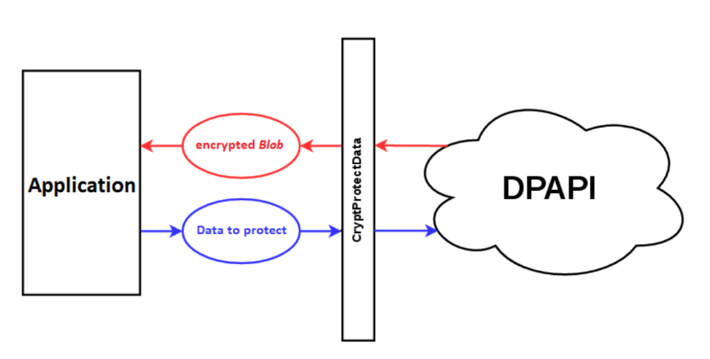
DPAPI Overview
LSA
RPC
!5f03cd802f4ee…
!QAZ2wsx
Notes:
- https://www.thehacker.recipes/ad/movement/credentials/dumping/dpapi-protected-secrets
https://docs.microsoft.com/en-us/previous-versions/ms995355(v%3Dmsdn.10)
Why does DPAPI exist?
Applications need a way to protect data
Pass in clear text, return BLOB
The protected data BLOB is an opaque structure because, in addition to the encrypted data, it also contains data to allow DPAPI to unprotect it
When an application calls one of the DPAPI function, the function make a local RPC call to LSA
LSA, like DPAPI is manipulated because it operates in a repeatable pattern (which we’ll utilize with Mimikatz later)
DPAPI does not store data, the location will be application specific
Only protects data, we’ll talk about that next
The protected data BLOB is an opaque structure because, in addition to the encrypted data, it also contains data to allow DPAPI to unprotect it. Being opaque, application developers do not need to parse or understand the format at all. An important point to remember is that DPAPI merely applies cryptographic protection to the data. It does not store any of the protected data; therefore applications calling DPAPI must implement their own storage of the protected data.
When an application calls one of the DPAPI functions, the functions make a local RPC call to the Local Security Authority (LSA). The endpoints of these RPC calls then call DPAPI private functions to protect or unprotect the data. These functions then call back into CryptoAPI, by using Crypt32.dll, for the actual encryption or decryption of the data in the security context of the LSA. The functions run in the security context of the LSA so that security audits can be generated.
The LSA also contains system-level functions for using DPAPI. These functions are available to any thread running inside the LSA and only to those threads. This is because the functions provide additional options for LSA threads, specifically to allow LSA threads to protect user data that cannot be unprotected by non-LSA threads that are using DPAPI, such as user applications.

Slide 8
DPAPI Password to Password
OS
Application
Master Key
Decrypt
“Enter Password in Windows”
Derives
MK Encryption Key
Symmetric Session Key
“Saved Password in Chrome”
Derives
512 Random Encrypted Bits
On Disk
“Secret”
Decrypt
User Password
Protected Data BLOB
SHA-1 Hash + Opaque 16 Random Bytes +
Opaque Iteration count
“PKCS #5”
Opaque 16 Random Bytes + MasterKey + ApplicationSpecific (Entropy/Password)
“Application Algorithm”
Windows Password
708 Bits +
Description Text +
Encrypted Data +
Salt (optional)
“Application Secret”
Notes:
https://docs.microsoft.com/en-us/previous-versions/ms995355(v%3Dmsdn.10)
Start from left to right
Entering your windows logon password into chrome to retrieve a saved password
Your windows logon password is hashed via SHA-1 (on Windows 10, it’s done 4000 times), but the iteration count and 16 bytes are appended to the hash unencrypted
The master key is 512 bits of random data, only visible to the user on disc.
The symmetric session key is created based on specs from the application and completes the symmetric key handshake.
After the handshake is negotiated, the protected BLOB saved in the application specific location is decrypted
Password appears to user in plaintext
The bold circle indicates the center of the DPAPI key relationships: the user password. On standalone systems, the recovery key protects the password to allow users to reset their passwords with the PRD (password reset disk). The user password is used to derive the MasterKey Encryption Key, which is used to protect the MasterKey. Finally, a derivation of this password, the user credential, is stored in the "Credential History" file, which allows DPAPI to access MasterKeys protected under old passwords.
On domain workstations, a Domain Controller public key also protects the MasterKey. This allows DPAPI to access a Domain Controller and restore the MasterKey, if it cannot use the MasterKey Encryption Key. Finally, the MasterKey is used to derive the Symmetric Session Key, which then protects the application data.
Master Key
We said earlier that DPAPI generates a strong key called the MasterKey. Calling the MasterKey a key isn't really correct because it is never used in any explicit encryption or decryption functions. The MasterKey is more accurately a strong secret: strong because it is 512 bits of random data, and secret because it is used, with some additional data, to generate an actual symmetric session key. This secret, however, needs to be kept secure from everyone but the intended user.
To protect this secret, DPAPI uses the Password-Based Key Derivation Function, PBKDF2, described in PKCS #5 (Public Key Cryptography Standards). First, DPAPI takes the user's password and passes it through SHA-1 to get a password hash. This is the logon credential mentioned earlier. Next, the password hash is provided to the PBKDF2 function, along with sixteen random bytes for a salt and an iteration count. The PBKDF2 function calls an additional function a number of times, specified by the iteration count, to derive a key from the given data. DPAPI uses SHA-1 for that underlying function. The salt and iteration count are both non-secret values, and therefore are stored along with the encrypted MasterKey, but are not encrypted. This allows DPAPI to easily decrypt the MasterKey, given the user's password.
At this point, if the computer is a domain member, the backup steps, outlined in the Key Backup and Restoration in DPAPI section, are performed. Finally, the encrypted MasterKey and HMAC, salt, iteration count, and backup MasterKey are all stored in a MasterKey file, which resides in the user's profile directory.
Session Key
The session key is the real symmetric key that is used for encrypting and decrypting the application data. DPAPI uses a simple process to derive the session key. First, 16 bytes of random data are generated and then hashed, by using SHA-1, with the MasterKey. This hash is then appended with the optional entropy and optional user password, mentioned earlier, by using CryptHashData(), a CryptoAPI call. The result is then passed to CryptDeriveKey(), another CryptoAPI call, which derives and returns the session key.
As we mentioned earlier, the session key is never stored anywhere; it is derived, used, and then removed from memory. So that DPAPI can unprotect the data, the generated random bytes are stored in the protected data BLOB. These random bytes are stored unprotected; however, since the MasterKey is protected, they are authenticated with an HMAC to prevent tampering.
Data BLOB
Contains application specific data, salt, masterkey
The default iteration count is 4000, which increases the work load required to brute-force compromise the password by a factor of 4000, without creating undue performance restrictions in normal operations. There is a registry valueMasterKeyIterationCountstored in the HKEY_LOCAL_MACHINE\Software\Microsoft\Cryptography\Protect\Providers\GUIDkey that allows a system administrator to increase this iteration count. It cannot, however, be decreased below 4000.

Slide 9
DPAPI Domain Context
DPAPI
Application
MK Encryption Key
Symmetric Session Key
User Password
Master Key
Protected Data BLOB
Domain Controller Key
Notes:
https://docs.microsoft.com/en-us/previous-versions/ms995355(v%3Dmsdn.10)
On domain workstations, a Domain Controller public key also protects the MasterKey.
This allows DPAPI to access a Domain Controller and restore the MasterKey, if it cannot use the MasterKey Encryption Key.

Slide 10
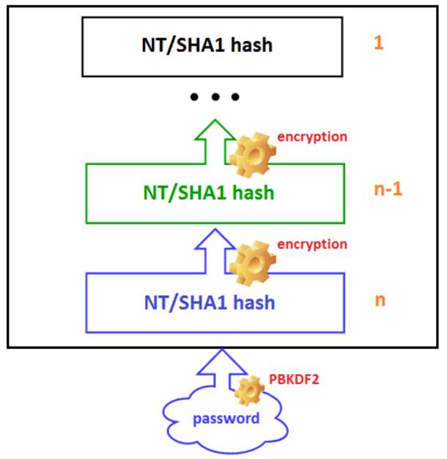
DPAPI Password Changes
User Password
Old Master Key
512 Random Bits
Notes:
- https://www.thehacker.recipes/ad/movement/credentials/dumping/dpapi-protected-secrets
- If the password provided doesn’t match decrypt the MK Encryption Key, there is a built-in method to check against previous hashes stored within the CREDHIST file

Slide 11
DPAPI – Locations
Operating System stores encrypted BLOBs per user at:
C:\Users\<USERNAME>\AppData\Roaming\Microsoft\Protect\<SID>\<GUID>
Password history is also located here
Google Chrome stores encrypted BLOBs per user at:
C:\Users\<USERNAME>\AppData\Local\Google\Chrome\User Data\Default\Login Data
These files are protected with the “Protected Operating System” type
Notes:
https://www.insecurity.be/blog/2020/12/24/dpapi-in-depth-with-tooling-standalone-dpapi/
These files are protected with the “Protected Operating System” type which is why they are not shown even with “Show Hidden Items”, however a high integrity prompt can still view them with dir /a

Slide 12
Overview
Background
Problem
Solution
Notes:
Review slide.

Slide 13



Problem
Current Operating Environment
Other
Networks
Facebook
Internal Web Resources
DC
Workstation
Webmail
File Server
AWS
Cloud Services
Notes:
Number of procedures on credential harvest total vs how many techniques utilize different primitives
Few JCTM pages on DPAPI
Dependence on other credential harvesting methods
Limited initial access vectors/credentials
Classified vignettes

Slide 14
Overview
Background
Problem
Solution
Technique
Planning Considerations
Google Chrome (standalone)
Google Chrome (w/SYSTEM)
Google Chrome (domain)
Notes:
Review slide.

Slide 15
Technique
Commercial tools available
Using Mimikatz to steal credentials from Google Chrome
Other targets for this technique
Google Talk, Dropbox, iCloud, Safari, Skype, KeePass, Internet Explorer, Outlook, Windows Mail, Windows RDP
Windows Operating System (Windows Vault/Credential Manager, WEP & WPA keys)
Notes:
Review slide.

Slide 16
Planning Consideration
Windows NT 5+
Chrome version < 80 (Mimikatz limitation)
Administrator/System access
Note: Different process for admin vs. SYSTEM
Ability to run Mimikatz
Notes:
- https://www.thehacker.recipes/ad/movement/credentials/dumping/dpapi-protected-secrets
Algorithms
Windows 2000 : Cipher(RC4) Hashing (SHA1) PBKDF2 Iterations (1)
Windows XP : Cipher(3DES) Hashing (SHA1) PBKDF2 Iterations (4000)
Windows Vista : Cipher(3DES) Hashing (SHA1) PBKDF2 Iterations (2400)
Windows 7 : Cipher(AES256) Hashing (SHA512) PBKDF2 Iterations (5600)
Windows 10 : Cipher(AES256) Hashing (SHA512) PBKDF2 Iterations (8000)

Slide 17
Google Chrome (Standalone)
https://www.youtube.com/watch?v=WKSqEv7S-BY
Notes:
https://www.youtube.com/watch?v=WKSqEv7S-BY

Slide 18
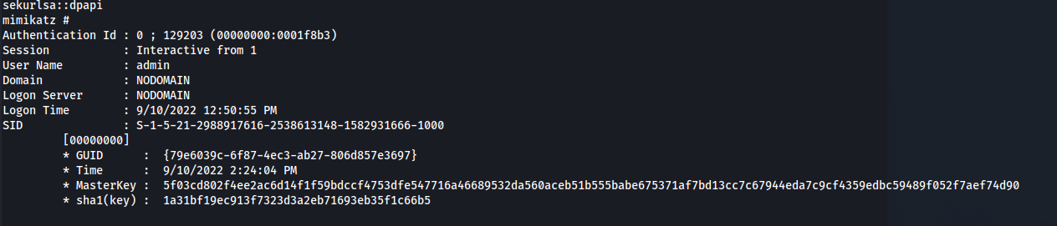
From SYSTEM
Specify the Master Key
dpapi::chrome /in:"C:\Users\admin\AppData\Local\Google\Chrome\User Data\Default\Cookies"
/masterkey:5f03cd802f4ee2ac6d14f1f59bdccf4753dfe547716a46689532da560aceb51b555babe675371af7bd13cc7c67944eda7c9cf4359edbc59489f052f7aef74d90
Notes:
When executing this TTP from a SYSTEM context, mimikatz would attempt to use the masterkey from SYSTEM, which is not necessarily the user whose passwords you are trying to steal
Get all the masterkeys on disk with sekurlsa::dpapi

Slide 19


Google Chrome (Offline)
Target DC
Target
Operator
2. Download
MasterKey Files
MKEK (.pvk)
Chrome Files
3. Move MasterKey files to …/AppData/…
4. Run mimikatz “dpapi::masterkey” with specified MasterKey “/in” and encryption key “/pvk” to decrypt the MasterKey
5. Run mimikatz “dpapi::create” to create a MasterKey based on the stolen user on the attacker’s machine (need user’s cleartext password)
6. Copy the newly created MasterKey to the AppData location
7. Specify newly created MasterKey when using dpapi:chrome
1. Query Domain User MKEK
Notes:
How would we do this process offline?
First, in a domain environment you would need the MK Encryption Key (shown)
Note: Wouldn’t need this online, as mimikatz would automatically negotiate for this key on the local system
Need the User’s MasterKey (not pictured, see previous slide) and CREDHIST files
Need the loot files
Move the files into a VM back to their original locations
Copy the MasterKey <SID> folder into AppData
Run mimikatz “dpapi::masterkey” with specified masterkey “/in” and encryption key “/pvk” to decrypt the masterkey
Run mimikatz “dpapi::create” to create a masterkey based on the stolen user on the attacker’s machine
Copy the newly created masterkey to the AppData location
Specify newly created masterkey when using dpapi:chrome

Slide 20
Summary
DPAPI
Overview
Password to Password
Conditions & Locations
Think outside the box for credentialed access
Use Mimikatz to steal passwords from Google Chrome
Standalone
SYSTEM
Offline

Slide 21
32 WPS Syllabus Objectives
Describe DPAPI
Describe how Windows utilizes DPAPI to store credentials
Illustrate the DPAPI encryption/decryption process
Locate the DPAPI storage locations on Windows
Demonstrate stealing Google Chrome session using Mimikatz
Demonstrate stealing Google Chrome saved passwords using Mimikatz
Notes:
Describe DPAPI (slide 6)
Describe how Windows utilizes DPAPI to store credentials (slide 7)
Illustrate the DPAPI encryption/decryption process (slide 8)
Locate the DPAPI storage locations on Windows (slide 11)
Demonstrate stealing Google Chrome session using Mimikatz (slide 17)
Demonstrate stealing Google Chrome saved passwords using Mimikatz (slide 17)

Slide 22
Notes:
Questions?

Slide 23
References
https://attack.mitre.org/matrices/enterprise/
https://posts.specterops.io/operational-guidance-for-offensive-user-dpapi-abuse-1fb7fac8b107
https://docs.microsoft.com/en-us/previous-versions/ms995355(v%3Dmsdn.10)
https://docs.microsoft.com/en-us/windows/win32/seccng/cng-dpapi
https://www.youtube.com/watch?v=WSJjIsElJ3U
https://www.ired.team/offensive-security/credential-access-and-credential-dumping/reading-dpapi-encrypted-secrets-with-mimikatz-and-c++
https://www.insecurity.be/blog/2020/12/24/dpapi-in-depth-with-tooling-standalone-dpapi/

Slide 24
Notes:
Murder Board Blew - DPAPI

Slide 25
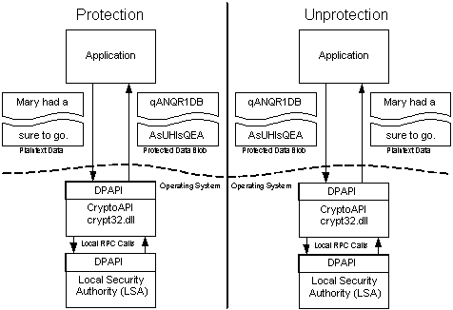
Why Does DPAPI Exist?

Slide 26
DPAPI – Session Keys
DPAPI uses the user’s logon credential (password/CAC/PIN) to encrypt/decrypt data
User access != All application access
Each application uses an additional secret to protect data
DPAPI generates a “MasterKey” protected by the user’s password
A symmetric session key is generated based on the MasterKey, random data, and application specific data. The session key is used to protect the data.
The session key is never stored, only the random data used to generate the key in a “BLOB”
When the data BLOB is passed back in to DPAPI the random data is used to re-derive the session key and unprotect the data
Notes:
https://docs.microsoft.com/en-us/previous-versions/ms995355(v%3Dmsdn.10)
DPAPI is focused on providing data protection for users. Because DPAPI requires a password to provide protection, the logical step is for DPAPI to use a user's logon password, which it does, in a way. DPAPI actually uses the user's logon credential. In a typical system, in which the user logs on with a password, the logon credential is simply a hash of the user's password. In a system in which the user logs on with a smart card, however, the credential would be different. To keep matters simple, we'll use the terms user password, logon password, or just password to refer to this credential.
A small drawback to using the logon password is that all applications running under the same user can access any protected data that they know about. Of course, because applications must store their own protected data, gaining access to the data could be somewhat difficult for other applications, but certainly not impossible. To counteract this, DPAPI allows an application to use an additional secret when protecting data. This additional secret is then required to unprotect the data.
Technically, this "secret" should be called secondary entropy. It is secondary because, while it doesn't strengthen the key used to encrypt the data, it does increase the difficulty of one application, running under the same user, to compromise another application's encryption key. Applications should be careful about how they use and store this entropy. If it is simply saved to a file unprotected, then adversaries could access the entropy and use it to unprotect an application's data.
Additionally, the application can pass in a data structure that will be used by DPAPI to prompt the user. This "prompt structure" allows the user to specify an additional password for this particular data. We discuss this structure further in the Using DPAPI section.
DPAPI initially generates a strong key called a MasterKey, which is protected by the user's password. DPAPI uses a standard cryptographic process called Password-Based Key Derivation, described in PKCS #5, to generate a key from the password. This password-derived key is then used with Triple-DES to encrypt the MasterKey, which is finally stored in the user's profile directory.
The MasterKey, however, is not used explicitly to protect the data. Instead, a symmetric session key is generated based on the MasterKey, some random data, and any additional entropy, if an application chooses to supply it. It is this session key that is used to protect the data. The session key is never stored. Instead, DPAPI stores the random data it used to generate the key in the opaque data BLOB. When the data BLOB is passed back in to DPAPI, the random data is used to re-derive the key and unprotect the data.
For security reasons, MasterKeys will expire, which means that after a period of time (the hard-coded value being three months), a new MasterKey is generated and protected in the same manner. This expiration prevents an attacker from compromising a single MasterKey and accessing all of a user's protected data.
You are probably wondering how an application can unprotect data that was protected under a MasterKey that has expired, because the session key is derived from the MasterKey, right? Well the answer involves a two-step process. First, DPAPI does not delete any expired MasterKeys. Instead, they are kept forever in the user's profile directory, protected by the user's password. Second, it stores the Globally Unique Identifier (GUID) of the MasterKey used to protect the data in the opaque data BLOB that is returned to applications. When the data BLOB is passed back in to DPAPI, the MasterKey that corresponds to the GUID is used to unprotect the data.
The other question you might have is how does DPAPI access MasterKeys after a user changes his or her password? The answer is again a two-step process. First, DPAPI hooks into the password-changing module and when a user's password is changed, all MasterKeys are re-encrypted under the new password. Second, the system keeps a "Credential History" file in the user's profile directory. When a user changes his or her password, the old password is added to the top of this file and then the file is encrypted by the new password. If necessary, DPAPI will use the current password to decrypt the "Credential History" file and try the old password to decrypt the MasterKey. If this fails, the old password is used to again decrypt the "Credential History" file and the next previous password is then tried. This continues until the MasterKey is successfully decrypted.

Slide 27
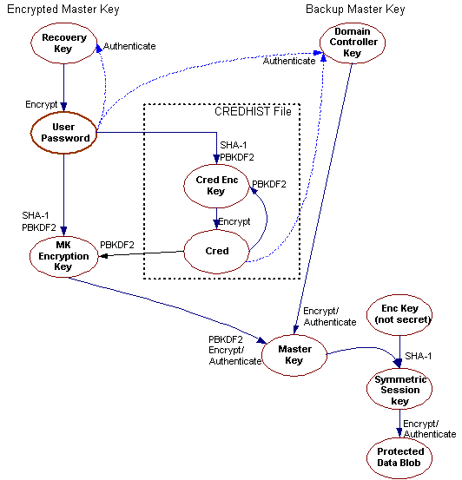
DPAPI – Session Key Diagram
Active Directory
Typical Process
Changed Passwords
“Strong Secret”
Notes:
https://docs.microsoft.com/en-us/previous-versions/ms995355(v%3Dmsdn.10)
The bold circle indicates the center of the DPAPI key relationships: the user password. On standalone systems, the recovery key protects the password to allow users to reset their passwords with the PRD (password reset disk). The user password is used to derive the MasterKey Encryption Key, which is used to protect the MasterKey. Finally, a derivation of this password, the user credential, is stored in the "Credential History" file, which allows DPAPI to access MasterKeys protected under old passwords.
On domain workstations, a Domain Controller public key also protects the MasterKey. This allows DPAPI to access a Domain Controller and restore the MasterKey, if it cannot use the MasterKey Encryption Key. Finally, the MasterKey is used to derive the Symmetric Session Key, which then protects the application data.
Master Key
We said earlier that DPAPI generates a strong key called the MasterKey. Calling the MasterKey a key isn't really correct because it is never used in any explicit encryption or decryption functions. The MasterKey is more accurately a strong secret: strong because it is 512 bits of random data, and secret because it is used, with some additional data, to generate an actual symmetric session key. This secret, however, needs to be kept secure from everyone but the intended user.
To protect this secret, DPAPI uses the Password-Based Key Derivation Function, PBKDF2, described in PKCS #5 (Public Key Cryptography Standards). First, DPAPI takes the user's password and passes it through SHA-1 to get a password hash. This is the logon credential mentioned earlier. Next, the password hash is provided to the PBKDF2 function, along with sixteen random bytes for a salt and an iteration count. The PBKDF2 function calls an additional function a number of times, specified by the iteration count, to derive a key from the given data. DPAPI uses SHA-1 for that underlying function. The salt and iteration count are both non-secret values, and therefore are stored along with the encrypted MasterKey, but are not encrypted. This allows DPAPI to easily decrypt the MasterKey, given the user's password.
At this point, if the computer is a domain member, the backup steps, outlined in the Key Backup and Restoration in DPAPI section, are performed. Finally, the encrypted MasterKey and HMAC, salt, iteration count, and backup MasterKey are all stored in a MasterKey file, which resides in the user's profile directory.
Session Key
The session key is the real symmetric key that is used for encrypting and decrypting the application data. DPAPI uses a simple process to derive the session key. First, 16 bytes of random data are generated and then hashed, by using SHA-1, with the MasterKey. This hash is then appended with the optional entropy and optional user password, mentioned earlier, by using CryptHashData(), a CryptoAPI call. The result is then passed to CryptDeriveKey(), another CryptoAPI call, which derives and returns the session key.
As we mentioned earlier, the session key is never stored anywhere; it is derived, used, and then removed from memory. So that DPAPI can unprotect the data, the generated random bytes are stored in the protected data BLOB. These random bytes are stored unprotected; however, since the MasterKey is protected, they are authenticated with an HMAC to prevent tampering.
Data BLOB
Contains application specific data, salt, masterkey
The default iteration count is 4000, which increases the work load required to brute-force compromise the password by a factor of 4000, without creating undue performance restrictions in normal operations. There is a registry valueMasterKeyIterationCountstored in the HKEY_LOCAL_MACHINE\Software\Microsoft\Cryptography\Protect\Providers\GUIDkey that allows a system administrator to increase this iteration count. It cannot, however, be decreased below 4000.

Slide 28
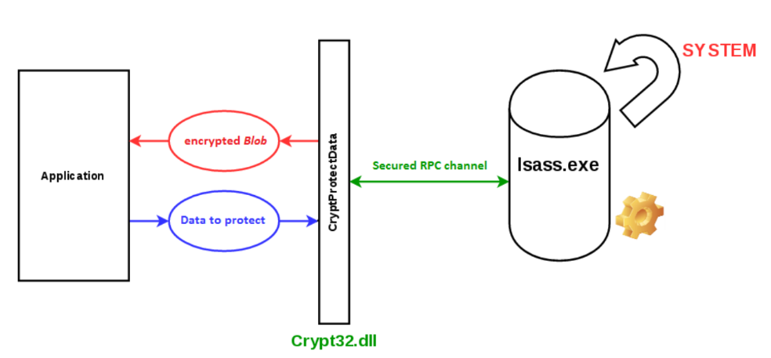
DPAPI – Crypto View
Notes:
https://docs.microsoft.com/en-us/previous-versions/ms995355(v%3Dmsdn.10)

Slide 29
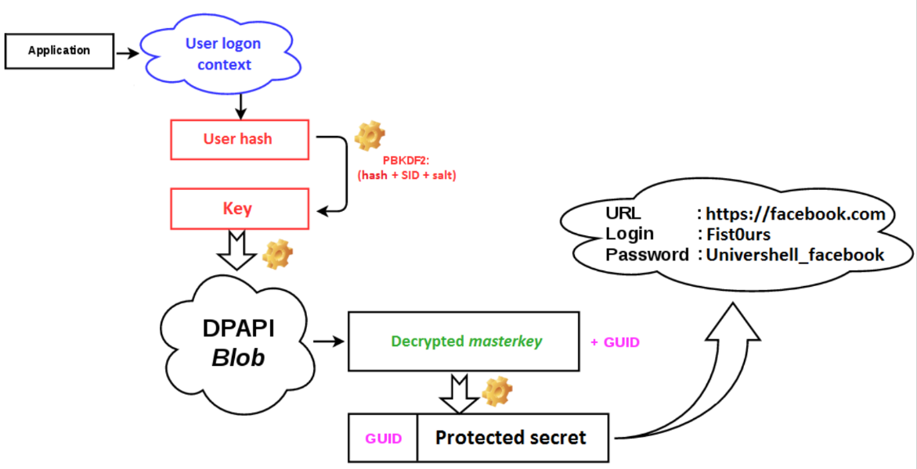
DPAPI – Internals
http://www.reddit.com
Blew_DPAPI
!QAZ2wsx!QAZ2wsx
Notes:
- https://www.thehacker.recipes/ad/movement/credentials/dumping/dpapi-protected-secrets

Slide 30
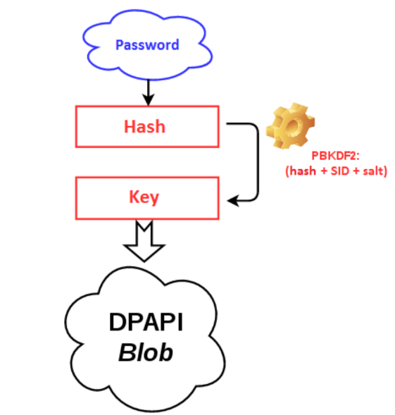
DPAPI – Crypto View
Notes:
- https://www.thehacker.recipes/ad/movement/credentials/dumping/dpapi-protected-secrets

Slide 31
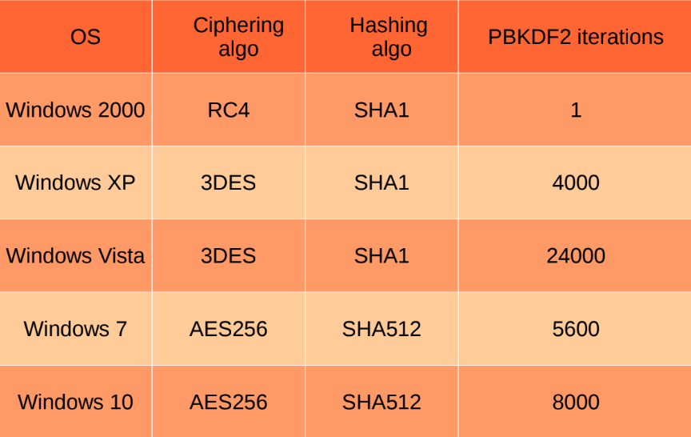
DPAPI – Encryption
Notes:
- https://www.thehacker.recipes/ad/movement/credentials/dumping/dpapi-protected-secrets

Slide 32
DPAPI – Functions
The user interfaces (applications) contain the only two functions that application developers need to know to use DPAPI
CryptProtectData()
Takes plaintext data as input and returns a data BLOB
CryptUnprotectData()
Takes a data BLOB and returns plaintext data
Link with Crypt32.lib or dynamically load Crypt32.dll
Notes:
https://docs.microsoft.com/en-us/previous-versions/ms995355(v%3Dmsdn.10)
There are two sets of interfaces to DPAPI, the user interfaces and the system interfaces. These are discussed, along with two data structures, the CRYPTPROTECT_PROMPTSTRUCT structure, which is the "prompt structure" mentioned earlier, and the protected data BLOB that holds the protected data.
The user interfaces contain the only two functions that application developers need to know to use DPAPI. The protect function:CryptProtectData()and the unprotect function: CryptUnprotectData(). The only requirement for applications to use these functions is to either link with Crypt32.lib or dynamically load Crypt32.dll. The protect function takes a plaintext data as input and returns an opaque protected data BLOB. The unprotect function takes this opaque data BLOB and returns the plaintext data.
The system interfaces are part of the LSA. These interfaces cannot be called by a user application. They exist so that LSA threads can use DPAPI and specify theCRYPTPROTECT_SYSTEMflag to protect data that cannot be unprotected outside the LSA.

Slide 33
Tools Currently Available
Passcape
Impacket
Mimikatz
Dpapick
Dpapilab
Notes:
- https://www.thehacker.recipes/ad/movement/credentials/dumping/dpapi-protected-secrets
Passcape: shareware + Windows only
Impacket: does not decrypt DPAPI protected secrets directly
Mimikatz: extracts secrets online and offline but Windows only
Dpapick: extracts secrets offline, first tool published to manage DPAPI offline
Dpapilab: an extension of dpapick

Slide 34
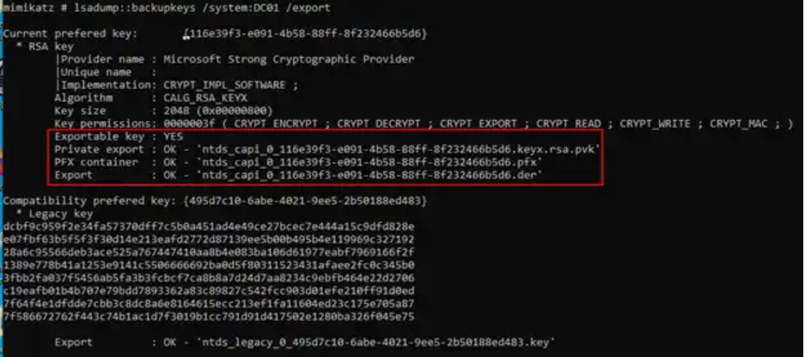
Google Chrome (Offline)
Domain
Encryption Key
Notes:
How would we do this process offline?
First, in a domain environment you would need the MK Encryption Key (shown)
Note: Wouldn’t need this online, as mimikatz would automatically negotiate for this key on the local system
Need the User’s MasterKey (not pictured, see previous slide) and CREDHIST files
Need the loot files
Move the files into a VM back to their original locations
Copy the MasterKey <SID> folder into AppData
Run mimikatz “dpapi::masterkey” with specified masterkey “/in” and encryption key “/pvk” to decrypt the masterkey
Run mimikatz “dpapi::create” to create a masterkey based on the stolen user on the attacker’s machine
Copy the newly created masterkey to the AppData location
Specify newly created masterkey when using dpapi:chrome

Slide 35
Problem
Lack of training and procedures on credential harvesting using DPAPI
Accessing systems/networks vs. Accessing applications
Prevalent Use Cases:
Existed since Windows 2000
DPAPI is used by
Google Chrome, Google Talk, Dropbox, iCloud, Safari, Skype, KeePass, Internet Explorer, Outlook, Windows Mail, Windows RDP
Windows Operating System
EFS certificates
WEP & WPA keys
Windows Vault/Credential Manager
Encrypting mail S-MIME
SSL/TLS in IIS
Notes:
https://elie.net/talk/reversing-dpapi-and-stealing-windows-secrets-offline/#
https://book.hacktricks.xyz/windows-hardening/windows-local-privilege-escalation/dpapi-extracting-passwords
https://www.thehacker.recipes/ad/movement/credentials/dumping/dpapi-protected-secrets
https://docs.microsoft.com/en-us/windows/win32/fileio/file-encryption
https://posts.specterops.io/operational-guidance-for-offensive-user-dpapi-abuse-1fb7fac8b107
Encrypted File System (EFS) provides an additional level of security for files and directories. It provides cryptographic protection of individual files on NTFS file system volumes using a public-key system.

