Slide 1
Print Instructions
Instructor prefers key sections of notes to be in bold
Do not print the following hidden slides in SSG: 0, 13, 14, 16, 18, 20, 22-27, 37, 46, 58-60, 64, 77, 86-90, 95, 96 and 105-110
Print the following slides full-size and in color in the back of the SSG: 12, 15, 17, 19, 21, 44, 68, 74, 76, 79, 80, 82, 83, 84 and 85
Notes:
Print Instructions.

Slide 2
Notes:
MSN9xxK, DCO Planning: Detection, Analysis and Pivoting

Slide 3
So What?
“No plan of operations extends with certainty beyond the first encounter with the enemy’s main strength” - Prussian Field Marshal Helmuth von Moltke the Elder
Using detection (tools/analysis) with data will provide results, and you must be prepared to handle the outcomes
This lesson will provide a science to survive contact with the enemy and how to use information to move forward
“You need some foundation of science literacy so you can inoculate yourself against those who would exploit your absence of knowledge of how the science works for their own gain... the only point of the scientific method is to make sure you are not fooled into thinking something is true that is not or thinking that something is not true, that is. - Neil deGrasse Tyson

Slide 4
Academic Objectives
Define detection
Define True/False Positive/Negative
List the goals and categories of high-quality data
Discuss the factors when developing a collection strategy
List the products and steps in the detection phase
Define the 8 analysis methods
List the 4 stages of the incident response process
List the key data in a security incident case
List the suggested workflow steps for case management

Slide 5
Overview
Detection
Collection
Identification
Classification
Analysis
Pivoting

Slide 6
Compromise Assessment Timeline
Detection
Analysis
Pivot
Sensor Driven
Automated
Large amount of FP
Analyst Driven
Semi-automated/ Playbooks
Tuning
Adversary/ Hypothesis Driven
Manual
Sensor Data
Incident
Adversary Activity
Detection
Analysis
Pivot
Notes:
Motivator/Work Method: -
Method: -
Characteristics: -
Set expectations here for the scenario, which is a CPT responding to a potential compromise. While students may feel left out from MSP/CSSP units, these concepts still apply but on a much longer timeline with much finer tuning, but the overall process is the same. The goal for this lesson is to be able to charge into unfamiliar territory with a process to identify adversary activity. We’ll highlight more differences when we get to “Focusing Detection Coverage”

Slide 7
Detection
Process of identifying security related incidents
Tool/Sensor: Software or hardware component used for identifying, detecting, protecting, responding and recovering from security threats
Notes:
The purpose of this slide is to give a clean definition for “detection” in order to set the stage for the next few slides. The instructor should emphasize that the processes we’ll be going over will be focused on IDENTIFYING malicious activity, with pivoting/ investigations to come later.
Transition: You can’t begin an investigation until you identify malicious activity, so we’ll start by going over the process to do it.

Slide 8
Detection
Collection
Identification
Classification
Kerberoasting
Detection

Slide 9
Detection Timeline
Collection
Sensor Based
Automated
Large amount of FP
Raw
Telemetry
Collection
Notes:
Not the funnel of fidelity!
This slide describes the funnel of data that a cyber defender is faced with handling in any given engagement. While you may be presented with logs, sensors strategies, alerts, etc. You must identify each individual piece of the detection process to form a scientific and measured method to identifying the adversary
Collection is

Slide 10
TP/TN/FP/FN
True Positive – Identified security related event
True Negative – Un-identified non-security related event
False Positive – Identified non-security related event
False Negative – Un-identified security related event
Guilty vs. Not Guilty
FP ∝ 1/FN
Notes:
The guilty vs. not guilty example is used to both illustrate the FP/FN point as well as to question to students on which is worse.
If someone is identified as a criminal and falsely imprisoned (FP) is that worse than someone who is not identified and theoretically still free committing crimes?
“FP ∝ 1/FN“ is saying “False Positives are inversely proportional to False Negatives
This means that the more false positives you have, the more likely it is to reduce false negatives due to your sensor posture and the amount of data you are consuming.

Slide 11
Tools/Sensors Categories
Host
EDR
HIDS
SIEM
Vuln Scanner
Firewalls
Forensics
Network
NIDS
SIEM
Vuln Scanner
NIPS
Forensics
Memory
SIEM*
Forensics
APT
TIPs
Notes:
TIPs – Threat Intelligence Platform
SIEM – Security Information and Event Management
NIDS – Network Intrusion Detection System
NIPS – Network Intrusion Prevention System
EDR – Endpoint Detection and Response
The purpose of this slide is to introduce data sources as a refresher for beginning the discussion on data quality.
This is the where our data comes from
Make into a build slide with the values under each category a click to reveal leaving the instructor time to ask students to name a few

Slide 12
Data Quality in Collection
Goals
Reduce time engaging alerts
Improve consistency across data sources
Enhance automation workflows
Categories
Accuracy
Completeness
Consistency
Timeliness
Uniqueness
Validity
Notes:
Data quality can be defined as “data are of high quality if they are fit for their intended uses in operations, decision making and planning”.
Categories are defined by “DOD Guidelines on Data Quality Management”
End with “Not all the categories are particularly useful for building collection plans, but we’ll focus on
Use the Kerberoasting scenario to help bring out examples to explain the categories
You’re about to start taking stock of the data available to find Kerberoasting.
Accuracy: “A qualitative assessment of freedom from error”. To determine if the logs, artifacts and other telemetry are free from tampering would be a time-consuming effort, thus this category is not particularly useful for threat hunting.
Completeness: “The degree to which values are present in the attributes that require them”. To effectively evaluate completeness the ADS framework is a great tool to aid this process. The next lesson will cover this in more detail. Some metrics to pull for this are the % of endpoints sending required/needed data or % of data sources missing events or data values. A good question to help evaluate this metric is are all endpoints shipping all the data I need?
For our example, are all data sources reporting Kerberos ticket creation?
Consistency: “A measure of the degree to which a set of data satisfies a set of constraints”. This metric refers to difference when comparing records from one data source against others that contain the same type of information. Can you identify the required/needed data fields across all data sources available?
For our example, there are windows logs that cover Kerberos ticket creation, but what about EDRs? Registry entries? Differences between operating system logs (NT4 vs NT5+)?
Timeliness: “The degree to which specified data values are up to date”. This metric represent reality from the required/needed point in time. An example metric to help evaluate is the amount of time data needs to be retained.
For our example, which log are Kerberos ticket creation entries made in? How often does this log rotate by default? What about the data in our SIEM, how often does that rotate?
Uniqueness: “The state of being the only one of its kind”. This is a difficult metric to evaluate and is satisfied by completeness, with the removal of duplicates from other data sources. An example of evaluating this metric would be when building an ELK data pipeline, creating a schema that correctly coalesces data from windows and vendor logs.
Validity: “The quality of data that is founded on an adequate system of classification and is rigorous enough to compel acceptance”. Same problem as evaluating accuracy, when it comes to identifying tampering or data being misreported.
Sources:
https://posts.specterops.io/ready-to-hunt-first-show-me-your-data-a642c6b170d6
http://mitiq.mit.edu/ICIQ/Documents/IQ%20Conference%201996/Papers/DODGuidelinesonDataQualityManagement.pdf

Slide 13
Collection Strategy
Collection strategy is tied to collecting relevant data to detect and respond to threats
The tools and sensors used shape the strategy
The threats and vulnerable assets focus the strategy
Leveraging coverage and “analyst units” are key to developing a strategy

Slide 14
Building a Detection
Credential Access via Kerberoasting
Requires TGT
Sends TGS-REQ for an account with an SPN with a Kerberos encryption type
DC creates a service ticket with the hash of the account requested
Attacker extracts encrypted service ticket from the TGS-REP and cracks password offline
Notes:
To begin our process of detecting Kerberoasting we look at each step of the process and identify the actions taken by each entity involved as well as the requirements to execute this action
While an adversary having access to a TGT is still a major vulnerability, it would require separate analysis to identify. For now, lets focus on “Credential Access via Kerberoasting”. (addresses first green highlight)
For the 2nd bullet there’s 3 green highlights and I’ll explain why. First, identifying a TGS-REQ is something that would most easily be done via network traffic, thus making it difficult to show historical abuse, but still a valid collection. Second, only accounts with an assigned SPN (Service Principal Name) can be used to kerberoast, so this information is somewhat useful. Lastly, an attacker can change the type of encryption used (RC4, AES128 or AES256).
The rest of the highlights similarly show specific actions taken and data that can be tracked and collected.

Slide 15
Building a Detection
Collect
TGS-REQ requests (Kerberos Service Ticket requests)
Windows Event ID 4769
All “service”/administrative level accounts with SPN assigned
PowerShell, WMIC, LDAP, etc.
DC creates a service ticket and replies with TGS-REP
Network data
Notes:
Windows Event ID 4769 – A Kerberos Service Ticket was requested with Account Name (requestor), Service Name (requested ticket), and Client Address
The sub bullets build on the slide as you talk through “the data you’re collecting” and follow up afterwards with “how would we collect this data?”
For collecting all service accounts with SPN assigned:
get-adobject | Where-Object {$_.serviceprincipalname -ne $null -and $_.distinguishedname -like "*CN=Users*" -and $_.cn -ne "krbtgt"}
setspn -T offense -Q */*
Sources:
https://www.picussecurity.com/resource/blog/kerberoasting-attack-explained-mitre-attack-t1558.003#:~:text=The%20key%20Windows%20Event%20ID,Key%20Distribution%20Center%20(KDC).
https://posts.specterops.io/capability-abstraction-fbeaeeb26384
https://posts.specterops.io/kerberoasting-revisited-d434351bd4d1

Slide 16


Building a Detection
Created a hypothesis to identify malicious activity
Collected data sources to identify the activity
…now to mark one eye

Slide 17
Detection Timeline
Collection
Identification
Sensor Based
Automated
Large amount of FP
Alert/Definition Based
Semi-automated
Tuning
Raw
Telemetry
Security Related Events
Collection
ID
Notes:
Identification is

Slide 18
Building a Detection
Identify
All service tickets requested
Accounts that are requesting service tickets
Accounts that are being requested as service tickets
Devices that are requesting service tickets
The encryption type used to transmit the service ticket
This is a significant process to identify all the data sources in any given technique. You’ll learn about the ADS framework a bit more in the next lesson which will provide techniques for deciding which data source is the most efficient.

Slide 19
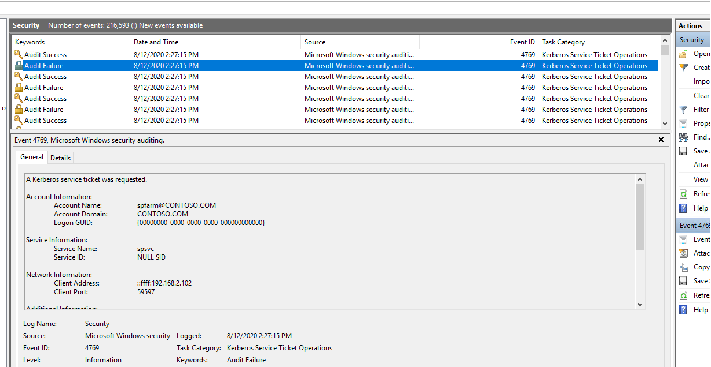
Is This Malicious?
Notes:
This is meant to show that we’ve taken a hypothesis and gone through a hasty detection process and encountered some of our conditions. However, the problem wasn’t fully scoped! The detection wasn’t identified or classified, and with that information we’ll know whether this view is security related.
Source
https://learn.microsoft.com/en-us/sharepoint/troubleshoot/performance/event-id-4769-error

Slide 20
Detection Timeline
Collection
Detection
Classification
Sensor Based
Automated
Large amount of FP
Alert/Definition Based
Semi-automated
Tuning
Criteria Based
Semi-automated
Raw
Telemetry
Security Related Events
Collection
Detection
Alert
Classification
Notes:
Not the funnel of fidelity!
This slide describes the funnel of data that a cyber defender is faced with handling in any given engagement. While you may be presented with logs, sensors strategies, alerts, etc. You must identify each individual piece of the detection process to form a scientific and measured method to identifying the adversary
Detection is

Slide 21
Building a Detection
Classify
All service tickets requested from compromised account
All service tickets requested from compromised device
All service tickets requested with RC4 encryption

Slide 22
Is This Malicious?
*spfarm & sppvc are default SharePoint accounts and AES256 is used
Notes:
Now that we’ve identified our classification criteria there shouldn’t be any question when looking at these events whether they are security related or not. We’ve identified what the conditions are for a high signal event, and what we’re looking at is noise.
Source
https://learn.microsoft.com/en-us/sharepoint/troubleshoot/performance/event-id-4769-error

Slide 23
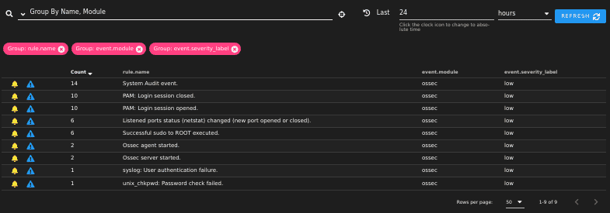
Alerts
Alerts are an identified detection, with an associated classification
Alert/Not-Alert/High/Medium/Low buckets
Signal to Noise Ratio
Notes:
“When everything is an alert, its all noise”

Slide 24
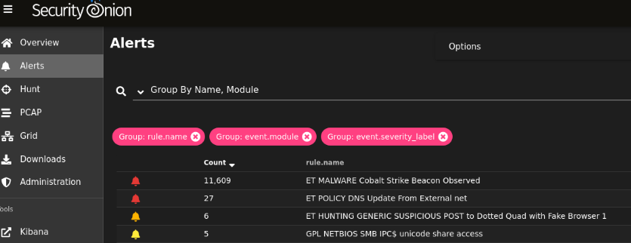
Execute a Plan
Ambiguous vs Unambiguous in hunting
Confidence levels in reporting

Slide 25
Query/Filter
Alerts are a specific telemetry meeting a condition
Queries/Filters are essentially the same thing, but in practice used differently
Queries/Filters bridge the gap between detection and analysis
Can you think of any queries you would use to detect Kerberoasting that wouldn’t meet the criteria of an alert?
Notes:
Transition: After focusing on identifying malicious activity, how can we use our tools and sensors to aid the analysis process? This will work mostly through queries and filters. We’ll go more in depth on the scientific methods of using queries in filters next.

Slide 26
Indicators of Compromise Overview
Definition: One or more pieces of forensic data, such as data found in system log entries or files, that identify potentially malicious activity on a system or network
Atomic
Fragments of data that can individually indicate a compromise (e.g., fully qualified domain names, IP addresses and e-mail addresses)
Behavioral
Combination of indicators that characterize / profile the behavior in a compromise, usually rooted in semantics versus syntax
Computed
Material involved in the incident that must be ‘computed’ (e.g., hashes)
Indicators of compromise answer ‘What happened’
See MSN750KD Indicators of Compromise: Strength of Indicators of Compromise
Notes:
Reference “Indicators of Compromise: Strength of IOCs/MSN750KD”
This slide is built directly from that presentation, and will be talked about more in depth there

Slide 27
Overview
Detection
Analysis
Analysis methods
Detection vs. Analysis
Pivoting

Slide 28
Analysis Methods
Temporal
Causal
Frequency
Correlation
Cluster
Anomaly
User and Entity Behavior Analytics (UEBA)
Kill Chain

Slide 29
Temporal Analysis
A method of problem-solving that involves examining data over time to detect trends.
Requirements:
Access to historical data logs
Tools for time-series analysis
Ability to normalize data for time-based comparison
Examples:
Identifying patterns in user logon activity
Detecting an increase in external traffic to sensitive devices at unusual hours
Notes:
Based on the requirements of temporal analysis, it makes sense that this is something that would be difficult to apply to a single host by manually pulling logs

Slide 30
Causal Analysis
A method of problem-solving that involves identifying cause and effect relationships
Requirements:
Detailed cases, incident reports or logs
Expertise in systems and network architecture
Examples:
Tracing the source of initial access to a phishing email
Linking system failure to malware executing

Slide 31
Frequency Analysis
A method of studying how often certain events occur to identify patterns or anomalies
Requirements:
Access to historical data logs
Statistical tools to display frequency distribution
Examples:
Identifying a spike in failed login attempts indicating a brute force attack
Observing frequent access to rarely used ports

Slide 32
Correlation Analysis
A statistical technique used to determine the interdependence or statistical relationship between two or more variables or datasets
Requirements:
Datasets from multiple tools, sources, and organizations (IDS, OS logs, firewalls)
Statistical tools to display correlation
Examples:
Correlating increases in data exfiltration attempts with employee exit dates
Correlating software update lapses and malware infections
Notes:
Another way to define this method is “bridging the gap between the human factors and the technical factors”

Slide 33
Cluster Analysis
A method of grouping a set of objects in such a way that objects in the same group (called a cluster) are more similar to each other than to those in other groups
Requirements:
Large dataset for meaningful clustering
Expertise in identifying relevant data features
Examples:
Grouping network traffic by type and origin to identify anomalous activities
Clustering user behavior to identify potential insider threats
Notes:
I’ve italicized the “user behavior” example because while this is an example of cluster analysis, this particular example would require a significant amount of analysis and would be most efficiently done with machine learning. Cluster Analysis in general would best be addressed with ML/AI.

Slide 34
Anomaly Analysis
A technique used to identify unusual patterns that do not conform to expected behavior
Requirements:
Baseline data to define “normal” behavior
Analytical tools for pattern recognition
Examples:
Detecting surge in network traffic from a device hosting a database
Detecting unusual login times or locations for sensitive accounts

Slide 35
UEBA Analysis
A technique using defined user behavior to identify security threats
Requirements:
Detailed logs of user activities and behaviors
UEBA software with machine learning capabilities
Examples:
Identifying a user accessing files irrelevant to their role
Notes:
Another italicized portion since ML/AI is not widely deployed in the DoD, however with sufficient information, this type of analysis can be done at a very small scale. The larger the organization and scope of the network, the more difficult this method becomes.

Slide 36
Kill Chain Analysis
A technique using the phases of a cyber attack to predict previous or future activity
Requirements:
Understanding of the Cyber Kill Chain framework (MITRE/LM)
Detailed incident data and threat intelligence
Examples:
Analyzing a ransomware attack to identify the delivery method and exploited vulnerability
Identifying an initial access method via phishing from malware execution

Slide 37
Overview
Detection
Analysis
Pivoting
Incident Response
Case Management (theory)

Slide 38
Pivoting (Threat Hunting)
The Hypothesized Red Scheme of Manuever (HRSoM) validity and update process
The role of ambiguous and unambiguous signals in investigations
Transitioning from identifying activities to a comprehensive RSoM
Using data gathered from Detection/Analysis to investigate and respond to incidents
Notes:
Is our HRSoM still valid based on current detections?
How often will we update or HRSoM? What will the triggers be?
Moving through detections should trigger investigations based on a combination of ambiguous and unambiguous signals.
How you pivot between identifying adversary activity and identifying an entire RSoM is by using investigations

Slide 39
Incident Response Process
Preparation (outside of scope)
Detection/Analysis
Eradication
Recovery
Defined by NIST 800-61
Notes:
Preparation is mostly focused on organizational training and developing detections which we’ve already discussed

Slide 40
Detection
The detection process is cyclical as information is uncovered
Indicators of Incident for Kerberoasting:
Abnormal service ticket requests
Unusual spikes in TGS requests

Slide 41
Eradication
Steps for removing the effects of the incident
Importance of identifying and mitigating vulnerabilities that caused the incident
Eradicate Kerberoasting:
Isolating affected systems
Resetting compromised accounts
Patching any application related vulnerabilities
Updating Kerberos configurations

Slide 42
Recovery
Process for restoring systems and services
Monitoring for signs of incident recurrence
Recovery from Kerberoasting:
Monitoring for future attacks/updating detections
Reinstating network access to devices/accounts

Slide 43
Investigation Planning
Do you use previous information to continue an investigation?
Focused on considerations for students to make decisions
Tactical Pause
Revising HRSoM
Notes:
Tactical pause is taking a “woof” or breathe to identify the difference between what the HRSoM is and what was found

Slide 44
Anatomy of a Case
Key Data
Incident identification data: time/date, categorization, detection method
Incident description: summary of incident, assets/systems, potential impact
Evidence and artifacts: logs, network captures, screenshots, emails, etc.
Response actions: steps taken to contain, eradicate, and recover
Communications: external communications related to the incident
Notes:
Examples of categorization high/medium/malware/unauthorized access
In communications “external” refers to external to the incident response team

Slide 45
Anatomy of a Case
Suggested Workflow
Initial Assessment: Determine severity and scope
Assignment and Tracking: Assign the case to appropriate team members and track progress
Evidence Collection: Gather evidence and document findings
Response Coordination: Coordinate containment, eradication and recovery actions
Reporting and Documentation: Continuously update with new findings, actions and resolutions
Review and Closure: Final review of the case to ensure completeness followed by closure

Slide 46
Build a Case
Notes:
Build a case based off the detection shown in slide 21 “Is This Malicious”

Slide 47
Build a Case
Case Title: Suspected Kerberoasting Attempt
Key Data from the Event Log:
Date and Time: 8/12/2020 2:27:15 PM
Source: Microsoft Windows security auditing.
Event ID: 4769
Task Category: Kerberos Service Ticket Operations
Account Information:
Account Name: spfarm@CONTOSO.COM
Account Domain: CONTOSO.COM
Service Information:
Service Name: spsvc
Service ID: NULL SID
Network Information:
Client Address: ::ffff:192.168.2.102
Client Port: 59597
Keywords: Audit Failure
Notes:
Build a case based off the detection shown in slide 21 “Is This Malicious”

Slide 48
Build a Case
Initial Assessment:
Review the log entry to confirm the abnormality.
Note the audit failure indicating a possible compromised service account or abnormal service ticket request.
Assignment and Tracking:
Assign the incident to a security analyst for investigation.
Track the incident in the incident management system with a unique identifier.

Slide 49
Build a Case
Evidence Collection and Analysis:
Collect relevant logs around the time frame of the detected event.
Analyze the service ticket requests from the account "spfarm" to determine if there was an unusual volume or pattern indicating Kerberoasting.
Response Coordination:
If Kerberoasting is confirmed, implement immediate containment measures such as disabling the suspected account or changing its credentials.
Coordinate with the network team to monitor traffic from the client address associated with the suspicious activity.

Slide 50
Build a Case
Reporting and Documentation:
Document all findings and actions taken in response to the suspected Kerberoasting attempt.
Ensure all evidence is preserved in a forensically sound manner.
Review and Closure:
Once the threat is neutralized, and systems are secure, review the case details to confirm that all aspects of the incident have been addressed.
Conduct a post-incident review to update procedures and policies as necessary to prevent similar incidents.

Slide 51
Overview
Detection
Collection
Identification
Classification
Analysis
Analysis methods
Detection vs. Analysis
Pivoting
Incident Response
Case Management (theory)

Slide 52
Academic Objectives
Define detection
Define True/False Positive/Negative
List the goals and categories of high-quality data
Discuss the factors when developing a collection strategy
List the products and steps in the detection phase
Define the 8 analysis methods
List the 4 stages of the incident response process

Slide 53
Notes:
Questions?

Slide 54
References
Department of Defense Dictionary of Military and Associated Terms, Jan 19
http://ndupress.ndu.edu/Media/News/NewsArticleView/ tabid/7849/Article/607722/jfq-78-three-approaches-to-center-of-gravity-analysis-the-islamic-state-of-iraq.aspx
https://www.youtube.com/watch?v=zKFiYStExK4
http://usacac.army.mil/CAC2/Repository/Planning-for-Action-Kem-August-2012.pdf
Joint Publication 2-0, Joint Intelligence, 22 Oct 13
Joint Publication 2-01.3, Joint Intelligence Preparation of the Operational Environment, 21 May 14
Joint Publication 5-0, Joint Planning, 16 Jun 17
JOPPA Handbook for Air, 4 Nov 16
Marine Corps Doctrinal Publication 1, Warfighting, 20 Jun 97
Notes:
References.

Slide 55
Notes:
MSN921K, Plans: Operational Level – Framing the Problem.

