Slide 1
Chapter 03 Spectral Analysis

Slide 2
Fourier analysis
Fourier analysis is a method of defining periodic waveforms in terms of trigonometric functions.
The method gets its name from a French mathematician and physicist named Jean Baptiste Joseph, Baron de Fourier, who lived during the 18th and 19th centuries.
Fourier analysis is used in electronics, acoustics, and communications.
Many waveforms consist of energy at a fundamental frequency and also at harmonic frequencies. The relative proportions of energy in the fundamental and the harmonics determines the shape of the wave.
The wave function (usually amplitude, frequency, or phase versus time) can be expressed as of a sum of sine and cosine functions called a Fourier Series, uniquely defined by constants known as Fourier coefficients.
If these coefficients are represented by a , a ₁ , a ₂ , a ₃ , ..., a _{n} , ... and b ₁ , b ₂ , b ₃ , ..., b _{n} , ..., then the Fourier series F (x), where x is an independent variable (usually time), has the following form:
F ( x ) = a /2 + a ₁ cos x + b ₁ sin x + a ₂ cos 2 x + b ₂ sin 2 x + ... + a _{n} cos nx + b _{n} sin nx + ...
In Fourier analysis, the objective is to calculate coefficients a , a ₁ , a ₂ , a ₃ , ..., a _{n} and b ₁ , b ₂ , b ₃ , ..., b _{n} up to the largest possible value of n . The greater the value of n, the more accurate is the Fourier-series representation of the waveform.

Slide 3
Fourier series and Fourier transform
To know the amplitude and phase of each frequency component contained in the signal, Fourier analysis is performed.
If signal is power signal, then fourier series is performed.
If signal is energy signal, then fourier transform is performed.
Fourier transform is the process of converting time domain signal to frequency domain.

Slide 4
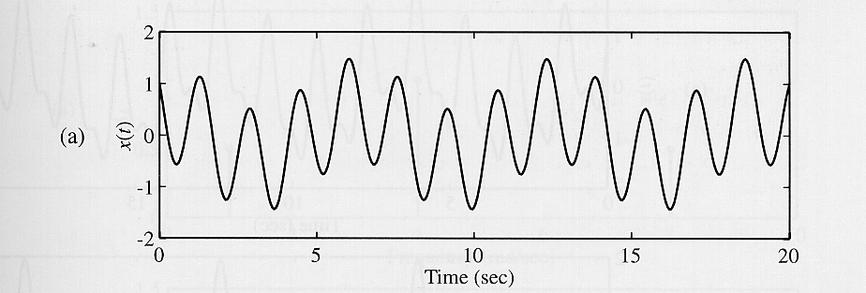
Example: Sum of Sinusoids
Consider the CT signal given by
The signal has only three frequency components at 1,4, and 8 rad/sec, amplitudes and phases
The shape of the signal x(t) depends on the relative magnitudes of the frequency components, specified in terms of the amplitudes

Slide 5
Fourier Series
As a matter of fact, sine waves and cosine waves are the basic building functions for any periodic signal.
Fourier series is a tool used to analyze any periodic signal.
We obtain the following information about the signal:
How many frequency component are present in the signal?
Their amplitudes
Their relative phase difference between these frequency components.
Types:
Trigonometric
Exponential
Polar

Slide 6
Drichlet’s condition for Fourier Series
To be described by the Fourier Series the waveform f(t) must satisfy the following mathematical properties:
1. f(t) is a single-value function except at possibly a finite number of points.
2. The integral for any t₀.
3. f(t) has a finite number of discontinuities within the period T.
4. f(t) has a finite number of maxima and minima within the period T.
In practice, f(t) = v(t) or i(t) so the above 4 conditions are always satisfied.

Slide 7
Trigonometric Form
It is simply a linear combination of sines and cosines at multiples of its fundamental frequency, f₀=1/T.
a₀ counts for any dc offset in x(t).
a₀, a_{n} and b_{n} are called the trigonometric Fourier Series Coefficients.
The n^{th} harmonic frequency is nf₀.

Slide 8
Trigonometric Form
To find a_{0 ,} a_{n} , b_{n} :

Slide 9
Example
f(t)
1
e^{-t/2}
−π
0
π
Fundamental period
T₀ = π
Fundamental frequency
f₀ = 1/T₀ = 1/π Hz
ω₀ = 2π/T₀ = 2 rad/s

Slide 10
Polar Form
Using single sinusoid,
Where, and are related to the trigonometric coefficients a_{n} and b_{n} as:
and

Slide 11
Compact Trigonometric
f(t)
1
e^{-t/2}
−π
0
π
Fundamental period
T₀ = π
Fundamental frequency
f₀ = 1/T₀ = 1/π Hz
ω₀ = 2π/T₀ = 2 rad/s

Slide 12

Exponential Fourier Series
Complex Exponentials

Slide 13
Exponential Fourier Series
A periodic signal x(t) is expressed in the exponential Fourier Series form as:
Where, C_{n} is the coefficient of exponential Fourier series and can be calculated as:

Slide 14
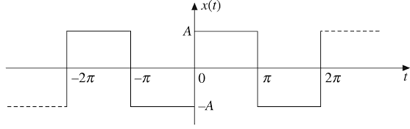
Example:
Obtain the exponential Fourier series for the waveform shown in Figure. Also draw the frequency spectrum.
Figure

Slide 15
Solution:
The periodic waveform shown in Figure 3 with a period T = 2π can be expressed as:
Let
And fundamental frequency:

Slide 16
Solution:
Exponential Fourier Series:

Slide 17
Cont.…

Slide 18
Cont.…
C_{n}
-5
-4
-3
-2
-1
0
1
2
3
4
5

Slide 19
Fourier Transform
We have seen that periodic signals can be represented with the Fourier series
Can aperiodic signals be analyzed in terms of frequency components?
Yes, and the Fourier transform provides the tool for this analysis
The major difference w.r.t. the line spectra of periodic signals is that the spectra of aperiodic signals are defined for all real values of the frequency variable not just for a discrete set of values

Slide 20
The Fourier Transform in the General Case
Given a signal x(t), its Fourier transform is defined as:
A signal x(t) is said to have a Fourier transform in the ordinary sense if the above integral converges
Given a signal x(t) with Fourier transform , x(t) can be recomputed from by applying the inverse Fourier transform given by:

Slide 21
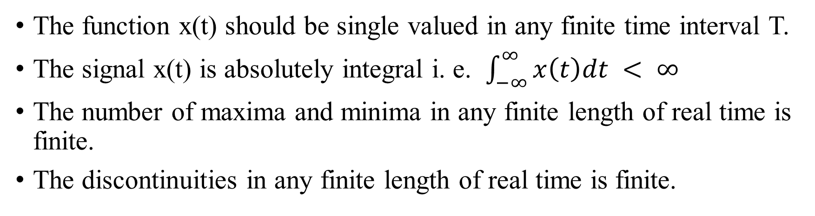
Drichlet condition for fourier transform
The function x(t) should be single valued in any finite time interval T.
The signal x(t) is absolutely integral i. e. $\int_{−∞}^{∞}{x\left(t\right)dt < ∞}$
The number of maxima and minima in any finite length of real time is finite.
The discontinuities in any finite length of real time is finite.

Slide 22
Properties of the Fourier Transform
Linearity:
Left or Right Shift in Time:
Time Scaling:

Slide 23
Properties of the Fourier Transform
Time Reversal:
Multiplication by a Power of t:
Multiplication by a Complex Exponential:
Multiplication by a Sinusoid (Modulation):

Slide 24
Properties of the Fourier Transform
Differentiation in the Time Domain:
Convolution in the Time Domain:
Multiplication in the Time Domain:

Slide 25
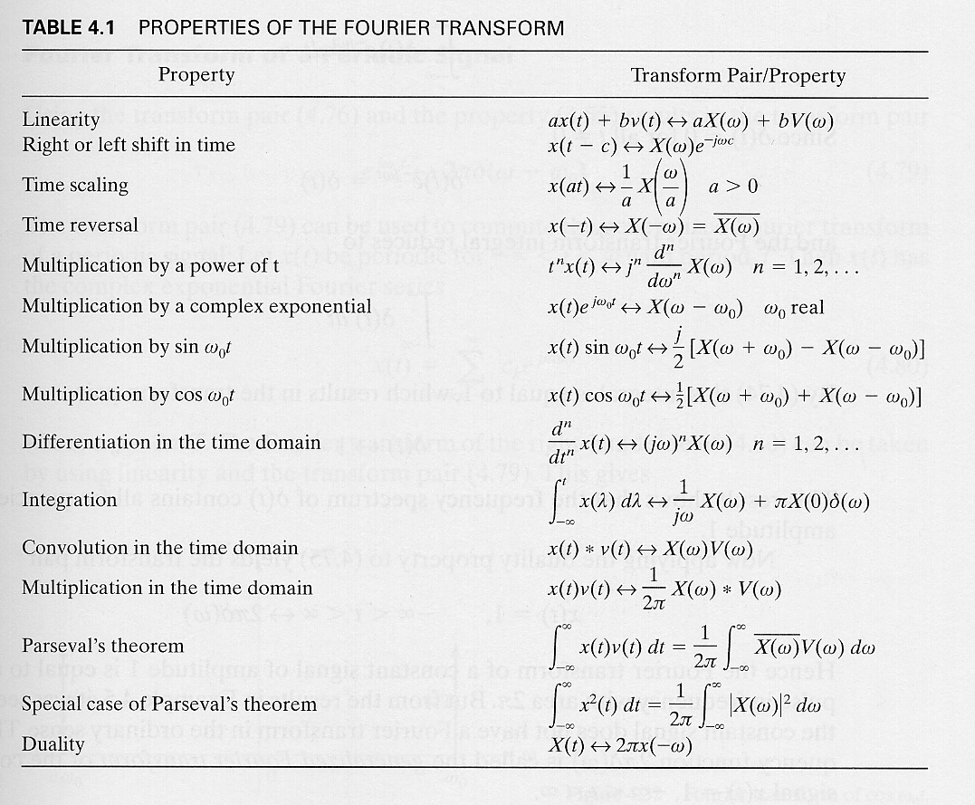

Slide 26

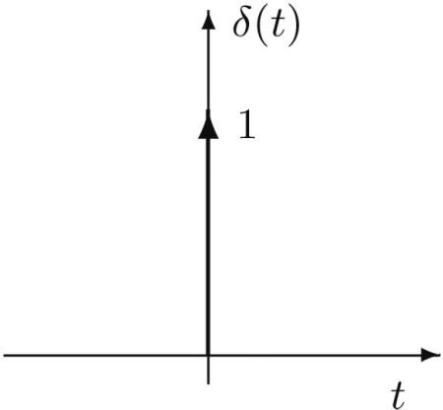
Example: Impulse Function δ(t)
F (ω) = F {δ(t)} = ∫ δ(t)e^{− jωt}dt = e^{− jωt}
−∞
∞
= e ^{j 0} = 1
t =0
δ(t) ⇔ 1
1 ⇔ 2πδ(ω)
F {δ(t)} 1
↔
ω
1 if t = 0 0 if t ≠ 0
δ(t) =
Delta function has unity area.

Slide 27
Example: Fourier Transform of Single Rectangular Pulse
τ
1 for − ≤ t ≤ ^{τ}
f (t) = rect(t ) = II(t /τ) =
2 2
0 for all t > ^{τ}
2
f (t) = rect(t ) = II(t /τ)
∞ τ/ 2
F (ω) = ∫ f (t)e^{− jωt} dt = ∫ e^{− jωt} dt
−∞ −τ/ 2
Pulse of
width τ
1
jωt
τ/ 2
− jωτ/ 2 jωτ/ 2
₌ e − e
⎛ e ⎞
=
⎜ ⎟
^{⎝ − jω⎠} −τ/ 2
jω
₋τ
τ
2
time t
₌ − j2sin(ωτ /2)_{=τ⋅} sin(ωτ /2)
2
0
τ
2
(ωτ /2)
jω
Remember ω = 2πf

Slide 28
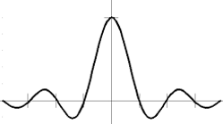
F (ω) =τ⋅ ^{sin(ωτ /2)} = τ⋅sinc(πfτ)
(ωτ /2)
1
sinc function
F(ω)
τ
₋τ
τ
2
time t
2
τ
2
0
Note the pulse is time centered
− 3π − 2π
τ
−π
τ
π
τ
2π
τ
3π
τ
ω
τ
0

Slide 29
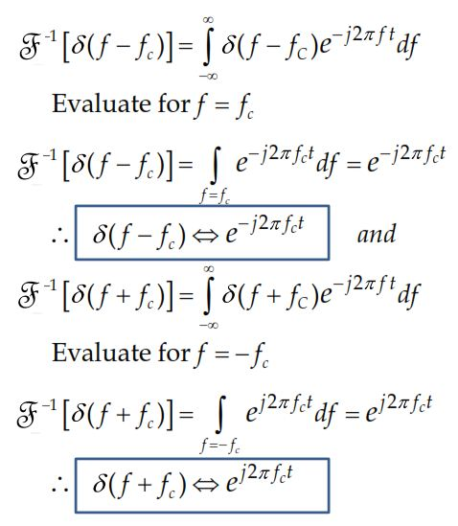

Fourier Transform of Complex Exponentials
∞
[ ]
( f − f ) = δ( f − f )e^{− j2πf t} df
F δ
∫
−1
c
C
−∞
Evaluate for f = f_{c}
[ ]
_{e}− j2πf_{c}t _{df = e}− j2πf_{c}t
F δ
∫
f = f_{c}
−1
( f − f ) =
c
∴ δ( f − f_{c} ) ⇔ e
j2πf t
and
c
[ ]
∞
( f + f ) = δ( f + f )e^{− j2πf t} df
F δ
∫
−1
c
C
−∞
Evaluate for f =− f_{c}
[ ]
_{e} j2πf_{c}t _{df = e} j2πf_{c}t
F δ
∫
f =− f_{c}
−1
( f + f ) =
c
∴ δ( f + f_{c} ) ⇔ e
j2πf t
c

Slide 30
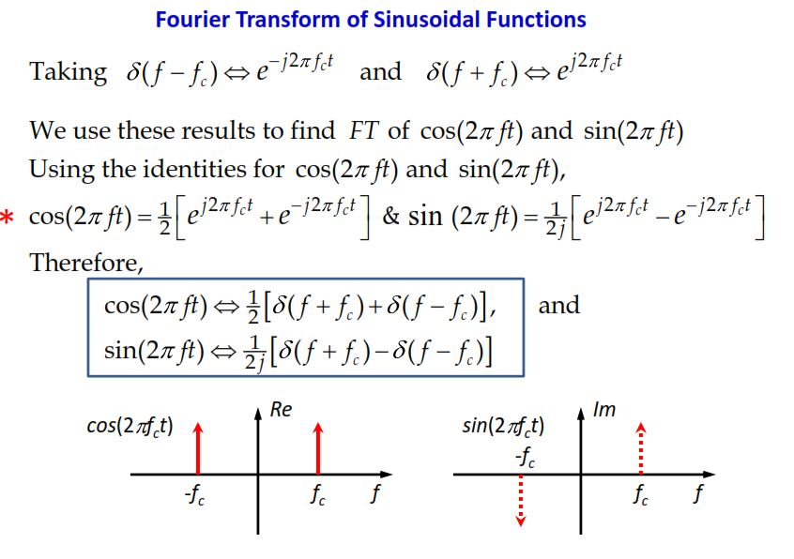

Slide 31
Power and Energy of signal
Energy signal
Energy is finite and non zero.
Non periodic signal are energy signal.
These signals are time limited.
The power of energy signal is zero.
Example: A single rectangular pulse.
Power signal
The normalized average power is finite and non zero.
Periodic (practical) signal are power signals.
These signals can exist infinite time.
Energy of power signal is infinite.
Example: A train of rectangular pulse.

Slide 32
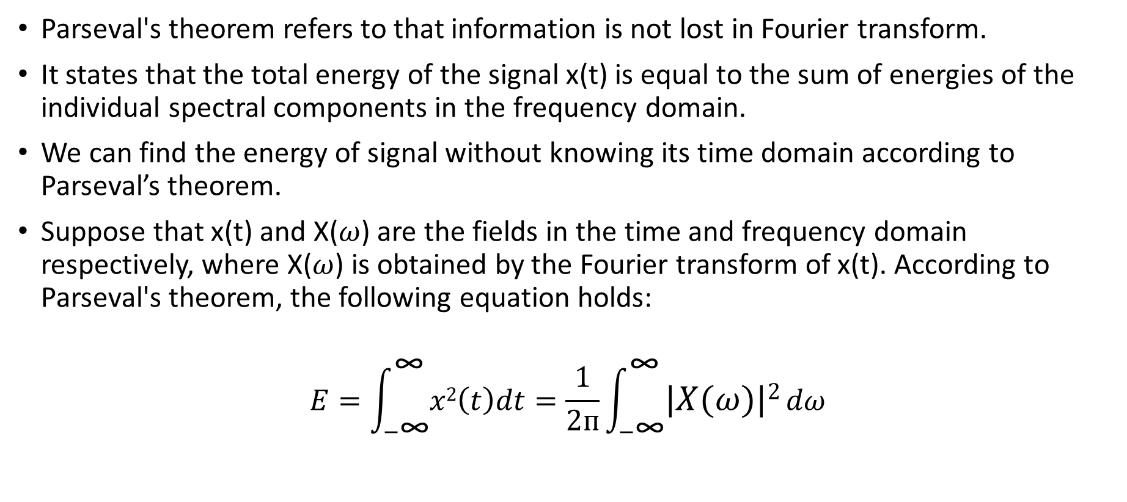
Parseval’s Theorem for Energy signals:
Parseval's theorem refers to that information is not lost in Fourier transform.
It states that the total energy of the signal x(t) is equal to the sum of energies of the individual spectral components in the frequency domain.
We can find the energy of signal without knowing its time domain according to Parseval’s theorem.
Suppose that x(t) and X($ω$) are the fields in the time and frequency domain respectively, where X($ω$) is obtained by the Fourier transform of x(t). According to Parseval's theorem, the following equation holds:
$$E=\int_{−\text{∞}}^{\text{∞}}{x2\left(t\right)dt}=\frac{1}{2ᴨ}\int_{−\text{∞}}^{\text{∞}}{\left|X(ω)\right|2}dω$$

Slide 33
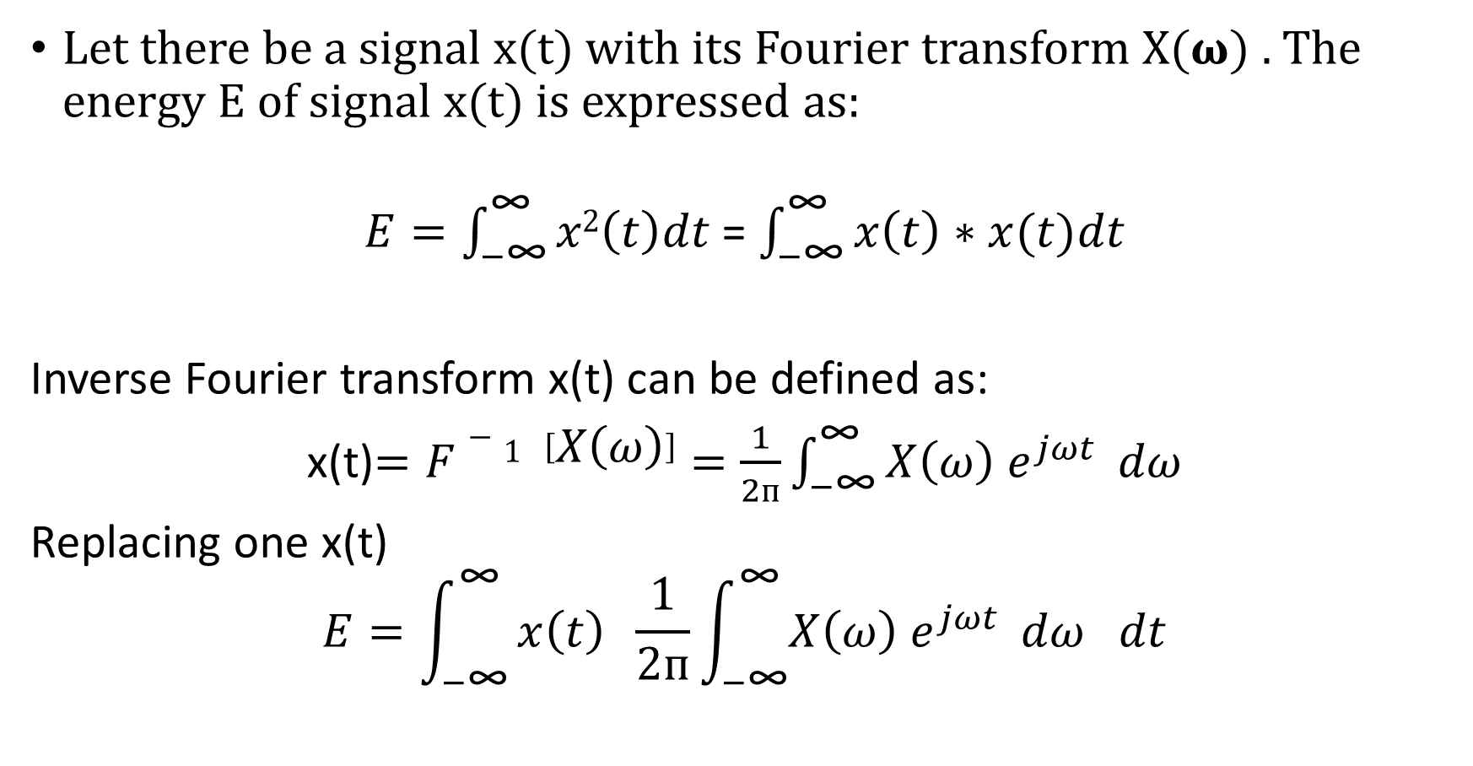
Proof:
Let there be a signal x(t) with its Fourier transform X(𝛚) . The energy E of signal x(t) is expressed as:
$E=\int_{−\text{∞}}^{\text{∞}}{x2\left(t\right)dt}$ = $\int_{−\text{∞}}^{\text{∞}}{x\left(t\right)∗x(t)dt}$
Inverse Fourier transform x(t) can be defined as:
x(t)$=F−1 \left[X\left(ω\right)\right]=\frac{1}{2ᴨ}\int_{−\text{∞}}^{\text{∞}}{X\left(ω\right) e^{jωt} }dω$
Replacing one x(t)
$$E=\int_{−\text{∞}}^{\text{∞}}{x\left(t\right) \frac{1}{2ᴨ}\int_{−\text{∞}}^{\text{∞}}{X\left(ω\right) e^{jωt} }dω dt}$$

Slide 34
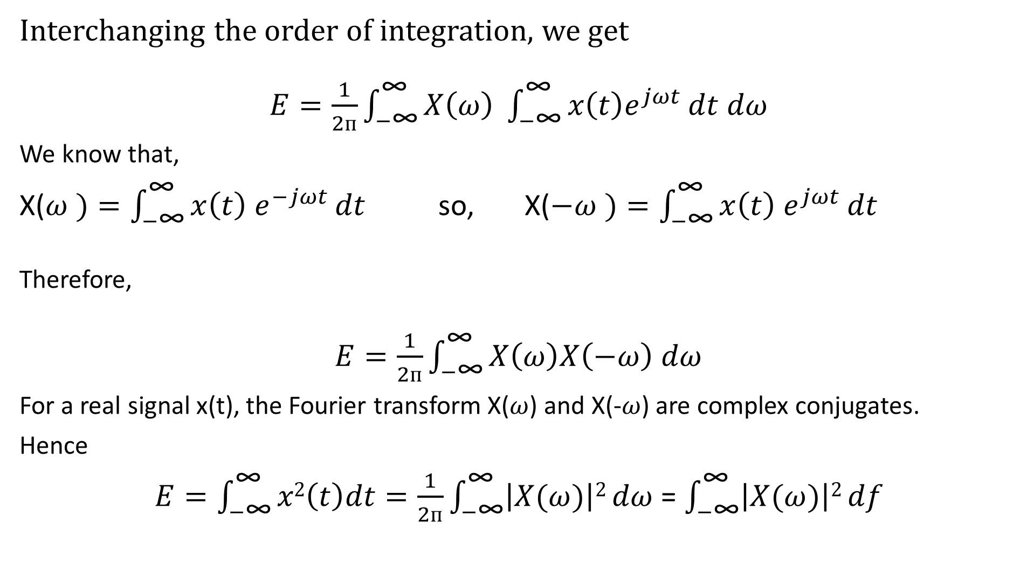
Interchanging the order of integration, we get
$E=\frac{1}{2ᴨ}\int_{−\text{∞}}^{\text{∞}}{X\left(ω\right) \int_{−\text{∞}}^{\text{∞}}{x\left(t\right)e^{jωt}}dt}$ $dω$
We know that,
X($ω )=\int_{−\text{∞}}^{\text{∞}}{x\left(t\right) e^{−jωt}}dt$ so, X($−ω )=\int_{−\text{∞}}^{\text{∞}}{x\left(t\right) e^{jωt}}dt$
Therefore,
$E=\frac{1}{2ᴨ}\int_{−\text{∞}}^{\text{∞}}{X\left(ω\right)X\left(−ω\right)}$ $dω$
For a real signal x(t), the Fourier transform X($ω$) and X(-$ω$) are complex conjugates.
Hence
$E=\int_{−\text{∞}}^{\text{∞}}{x2\left(t\right)dt}=\frac{1}{2ᴨ}\int_{−\text{∞}}^{\text{∞}}{\left|X(ω)\right|2}dω$ = $\int_{−\text{∞}}^{\text{∞}}{\left|X(ω)\right|2}df$

Slide 35
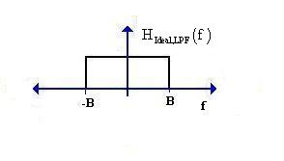
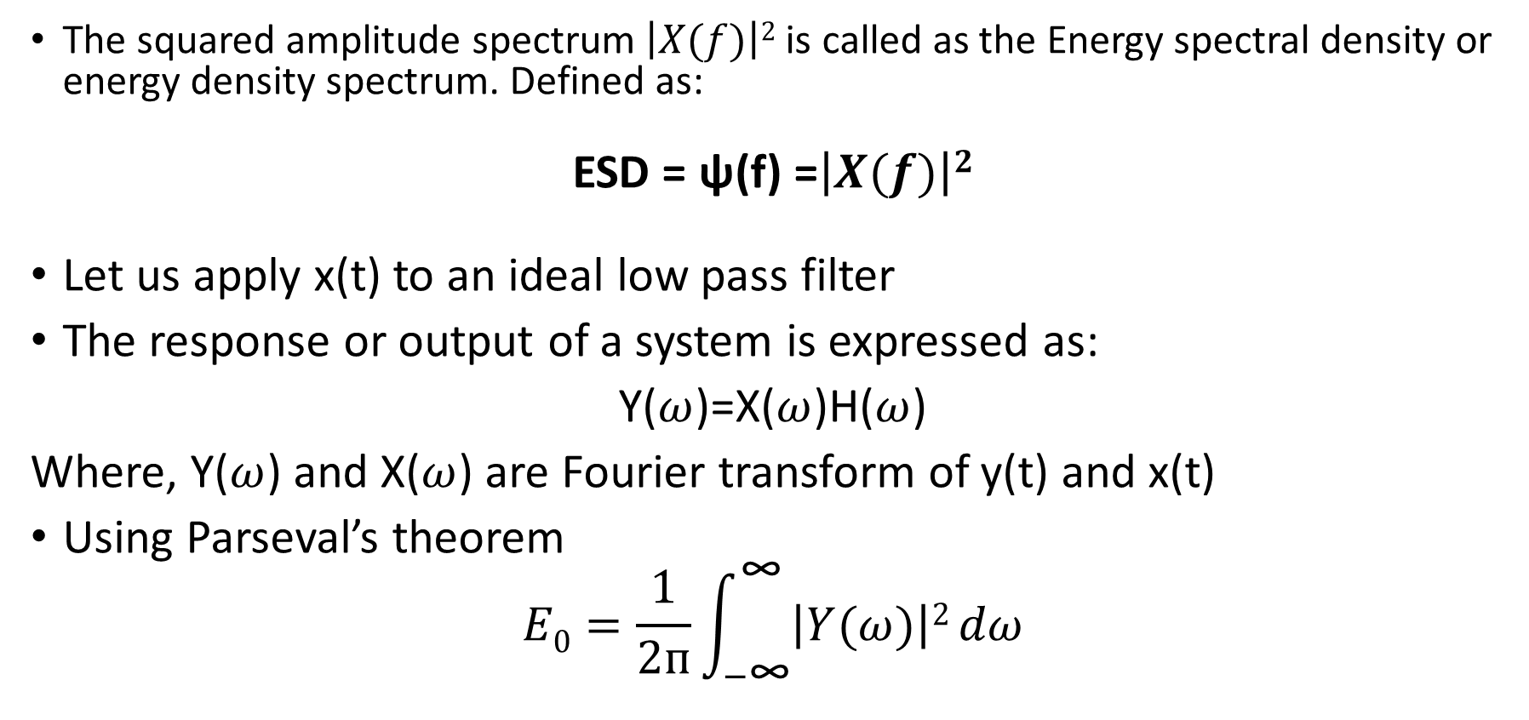
Energy Spectral Density:
The squared amplitude spectrum $\left|X(f)\right|2$ is called as the Energy spectral density or energy density spectrum. Defined as:
ESD = ψ(f) =$\left|X(f)\right|2$
Let us apply x(t) to an ideal low pass filter
The response or output of a system is expressed as:
Y($ω$)=X($ω$)H($ω$)
Where, Y($ω$) and X($ω$) are Fourier transform of y(t) and x(t)
Using Parseval’s theorem
$$E0=\frac{1}{2ᴨ}\int_{−\text{∞}}^{\text{∞}}{\left|Y(ω)\right|2}dω$$

Slide 36
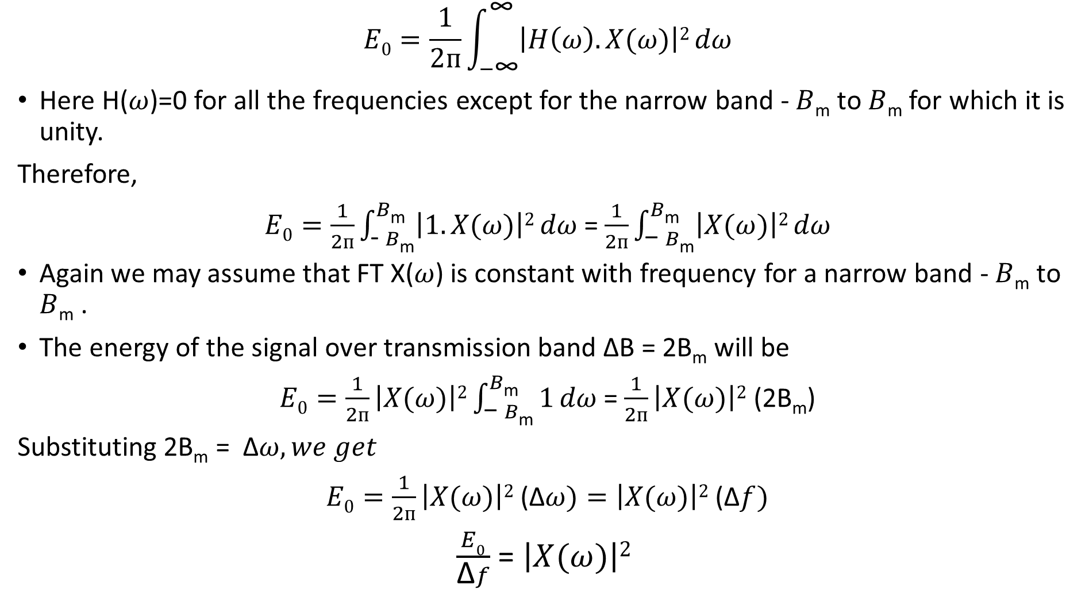
$$E0=\frac{1}{2ᴨ}\int_{−\text{∞}}^{\text{∞}}{\left|H\left(ω\right).X(ω)\right|2}dω$$
Here H($ω$)=0 for all the frequencies except for the narrow band - $B$_{m} to $B$_{m} for which it is unity.
Therefore,
$E0=\frac{1}{2ᴨ}\int_{\text{− }B\text{m}}^{B\text{m}}{\left|1.X(ω)\right|2}dω$ = $\frac{1}{2ᴨ}\int_{\text{− }B\text{m}}^{B\text{m}}{\left|X(ω)\right|2}dω$
Again we may assume that FT X($ω$) is constant with frequency for a narrow band - $B$_{m} to $B$_{m} .
The energy of the signal over transmission band ΔB = 2B_{m} will be
$E0=\frac{1}{2ᴨ}\left|X(ω)\right|2\int_{\text{− }B\text{m}}^{B\text{m}}{1}dω$ = $\frac{1}{2ᴨ}\left|X(ω)\right|2$ (2B_{m})
Substituting 2B_{m} = Δ$ω, we get$
$E0=\frac{1}{2ᴨ}\left|X(ω)\right|2$ (Δ$ω)=\left|X(ω)\right|2 \text{(}\text{Δ}f)$
$\frac{E0}{\text{Δ}f}$ = $\left|X(ω)\right|2$

Slide 37
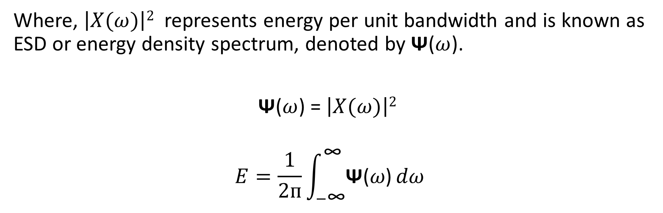
Where, $\left|X(ω)\right|2$ represents energy per unit bandwidth and is known as ESD or energy density spectrum, denoted by Ψ($ω$).
Ψ($ω$) = $\left|X(ω)\right|2$
$$E=\frac{1}{2ᴨ}\int_{−\text{∞}}^{\text{∞}}{\text{Ψ}\text{(}ω\text{)}}dω$$

Slide 38
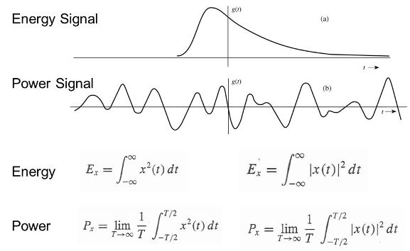

Parseval’s Theorem for Power Signals:
This theorem relates average power of a periodic signal to its fourier series coefficients
It states the total average power of a periodic signal x(t) is equal to the sum of average powers of individual fourier coefficients (C_{n}).
The average power of a signal x(t) is defined as:
If the signal can be represented as sum of fourier series components and power is defined as:
Where C_{n} is the amplitude of n^{th} harmonic component of fourier series.

Slide 39
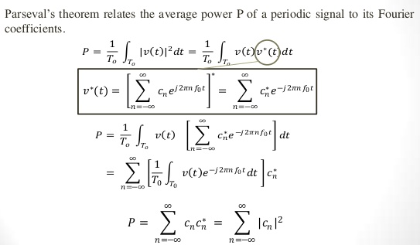
Proof:

Slide 40
Power Spectral Density Function:
In applying frequency-domain techniques to the analysis of random signals the natural approach is to Fourier transform the signals.
Unfortunately the Fourier transform of a stochastic process does not, strictly speaking, exist because it has infinite signal energy.
But the Fourier transform of a truncated version of a stochastic process does exist.

Slide 41
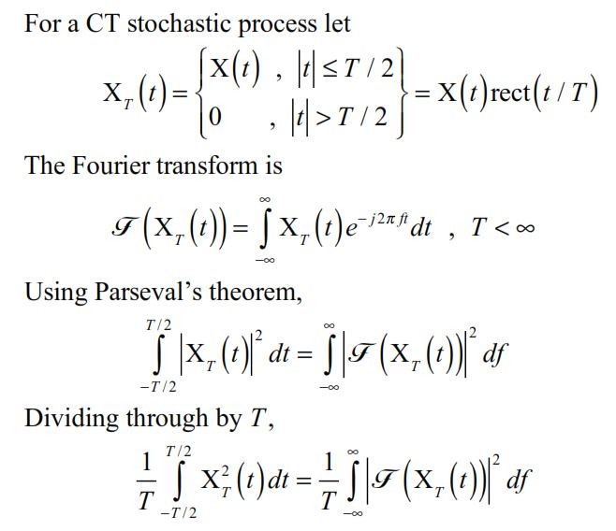

Slide 42
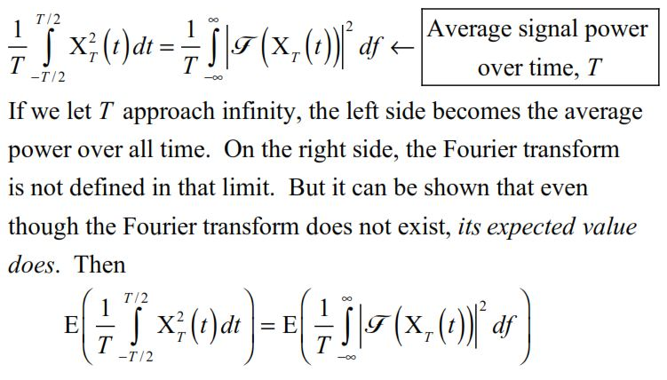

Slide 43
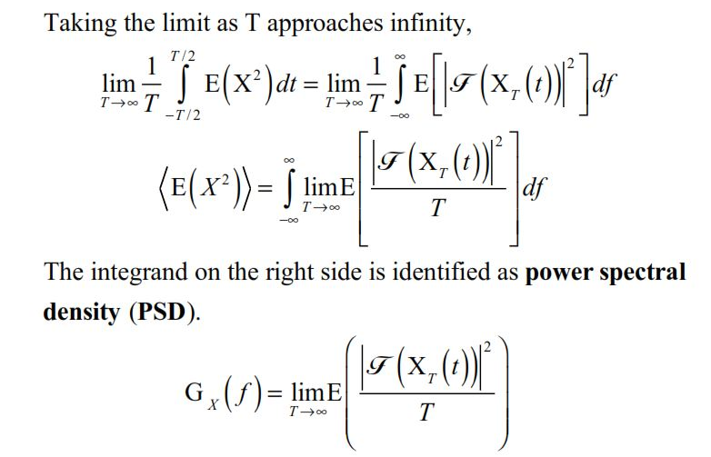

Slide 44
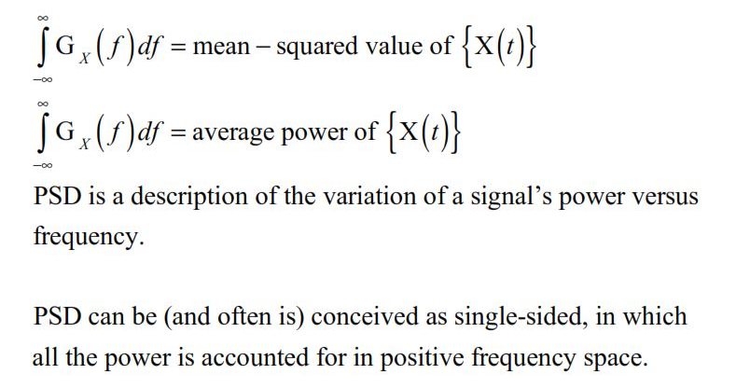

Slide 45
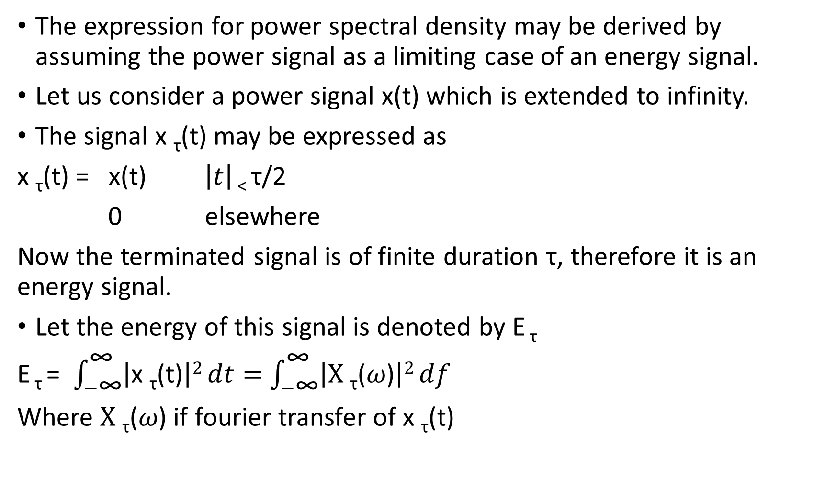
The expression for power spectral density may be derived by assuming the power signal as a limiting case of an energy signal.
Let us consider a power signal x(t) which is extended to infinity.
The signal x _{τ}(t) may be expressed as
x _{τ}(t) = x(t) $\left|t\right|$ < τ/2
0 elsewhere
Now the terminated signal is of finite duration τ, therefore it is an energy signal.
Let the energy of this signal is denoted by E _{τ}
E _{τ} = $\int_{−\text{∞}}^{\text{∞}}{\left|\text{x} \text{τ}\text{(}\text{t}\text{)}\right|2}dt=$ $\int_{−\text{∞}}^{\text{∞}}{\left|\text{X} \text{τ}\text{(}ω\text{)}\right|2}df$
Where $\text{X} \text{τ}\text{(}ω\text{)}$ if fourier transfer of $\text{x} \text{τ}\text{(}\text{t}\text{)}$

Slide 46
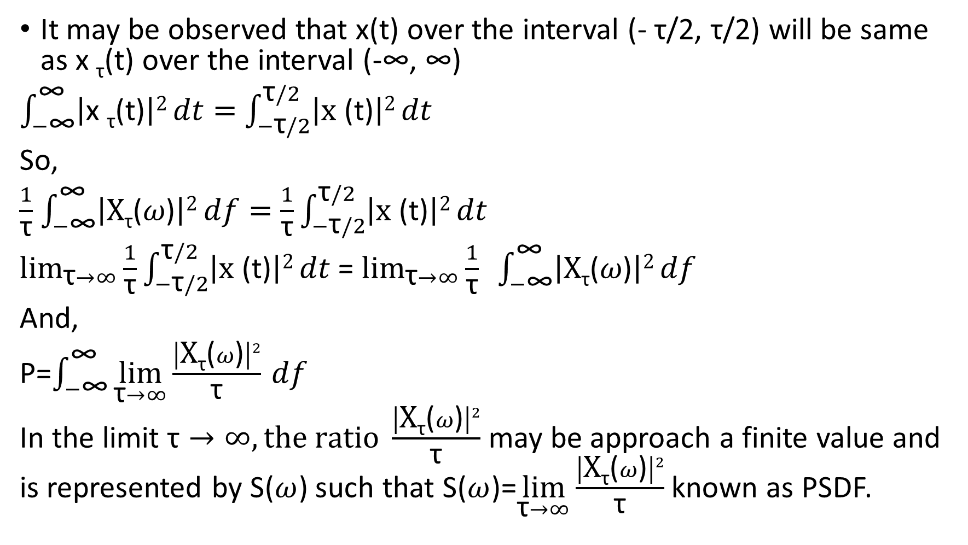
It may be observed that x(t) over the interval (- τ/2, τ/2) will be same as $\text{x} \text{τ}\text{(}\text{t}\text{)}$ over the interval (-∞, ∞)
$\int_{−\text{∞}}^{\text{∞}}{\left|\text{x} \text{τ}\text{(}\text{t}\text{)}\right|2}dt=$ $\int_{−\text{τ}/2}^{\text{τ}/2}{\left|\text{x} \text{(}\text{t}\text{)}\right|2}dt$
So,
$\frac{1}{\text{τ}}$ $\int_{−\text{∞}}^{\text{∞}}{\left|\text{X}\text{τ}\text{(}ω\text{)}\right|2}df=$ $\frac{1}{\text{τ}}\int_{−\text{τ}/2}^{\text{τ}/2}{\left|\text{x} \text{(}\text{t}\text{)}\right|2}dt$
$\lim_{\text{τ}→∞}{\frac{1}{\text{τ}}\int_{−\text{τ}/2}^{\text{τ}/2}{\left|\text{x} \text{(}\text{t}\text{)}\right|2}dt}$ = $\lim_{\text{τ}→∞}{\frac{1}{\text{τ}} \int_{−\text{∞}}^{\text{∞}}{\left|\text{X}\text{τ}\text{(}ω\text{)}\right|2}df}$
And,
P=$\int_{−\text{∞}}^{\text{∞}}{\lim_{\text{τ}→∞}\frac{\left|\text{X}\text{τ}\text{(}ω\text{)}\right|2}{\text{τ}}} df$
In the limit $\text{τ}→∞, the ratio \frac{\left|\text{X}\text{τ}\text{(}ω\text{)}\right|2}{\text{τ}}$ may be approach a finite value and is represented by S($ω$) such that S($ω$)=$\lim_{\text{τ}→∞}\frac{\left|\text{X}\text{τ}\text{(}ω\text{)}\right|2}{\text{τ}}$ known as PSDF.

Slide 47
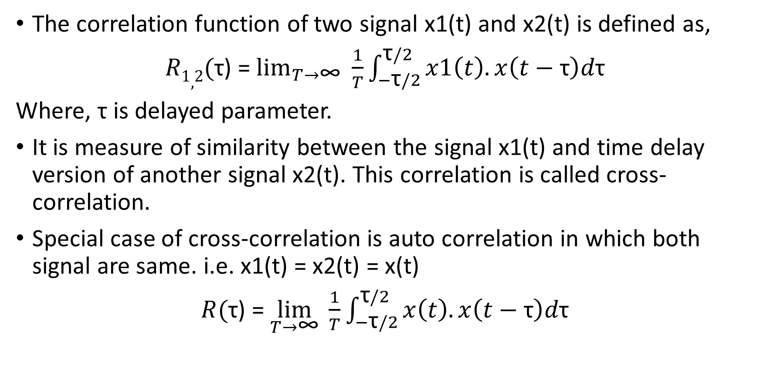
Auto correlation function and Psdf:
The correlation function of two signal x1(t) and x2(t) is defined as,
$R1,2($τ) = $\lim_{T→\text{∞}}{\frac{1}{T}}\int_{−\text{τ}/2}^{\text{τ}/2}{x1\left(t\right).x\left(t−\text{τ}\right)d\text{τ}}$
Where, τ is delayed parameter.
It is measure of similarity between the signal x1(t) and time delay version of another signal x2(t). This correlation is called cross- correlation.
Special case of cross-correlation is auto correlation in which both signal are same. i.e. x1(t) = x2(t) = x(t)
$R($τ) = $\lim_{T→\text{∞}}{\frac{1}{T}}\int_{−\text{τ}/2}^{\text{τ}/2}{x\left(t\right).x\left(t−\text{τ}\right)d\text{τ}}$

Slide 48
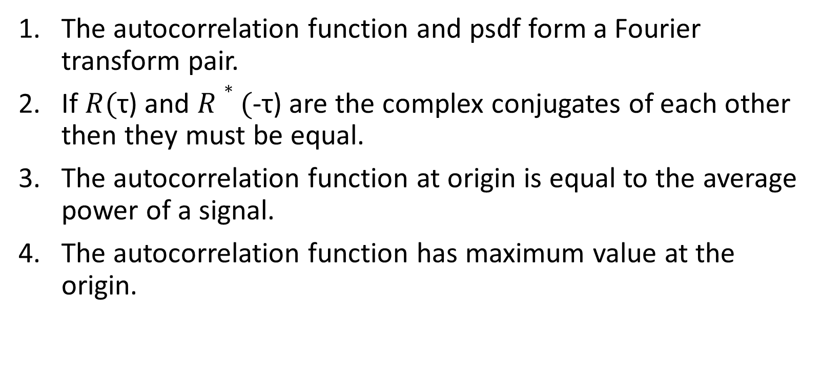
Properties of Autocorrelation function:
The autocorrelation function and psdf form a Fourier transform pair.
If $R($τ) and $R∗($-τ) are the complex conjugates of each other then they must be equal.
The autocorrelation function at origin is equal to the average power of a signal.
The autocorrelation function has maximum value at the origin.

Slide 49
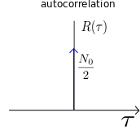
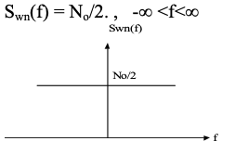
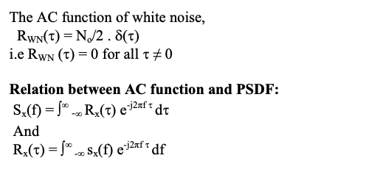
Psdf of white noise
Noise signals are random signals so, any two samples of noise signals are uncorrelated.
The special case of noise signal is white noise whose psdf is independent of frequency ( i.e, constant over entire frequency range).
The signal contains equal power within a fixed bandwidth at any center frequency.

Slide 50


Interpretation of power spectral density
Suppose a power signal u(t) is applied to a band pass filter followed by a power meter as shown in figure below.
Assume a filter has narrow bandwidth ∆ f centered on some frequency fc. Then the average power of the signal u(t) be

Slide 51

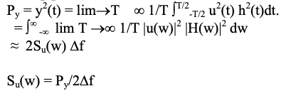
As the PSD is an even function of w the power contain in the positive side of frequency spectrum will be :
The o/p power of the BPF will be ,

Slide 52
What is SPECTRUM ANALYZER
The problems associated with non-real-time analysis in the frequency domain can be eliminated by using a spectrum analyzer. A spectrum analyzer is a real-time analyzer, which means that it simultaneously displays the amplitude of all the signals in the frequency range of the analyzer.
Spectrum analyzers, like wave analyzers, provide information about the voltage or energy of a signal as a function of frequency. Spectrum analyzers provide a graphical display on a CRT.

Slide 53
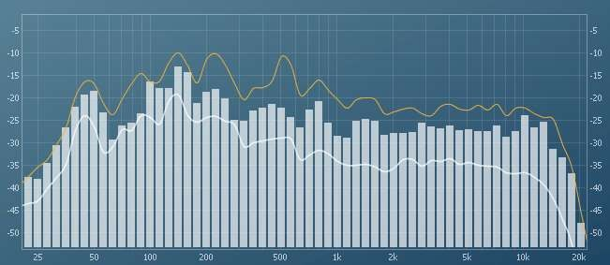
SPECTRUM ANALYZER
A spectrum analyzer measures the magnitude of an input signal versus frequency within the full frequency range of the instrument.
The input signal that a spectrum analyzer measures is electrical, however, spectral compositions of other signals, such as acoustic pressure waves and optical light waves, can be considered through the use of an appropriate transducer.

Slide 54
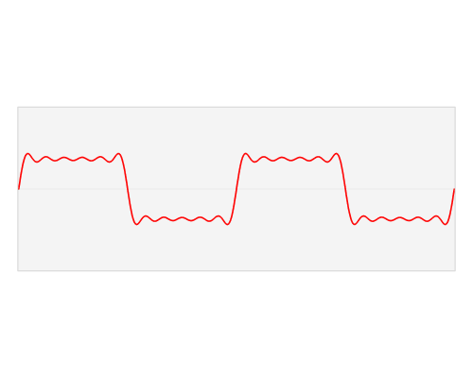
SPECTRUM ANALYZER
By analyzing the spectra of electrical signals, dominant frequency, power, distortion, harmonics, bandwidth, and other spectral components of a signal can be observed that are not easily detectable in time domain waveforms.
The display of a spectrum analyzer has frequency on the horizontal axis and the amplitude displayed on the vertical axis.

Slide 55
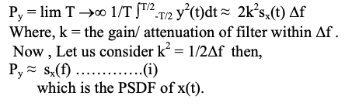
Analog spectrum analyzer
A spectrum analyzer is an instrument is used to visualize and measure PSDF of power type signal.
Measurement of PSDF is equivalent to passing the signal x(t) through a narrow band filter whose centered frequency can be sweep from near DC to infinity and observing or measuring output of the filter at each and every tuned frequency.
As we know if x(t) is passed through a NB(narrow band) filter tuned at w_{o} the average power of the output signal y(t) would be:

Slide 56

The above (i) can be obtained by passing x(t) through the NB filter centered at f₀, squaring the o/p of the filter and integrating it.
Now if we want to measure PSDF at frequency range we need weep the centered frequency of NF form zero to ∞ .
The accuracy of PSDF measurement increases with decrease in the bandwidth of narrow band filter.
In practice it is very difficult to weep the centre frequency of narrow band filter as they are constructed using quartz crystals.
Therefore another method in which narrow band filter is tuned to a precise frequency and the x(t) is frequency shifted in such a way that the frequency range of frequency shifted x(t) sequentially fall within the pass band of the filter, is employed to measure PSDF.

Slide 57
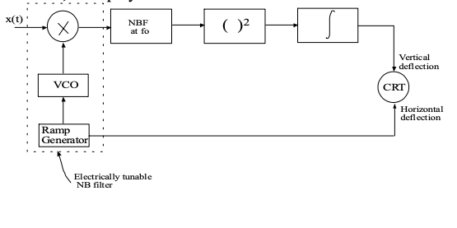
Figure : Analog spectrum analyzer

Slide 58
Assignment
PSDF of harmonic signal
Prove that in a LTI system when a power signal x(t) is applied the PSD of its output is equal to the PSD of its input multiplied by the squared amplitude response of the system.

Slide 59
Thank You

