Slide 1







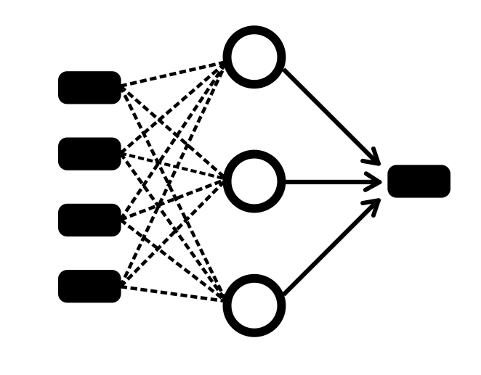









End-users
BEE (Bug rEport analyzEr)
GitHub Repository
GitHub Controller
Issue Classifier
Issues
Web API Controller
Sentence Classifier
Missing Elements Detector
O
E
S
Developers & Researchers

Slide 2
BEE (Bug rEport analyzEr)
GitHub Repository
GitHub Controller
Issue classifier
End-users
Issues
Web API Controller
Sentence classifier
Missing elements detector
Developers & Researchers

