Slide 1











$$¬\left(A\&B\right)=(¬A) ||(¬B)$$
De Morgan's laws
$$P\left(A \& B\right)=P\left(A\right) if A⊂B$$
$$¬(A|\left|B\right)=\left(¬A\right)\&(¬B)$$
$$P\left(A || B\right)=P\left(B\right) if A⊂B$$
$$P(A|B)=\frac{P\left(A \& B\right)}{P(B)}$$
Bayes law
$$P(A)+P(¬A)=1$$
complement
$$P\left(A | B\right)+P(¬A|B)=1$$
$$P\left(A \& B\right)=P\left(A\right)P\left(B | A\right)=P\left(B\right)P(A|B)$$
$$P\left(A || B\right)=P\left(A\right)+P\left(B\right)−P(A \& B)$$
$$P(A \& B)=P\left(A\right)+P\left(B\right)−P\left(A || B\right)$$
$$P\left((¬A\right)\&B)=P(B) −P(A\&B)$$
$$P(A|\left|B\right)=P\left(A\right)+P(¬A\&B)$$
$$P\left(A|\left|B\right||C\right)=P\left(A\right)+P\left(B\right)+P\left(C\right)−P\left(AB\right)−P\left(AC\right)−P\left(BC\right)+P(A\&B\&C)$$
$$P\left(\bigcup_{i=1}^{n}{A_{i}}\right)=\sum{P(A_{i})}− \sum{P(A_{i}\&A_{j})}+\sum{P\left(A_{i}\&A_{j}\&A_{k}\right)+…+{\left(−1\right)}^{n−1}}\bigcap_{i=1}^{n}{A_{i}}$$

Slide 2
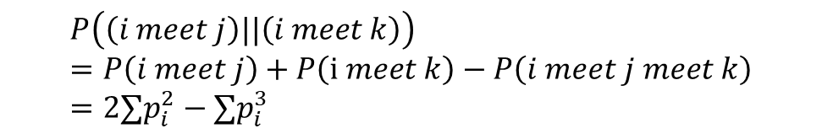

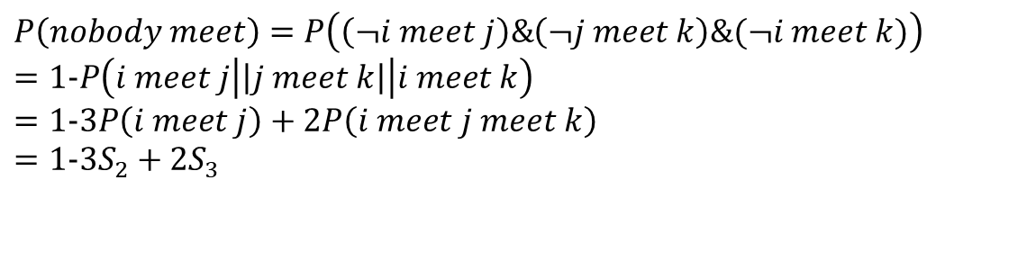
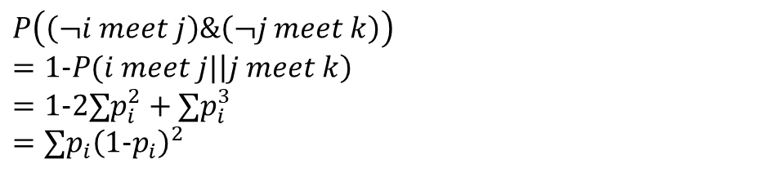
$$P\left(i meet j\right)=∑p_{i}^{2}≜S_{2}$$
$$P\left(i meet j meet k\right)=∑p_{i}^{3}≜S_{3}$$
$$P\left(\left(i meet j\right)\&\left(¬i meet k\right)\right)=∑p_{i}^{2}\left(1−p_{i}\right)=∑p_{i}^{2}−∑p_{i}^{3}$$
$$P\left(nobody meet\right)=P\left(\left(¬i meet j\right)\&\left(¬j meet k\right)\&(¬i meet k)\right)$$
$$=1−P\left(i meet j\left|\left|j meet k\right|\right|i meet k\right)$$
$$=1−3P\left(i meet j\right)+2P\left(i meet j meet k\right)$$
$$=1−3S_{2}+2S_{3}$$
$$P\left(\left(i meet j\right)||\left(i meet k\right)\right)=P\left(i meet j\right)+P\left(i meet k\right)−P\left(i meet j meet k\right)=2∑p_{i}^{2}−∑p_{i}^{3}$$
$$P\left(\left(¬i meet j\right)\&\left(¬j meet k\right)\right)$$
$$=1−P(i meet j|\left|j meet k\right)$$
$$=1−2∑p_{i}^{2}+∑p_{i}^{3}$$
$$=∑p_{i}{\left(1−p_{i}\right)}^{2}$$

Slide 3
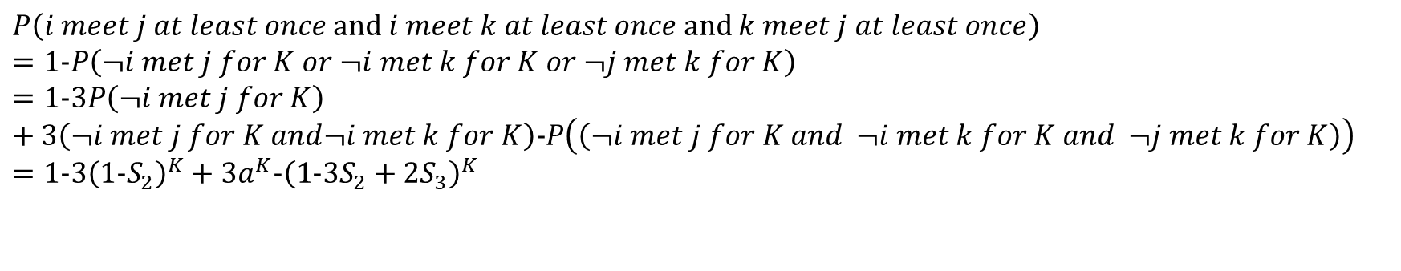
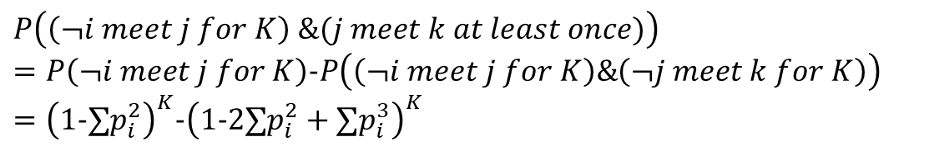
$$P\left(\left(¬i meet j\right)for K times\right)={\left(1−∑p_{i}^{2}\right)}^{K}$$
$$P\left(i meet j at least once\right)={1−\left(1−∑p_{i}^{2}\right)}^{K}$$
$$P\left(\left(¬i meet j \&¬i meet k\right)for K times\right)={\left(∑p_{i}{\left(1−p_{i}\right)}^{2}\right)}^{K}={\left(1−2∑p_{i}^{2}+∑p_{i}^{3}\right)}^{K}=a^{K}$$
$$P\left(\left(i meet j at least once)||(i meet k at least once\right) \right)=1−a^{K}$$
$$P\left(i meet j at least once and i meet k at least once and k meet j at least once\right)$$
$$=1−P\left(¬i met j for K or ¬i met k for K or ¬j met k for K\right)$$
$$=1−3P\left(¬i met j for K\right)+3\left(¬i met j for K and¬i met k for K\right)−P\left(\left(¬i met j for K and ¬i met k for K and ¬j met k for K\right)\right)$$
$$=1−3{\left(1−S_{2}\right)}^{K}+{3a}^{K}−{\left(1−3S_{2}+2S_{3}\right)}^{K}$$
$$P\left(\left(¬i meet j for K\right) \&(j meet k at least once)\right)$$
$$=P\left(¬i meet j for K\right)−P\left(\left(¬i meet j for K\right)\&\left(¬j meet k for K\right)\right)$$
$$={\left(1−∑p_{i}^{2}\right)}^{K}−{\left(1−2∑p_{i}^{2}+∑p_{i}^{3}\right)}^{K}$$
$$P\left(\left(¬i meet j for K\right) \&\left(¬i meet k for K\right)\&(j meet k at least once)\right)$$
$$=P\left(¬i meet j for K\&¬i meet k for K\right)−P\left(\left(¬i meet j for K\right)\&\left(¬j meet k for K\right)\&\left(¬i meet k for K\right)\right)$$
$$={\left(a\right)}^{K}−{\left(1−3S_{2}+2S_{3}\right)}^{K}$$

Slide 4
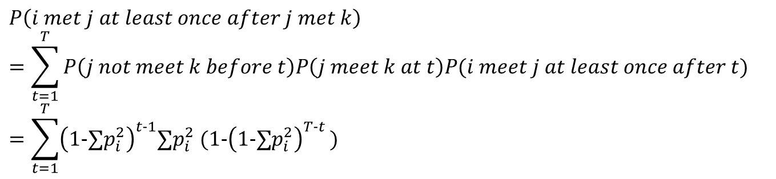
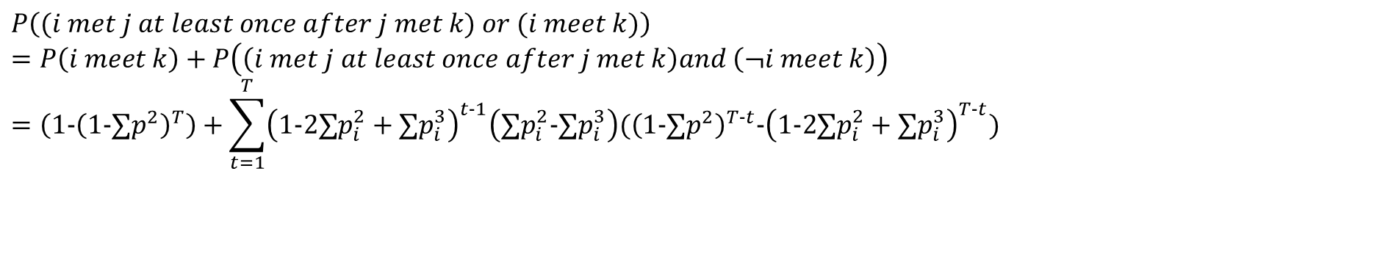
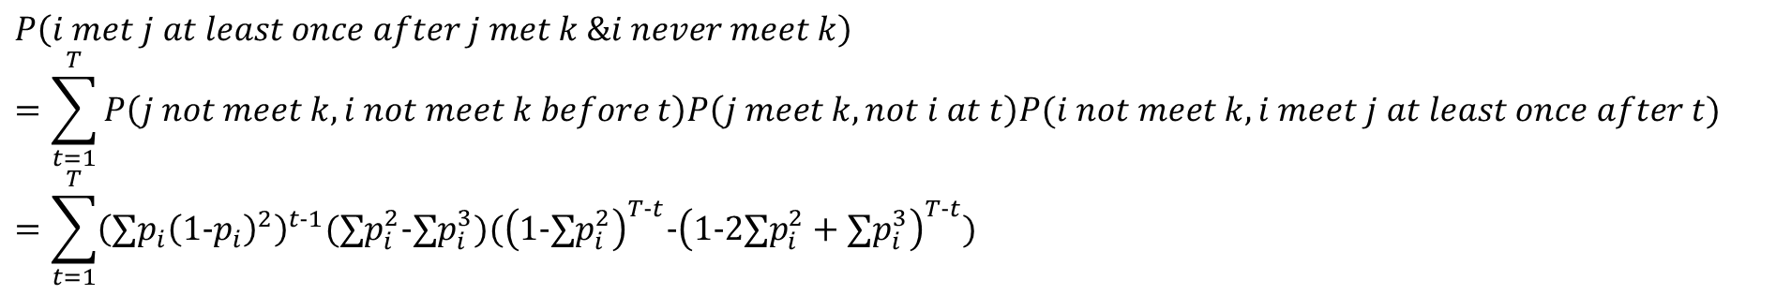
$$P\left(i met j at least once after j met k\right)=\sum_{t=1}^{T}{P\left(j not meet k before t\right)P\left(j meet k at t\right)P(i meet j at least once after t)}$$
$$=\sum_{t=1}^{T}{{\left(1−∑p_{i}^{2}\right)}^{t−1}∑p_{i}^{2} (1−{\left(1−∑p_{i}^{2}\right)}^{T−t })}$$
$$P\left(i met j at least once after or during j met k\right)=\sum_{t=1}^{T}{\begin{aligned}P\left(j not meet k before t\right)\left(P\left(j meet k not i at t\right)P\left(i meet j at least once after t\right)+P\left(i meet j meet k\right)\right)\end{aligned}}$$
$$P\left(i met j at least once after j met k \&i never meet k\right) =\sum_{t=1}^{T}{P\left(j not meet k, i not meet k before t\right)P\left(j meet k, not i at t\right)P(i not meet k, i meet j at least once after t)}$$
$$=\sum_{t=1}^{T}{{\left(∑p_{i}{\left(1−p_{i}\right)}^{2}\right)}^{t−1}(∑p_{i}^{2}−∑p_{i}^{3})({\left(1−∑p_{i}^{2}\right)}^{T−t}−{\left(1−2∑p_{i}^{2}+∑p_{i}^{3}\right)}^{T−t})}$$
$$P\left((i met j at least once after j met k) or (i meet k)\right)$$
$$=P\left(i meet k\right)+P\left(\left(i met j at least once after j met k\right)and \left(¬i meet k\right)\right)$$
$$=\left(1−{\left(1−∑p^{2}\right)}^{T}\right)+\sum_{t=1}^{T}{{\left(1−2∑p_{i}^{2}+∑p_{i}^{3}\right)}^{t−1}\left(∑p_{i}^{2}−∑p_{i}^{3}\right)({\left(1−∑p^{2}\right)}^{T−t}−{\left(1−2∑p_{i}^{2}+∑p_{i}^{3}\right)}^{T−t})}$$

Slide 5
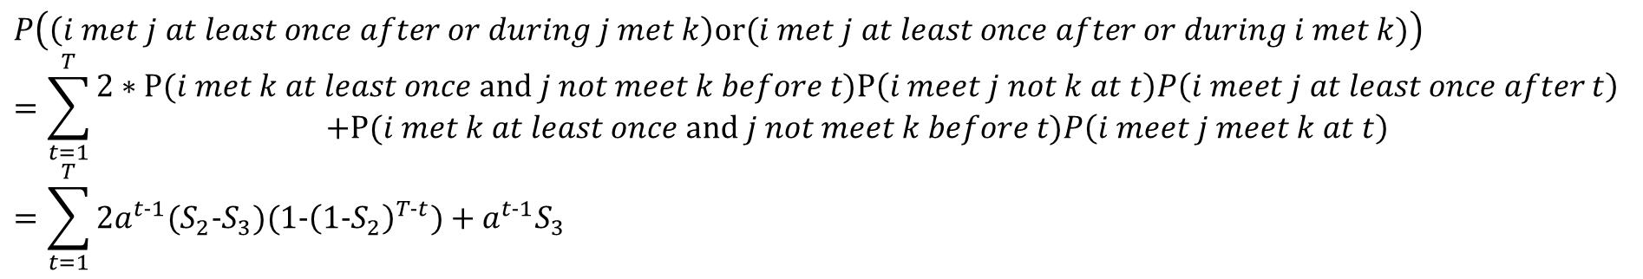
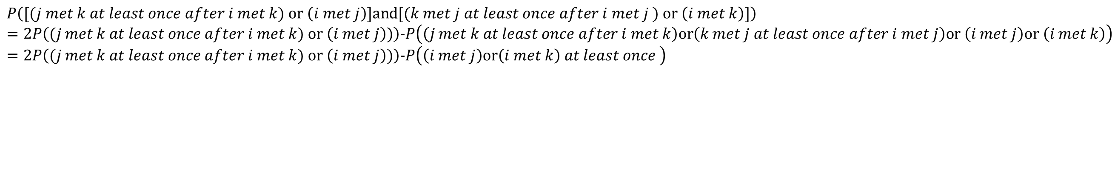
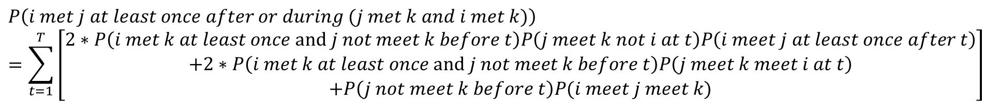
$$P\left(i met j at least once after or during (j met k and i met k)\right)$$
$$=\sum_{t=1}^{T}{\left[\begin{aligned}2∗P\left(i met k at least once and j not meet k before t\right)P\left(j meet k not i at t\right)P\left(i meet j at least once after t\right) \\ +2∗P\left(i met k at least once and j not meet k before t\right)P\left(j meet k meet i at t\right) \\ +P\left(j not meet k before t\right)P(i meet j meet k)\end{aligned}\right]}$$
$$P\left(\left(i met j at least once after or during j met k\right)or(i met j at least once after or during i met k)\right)$$
$$=\sum_{t=1}^{T}{\begin{aligned}2∗P(i met k at least once and j not meet k before t)P\left(i meet j not k at t\right)P\left(i meet j at least once after t\right) \\ +P(i met k at least once and j not meet k before t)P\left(i meet j meet k at t\right)\end{aligned}}$$
$$=\sum_{t=1}^{T}{2a^{t−1}{(S}_{2}−S_{3})(1−{\left(1−S_{2}\right)}^{T−t})+a^{t−1}S_{3} }$$
Single source percolation
$$P\left([(j met k at least once after i met k) or \left(i met j\right)]and[(k met j at least once after i met j ) or \left(i met k\right)]\right)$$
$$=2P\left((j met k at least once after i met k) or \left(i met j\right))\right)−P\left(\left(j met k at least once after i met k\right)or\left(k met j at least once after i met j\right)or \left(i met j\right)or \left(i met k\right)\right)$$
$$=2P\left((j met k at least once after i met k) or \left(i met j\right))\right)−P\left(\left(i met j\right)or\left(i met k\right) at least once \right)$$

Slide 6
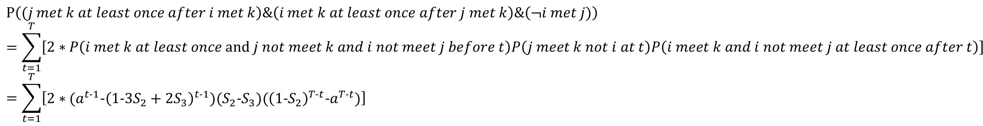
$$P\left((j met k at least once after i met k\right)\&\left(i met k at least once after j met k\right)\&\left(¬i met j)\right)$$
$$=\sum_{t=1}^{T}{\left[\begin{aligned}2∗P\left(i met k at least once and j not meet k and i not meet j before t\right)P\left(j meet k not i at t\right)P\left(i meet k and i not meet j at least once after t\right)\end{aligned}\right]}$$
$$=\sum_{t=1}^{T}{\left[\begin{aligned}2∗(a^{t−1}−{\left(1−3S_{2}+2S_{3}\right)}^{t−1})(S_{2}−S_{3})({\left(1−S_{2}\right)}^{T−t}−a^{T−t})\end{aligned}\right]}$$

Slide 7
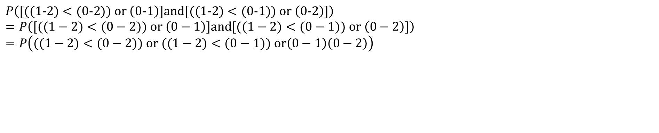
Single source percolation
$$P\left([((1−2)<(0−2)) or \left(0−1\right)]and[((1−2)<(0−1)) or \left(0−2\right)]\right)$$
$$=P\left([((1−2)<(0−2)) or \left(0−1\right)]and[((1−2)<(0−1)) or \left(0−2\right)]\right)$$
$$=P\left(((1−2)<(0−2)) or ((1−2)<(0−1)) or\left(0−1\right)\left(0−2\right)\right)$$

Slide 8
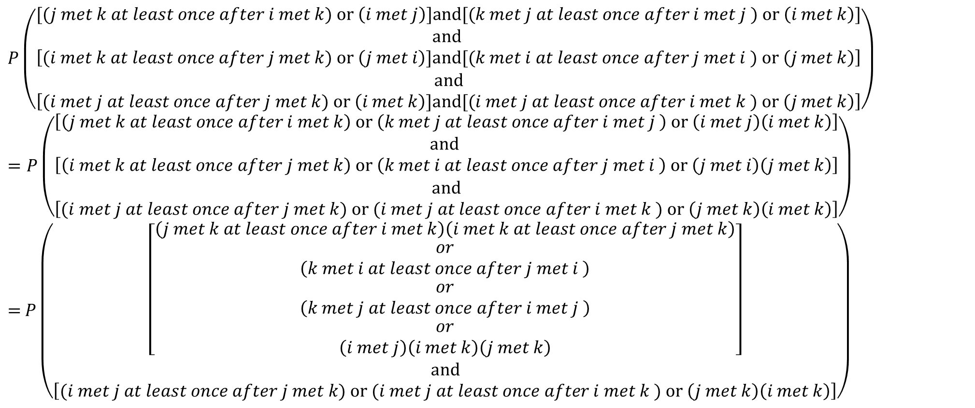
Full percolate
$$P\left(\begin{aligned}[(j met k at least once after i met k) or \left(i met j\right)]and[(k met j at least once after i met j ) or \left(i met k\right)] \\ \begin{aligned}and \\ \left[(i met k at least once after j met k) or \left(j met i\right)]and[(k met i at least once after j met i ) or \left(j met k\right)\right] \\ and \\ \left[(i met j at least once after j met k) or \left(i met k\right)]and[(i met j at least once after i met k ) or \left(j met k\right)\right]\end{aligned}\end{aligned}\right)$$
$$=P\left(\begin{aligned}\begin{aligned}\left[\left(j met k at least once after i met k\right) or \left(k met j at least once after i met j \right) or \left(i met j\right)\left(i met k\right)\right] \\ \begin{aligned}and \\ \left[\left(i met k at least once after j met k\right) or \left(k met i at least once after j met i \right) or \left(j met i\right)\left(j met k\right)\right]\end{aligned}\end{aligned} \\ \begin{aligned}and \\ \left[(i met j at least once after j met k) or (i met j at least once after i met k ) or \left(j met k\right)\left(i met k\right)\right]\end{aligned}\end{aligned}\right)$$
$=$ $P\left(\begin{aligned}\begin{aligned}\left[\begin{aligned}\begin{aligned}\left(j met k at least once after i met k\right)\left(i met k at least once after j met k\right) \\ \begin{aligned}or \\ \left(k met i at least once after j met i \right)\end{aligned}\end{aligned} \\ \begin{aligned}or \\ \left(k met j at least once after i met j \right) \\ \begin{aligned}or \\ \left(i met j\right)\left(i met k\right)\left(j met k\right)\end{aligned}\end{aligned}\end{aligned}\right]\end{aligned} \\ \begin{aligned}and \\ \left[(i met j at least once after j met k) or (i met j at least once after i met k ) or \left(j met k\right)\left(i met k\right)\right]\end{aligned}\end{aligned}\right)$
i percolation
j percolation
k percolation

Slide 9
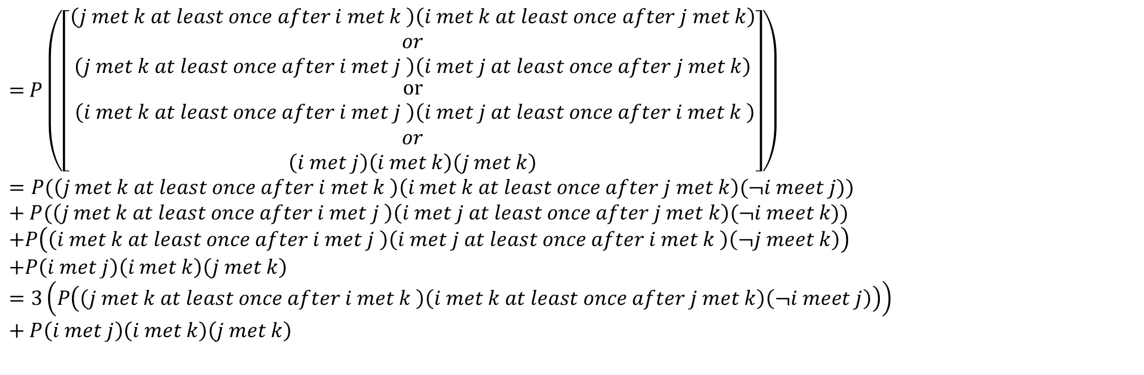
Full percolate 2
$=$ $P\left(\begin{aligned}\begin{aligned}\left[\begin{aligned}\begin{aligned}\begin{aligned}\begin{aligned}\left(j met k at least once after i met k \right)\left(i met k at least once after j met k\right) \\ or \\ \left(j met k at least once after i met j \right)\left(i met j at least once after j met k\right)\end{aligned}\end{aligned}\end{aligned} \\ or \\ \begin{aligned}\left(i met k at least once after i met j \right)\left(i met j at least once after i met k \right)\end{aligned} \\ or \\ \left(i met j\right)\left(i met k\right)\left(j met k\right)\end{aligned}\right]\end{aligned}\end{aligned}\right)$
$$=P(\left(j met k at least once after i met k \right)\left(i met k at least once after j met k\right)(¬i meet j))+P(\left(j met k at least once after i met j \right)\left(i met j at least once after j met k\right)(¬i meet k))$$
$$+P\left(\left(i met k at least once after i met j \right)\left(i met j at least once after i met k \right)\left(¬j meet k\right)\right)$$
$$+P\left(i met j\right)\left(i met k\right)\left(j met k\right)$$
$$=3\left(P\left(\left(j met k at least once after i met k \right)\left(i met k at least once after j met k\right)\left(¬i meet j\right)\right)\right)+P\left(i met j\right)\left(i met k\right)\left(j met k\right)$$

Slide 10
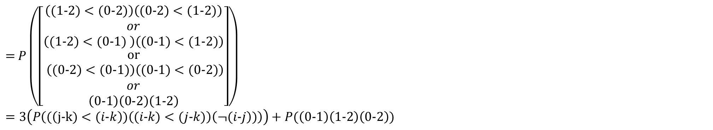
Full percolate 2
$=$ $P\left(\begin{aligned}\begin{aligned}\left[\begin{aligned}\begin{aligned}\begin{aligned}\begin{aligned}\left((1−2)<(0−2)\right)\left((0−2)<(1−2)\right) \\ or \\ \left((1−2)<(0−1) \right)\left((0−1)<(1−2)\right)\end{aligned}\end{aligned}\end{aligned} \\ or \\ \begin{aligned}\left((0−2)<(0−1)\right)\left((0−1)<(0−2)\right)\end{aligned} \\ or \\ \left(0−1\right)\left(0−2\right)\left(1−2\right)\end{aligned}\right]\end{aligned}\end{aligned}\right)$
$$=3\left(P\left((\left(j−k)<(i−k\right))\left((i−k)<(j−k)\right)\left(¬(i−j\right))\right)\right)+P(\left(0−1\right)\left(1−2\right)\left(0−2\right))$$

Slide 11
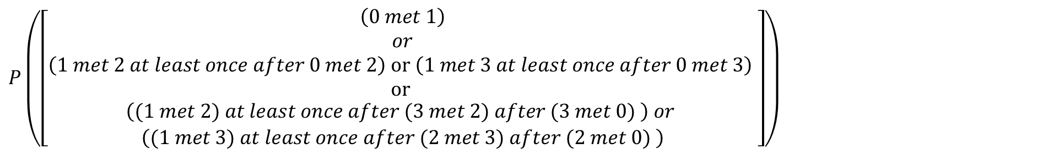
Number of path from i to j with length k: $\frac{\left(N−2\right)!}{\left(N−2−k\right)!}$
Percolation from 0 to 1 (4 robots)
$$P\left(\begin{aligned}\left[\begin{aligned}\left(0 met 1\right) \\ or \\ \left(1 met 2 at least once after 0 met 2\right) or \left(1 met 3 at least once after 0 met 3\right) \\ or \\ \begin{aligned}\left((1 met 2) at least once after (3 met 2) after (3 met 0) \right) or \\ \left((1 met 3) at least once after (2 met 3) after (2 met 0) \right)\end{aligned}\end{aligned}\right]\end{aligned}\right)$$
Path length 1
Path length 2
Path length 3

Slide 12
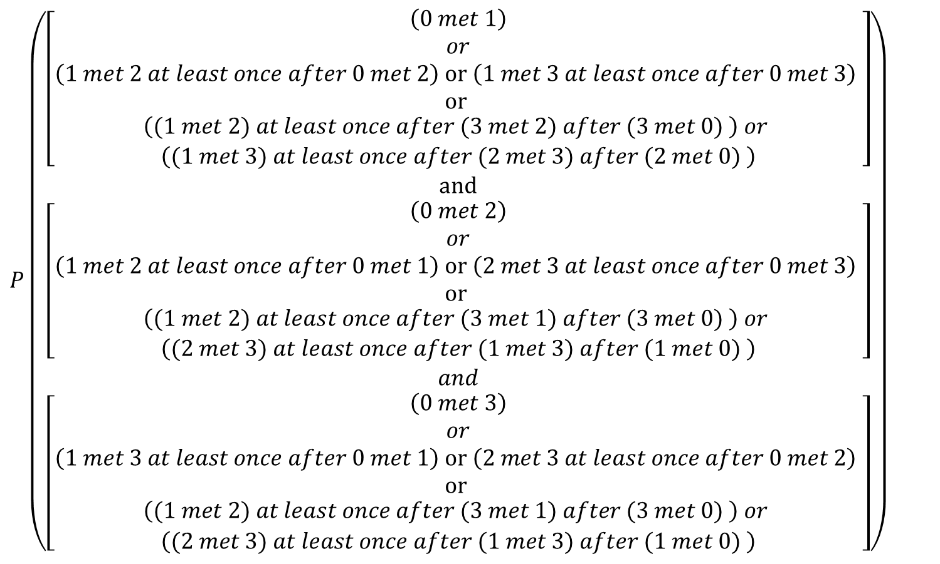
Single source (0) percolation (4 robot)
$$P\left(\begin{aligned}\left[\begin{aligned}\left(0 met 1\right) \\ or \\ \left(1 met 2 at least once after 0 met 2\right) or \left(1 met 3 at least once after 0 met 3\right) \\ or \\ \begin{aligned}\left((1 met 2) at least once after (3 met 2) after (3 met 0) \right) or \\ \left((1 met 3) at least once after (2 met 3) after (2 met 0) \right)\end{aligned}\end{aligned}\right] \\ and \\ \left[\begin{aligned}\left(0 met 2\right) \\ or \\ \left(1 met 2 at least once after 0 met 1\right) or \left(2 met 3 at least once after 0 met 3\right) \\ or \\ \begin{aligned}\left((1 met 2) at least once after (3 met 1) after (3 met 0) \right) or \\ \left((2 met 3) at least once after (1 met 3) after (1 met 0) \right)\end{aligned}\end{aligned}\right] \\ and \\ \left[\begin{aligned}\left(0 met 3\right) \\ or \\ \left(1 met 3 at least once after 0 met 1\right) or \left(2 met 3 at least once after 0 met 2\right) \\ or \\ \begin{aligned}\left((1 met 2) at least once after (3 met 1) after (3 met 0) \right) or \\ \left((2 met 3) at least once after (1 met 3) after (1 met 0) \right)\end{aligned}\end{aligned}\right]\end{aligned}\right)$$

Slide 13
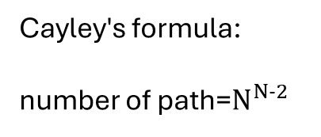
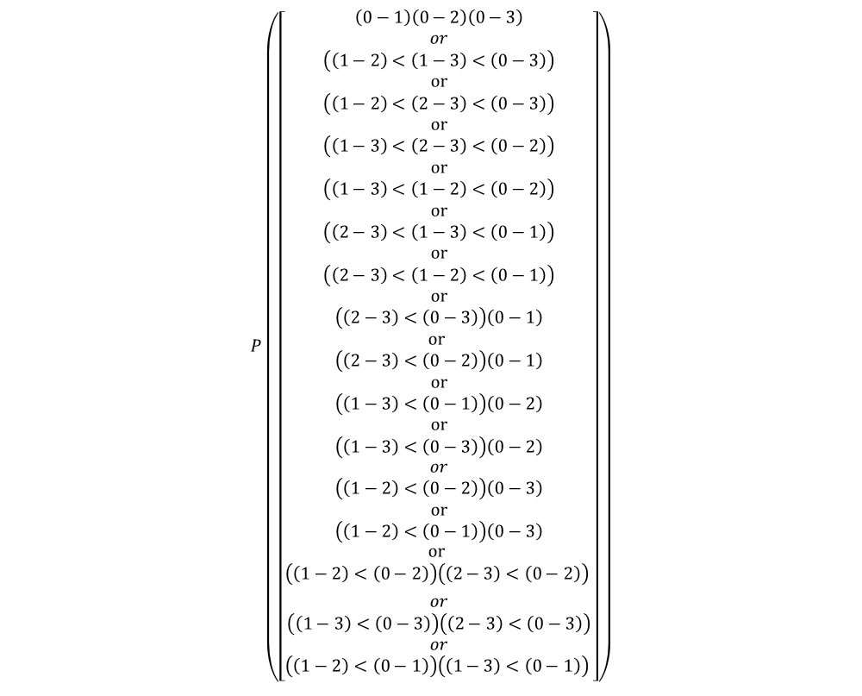
Cayley's formula:
number of path=$N^{N−2}$
$$P\left(\begin{aligned}\left[\begin{aligned}\begin{aligned}\begin{aligned}\left(0−1\right)\left(0−2\right)\left(0−3\right) \\ or \\ \left(\left(1−2\right)<\left(1−3\right)<\left(0−3\right)\right) \\ or \\ \left(\left(1−2\right)<\left(2−3\right)<\left(0−3\right)\right) \\ or \\ \left(\left(1−3\right)<\left(2−3\right)<\left(0−2\right)\right) \\ or \\ \left(\left(1−3\right)<\left(1−2\right)<\left(0−2\right)\right) \\ or \\ \left(\left(2−3\right)<\left(1−3\right)<\left(0−1\right)\right) \\ or \\ \left(\left(2−3\right)<\left(1−2\right)<\left(0−1\right)\right) \\ or \\ \begin{aligned}\left(\left(2−3\right)<\left(0−3\right)\right)\left(0−1\right) \\ or \\ \left(\left(2−3\right)<\left(0−2\right)\right)\left(0−1\right) \\ or \\ \left(\left(1−3\right)<\left(0−1\right)\right)\left(0−2\right) \\ or \\ \left(\left(1−3\right)<\left(0−3\right)\right)\left(0−2\right)\end{aligned}\end{aligned} \\ or \\ \begin{aligned}\begin{aligned}\left(\left(1−2\right)<\left(0−2\right)\right)\left(0−3\right) \\ or \\ \left(\left(1−2\right)<\left(0−1\right)\right)\left(0−3\right) \\ \begin{aligned}or \\ \left(\left(1−2\right)<\left(0−2\right)\right)\left(\left(2−3\right)<\left(0−2\right)\right) \end{aligned} \\ \end{aligned} \\ \begin{aligned}or \\ \begin{aligned}\left(\left(1−3\right)<\left(0−3\right)\right)\left(\left(2−3\right)<\left(0−3\right)\right) \\ or \\ \begin{aligned}\left(\left(1−2\right)<\left(0−1\right)\right)\left(\left(1−3\right)<\left(0−1\right)\right) \end{aligned}\end{aligned}\end{aligned}\end{aligned} \\ \end{aligned}\end{aligned}\right]\end{aligned}\right)$$

Slide 14
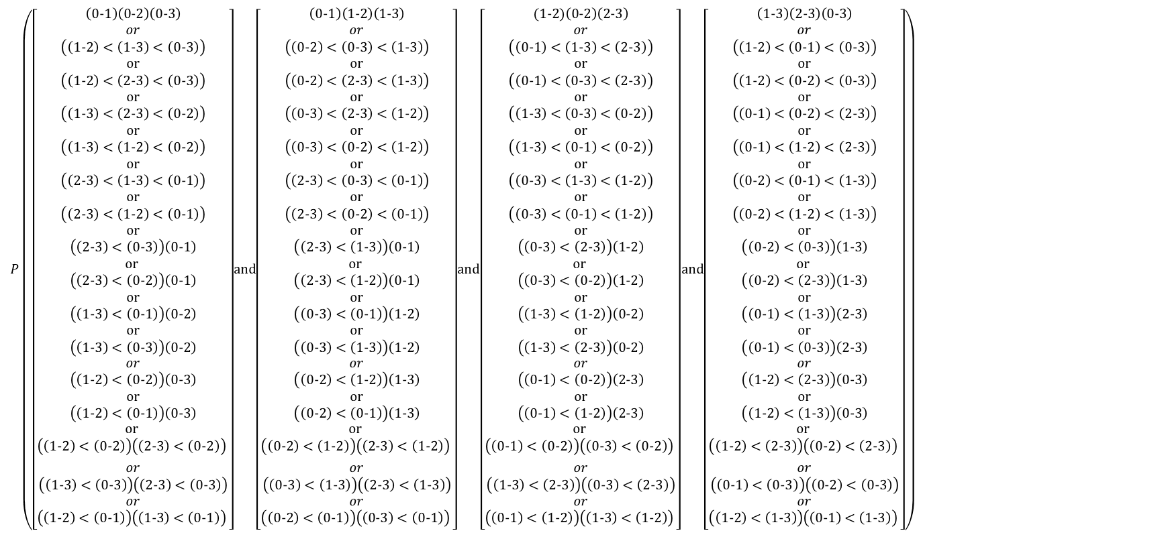
Full percolation (4-robot)
$$P\left(\begin{aligned}\left[\begin{aligned}\begin{aligned}\begin{aligned}\left(0−1\right)\left(0−2\right)\left(0−3\right) \\ or \\ \left(\left(1−2\right)<\left(1−3\right)<\left(0−3\right)\right) \\ or \\ \left(\left(1−2\right)<\left(2−3\right)<\left(0−3\right)\right) \\ or \\ \left(\left(1−3\right)<\left(2−3\right)<\left(0−2\right)\right) \\ or \\ \left(\left(1−3\right)<\left(1−2\right)<\left(0−2\right)\right) \\ or \\ \left(\left(2−3\right)<\left(1−3\right)<\left(0−1\right)\right) \\ or \\ \left(\left(2−3\right)<\left(1−2\right)<\left(0−1\right)\right) \\ or \\ \begin{aligned}\left(\left(2−3\right)<\left(0−3\right)\right)\left(0−1\right) \\ or \\ \left(\left(2−3\right)<\left(0−2\right)\right)\left(0−1\right) \\ or \\ \left(\left(1−3\right)<\left(0−1\right)\right)\left(0−2\right) \\ or \\ \left(\left(1−3\right)<\left(0−3\right)\right)\left(0−2\right)\end{aligned}\end{aligned} \\ or \\ \begin{aligned}\begin{aligned}\left(\left(1−2\right)<\left(0−2\right)\right)\left(0−3\right) \\ or \\ \left(\left(1−2\right)<\left(0−1\right)\right)\left(0−3\right) \\ \begin{aligned}or \\ \left(\left(1−2\right)<\left(0−2\right)\right)\left(\left(2−3\right)<\left(0−2\right)\right) \end{aligned} \\ \end{aligned} \\ \begin{aligned}or \\ \begin{aligned}\left(\left(1−3\right)<\left(0−3\right)\right)\left(\left(2−3\right)<\left(0−3\right)\right) \\ or \\ \begin{aligned}\left(\left(1−2\right)<\left(0−1\right)\right)\left(\left(1−3\right)<\left(0−1\right)\right) \end{aligned}\end{aligned}\end{aligned}\end{aligned} \\ \end{aligned}\end{aligned}\right]\end{aligned}and\begin{aligned}\left[\begin{aligned}\begin{aligned}\begin{aligned}\left(0−1\right)\left(1−2\right)\left(1−3\right) \\ or \\ \left(\left(0−2\right)<\left(0−3\right)<\left(1−3\right)\right) \\ or \\ \left(\left(0−2\right)<\left(2−3\right)<\left(1−3\right)\right) \\ or \\ \left(\left(0−3\right)<\left(2−3\right)<\left(1−2\right)\right) \\ or \\ \left(\left(0−3\right)<\left(0−2\right)<\left(1−2\right)\right) \\ or \\ \left(\left(2−3\right)<\left(0−3\right)<\left(0−1\right)\right) \\ or \\ \left(\left(2−3\right)<\left(0−2\right)<\left(0−1\right)\right) \\ or \\ \begin{aligned}\left(\left(2−3\right)<\left(1−3\right)\right)\left(0−1\right) \\ or \\ \left(\left(2−3\right)<\left(1−2\right)\right)\left(0−1\right) \\ or \\ \left(\left(0−3\right)<\left(0−1\right)\right)\left(1−2\right) \\ or \\ \left(\left(0−3\right)<\left(1−3\right)\right)\left(1−2\right)\end{aligned}\end{aligned} \\ or \\ \begin{aligned}\begin{aligned}\left(\left(0−2\right)<\left(1−2\right)\right)\left(1−3\right) \\ or \\ \left(\left(0−2\right)<\left(0−1\right)\right)\left(1−3\right) \\ \begin{aligned}or \\ \left(\left(0−2\right)<\left(1−2\right)\right)\left(\left(2−3\right)<\left(1−2\right)\right) \end{aligned} \\ \end{aligned} \\ \begin{aligned}or \\ \begin{aligned}\left(\left(0−3\right)<\left(1−3\right)\right)\left(\left(2−3\right)<\left(1−3\right)\right) \\ or \\ \begin{aligned}\left(\left(0−2\right)<\left(0−1\right)\right)\left(\left(0−3\right)<\left(0−1\right)\right) \end{aligned}\end{aligned}\end{aligned}\end{aligned} \\ \end{aligned}\end{aligned}\right]\end{aligned}and\begin{aligned}\left[\begin{aligned}\begin{aligned}\begin{aligned}(1−2)\left(0−2\right)\left(2−3\right) \\ or \\ \left(\left(0−1\right)<\left(1−3\right)<\left(2−3\right)\right) \\ or \\ \left(\left(0−1\right)<\left(0−3\right)<\left(2−3\right)\right) \\ or \\ \left(\left(1−3\right)<\left(0−3\right)<\left(0−2\right)\right) \\ or \\ \left(\left(1−3\right)<\left(0−1\right)<\left(0−2\right)\right) \\ or \\ \left(\left(0−3\right)<\left(1−3\right)<\left(1−2\right)\right) \\ or \\ \left(\left(0−3\right)<\left(0−1\right)<\left(1−2\right)\right) \\ or \\ \begin{aligned}\left(\left(0−3\right)<\left(2−3\right)\right)\left(1−2\right) \\ or \\ \left(\left(0−3\right)<\left(0−2\right)\right)\left(1−2\right) \\ or \\ \left(\left(1−3\right)<\left(1−2\right)\right)\left(0−2\right) \\ or \\ \left(\left(1−3\right)<\left(2−3\right)\right)\left(0−2\right)\end{aligned}\end{aligned} \\ or \\ \begin{aligned}\begin{aligned}\left(\left(0−1\right)<\left(0−2\right)\right)\left(2−3\right) \\ or \\ \left(\left(0−1\right)<\left(1−2\right)\right)\left(2−3\right) \\ \begin{aligned}or \\ \left(\left(0−1\right)<\left(0−2\right)\right)\left(\left(0−3\right)<\left(0−2\right)\right) \end{aligned} \\ \end{aligned} \\ \begin{aligned}or \\ \begin{aligned}\left(\left(1−3\right)<\left(2−3\right)\right)\left(\left(0−3\right)<\left(2−3\right)\right) \\ or \\ \begin{aligned}\left(\left(0−1\right)<\left(1−2\right)\right)\left(\left(1−3\right)<\left(1−2\right)\right) \end{aligned}\end{aligned}\end{aligned} \\ \end{aligned}\end{aligned}\end{aligned}\right]\end{aligned}and\begin{aligned}\left[\begin{aligned}\begin{aligned}\begin{aligned}\left(1−3\right)\left(2−3\right)\left(0−3\right) \\ or \\ \left(\left(1−2\right)<\left(0−1\right)<\left(0−3\right)\right) \\ or \\ \left(\left(1−2\right)<\left(0−2\right)<\left(0−3\right)\right) \\ or \\ \left(\left(0−1\right)<\left(0−2\right)<\left(2−3\right)\right) \\ or \\ \left(\left(0−1\right)<\left(1−2\right)<\left(2−3\right)\right) \\ or \\ \left(\left(0−2\right)<\left(0−1\right)<\left(1−3\right)\right) \\ or \\ \left(\left(0−2\right)<\left(1−2\right)<\left(1−3\right)\right) \\ or \\ \begin{aligned}\left(\left(0−2\right)<\left(0−3\right)\right)\left(1−3\right) \\ or \\ \left(\left(0−2\right)<\left(2−3\right)\right)\left(1−3\right) \\ or \\ \left(\left(0−1\right)<\left(1−3\right)\right)\left(2−3\right) \\ or \\ \left(\left(0−1\right)<\left(0−3\right)\right)\left(2−3\right)\end{aligned}\end{aligned} \\ or \\ \begin{aligned}\begin{aligned}\left(\left(1−2\right)<\left(2−3\right)\right)\left(0−3\right) \\ or \\ \left(\left(1−2\right)<\left(1−3\right)\right)\left(0−3\right) \\ \begin{aligned}or \\ \left(\left(1−2\right)<\left(2−3\right)\right)\left(\left(0−2\right)<\left(2−3\right)\right) \end{aligned} \\ \end{aligned} \\ \begin{aligned}or \\ \begin{aligned}\left(\left(0−1\right)<\left(0−3\right)\right)\left(\left(0−2\right)<\left(0−3\right)\right) \\ or \\ \begin{aligned}\left(\left(1−2\right)<\left(1−3\right)\right)\left(\left(0−1\right)<\left(1−3\right)\right) \end{aligned}\end{aligned}\end{aligned}\end{aligned} \\ \end{aligned}\end{aligned}\right]\end{aligned}\right)$$

Slide 15




$${(1−S_{2})}^{K}≈e^{−KS_{2} }$$
$$1−{(1−S_{2})}^{K}≈KS_{2}$$
$$n!≈\sqrt{2πn }\frac{n^{n}}{e^{n}}$$
$$C_{r}^{n}p^{k}{\left(1−p\right)}^{n−k}≈e^{−np}\frac{{\left(np\right)}^{k}}{k!}$$
Poison approximation
(big n, small p)
Temporal connectivity
Markov's inequality
epidemic modeling
Mean-field theory

