Slide 1
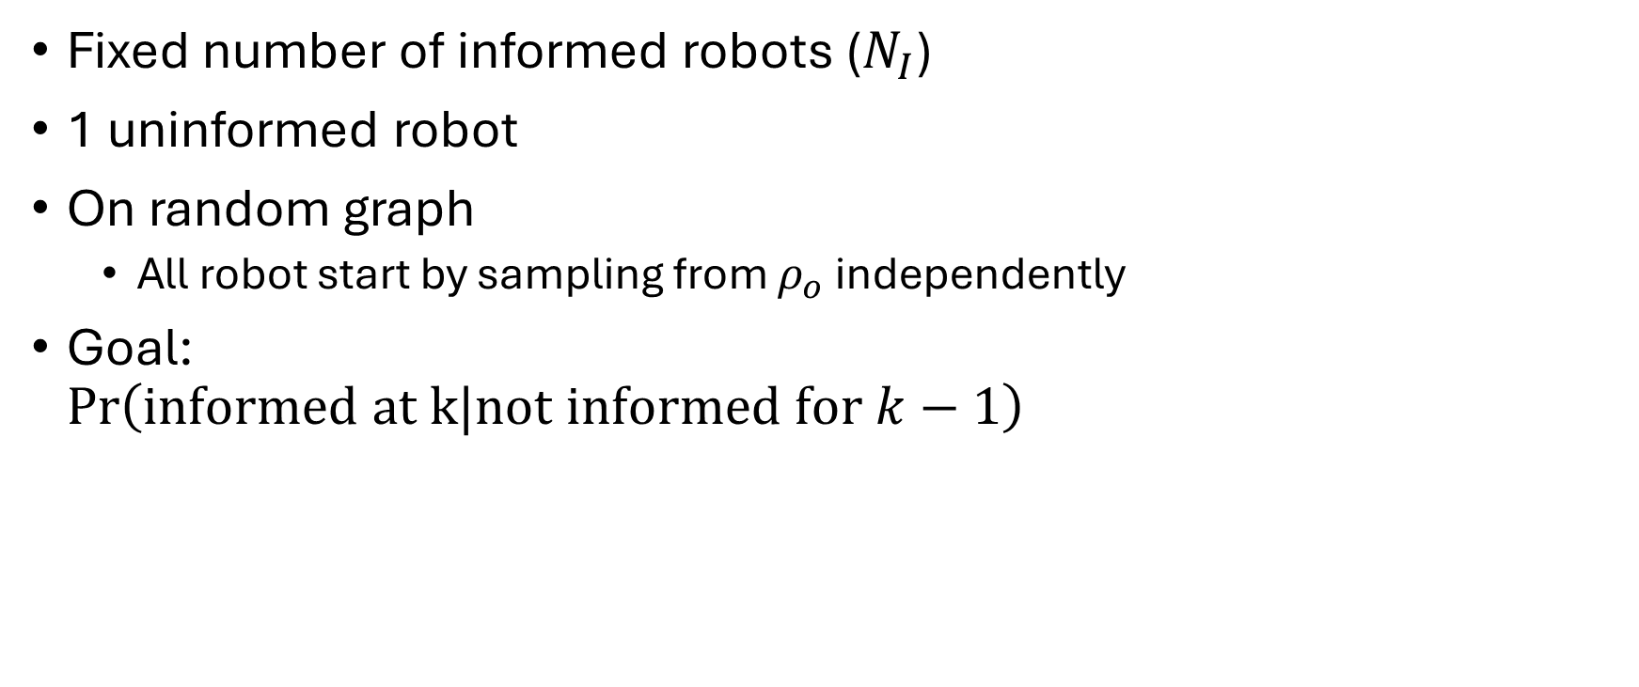
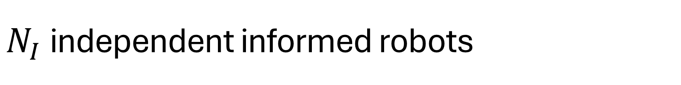
$N_{I}$independent informed robots
Fixed number of informed robots ($N_{I}$)
1 uninformed robot
On random graph
All robot start by sampling from $ρ_{o}$ independently
Goal: $\operatorname{Pr}\left(informed at k|not informed for k−1\right)$

Slide 2
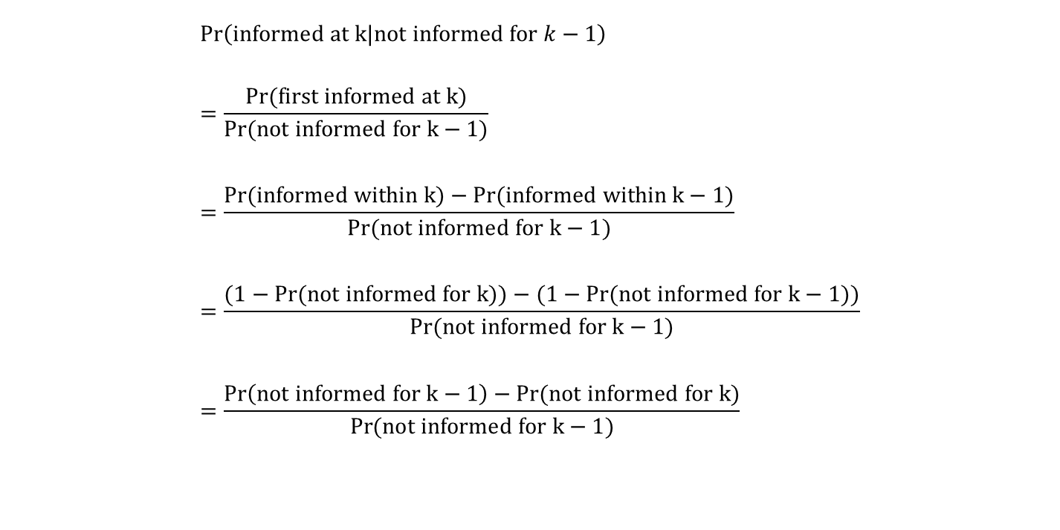

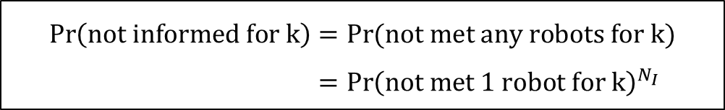
$N_{I}$independent informed robots Derivation
$$\operatorname{Pr}\left(informed at k|not informed for k−1\right) \\ =\frac{\operatorname{Pr}{(first informed at k)}}{\operatorname{Pr}{(not informed for k−1)}} \\ =\frac{\operatorname{Pr}{(informed within k)}−\operatorname{Pr}{(informed within k−1)}}{\operatorname{Pr}{(not informed for k−1)}} \\ =\frac{(1−\operatorname{Pr}{(not informed for k))}−(1−\operatorname{Pr}{(not informed for k−1))}}{\operatorname{Pr}{(not informed for k−1)}} \\ =\frac{\operatorname{Pr}\left(not informed for k−1\right)−\operatorname{Pr}{(not informed for k)}}{\operatorname{Pr}{(not informed for k−1)}}$$
$$\operatorname{Pr}\left(not informed for k\right)=\operatorname{Pr}{(not met any robots for k)} \\ ={\operatorname{Pr}\left(not met 1 robot for k\right)}^{N_{I}}$$
ONLY IF INDEPENDENT

Slide 3
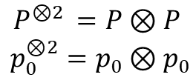
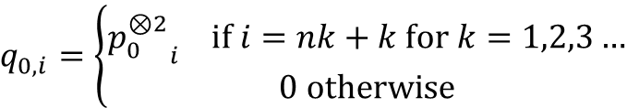
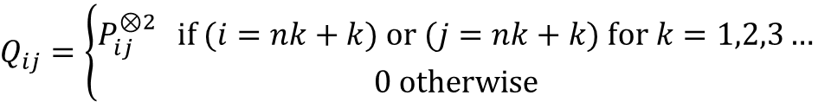
Not meet 1 robot on graph
Given stochastic matrix $P$, initial distribution $p_{0}$
$$P^{⊗2 }=P⊗P$$
$$p_{0}^{⊗2}=p_{0}⊗p_{0}$$
$$Q_{ij}=\left\{\begin{aligned}P_{ij}^{⊗2 } if (i=nk+k) or (j=nk+k) for k=1,2,3… \\ &0 otherwise\end{aligned}\right.$$
$$q_{0,i}=\left\{\begin{aligned}{p_{0}^{⊗2}}_{i} if i=nk+k for k=1,2,3… \\ &0 otherwise\end{aligned}\right.$$
$$\operatorname{Pr}\left(not met for k\right)={1^{T}Q}^{k}q_{0}$$

Slide 4
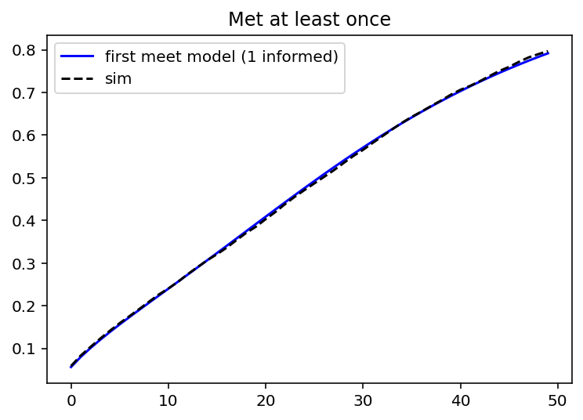
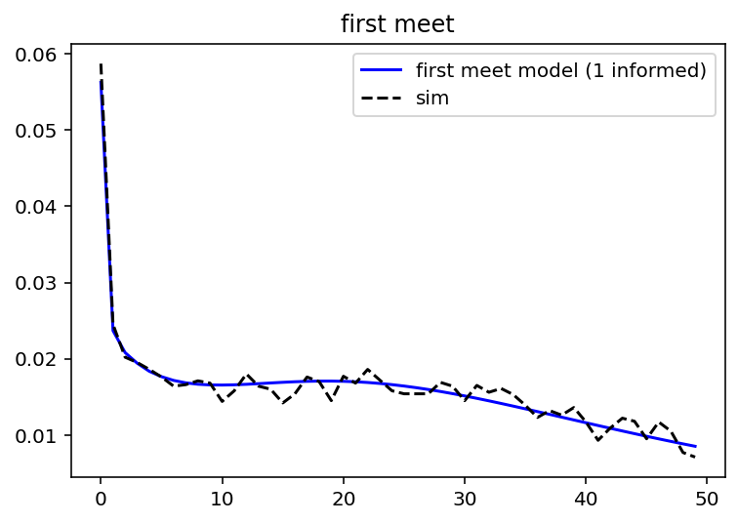
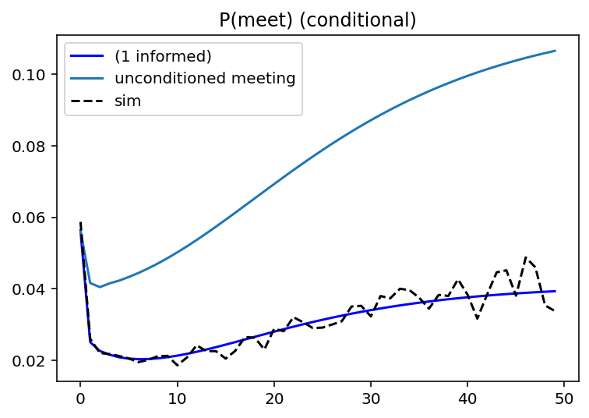

1 informed robot
*Unconditioned $=S_{2}$

Slide 5
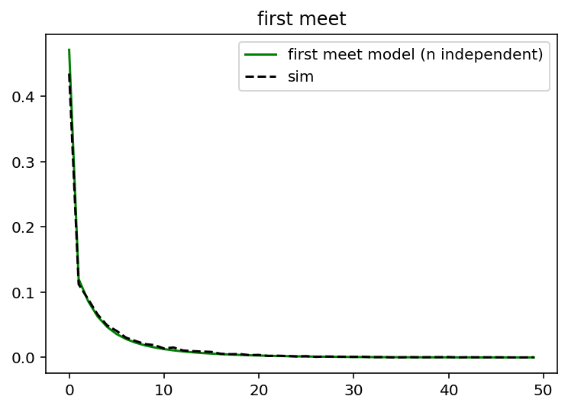
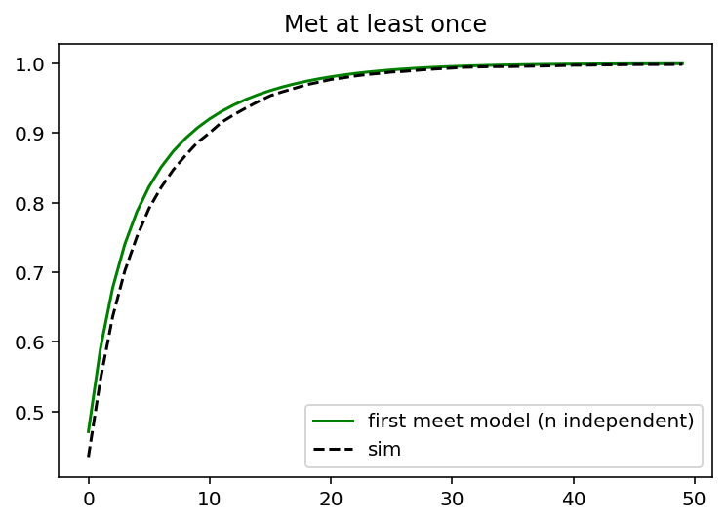
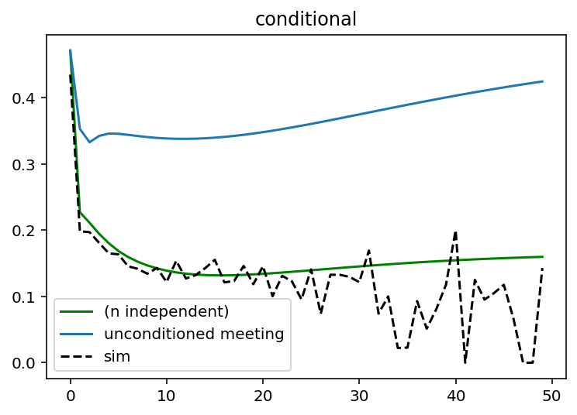

Results (independent informed robots)
*Unconditioned $=1−{\left(1−S_{2}\right)}^{N_{I}}$

Slide 6
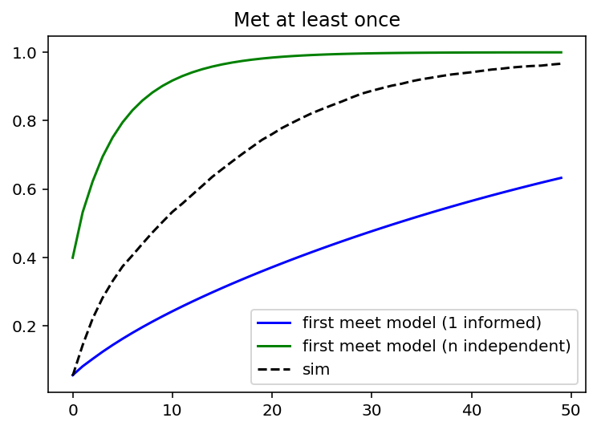
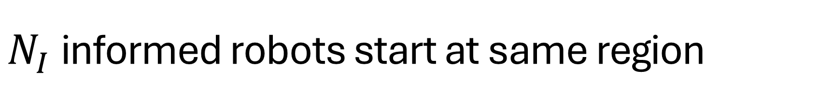
$N_{I}$informed robots start at same region
Starts as effectively 1 informed robot and tends toward n independent robots

