Slide 1
Percolation of information in an ergodic robotic network

Slide 2
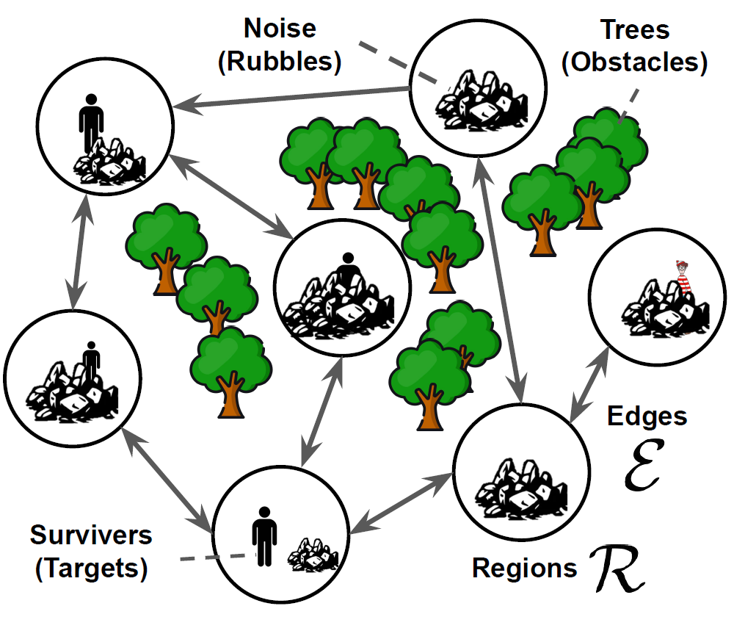
Motivation
Ergodicity: The total visitation frequency of each region is proportional to the noise of observation
Swarm ergodicity requires all robots to have the same information about the regions
Previously done by central information processing
Decentralize by locally sharing collected information
How to maintain ergodicity

Slide 3
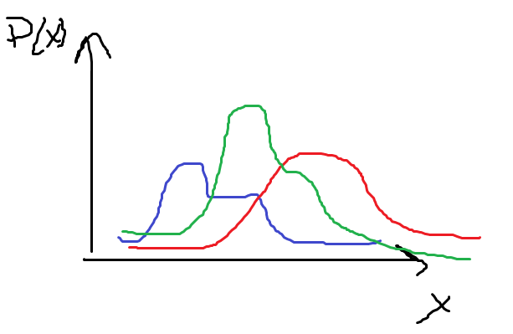
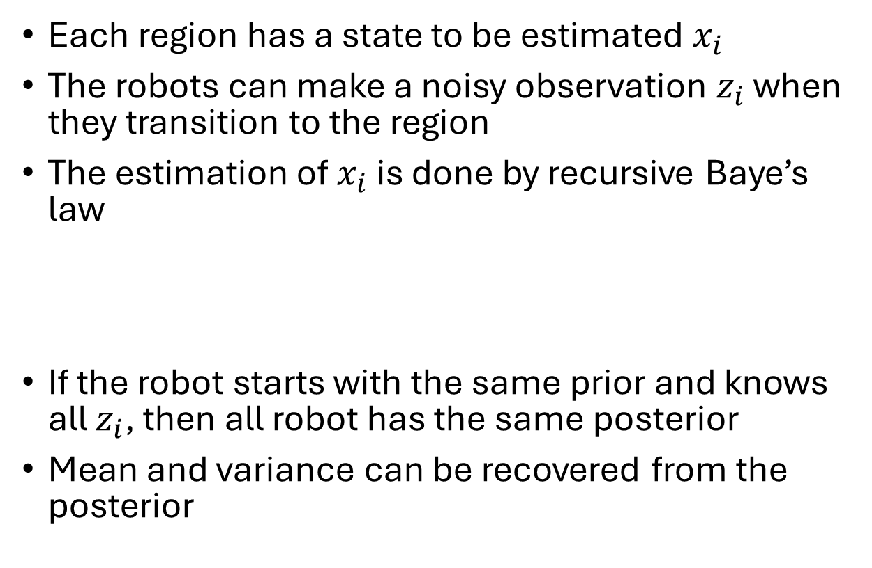
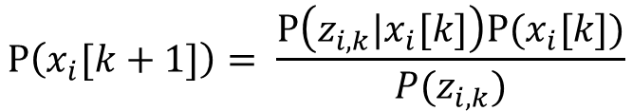
Recap
Each region has a state to be estimated $x_{i}$
The robots can make a noisy observation $z_{i}$ when they transition to the region
The estimation of $x_{i}$ is done by recursive Baye’s law
If the robot starts with the same prior and knows all $z_{i}$, then all robot has the same posterior
Mean and variance can be recovered from the posterior
Likelihood
prior
posterior
$$\text{P}\left(x_{i}[k+1]\right)= \frac{\text{P}\left(z_{i,k}|x_{i}[k]\right)\text{P}(x_{i}[k])}{P(z_{i,k})}$$

Slide 4
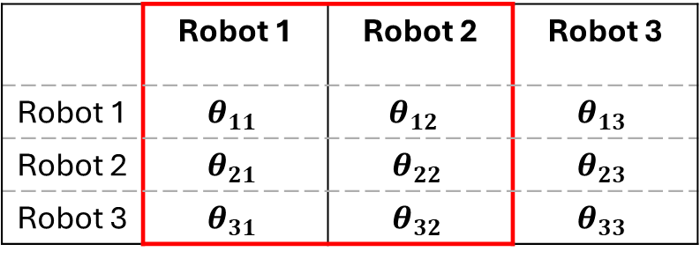
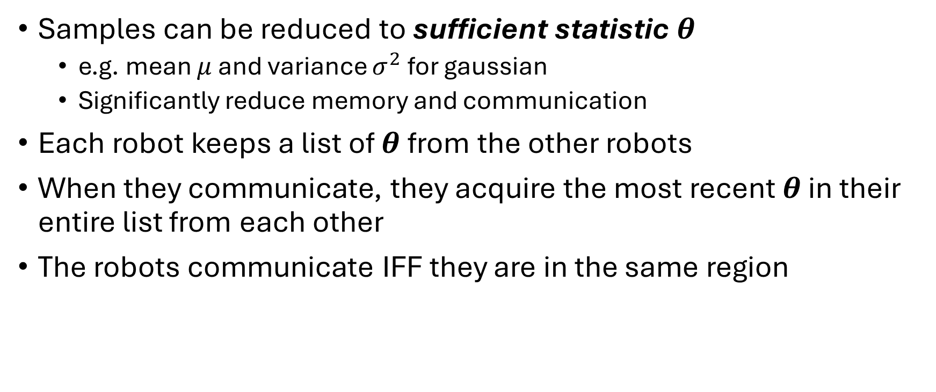
Communication Protocol
Samples can be reduced to sufficient statistic $θ$
e.g. mean $μ$ and variance $σ^{2}$ for gaussian
Significantly reduce memory and communication
Each robot keeps a list of $θ$from the other robots
When they communicate, they acquire the most recent $θ$ in their entire list from each other
The robots communicate IFF they are in the same region
 | Robot 1 | Robot 2 | Robot 3
Robot 1 | $$θ_{11}$$ | $$θ_{12}$$ | $$θ_{13}$$
Robot 2 | $$θ_{21}$$ | $$θ_{22}$$ | $$θ_{23}$$
Robot 3 | $$θ_{31}$$ | $$θ_{32}$$ | $$θ_{33}$$

Slide 5
Problem Formulation
Assume every robot has a fixed initial piece of information
All robot has the same probability distribution of existing in the regions
How many time step can we expect all the initial information is shared to every robot?
Conjecture:
there is a sharp time step where the information is almost certainly shared across the robot network (as the number of robot tends to infinity)

Slide 6

Pictorial Representation
Robot 1
Robot 2
Robot 3
Robot 4
temporal graph
$$θ_{1}$$
k=1
k=2
k=3
Acquired
Acquired
Acquired
Missing

Slide 7
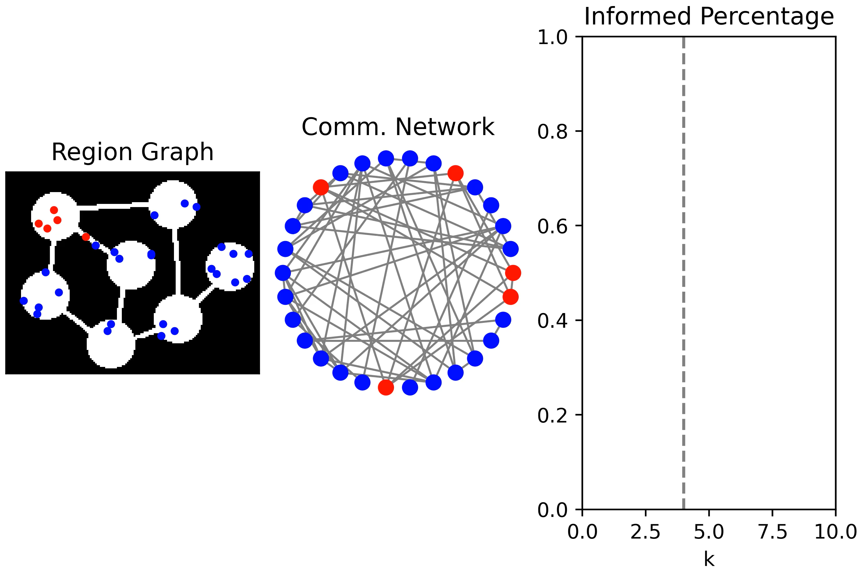

Slide 8
Percolation Theory
Historically: a study of how fluid flow through porous material in statistical mechanic
e.g. water passing through coffee grounds
In mathematics: A study of change of connectivity by adding random link in a graph
Often shows critical phenomenon
A sudden change in behaviour when a parameter pass the critical point as it is being smoothly varied
e.g. ising model (magnets) , Erdős–Rényi model (random graph), phase change (boiling water)

Slide 9
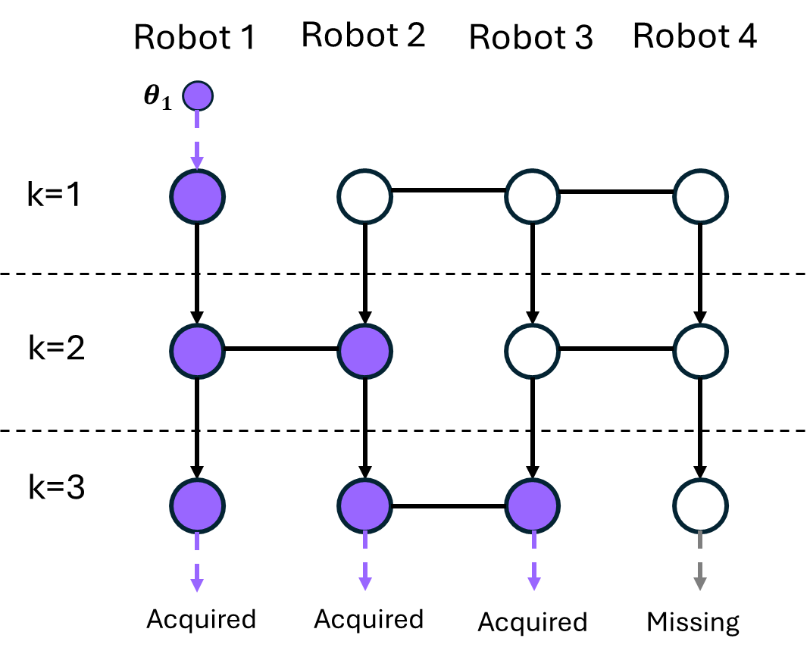
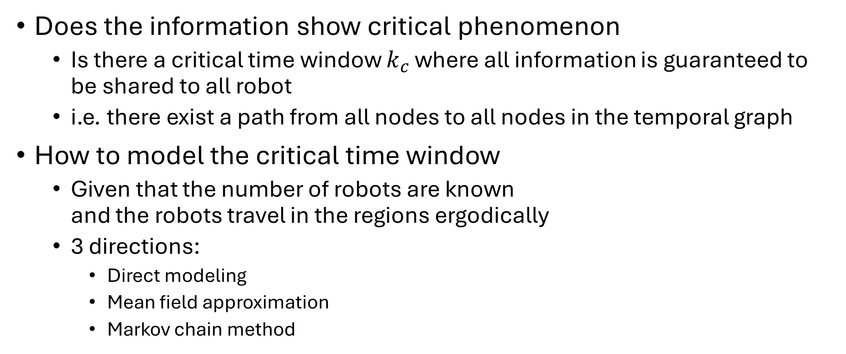
Information Percolation
Does the information show critical phenomenon
Is there a critical time window $k_{c}$ where all information is guaranteed to be shared to all robot
i.e. there exist a path from all nodes to all nodes in the temporal graph
How to model the critical time window
Given that the number of robots are known and the robots travel in the regions ergodically
3 directions:
Direct modeling
Mean field approximation
Markov chain method

Slide 10
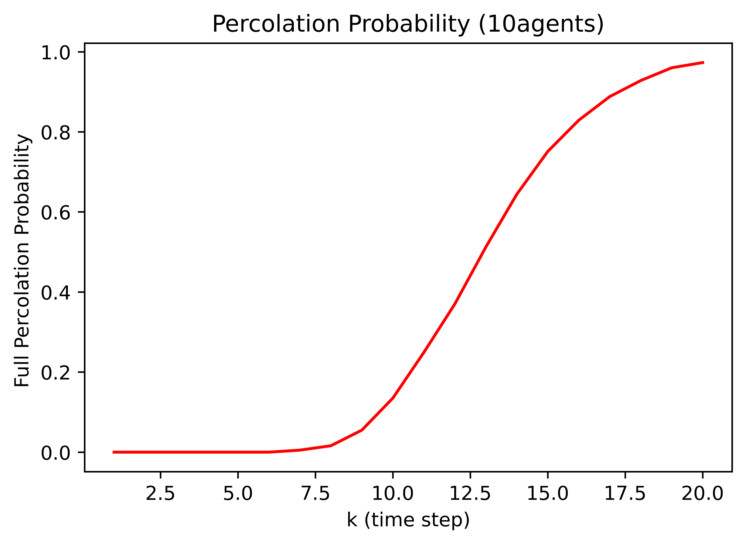
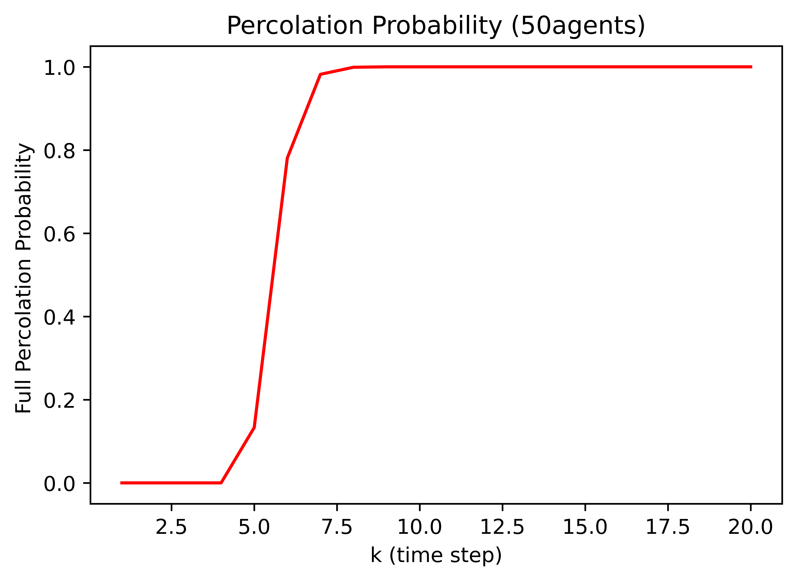
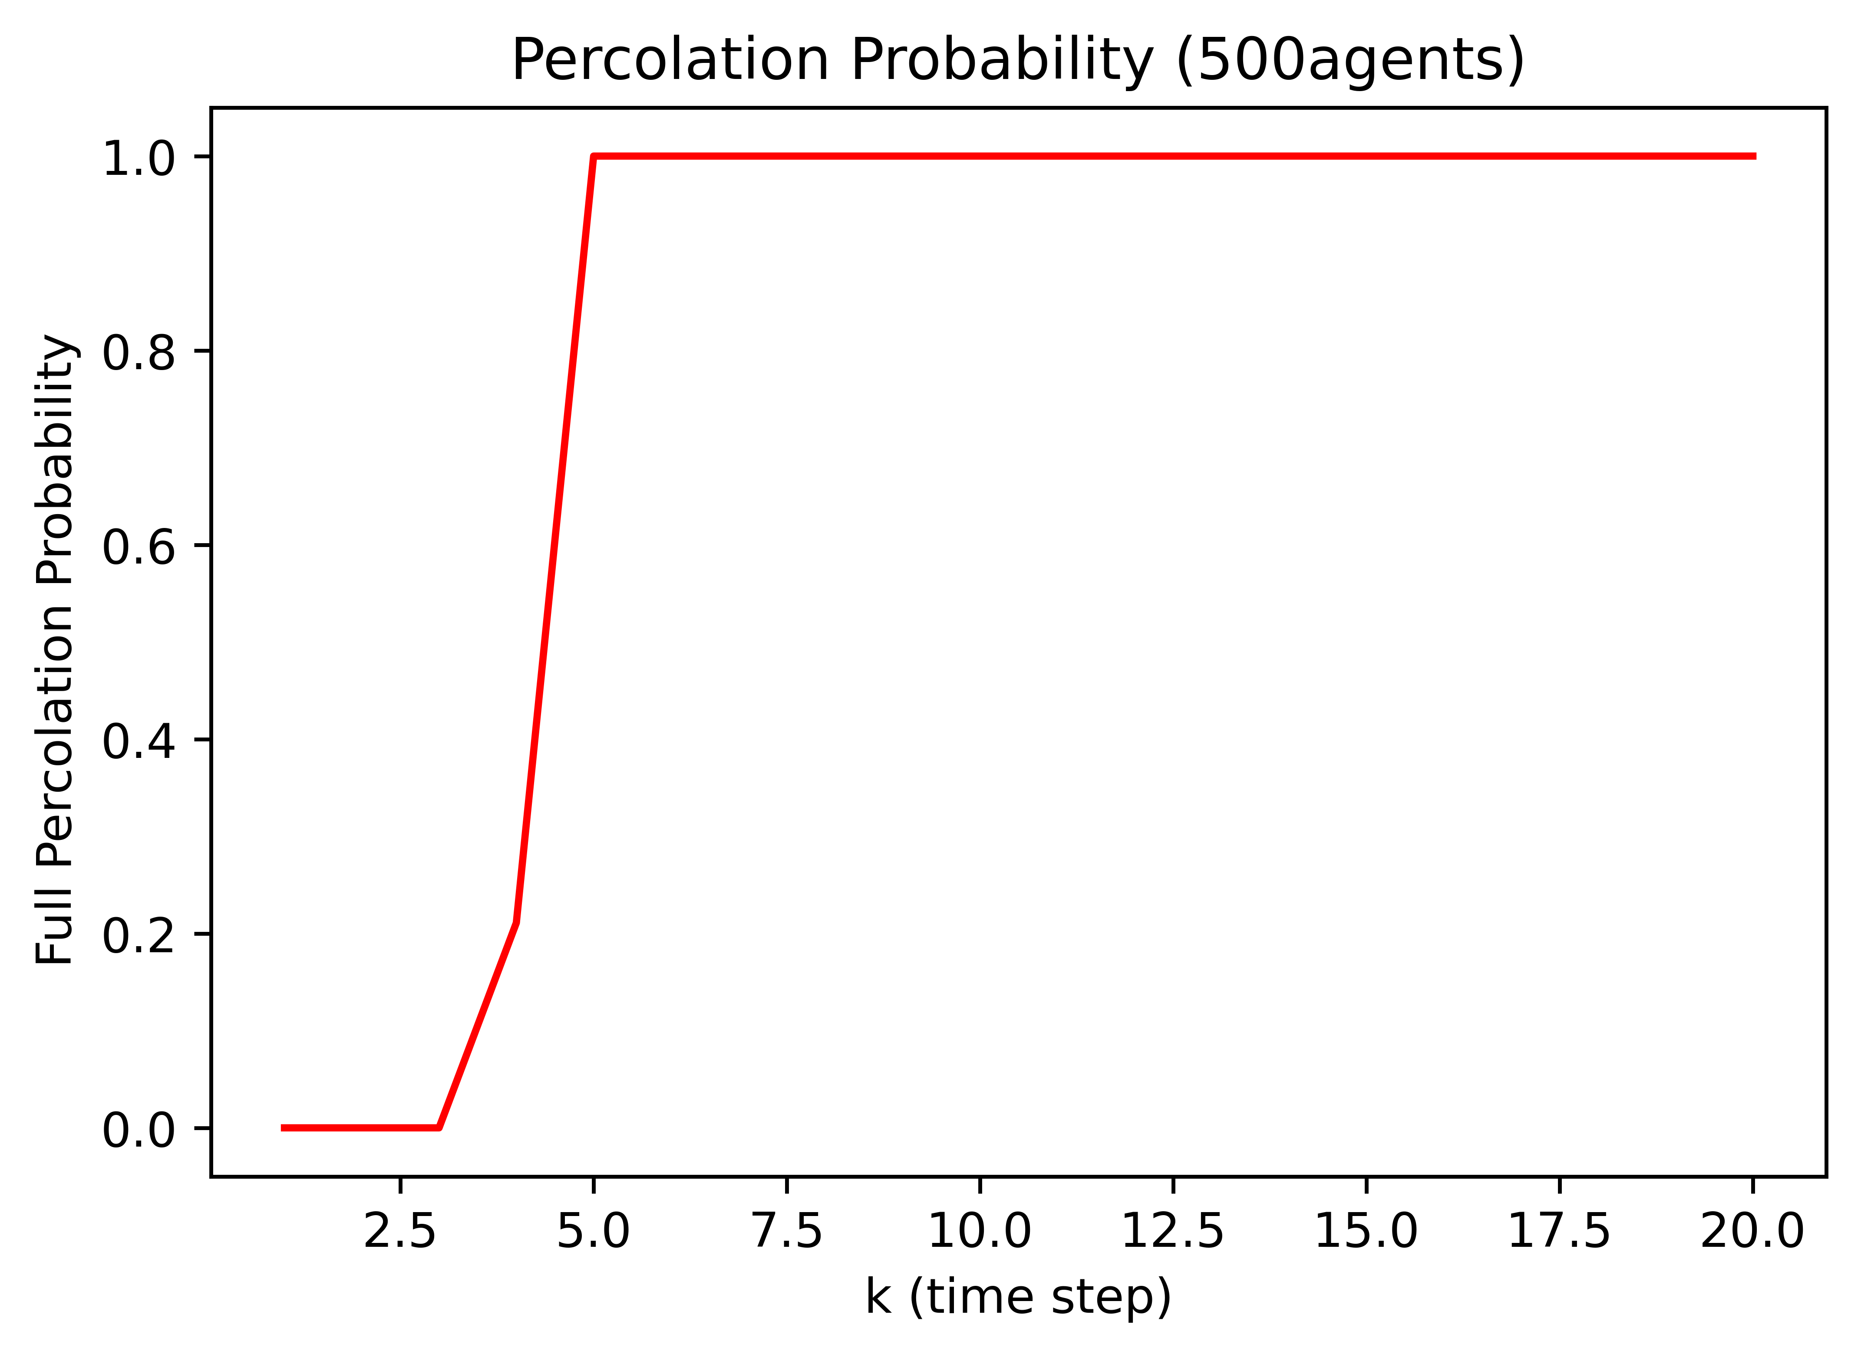
Simulated Result
Setting:
10 regions E-R graph
Uniform distribution
1000 trials
REMC transition law
Key results:
Critical phenomenon exists
The more robots, the sharper the phase change is
The more robots, the smaller the critical time window is

Slide 11
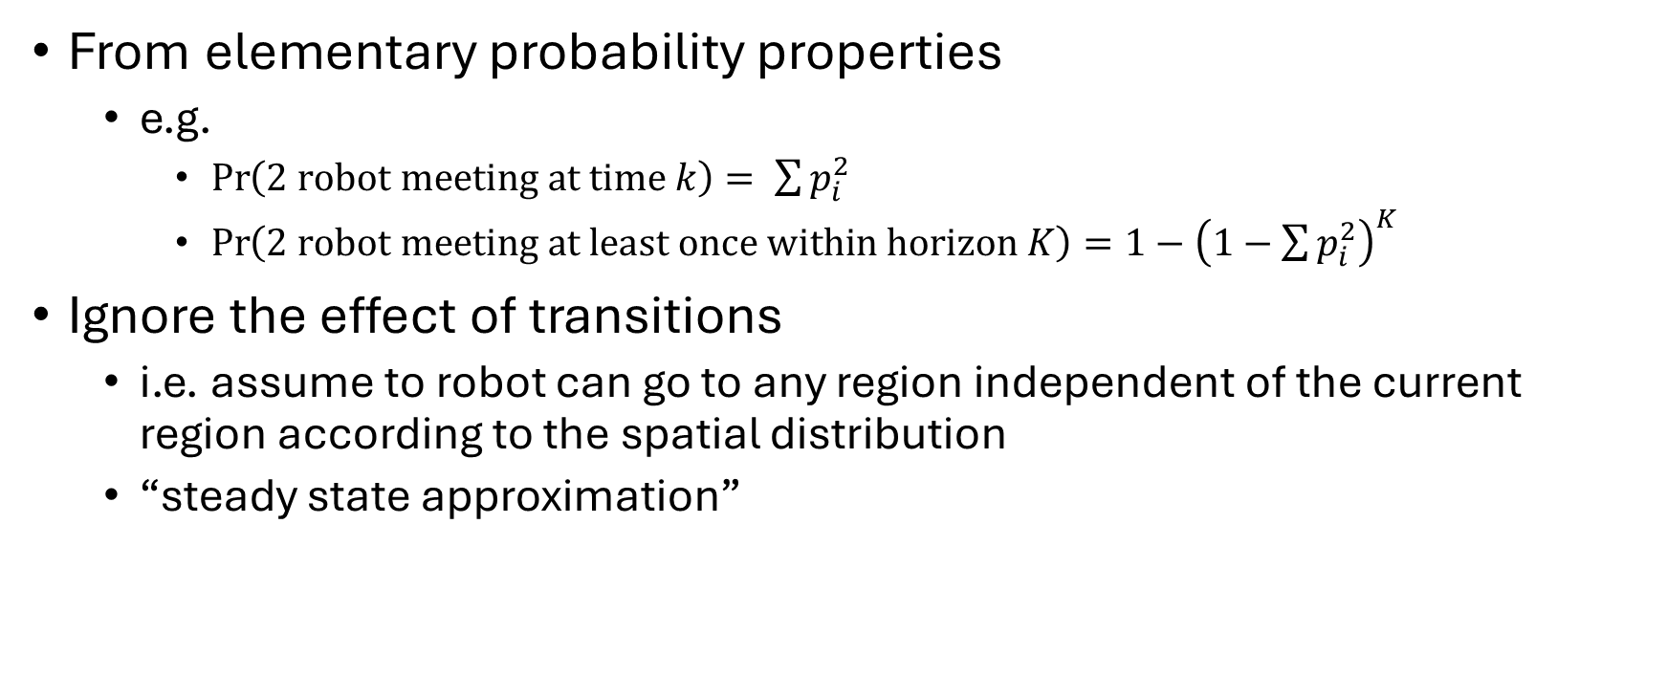
Modeling – direct method
From elementary probability properties
e.g.
$\operatorname{Pr}\left(2 \text{robot} \text{meeting} \text{at} \text{time} k\right)= \sum{p_{i}^{2}}$
$\operatorname{Pr}\left(2 \text{robot} \text{meeting} \text{at} \text{least} \text{once} \text{within} \text{horizon} K\right)=1−{\left(1−\sum{p_{i}^{2}}\right)}^{K}$
Ignore the effect of transitions
i.e. assume to robot can go to any region independent of the current region according to the spatial distribution
“steady state approximation”

Slide 12
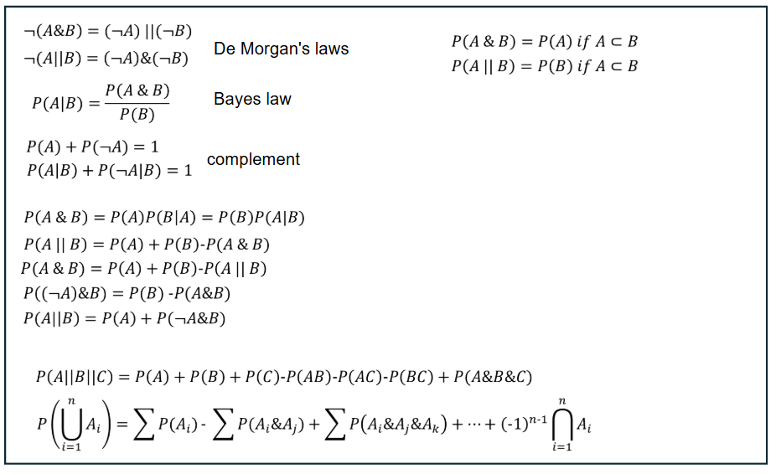
List of probability properties

Slide 13
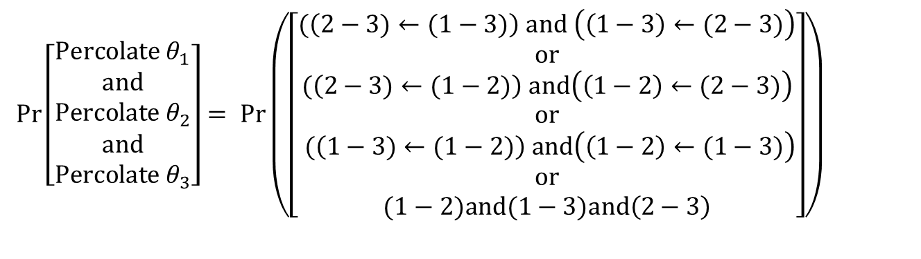
Direct method – 3 robot system
Find the condition for single source percolation (just percolate information of robot 1)
(1 meet 2 at least once) and (2 meet 3 at least once) or (1 meet 3) etc.
Number of conditions = number of spanning tree rooting at robot 1
Combine the conditions of all sources by intersection
$$Pr\left(percolate θ_{1}\right)= Pr\left((\left(2−3\right)←\left(1−2\right)) or (1−3)\right)and\left((\left(2−3\right)←\left(1−3\right)) or (1−2)\right)$$
$\operatorname{Pr}\left[\begin{matrix}Percolate θ_{1} \\ \begin{aligned}and \\ Percolate θ_{2}\end{aligned} \\ \begin{aligned}and \\ Percolate θ_{3}\end{aligned}\end{matrix}\right]= Pr\left(\begin{aligned}\begin{aligned}\left[\begin{aligned}\begin{aligned}\begin{aligned}\begin{aligned}(\left(2−3)←(1−3)\right) and \left(\left(1−3\right)←(2−3)\right) \\ or \\ (\left(2−3)←(1−2)\right) &and\left(\left(1−2\right)←(2−3)\right)\end{aligned}\end{aligned}\end{aligned} \\ or \\ \begin{aligned}(\left(1−3)←(1−2)\right) &and\left(\left(1−2\right)←(1−3)\right)\end{aligned} \\ or \\ \begin{aligned}(1−2)and(1−3)&and\left(2−3\right)\end{aligned}\end{aligned}\right]\end{aligned}\end{aligned}\right)$

Slide 14
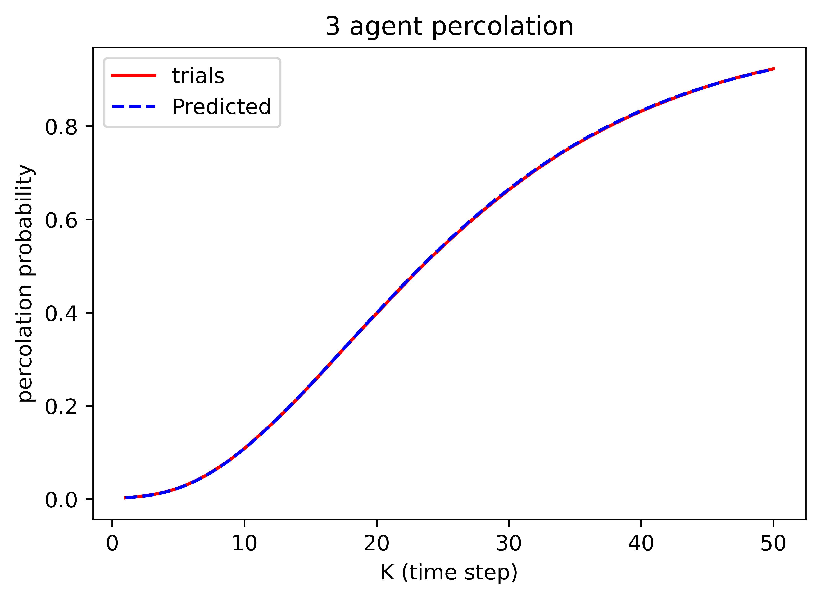
3 - robot results

Slide 15

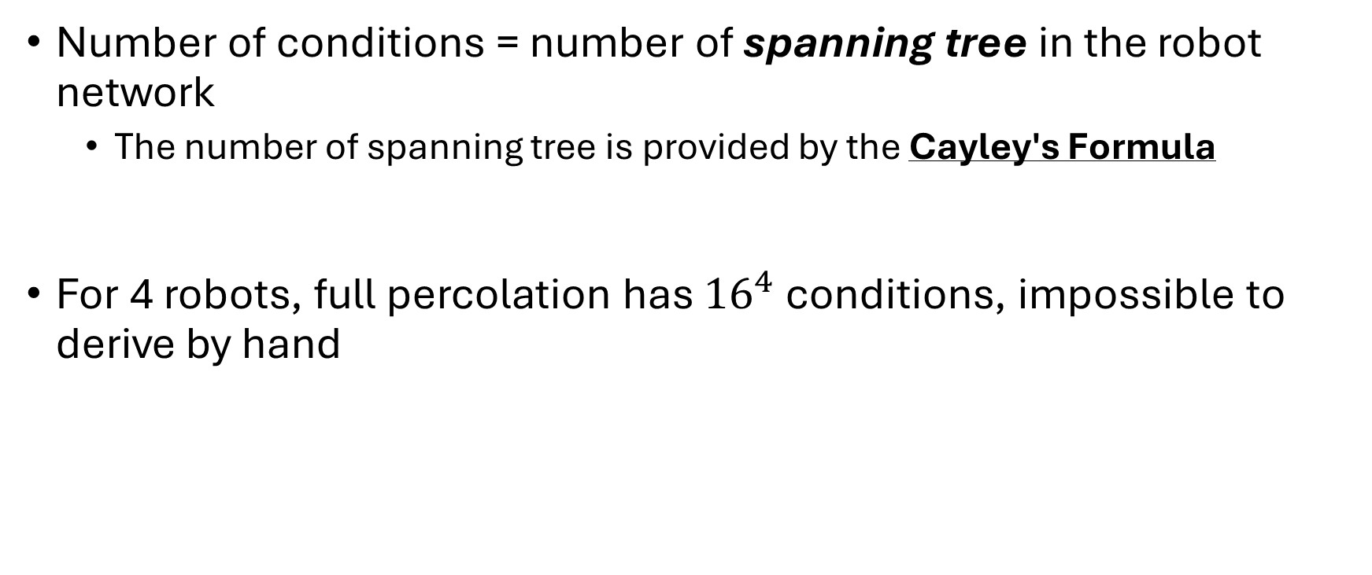
Direct Method Problem
Number of conditions = number of spanning tree in the robot network
The number of spanning tree is provided by the Cayley's Formula
For 4 robots, full percolation has ${16}^{4}$ conditions, impossible to derive by hand
$$N^{N−2}$$

Slide 16
Mean Field Approximation
Popular method for handling statistic problem with large amount of variables
e.g. Ising model, Navier-Stokes, pandemic modelling
Treat the swarm as continuous variables and approximate the dynamic using expected value
E.g. it is possible to have 1.53 robot in a region

Slide 17

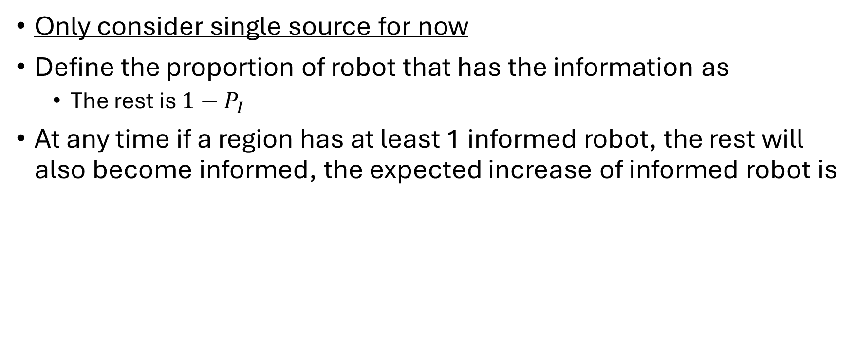

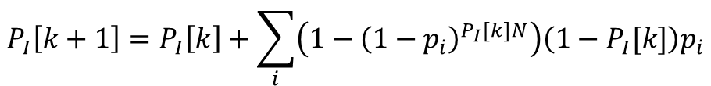
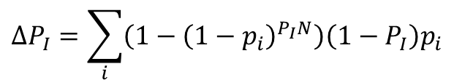
Mean Field Approximation - Formulation
Only consider single source for now
Define the proportion of robot that has the information as
The rest is $1−P_{I}$
At any time if a region has at least 1 informed robot, the rest will also become informed, the expected increase of informed robot is
$$P_{I}$$
$$ΔP_{I}=\sum_{i}{\left(1−{\left(1−p_{i}\right)}^{P_{I}N}\right)\left(1−P_{I}\right)p_{i}}$$
Solve the difference equation
$$P_{I}\left[k+1\right]=P_{I}\left[k\right]+\sum_{i}{\left(1−{\left(1−p_{i}\right)}^{P_{I}[k]N}\right)\left(1−P_{I}[k]\right)p_{i}}$$
Probability of at least one informed robot in the region
Expected number of uninformed robot in the region
$$P_{I}[0]=\frac{1}{N}$$
Only 1 informed robot out of N initially

Slide 18
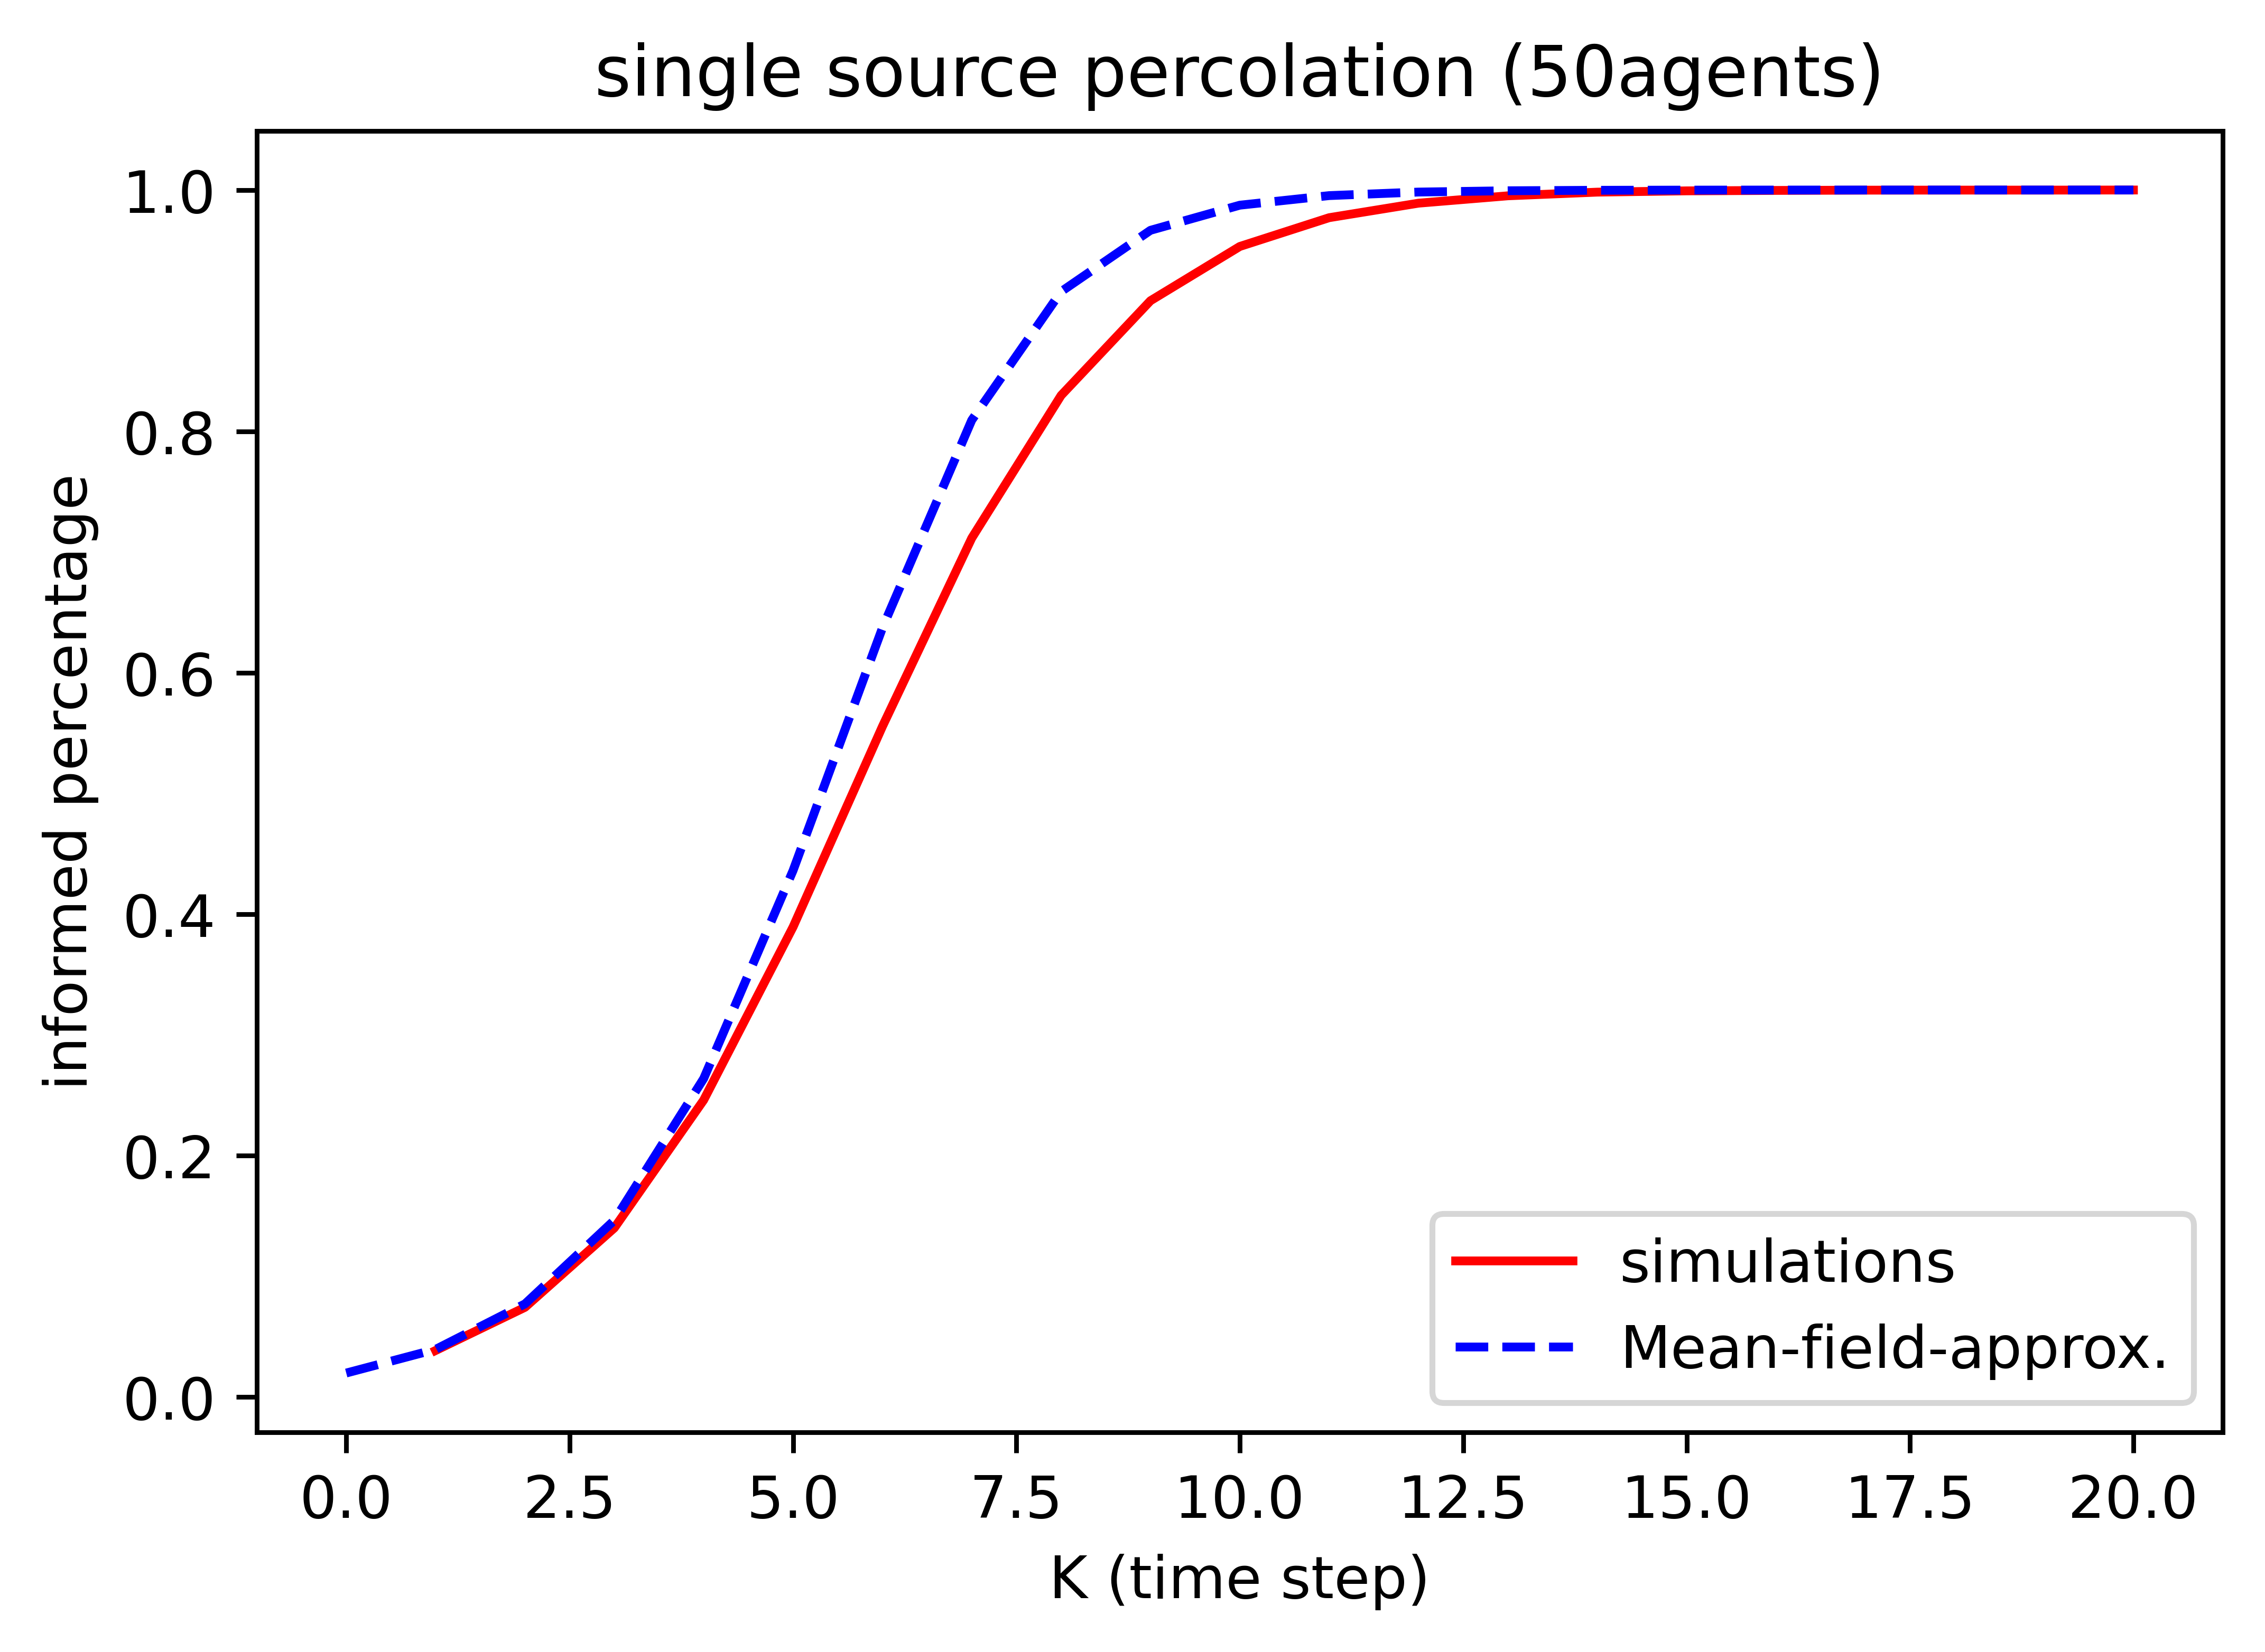
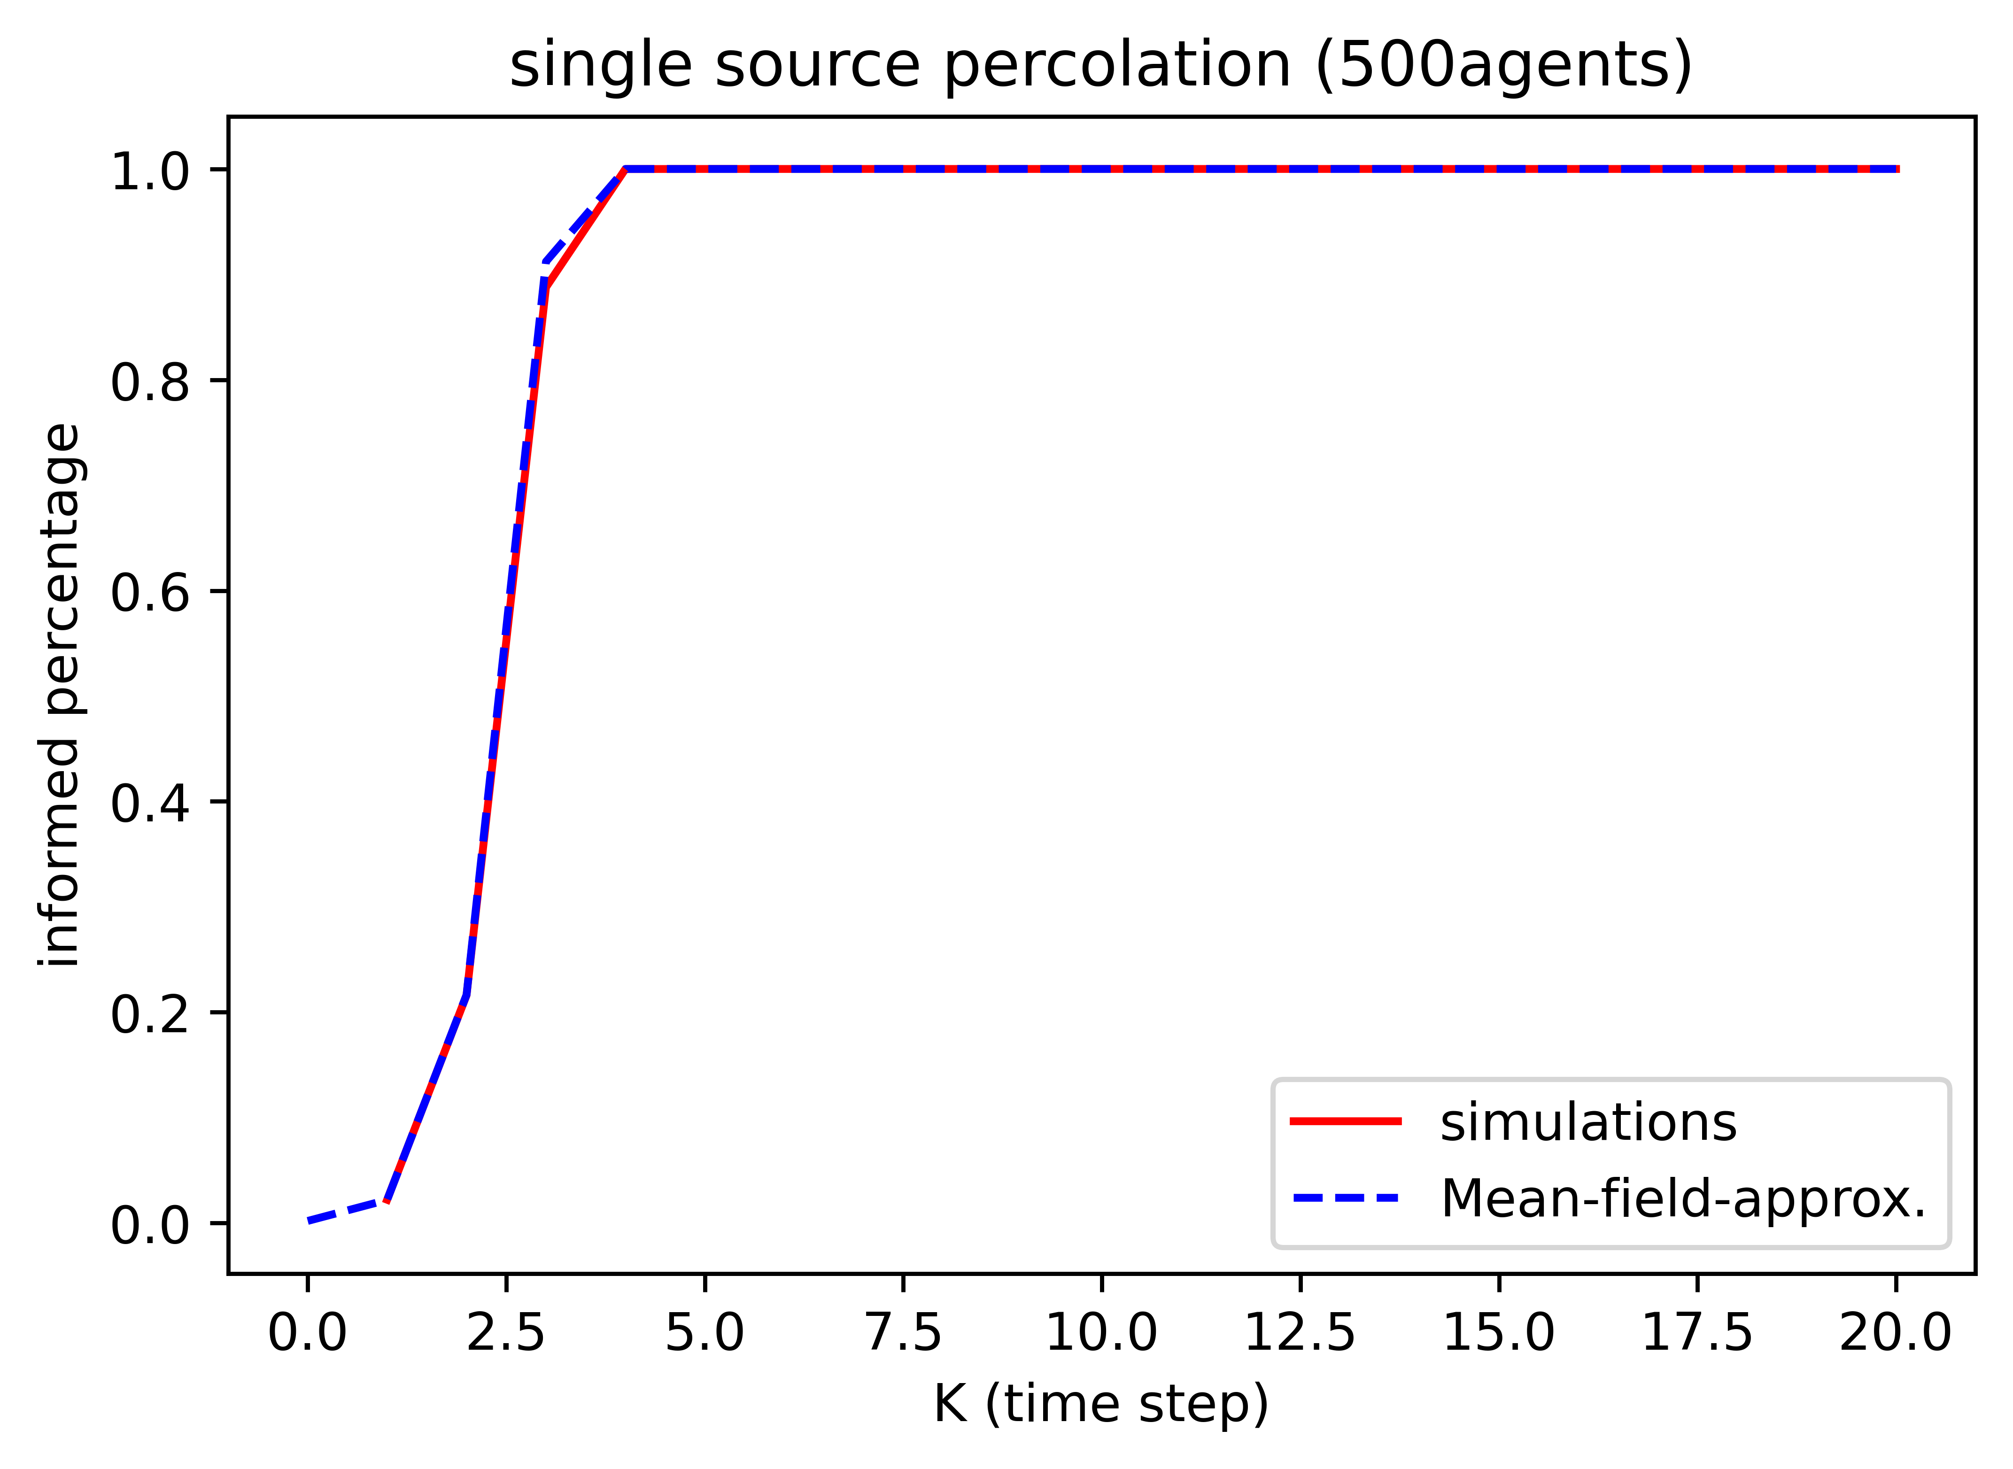
Mean Field Approx – Result
IMPORTANT: y-axis is different from previous plots
Only good for a lot of robots
underestimate with few robots
Hard to translate to critical percolation
The difference equation only approach 1
⇒ Full percolation requires infinite time in MFA
Don’t know how to handle multi-source percolation yet

Slide 19
Markov Chain Formulation
IMPORTANT: this Markov chain is not related to the ergodic Markov chain
Consider the number of informed robot as a state
Every time step, after the robot moved, there is a chance of the numer of informed robots increasing (transition to subsequent state) or stays constant (self loop). But never decrease (go back to previous states)
Eventually the chain terminates at all robots being informed
This is called an absorbing chain
1 informed robot
2 informed robot
N informed robot

Slide 20
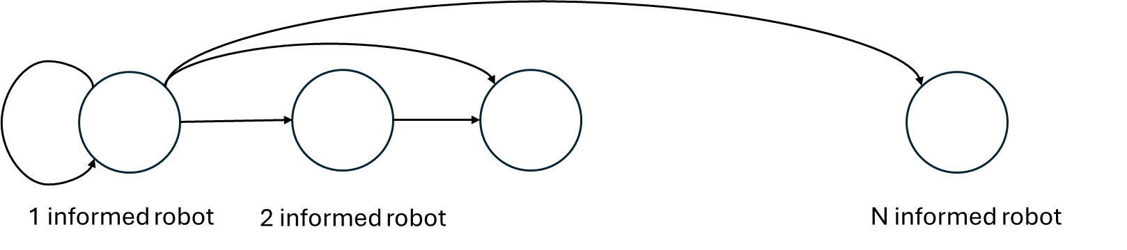




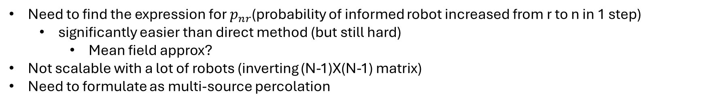


Expected Absorption Time
$$p_{N1}$$
$$p_{11}$$
$$p_{21}$$
The corresponding stochastic matrix is
The expected absorption time is given by
$$Q$$
$$M= \left[\begin{matrix}p_{11} & 0 & 0 & ⋯ & 0 \\ p_{21} & p_{22} & 0 & ⋯ & ⋮ \\ ⋮ & ⋮ & ⋱ & & ⋮ \\ ⋮ & ⋮ & p_{nr} & ⋱ & 0 \\ p_{N1} & p_{N2} & ⋯ & & 1\end{matrix}\right]$$
$${t=1^{T}\left(I−Q\right)}^{−1}{\left[\begin{matrix}1 & 0 & 0 & ⋯ \end{matrix}\right]}^{T}$$
Need to find the expression for $p_{nr}$(probability of informed robot increased from r to n in 1 step)
significantly easier than direct method (but still hard)
Mean field approx?
Not scalable with a lot of robots (inverting (N-1)X(N-1) matrix)
Need to formulate as multi-source percolation

Slide 21
Summary
Mean-field Approx.
Good for more robots
Only model informed percentage
Single Source
Markov chain absorption time
No expression of transition rate yet
Has to inverse big matrix
Percolation
On Markov chain
Complete Graph assumption
(time independent)
3-robot solution
Not generalizable
Multi-Source
Direct meeting assumption
Does not consider indirect information spread
Erdos-Renyi
Only good for small meeting chance
Not considering forward information flow

Slide 22
1/29/26 Updates

Slide 23

Recep
Single source percolation can be estimated with first hit model if the transition probability of the Markov model can be found
E.g. If 2 robot is informed, what is the probability that 5 will be informed in the next step

Slide 24


First Hitting Time Method (fully connected)
Pairwise approximation
(accurate if meeting chance is not too high)
Pairwise meeting chance
(fully connected)
$$Q$$
$$p_{nr}=\operatorname{Pr}\left(r newly informed | n informed\right)= C_{r}^{N−n}{\left(1−{\left(1−S_{2}\right)}^{n} \right)}^{r}{\left({\left(1−S_{2}\right)}^{n}\right)}^{N−n−r}$$
$$M= \left[\begin{matrix}p_{11} & 0 & 0 & ⋯ & 0 \\ p_{21} & p_{22} & 0 & ⋯ & ⋮ \\ ⋮ & ⋮ & ⋱ & & ⋮ \\ ⋮ & ⋮ & p_{nr} & ⋱ & 0 \\ p_{N1} & p_{N2} & ⋯ & & 1\end{matrix}\right]$$
How many way to get r uninformed robots
r robots meet with at least 1 informed robots
Rest of the uninformed robot does not meet with any informed robot
Initial distribution
$$\operatorname{Pr}\left(N informed at k\right)=1−1^{T}Q^{k}{\left[\begin{matrix}1 & 0 & 0 & ⋯\end{matrix}\right]}^{T}$$
Probability of not absorbed in k step

Slide 25
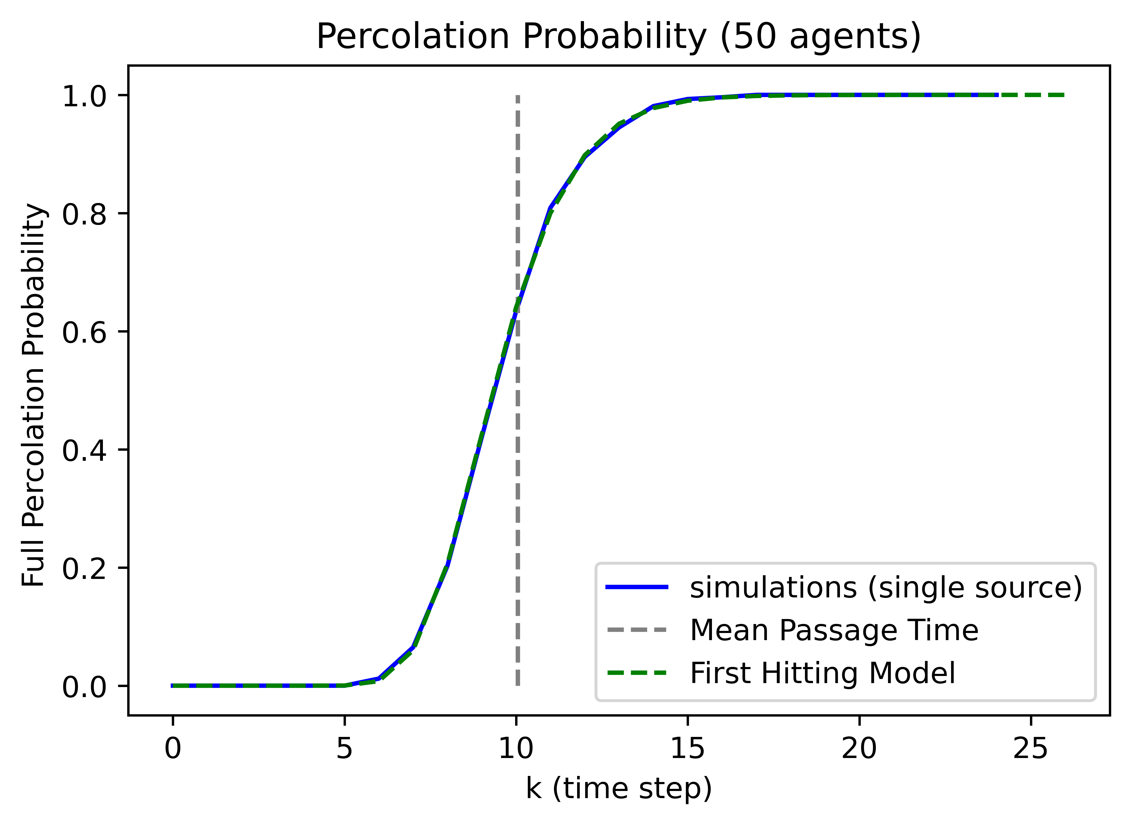

Slide 26


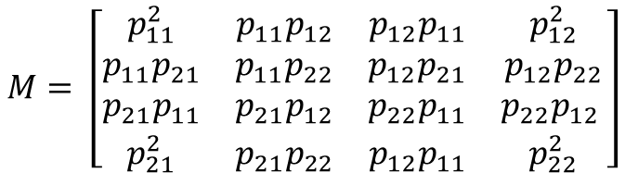







Pairwise Meeting Chance on Region Graph
Region graph
Consider 2 agents on a region graph with a given transition matrix
Create new state space with the cartesian product
Find initial state in combined state space
Remove “collision states”
$$p_{12}$$
Initial distribution
$$p_{11}$$
1
2
$$ρ_{0}={\left[\begin{matrix}ρ_{0,1} & ρ_{0,2}\end{matrix}\right]}^{T}$$
Cartesian product
$$\operatorname{Pr}\left(meet at least once within k\right)=1−1^{T}Q^{k}q_{o}$$
1,1
$$p_{11}p_{21}$$
(1,1)
(1,2)
(2,1)
(2,2)
1,2
$$Q$$
$$p_{11}p_{21}$$
$$M= \left[\begin{matrix}p_{11}^{2} & p_{11}p_{12} & p_{12}p_{11} & p_{12}^{2} \\ p_{11}p_{21} & p_{11}p_{22} & p_{12}p_{21} & p_{12}p_{22} \\ p_{21}p_{11} & p_{21}p_{12} & p_{22}p_{11} & p_{22}p_{12} \\ p_{21}^{2} & p_{21}p_{22} & p_{12}p_{11} & p_{22}^{2}\end{matrix}\right]$$
2,1
$$p_{21}^{2}$$
2,2
$$m_{0}={\left[\begin{matrix}ρ_{0,1}^{2} & ρ_{0,1}ρ_{0,2} & ρ_{0,2}ρ_{0,1} & ρ_{0,2}^{2}\end{matrix}\right]}^{T}$$
$$q_{0}$$

Slide 27
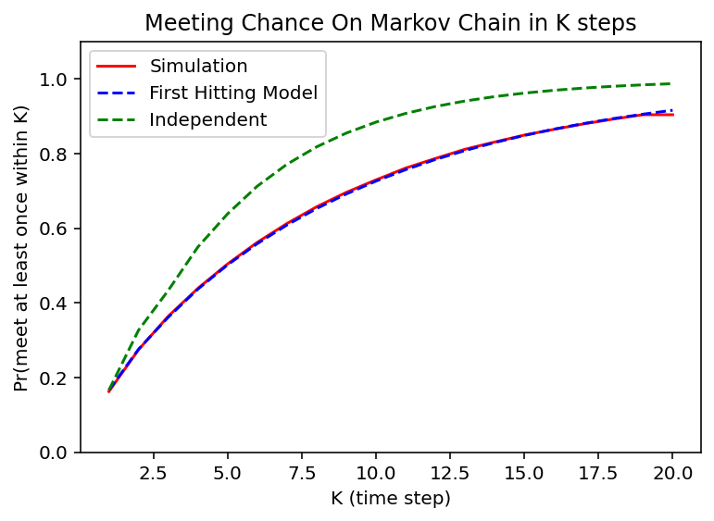

Slide 28
Conditional Pairwise Meeting Chance
We need the conditional meeting chance
Given that the robot never met an informed robot, what is the chance of meeting an informed robot in the next step
1s at collision states
$$\operatorname{Pr}{(first meet at k)= \left[\begin{matrix}1 & 0 & 0 & 1 & ⋯\end{matrix}\right]PQ^{k−1}q_{0}}$$
Space distribution never met from 0 to k-1
$$\operatorname{Pr}\left(meet at K \right|never met before)= \frac{\operatorname{Pr}{(first meet at K)}}{1−\sum_{1}^{K−1}{\operatorname{Pr}{(first meet at k)}}}$$
(Probably can be simplified)
Interesting effect: the longer K is, the lower this probability is, but approach a fix value for very big K
Interpretation: if they haven’t meet in a long time, they probably are initially very far away in the region graph

Slide 29
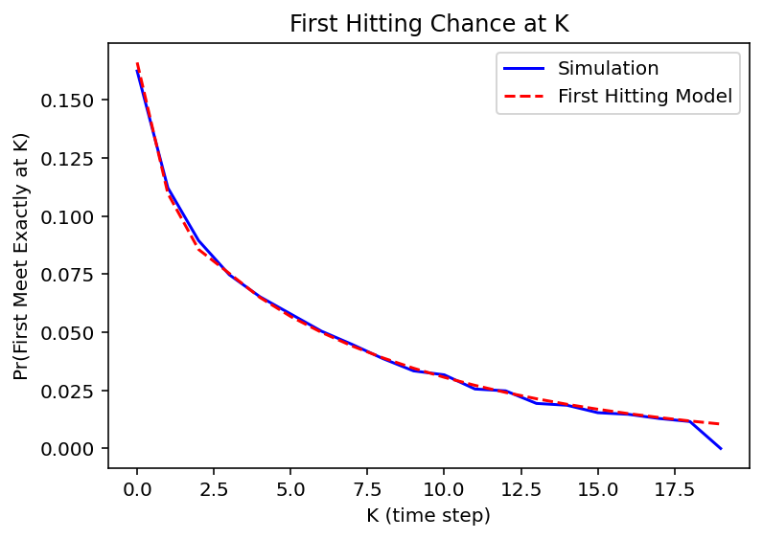

Slide 30
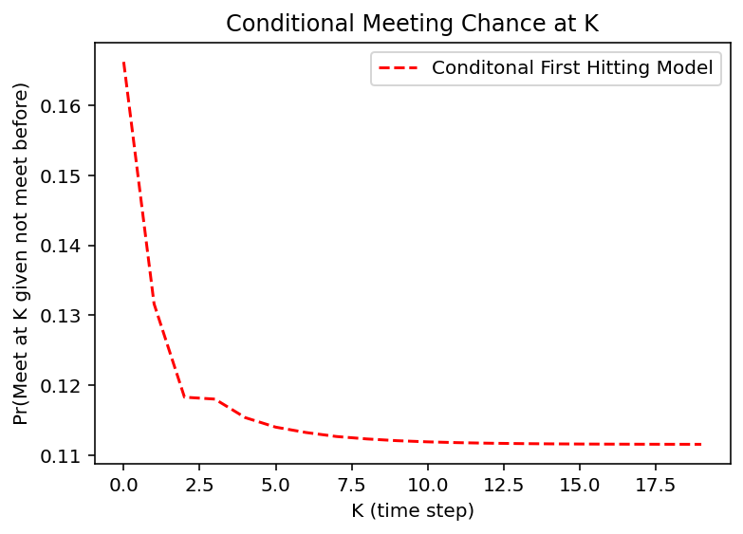

Slide 31
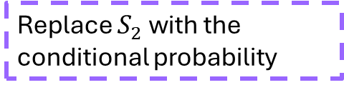
Combine Meeting chance and percolation
Fully connected percolation transition probability
$$p_{nr}=\operatorname{Pr}\left(r newly informed | n informed\right)= C_{r}^{N−n}{\left(1−{\left(1−S_{2}\right)}^{n} \right)}^{r}{\left({\left(1−S_{2}\right)}^{n}\right)}^{N−n−r}$$
Now its time varying
$$p_{nr}[k]=\operatorname{Pr}\left(r newly informed | n informed\right)= C_{r}^{N−n}{\left(1−{\left(1−S_{2}\right)}^{n} \right)}^{r}{\left({\left(1−S_{2}\right)}^{n}\right)}^{N−n−r}$$
Replace $S_{2}$ with the conditional probability
$$\operatorname{Pr}\left(meet at K \right|never meet before)=\frac{\operatorname{Pr}{(first meet at K)}}{1−\sum_{k=0}^{K−1}{\operatorname{Pr}{(first meet at k)}}}$$

Slide 32
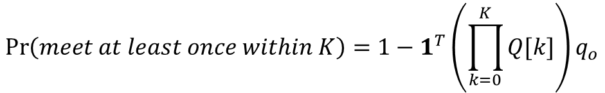
Time varying first hit model
$$\operatorname{Pr}\left(meet at least once within k\right)=1−1^{T}Q^{k}q_{o}$$
Original first hit model
$$\operatorname{Pr}\left(meet at least once within K\right)=1−1^{T}\left(\prod_{k=0}^{K}{Q[k]}\right)q_{o}$$
Time varying first hit model

Slide 33
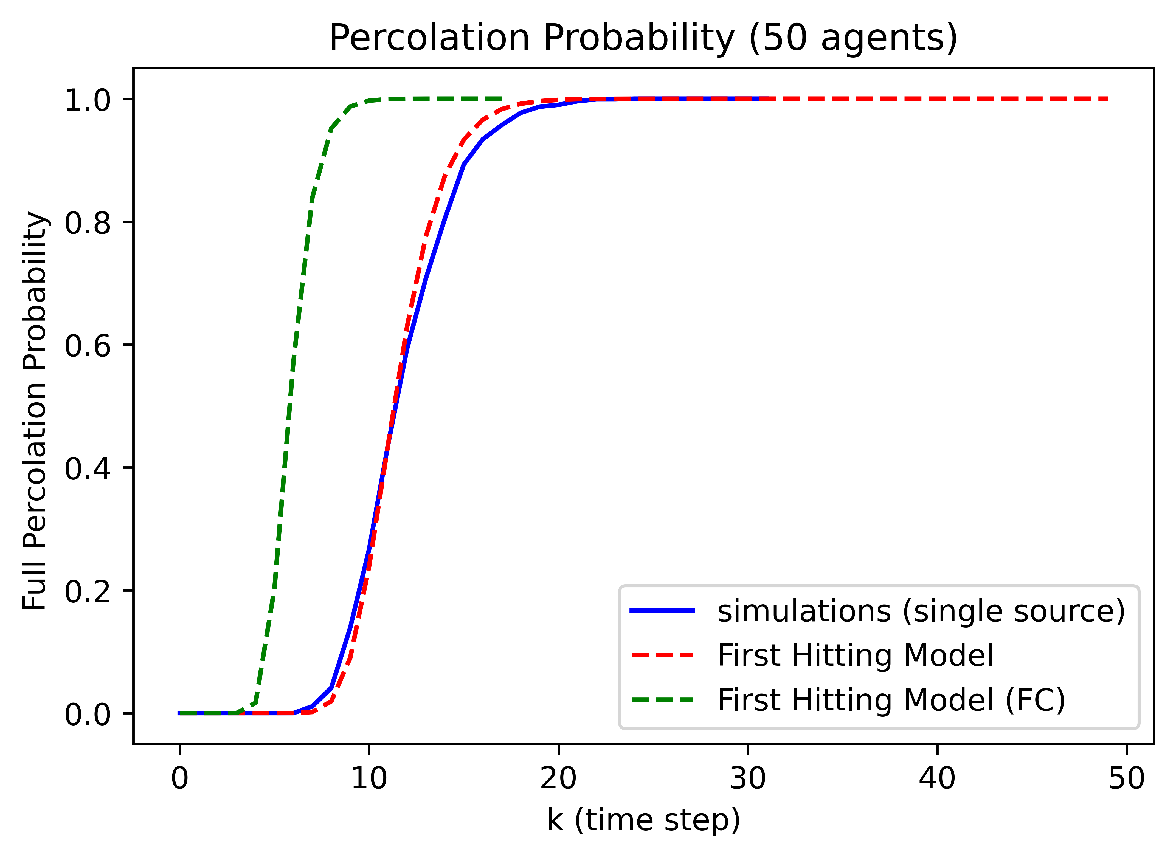

Slide 34
2/28/26

Slide 35

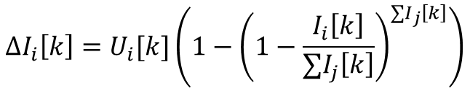

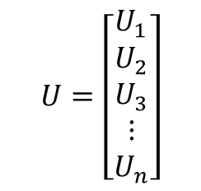

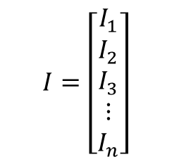
Graph-MFA
$$I=\left[\begin{matrix}I_{1} \\ \begin{aligned}I_{2} \\ I_{3} \\ ⋮ \\ I_{n}\end{aligned}\end{matrix}\right]$$
Number of informed robots in each region
$I\left[k+1\right]=P(I\left[k\right]+ΔI[k]$)
$$U=\left[\begin{matrix}U_{1} \\ \begin{aligned}U_{2} \\ U_{3} \\ ⋮ \\ U_{n}\end{aligned}\end{matrix}\right]$$
Number of uninformed robots in each region
$U\left[k+1\right]=P(U\left[k\right]−ΔI[k]$)
$$ΔI_{i}\left[k\right]=U_{i}[k]\left(1−{\left(1−\frac{I_{i}\left[k\right]}{∑I_{j}\left[k\right]}\right)}^{∑I_{j}\left[k\right]}\right)$$
$$1^{⊤}(I+U)=N$$
Problem: probability is not independent in time

Slide 36

Informed probability
$$p_{nr}=\operatorname{Pr}\left(r newly informed | n informed\right)= C_{r}^{N−n}{\left(\operatorname{Pr}{(\text{informed} \text{at} k)}\right)}^{r}{\left(1−\operatorname{Pr}{(\text{informed} \text{at} k)}\right)}^{N−n−r}$$
Need $\operatorname{Pr}\left(\text{informed} at k\right| \text{not} \text{informed} \text{for} k−1, I[k])$
$$\operatorname{Pr}\left(\text{informed} at k\right| \text{not} \text{informed} \text{for} k−1,I[k])= \frac{P(\text{first} \text{informed} \text{at} k\text{ | }I[k])}{P\left(\text{not} \text{informed} \text{for} k−1 \right| I[k])}$$
i.e. It is more likely to not be informed if haven’t been inform for a long time

Slide 37
03/09/2026

Slide 38
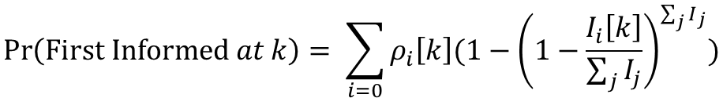
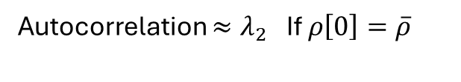
Approximation?
$$\operatorname{Pr}\left(\text{First} \text{Informed} at k\right)= \sum_{i=0}{ρ_{i}\left[k\right](1−{\left(1−\frac{I_{i}\left[k\right]}{\sum_{j}{I_{j}}}\right)}^{\sum_{j}{I_{j}}})}$$
Autocorrelation $≈λ_{2} \text{If} ρ\left[0\right]=\overline{ρ}$
$$\operatorname{Pr}\left(\text{First} \text{Informed} at k| \text{not} \text{informed} \text{before} k\right)≤\frac{1}{1+λ_{2}}Pr\left(\text{First} \text{Informed} at k\right)$$

Slide 39
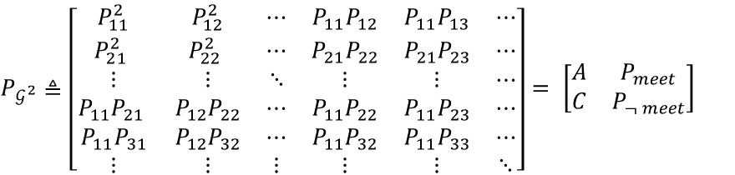
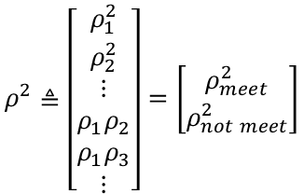


(1,1)
(2,2)
(1,2)
(1,3)
$$ρ≜\left[\begin{aligned}ρ_{1} \\ ρ_{2} \\ ⋮\end{aligned}\right]$$
$$P≜ \left[\begin{matrix}P_{11} & P_{12} & ⋯ \\ P_{21} & P_{22} & ⋯ \\ ⋮ & ⋮ & ⋱\end{matrix}\right]$$
$$ρ^{2}≜\left[\begin{aligned}\begin{matrix}ρ_{1}^{2} \\ ρ_{2}^{2}\end{matrix} \\ ⋮ \\ ρ_{1}ρ_{2} \\ ρ_{1}ρ_{3} \\ ⋮\end{aligned}\right]=\left[\begin{aligned}ρ_{meet}^{2} \\ ρ_{not meet}^{2}\end{aligned}\right]$$
$P_{𝒢^{2}}≜\left[\begin{matrix}P_{11}^{2} & P_{12}^{2} & ⋯ & P_{11}P_{12} & P_{11}P_{13} & ⋯ \\ P_{21}^{2} & P_{22}^{2} & ⋯ & P_{21}P_{22} & P_{21}P_{23} & ⋯ \\ ⋮ & ⋮ & ⋱ & ⋮ & ⋮ & ⋯ \\ P_{11}P_{21} & P_{12}P_{22} & ⋯ & P_{11}P_{22} & P_{11}P_{23} & ⋯ \\ P_{11}P_{31} & P_{12}P_{32} & ⋯ & P_{11}P_{32} & P_{11}P_{33} & ⋯ \\ ⋮ & ⋮ & ⋮ & ⋮ & ⋮ & ⋱\end{matrix}\right]= \left[\begin{matrix}A & P_{meet} \\ C & P_{¬ meet}\end{matrix}\right]$
Combined distribution
Combined transition
$$\operatorname{Pr}\left(Meeting at K\right)=\left[\begin{matrix}1_{n}^{T} & 0\end{matrix}\right]{\left(P_{𝒢^{2}}\right)}^{K}ρ^{2}[0]={\left(ρ\left[K\right]\right)}^{T}ρ\left[K\right]$$
$$\operatorname{Pr}\left(Not Meeting within K\right)=\left[\begin{matrix}0_{n} & 1^{T}\end{matrix}\right]{\left[\begin{matrix}0 & 0 \\ 0 & P_{¬meet}\end{matrix}\right]}^{K}\left[\begin{aligned}0 \\ ρ_{¬ meet}^{2}[0]\end{aligned}\right]$$
$$Pr\left(First Meeting at K\right){=\left[\begin{matrix}1_{n}^{T} & 0\end{matrix}\right]\left(P_{𝒢^{2}}\right){\left[\begin{matrix}0 & 0 \\ 0 & P_{¬meet}\end{matrix}\right]}^{K−1}}\left[\begin{aligned}0 \\ ρ_{¬meet}^{2}[0]\end{aligned}\right]$$
$$\operatorname{Pr}\left(Meeting at K| not met before K\right)=\frac{Pr\left(First Meeting at K\right)}{\operatorname{Pr}\left(Not Meeting within K−1\right)}=\frac{\left[\begin{matrix}1_{n}^{T} & 0\end{matrix}\right]\left(P_{𝒢^{2}}\right){\left[\begin{matrix}0 & 0 \\ 0 & P_{¬meet}\end{matrix}\right]}^{K−1}\left[\begin{aligned}0 \\ ρ_{¬meet}^{2}[0]\end{aligned}\right]}{\left[\begin{matrix}0_{n} & 1^{T}\end{matrix}\right]{\left[\begin{matrix}0 & 0 \\ 0 & P_{¬meet}\end{matrix}\right]}^{K−1}\left[\begin{aligned}0 \\ ρ_{¬meet}^{2}[0]\end{aligned}\right]}=\frac{{1_{n}^{T}P}_{meet}P_{¬meet}^{K−1}ρ_{¬meet}^{2}[0]}{1_{n}^{T}P_{¬meet}^{K−1}ρ_{¬meet}^{2}[0]}$$

Slide 40
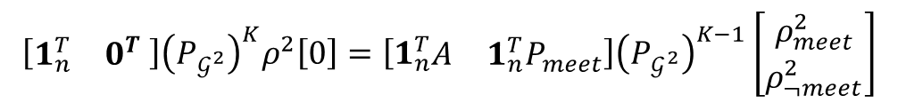

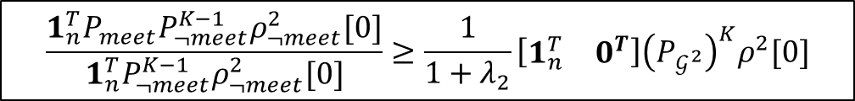
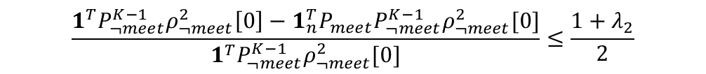



$$\operatorname{Pr}\left(First Meeting at K| not met before K\right)=\frac{{1_{n}^{T}P}_{meet}P_{¬meet}^{K−1}ρ_{¬meet}^{2}[0]}{1^{T}P_{¬meet}^{K−1}ρ_{¬meet}^{2}[0]}= \frac{c^{T}v_{K−1}}{1^{T}v_{K−1 }}$$
$$\min_{v}{\frac{c^{T}v}{1^{T}v}}=\min_{v∈∆}{c^{T}v}=\min_{i}{c_{i}}$$
$$\frac{{1_{n}^{T}P}_{meet}P_{¬meet}^{K−1}ρ_{¬meet}^{2}[0]}{1_{n}^{T}P_{¬meet}^{K−1}ρ_{¬meet}^{2}[0]}≥\frac{1}{{1+λ}_{2}}\left[\begin{matrix}1_{n}^{T} & 0^{T}\end{matrix}\right]{\left(P_{𝒢^{2}}\right)}^{K}ρ^{2}[0]$$
$\frac{1^{T}P_{¬meet}^{K}ρ_{¬meet}^{2}[0]}{1^{T}P_{¬meet}^{K−1}ρ_{¬meet}^{2}[0]}≤ω≤\frac{1+λ_{2}}{2}$ $≤1$
$$\left[\begin{matrix}1_{n}^{T} & 0^{T} \end{matrix}\right]{\left(P_{𝒢^{2}}\right)}^{K}ρ^{2}\left[0\right]={\left[1_{n}^{T}\begin{matrix}A & {1_{n}^{T}P}_{meet}\end{matrix}\right]\left(P_{𝒢^{2}}\right)}^{K−1}\left[\begin{aligned}ρ_{meet}^{2} \\ ρ_{¬meet}^{2}\end{aligned}\right]$$
$$\frac{1^{T}P_{¬meet}^{K−1}ρ_{¬meet}^{2}\left[0\right]−1_{n}^{T}P_{meet}P_{¬meet}^{K−1}ρ_{¬meet}^{2}[0]}{1^{T}P_{¬meet}^{K−1}ρ_{¬meet}^{2}[0]}≤\frac{1+λ_{2}}{2}$$
$$\frac{1_{n}^{T}P_{meet}P_{¬meet}^{K−1}ρ_{¬meet}^{2}\left[0\right]}{1^{T}P_{¬meet}^{K−1}ρ_{¬meet}^{2}\left[0\right]}≥1−\frac{1+λ_{2}}{2}$$
$$\frac{1_{n}^{T}P_{meet}P_{¬meet}^{K−1}ρ_{¬meet}^{2}\left[0\right]}{1^{T}P_{¬meet}^{K−1}ρ_{¬meet}^{2}\left[0\right]}≥\frac{1−λ_{2}}{2}$$

Slide 41
Metastability

Slide 42


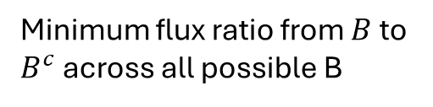

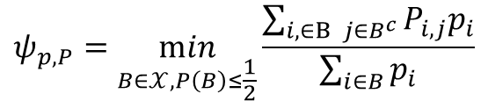
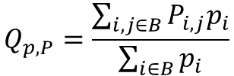
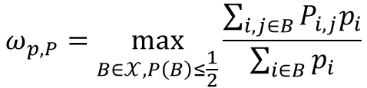


Metastability
$$𝒳$$
$$B^{c}$$
$$B$$
Flux ratio
$$Q_{p,P}=\frac{\sum_{i, j∈B}{P_{i,j}p_{i}}}{\sum_{i∈B}{p_{i}}}$$
Probability of staying in B given already in B
Metastability
Conductance
$$2ω_{p,P }−1≤λ_{P,2}$$
$$ω_{p,P}=\max_{B∈𝒳, P\left(B\right)≤\frac{1}{2}}{\frac{\sum_{i, j∈B}{P_{i,j}p_{i}}}{\sum_{i∈B}{p_{i}}}}$$
$$ψ_{p,P}=\min_{B∈𝒳, P\left(B\right)≤\frac{1}{2}}{\frac{\sum_{i,∈B j∈B^{c}}{P_{i,j}p_{i}}}{\sum_{i∈B}{p_{i}}}}$$
$$\frac{1}{ω_{p,P}}≥\frac{2}{λ_{2}+1}$$
Maximum flux ratio across all possible subset
Minimum flux ratio from $B$ to $B^{c}$ across all possible B

Slide 43





Conditional informed probability
$$\frac{P\left(\text{informed} \text{at} k+1\right)P(\text{uninformed} \text{at} \text{k})}{P(\text{uninformed} \text{at} k+1 )}≥\frac{2}{1+λ_{2}}P(\text{informed} \text{at} k+1)$$
$$Q(\text{uninformed} \text{at} \text{k}\text{)}≤\max_{B}{Q\left(B\right)}=ω$$
objective
$$\frac{1}{Q(\text{uninformed} \text{at} \text{k}\text{)}}≥\frac{1}{ω}≥\frac{2}{1+λ_{2}}$$
$$\frac{P(i\text{nformed} \text{at} k\text{+1 }\& \text{uninformed} \text{at} k)}{P(\text{uninformed} \text{at} \text{k})}≥\frac{1}{1+λ_{2}}P(\text{informed} \text{at} k+1)$$
$$\frac{P(\text{informed} \text{at} k+1)}{Q(\text{uninformed} \text{at} \text{k}\text{)}}≥\frac{2}{1+λ_{2}}P(\text{informed} \text{at} k+1)$$
$B→$all possible uninformed state at k
$$\frac{P\left(\text{informed} \text{at} k+1\right)P(\text{uninformed} \text{at} \text{k})}{\sum_{i,j }{p_{i}P_{i,j}}}≥\frac{2}{1+λ_{2}}P(\text{informed} \text{at} k+1)$$
$B^{c}→$all possible informed state at k
$$\frac{P\left(\text{informed} \text{at} k+1\right)P(\text{uninformed} \text{at} \text{k})}{P(\text{uninformed} \text{at} k+1 \& \text{uninformed} \text{at} k)}≥\frac{2}{1+λ_{2}}P(\text{informed} \text{at} k+1)$$
$$\frac{P\left(\text{informed} \text{at} k+1\right)P(\text{uninformed} \text{at} \text{k})}{P\left(\text{uninformed} \text{at} k\right)−P(\text{informed} \text{at} k+1 \& \text{uninformed} \text{at} k)}≥\frac{2}{1+λ_{2}}P(\text{informed} \text{at} k+1)$$
$$\frac{P\left(\text{uninformed} \text{at} k\right)−P(\text{informed} \text{at} k+1 \& \text{uninformed} \text{at} k)}{P\left(\text{informed} \text{at} k+1\right)P(\text{uninformed} \text{at} \text{k})}≤\frac{1+λ_{2}}{2P(\text{informed} \text{at} k+1)}$$

Slide 44



objective
$$\frac{P(i\text{nformed} \text{at} k\text{+1 }\& \text{uninformed} \text{at} k)}{P(\text{uninformed} \text{at} \text{k})}≥\frac{1}{1+λ_{2}}P(\text{informed} \text{at} k+1)≥\frac{1−λ_{2}}{2}$$
$$1−\frac{P(\text{informed} \text{at} k+1 \& \text{uninformed} \text{at} k)}{P(\text{uninformed} \text{at} \text{k})}≤\frac{1+λ_{2}}{2}$$
$$1−\frac{1+λ_{2}}{2}≤\frac{P(\text{informed} \text{at} k+1 \& \text{uninformed} \text{at} k)}{P(\text{uninformed} \text{at} \text{k})}$$
$$\frac{1−λ_{2}}{2}≤\frac{P(\text{informed} \text{at} k+1 \& \text{uninformed} \text{at} k)}{P(\text{uninformed} \text{at} \text{k})}$$
$$\frac{(1−λ_{2})P(\text{informed} \text{at} \text{k}\text{+1)}}{2P(\text{informed} \text{at} \text{k}\text{+1)}}≤\frac{P(\text{informed} \text{at} k+1 \& \text{uninformed} \text{at} k)}{P(\text{uninformed} \text{at} \text{k})}$$

Slide 45
Full Absorbing Chain Method

Slide 46

Mean field method requires $λ_{2}$ correction
Because ignored graph structure
Informed probability is a matrix not a scalar
Need to estimate where the robots are informed

Slide 47







Region-aware absorbing chain
Expand nodes to sub-graphs
1 informed robot
2 informed robot
3 informed robot
2 uninformed robot in region 1,
1 informed robot in region 2
$$\left[\begin{matrix}1 \\ \begin{aligned}0 \\ ⋮\end{aligned}\end{matrix}\right],\left[\begin{matrix}0 \\ \begin{aligned}2 \\ ⋮\end{aligned}\end{matrix}\right]$$
$$\left[\begin{matrix}0 \\ \begin{aligned}0 \\ ⋮\end{aligned}\end{matrix}\right],\left[\begin{matrix}3 \\ \begin{aligned}0 \\ ⋮\end{aligned}\end{matrix}\right]$$
$$\left[\begin{matrix}2 \\ \begin{aligned}0 \\ ⋮\end{aligned}\end{matrix}\right],\left[\begin{matrix}0 \\ \begin{aligned}1 \\ ⋮\end{aligned}\end{matrix}\right]$$
$$\left[\begin{matrix}0 \\ \begin{aligned}0 \\ ⋮\end{aligned}\end{matrix}\right],\left[\begin{matrix}2 \\ \begin{aligned}1 \\ ⋮\end{aligned}\end{matrix}\right]$$
$$\left[\begin{matrix}0 \\ \begin{aligned}2 \\ ⋮\end{aligned}\end{matrix}\right],\left[\begin{matrix}1 \\ \begin{aligned}0 \\ ⋮\end{aligned}\end{matrix}\right]$$
$$\left[\begin{matrix}0 \\ \begin{aligned}1 \\ ⋮\end{aligned}\end{matrix}\right],\left[\begin{matrix}2 \\ \begin{aligned}0 \\ ⋮\end{aligned}\end{matrix}\right]$$
$$\left[\begin{matrix}0 \\ \begin{aligned}0 \\ ⋮\end{aligned}\end{matrix}\right],\left[\begin{matrix}0 \\ \begin{aligned}3 \\ ⋮\end{aligned}\end{matrix}\right]$$

Slide 48












N=3, n=2
$$p_{11}^{2}p_{22}+2p_{11}p_{21}p_{22}+p_{11}^{2}p_{12}+2p_{12}p_{11}p_{21}+p_{12}p_{21}^{2}+p_{21}^{2}p_{22}=1$$
$$I=1$$
$$I=2$$
$$\left[\begin{matrix}2 \\ 0\end{matrix}\right],\left[\begin{matrix}0 \\ 1\end{matrix}\right]$$
$$\left[\begin{matrix}0 \\ 2\end{matrix}\right],\left[\begin{matrix}1 \\ 0\end{matrix}\right]$$
$$\left[\begin{matrix}1 \\ 0\end{matrix}\right],\left[\begin{matrix}0 \\ 2\end{matrix}\right]$$
$$\left[\begin{matrix}0 \\ 1\end{matrix}\right],\left[\begin{matrix}2 \\ 0\end{matrix}\right]$$
$$P=\left[\begin{matrix}p_{11}^{2}p_{22} & p_{12}^{2}p_{21} & 0 & 0 & 0 \\ p_{12}p_{21}^{2} & {p_{11}p}_{22}^{2} & 0 & 0 & 0 \\ 2p_{11}p_{21}p_{22} & 2p_{21}p_{22}p_{12} & p_{11}p_{22}^{2} & p_{12}p_{21}^{2} & 0 \\ 2p_{12}p_{11}p_{21} & 2p_{11}p_{12}p_{22} & {p_{12}^{2}p}_{21} & {p_{11}^{2}p}_{22} & 0 \\ p_{11}^{2}p_{12}+p_{21}^{2}p_{22} & p_{22}^{2}p_{21}+p_{12}^{2}p_{11} & 1−p_{11}p_{22}^{2}−{p_{12}^{2}p}_{21} & 1−p_{12}p_{21}^{2}+p_{21}p_{22}^{2} & 1\end{matrix}\right]$$
$$=\left[\begin{matrix}Q_{11} & 0 & 0 \\ Q_{21} & Q_{22} & 0 \\ q_{31}^{T} & q_{32}^{T} & 1\end{matrix}\right]$$
$$\operatorname{Pr}{(\text{informed} \text{at} k)}≈\frac{1}{1+λ_{2}}(1−{\left(1−ρ^{T}ρ\right)}^{∑I }) ≈\frac{1}{1+λ_{2}}\sum_{i=0}{ρ_{i}\left[k\right](1−{\left(1−\frac{I_{i}\left[k\right]}{\sum_{j}{I_{j}}}\right)}^{\sum_{j}{I_{j}}})}$$
$$\operatorname{Pr}\left(\text{1 }\text{informed} \text{at} \text{K}\right)={1^{T}Q}_{11}^{K}\left[\begin{matrix}ρ_{1}^{2}ρ_{2} \\ ρ_{1}ρ_{2}^{2}\end{matrix}\right]$$
$$\operatorname{Pr}\left(\text{2 }\text{informed} \text{exactly} \text{at} \text{K}\right)=1^{T}Q_{21}Q_{11}^{K−1}\left[\begin{matrix}ρ_{1}^{2}ρ_{2} \\ ρ_{1}ρ_{2}^{2}\end{matrix}\right]$$
$${Q_{rn}≈p_{rn}=C}_{r}^{N−n}{\left(\operatorname{Pr}{(\text{informed} \text{at} k)}\right)}^{r}{\left(1−\operatorname{Pr}{(\text{informed} \text{at} k)}\right)}^{N−n−r}$$
$$\operatorname{Pr}\left(\text{3 }\text{informed} \text{exactly} \text{at} \text{K}\right)=\left[\begin{matrix}q_{31}^{T} & q_{32}^{T}\end{matrix}\right]{\left[\begin{matrix}Q_{11} & 0 \\ Q_{21} & Q_{22}\end{matrix}\right]}^{K−1}\left[\begin{matrix}ρ_{1}^{2}ρ_{2} \\ ρ_{1}ρ_{2}^{2} \\ ρ_{1}ρ_{2}^{2} \\ ρ_{1}^{2}ρ_{2}\end{matrix}\right]$$
$$λ\left(P\right)=\bigcup{λ(Q_{ii})}≤λ_{2}$$

Slide 49

$$\operatorname{Pr}\left(\text{3 }\text{informed} \text{a}\text{t} \text{K}\right)=1−{1^{T}\left[\begin{matrix}Q_{11} & 0 \\ Q_{21} & Q_{22}\end{matrix}\right]}^{K}\left[\begin{matrix}ρ_{1}^{2}ρ_{2} \\ ρ_{1}ρ_{2}^{2} \\ ρ_{1}ρ_{2}^{2} \\ ρ_{1}^{2}ρ_{2}\end{matrix}\right]$$

Slide 50

How many way to arrange $i$ informed robots out of $N$ robots in $n$ regions, such that no uninformed robots get informed
$$\dim\left(Q_{ii}\right)=C_{i}^{n+i−1}C^{}$$
Eigenvalues of block triangular matrix is union of eigenvalues of the blocks

Slide 51
10/05/26

Slide 52







$$p_{j}\left[k\right]=e_{j}^{T}P^{k}p\left[0\right]$$
$$\sum_{i∈A}{p_{i}}\left[k\right]=1_{A}^{T}P^{k}p\left[0\right]$$
$$P_{BA}[k]=\frac{\sum_{i∈B j∈A}{P_{ij}p_{j}[k]}}{\sum_{j∈A}{p_{j}}[k]}$$
$$=\frac{(\sum_{i∈B, j∈A}{P_{ij}e_{j}^{T})P^{k}p\left[0\right]}}{1_{A}^{T}P^{k}p\left[0\right]}$$
$$=\frac{{1^{T}Q_{BA}P}^{k}p\left[0\right]}{1_{A}^{T}P^{k}p\left[0\right]}$$
(Flux ratio)
A
$$P_{BA}$$
B
Lumped chain
A
B
$$\left[\begin{matrix}2 \\ \begin{aligned}0 \\ ⋮\end{aligned}\end{matrix}\right],\left[\begin{matrix}0 \\ \begin{aligned}1 \\ ⋮\end{aligned}\end{matrix}\right]$$
$$\left[\begin{matrix}1 \\ \begin{aligned}0 \\ ⋮\end{aligned}\end{matrix}\right],\left[\begin{matrix}0 \\ \begin{aligned}2 \\ ⋮\end{aligned}\end{matrix}\right]$$
$$\left[\begin{matrix}0 \\ \begin{aligned}2 \\ ⋮\end{aligned}\end{matrix}\right],\left[\begin{matrix}1 \\ \begin{aligned}0 \\ ⋮\end{aligned}\end{matrix}\right]$$
$$\left[\begin{matrix}0 \\ \begin{aligned}1 \\ ⋮\end{aligned}\end{matrix}\right],\left[\begin{matrix}2 \\ \begin{aligned}0 \\ ⋮\end{aligned}\end{matrix}\right]$$

Slide 53




$$P_{BA}[k]=\frac{\sum_{i∈B, j∈A}{P_{ij}p_{j}[k]}}{\sum_{j∈A}{p_{j}}[k]}$$
$$P=\left[\begin{matrix}p_{11}^{2}p_{22} & p_{12}^{2}p_{21} & 0 & 0 & 0 \\ p_{12}p_{21}^{2} & {p_{11}p}_{22}^{2} & 0 & 0 & 0 \\ 2p_{11}p_{21}p_{22} & 2p_{21}p_{22}p_{12} & p_{11}p_{22}^{2} & p_{12}p_{21}^{2} & 0 \\ 2p_{12}p_{11}p_{21} & 2p_{11}p_{12}p_{22} & {p_{12}^{2}p}_{21} & {p_{11}^{2}p}_{22} & 0 \\ p_{11}^{2}p_{12}+p_{21}^{2}p_{22} & p_{22}^{2}p_{21}+p_{12}^{2}p_{11} & 1−p_{11}p_{22}^{2}−{p_{12}^{2}p}_{21} & 1−p_{12}p_{21}^{2}+p_{21}p_{22}^{2} & 1\end{matrix}\right]$$
$$P_{21}\left[k\right]=\frac{{1^{T}\left[\begin{matrix}0 & 0 & 0 \\ Q_{21} & 0 & 0 \\ 0 & 0 & 0\end{matrix}\right]\left[\begin{matrix}Q_{11} & 0 & 0 \\ Q_{21} & Q_{22} & 0 \\ q_{31} & q_{32} & 1\end{matrix}\right]}^{k}p\left[0\right]}{1_{A}^{T}{\left[\begin{matrix}Q_{11} & 0 & 0 \\ Q_{21} & Q_{22} & 0 \\ q_{31} & q_{32} & 1\end{matrix}\right]}^{k}p\left[0\right]}$$
$$=\frac{1^{T}\left[\begin{matrix}0 & 0 & 0 \\ Q_{21} & 0 & 0 \\ 0 & 0 & 0\end{matrix}\right]\left[\begin{matrix}Q_{11}^{k} & 0 & 0 \\ 0 & 0 & 0 \\ 0 & 0 & 0\end{matrix}\right]p\left[0\right]}{1^{T}\left[\begin{matrix}Q_{11}^{k} & 0 & 0 \\ 0 & 0 & 0 \\ 0 & 0 & 0\end{matrix}\right]p\left[0\right]}$$
$$≈\frac{1^{T}Q_{21}π(Q_{11})}{1^{T}π(Q_{11})}$$
$$\frac{v^{T}NMn}{v^{T}Mn}$$
Approximate with normalized first eigenvector (quasi stable distribution) of Q11

Slide 54


Slide 55






















1 robot getting informed in 1 step
informed
$$N_{I}=2, n=2$$
meet
$$ρ_{𝒢 }=\frac{1}{ρ_{1}ρ_{2}^{2}+ρ_{1}^{2}ρ_{2}}\left[\begin{matrix}ρ_{1}ρ_{2}^{2} \\ ρ_{1}^{2}ρ_{2}\end{matrix}\right]$$
Uninformed
$$p_{11}p_{12}^{2}$$
$$\left[\begin{matrix}1 \\ \begin{aligned}0\end{aligned}\end{matrix}\right],\left[\begin{matrix}2 \\ \begin{aligned}0\end{aligned}\end{matrix}\right]$$
$$p_{11}p_{22}^{2}$$
$$p_{11}^{2}p_{12}$$
$$\left[\begin{matrix}1 \\ \begin{aligned}0\end{aligned}\end{matrix}\right],\left[\begin{matrix}0 \\ \begin{aligned}2\end{aligned}\end{matrix}\right]$$
$$\left[\begin{matrix}1 \\ \begin{aligned}0\end{aligned}\end{matrix}\right],\left[\begin{matrix}0 \\ \begin{aligned}2\end{aligned}\end{matrix}\right]$$
$$2p_{11}p_{12}p_{22}$$
$$\left[\begin{matrix}1 \\ \begin{aligned}0\end{aligned}\end{matrix}\right],\left[\begin{matrix}1 \\ \begin{aligned}1\end{aligned}\end{matrix}\right]$$
$${2p}_{11}p_{21}p_{12}$$
$$p_{21}p_{12}^{2}$$
$$p_{12}p_{21}^{2}$$
$$2p_{21}p_{22}p_{12}$$
$$\left[\begin{matrix}0 \\ \begin{aligned}1\end{aligned}\end{matrix}\right],\left[\begin{matrix}1 \\ \begin{aligned}1\end{aligned}\end{matrix}\right]$$
$$\left[\begin{matrix}0 \\ \begin{aligned}1\end{aligned}\end{matrix}\right],\left[\begin{matrix}2 \\ \begin{aligned}0\end{aligned}\end{matrix}\right]$$
$$\left[\begin{matrix}0 \\ \begin{aligned}1\end{aligned}\end{matrix}\right],\left[\begin{matrix}2 \\ \begin{aligned}0\end{aligned}\end{matrix}\right]$$
$$2p_{11}p_{22}p_{12}$$
$$p_{22}p_{11}^{2}$$
$$2p_{21}p_{22}^{2}$$
$$\left[\begin{matrix}0 \\ \begin{aligned}1\end{aligned}\end{matrix}\right],\left[\begin{matrix}0 \\ \begin{aligned}2\end{aligned}\end{matrix}\right]$$
$$p_{22}p_{21}^{2}$$
$$\operatorname{Pr}{\begin{aligned}\left(Inform at 1\right)=ψ=ρ_{𝒢 ,1}\left(1−p_{11}p_{22}^{2}−p_{21}p_{12}^{2}\right)\end{aligned}}+ρ_{𝒢 ,2}(1−p_{22}p_{11}^{2}−p_{12}p_{21}^{2})$$

Slide 56








Statistical mechanics 1
Multinomial Distribution
Flux matrix
$$K= \left[\begin{matrix}n_{11} & n_{12} & ⋯ \\ n_{21} & n_{22} & ⋯ \\ ⋮ & ⋮ & ⋱\end{matrix}\right]$$
$$K^{T}1=n$$
$$K1=m$$
$$𝔼\left[K\right]=PDiag(ρ)$$
$$ℙ\left(K\right)=\prod_{i}{\left(\frac{n_{i}!}{\prod_{j}{n_{ji}}}\prod_{j}{P_{ji}^{n_{ji}}}\right)}$$
Number of configuration = $\left(\begin{matrix}N+n−1 \\ N\end{matrix}\right)$
Probability of configuration $Pr\left(n\right)=Pr\left[\begin{matrix}n_{1} \\ n_{2} \\ ⋮\end{matrix}\right]=\frac{N!}{\prod_{i}{(n_{i}!)}}\prod_{i}{ρ_{i}^{n_{i}}}$
Probability of non-meeting configuration $=\frac{N_{I}!}{\prod_{i}{(n_{i}!)}}ρ_{j}\prod_{i}{ρ_{i}^{n_{i}}}$
Transition probability from $\left[\begin{matrix}n_{1} \\ n_{2} \\ ⋮\end{matrix}\right] to\left[\begin{matrix}m_{1} \\ m_{2} \\ ⋮\end{matrix}\right]=\sum_{K^{T}1=n\text{,}K1=m }{ℙ\left(K\right)}$
No robot transition to region j =$\prod_{i}{{\left(1−P_{ji}\right)}^{n_{i}}}$
Probability of no robot in region $i ={\left(1−ρ_{i}\right)}^{N}$
Not meet (given n,i) =$\sum_{j}{P_{ji}\prod_{k}{{\left(1−P_{jk}\right)}^{n_{k}}}}$
Total probability of not meeting = $\sum_{i}{ρ_{i}}{\left(1−ρ_{i}\right)}^{N_{I}}$
Total probability of meeting = $1− \sum_{i}{ρ_{i}}{\left(1−ρ_{i}\right)}^{N_{I}}$
Not meet (given n) =$\sum_{i}{ρ_{i}}\sum_{j}{P_{ji}\prod_{k}{{\left(1−P_{jk}\right)}^{n_{k}}}}$

Slide 57






Statistical mechanics 2
Total probability of not meeting at 0 = $\sum_{i}{ρ_{i}}{\left(1−ρ_{i}\right)}^{N_{I}}$
Not meet at 1 (given n) $\sum_{i}{ρ_{i}}\sum_{j}{P_{ji}\prod_{k}{{\left(1−P_{jk}\right)}^{n_{k}}}}$
$Pr\left(n\right)=Pr\left[\begin{matrix}n_{1} \\ n_{2} \\ ⋮\end{matrix}\right]=\frac{N!}{\prod_{i}{(n_{i}!)}}\prod_{i}{ρ_{i}^{n_{i}}}$
Not meet at 1 (given not meet at 0, n)
$$\frac{1}{\sum_{i, n_{i}=0 }{ρ_{i}}}\sum_{i, n_{i}=0 }{ρ_{i}}\sum_{j}{P_{ji}\prod_{k}{{\left(1−P_{jk}\right)}^{n_{k}}}}$$
Not meet at 1 (given not meet at 0)
$$\frac{1}{\sum_{i}{ρ_{i}}{\left(1−ρ_{i}\right)}^{N_{I}}}\sum_{n}{\left(\operatorname{Pr}{(n)}\frac{1}{\sum_{i, n_{i}=0 }{ρ_{i}}}\sum_{i, n_{i}=0 }{ρ_{i}}\sum_{j}{P_{ji}\prod_{k}{{\left(1−P_{jk}\right)}^{n_{k}}}}\right)}$$
Not meet at 1 (given not meet at 0, $N_{I}=1$)
$$\sum_{k}{\left(\frac{ρ_{k}}{1−ρ_{k}}\sum_{i≠k }{ρ_{i}}\sum_{j}{P_{ji}\left(1−P_{jk}\right)}\right)}$$
Not meet at 1 (given not meet at 0)
$$≈{\left[\sum_{k}{\left(\frac{ρ_{k}}{1−ρ_{k}}\sum_{i≠k }{ρ_{i}}\sum_{j}{P_{ji}\left(1−P_{jk}\right)}\right)}\right]}^{N_{I}}$$

Slide 58







$$\left[\begin{matrix}Q_{11} & Q_{12} \\ Q_{21} & Q_{22}\end{matrix}\right]\left[\begin{matrix}π_{1} \\ π_{2}\end{matrix}\right]=\left[\begin{matrix}π_{1} \\ π_{2}\end{matrix}\right]$$
$$\left[\begin{matrix}Q_{11}π_{1}+Q_{12}π_{2} \\ Q_{21}π_{1}+Q_{22}π_{2 }\end{matrix}\right]=\left[\begin{matrix}π_{1} \\ π_{2}\end{matrix}\right]$$
$$P\left(informed at 1\right)=P\left(meet at 1|not meet at 0\right)$$
$$P\left(informed at 1\right)≈\frac{1}{λ_{2}+1}P\left(meeting at 1\right)$$
$$P\left(meeting at 1\right)=1^{T}{\left[\begin{matrix}Q_{21} & Q_{22}\end{matrix}\right]ρ}_{0}^{N}$$
$$P\left(informed at 1\right)=\frac{1^{T}\left[\begin{matrix}Q_{21} & 0\end{matrix}\right]ρ_{0}^{N}}{\left[\begin{matrix}1^{T} & 0^{T}\end{matrix}\right]ρ_{0}^{N}}$$
$$P_{compound}= \left[\begin{matrix}Q_{11} & Q_{12} \\ Q_{21} & Q_{22}\end{matrix}\right]$$
$$P\left(informed at 1\right)=\frac{P\left(meeting at 1\right)−P(meet at 0 and 1)}{P(not meet at 0)}=\frac{P\left(meeting at 1\right)−1^{T}{\left[\begin{matrix}0 & Q_{22}\end{matrix}\right]ρ}_{0}^{N}}{\left[\begin{matrix}1^{T} & 0^{T}\end{matrix}\right]ρ_{0}^{N}}$$
$$\frac{P\left(meeting at 1\right)}{P\left(informed at 1\right)}=\frac{\left(\left[\begin{matrix}1^{T} & 0^{T}\end{matrix}\right]ρ_{0}^{N}\right){\left[\begin{matrix}{1^{T}Q}_{21} & 1^{T}Q_{22}\end{matrix}\right]ρ}_{0}^{N}}{1^{T}\left[\begin{matrix}Q_{21} & 0\end{matrix}\right]ρ_{0}^{N}}=\frac{{\left(\left[\begin{matrix}1^{T} & 0^{T}\end{matrix}\right]ρ_{0}^{N}\right)\left[1^{T}\begin{matrix}Q_{21} & 0\end{matrix}\right]ρ}_{0}^{N}+{\left(\left[\begin{matrix}1^{T} & 0^{T}\end{matrix}\right]ρ_{0}^{N}\right)\left[\begin{matrix}0 & 1^{T}Q_{22}\end{matrix}\right]ρ}_{0}^{N}}{\left[\begin{matrix}{1^{T}Q}_{21} & 0\end{matrix}\right]ρ_{0}^{N}}$$
$$=\left(\left[\begin{matrix}1^{T} & 0^{T}\end{matrix}\right]ρ_{0}^{N}\right)+\frac{{\left(\left[\begin{matrix}1^{T} & 0^{T}\end{matrix}\right]ρ_{0}^{N}\right)\left[\begin{matrix}0 & 1^{T}Q_{22}\end{matrix}\right]ρ}_{0}^{N}}{\left[\begin{matrix}{1^{T}Q}_{21} & 0\end{matrix}\right]ρ_{0}^{N}}$$
If rho0 = pi
$$\frac{1^{T}π_{1}({1^{T}Q}_{21}π_{1}+1^{T}Q_{22}π_{2})}{1^{T}Q_{21}π_{1}}=\frac{1^{T}π_{1}(1−1^{T}π_{1})}{1^{T}Q_{21}π_{1}}$$

Slide 59




Generalize
$$P\left(informed at 1\right)≈\frac{1}{λ_{2}+1}P\left(meeting an informed robot\right)$$
Given $ρ[0]$ find combined initial vector $ρ^{N}[0]$
Given $P$ find compound transition $P_{combined}$
Partition to state of robot 1 being with other informed robots (informed state) and not being with other informed robots (uninformed state)
Informed probability is the flux ratio from uninformed to informed
$$P_{compound}= \left[\begin{matrix}Q & 0 \\ q^{T} & 1\end{matrix}\right]$$
$$\left[\begin{matrix}Q & 0 \\ q^{T} & 1\end{matrix}\right]\left[\begin{matrix}π_{q} \\ 1−{1^{T}π}_{q}\end{matrix}\right]=\left[\begin{matrix}{λπ}_{q} \\ 1+{{(q^{T}−1}^{T})π}_{q}\end{matrix}\right]=\left[\begin{matrix}{λπ}_{q} \\ 1−{λ1^{T}π}_{q}\end{matrix}\right]$$
Where $Qπ_{q}=λπ_{q}$
$$P\left(informed\right)=1−{1_{Q}^{T}\left[\begin{matrix}Q & 0\end{matrix}\right]ρ}^{N}=1−{\left[\begin{matrix}1^{T}−q^{T} & 0\end{matrix}\right]ρ}^{N}$$
$$=\left[\begin{matrix}q^{T} & 1\end{matrix}\right]ρ^{N}=\left[\begin{matrix}q^{T} & 0\end{matrix}\right]ρ^{N}+\left[\begin{matrix}0^{T} & 1\end{matrix}\right]ρ^{N}$$
$$P\left(informed at 1\right)=\frac{\left[\begin{matrix}q^{T} & 0\end{matrix}\right]ρ^{N}}{\left[\begin{matrix}1^{T} & 0\end{matrix}\right]ρ^{N}}=\frac{P\left(informed\right)−\left[\begin{matrix}0^{T} & 1\end{matrix}\right]ρ^{N}}{1−\left[\begin{matrix}0^{T} & 1\end{matrix}\right]ρ^{N}}=\frac{P\left(informed\right)−P\left(informed at 0\right)}{1−P\left(informed at 0\right)}$$
$P\left(informed at 1 \right)$ $\left(1−\left[\begin{matrix}0^{T} & 1\end{matrix}\right]ρ^{N}\right)+\left[\begin{matrix}0^{T} & 1\end{matrix}\right]ρ^{N}=P\left(informed\right)$
$P\left(informed at 1\right)+P\left(informed at 0\right)(1−P\left(informed at 1\right))$ $=P\left(informed\right)$

Slide 60

Independent approximation
$$Q_{N_{I}+r,N_{I }}≈C_{r}^{N−N_{I}}{\left(ψ_{ N_{I}}\right)}^{r}{\left(1−ψ_{N_{I}}\right)}^{N−N_{I}−r}$$

Slide 61

Kemeny constant
Average time to reach each node for the first time
$$𝒦=Tr\left(\sum_{k=0}^{∞}{{\left(P−π1^{T}\right)}^{k}}\right)=Tr{\left(I−\left(P−π1^{T}\right)\right)}^{−1}=1+\sum_{i=2}^{n}{\frac{1}{1−λ_{i}}}$$
$$𝒦(K)=Tr\left(\sum_{k=0}^{K}{{\left(P−π1^{T}\right)}^{k}}\right)=Tr\left({\left(I−\left(P−π1^{T}\right)\right)}^{−1}\left(I−{\left(P−π1^{T}\right)}^{K}\right)\right)=1+\sum_{i=2}^{n}{\frac{1−λ_{i}^{K}}{1−λ_{i}}}$$

Slide 62





Product chain
$$𝒦=Tr{\left(I−\left(P−{v_{1}1}^{T}\right)\right)}^{−1}$$
$$𝒦^{⊗n}=Tr{\left(I−\left(P^{⊗n}−{\left(v_{1}1^{T}\right)}^{⊗n}\right)\right)}^{−1}$$
$$P⊗P=P^{⊗2}=\left[\begin{matrix}P_{11}P & P_{12}P & ⋯ \\ P_{21}P & P_{22}P & ⋯ \\ ⋮ & ⋮ & ⋱\end{matrix}\right]$$
$$\left(P⊗P\right)\left(v_{1}⊗v_{1}\right)=\left(Pv_{1}\right)⊗\left(Pv_{1}\right)=v_{1}⊗v_{1}$$
$$P^{⊗n}{v_{1}}^{⊗n}={v_{1}}^{⊗n}$$
$$\left(P⊗P\right)\left(v_{i}⊗v_{j}\right)=\left(Pv_{i}\right)⊗\left(Pv_{j}\right)=λ_{i}λ_{j}{(v}_{i}⊗v_{j})$$
$$Tr\left(P^{⊗n}\right)={\left(Tr\left(P\right)\right)}^{n}$$

