Slide 1
Percolation of information in an ergodic robotic network

Slide 2
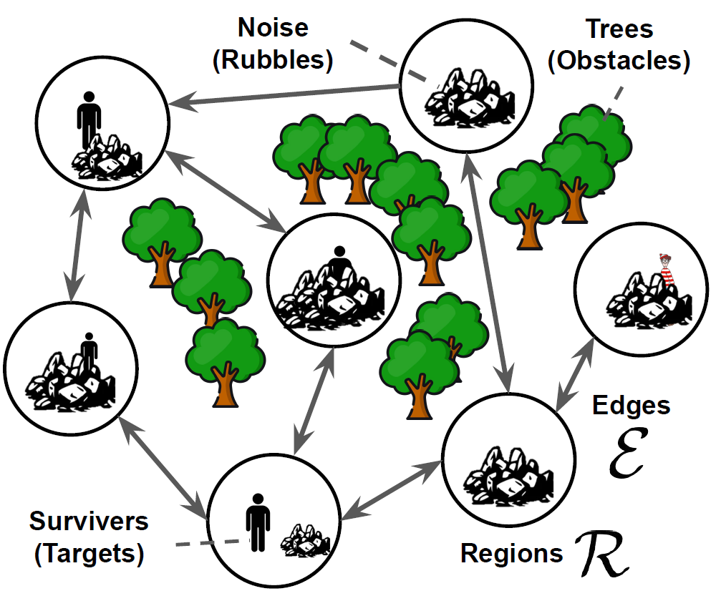
Motivation
Ergodicity: The total visitation frequency of each region is proportional to the noise of observation
Swarm ergodicity requires all robots to have the same information about the regions
Previously done by central information processing
Decentralize by locally sharing collected information
How to maintain ergodicity

Slide 3
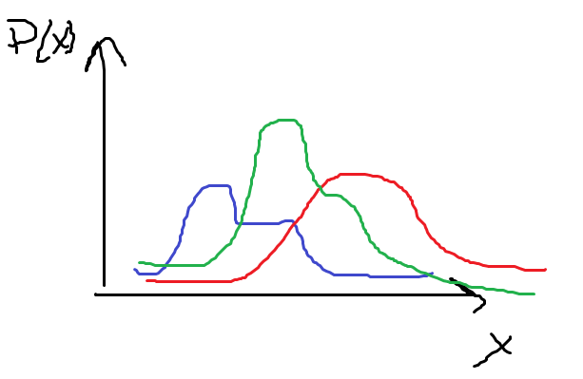
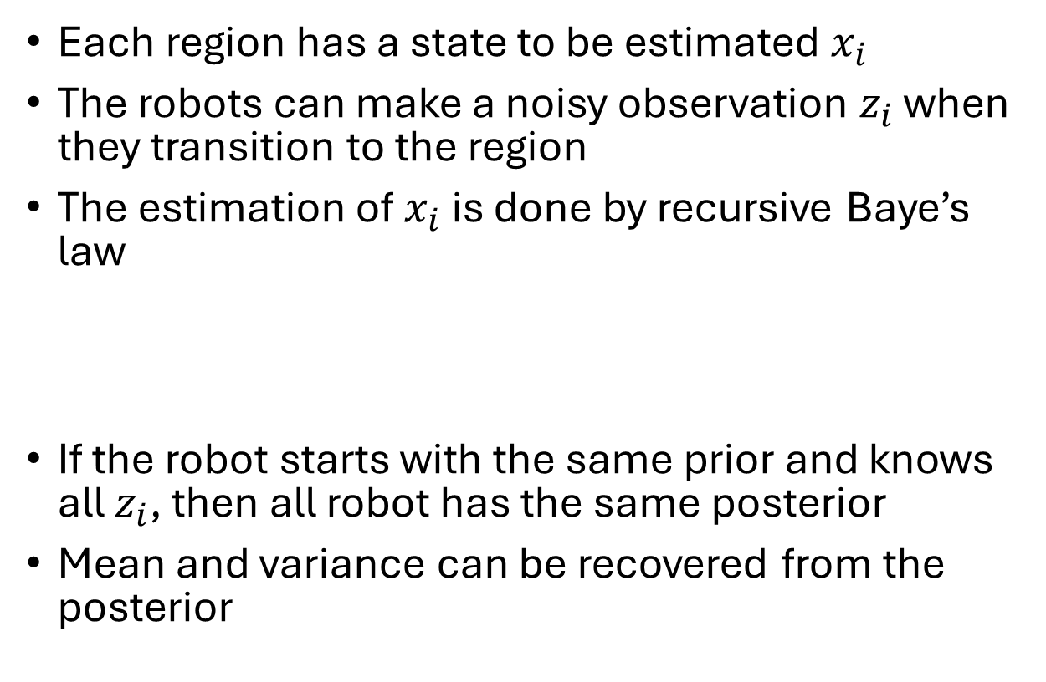
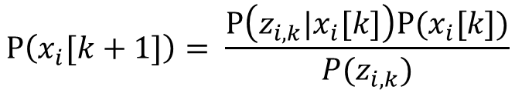
Recap
Each region has a state to be estimated $x_{i}$
The robots can make a noisy observation $z_{i}$ when they transition to the region
The estimation of $x_{i}$ is done by recursive Baye’s law
If the robot starts with the same prior and knows all $z_{i}$, then all robot has the same posterior
Mean and variance can be recovered from the posterior
Likelihood
prior
posterior
$$\text{P}\left(x_{i}[k+1]\right)= \frac{\text{P}\left(z_{i,k}|x_{i}[k]\right)\text{P}(x_{i}[k])}{P(z_{i,k})}$$

Slide 4
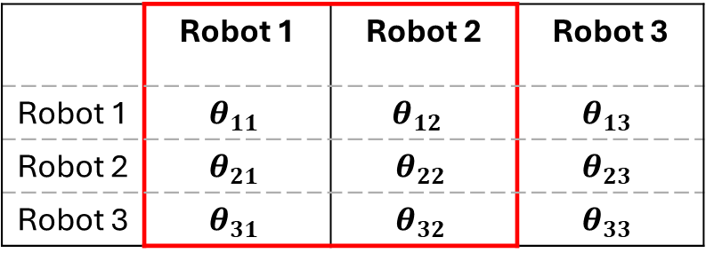
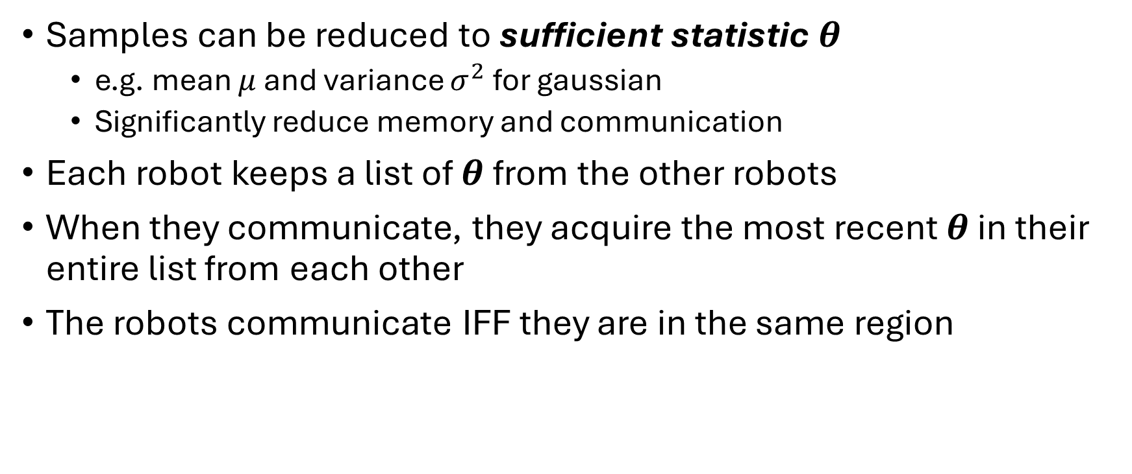
Communication Protocol
Samples can be reduced to sufficient statistic $θ$
e.g. mean $μ$ and variance $σ^{2}$ for gaussian
Significantly reduce memory and communication
Each robot keeps a list of $θ$from the other robots
When they communicate, they acquire the most recent $θ$ in their entire list from each other
The robots communicate IFF they are in the same region
 | Robot 1 | Robot 2 | Robot 3
Robot 1 | $$θ_{11}$$ | $$θ_{12}$$ | $$θ_{13}$$
Robot 2 | $$θ_{21}$$ | $$θ_{22}$$ | $$θ_{23}$$
Robot 3 | $$θ_{31}$$ | $$θ_{32}$$ | $$θ_{33}$$

Slide 5
Problem Formulation
Assume every robot has a fixed initial piece of information
All robot has the same probability distribution of existing in the regions
How many time step can we expect all the initial information is shared to every robot?
Conjecture:
there is a sharp time step where the information is almost certainly shared across the robot network (as the number of robot tends to infinity)

Slide 6

Pictorial Representation
Robot 1
Robot 2
Robot 3
Robot 4
temporal graph
$$θ_{1}$$
k=1
k=2
k=3
Acquired
Acquired
Acquired
Missing

Slide 7
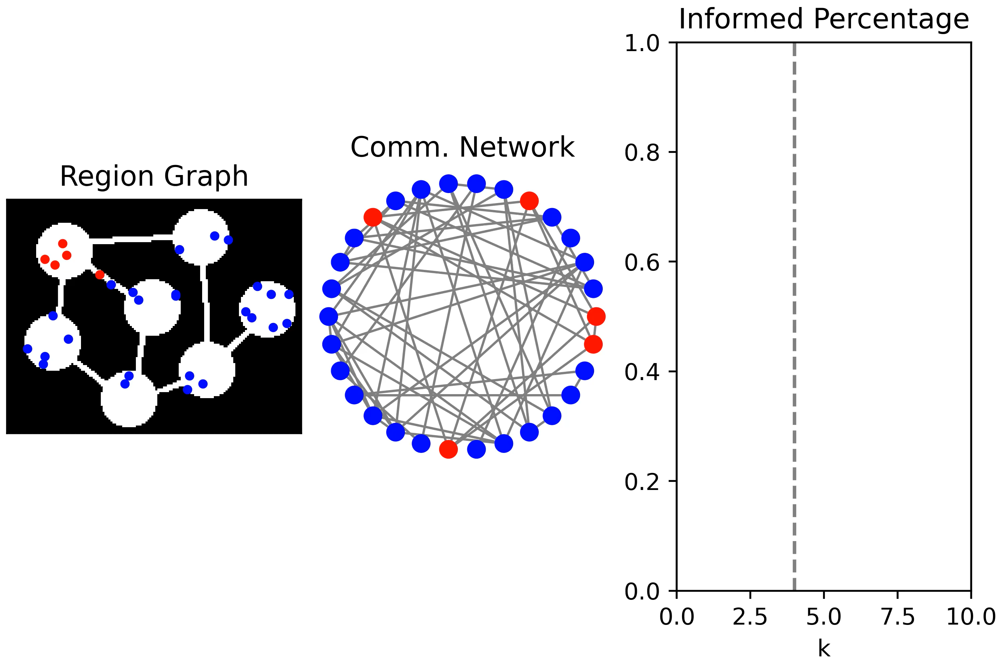

Slide 8
Percolation Theory
Historically: a study of how fluid flow through porous material in statistical mechanic
e.g. water passing through coffee grounds
In mathematics: A study of change of connectivity by adding random link in a graph
Often shows critical phenomenon
A sudden change in behaviour when a parameter pass the critical point as it is being smoothly varied
e.g. ising model (magnets) , Erdős–Rényi model (random graph), phase change (boiling water)

Slide 9
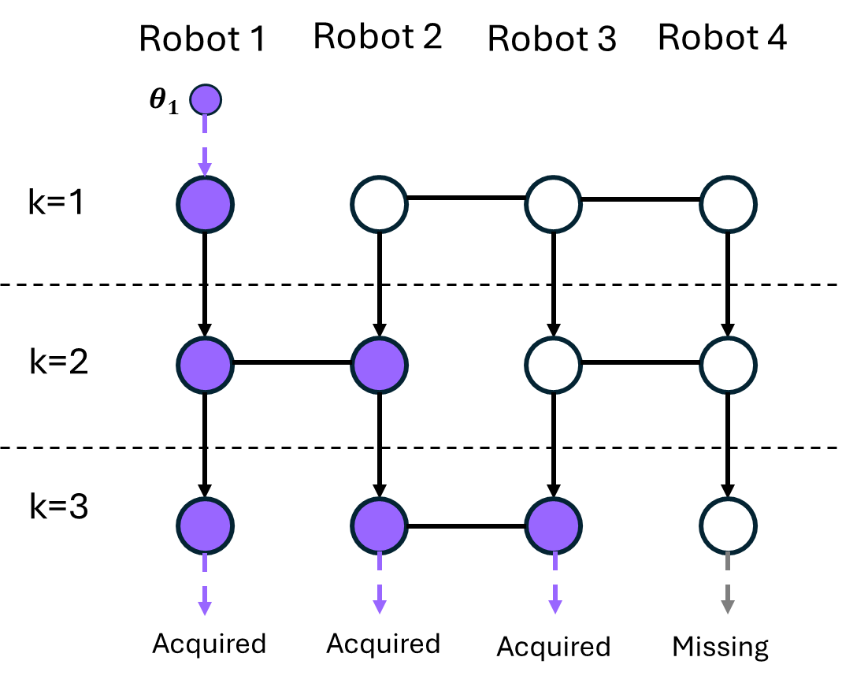
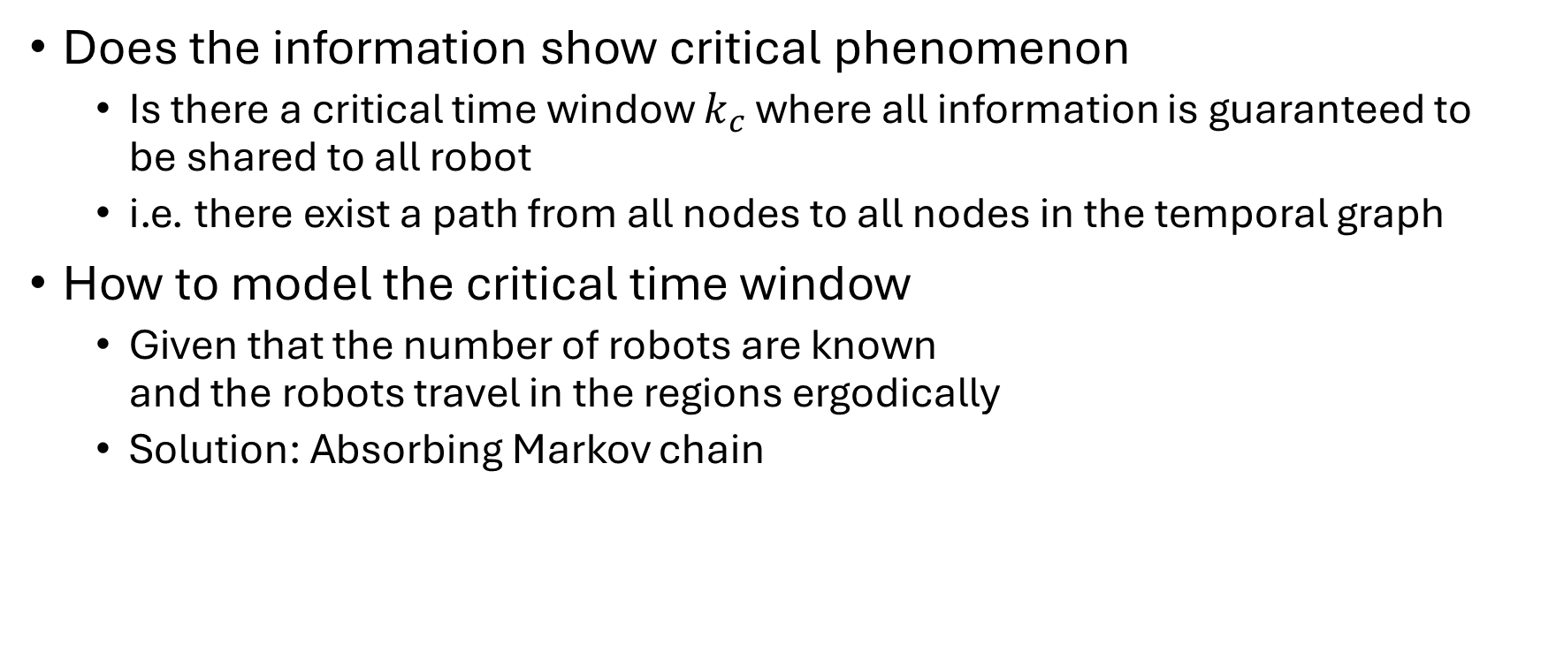
Information Percolation
Does the information show critical phenomenon
Is there a critical time window $k_{c}$ where all information is guaranteed to be shared to all robot
i.e. there exist a path from all nodes to all nodes in the temporal graph
How to model the critical time window
Given that the number of robots are known and the robots travel in the regions ergodically
Solution: Absorbing Markov chain

Slide 10
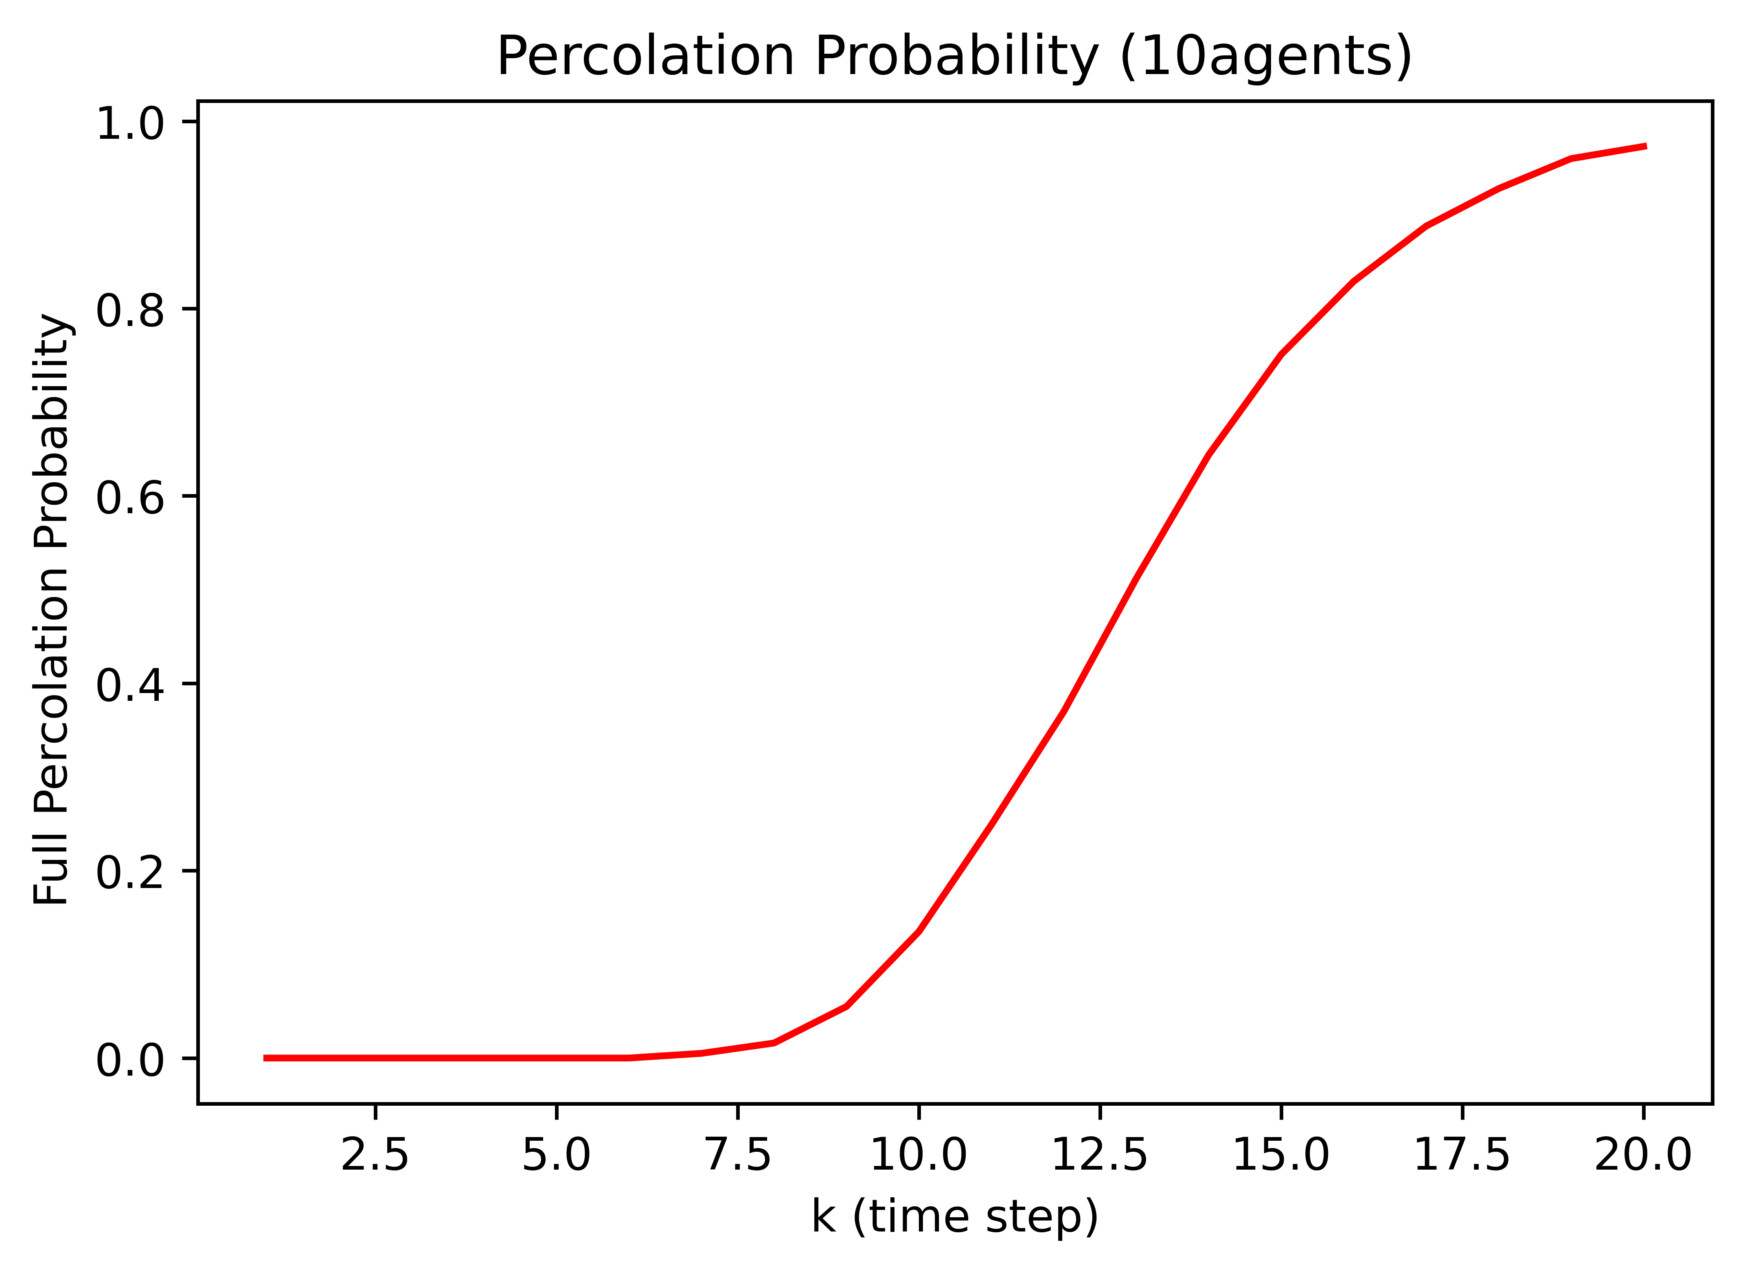
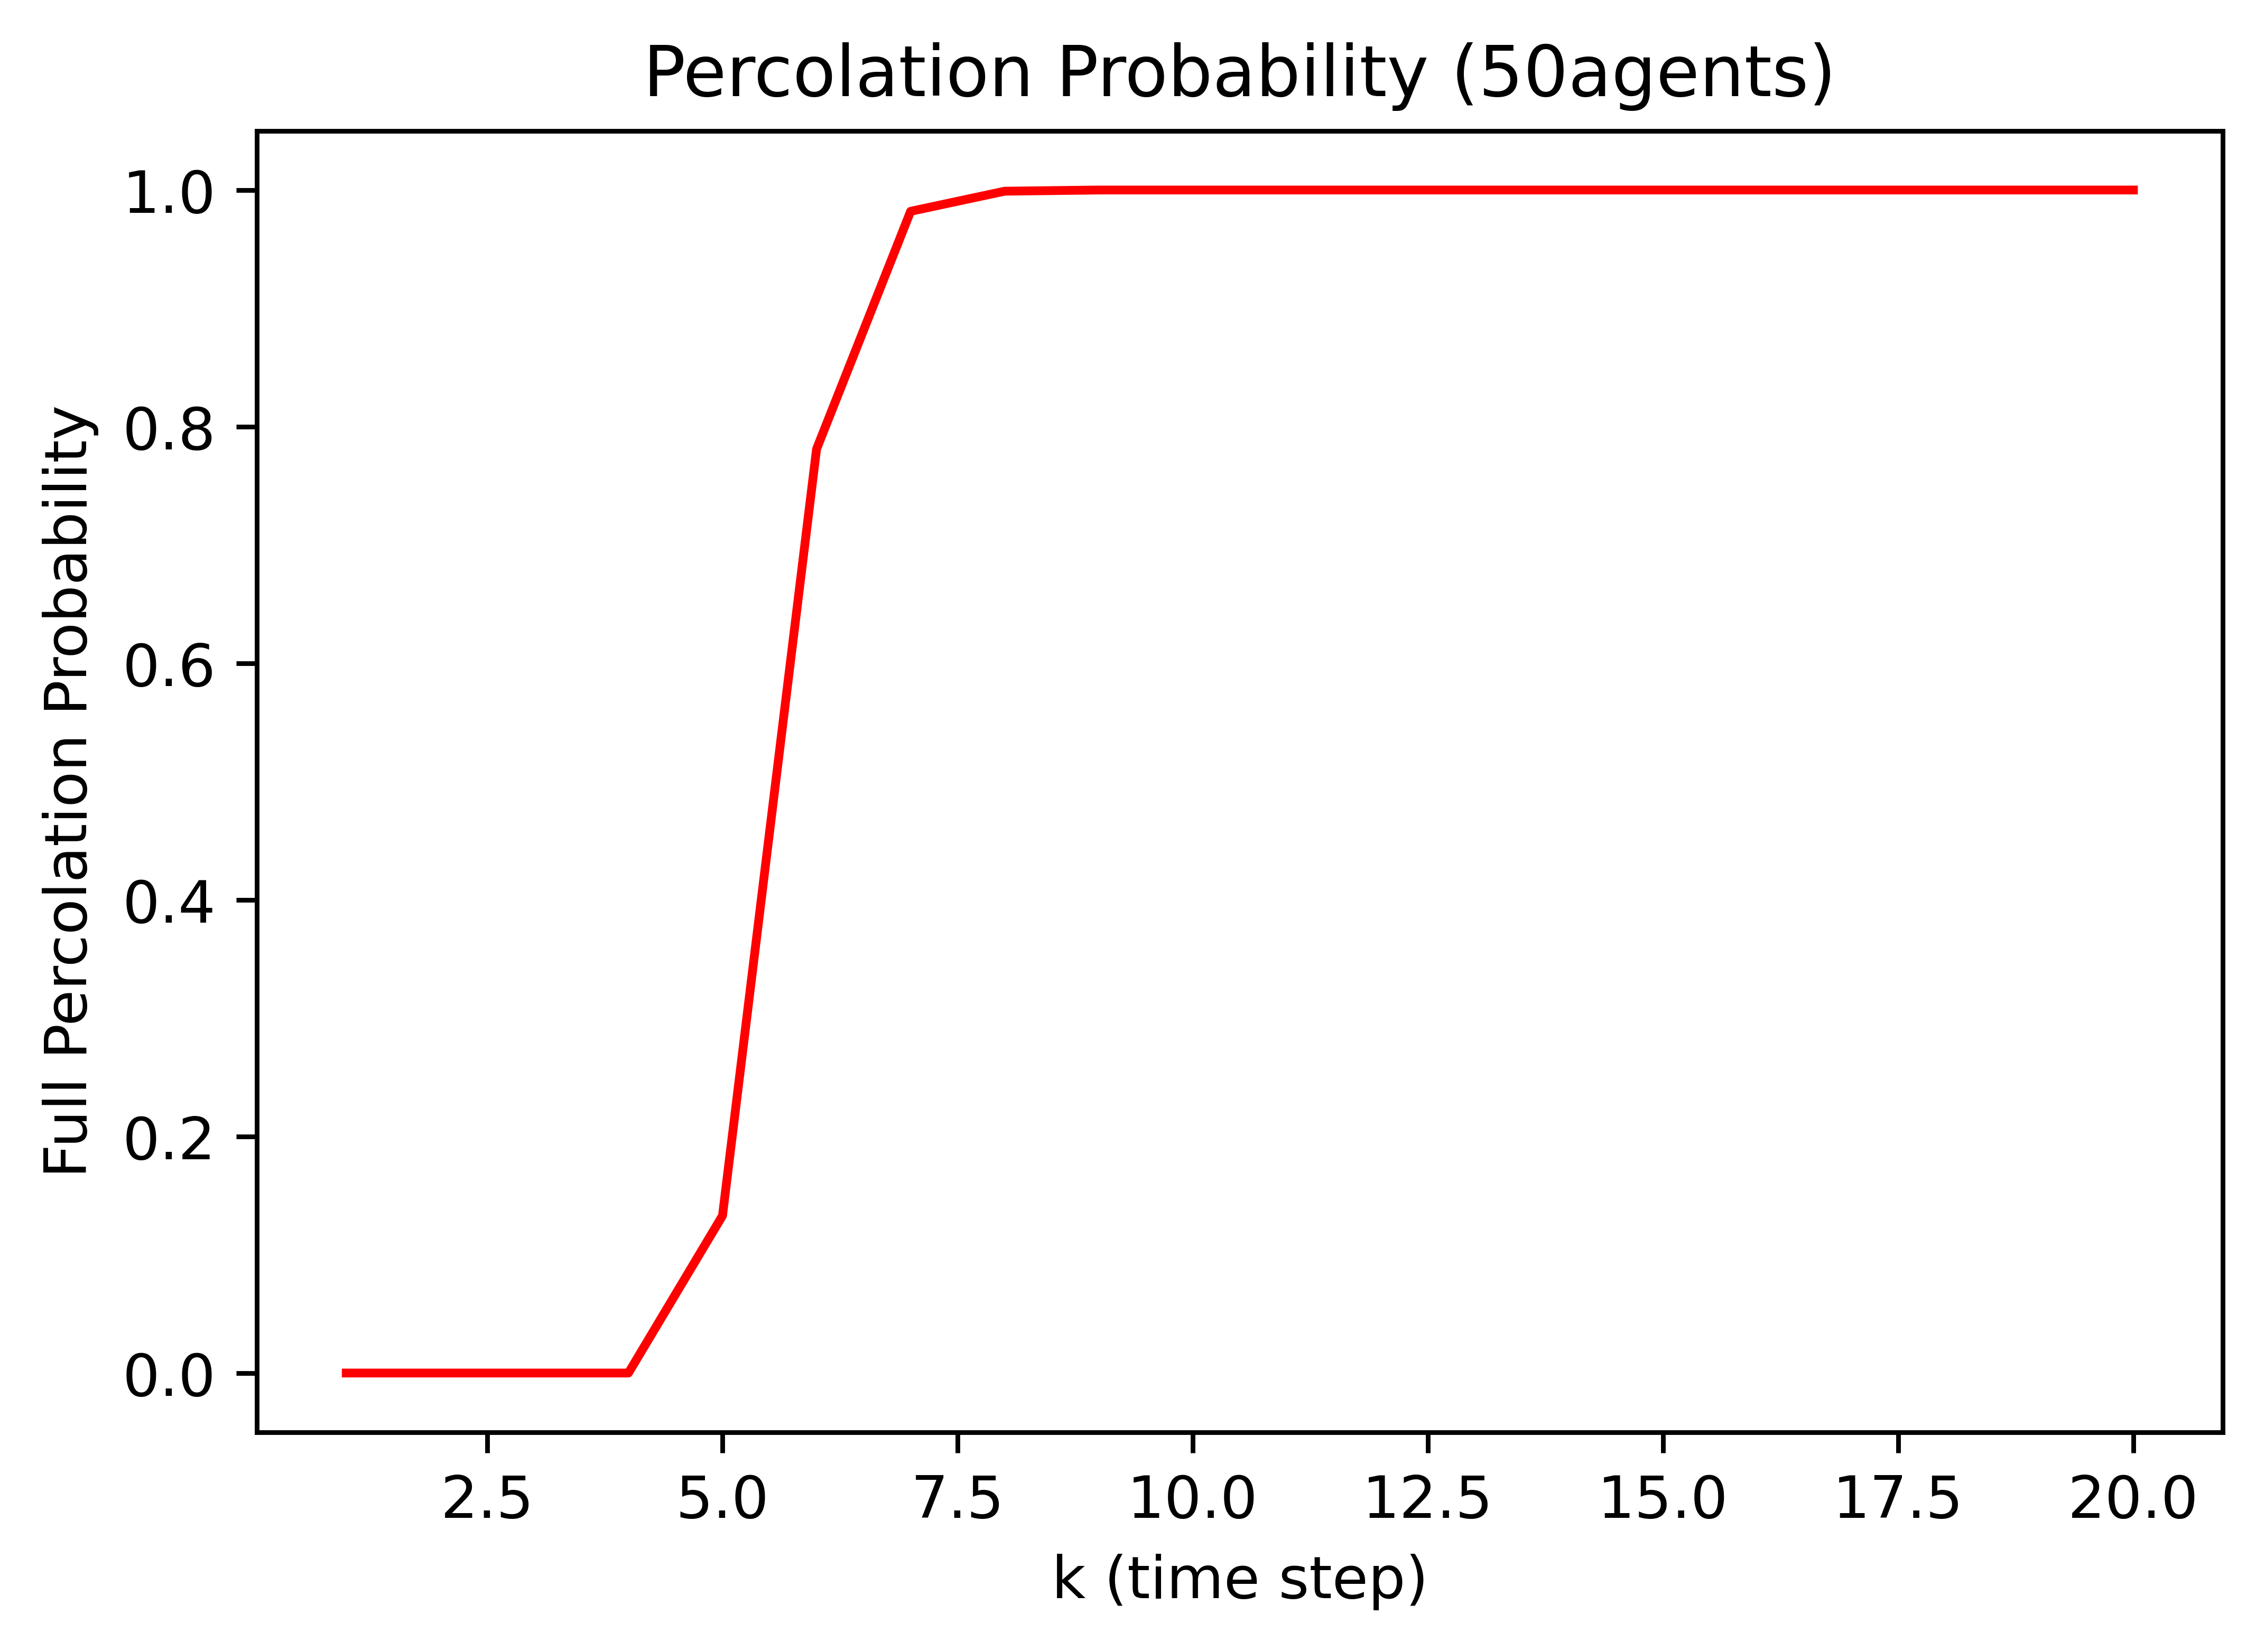
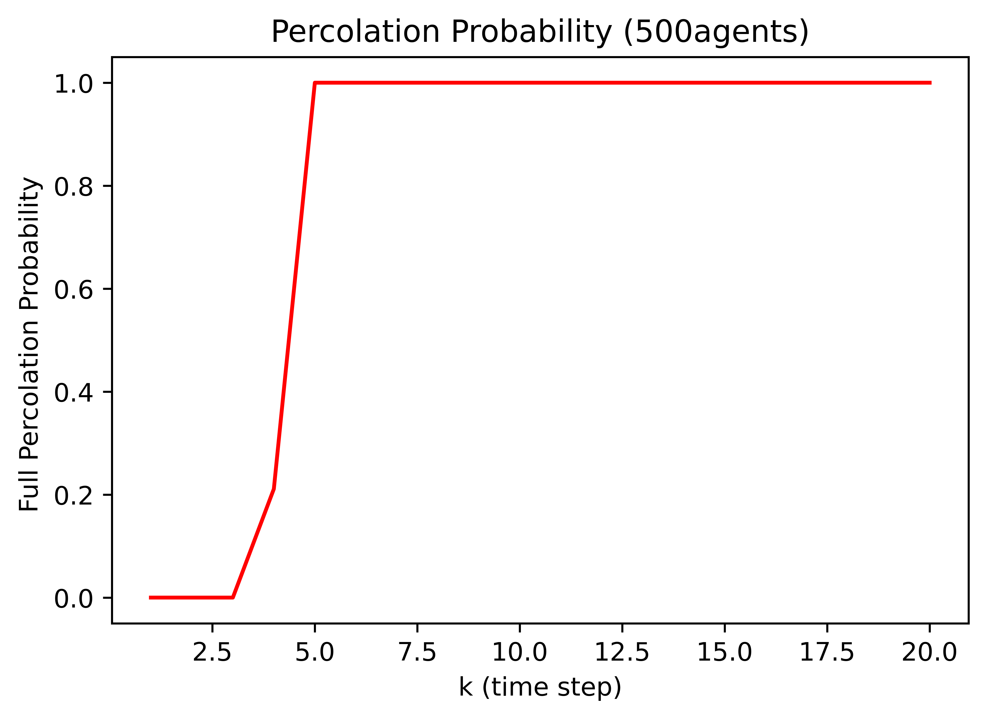
Simulated Result
Setting:
10 regions E-R graph
Uniform distribution
1000 trials
REMC transition law
Key results:
Critical phenomenon exists
The more robots, the sharper the phase change is
The more robots, the smaller the critical time window is

Slide 11
Mean Field Approximation
Popular method for handling statistic problem with large amount of variables
e.g. Ising model, Navier-Stokes, pandemic modelling
Treat the swarm as continuous variables and approximate the dynamic using expected value
E.g. it is possible to have 1.53 robot in a region

Slide 12

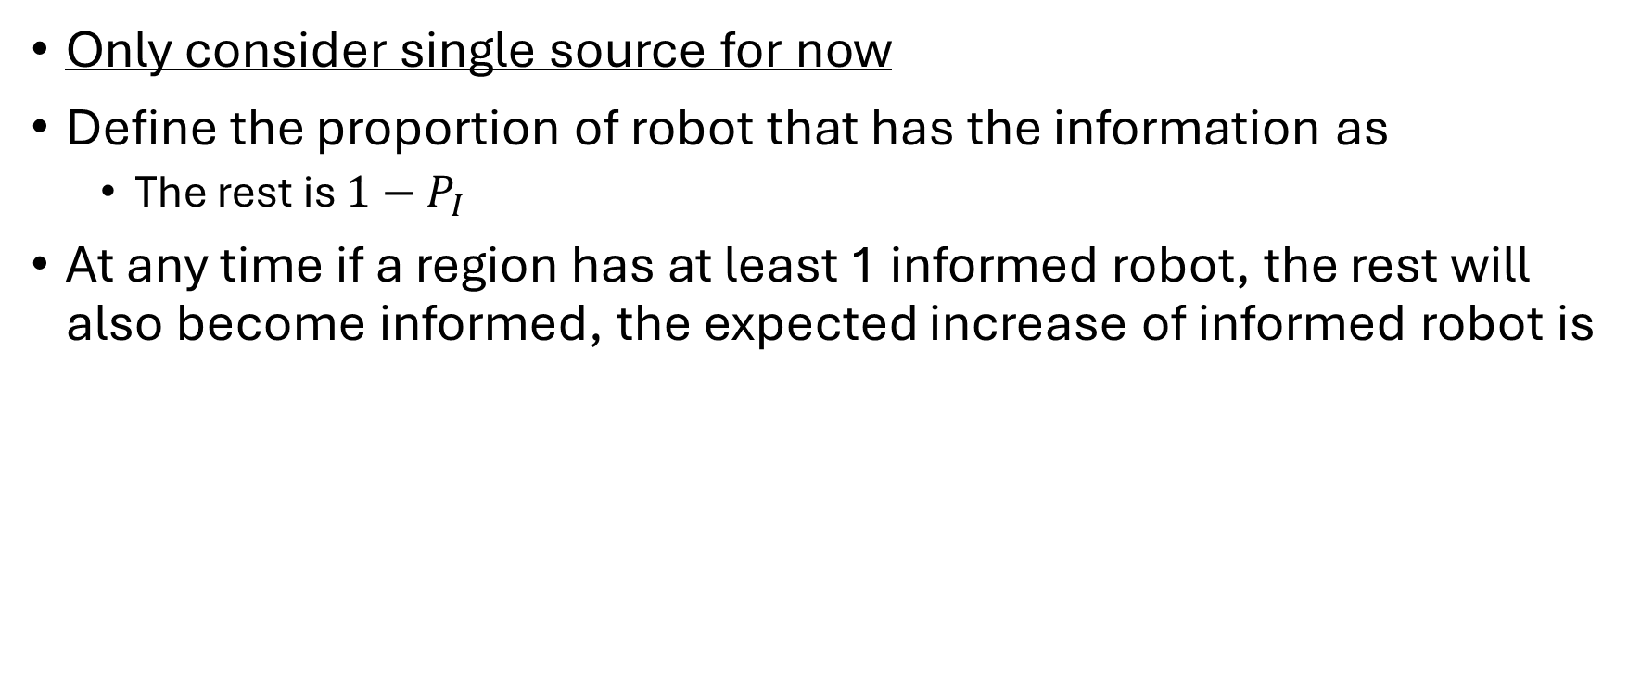

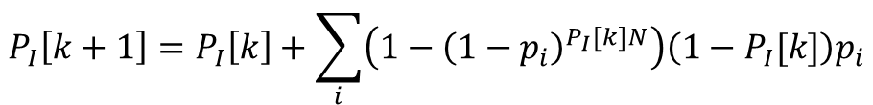
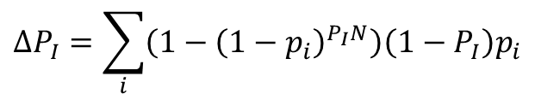
Mean Field Approximation - Formulation
Only consider single source for now
Define the proportion of robot that has the information as
The rest is $1−P_{I}$
At any time if a region has at least 1 informed robot, the rest will also become informed, the expected increase of informed robot is
$$P_{I}$$
$$ΔP_{I}=\sum_{i}{\left(1−{\left(1−p_{i}\right)}^{P_{I}N}\right)\left(1−P_{I}\right)p_{i}}$$
Solve the difference equation
$$P_{I}\left[k+1\right]=P_{I}\left[k\right]+\sum_{i}{\left(1−{\left(1−p_{i}\right)}^{P_{I}[k]N}\right)\left(1−P_{I}[k]\right)p_{i}}$$
Probability of at least one informed robot in the region
Expected number of uninformed robot in the region
$$P_{I}[0]=\frac{1}{N}$$
Only 1 informed robot out of N initially

Slide 13
Markov Chain Formulation
IMPORTANT: this Markov chain is not related to the ergodic Markov chain
Consider the number of informed robot as a state
Every time step, after the robot moved, there is a chance of the numer of informed robots increasing (transition to subsequent state) or stays constant (self loop). But never decrease (go back to previous states)
Eventually the chain terminates at all robots being informed
This is called an absorbing chain
1 informed robot
2 informed robot
N informed robot

Slide 14
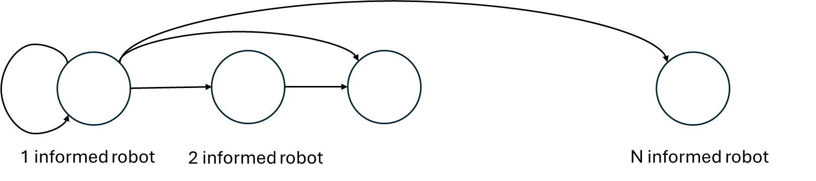




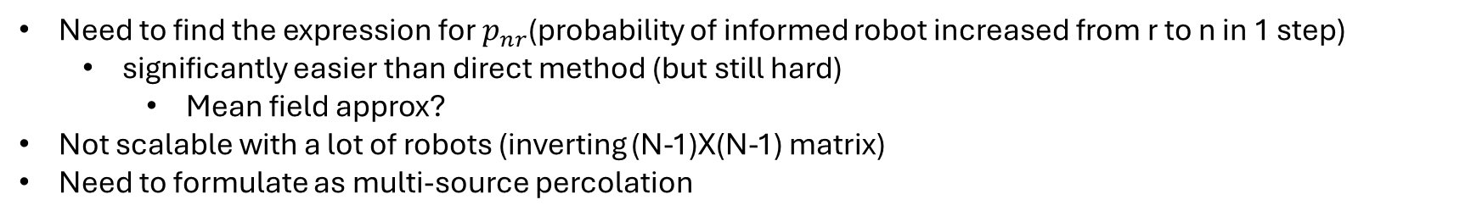


Expected Absorption Time
$$p_{N1}$$
$$p_{11}$$
$$p_{21}$$
The corresponding stochastic matrix is
The expected absorption time is given by
$$Q$$
$$M= \left[\begin{matrix}p_{11} & 0 & 0 & ⋯ & 0 \\ p_{21} & p_{22} & 0 & ⋯ & ⋮ \\ ⋮ & ⋮ & ⋱ & & ⋮ \\ ⋮ & ⋮ & p_{nr} & ⋱ & 0 \\ p_{N1} & p_{N2} & ⋯ & & 1\end{matrix}\right]$$
$${t=1^{T}\left(I−Q\right)}^{−1}{\left[\begin{matrix}1 & 0 & 0 & ⋯ \end{matrix}\right]}^{T}$$
Need to find the expression for $p_{nr}$(probability of informed robot increased from r to n in 1 step)
significantly easier than direct method (but still hard)
Mean field approx?
Not scalable with a lot of robots (inverting (N-1)X(N-1) matrix)
Need to formulate as multi-source percolation

Slide 15



First Hitting Time Method (fully connected)
Pairwise approximation
(accurate if meeting chance is not too high)
Pairwise meeting chance
(fully connected)
$$Q$$
$$p_{nr}=\operatorname{Pr}\left(r newly informed | n informed\right)= C_{r}^{N−n}{\left(1−{\left(1−S_{2}\right)}^{n} \right)}^{r}{\left({\left(1−S_{2}\right)}^{n}\right)}^{N−n−r}$$
$$M= \left[\begin{matrix}p_{11} & 0 & 0 & ⋯ & 0 \\ p_{21} & p_{22} & 0 & ⋯ & ⋮ \\ ⋮ & ⋮ & ⋱ & & ⋮ \\ ⋮ & ⋮ & p_{nr} & ⋱ & 0 \\ p_{N1} & p_{N2} & ⋯ & & 1\end{matrix}\right]$$
How many way to get r uninformed robots
r robots meet with at least 1 informed robots
Rest of the uninformed robot does not meet with any informed robot
Initial distribution
$$\operatorname{Pr}\left(N informed at k\right)=1−1^{T}Q^{k}{\left[\begin{matrix}1 & 0 & 0 & ⋯\end{matrix}\right]}^{T}$$
Probability of not absorbed in k step

Slide 16
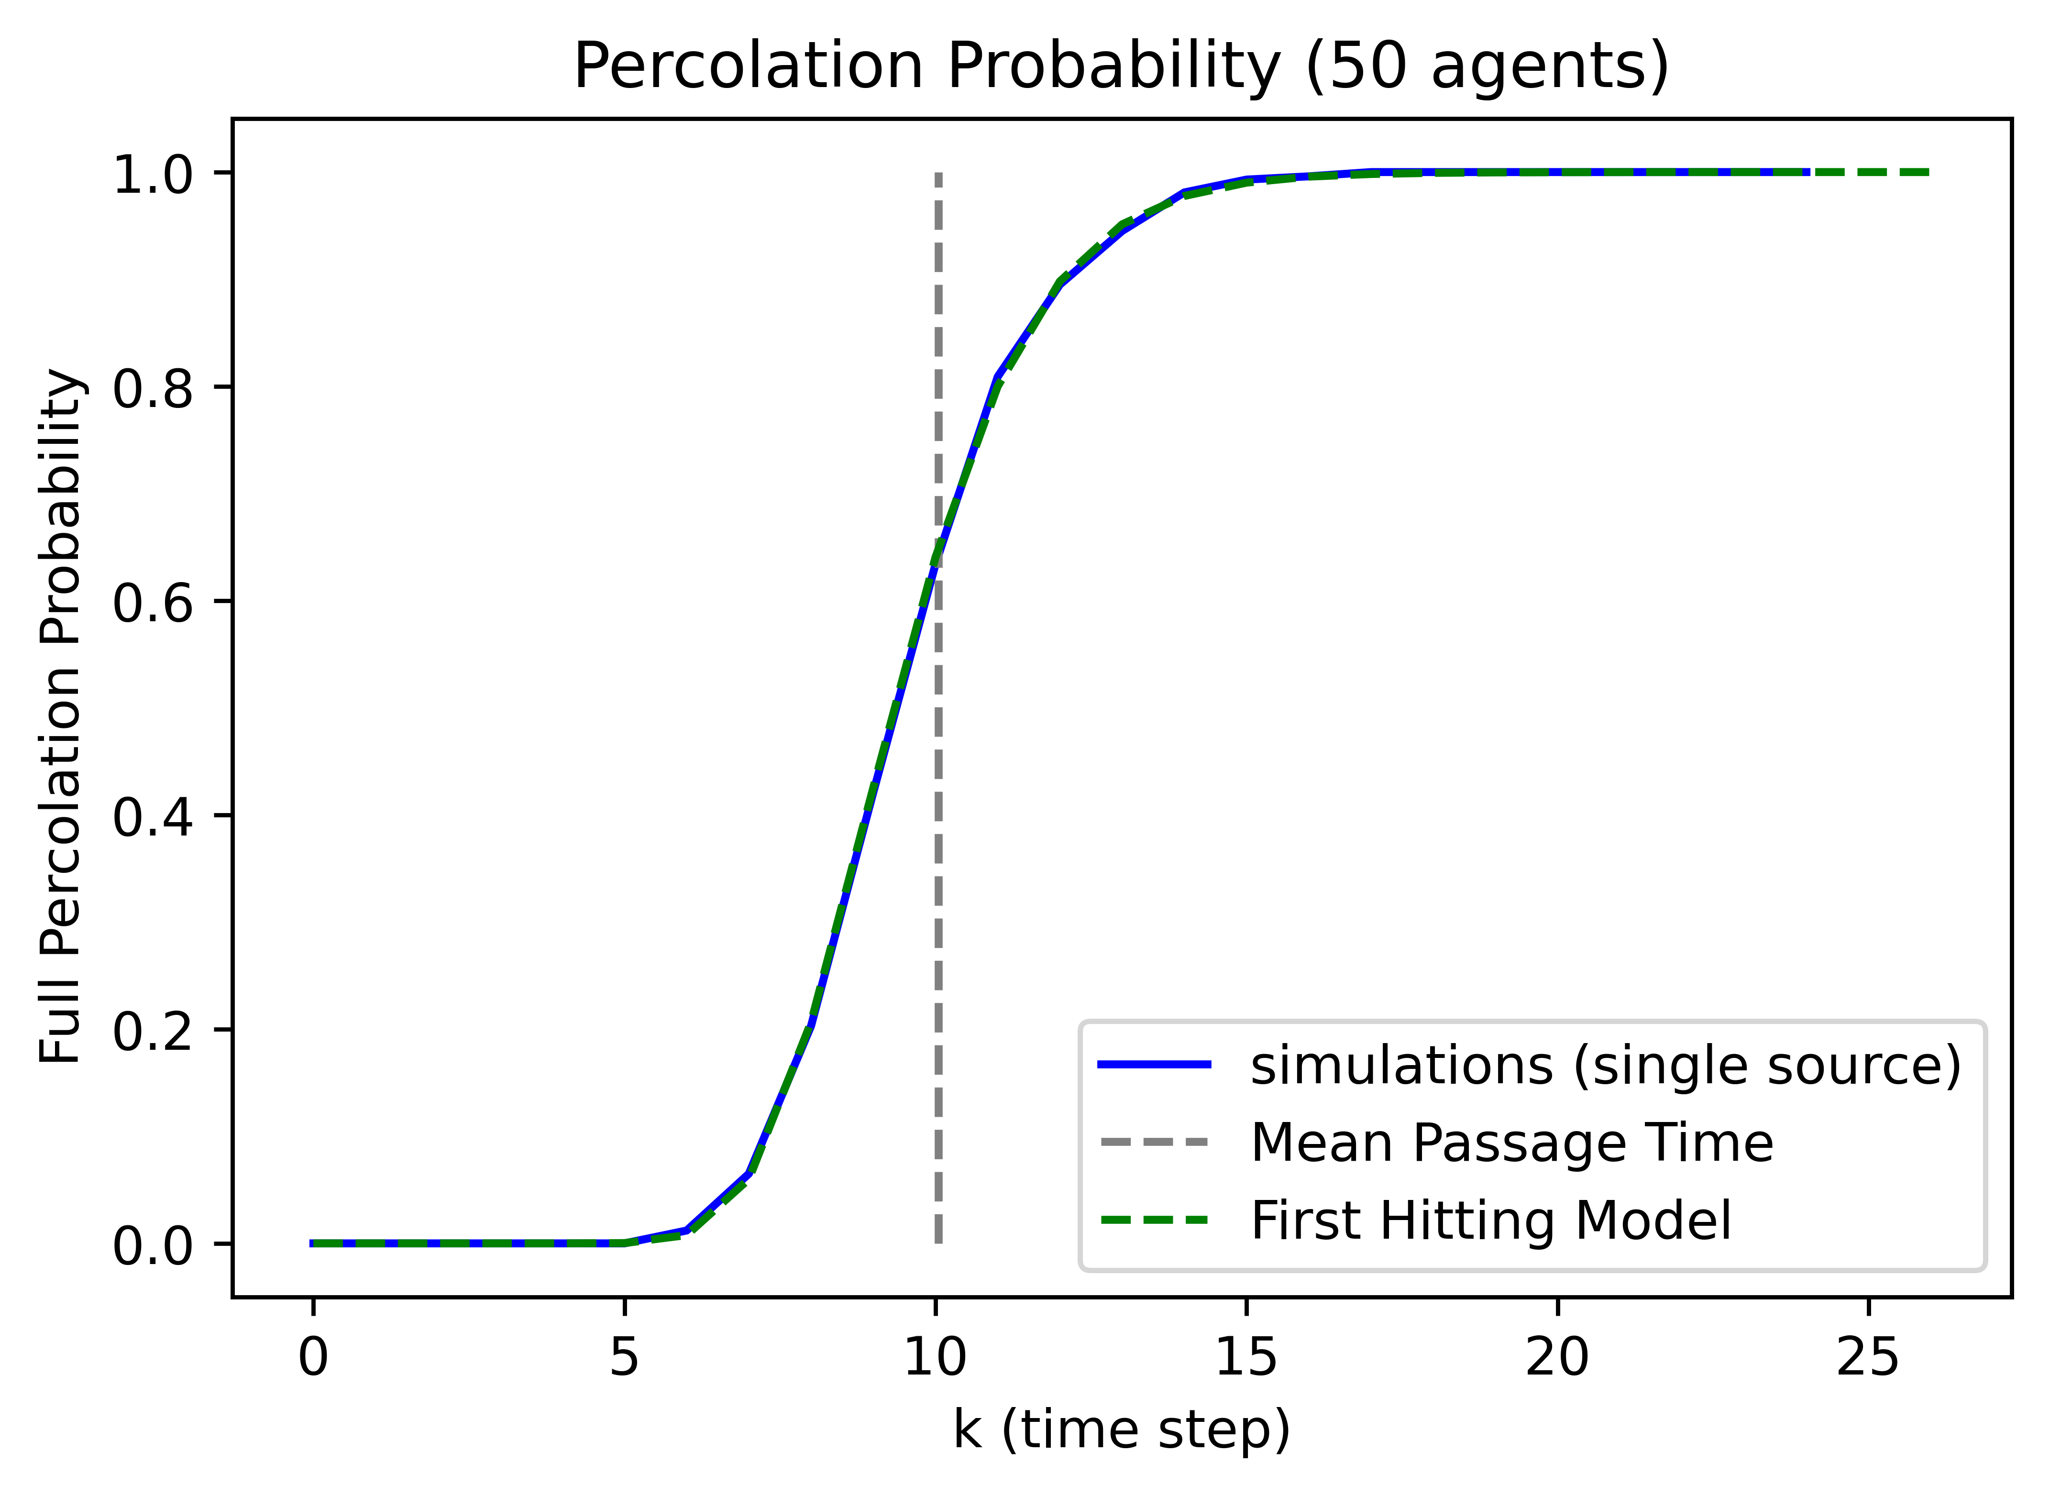

Slide 17


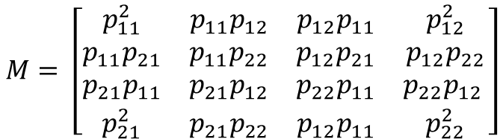







Pairwise Meeting Chance on Region Graph
Region graph
Consider 2 agents on a region graph with a given transition matrix
Create new state space with the cartesian product
Find initial state in combined state space
Remove “collision states”
$$p_{12}$$
Initial distribution
$$p_{11}$$
1
2
$$ρ_{0}={\left[\begin{matrix}ρ_{0,1} & ρ_{0,2}\end{matrix}\right]}^{T}$$
Cartesian product
$$\operatorname{Pr}\left(meet at least once within k\right)=1−1^{T}Q^{k}q_{o}$$
1,1
$$p_{11}p_{21}$$
(1,1)
(1,2)
(2,1)
(2,2)
1,2
$$Q$$
$$p_{11}p_{21}$$
$$M= \left[\begin{matrix}p_{11}^{2} & p_{11}p_{12} & p_{12}p_{11} & p_{12}^{2} \\ p_{11}p_{21} & p_{11}p_{22} & p_{12}p_{21} & p_{12}p_{22} \\ p_{21}p_{11} & p_{21}p_{12} & p_{22}p_{11} & p_{22}p_{12} \\ p_{21}^{2} & p_{21}p_{22} & p_{12}p_{11} & p_{22}^{2}\end{matrix}\right]$$
2,1
$$p_{21}^{2}$$
2,2
$$m_{0}={\left[\begin{matrix}ρ_{0,1}^{2} & ρ_{0,1}ρ_{0,2} & ρ_{0,2}ρ_{0,1} & ρ_{0,2}^{2}\end{matrix}\right]}^{T}$$
$$q_{0}$$

Slide 18
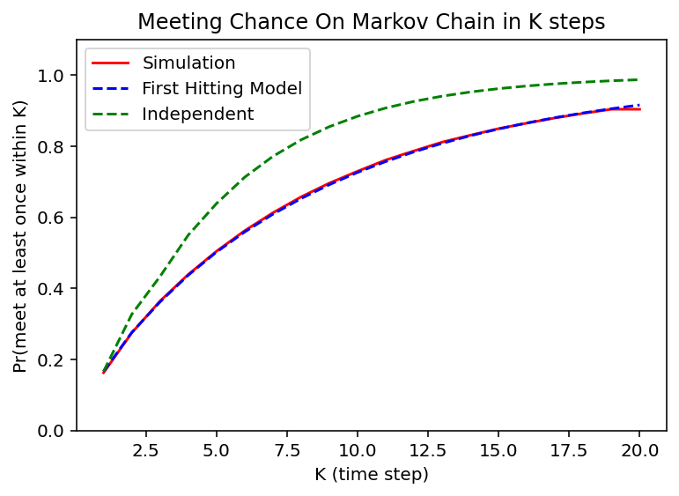

Slide 19
Conditional Pairwise Meeting Chance
We need the conditional meeting chance
Given that the robot never met an informed robot, what is the chance of meeting an informed robot in the next step
1s at collision states
$$\operatorname{Pr}{(first meet at k)= \left[\begin{matrix}1 & 0 & 0 & 1 & ⋯\end{matrix}\right]PQ^{k−1}q_{0}}$$
Space distribution never met from 0 to k-1
$$\operatorname{Pr}\left(meet at K \right|never met before)= \frac{\operatorname{Pr}{(first meet at K)}}{1−\sum_{1}^{K−1}{\operatorname{Pr}{(first meet at k)}}}$$
(Probably can be simplified)
Interesting effect: the longer K is, the lower this probability is, but approach a fix value for very big K
Interpretation: if they haven’t meet in a long time, they probably are initially very far away in the region graph

Slide 20
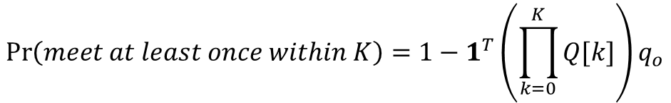
Time varying first hit model
$$\operatorname{Pr}\left(meet at least once within k\right)=1−1^{T}Q^{k}q_{o}$$
Original first hit model
$$\operatorname{Pr}\left(meet at least once within K\right)=1−1^{T}\left(\prod_{k=0}^{K}{Q[k]}\right)q_{o}$$
Time varying first hit model

Slide 21







Region-aware absorbing chain
Expand nodes to sub-graphs
1 informed robot
2 informed robot
3 informed robot
2 uninformed robot in region 1,
1 informed robot in region 2
$$\left[\begin{matrix}1 \\ \begin{aligned}0 \\ ⋮\end{aligned}\end{matrix}\right],\left[\begin{matrix}0 \\ \begin{aligned}2 \\ ⋮\end{aligned}\end{matrix}\right]$$
$$\left[\begin{matrix}0 \\ \begin{aligned}0 \\ ⋮\end{aligned}\end{matrix}\right],\left[\begin{matrix}3 \\ \begin{aligned}0 \\ ⋮\end{aligned}\end{matrix}\right]$$
$$\left[\begin{matrix}2 \\ \begin{aligned}0 \\ ⋮\end{aligned}\end{matrix}\right],\left[\begin{matrix}0 \\ \begin{aligned}1 \\ ⋮\end{aligned}\end{matrix}\right]$$
$$\left[\begin{matrix}0 \\ \begin{aligned}0 \\ ⋮\end{aligned}\end{matrix}\right],\left[\begin{matrix}2 \\ \begin{aligned}1 \\ ⋮\end{aligned}\end{matrix}\right]$$
$$\left[\begin{matrix}0 \\ \begin{aligned}2 \\ ⋮\end{aligned}\end{matrix}\right],\left[\begin{matrix}1 \\ \begin{aligned}0 \\ ⋮\end{aligned}\end{matrix}\right]$$
$$\left[\begin{matrix}0 \\ \begin{aligned}1 \\ ⋮\end{aligned}\end{matrix}\right],\left[\begin{matrix}2 \\ \begin{aligned}0 \\ ⋮\end{aligned}\end{matrix}\right]$$
$$\left[\begin{matrix}0 \\ \begin{aligned}0 \\ ⋮\end{aligned}\end{matrix}\right],\left[\begin{matrix}0 \\ \begin{aligned}3 \\ ⋮\end{aligned}\end{matrix}\right]$$

Slide 22



















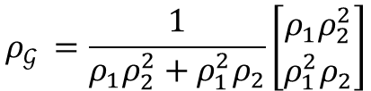


1 robot getting informed in 1 step
informed
$$N_{I}=2, n=2$$
meet
$$ρ_{𝒢 }=\frac{1}{ρ_{1}ρ_{2}^{2}+ρ_{1}^{2}ρ_{2}}\left[\begin{matrix}ρ_{1}ρ_{2}^{2} \\ ρ_{1}^{2}ρ_{2}\end{matrix}\right]$$
Uninformed
$$p_{11}p_{12}^{2}$$
$$\left[\begin{matrix}1 \\ \begin{aligned}0\end{aligned}\end{matrix}\right],\left[\begin{matrix}2 \\ \begin{aligned}0\end{aligned}\end{matrix}\right]$$
$$p_{11}p_{22}^{2}$$
$$p_{11}^{2}p_{12}$$
$$\left[\begin{matrix}1 \\ \begin{aligned}0\end{aligned}\end{matrix}\right],\left[\begin{matrix}0 \\ \begin{aligned}2\end{aligned}\end{matrix}\right]$$
$$\left[\begin{matrix}1 \\ \begin{aligned}0\end{aligned}\end{matrix}\right],\left[\begin{matrix}0 \\ \begin{aligned}2\end{aligned}\end{matrix}\right]$$
$$2p_{11}p_{12}p_{22}$$
$$\left[\begin{matrix}1 \\ \begin{aligned}0\end{aligned}\end{matrix}\right],\left[\begin{matrix}1 \\ \begin{aligned}1\end{aligned}\end{matrix}\right]$$
$${2p}_{11}p_{21}p_{12}$$
$$p_{21}p_{12}^{2}$$
$$p_{12}p_{21}^{2}$$
$$2p_{21}p_{22}p_{12}$$
$$\left[\begin{matrix}0 \\ \begin{aligned}1\end{aligned}\end{matrix}\right],\left[\begin{matrix}1 \\ \begin{aligned}1\end{aligned}\end{matrix}\right]$$
$$\left[\begin{matrix}0 \\ \begin{aligned}1\end{aligned}\end{matrix}\right],\left[\begin{matrix}2 \\ \begin{aligned}0\end{aligned}\end{matrix}\right]$$
$$\left[\begin{matrix}0 \\ \begin{aligned}1\end{aligned}\end{matrix}\right],\left[\begin{matrix}2 \\ \begin{aligned}0\end{aligned}\end{matrix}\right]$$
$$2p_{11}p_{22}p_{12}$$
$$p_{22}p_{11}^{2}$$
$$2p_{21}p_{22}^{2}$$
$$\left[\begin{matrix}0 \\ \begin{aligned}1\end{aligned}\end{matrix}\right],\left[\begin{matrix}0 \\ \begin{aligned}2\end{aligned}\end{matrix}\right]$$
$$p_{22}p_{21}^{2}$$
$$\operatorname{Pr}{\begin{aligned}\left(Inform at 1\right)=ψ=ρ_{𝒢 ,1}\left(1−p_{11}p_{22}^{2}−p_{21}p_{12}^{2}\right)\end{aligned}}+ρ_{𝒢 ,2}(1−p_{22}p_{11}^{2}−p_{12}p_{21}^{2})$$

Slide 23
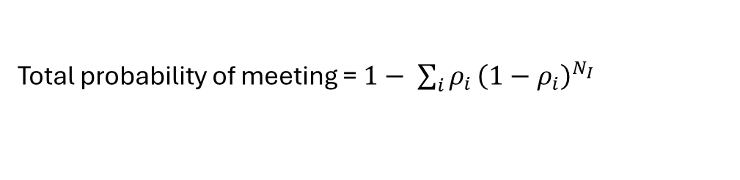
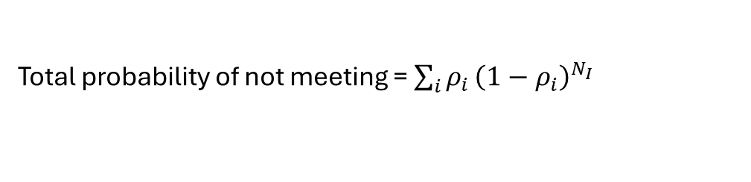

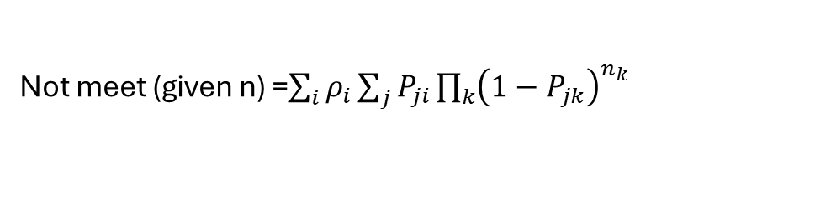
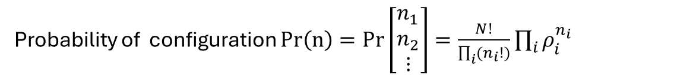
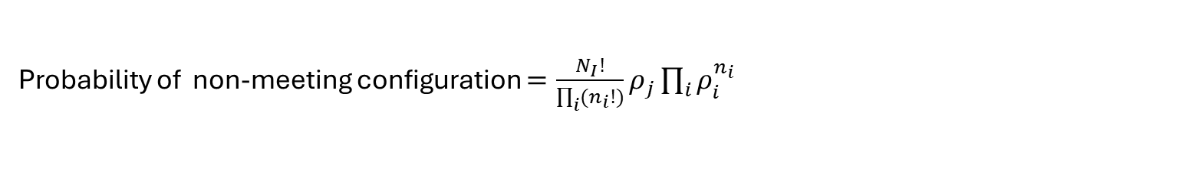
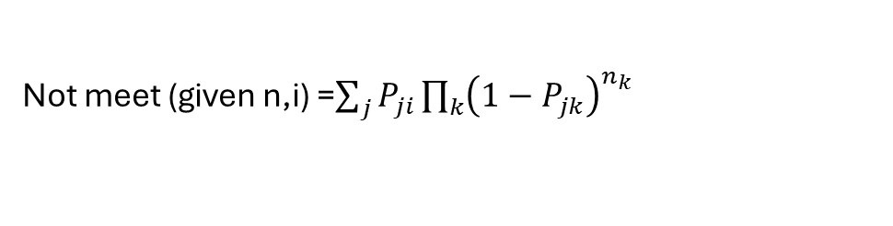
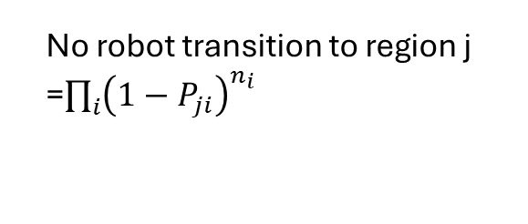
Statistical mechanics 1
Multinomial Distribution
Flux matrix
$$K= \left[\begin{matrix}n_{11} & n_{12} & ⋯ \\ n_{21} & n_{22} & ⋯ \\ ⋮ & ⋮ & ⋱\end{matrix}\right]$$
$$K^{T}1=n$$
$$K1=m$$
$$𝔼\left[K\right]=PDiag(ρ)$$
$$ℙ\left(K\right)=\prod_{i}{\left(\frac{n_{i}!}{\prod_{j}{n_{ji}}}\prod_{j}{P_{ji}^{n_{ji}}}\right)}$$
Number of configuration = $\left(\begin{matrix}N+n−1 \\ N\end{matrix}\right)$
Probability of configuration $Pr\left(n\right)=Pr\left[\begin{matrix}n_{1} \\ n_{2} \\ ⋮\end{matrix}\right]=\frac{N!}{\prod_{i}{(n_{i}!)}}\prod_{i}{ρ_{i}^{n_{i}}}$
Probability of non-meeting configuration $=\frac{N_{I}!}{\prod_{i}{(n_{i}!)}}ρ_{j}\prod_{i}{ρ_{i}^{n_{i}}}$
Transition probability from $\left[\begin{matrix}n_{1} \\ n_{2} \\ ⋮\end{matrix}\right] to\left[\begin{matrix}m_{1} \\ m_{2} \\ ⋮\end{matrix}\right]=\sum_{K^{T}1=n\text{,}K1=m }{ℙ\left(K\right)}$
No robot transition to region j =$\prod_{i}{{\left(1−P_{ji}\right)}^{n_{i}}}$
Probability of no robot in region $i ={\left(1−ρ_{i}\right)}^{N}$
Not meet (given n,i) =$\sum_{j}{P_{ji}\prod_{k}{{\left(1−P_{jk}\right)}^{n_{k}}}}$
Total probability of not meeting = $\sum_{i}{ρ_{i}}{\left(1−ρ_{i}\right)}^{N_{I}}$
Total probability of meeting = $1− \sum_{i}{ρ_{i}}{\left(1−ρ_{i}\right)}^{N_{I}}$
Not meet (given n) =$\sum_{i}{ρ_{i}}\sum_{j}{P_{ji}\prod_{k}{{\left(1−P_{jk}\right)}^{n_{k}}}}$

Slide 24


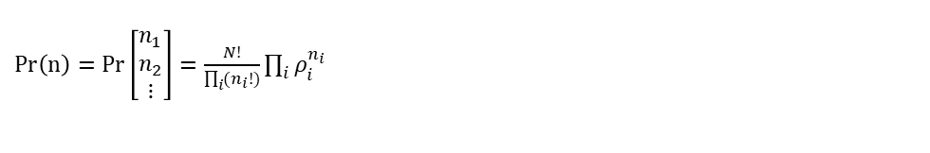


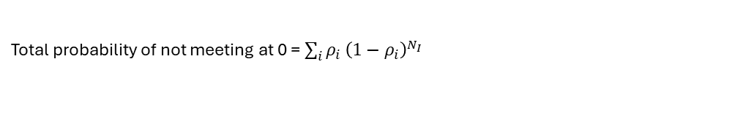
Statistical mechanics 2
Total probability of not meeting at 0 = $\sum_{i}{ρ_{i}}{\left(1−ρ_{i}\right)}^{N_{I}}$
Not meet at 1 (given n) $\sum_{i}{ρ_{i}}\sum_{j}{P_{ji}\prod_{k}{{\left(1−P_{jk}\right)}^{n_{k}}}}$
$Pr\left(n\right)=Pr\left[\begin{matrix}n_{1} \\ n_{2} \\ ⋮\end{matrix}\right]=\frac{N!}{\prod_{i}{(n_{i}!)}}\prod_{i}{ρ_{i}^{n_{i}}}$
Not meet at 1 (given not meet at 0, n)
$$\frac{1}{\sum_{i, n_{i}=0 }{ρ_{i}}}\sum_{i, n_{i}=0 }{ρ_{i}}\sum_{j}{P_{ji}\prod_{k}{{\left(1−P_{jk}\right)}^{n_{k}}}}$$
Not meet at 1 (given not meet at 0)
$$\frac{1}{\sum_{i}{ρ_{i}}{\left(1−ρ_{i}\right)}^{N_{I}}}\sum_{n}{\left(\operatorname{Pr}{(n)}\frac{1}{\sum_{i, n_{i}=0 }{ρ_{i}}}\sum_{i, n_{i}=0 }{ρ_{i}}\sum_{j}{P_{ji}\prod_{k}{{\left(1−P_{jk}\right)}^{n_{k}}}}\right)}$$
Not meet at 1 (given not meet at 0, $N_{I}=1$)
$$\sum_{k}{\left(\frac{ρ_{k}}{1−ρ_{k}}\sum_{i≠k }{ρ_{i}}\sum_{j}{P_{ji}\left(1−P_{jk}\right)}\right)}$$
Not meet at 1 (given not meet at 0)
$$≈{\left[\sum_{k}{\left(\frac{ρ_{k}}{1−ρ_{k}}\sum_{i≠k }{ρ_{i}}\sum_{j}{P_{ji}\left(1−P_{jk}\right)}\right)}\right]}^{N_{I}}$$

Slide 25





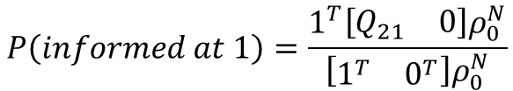
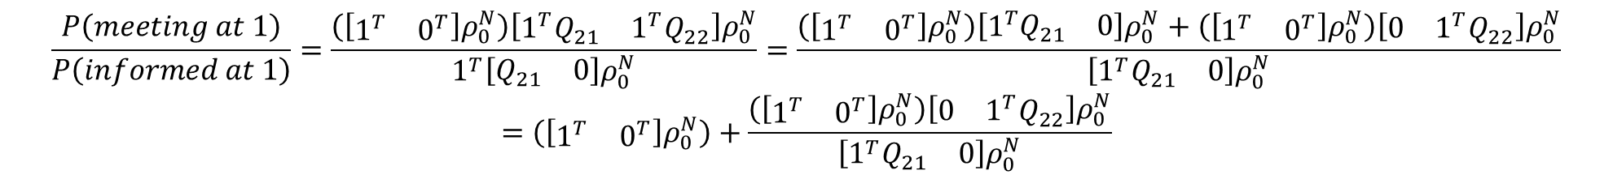
$$\left[\begin{matrix}Q_{11} & Q_{12} \\ Q_{21} & Q_{22}\end{matrix}\right]\left[\begin{matrix}π_{1} \\ π_{2}\end{matrix}\right]=\left[\begin{matrix}π_{1} \\ π_{2}\end{matrix}\right]$$
$$\left[\begin{matrix}Q_{11}π_{1}+Q_{12}π_{2} \\ Q_{21}π_{1}+Q_{22}π_{2 }\end{matrix}\right]=\left[\begin{matrix}π_{1} \\ π_{2}\end{matrix}\right]$$
$$P\left(informed at 1\right)=P\left(meet at 1|not meet at 0\right)$$
$$P\left(informed at 1\right)≈\frac{1}{λ_{2}+1}P\left(meeting at 1\right)$$
$$P\left(meeting at 1\right)=1^{T}{\left[\begin{matrix}Q_{21} & Q_{22}\end{matrix}\right]ρ}_{0}^{N}$$
$$P\left(informed at 1\right)=\frac{1^{T}\left[\begin{matrix}Q_{21} & 0\end{matrix}\right]ρ_{0}^{N}}{\left[\begin{matrix}1^{T} & 0^{T}\end{matrix}\right]ρ_{0}^{N}}$$
$$P_{compound}= \left[\begin{matrix}Q_{11} & Q_{12} \\ Q_{21} & Q_{22}\end{matrix}\right]$$
$$P\left(informed at 1\right)=\frac{P\left(meeting at 1\right)−P(meet at 0 and 1)}{P(not meet at 0)}=\frac{P\left(meeting at 1\right)−1^{T}{\left[\begin{matrix}0 & Q_{22}\end{matrix}\right]ρ}_{0}^{N}}{\left[\begin{matrix}1^{T} & 0^{T}\end{matrix}\right]ρ_{0}^{N}}$$
$$\frac{P\left(meeting at 1\right)}{P\left(informed at 1\right)}=\frac{\left(\left[\begin{matrix}1^{T} & 0^{T}\end{matrix}\right]ρ_{0}^{N}\right){\left[\begin{matrix}{1^{T}Q}_{21} & 1^{T}Q_{22}\end{matrix}\right]ρ}_{0}^{N}}{1^{T}\left[\begin{matrix}Q_{21} & 0\end{matrix}\right]ρ_{0}^{N}}=\frac{{\left(\left[\begin{matrix}1^{T} & 0^{T}\end{matrix}\right]ρ_{0}^{N}\right)\left[1^{T}\begin{matrix}Q_{21} & 0\end{matrix}\right]ρ}_{0}^{N}+{\left(\left[\begin{matrix}1^{T} & 0^{T}\end{matrix}\right]ρ_{0}^{N}\right)\left[\begin{matrix}0 & 1^{T}Q_{22}\end{matrix}\right]ρ}_{0}^{N}}{\left[\begin{matrix}{1^{T}Q}_{21} & 0\end{matrix}\right]ρ_{0}^{N}}$$
$$=\left(\left[\begin{matrix}1^{T} & 0^{T}\end{matrix}\right]ρ_{0}^{N}\right)+\frac{{\left(\left[\begin{matrix}1^{T} & 0^{T}\end{matrix}\right]ρ_{0}^{N}\right)\left[\begin{matrix}0 & 1^{T}Q_{22}\end{matrix}\right]ρ}_{0}^{N}}{\left[\begin{matrix}{1^{T}Q}_{21} & 0\end{matrix}\right]ρ_{0}^{N}}$$
If rho0 = pi
$$\frac{1^{T}π_{1}({1^{T}Q}_{21}π_{1}+1^{T}Q_{22}π_{2})}{1^{T}Q_{21}π_{1}}=\frac{1^{T}π_{1}(1−1^{T}π_{1})}{1^{T}Q_{21}π_{1}}$$

Slide 26
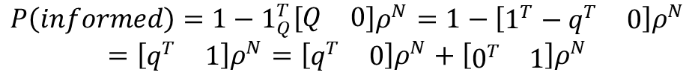
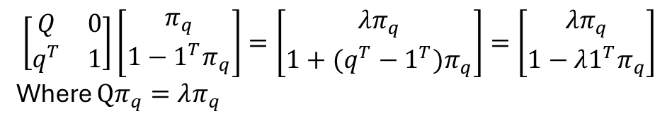
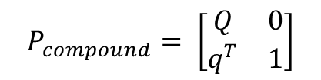
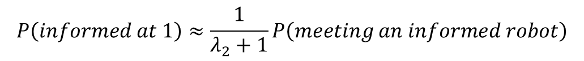
Generalize
$$P\left(informed at 1\right)≈\frac{1}{λ_{2}+1}P\left(meeting an informed robot\right)$$
Given $ρ[0]$ find combined initial vector $ρ^{N}[0]$
Given $P$ find compound transition $P_{combined}$
Partition to state of robot 1 being with other informed robots (informed state) and not being with other informed robots (uninformed state)
Informed probability is the flux ratio from uninformed to informed
$$P_{compound}= \left[\begin{matrix}Q & 0 \\ q^{T} & 1\end{matrix}\right]$$
$$\left[\begin{matrix}Q & 0 \\ q^{T} & 1\end{matrix}\right]\left[\begin{matrix}π_{q} \\ 1−{1^{T}π}_{q}\end{matrix}\right]=\left[\begin{matrix}{λπ}_{q} \\ 1+{{(q^{T}−1}^{T})π}_{q}\end{matrix}\right]=\left[\begin{matrix}{λπ}_{q} \\ 1−{λ1^{T}π}_{q}\end{matrix}\right]$$
Where $Qπ_{q}=λπ_{q}$
$$P\left(informed\right)=1−{1_{Q}^{T}\left[\begin{matrix}Q & 0\end{matrix}\right]ρ}^{N}=1−{\left[\begin{matrix}1^{T}−q^{T} & 0\end{matrix}\right]ρ}^{N}$$
$$=\left[\begin{matrix}q^{T} & 1\end{matrix}\right]ρ^{N}=\left[\begin{matrix}q^{T} & 0\end{matrix}\right]ρ^{N}+\left[\begin{matrix}0^{T} & 1\end{matrix}\right]ρ^{N}$$
$$P\left(informed at 1\right)=\frac{\left[\begin{matrix}q^{T} & 0\end{matrix}\right]ρ^{N}}{\left[\begin{matrix}1^{T} & 0\end{matrix}\right]ρ^{N}}=\frac{P\left(informed\right)−\left[\begin{matrix}0^{T} & 1\end{matrix}\right]ρ^{N}}{1−\left[\begin{matrix}0^{T} & 1\end{matrix}\right]ρ^{N}}=\frac{P\left(informed\right)−P\left(informed at 0\right)}{1−P\left(informed at 0\right)}$$
$P\left(informed at 1 \right)$ $\left(1−\left[\begin{matrix}0^{T} & 1\end{matrix}\right]ρ^{N}\right)+\left[\begin{matrix}0^{T} & 1\end{matrix}\right]ρ^{N}=P\left(informed\right)$
$P\left(informed at 1\right)+P\left(informed at 0\right)(1−P\left(informed at 1\right))$ $=P\left(informed\right)$

Slide 27

Independent approximation
$$Q_{N_{I}+r,N_{I }}≈C_{r}^{N−N_{I}}{\left(ψ_{ N_{I}}\right)}^{r}{\left(1−ψ_{N_{I}}\right)}^{N−N_{I}−r}$$

