Slide 1

Educational Investment vs. Outcome
Predictive Machine Learning Exploration
by Bryan Beus

Slide 2


Project Links
The PDF is an abbreviated version of the project
  The full project can be found on Github:
    https://github.com/blue-santa/comparing-training-req-to-salary-exp
  My website and blog contain more of my work:
    https://bluesanta.io

Slide 3

Problem Identification
The cost of college education tuition is 40 times more expensive than it was in 1963.
  Adjusted for inflation, this is an increase of 312.4%
  (source : Hanson, Melanie. “College Tuition Inflation Rate” EducationData.org, 2025-11-26, https://educationdata.org/college-tuition-inflation-rate)

Slide 4

Problem Identification
In 1963, the average household income was $6,700/year.
Adjusted for inflation, that’s $62,000/year.
(source: https://www.census.gov/library/publications/1964/demo/p60-043.html)

Slide 5

Problem Identification
In 2026, average household income is around $85,828/year.
Adjusted for inflation, this represents only a 32.3% increase since 1963.
(source: https://www.visualcapitalist.com/mapped-household-income-varies-major-us-metros/)

Slide 6
Problem Identification
A prospective college student may want to carefully consider whether their chosen educational investment will provide a suitable financial return.

Slide 7
Problem Identification
This project, “Comparing Training Requirements to Salary Expectations,” addresses this problem.
Specifically, this study compares the amount of education that is required for a career against its financial outcome.

Slide 8
Our Two Datasets
BLS Wage Data
  Provides wage data
  Careers are joinable on “OCC Codes”
O*NET Career Data
  Provides survey data where respondents indicate how much education is needed for career success
  Careers are also joinable on “OCC Codes”

Slide 9
Data Wrangling
Data for each set was downloaded from their respective websites
Each dataset went through several stages of wrangling
A PostgreSQL database provided archival support

Slide 10
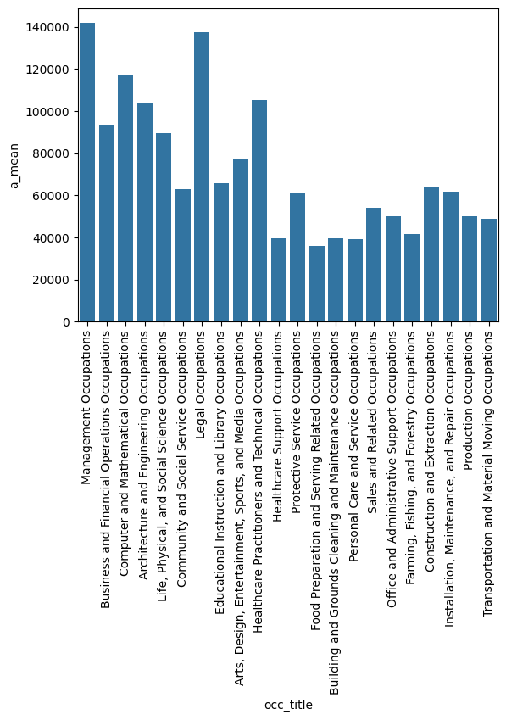
Exploratory Data Analysis
At a glance some careers were noticeably more financially rewarding than others:
  Management and Legal occupations were the most lucrative
  Food Preparation and Serving occupation were the lowest

Slide 11
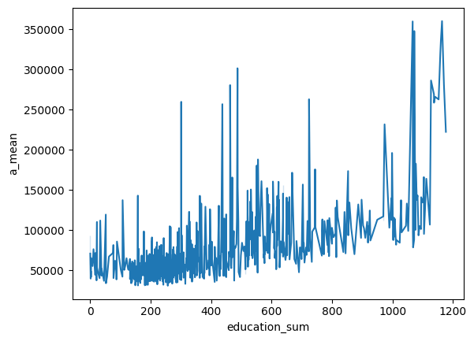
Exploratory Data Analysis
More education slowly but surely leads to a higher expected income

Slide 12
Exploratory Data Analysis
However, some careers become lucrative with far less educational investment

Slide 13

Lesser Education - Higher Income
Three careers that provided higher levels of income while requiring less educational investment:
  Athletes and Sports Competitors
    Education Score: 301
    Average salary: $259,750
  Family Medicine Physicians
    Education Score: 437
    Average salary: $256,830
  Airline Pilots, Copilots, and Flight Engineers
    Education Score: 463
    Average salary: $280,570

Slide 14

Higher Education - Higher Income
Three careers that provided higher levels of income, but required significant educational investment:
  Oral and Maxillofacial Surgeons
    Education score: 1164
    Average income: $360,240
  Obstetricians and Gynecologists
    Education score: 1171
    Average income: $281,130
  Pediatricians, General
    Education score: 1177
    Average income: $222,340

Slide 15

Predictive Modeling
The study explored three different models to predict outcome:
  Linear Regression
  Ordinary Least Squares
  Ridge Regression

Slide 16
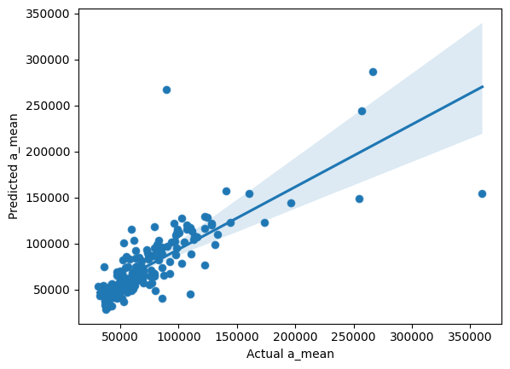
Linear Regression
The Linear Regression model had the highest R^2 score at 0.795

Slide 17
Credits
Study conducted by Bryan Beus: bluesanta.io
Datasets: O*NET, BLS Wage Data
  Image authors and sources:
    Wikimedia Commons, OpenVerse, Andrew Schewgler, byronv2, Wally Gobetz, sf-dvs, Scott Thomas

