Slide 1
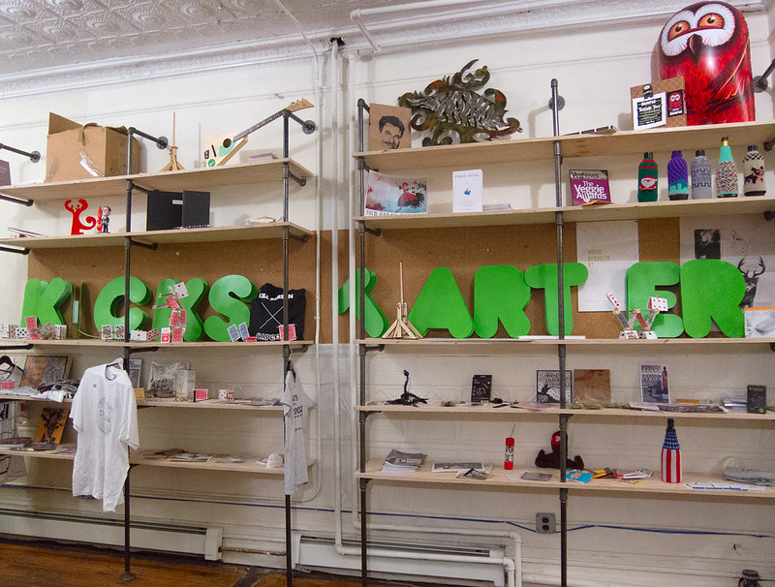
Kickstarter Campaign Analysis
A Data Essay by Bryan Beus

Slide 2

Problem Identification
Small-business owners sometimes have valuable ideas that require funding in order to become a reality
Crowdsourcing is when an entrepreneur turns to the open internet for support for their ideas

Slide 3
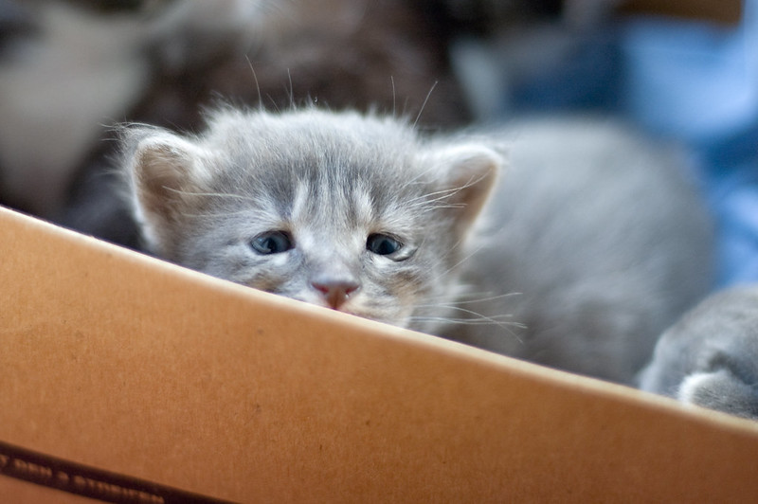
Problem Identification
A successful crowdsourcing campaign can help the entrepreneur, but a failed campaign can lead to a loss of time, resources, and social investment

Slide 4

Project Context
The data-driven essay assists crowdsourcing entrepreneurs through:
  analytical techniques
  an open-source dataset
  predictive modeling

Slide 5
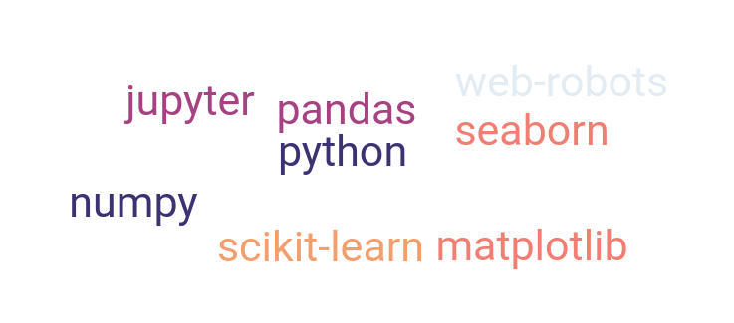
Solution Scope
The scope of this essay includes tools such as:
  Web Robots archive
  Python
  Jupyter
  Numpy
  Matplotlib
  Scikit-Learn
  Seaborn

Slide 6

Constraints
Based on publicly available datasets:
  Incomplete web-scrapings
  Selection bias
Only general categorization
  Small-business owners may find that their project niche is difficult to relate

Slide 7
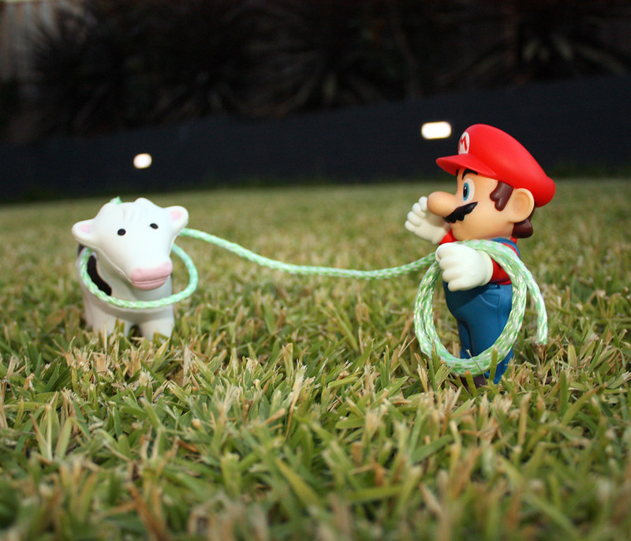
Data Wrangling
Kickstarter dataset
  Import to Jupyter
  Convert json to pandas dataframe
  Remove duplicates, null values
  Drop unnecessary columns
  Export as parquet file

Slide 8
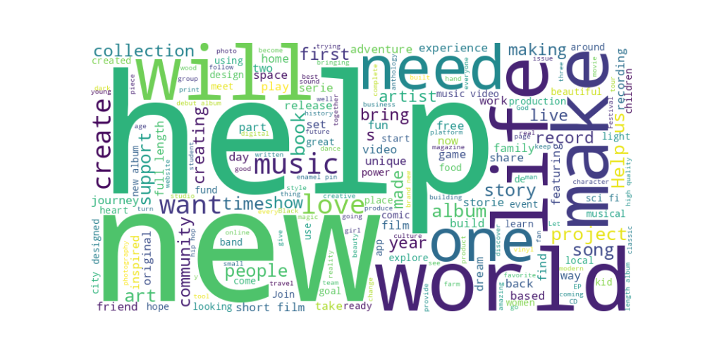
Exploratory Data Analysis
Word cloud based on common terms from Kickstarter project descriptions

Slide 9
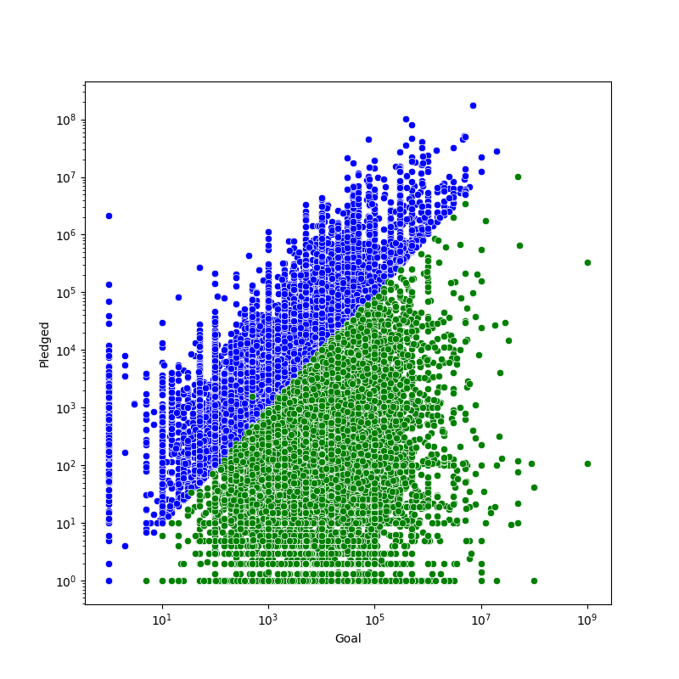
Exploratory Data Analysis
Goal vs Outcome
  Successful campaigns in blue
  Failed campaigns in green
Note the some projects that had a goal of $1 and received millions, as well as vice versa

Slide 10
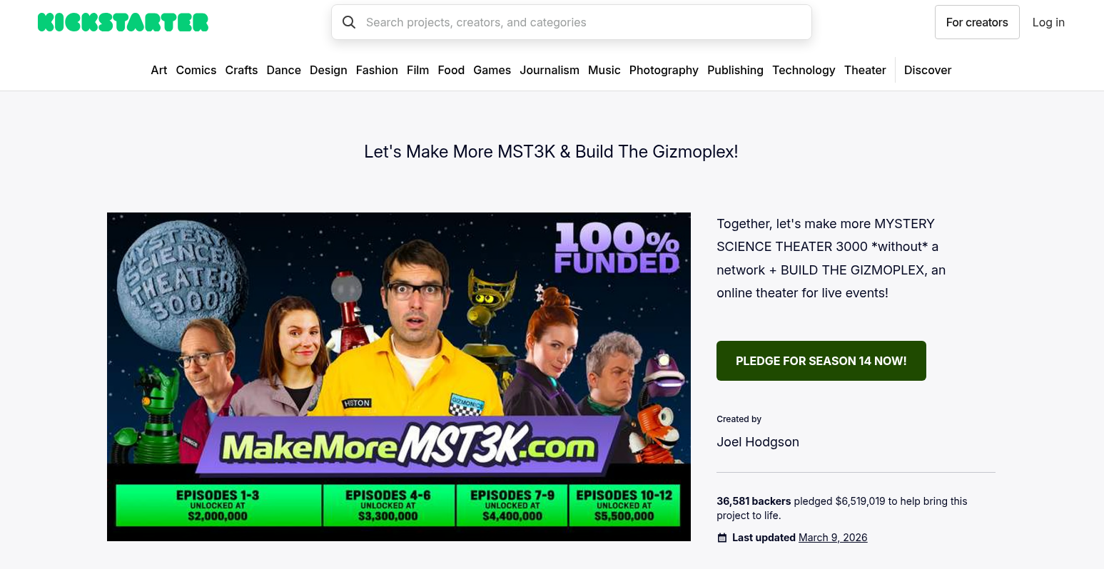
Exploratory Data Analysis
A notable project
  Mystery Science Theater 3000
  Goal: $2M USD, Pledge: $6.5M USD

Slide 11
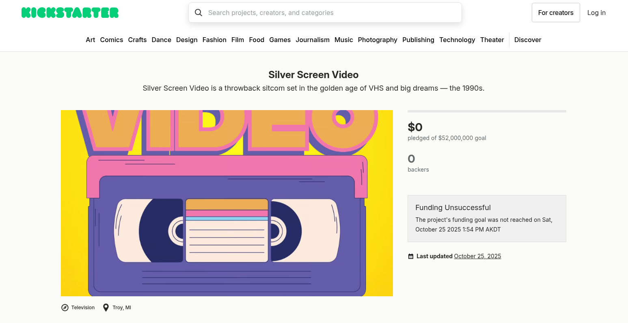
Exploratory Data Analysis
A notable project
  Silver Screen Video
  Goal: $52M USD, Pledge: $0 USD

Slide 12
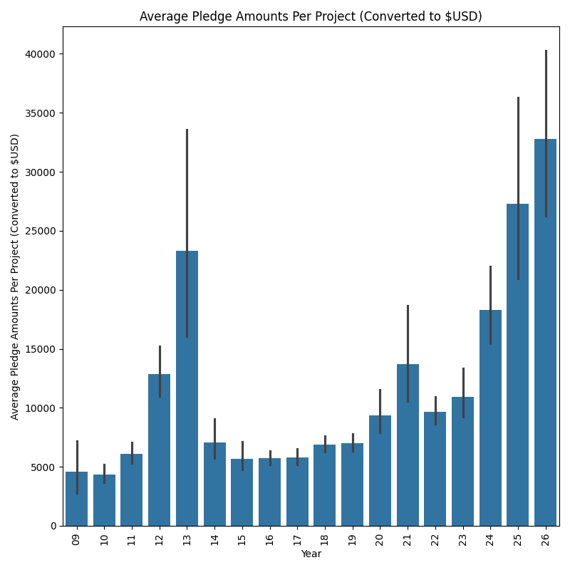
Exploratory Data Analysis
Average pledged amounts per project are increasing
(Note that this analysis could be subject to selection bias)

Slide 13
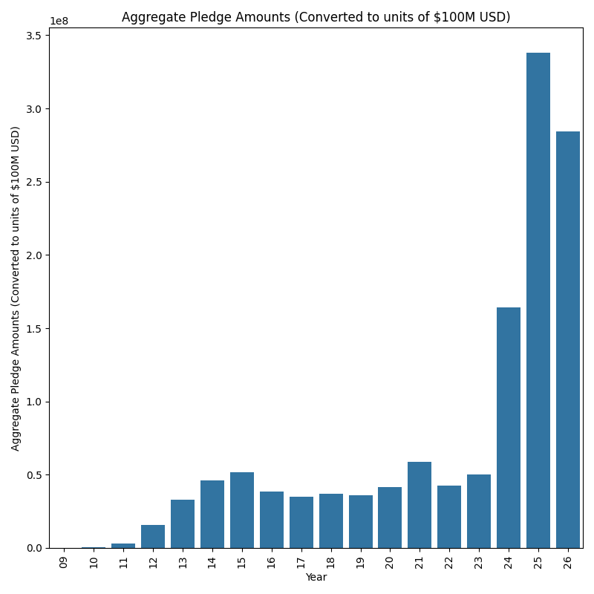
Exploratory Data Analysis
Total pledged amounts are also increasing
(Note possible selection bias)

Slide 14
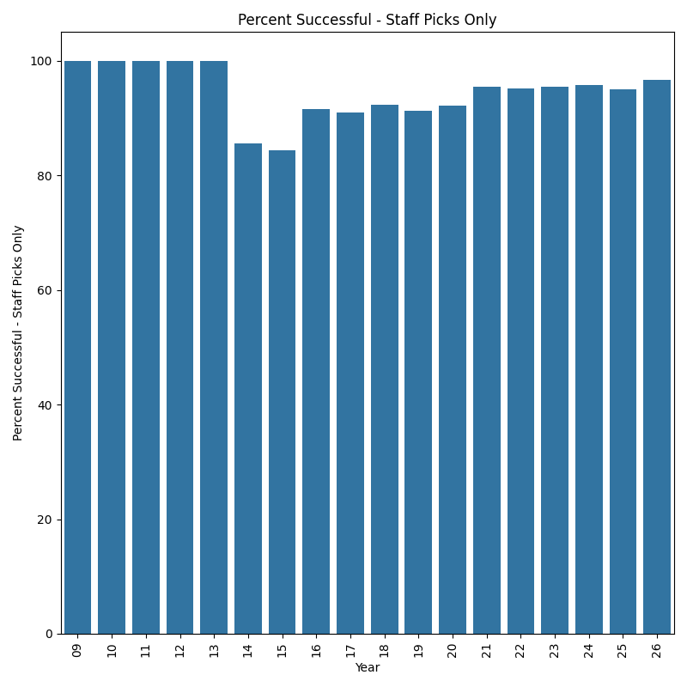
Exploratory Data Analysis
Kickstarter projects that earn a “Staff Pick” highlight have an 80% chance or more of success

Slide 15
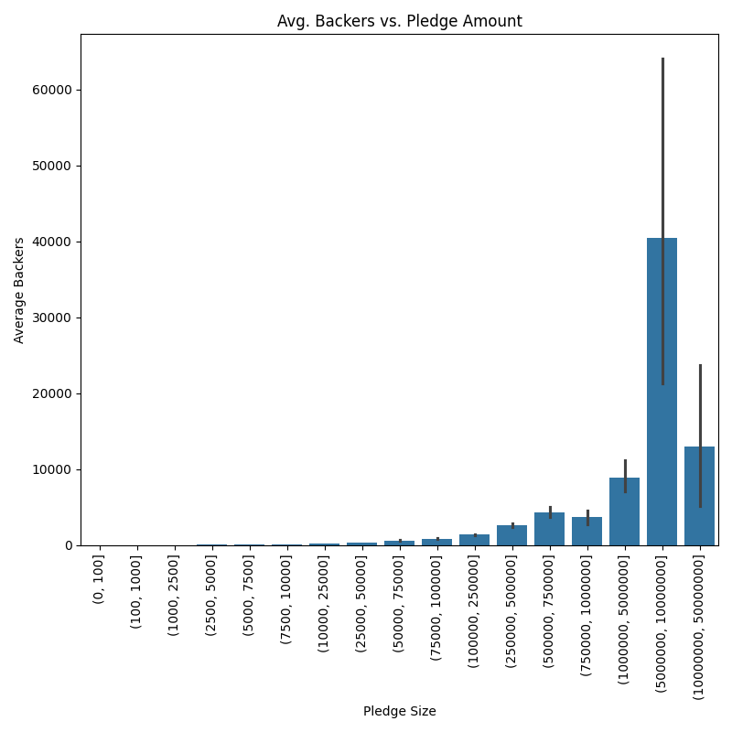
Exploratory Data Analysis
Note that a project can earn as much as $100K without requiring more than 1000 backers
Even 350 backers can raise $25K
Seven-figure sums, however, require tens of thousands of backers

Slide 16
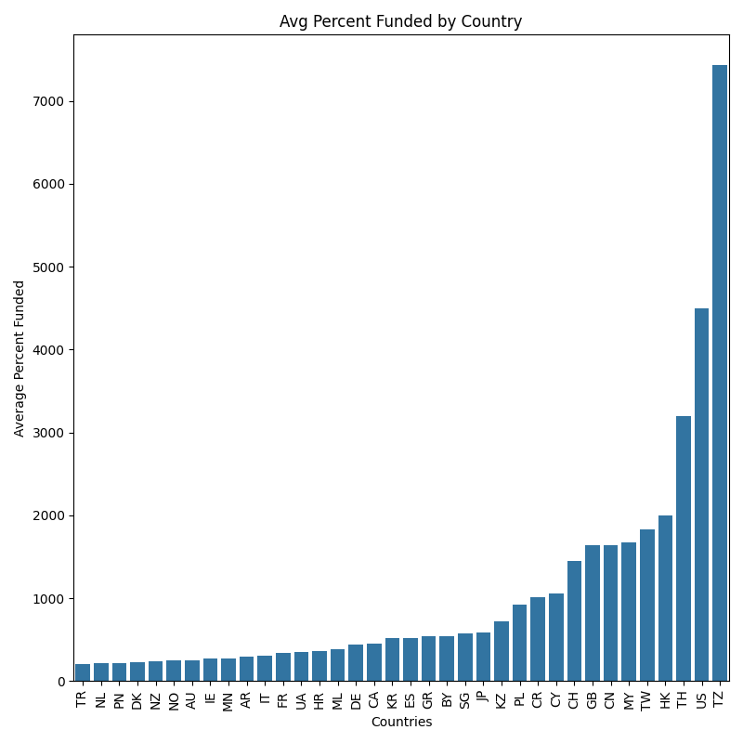

Exploratory Data Analysis
Among successful projects, Tanzania is surprisingly the highest overachieving country, with an average of over 7000% project funding
This is likely due to a limited number of campaigns and skewed data

Slide 17
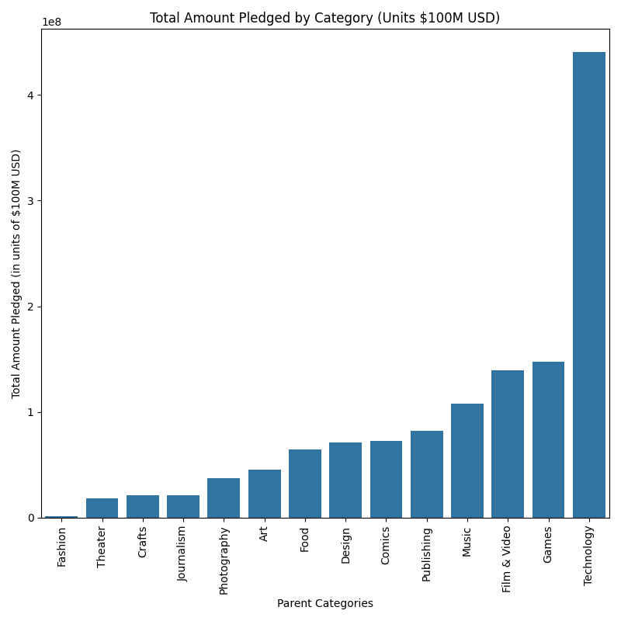
Exploratory Data Analysis
The most lucrative category by far is Technology, followed by Games, Film & Video, and Music

Slide 18
Exploratory Data Analysis
Actionable Insights
  Research how many committed donors beforehand
    If only a few, keep goal at $100 or below
    Considerable sums of $25000 < require 350+ backers

Slide 19
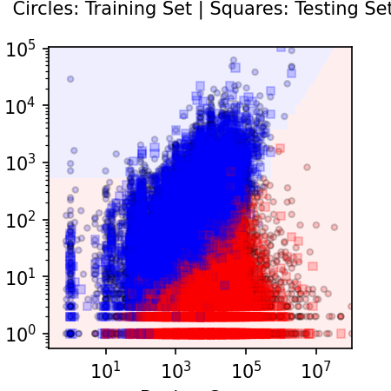
Predictive Modeling
Logistic Regression Classification Decision Boundary Graph:
  Successful campaigns in red
  Failed campaigns in blue
  x-axis: goal
  Y-axis: pledge
Note that successful campaigns are usually less ambitious

Slide 20
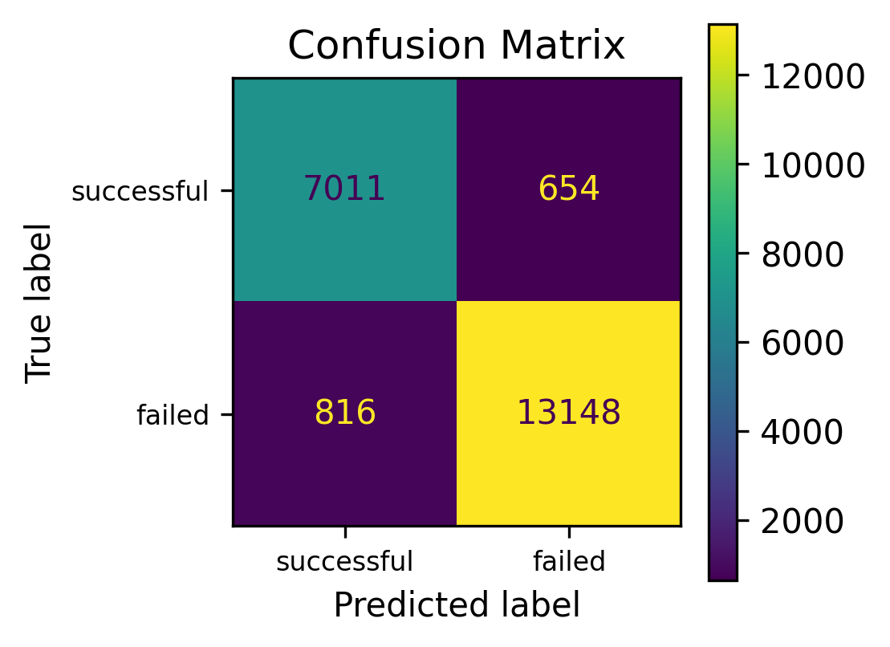
Predictive Modeling
Logistic Regression Confusion Matrix
  Overall accuracy: 0.92
Logistic Regression model can likely provide a reasonably accurate prediction
Notable features include:
  Goal amount, expected backers, currency, location, category

Slide 21
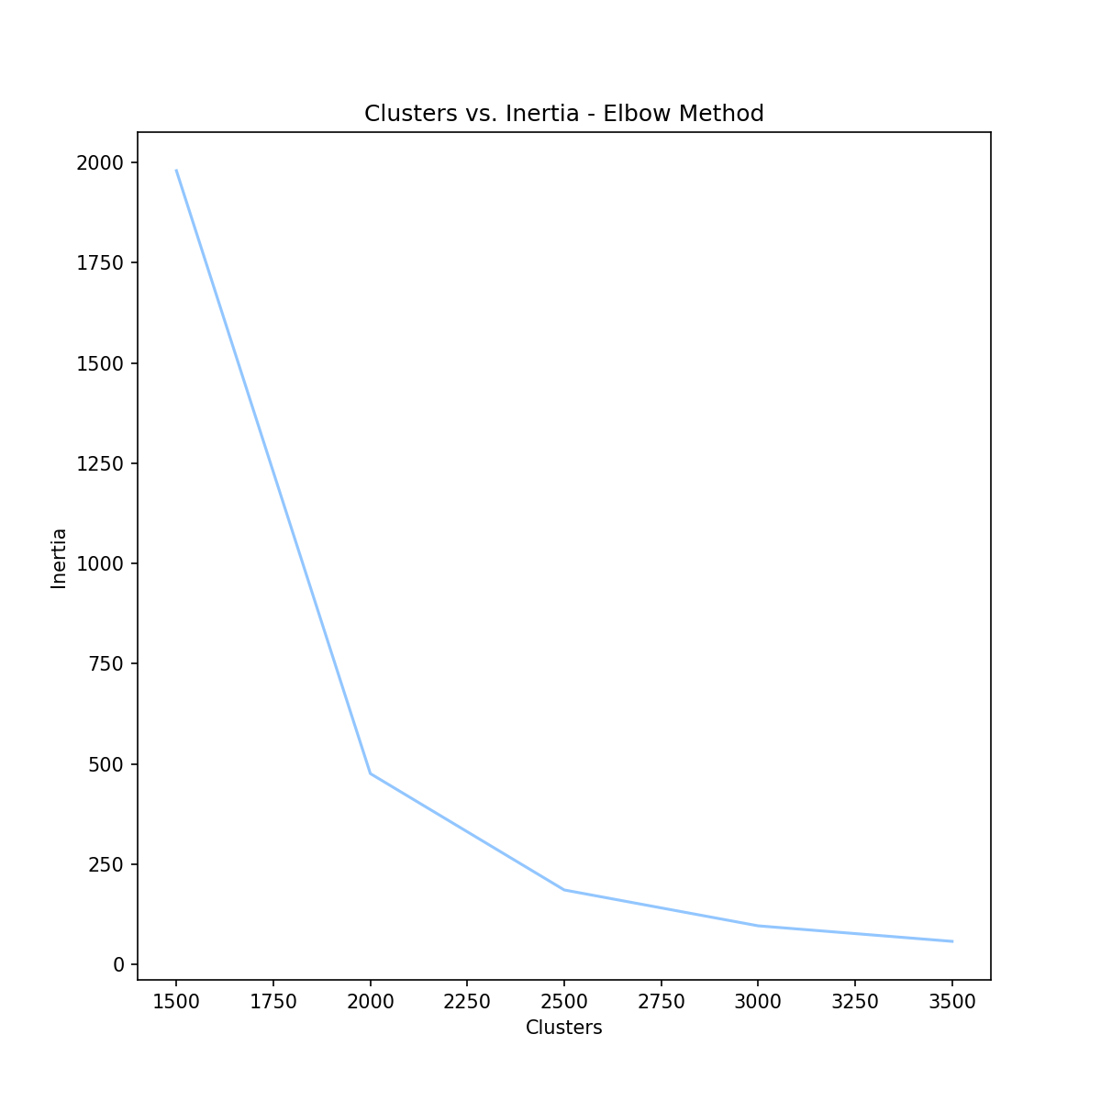
Predictive Modeling
K-Means Clustering
  Total data rows: 86K
Inertia Elbow method:
  Ideal number of clusters is likely 2250

Slide 22
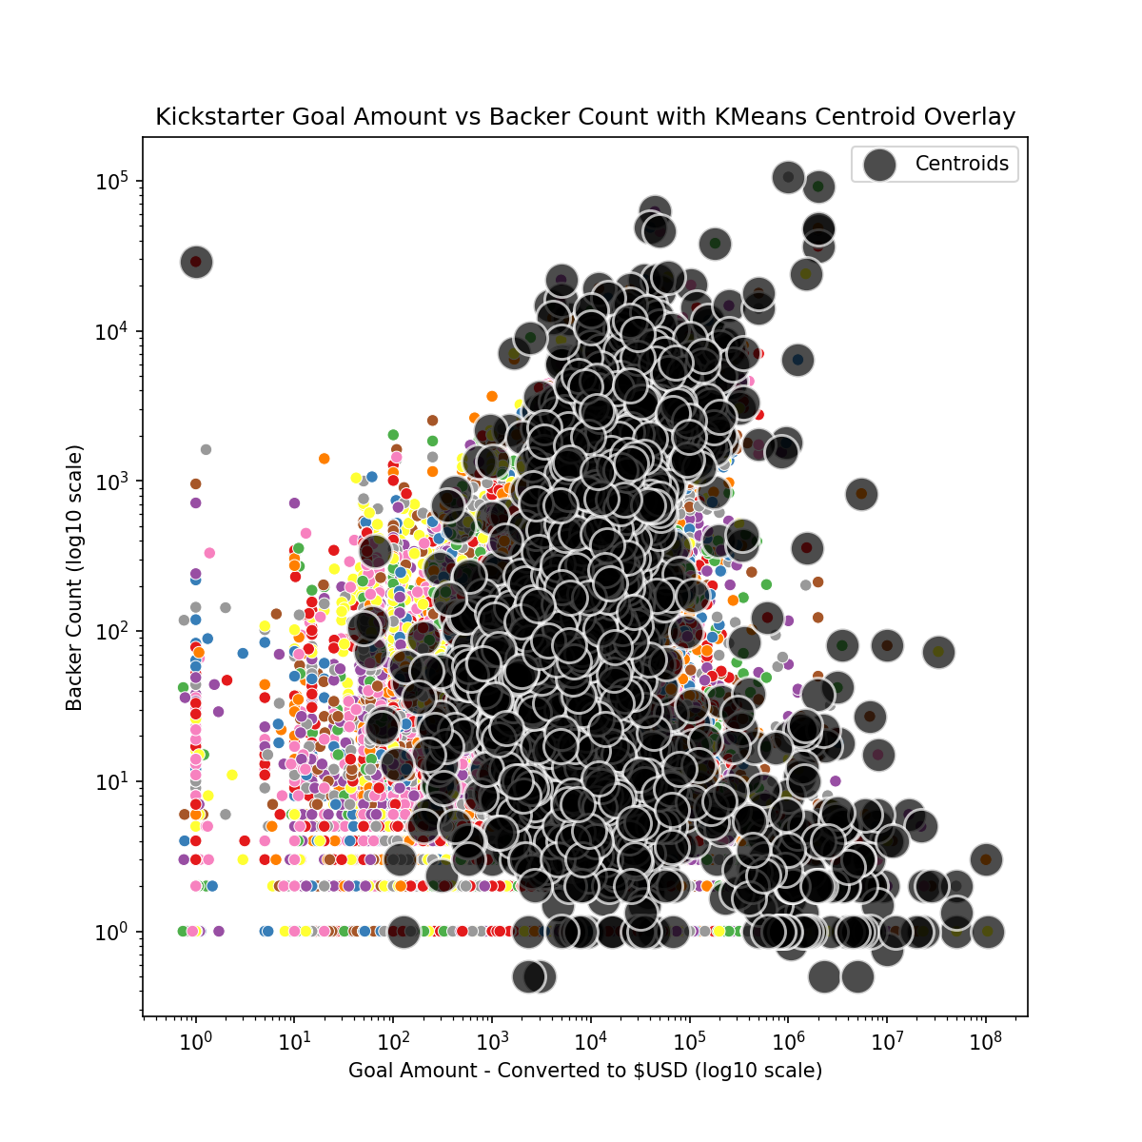
Predictive Modeling
Successful K-Means Cluster
Use case:
  A Kickstarter candidate can put their parameters into the model and find similar projects in the same predicted cluster
  This provides a useful tool for research and development

Slide 23
Conclusion
Recommendations and Insights:
  Keep project simple and low cost
  Research your number of committed supporters beforehand
  Limit your goal to a number that can be achieved
  Use K-Means Clustering to find similar projects and research their working models
  To see a more complete version, visit:
    https://github.com/blue-santa/kickstarter-campaign-analysis
    https://bluesanta.io

Slide 24
Image Credits
Scott Beale / Laughing Squid
Peter Mooney
Laura Taylor
Janeeke Staaks
eflon
david_a_l
Rod Waddington

