Slide 1
Sensor fusion-based group-level emotion recognition using Machine Learning
@問題点
M1 劉浥(21860638)
情報科学域
指導教員 山口亨
Notes:
Today,My presentation title is <Sensor fusion-based group-level emotion recognition using machine learning>.

Slide 2
Issues
（1）The amount of data is small,Dirty data exsits
（2）HRV seems to show individual differences.
（3）An attempt at Two-person experiments

Slide 3




Issues
（1）The amount of data is too little
（One persopn 6 experiments，one experiments
only have 60s‘ data）
Train CNN,LSTM Network to classify whether it's Relax,
Joy,Fear or not---------But not work well(Too little data).
Use SVM to classify whether it's Fear or not。
accuracy is about 66% ± 7%(It seems Fear is most easy to classify)
(Joy+Relax) or not
accuracy is about 60±6%
*Self-report not accurate？
*have no uniform standard？
*Use Regression to evaluate Valence and Arousal？

Slide 4
Issues
（1）Dirty data exsits
someone‘s Self-report data have a Contradiction
（self-report not accurate）
The muse brainwave sensor has a poor contact problem。
some people‘s EEG DATA exist 0 values
EX. AF8 channel all got a value of 0
*Can i fill them with average value?

Slide 5
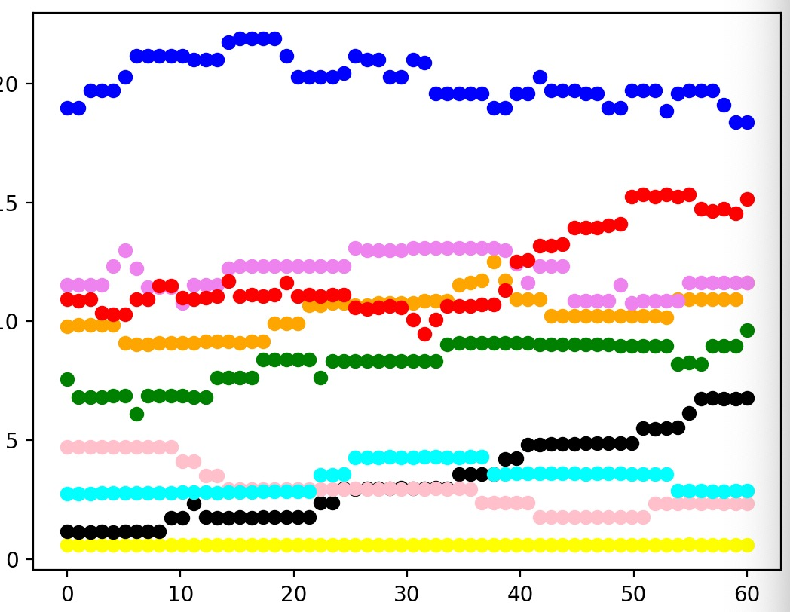
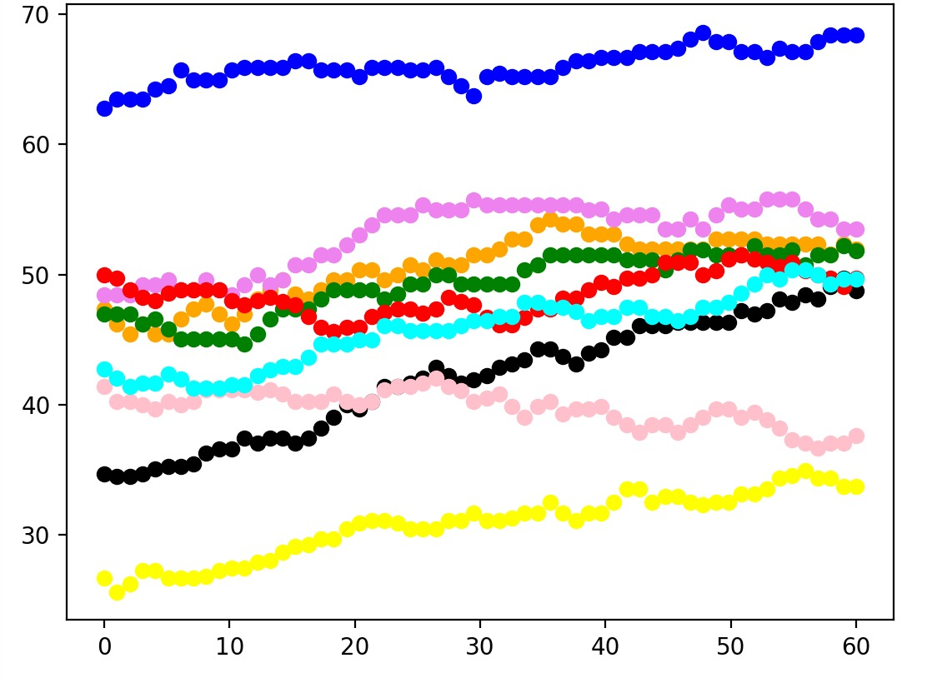
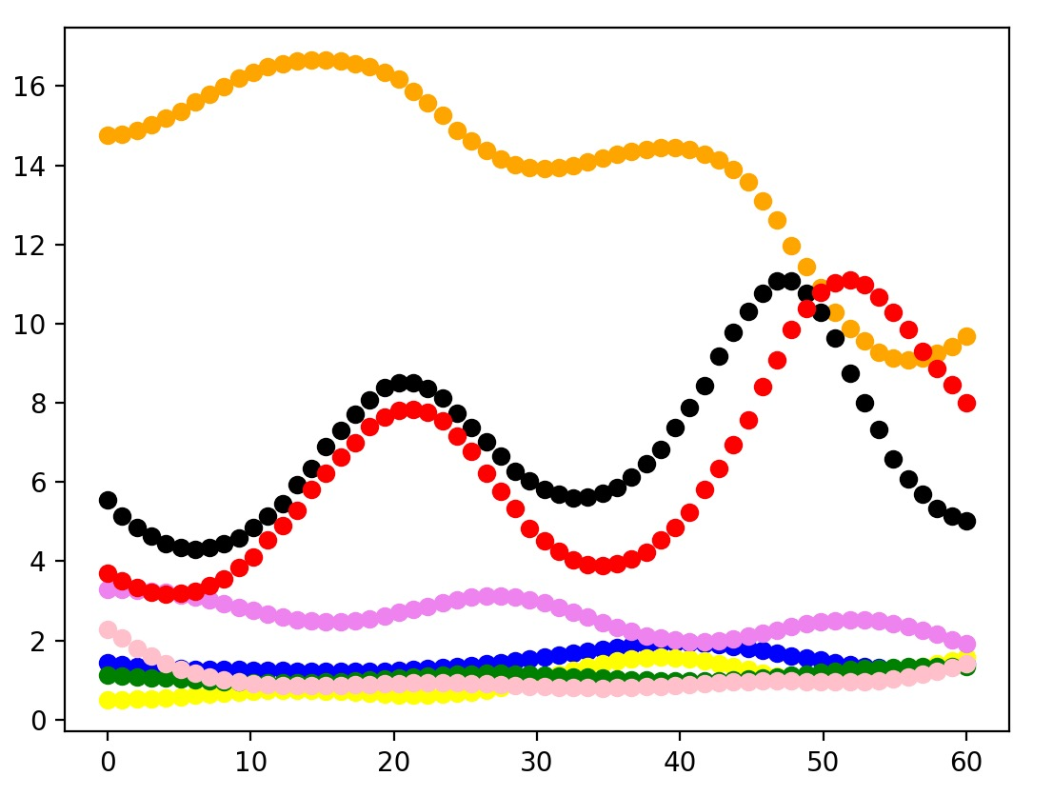
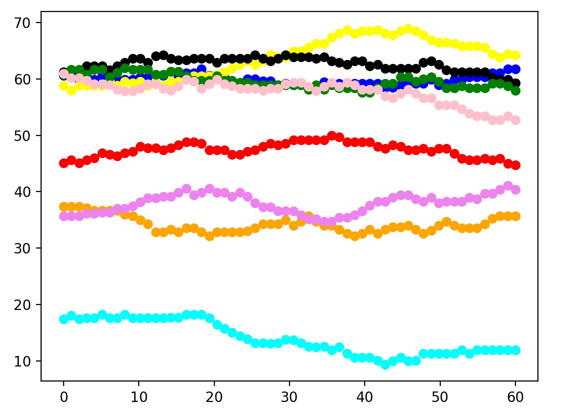
Issues
（2）HRV seems to show individual differences.
pnn50 Relax
pnn20 Relax
LF/HF Joy
Blue Line collaborator shows a higher pnn in relax,sad
fat collaborators seem to show lower HRV values
Not using these data?but there are too many data that differ significantly from most people's values
pnn20 Happy

Slide 6

Issues
（2）An attempt at Two-person experiments
Two people talk to each other with a certain topic in different virtual world
SAI and LI 's have very similar Evaluations about the atmosphere of the conversation
NEXT Experiment world
At Horizon workrooms
talk to each other just like a meeting
or a Tea Party？

Slide 7
[1]Katsigiannis, S., & Ramzan, N. (2018). DREAMER: A Database for Emotion Recognition Through EEG and ECG Signals From Wireless Low-cost Off-the-Shelf Devices. IEEE Journal of Biomedical and Health Informatics, 22(1), 98–107.
[2]N S Suhaimi, J Teo and J Mountstephens, Emotional State Classification in Virtual Reality Using Wearable Electroencephalography, Materials Science and Engineering, Volume 341, International Conference on Applied Electronic and Engineering 2017 (ICAEE2017) 7–8 August 2017, Kuching, Sarawak, Malaysia
[3]Yuhei Ikeda, Ryota Horie, Midori Sugaya.Estimating Emotion with Biological Information for Robot Interaction[C].International Conference on Knowledge Based and Intelligent Information and Engineering Systems, KES2017, 6-8 September 2017, Marseille, France

