Slide 1
Sensor fusion-based group-level emotion recognition using Machine Learning
@問題点
M1 劉浥(21860638)
情報科学域
指導教員 山口亨
Notes:
Today,My presentation title is <Sensor fusion-based group-level emotion recognition using machine learning>.

Slide 2

Background
The era of the Metaverse is coming
Affective computing in the Virtual Reality
→Virtual World/Virtual Meeting/Virtual Human Interaction
A limit——when facial expressions or words do not match the real emotions inside
→For example, people can fake a smile when feeling angry inside[1].
→Use biometric information to evaluate inner mood and so on
To find——the relationship between the Individual emotion・Group Atmosphere and biometric information
→Group Atmosphere recognition under group-level interaction

Slide 3

Related Research
DNP has developed a "next-generation stealth space" [2]
→Use sensors to detect human movement,conversation and
indoor environment(Temperature, humidity and CO2 concentration)
→Emit light and sound according to the room atmosphere.
In Yuhei Ikeda's research
→Brain waves and heart rate were uesd for Estimating Emotion for Robot Interaction[1]
In Marín-Morales's research
→They researched emotion recognition from brain and heartbeat dynamics using wearable sensors in virtual reality[3].
In Shohei Kato's research
→They researched Dialogue Mood Estimation Focusing on Intervals of Utterance State[4]
→They also used Speech Sounds considering Personality Trait of Speaker for Dialogue Mood Estimation[5]
In N S Suhaimi’s research
→They have a try on Emotion state classification of EEG brain signal using SVM and KNN[6]

Slide 4
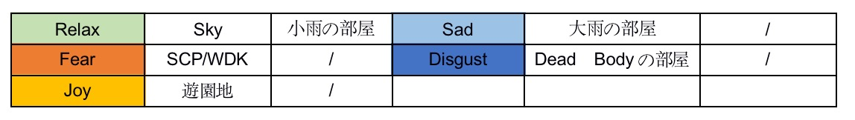
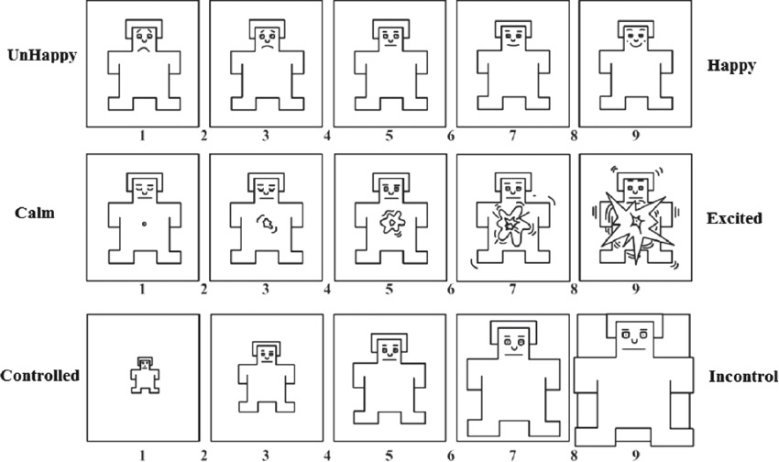
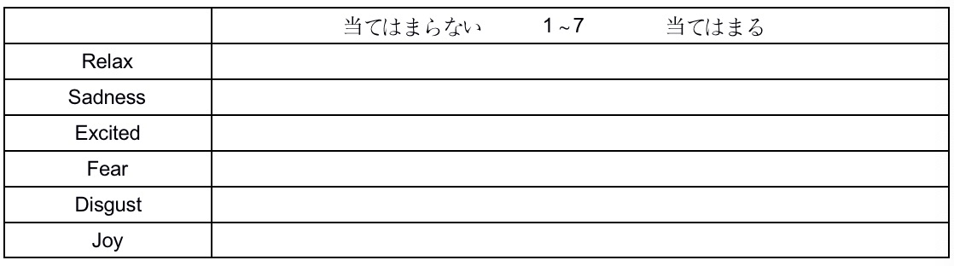
Emotion Arouse Experiment
Six worlds for arousing different emotions in VRchat with Reference to AVRS[7]
Use SAM Questionaire and six emotion questionaire for self-report
＊EMOTION QUESTIONAIRE
＊SAM QUESTIONAIRE

Slide 5

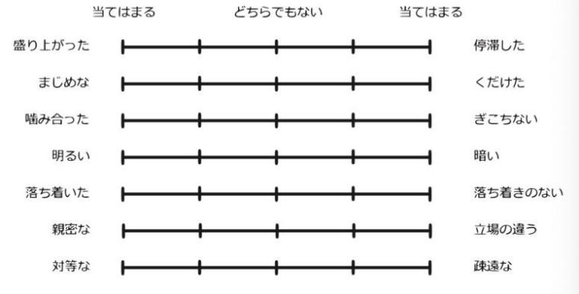
Atmosphere Experiment
Collaborators have a conversation on a certain topic
Experiment VR APP：Horizon Workrooms
Use uttrance questionaire for self-report
Facebook's Horizon Workrooms
＊UTTRANCE QUESTIONAIRE[8]

Slide 6
Data
Data Info of Emotion Arouse Experiments
ID | Name | Date | Note | Used
1 | cuidewen | 09-22/11-20 | / | √
2 | cuidewen | 09-24 | / | √
3 | liuyi | 09-23/09-24 | / | √
4 | Chengyongjie | 09-27 | relax0,relax1 AF8 lost (Average data were filled) | √
5 | kawata | 10-14 | joy5 ex data lost(Joy data not used) | √
6 | sekiguchi | 10-14 | relax0,relax1,sad2 pnn50 seems too high | √
7 | qizhen | 09-28/10-18/10-28 | Fear3 pnn50 seems too low | √
8 | lijianzhan | 10-21 | / | √
9 | sai | 10-28/11-20 | Joy5 pnn50 seems too high | √
10 | zhenqi | 10-19/10-28 | Almost all exs pnn50 are 0 | ×

Slide 7
Self-report
Self-report(Average) result of Emotion Arouse Experiment
 | Valence | Arousal | Dominance | Emotion Value
Relax1 | 5.25 | 1.75 | 6.125 | 5.56
Relax2 | 4 | 1.75 | 5.5 | 6
Sad | 2 | 3.75 | 2.875 | 5.25
Fear | 1.875 | 6.25 | 1.5 | 6
Disgust | 2.5 | 5.375 | 3.25 | 6
Joy | 7.14 | 3.71 | 5.86 | 5.86
Valence Arousal Dominance 1-9
Emotion Value 1-7
There are situations where collaborators are happy and relaxed
(Fear meanwhile Disgust) at the same time
->those emotions seem not discrete

Slide 8
Process
Muse Monitor
Recorder
Polar H10
ECG
EEG
Voice
HRV
Five Brainwaves，Attention，Meditation
Acc，Gyro
Conv2D and MaxPooling2D
(特徴抽出)
CNN
normalization,PCA,
one-hot
the amount of Data
is too small（Hard to
use Deep learning）
CNN-LSTM,CNN-SVM
SVM/Naive Bayies/KNN
Arousal,Valence,Dominance
Joy,Fear,Relax,Disgust,Relax

Slide 9
Result
Single Class Classification(Train:Test 7:3)
 | SVM | Naive Baiyes | KNN
Relax | 0.6875±0.15 | 0.625±0.15 | 0.5625±0.15
Sad | 0.6875±0.15 | 0.625±0.15 | 0.625±0.15
Fear | 0.6875±0.07 | 0.625±0.07 | 0.6875±0.15
Disgust | 0.5625±0.15 | 0.625±0.15 | 0.5625±0.07
Joy | 0.625±0.15 | 0.5625±0.07 | 0.625±0.07
Used Algorithm
Next Algorithm
SVM KNN Naive Baiyes
SVR RFR KernelRidge
CNN LSTM
SVM-RFE?
CNN-SVM? CNN-LSTM?
DNN for Regression?
Clustering?

Slide 10
Issues
（1）The amount of data is small,Dirty data exsits
（2）HRV seems to show individual differences
（3）Have a try to use CNN-SVM/CNN-LSTM/...
（4）Next Attempt :Multi-person experiments(Atmosphere)

Slide 11
Reference
[1]Yuhei Ikeda, Ryota Horie, Midori Sugaya.Estimating Emotion with Biological Information for Robot Interaction[C].International Conference on Knowledge Based and Intelligent Information and Engineering Systems, KES2017, 6-8 September 2017, Marseille, France
[2]室内の人の動きや会話等をセンサーで感知し室内状況に合わせて壁や天井から光や音を発する「次世代ステルス空間」を開発https://www.dnp.co.jp/news/detail/1191077_1587.html
[3]Marín-Morales, J., Higuera-Trujillo, J.L., Greco, A. et al. Affective computing in virtual reality: emotion recognition from brain and heartbeat dynamics using wearable sensors. Sci Rep 8, 13657 (2018). https://doi.org/10.1038/s41598-018-32063-4
[4]Kaoru Toyoda, Yoshihiro Miyakoshi, Ryosuke Yamanishi, Shohei Kato, Dialogue Mood Estimation Focusing on Intervals of Utterance State, Transactions of the Japanese Society for Artificial Intelligence, 2012, Volume 27, Issue 2, Pages 16-21, Released January 13, 2012, Online ISSN 1346-8030, Print ISSN 1346-0714
[5]T. Hasegawa and S. Kato, "Dialogue Mood Estimation from Speech Sounds Clusterized with Speakers' Personality Traits," 2019 IEEE 8th Global Conference on Consumer Electronics (GCCE), 2019, pp. 399-401, doi: 10.1109/GCCE46687.2019.9015238.

Slide 12
Reference
[6]N S Suhaimi, J Teo and J Mountstephens, Emotional State Classification in Virtual Reality Using Wearable Electroencephalography, Materials Science and Engineering, Volume 341, International Conference on Applied Electronic and Engineering 2017 (ICAEE2017) 7–8 August 2017, Kuching, Sarawak, Malaysia
[7]Zhang, W.; Shu, L.; Xu, X.; Liao, D. Affective Virtual Reality System (AVRS): Design and Ratings of Affective
VR Scences. In Proceedings of the International Conference on Virtua lReality and Visualization, Zhengzhou,
China, 21–22 October 2017
[8]長谷川 達也, 加藤 昇平, 話者の性格特性を考慮した対話音声からの対話雰囲気推定, 人工知能学会全国大会論文集, 2019, JSAI2019 巻, 第33回 (2019), セッションID 1O4-J-12-04, p. 1O4J1204

