Slide 1
Sensor fusion-based group-level emotion recognition using Machine Learning
@公開期末発表
M1 劉浥(21860638)
情報科学域
指導教員 山口亨
Notes:
Today,My presentation title is <Sensor fusion-based group-level emotion recognition using machine learning>.

Slide 2

Introduction
（1）Affective computing is very important for research in
psychological health,Human-Computer interaction, etc[1].
→However,It's difficult to estimate emotion , not only for robots, but
even for people themselves
（2）Extensive research has been carried out , especially focused on extracting the rules and features of expressions .
→such as user’s eye-gaze direction, head position, facial and mouth expression and behaviours
（3）the limitation of these approaches is that it is difficult to apply them when facial expressions or words and emotion differ from the norm[2].
→For example, people can fake a smile when feeling angry inside.
Notes:
In the first section,i am going to make an introduction about Affective computing and research background .
so i tend to use brainwaves，heart rate rather than expression features

Slide 3

Background
（1）The essence of emotion recognition is value recognition
→Other person's physical condition, social status, attitude toward material things will affect each other's emotions.
（2）Individual and group emotions affect each other.
→human's Altercentric Cognition（他者中心性）[3]
（3）Emotions tend to be influenced by the past.
→Human emotions have a lasting impact.So for emotions recognition,time-series Algorithm(RNN,LSTM,GRU) can be considered.
（4）some people do not express themselves with observable information
→Biological information such as brain waves and heartbeat are some of the best signals that cannot be controlled by people intentionally[2].
Notes:
for background,we know...

Slide 4
Related Research
（1）In Castellano‘s research, facial expressions, voice, and gestures were fused together to Estimate emotions. The accuracy was 78.3%[4].
→Scherer et al. also added body posture to the experiment. The accuracy was 79%.
（2）In Yuhei Ikeda's research,brain waves and heart rate were uesd for Estimating Emotion with Biological Information for Robot Interaction[2].
（3）In Alice Chirico's research,they researched Affective computing in virtual reality. And they realize emotion recognition from brain and heartbeat dynamics using wearable sensors[5]
（4）In Fei Tao's reserach,they proposed an advanced LSTM（A-LSTM）for emotion recognition，which improves the accuracy by 5.5% compared to the classical LSTM[6].
Notes:
(4)Related Research,...

Slide 5
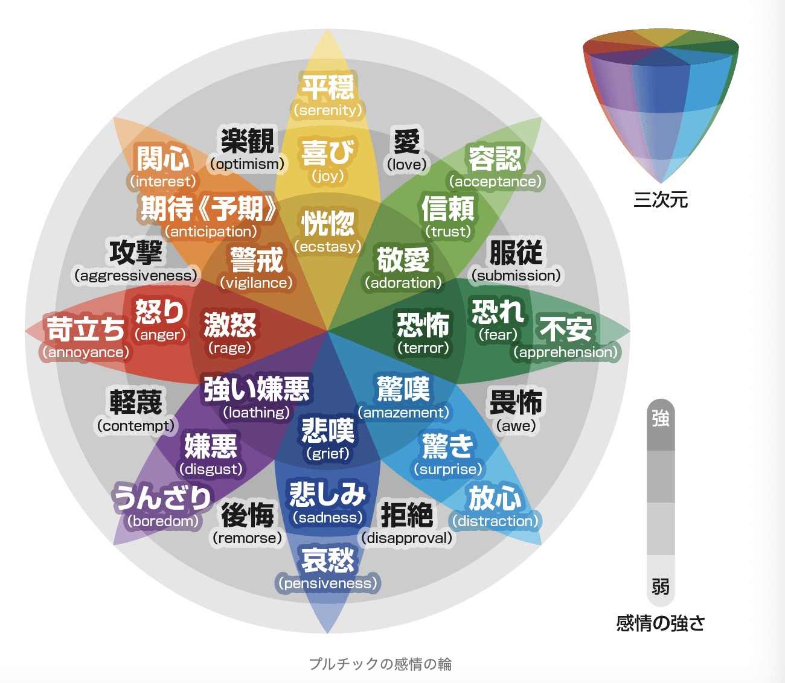
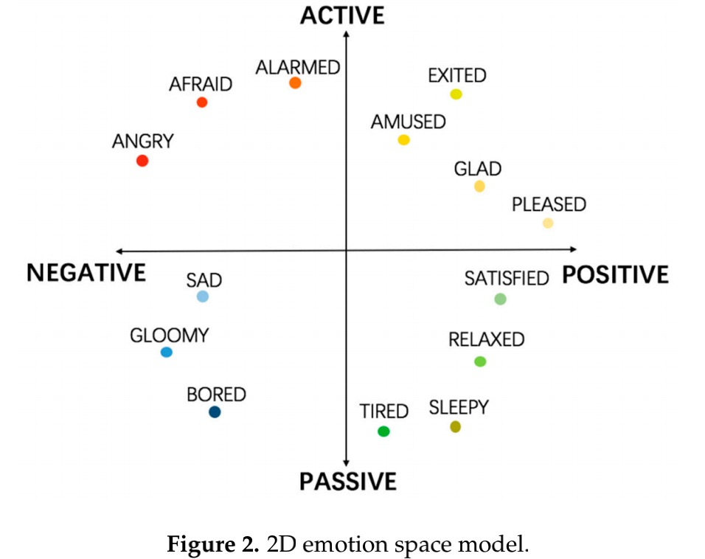
Emotion Model
(The most popular emotional model[7])
A circular model proposed by Russell in 1980 .
(3Dimension emotional model)
Robert Plutchik's Wheel of Emotions can be considered.
Notes:
In the second section,i will introduce emotion model and emotion arousal functions that i used according to others researches.

Slide 6

Emotion Arousal
（1）Incident elicitation is a technique that uses images, sounds, videos, smells, etc. to stimulate subjects and induce emotions[7].
→But it tend to be influneced by environment and difficult to arouse stronger emotion for ordinary person.
（2）VR based Emotion Arousal can be considered
Diff between VR simulation and real-world:
Marín-Morales et al. analyzed emotional states and behavioral resp
onses elicited in vr and real-world,and found no differences in subjec
ts' self-evaluations, but in brain dynamics.(2019)
Validity of VR simulation：
Chirico et al. proved that VR-based emotion induction methods can induce stronger (Awe)emotions.(2017)
a VR simulation model:
Nariro Yoshida(Tokyo University) proposed a model Inducing emotional experiences using pseudo-body responses(擬似身体反応). (2017)
Notes:
According to the related research

Slide 7




Image
（１）Three people in the same room
（２）When Go back home
Angery
Environment:
Weather: Rain
Temperature: Cold
Air Pressure: Low
Lighting: Dark
もう！
Sad
Happy
unhappy
I was scolded by my boss yesterday (Yesterday's Discomfort)
I'm lonely and alone (Long term observation)
I also caught a cold (Health condition)
すみません~
ははは〜
Notes:
To make a image of the use case,i will give two examples.
First image,when three people in the same room,We can see someones emotion have a relation with others emotion.Therefore, I consider to conduct a comprehensive analysis in combination with the emotional state of group-level people.
Another example is a single dog.when go back home, the environment is bad ,and he hasn't had much luck recently ,so we tend to believe he has a greater tendency to feel sad.

Slide 8

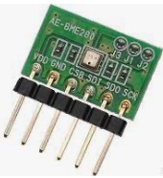

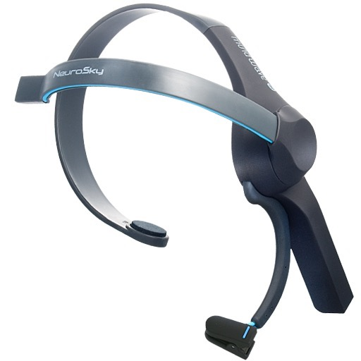
System Design
（1
Estimote indoor location
people in the same room will be detected,so the information of them will be sent to the servers
Beacon
Fitbit
Heart rate, acceleration,
(respiration,skin electric, etc.)
Time series data and personal information
Environmental sensors
（RASPBERRY PI）
LSTM/RNN/GRU...
database
RASPBERRY PI
Indoor people's
Emotional state output
Mindwave Mobile
brainwave and heart rate
Notes:
For System Design,I will use Beacon to detect the people in the same room,so their information will be considered together.
I will use fitbit, Jins glasses, Mindwave Mobile to get biological information . And Raspberry PI will do as a server to get environment data and calculate.
These time series data and personal information will be put into LSTM algorithm to recognize emotion state.All this data will be saved at database.

Slide 9
Experiment Design
In first step experiment, we set the procedure as follows.
(1) The collaborators answer the questions about their attributes from the questionnaire.
(2) The collaborators takes several minutes’ rest.
(3) The collaborators watch the videos/play acting.
During this time, the sensors detect the biological information.
(4) The collaborators answer the evaluation questionnaire for each section, then the questionnaire is evaluated.
Notes:
In first step experiment,we set the procedures as follows.
First,the collaborators answer the questions about their attributes from the questionnaire.
And then,they will take several minutes rest.
Next,the collaborators watch the videos or play acting together.meanwhile, the sensors detect the biological information.
Finally,the collaborators should answer the evaluation questionnaire

Slide 10
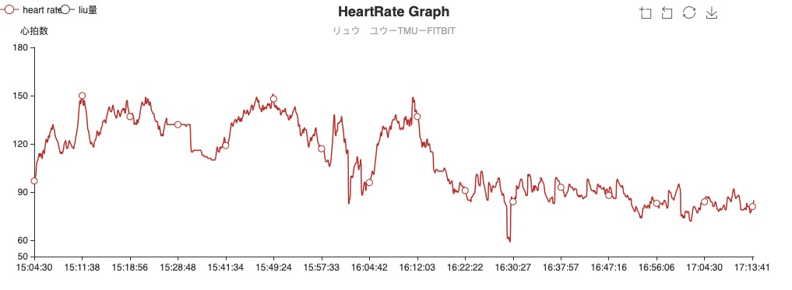
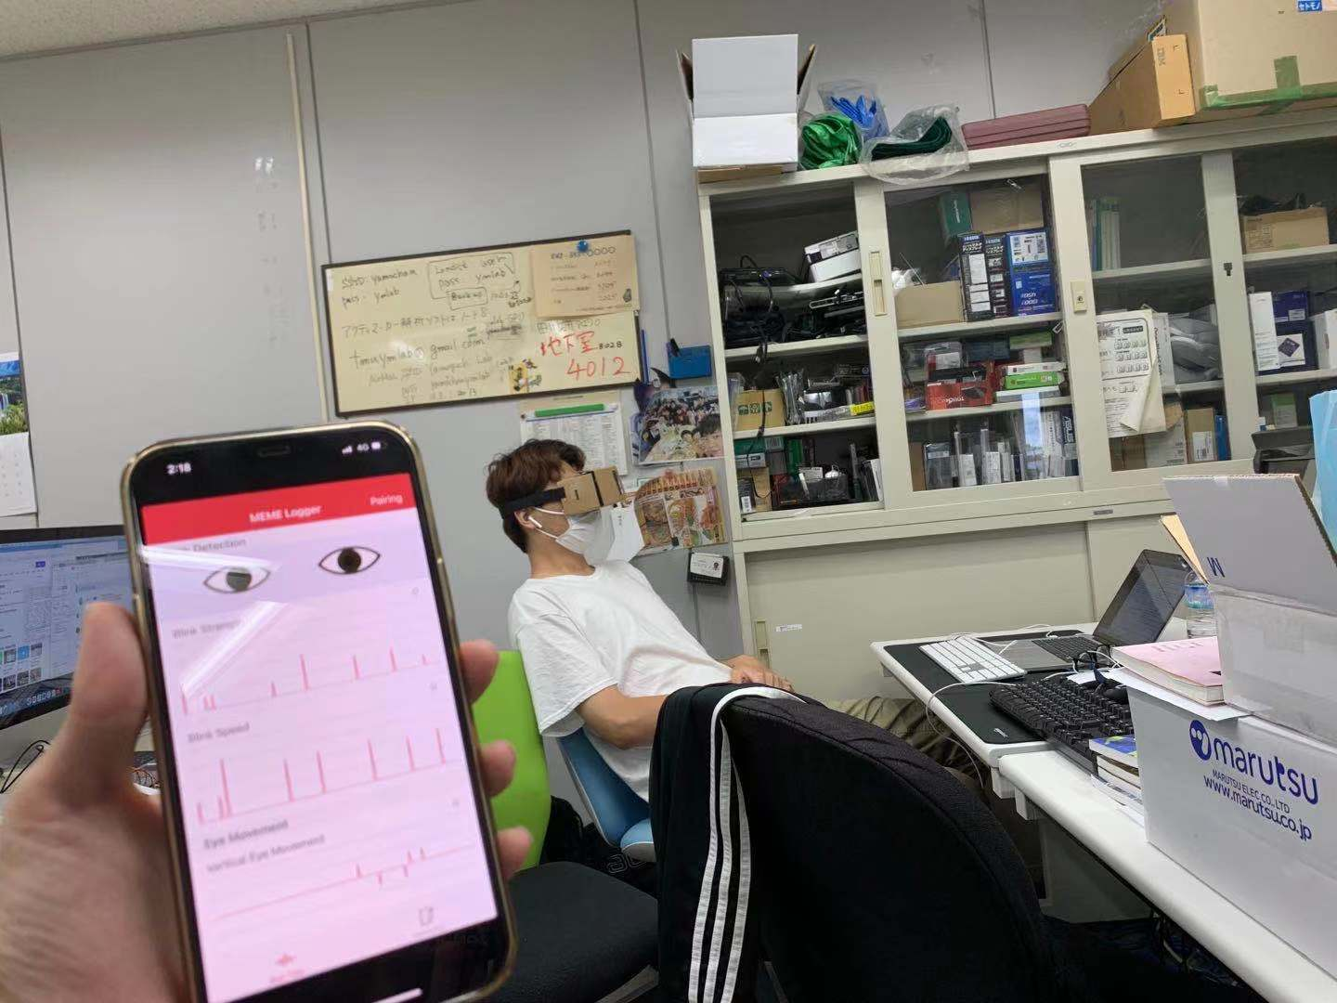
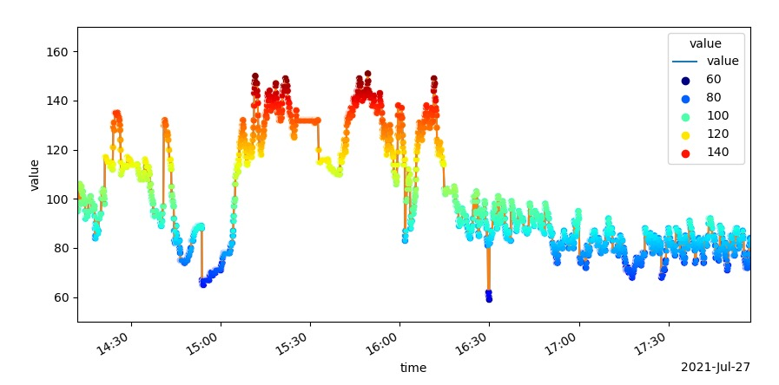
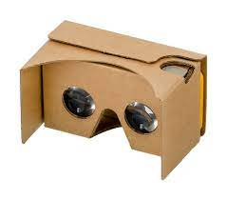
Experiment Image
First step experiment
wearing JINS glasses and fitbit
use google cardboard 3D glasses
watch horror vedios
and relaxing vedios
visualized heart rate
using pyecharts and matplotlib
Notes:
)Experiment Image
we were wearing JINS glasses ,fitbit,and google cardboard 3D glasses.The collaborators watched the horror vedios and relaxing vedios.And i I had a try to visualize the data using pyecharts and matplotlib.

Slide 11
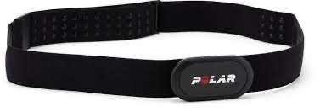
Concluding remarks
（1）The heart rates collected by fitbit(charge2)
seems not accurate,we need a better device
to collect biometric information.
（2）we need a quieter environment , more appropriate rest time between each section,and collect group-level data through acting.
（1）We can do Pre-segmentation of users by their personality,personal info,emotion state. etc.
（2）Consider the effect of cross-cultural differences on emotion generation.
（3）Apply our system to robots(Kebbi,Pepper) for daily health care.
Polar H10
（HR、ACC、ECG）
Notes:
→different models can be trained and used for different kinds of people.

Slide 12
References
[1]Dzedzickis, Kaklauskas, and Bucinskas. "Human Emotion Recognition: Review of Sensors and Methods." Sensors 20.3(2020):592.
[2]Yuhei Ikeda, Ryota Horie, Midori Sugaya.Estimating Emotion with Biological Information for Robot Interaction[C].International Conference on Knowledge Based and Intelligent Information and Engineering Systems, KES2017, 6-8 September 2017, Marseille, France
[3] Kampis, D. , and V. Southgate . "Altercentric Cognition: How Others Influence Our Cognitive Processing." Trends in Cognitive Sciences 24.11(2020).
[4][1] Castellano, G. , L. Kessous , and G. Caridakis . "Emotion Recognition through Multiple Modalities: Face, Body Gesture, Speech." Springer Berlin Heidelberg (2008).
[5]Chirico, A. et al. Effectiveness of Immersive Videos in Inducing Awe: An Experimental Study.
Sci. Rep. 7, 1–11 (2017).
[6]Tao, F., & Liu, G. Advanced LSTM: A Study About Better Time Dependency Modeling in Emotion Recognition. 2018 IEEE International Conference on Acoustics, Speech and Signal Processing (ICASSP).
[7]潘家辉, 何志鹏, 李自娜, 等. 多模态情绪识别研究综述[J]. 智能系统学报, 2020, 15(4): 633-645.
Notes:
Finally,This is my references,And my presentation is over.Thank you.

