Slide 1
Group-level Emotion Classification via Reinforced Self-training
@中間発表
M2 LIU YI(21860638)
情報科学域
指導教員 下川原英理

Slide 2


Section1- Introduction
Contactless Virtual Social
become popular in recent years
A smart virtual space/virtual agent
is expected, to help conversation on those online virtual world platforms
Dialogue atmosphere
is a metric used to describe group-level interactions，which is different from individual emotion

Slide 3
Section2- Related Work
Mood Enginnering[5]
→"Atmosphere"
→Proposed by the Japanese Society for Artificial Intelligence(JSAI) in 2013.
DNP(Dai Nippon Printing Co., Ltd.)——"next-generation stealth space"
Change the color of light and music in a room by using sensors to detect the status of people’s presence and conversations and the indoor environment.
In Shohei Kato's research
They researched Dialogue Mood Estimation Focusing on Intervals of Utterance State[6]
Use Speech Sounds considering Personality Trait of Speaker for Dialogue Mood Estimation[7]

Slide 4
Section2- Related Work
Reinforced Self-Training
Zero-shot Text Classification via Reinforced Self-training(Z Ye et al.,2020)
proposed a reinforced self-training model for zero-shot learning in NLP
Reinforcement learning for relation classification from noise data
proposed a policy network to automatically identify wrongly-labeled instances in training set
Learning what data to learn(Fan et al.2017)
proposed an adaptive data selection strategy, enabling to dynamically choose different data at different training stages.

Slide 5
Section1- Proposed Model
high level/quality
labeled dataset
train
Matching Model
predict
unlabeled dataset
reward
evaluation
Reinforcement Learning Policy Network
add pseudo
labeled instances
Do data selection
evaluation by interaction with
VR avater and HRV changes
reward
Avater/HRV

Slide 6
Section4- Experiment Design
Experiment Setting
APP: VRChat
Group Composition: 3 people a group（1 main speaker,and 2 auxiliary speaker）
Participants: more than 10 different main talkers（20 rounds of experiments）
Device: VIVE Pro Eye, Polar H10, Oculus Quest2
Details:
One participant wear sensors and VR headset(Main talker)
other two participants just wear VR headset and talk(Talk Agent)
Each conversation lasted approximately 3 minutes

Slide 7
Section4- Experiment Design
Target
Find
Gaze/Mouth movement/Heart rate
connection?
Dialogue Mood
When
Self-assessment
, can
Biometric information
estimate
Dialogue Mood?_x0008_
Others' assessment
Did
different VR settings(VR world)
effect
Dialogue Mood?
Can
data collected from daily conversations
be applied to
Reinforced Self-Training?

Slide 8
Section4- Experiment Design
Communication setting
VR world setting
evaluate the
dialogue atmosphere
and self-report own emotions
evaluate the
dialogue atmosphere
and player1's emotions
Arousal
VR&Sensor
VR
communication
Fear/Disgust
Joy
Player1
Player2
Valence
Sad
Peaceful
VR
evaluate the
dialogue atmosphere
and player1's emotions
*4 kinds of world that
match up to 4 quadrants
Player3

Slide 9
Section4- Experiment Design
Raw Data:
Experiment schedule:
ECG
Audio(wav)
Eye tracking
Lip tracking
Head position&rotation
1st experiment (negative group)
Stay in a Fearful VR environment
Talk about positive topics
Talk about controversial topics
Talk about negative topics
Stay in a Saddening VR environment
Talk about positive topics
Talk about controversial topics
Talk about negative topics
2st experiment (positive group)
Stay in a Delightful VR environment
Talk about positive topics
Talk about controversial topics
Talk about negative topics
Stay in a Peaceful VR environment
Talk about positive topics
Talk about controversial topics
Talk about negative topics

Slide 10
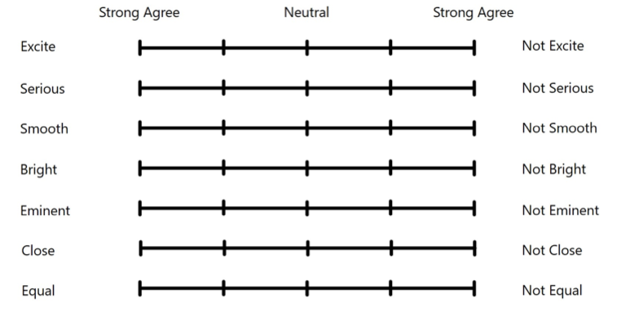
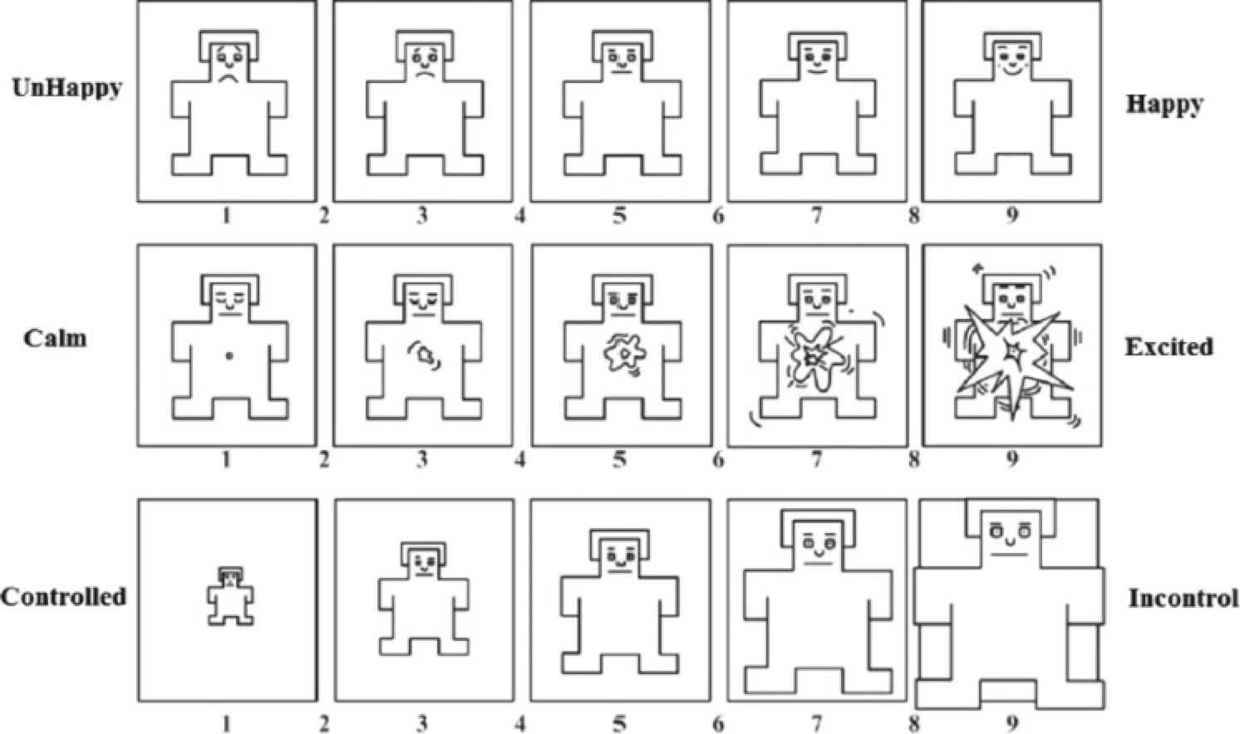
Section4- Experiment Design
Questionnaire
Main talker will be asked to self-report
their emotions by SAM questionnaire
3 collaborators will evaluate the dialogue atmosphere after the experiment

Slide 11
Section4- Experiment Design
Data Flow
ECG
R-R Interval
Heart Rate Variability(HRV)
Audio(wav)
Time-domain Audio Features
Train class
Matching Model
Eye tracking Data
Pupil Diameter&EyeOpen
Pupil Position
Nearest Neighbor Index
of pupil position
SVM-Regression/
Transformer-Regression
Head position&rotation

Slide 12
Section5- Reinforcement Learning Network
For Reinforcement Learning Network
(1)State:
preprocessed biological data and confidence point
(2)Action:
Two class, whether choose this sample
(3)Reward:
Based on the model’s performance on validation set
(4)Policy Network:
multi-layer perception(MLP)
Input is State
Output is Action’s probability distribution

Slide 13
Section6- Machine Learning Plan
After normalization, optimization...Train Machine Learning Model..
 |  | SVM | SVM+RL | Transformer | Transformer+RL | LSTM | LSTM+RL
Emotion | Valence
 | Arousal
 | Dominace
Atmosphere | Excite
 | Serious
 | Smooth
 | Bright
 | Eminent
 | Close
 | Equal
Then investigate whether the model is able to draw out individual differences to get a higher score

Slide 14
Section6- Conclusion&Discussion
A Reinforced Self-training model will be applied to dialogue mood recognition under conversation conditions
We expect our Reinforcement learning-based data selection strategy can evolve our AI to match the user's differential traits better
We alter the VR environment to explore the effect of ambience on dialogue mood, as well as the effect on collaborators' assessment.

Slide 15
Section7- Research Schedule
Master1
<Sensor Fusion-based Emotion Classification In Virtual Reality Using Machine Learning>
2021.8
midterm presentation
2022.3
NCSP22 oral presentation
2021.9-11
experimen&ML
Master2
<Sensor Fusion-based Group-level
Emotion Classification In Virtual Reality>
2022.8
midterm presentation
2023.3
Graduation Thesis
2022.9-11
experiment&ML
<Group-level Emotion Classification via Reinforced Self-training>

Slide 16
Acknowledgment
Thank you for listening
ご清聴ありがとうございます

