Slide 1
Zero-shot Emotion Classification via Reinforced Self-training
@進捗報告
M2 LIU YI(21860638)
情報科学域
指導教員 下川原英理
Notes:
Hello,everyone.
Today,My presentation title is <Sensor Fusion-based Emotion Classifcation In Virtual Reality Using Machine Learning>.

Slide 2
Zero-shot Learning
Zero-shot learning (ZSL)
ZSL is a challenging task as no labeled data is available
for unseen classes during training.
When we could use ZSL?
A more
generalizable AI
If we need
that can even recognize non-observed classes
Lack of labled training data
labeling is a pain
or we even don't have the data at all
If we are

Slide 3

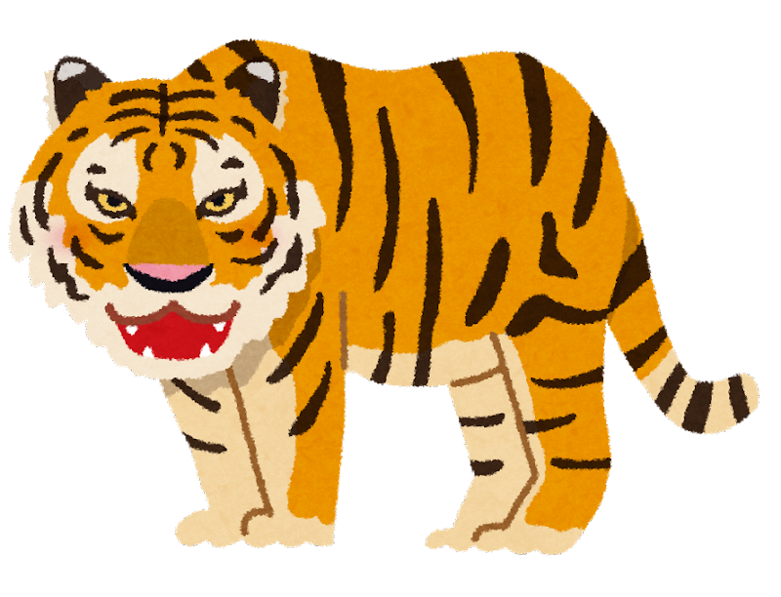
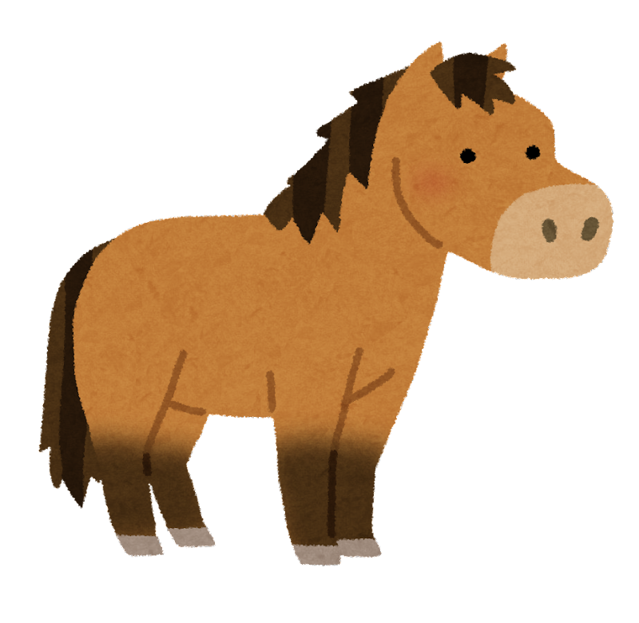




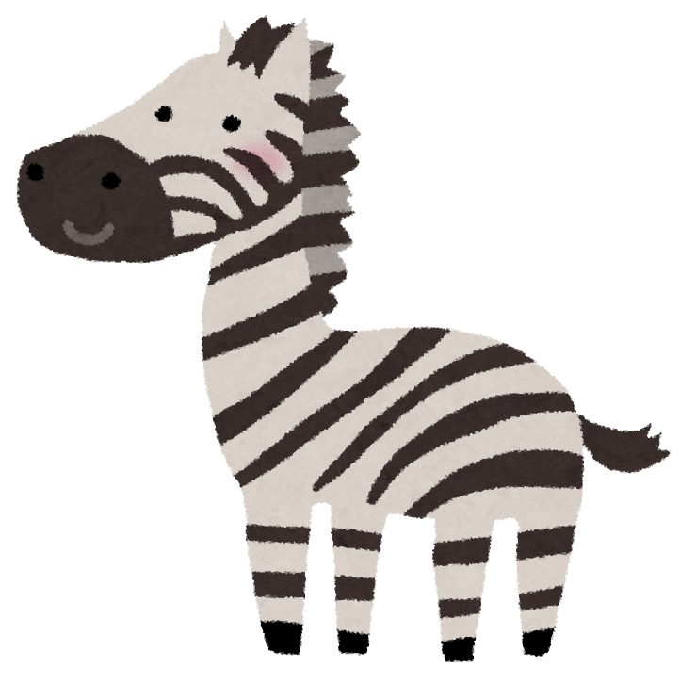
Zero-shot Learning
It's tiger! It's horse!
It's panda!
I have learned it!
You wanna me to recognize zebra?
I'v never seen it!
The zebra is horselike, has stripes like a tiger, and it is black&white like a panda
Thank you for your description!
So this is a zebra,right?
Notes:
This is an example that can help better understand the idea of ZSL

Slide 4
Zero-shot Learning
Semantic space
Feature space
extracted from Image
Semantic space
transformed from auxiliary information
So we do not need Zebra's image
we only need Semantic space about zebra

Slide 5
Zero-shot Learning
We need some form of auxiliary information
and this type of information can be of several types:
Attributes
Textual description
Class-class similarity
Can be converted to
semantic space

Slide 6
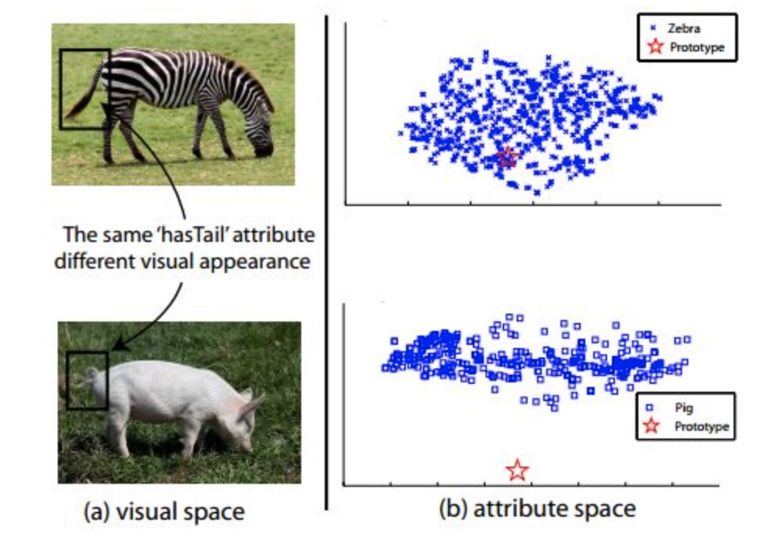
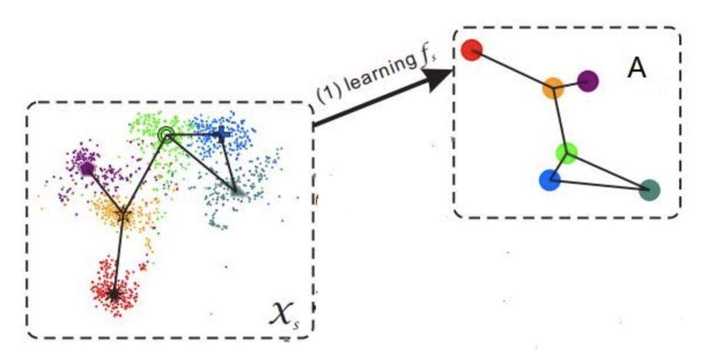
Zero-shot Learning
Issues in ZSL
How to accurately define
the description of the Zero-shot class
how about learning it from the (unseen)test dataset?
Hubness problem
In high-dimensional space, some points
will be the nearest neighbors of most points
Domain shift problem
Semantic gap
Semantic loss

Slide 7
Zero-shot Learning for emotion classification
Complex, compounded emotional expressions are common!
*Ex. happily surprised and angrily surprised
Individual differences
enumerate all emotional biometric data
it is difficult！
Because of
environmental influences
collect enough samples for each category
diversity of emotional expressions
For the relatively rare samples of emotional expressions
It's just like unseen class! (So can we use Class-class similarity or sth..?)
Notes:
The reason Why I want to try Zero-shot Learning for biometric data based emotion classification is...
EX. happily surprised and angrily surprised
are two distinct compound emotion categories

Slide 8
Self-training and Reinforcement Learning Model
high level/quality
labeled dataset
train
Matching Model
predict
low level/quality
labeled dataset
predict
unlabeled dataset
reward
evaluation
Reinforcement Learning Policy Network
add pseudo
labeled instances
Do data selection
validation
via interaction with player
reward
Avater
Notes:
First, train emotion classification model using train set, then predict using low-level labeled dataset/unlabeled dataset
Policy Network will select the data from the low-level labeled dataset/unlabeled dataset based on the predict result
If the Policy Network selects high-quality samples, new model will get a better performance on validation set, and get reward.
If the Policy Network adopts the wrong policy, the model will get poor results and return negative rewards

Slide 9

Experiment Design
APP: VRChat
Participants: more than 20 groups of collaborators (3 people a group)
Used Raw Data:
Details:
One participant wear sensors and VR headset as a main talker
other two participants just wear VR headset and talk
Each conversation lasted approximately three minutes
Topics:
Talk about specific topics that are likely to cause emotional fluctuations or produce opposing positions
ECG
Audio(wav)
Eye tracking
Head position&rotation

Slide 10
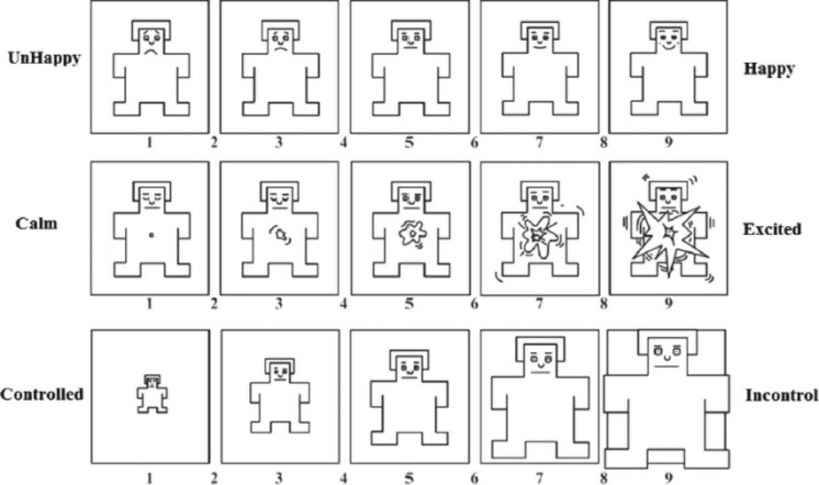
Experiment Design
I am not sure which questionnaire to use

Slide 11
Data-processing and Matching Model
ECG
R-R Interval
Heart Rate Variability(HRV)
Audio(wav)
Time-domain Audio Features
Train class
Matching Model
Eye tracking Data
Pupil Diameter&EyeOpen
Pupil Position
Nearest Neighbor Index
of pupil position
SVM-Regression/
Transformer-Regression/
LSTM
Head position&rotation

Slide 12
Reinforcement Learning for Self-training
Time-series data selection
Biometric data of 3minutes Dialogue
Interval
Clip2
Clip Length
*Ex. If set interval 1s,
clip length 30s,
we can get about 270 clips
Time-series data
.......
Clip1
ClipN
Policy network
Train a policy network to decide whether select this clip or not

Slide 13
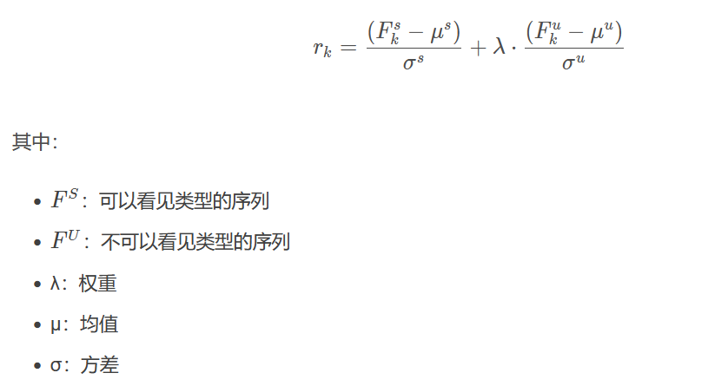
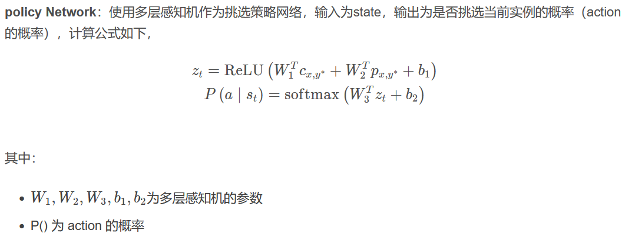
Reinforcement Learning Network
For Reinforcement Learning Network
(1)State:
preprocessed biological data and confidence point
(2)Action:
Two class, whether choose this sample
(3)Reward:
Based on the model’s performance on validation set
(4)Policy Network:
Input is State
Output is Action’s probability distribution
Notes:
First, train emotion classification model using train set, then predict using low-level labeled dataset/unlabeled dataset
Policy Network will select the data from the low-level labeled dataset/unlabeled dataset based on the predict result
If the Policy Network selects high-quality samples, new model will get a better performance on validation set, and get reward.
If the Policy Network adopts the wrong policy, the model will get poor results and return negative rewards

Slide 14
Discussion
How to collect high quality data to train a not bad Matching Model first
What algorithm to use to train Matching Model
What Policy Network algorithm to use
How to balance the reward and evaluation of RL?
How to design the interaction between avater and player in VR

Slide 15
Acknowledgment
Thank you for listening
ご清聴ありがとうございます
Notes:
Thank u for listening,

Slide 16
Related Work
There are extensive works proposed in zero-shot image/text classification task
Related Work
Zero-shot Text Classification via Reinforced Self-training
A Generalized Zero-Shot Framework for Emotion Recognition from Body Gestures

Slide 17
Why emotion and dialogue mood？
VRにおける、複数人の対話の雰囲気や個人の感情を把握して適切な介入を行うことで、コミュニケーションを円滑させる対話支援アバターの開発を目指す。
The goal is to develop a dialogue support avatar in VR
雰囲気工学では，多人数の会話場における雰囲気を分析することや，複数の会話エージェントや会話ロボットによる人工的な言語，非言語情報が作り出す会話場の雰囲気の分析を目指す

Slide 18
Shortcomings of the previous study
Shortcomings of the previous study
Insufficient amount of experimental data
individual differences appeared
The means of feature extraction of the data needs to be improved
Difficulty in confirming whether self-report accurately describe their own emotions
Collaborators exposed to VR for the first time tend to show excitement

Slide 19
Question
如何保证收集到高质量的情感数据以训练出高质量的Matching Model
要用什么Policy Network算法
reward和evaluation的平衡怎么办
VR中avater和player的交互方式怎么设计
avater的evaluation/reward策略怎么设计

