Slide 1
Final presentation(Internship)
Mar 30th, 2022
Liu Yi
TDD. Dept.
Rakuten Group, Inc.
Notes:
Good afternoon, everyone.
It’s my honor to make a final presentation to talk about my internship in Rakuten Travel.

Slide 2
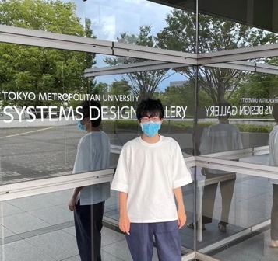



Yi Liu
MY EDUCATION EXPERIENCE
Tokyo Metropolitan University
Systems Design, Computer Science.
I AM FROM
Hangzhou, Zhejiang Province, China.
MY HOBBY
Travel, Camping
Badminton, Pokémon.
Notes:
Let me make a brief introduction about myself.
My name is …

Slide 3
Agenda
About the Internship
Details of the Internship project
What I achieved from my Internship
Discussions
My feelings about my Internship
Notes:
This is today‘s agenda
at the first section, I’m going to briefly introduce my internship and my work.
And then I will talk about my achievement and feelings about my internship

Slide 4

1.About the Internship
Team: Product Justice Team
Mentor: Sato, Suguru |TDD
Period: 3.2 - 4.1(13 days)
Notes:
I belong to Product Justice Team in Rakuten Travel Development Department.
My mentor is Sato, suguru, he is a good teacher and teaches me a lot.
My internship is from March second to April first
My goal is to learn how to be an API development engineer in Rakuten Travel.

Slide 5
1.About the Internship
201 - Notification mail - ReadAPI Change
ReadAPI is an API that can get user’s Booking Information
When a reservation is completed.
An auto-mail with booking information will be sent.
Before this action,
we should call ReadAPI to get the reservation data.
Notes:
My work mainly focus on Project Two-zero-one - Notification Mail - readapi change.
ReadAPI is an API that can get user’s Booking Information
When a reservation is completed.
An auto-mail with booking information will be sent.
Before this action,
we should call ReadAPI to get the reservation data.

Slide 6
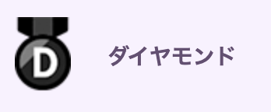
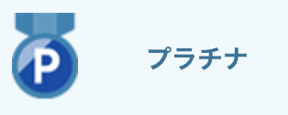
1.About the Internship
201 - Notification mail
- ReadAPI Change
Get Reward Detail Snapshot Data from Data Base
For diamond and platinum users
Reservation’s hidden rewards information should be shown in mail.
Change:
So I need to change the ReadAPI
To fetch hidden reward data.
Convert the data to the format that we need
Test the API using Postman, Log4J and Junit4
Notes:
In project 201, For diamond and platinum users,
we need to fetch hidden rewards information of the reservation
,then response the data in Json format.
So to show the hidden rewards in the notification mail.
what I need to do is that
I need to change the ReadAPI so it can fetch hidden reward data for sending e-mails.
On the left , my work is divided into three sections,
Get the data ,convert the data , do test.
and I’d like to talk about the details of my work.

Slide 7

2.Details of the Internship project
Get Reward Detail Snapshot Data from Data Base
Convert the data to the format that we need
Fetch data from Database
using daoManager
Then save the data to DTO (readDetailDto)
Convert the Reward Data
(saved in readDetailDto)
to RewardSnapshotInfoBean
Build and deploy the project by Jenkins
Notes:
In Section one and two.
I fetched the data from database using daoManager.
And then saved the data to DTO.
Next, I convert the Reward Data to the format that we hope.
Finally, I build and deploy the project by Jenkins.

Slide 8
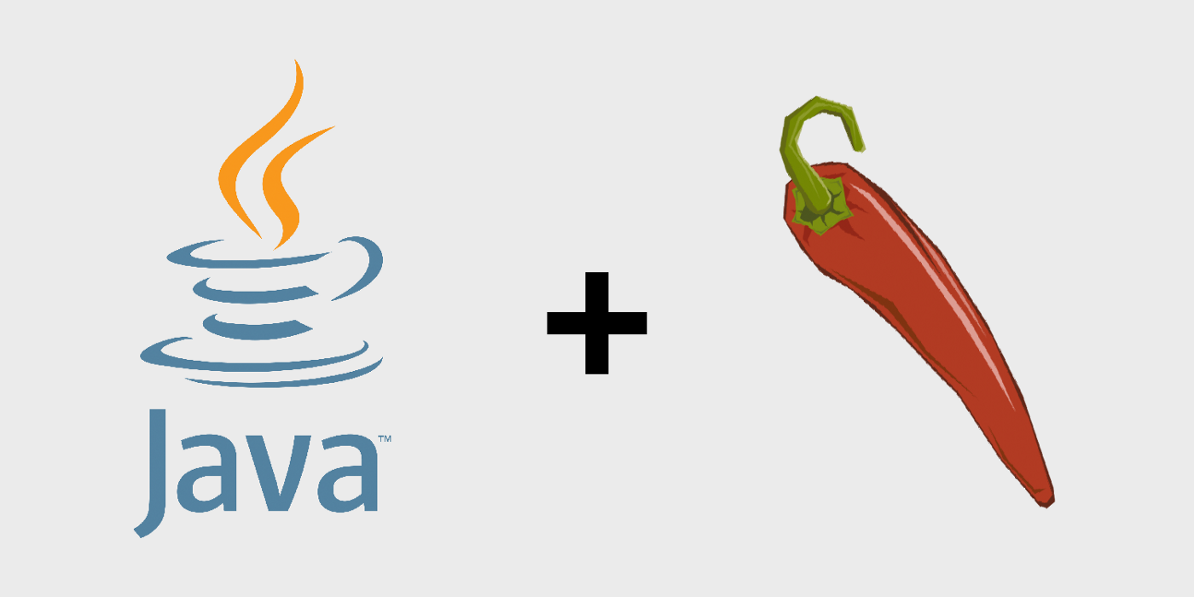
2.Details of the Internship project(Section1)
Get Reward Detail Snapshot Data from Database
In rt-booking-common-util Project
Add DhRewardSnapshot.java
*Mapped to Reward reservation snapshot table
In readapi Project
In ReadDetailDto.java
Add List<DhRewardSnapshot>
In getRewardDetailSnapshotItems Function
Fetch data from Database use daoManager
Then save the data to DTO (readDetailDto).
Lombok Library

Slide 9

2.Details of the Internship project (Section2)
Convert the data to the format that we need
In rt-bookingapi-beans Project
Create RewardSnapshotInfoBean.java
Correspond to Response format
In readapi Project
In HotelDomesticRakutenResponseBeanFactory.java
Create setRewardDetailSnapshotInfo function
Convert the Reward Data (in readDetailDto)
into RewardSnapshotInfoBean
Build and deploy the project by Jenkins
Jackson Library

Slide 10



2.Details of the Internship project
Test the API using Postman, Log4J and Junit4
Test the API response using POSTMAN
Check the Log and debud
Design the Test Cases, write test Dev Spec in the confluence
Write Junit4 Test to test my core method.
Notes:
In Section3
I test the API using Postman,Log4J and Junit4.
By checking the Log, I found a bug and I debugged my code.
Then I designed the Test Cases, wrote the test development Specification and write Junit Test to test my code.

Slide 11





3. What I achieved from my Internship
Get familiar with Rakuten Travel
Work Area, My co-workers, Devleopment rules,
Project wishlist and DevSpec, Organization Structure…
Learn how to do enterprise development
Maven, Git, Jenkins, PL/SQL, Log4j, Postman
Spring, SpringBoot, DTO, DAO
Exceptions, Lombok, Jackson, CollectionUtils
API Testing, Junit Test
Notes:
I have two main achievements from my internship
First
I got familiar with Rakuten Travel’s people, environment and business.
Second
I learned how to do enterprise development in Rakuten Travel
I learned how to use tools, frames, libraries and testing, it’s amazing~

Slide 12
4. Discussions
Enterprise development
-- Different!! –
Individual development
*Ex. Bigger project size, stringent security,
stringent test, different way to build and deploy
Cooperation and communication
Is important
Notes:
Discussions
I find Enterprise development is quite different from individual development
For example, Enterprise development has…
Cooperation and communication Is important
Because we must make our production user-friendly and reliable.

Slide 13
4. Discussions
Code comments
more beautiful and readable code
less useless comments
When should we write comments
Complex
Complex business logic, Complex Algorithm, parameters and Unconventional situations
Core
Core Interfaces, classes and functions
TODO
No good solution right now → //TODO
Notes:
I also encounterred a confliction in Code comments.
I talked to my mentor Sato-san and I investigated it on the Internet about how to write comments.
My conclusion is that we should try our best to write beautiful and readable code，
and reduce useless comments.
We still need comments.
But When should we write comments in our code?
I think there are mainly three situations.
First, Complex situations, for example, complex business logic, complex algorithm, parameters and unconventional situations.
Second, we should comment our core interfaces, classes and functions.
Third, sometimes when there is no better solution yet, TODO comment is necessary.
If we pay more attention about our comment, variable naming and other coding manner,
We can write more beautiful, readable and reliable code.

Slide 14
5. My feelings about my Internship
TDD is a dynamic, powerful team.
My co-workers are all kind and skilled.
I learned a lot about how to develop in Rakuten Travel,
It’s amazing!
Rakuten Travel’s Business is interesting!
Rakuten’s canteen dishes are delicious!
Notes:
Finally, I’d like to talk about my feelings.

Slide 15
Thank you for your kind attention!
Notes:
My presentation is over。
Thank you for your kind attention!
インターンシップのプロジェクトを取り込む最初、プロジェクトの大きさにびっくりました。どこから始めたらいいのかわからなかったので、何回もDEV SPECを見て、やることを理解して、着手するところを見つける次第、開発を開始しました。途中分からないことがあったら、インターネットを調べたり、メンターさんに聞いたりして、なんとなく順調に開発しました。
プロジェクトが大きいので、最初は他の人のコードを理解することがちょっと難しい、
そしてコードのコメント問題などについてもメンターさんや渡辺さんに話しました。
もっと綺麗な、リーダブルなコードを書くために、技術力やコードマナーなどの学習を引き続き頑張りたい。

