Slide 1
Introduction
Mar 9th, 2022
Liu Yi
TDD. Dept.
Rakuten Group, Inc.

Slide 2
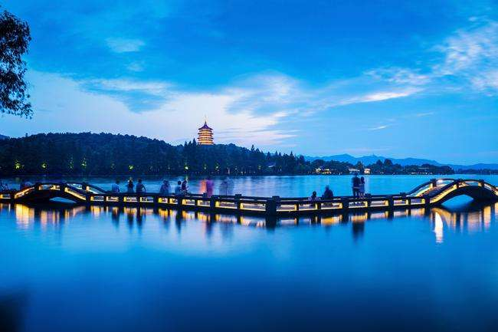
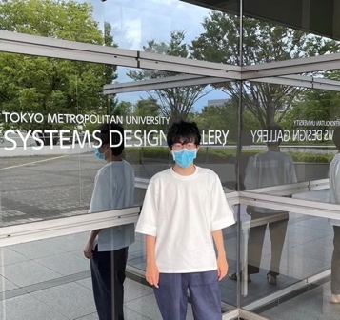
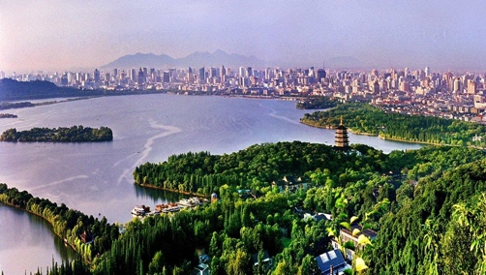
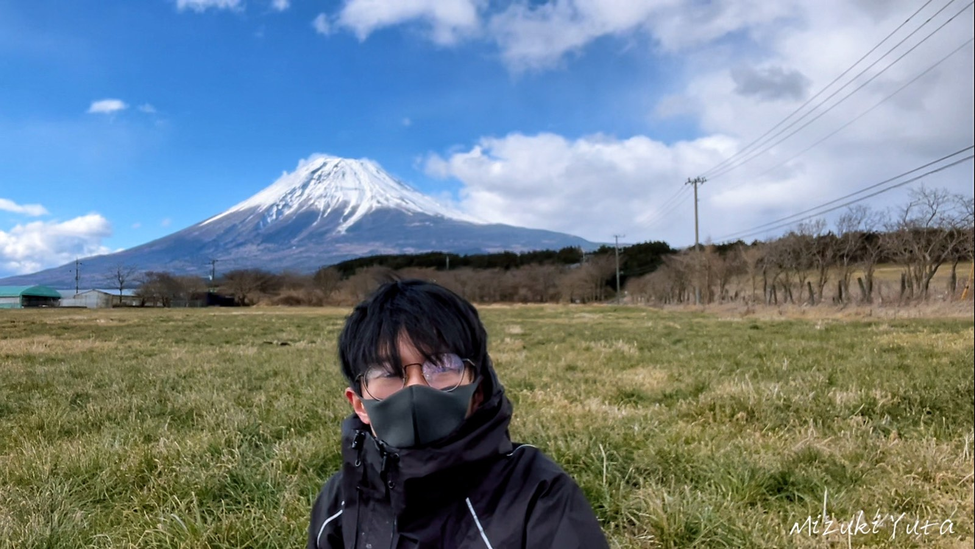
Yi Liu
MY EDUCATION EXPERIENCE
Tokyo Metropolitan University
Systems Design, Computer Science.
I AM FROM
Hangzhou City, Zhejiang Province, China.
MY HOBBY
Travel, Camping, Food Tour
Badminton, Pokémon.
Notes:
Hangzhou is one of the most famous tourist cities in China not only famous for its natural beauty but also famous for its history.

Slide 3




RESEARCH CONTENT
MY PROGRAMMING SKILL
Python
Java
Unity3D+C#
Human-computer interaction(HCI)
<Sensor Fusion-based Emotion Classification
In Virtual Reality Using Machine Learning>
oral presentation at NCSP22
Use brain waves and heart rates to recognize emotion and atmosphere in VR

Slide 4
PURURPOSE OF THE INTERNSHIP
Rakuten Travel is a dynamic, powerful team.
Learn how to do business-level development as an engineer.
Gain practical experience.
Meet more interesting and skilled people in Rakuten Travel.

Slide 5
Nice to meet you!

