Slide 1
Divide-and-conquer: closest pair (Chap.33)
Given a set of points, find the closest pair (measured in Euclidean distance)
Brute-force method: O(n²).
Divide-and-conquer method:
  Want to be lower than O(n²), so expect O(nlgn).
  Need T(n)=2T(n/2)+O(n).
How?
  Divide : into two subsets (according to x-coordinate)
  Conquer: recursively on each half.
  Combine: select closer pair of the above.
what left?
One point from the left half and the other from the right
may have closer distance.

Slide 2
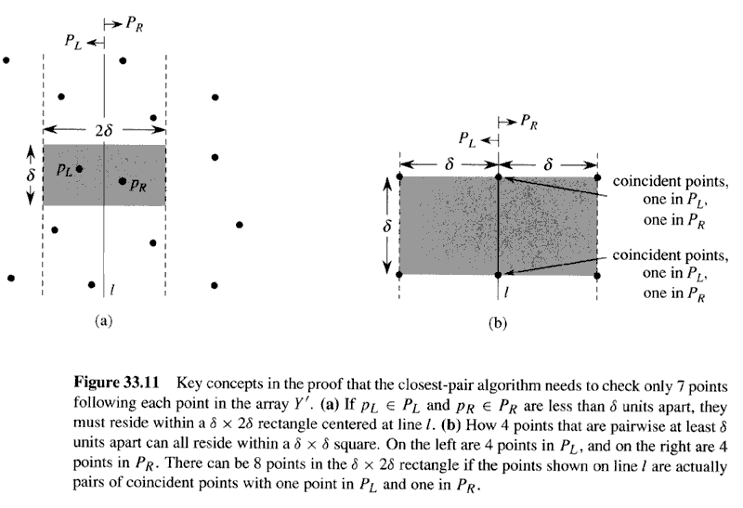
Copyright © The McGraw-Hill Companies, Inc. Permission required for reproduction or display.
δ_{L}: minimum distance of P_{L}
δ_{R}: minimum distance of P_{R}
δ=min{δ_{L}, δ_{R}}.

Slide 3
Divide and conquer
Divide : into two subsets (according to x-coordinate) : P_{L}<=l <=P_{R} (O(n))
Conquer: recursively on each half.
    Get δ_{L}, δ_{R}
    2T(n/2).
Combine:
  select closer pair of the above. δ=min{δ_{L}, δ_{R}), O(1)
  Find the smaller pairs, one∈P_{L} and the other∈P_{R}
    Creat an array Y’ of points within 2δ vertical strip, sorted by y-coor. O(nlgn) or O(n).
    for each point in Y’, compare it with its following 7 points. O(7n).
      If a new smaller δ’ is found, then it is new δ and the new pair is found.

Slide 4
Sort points according to coordinates
Sort points by x-coordinates will simplify the division.
Sorting by y-coordinates will simplify the computation of distances of cross points.
sorting in recursive function will not work
  O(nlg n), so total cost: O(n lg²n)
Instead, pre-sort all the points, then the half division will keep the points sorted
  The opposite of merge sort.

Slide 5
CLOSEST_PAIR(P, X, Y)
P: set of points, X: sorted by x-coordinate, Y: sorted by y-coordinate
Divide P into P_{L} and P_{R}, X into X_{L} and X_{R}, Y into Y_{L} and Y_{R},
  δ₁=CLOSET-PAIR(P_{L},X_{L},Y_{L}) and //T(n/2)
  δ₂=CLOSET-PAIR(P_{R},X_{R},Y_{R}) //T(n/2)
Combine:
  δ=min(δ₁, δ₂)
  compute the minimum distance between the points p_{l}∈P_{L} and p_{r} ∈P_{R} . // O(n).
    Form Y′, which is the points of Y within 2δ-wide vertical strip.
    For each point p in Y′, 7 following points for comparison.

Slide 6
CLOSEST-PAIR
Sort X (or X_{L}, X_{R}) and Y (or Y_{L},Y_{R}):
  Pre-sort first,
  Cut X to get X_{L} and X_{R}, naturally sorted.
    P_{L}= X_{L} , P_{R}= X_{R}
  From Y, get sorted Y_{L} and Y_{R} by the algorithm: (p.961)
    Length[Y_{L}]=length[Y_{R} ]=0
    For i=1 to length[Y]
      If(Y[i]∈P_{L} )then
        Length[Y_{L}]++, Y_{L}[Length[Y_{L}]]=Y[i]
      Else
        Length[Y_{R}]++, Y_{R}[Length[Y_{R}]]=Y[i]
Question: Y[i]∈P_{L} ?
P_{L} is defined by line=x, so Y[i].x≤x .
Any further question?

Slide 7
In summary
T(n)=- O(1), if n<=3.
      2T(n/2)+O(nlgn)→ O(nlg²n)
T’(n)=O(nlgn)+T(n)
  T(n)=2T(n/2)+O(n)
  So O(nlgn)+O(nlgn)=O(nlgn).
Improvements: Comparing 5 not 7?
Does not pre-sort Y?
Different distance definition?
Three dimensions?

