Slide 1
CS 370 Introduction to Security
Ancient Cryptography and Cryptography Basics
Yeongjin Jang

Slide 2


Cryptography
Suppose you need to communicate with others securely/privately
Let’s have Local Boyz for dinner!

Slide 3

Cryptography
Others can see the message if you send it over w/o any protection
Let’s have Local Boyz for dinner!
Local Boyz…

Slide 4

Cryptography
Cryptography can make our communication secure
Let’s have Local Boyz for dinner!
32843209482390472390230966
????????
What’s that number??

Slide 5
Cryptography
But the other end must know what the plaintext message is
Let’s have Local Boyz for dinner!
Local Boyz…
32843209482390472390230966
????????
What’s that number??

Slide 6
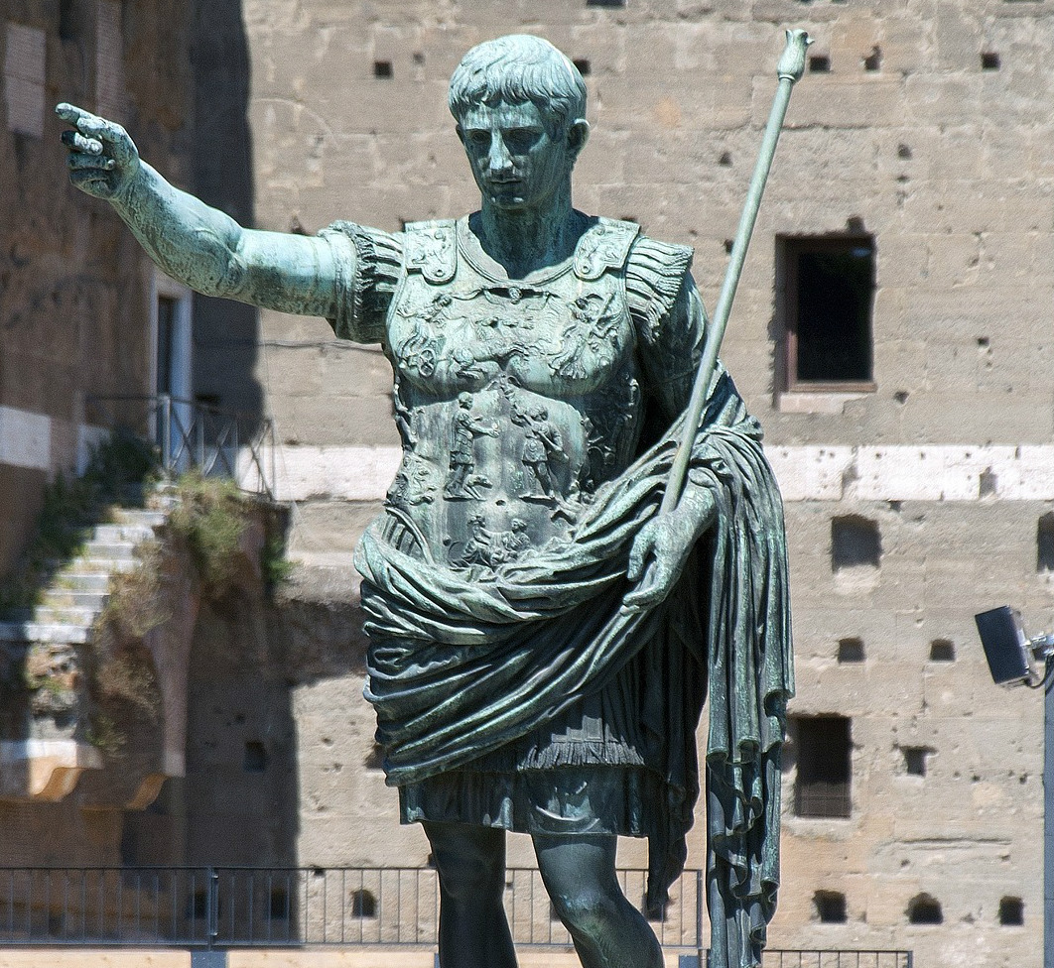
Cryptography in Roman Empire
CAESAR CIPHER
Algorithm
Shift characters by 3
ABCDEFGHIJKLMNOPQRSTUVWXYZ
DEFGHIJKLMNOPQRSTUVWXYZABC
HELLO
KHOOR

Slide 7
CAESAR Cipher
Shift by 3
KHOOR
-3
HELLO
HELLO
KHOOR
KHOOR???
Is it secure?

Slide 8
Anyone Who Knows the Offset Can Decrypt the Ciphertext
Shift by 3
HELLO
KHOOR
KHOOR???
-3
HELLO!
ABCDEFGHIJKLMNOPQRSTUVWXYZ
DEFGHIJKLMNOPQRSTUVWXYZABC

Slide 9
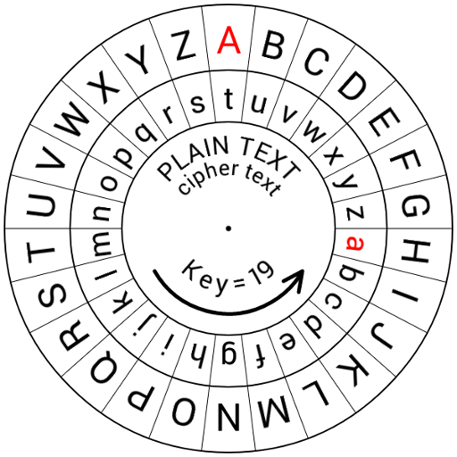
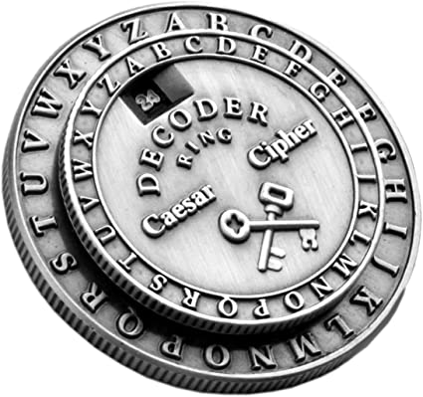
CAESAR Cipher is too easy.. Let’s Make it More Complex
Rotation-based Substitution Cipher
Let us choose the offset, not only the 3
Image from: https://www.amazon.com/Nicolas-Berne-Caesar-Cipher-Wheel/dp/B013KR53SS
https://www.amazon.com/Retroworks-Classic-Caesar-Medallion-Decoder/dp/B004D1L0B0

Slide 10
ROT-N Cipher
We can set whatever N (between 0 and 25) in ROT-N cipher
If you don’t know N, you cannot decrypt it!

Slide 11
Anyone Who Knows the Offset Can Decrypt the Ciphertext
ABCDEFGHIJKLMNOPQRSTUVWXYZ
NOPQRSTUVWXYZABCDEFGHIJKLM
Shift by 13
URYYB???
-13
HELLO!
HELLO
URYYB
URYYB???
-3
ROVVY???
Is it secure?
ABCDEFGHIJKLMNOPQRSTUVWXYZ
DEFGHIJKLMNOPQRSTUVWXYZABC

Slide 12
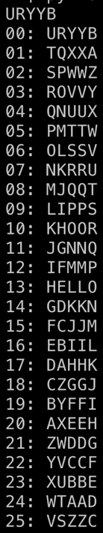

Anyone Who Knows the Offset Can Decrypt the Ciphertext
ABCDEFGHIJKLMNOPQRSTUVWXYZ
NOPQRSTUVWXYZABCDEFGHIJKLM
Shift by 13
URYYB???
-13
HELLO!
HELLO
URYYB
URYYB???
-13
HELLO???

Slide 13
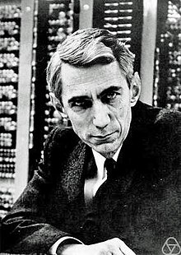
What is a Secure Cryptography?
Shannon’s Intuition
If attackers cannot distinguish a message M from
A random number R
Then it is perfectly secure
Claude Shannon (1916 ~ 2001)
A Father of Information Theory
and Modern Cryptography

Slide 14
What is a Secure Cryptography?
More formally
A message M has a distribution D
D is known to adversary (English, etc..)
Adversary observes Ciphertext C which is Enc(M)
Knowledge of adversary before observing C
Distribution of D
Knowledge of adversary after observing C
Distribution of D | C
Shannon Secrecy
Distribution of D == Distribution of D|C
Then the scheme is perfectly secure
This intuitively means
Observing many Cs does not give any information to adversary
Claude Shannon (1916 ~ 2001)
A Father of Information Theory
and Modern Cryptography

Slide 15
Definition of Perfect Secrecy
For every pair of m1, m2 in M and for all c,
Pr [k <- KG : Enc (m1, k) = c] = Pr[k <- KG: Enc(m2, k) = c]
Implications
Probability that the encryption of m1 with k resulting in c
is the same as
Probability that the encryption of m2 with k resulting in c
Adversary cannot distinguish which message the c corresponds to

Slide 16
XOR Cipher
A simple XOR Cipher is with perfect secrecy
Scheme
For a message M with length L
Get a random key K with length L
Compute ciphertext C
C = M ⊕ K

Slide 17
XOR Cipher
A simple XOR Cipher is with perfect secrecy
Scheme
C = M ⊕ K
Example
Message | H (0x48) | E (0x45) | L (0x4c) | L (0x4c) | O (0x4f)
Key | A (0x41) | B (0x42) | C (0x43) | D (0x44) | E (0x45)
Ciphertext | 0x9 | 0x7 | 0xf | 0x8 | 0xa

Slide 18
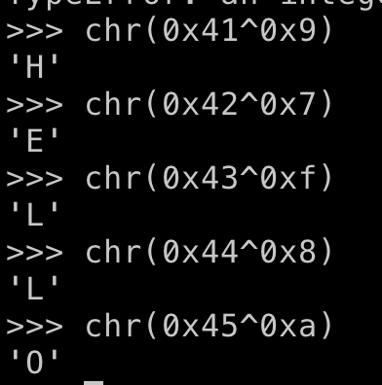
XOR Cipher
Decryption
Message | H (0x48) | E (0x45) | L (0x4c) | L (0x4c) | O (0x4f)
Key | A (0x41) | B (0x42) | C (0x43) | D (0x44) | E (0x45)
Ciphertext | 0x9 | 0x7 | 0xf | 0x8 | 0xa
Decrypt | H | E | L | L | O

Slide 19
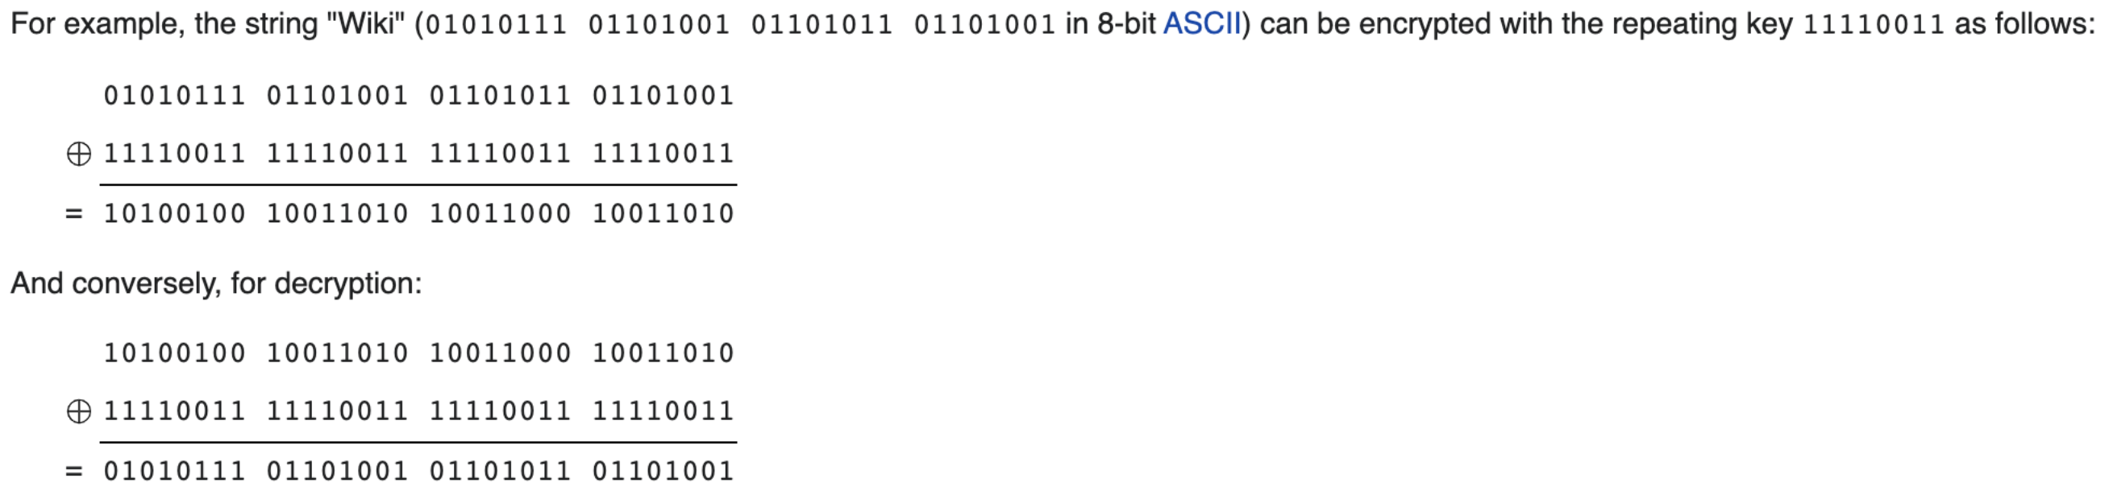
Example in Bits
Image from: https://en.wikipedia.org/wiki/XOR_cipher

Slide 20
How is It Perfectly Secure?
Key must be selected randomly
The distribution of K is random
Ciphertext distribution is independent to the message distribution
C = M ⊕ K
No matter how you choose M, if you choose K randomly, then it’s good

Slide 21
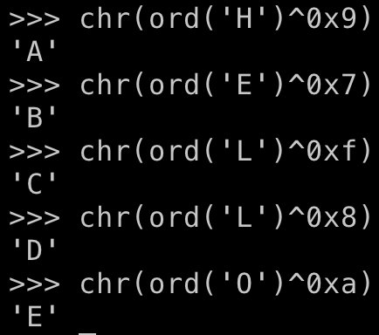
CAVEAT
Re-using the key make the scheme weak
Suppose the attacker knows
HELLO -> 0x9, 0x7, 0xf, 0x8, 0xa
They can calculate the key by

Slide 22
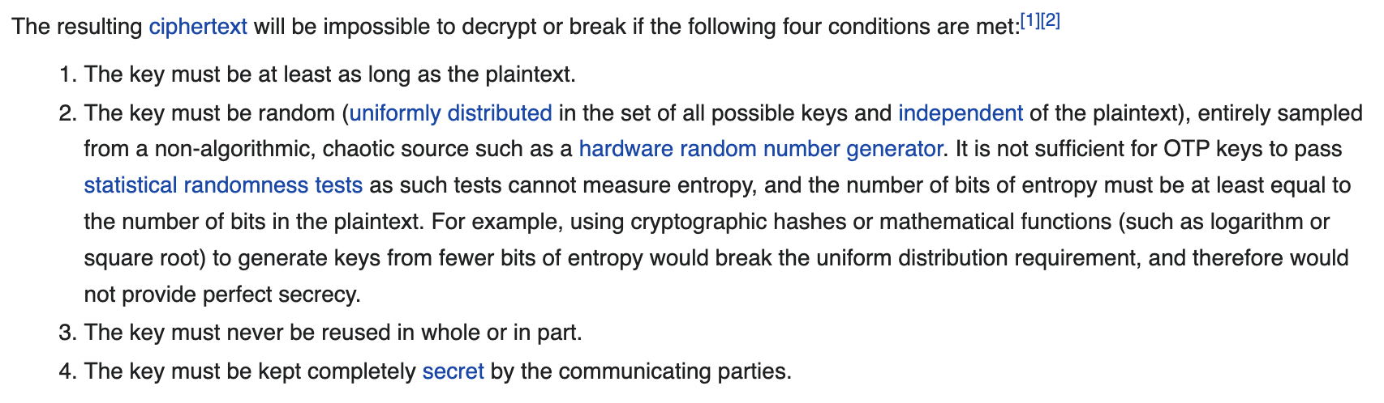
Generic Version of XOR Cipher
One-time Pad
https://en.wikipedia.org/wiki/One-time_pad

Slide 23
Tutorials for the Challenges!

