Slide 1
CS 370 Introduction to Security
Symmetric Encryption (Block Cipher: DES/AES)
Yeongjin Jang

Slide 2




Recap: Cryptography
Cryptography can make our communication secure
Let’s have Local Boyz for dinner!
32843209482390472390230966
????????
What’s that number??

Slide 3
Recap: Perfect Secrecy
Implication
If the distribution of the ciphertext is the same as the distribution of a random number, then
Adversaries may never tell if the message is a ciphertext of a plaintext or
A random number…
Let’s have Local Boyz for dinner!
32843209482390472390230966
????????
What’s that number??

Slide 4
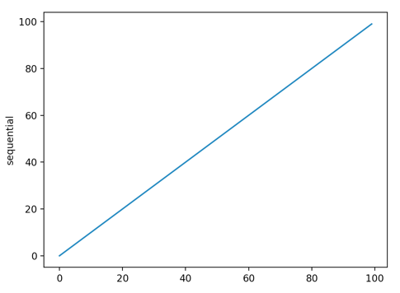
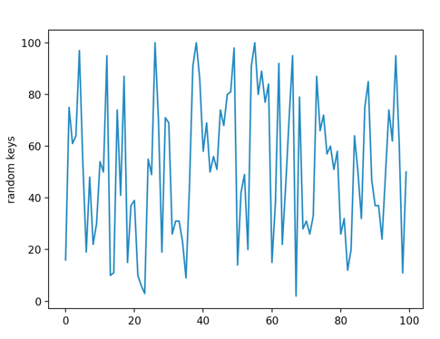
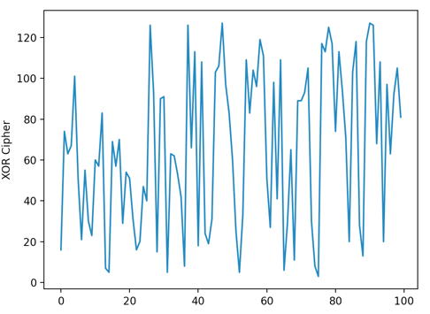
Recap: XOR Cipher
Plaintext:
0—100
sequentially
Perfect Secrecy
Message M = 123456
Random Key K = 284603
Encrypted data E = M ^ K = 374267
Message M’ = 123457
Random Key K’ = 513773
Encrypted Data E = M’ ^ K’ = 406700
Message M’’ = 123458
Random Key K’’ = 627151
Encrypted Data E = M’’ ^ K’’ = 553869
One-time Pad:
0—100
Randomly
chosen
Ciphertext:
0—128
Randomly
distributed

Slide 5
Limitations in Using Perfect Secrecy Scheme in Reality
Key size must be the same with the message size
1GB video file, then we need an 1GB key
Key MUST NOT be re-used!!!
We need to share the key beforehand to the other party
Wait, share an 1GB key before hand to send 1GB of data later?
Then, what about hand out the data at that time, not the key???
There could be some of such use cases but
Impractical… we wish to have a short key to encrypt a big chunks of data..

Slide 6

What if We Could Have an Identical Random Generator Pot?
Dream about the world that has
A random number generator
Physically meet and share the identical generator securely

Slide 7
What if We Could Have an Identical Random Generator Pot?
Dream about the world that has
A random number generator
A random number generator

Slide 8
What if We Could Have an Identical Random Generator Pot?
Dream about the world that has
1: 0x1b395a46
2: 0xf1737202
3: 0xccf0de05
4: 0x908b0feb
5: 0x9d4c9add
…
1: 0x1b395a46
2: 0xf1737202
3: 0xccf0de05
4: 0x908b0feb
5: 0x9d4c9add
…
A random number generator
A random number generator

Slide 9
What if We Could Have an Identical Random Generator Pot?
Dream about the world that has
Encrypt message 1 with 0x1b395a46
Encrypt message 2 with 0xf1737202
Encrypt message 3 with 0xccf0de05…
Decrypt message 1 with 0x1b395a46
Decrypt message 2 with 0xf1737202
Decrypt message 3 with 0xccf0de05…
1: 0x1b395a46
2: 0xf1737202
3: 0xccf0de05
4: 0x908b0feb
5: 0x9d4c9add
…
1: 0x1b395a46
2: 0xf1737202
3: 0xccf0de05
4: 0x908b0feb
5: 0x9d4c9add
…
A random number generator
A random number generator

Slide 10
What if We Could Have an Identical Random Generator Pot?
Dream about the world that has
Encrypt message 1 with 0x1b395a46
Encrypt message 2 with 0xf1737202
Encrypt message 3 with 0xccf0de05…
Decrypt message 1 with 0x1b395a46
Decrypt message 2 with 0xf1737202
Decrypt message 3 with 0xccf0de05…
We can securely encrypt messages with
One-time Pad (e.g., XOR Cipher)
1: 0x1b395a46
2: 0xf1737202
3: 0xccf0de05
4: 0x908b0feb
5: 0x9d4c9add
…
1: 0x1b395a46
2: 0xf1737202
3: 0xccf0de05
4: 0x908b0feb
5: 0x9d4c9add
…
A random number generator
A random number generator

Slide 11
Stream Cipher
If we have an identical random number generator, we can use that for the One-time Pad?
Can we create one?

Slide 12
RC4/RC5
A stream of random number generator based on the selected key
https://en.wikipedia.org/wiki/RC4
https://en.wikipedia.org/wiki/RC5
Physically meet and share
40~2048 bits of keys
(max 512 bytes, short!)
RC4 or
RC5
Algorithm
RC4 or
RC5
Algorithm

Slide 13

RC4/RC5
A stream of random number generator based on the selected key
RC4 or
RC5
Algorithm
RC4 or
RC5
Algorithm
Key: 0xd7fe6798a7c6a9859b289ce
Key: 0xd7fe6798a7c6a9859b289ce

Slide 14
RC4/RC5
A stream of random number generator based on the selected key
1: 0x1b395a46
2: 0xf1737202
3: 0xccf0de05
4: 0x908b0feb
5: 0x9d4c9add
…
1: 0x1b395a46
2: 0xf1737202
3: 0xccf0de05
4: 0x908b0feb
5: 0x9d4c9add
…
RC4 or
RC5
Algorithm
RC4 or
RC5
Algorithm
Key: 0xd7fe6798a7c6a9859b289ce
Key: 0xd7fe6798a7c6a9859b289ce

Slide 15
RC4/RC5
A stream of random number generator based on the selected key
Encrypt message 1 with 0x1b395a46
Encrypt message 2 with 0xf1737202
Encrypt message 3 with 0xccf0de05…
Decrypt message 1 with 0x1b395a46
Decrypt message 2 with 0xf1737202
Decrypt message 3 with 0xccf0de05…
We can securely encrypt messages with
One-time Pad (e.g., XOR Cipher)
1: 0x1b395a46
2: 0xf1737202
3: 0xccf0de05
4: 0x908b0feb
5: 0x9d4c9add
…
1: 0x1b395a46
2: 0xf1737202
3: 0xccf0de05
4: 0x908b0feb
5: 0x9d4c9add
…
RC4 or
RC5
Algorithm
RC4 or
RC5
Algorithm
Key: 0xd7fe6798a7c6a9859b289ce
Key: 0xd7fe6798a7c6a9859b289ce

Slide 16
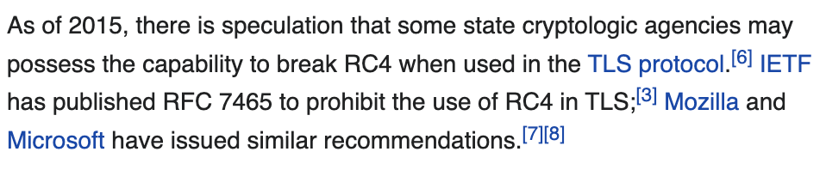
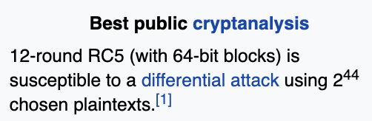
Insecure RC4/RC5
Read the Wikipedia articles for their weaknesses
https://en.wikipedia.org/wiki/RC4
https://en.wikipedia.org/wiki/RC5
RC4 RC5
Have no mathematical proof or
Have an attack against these…

Slide 17
Block Cipher
Cryptographers built a restricted encryption model to only encrypt
Fixed size message (a block, e.g., 16-byte (128-bit) or 32-byte (256-bit))
Why having such a restriction?
Restricting the size simplifies modeling the encryption
They may provide a proof that attackers break this with a very low chance
E.g., breaking once in 2¹²⁶ cases, requiring 85070591730234615865843651857942052864 trials
Breaking here means that distinguishing the part ciphertext is
not a random number at all

Slide 18
Block Cipher
cs370{16bytemsg}
0x63733337307b3136627974656d73677d
M
Block: a fixed sized message (16-byte here for the example)
Key: A secret between sender and receiver (short, 16-byte here for the example)
M: Plaintext message
E : Encrypted message
Block cipher
K
Key: 0xd7fe6798a7c6a9859b289ce
E
0x354a820534573738475066bd38bf1540

Slide 19
Block Cipher Decryption
E
0x354a820534573738475066bd38bf1540
Decryption works in backward
The inverse function of encryption
M: Plaintext message
E : Encrypted message
Block cipher
Decryption
K
Key: 0xd7fe6798a7c6a9859b289ce
cs370{16bytemsg}
0x63733337307b3136627974656d73677d
M

Slide 20

What Does the Block Cipher Do?
Generating a permutation of the numbers in
{0,1}^{n} -> {0,1}^{n}
It’s permutation, so it must be one-to-one mapping
It’s like shuffling the card
msg | Ciphertext
0 | 0xaf531b0e1
1 | 0x14a986e7a
2 | 0xad738009d
3 | 0x5ed6985c5
4 | 0xf3b8aa2e8
5 | 0xad04ec00e
… | 0x59fd94c21

Slide 21
What Does the Block Cipher Do?
The key (e.g., 16-byte or 32-byte) determines how to shuffle the numbers
K1
K2
K3
K4
msg | Ciphertext
0 | 0xaf531b0e1
1 | 0x14a986e7a
2 | 0xad738009d
3 | 0x5ed6985c5
4 | 0xf3b8aa2e8
5 | 0xad04ec00e
… | 0x59fd94c21
msg | Ciphertext
0 | 0x89075eff9
1 | 0xdb441917
2 | 0xe18452e0
3 | 0x5d4566ecc
4 | 0x120a1ce0b
5 | 0x14e09f4c3
… | 0x38057e94
msg | Ciphertext
0 | 0x3ee82813
1 | 0xbc28e1c1
2 | 0x700dba64
3 | 0xfe9586d9
4 | 0xe3b0fa46
5 | 0x41c5f70f
… | 0x845c6d67
msg | Ciphertext
0 | 0x87372de1
1 | 0x19f1a578
2 | 0x9449fe68
3 | 0xa0e82ffe
4 | 0xba9f4d4b
5 | 0x5156b9ba
… | 0x61e0bb0d

Slide 22
How Can We Use a Block Cipher
Suppose you need to communicate with others securely/privately
Meet and exchange the 16-byte key
0x5ed6985c539dccf8e62cbaf5a8d563fb

Slide 23
How Can We Use a Block Cipher
Each will use the same block cipher algorithm
With the same key K
M: 3
Send 3
Block cipher
K
0x5ed6985c539dccf8e62cbaf5a8d563fb
E: 0xa0e82ffe

Slide 24
How Can We Use a Block Cipher
Each will use the same block cipher algorithm
With the same key K
0xa0e82ffe
Send 3

Slide 25
How Can We Use a Block Cipher
Each will use the same block cipher algorithm
With the same key K
0xa0e82ffe is
3
0xa0e82ffe
E: 0xa0e82ffe
Send 3
Block cipher ⁻¹
Inverse
K
0x5ed6985c539dccf8e62cbaf5a8d563fb
M: 3

Slide 26
How Can We Use a Block Cipher
Each will use the same block cipher algorithm
With the same key K
Send 3
msg | Ciphertext
0 | 0x87372de1
1 | 0x19f1a578
2 | 0x9449fe68
3 | 0xa0e82ffe
4 | 0xba9f4d4b
5 | 0x5156b9ba
… | 0x61e0bb0d
msg | Ciphertext
0 | 0x87372de1
1 | 0x19f1a578
2 | 0x9449fe68
3 | 0xa0e82ffe
4 | 0xba9f4d4b
5 | 0x5156b9ba
… | 0x61e0bb0d

Slide 27
How Can We Use a Block Cipher
Each will use the same block cipher algorithm
With the same key K
0xa0e82ffe
0xa0e82ffe is
3
Send 3
msg | Ciphertext
0 | 0x87372de1
1 | 0x19f1a578
2 | 0x9449fe68
3 | 0xa0e82ffe
4 | 0xba9f4d4b
5 | 0x5156b9ba
… | 0x61e0bb0d
msg | Ciphertext
0 | 0x87372de1
1 | 0x19f1a578
2 | 0x9449fe68
3 | 0xa0e82ffe
4 | 0xba9f4d4b
5 | 0x5156b9ba
… | 0x61e0bb0d

Slide 28
How Can We Use a Block Cipher
Each will use the same block cipher algorithm
With the same key K
0xa0e82ffe
0xa0e82ffe is
3
Send 3
The attacker
Don’t know the key

Slide 29
How Can We Use a Block Cipher
Each will use the same block cipher algorithm
With the same key K
0xa0e82ffe
0xa0e82ffe is
3
Send 3
What is
0xa0e82ffe???
The attacker
Don’t know the key

Slide 30
How Can We Use a Block Cipher
Each will use the same block cipher algorithm
With the same key K
0xa0e82ffe
0xa0e82ffe is
3
Send 3
What is
0xa0e82ffe???
The attacker
Don’t know the key
Maybe, attacker may try on all the keys to reveal the message
Brute-force attack

Slide 31
Pseudorandom Permutation (PRP)
A function generates a permutation (based on a key K)
Whose sequence cannot be distinguished from a random permutation
https://en.wikipedia.org/wiki/Pseudorandom_permutation
Ideally Block Cipher must be a random permutation
We cannot have a true random permutation
Pseudorandom permutation is not a true random permutation
Not perfectly secure

Slide 32
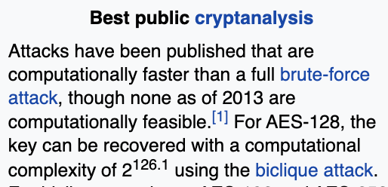
Pseudorandom Permutation (PRP)
A well-designed PRP should have
Attacker’s chance to distinguish the permutation (shuffling) from random is
EXTREMELY LOW
Not ideal, but works in reality
Example (AES): https://en.wikipedia.org/wiki/Advanced_Encryption_Standard
After computing 2^{126.1}, it may be broken

Slide 33
How Difficult 2^{126.1} is?
2^{126.1}
9.1176402658 * 10³⁷
Suppose you can compute AES in 1 cycle (needs 20~30 cycles though)
We have 6GHz CPU
9.1176402658 * 10³⁷ / 6*10⁹
Would take 1.5196 * 10²⁸ seconds
More than 481,860,000,000,000,000,000 years
With 1 billion computers? A supercomputer?
Would took 481,860,000,000 years

Slide 34
Summary
We can share a short key and communicate if
We can generate many random numbers (or numbers looking like random)
It must be shared between two party (identical random number generator)
Stream Cipher uses random number generator but
It’s hard to provide mathematical proof -> attack can be possible
Block Cipher has a restricted model but
Cryptographers can provide a proof that
A Block Cipher is PRP, and it is hard to break (e.g., requiring 2^{126.1} trials)

Slide 35
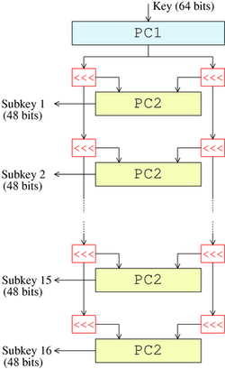
A History of the Block Cipher
M (64 bits)
DES (Data Encryption Standard)
https://en.wikipedia.org/wiki/Data_Encryption_Standard
Block cipher
K
(56 bits)
E (64 bits)

Slide 36
A History of the Block Cipher
M (64-bits)
DES (Data Encryption Standard)
https://en.wikipedia.org/wiki/Data_Encryption_Standard
Federal Information Processing Standard (FIPS)
Developed by IBM
Keysize: 56-bits, 7-bytes (short)
Block size: 64-bits (8-bytes)
Ciphertext size: 64-bits (8-bytes)
Block cipher
K
(56-bits)
E (64-bits)

Slide 37
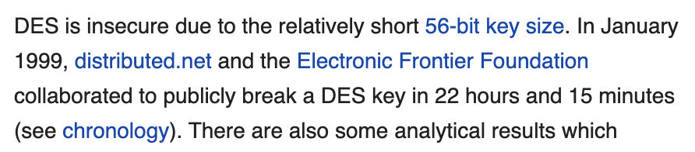
Why the Key Size is 56-bits?
64-bits brute-forcing (trying all the keys to reveal the permutation)
Was difficult in 1977 (the year the DES was standardized)
Then why shorter key?
Broken in 1999 by EFF?!?!?!?!

Slide 38
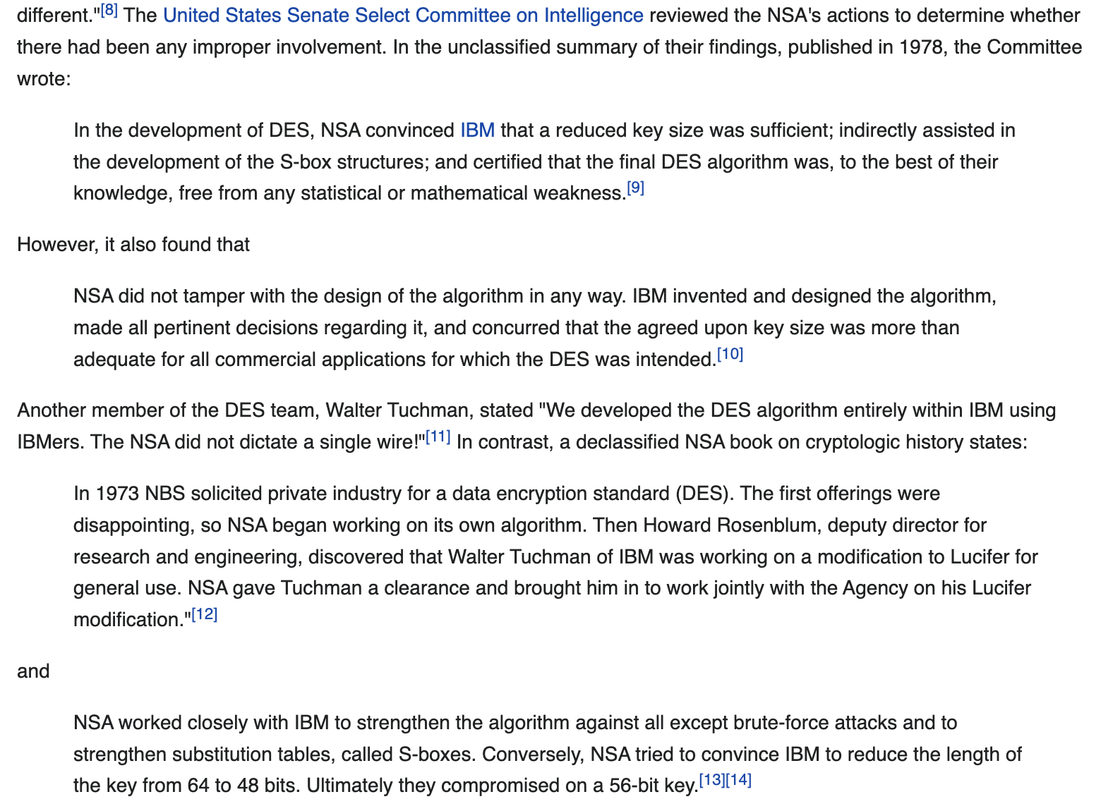
Why the Key Size is 56-bits?

Slide 39
Implications
The key size determines a block cipher’s strength
If the algorithm is designed well and proved as a
Pseudorandom Permutation (PRP)
Using a smaller number of bits in key would make the cipher
Be more easily broken by brute-force attacker
What is a brute-force attack against the Block Cipher?
Trying all the keys to decrypt the message
(Trying all possible permutations…)

Slide 40
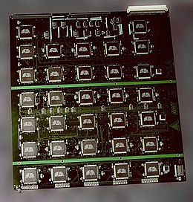
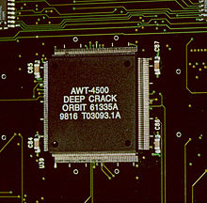
Advanced Encryption Standards (AES)
Developed to replace weak DES
EFF break DES in 1999
https://en.wikipedia.org/wiki/EFF_DES_cracker
Deep Crack chip

Slide 41
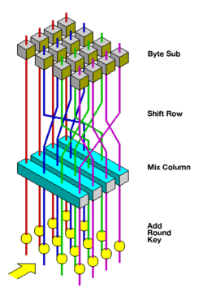
AES
Key size
128-bits, 192-bits, 256-bits
We can choose any of bit-length of the key among those three
Block size
16-byte
Will have more rounds for longer keys
Ciphertext size
The same as the block size

Slide 42
How Can We Use AES (Encryption)?
M (128-bits)
Suppose we need to encrypt a 16-byte block
Then we can get Enc(M) = E
E is also in 16-byte
AES
Encryption
Enc(M)
K
(128-bits)
E (128-bits)

Slide 43
How Can We Use AES (Decryption)?
E (128-bits)
Suppose we need to decrypt a 16-byte block
Then we can get Dec(E) = M
M is also in 16-byte
AES
Decryption
Dec(E)
K
(128-bits)
M (128-bits)

Slide 44
How Can We Use AES (Decryption)?
E (128-bits)
Suppose we need to decrypt a 16-byte block
Then we can get Dec(E) = M
M is also in 16-byte
AES
Decryption
Dec(E)
K
(128-bits)
We sometimes write Dec() as Enc⁻¹() because
The decryption operation is actually an inverse operation of the encryption
M (128-bits)

Slide 45
Can We Encrypt Blocks That Its Size is Less Than 16 byte?
YES
We can ignore the rest of bits
How?
Via padding (add some meaningless but identifiable data)
ECB (Electronic Code Book)
A padding scheme to indicate the length of the message
Pad the length of the padding as byte for the length of the padding…

Slide 46
How ECB Works?
Suppose you want to encrypt 15 byte of data
“0123456789ABCDE” ← a 15-byte string
We need 1 byte padding to make it to be 16-byte block
pos | 0 | 1 | 2 | 3 | 4 | 5 | 6 | 7 | 8 | 9 | 10 | 11 | 12 | 13 | 14 | 15
value | 0 | 1 | 2 | 3 | 4 | 5 | 6 | 7 | 8 | 9 | A | B | C | D | E

Slide 47
How ECB Works?
Suppose you want to encrypt 15 byte of data
“0123456789ABCDE” ← a 15-byte string
‘0’ ~ ‘9’ are 0x31 ~ 0x39, ’A’ ~ ‘E’ are 0x41 ~ 0x45
We need 1 byte padding to make it to be 16-byte block
Make the padding value as the length of the padding
0x1
pos | 0 | 1 | 2 | 3 | 4 | 5 | 6 | 7 | 8 | 9 | 10 | 11 | 12 | 13 | 14 | 15
val | 0x30 | 0x31 | 0x32 | 0x33 | 0x34 | 0x35 | 0x36 | 0x37 | 0x38 | 0x39 | 0x41 | 0x42 | 0x43 | 0x44 | 0x45 | 0x01

Slide 48
How ECB Works?
Suppose you want to encrypt 14 byte of data
“0123456789ABCD” ← a 14-byte string
‘0’ ~ ‘9’ are 0x31 ~ 0x39, ’A’ ~ ‘E’ are 0x41 ~ 0x45
We need 2 bytes padding to make it to be 16-byte block
Make the padding value as the length of the padding
0x2 * 2
pos | 0 | 1 | 2 | 3 | 4 | 5 | 6 | 7 | 8 | 9 | 10 | 11 | 12 | 13 | 14 | 15
val | 0x30 | 0x31 | 0x32 | 0x33 | 0x34 | 0x35 | 0x36 | 0x37 | 0x38 | 0x39 | 0x41 | 0x42 | 0x43 | 0x44 | 0x02 | 0x02

Slide 49
How ECB Works?
Suppose you want to encrypt 13 byte of data
“0123456789ABC” ← a 13-byte string
‘0’ ~ ‘9’ are 0x31 ~ 0x39, ’A’ ~ ‘E’ are 0x41 ~ 0x45
We need 3 bytes padding to make it to be 16-byte block
Make the padding value as the length of the padding
0x3 * 3
pos | 0 | 1 | 2 | 3 | 4 | 5 | 6 | 7 | 8 | 9 | 10 | 11 | 12 | 13 | 14 | 15
val | 0x30 | 0x31 | 0x32 | 0x33 | 0x34 | 0x35 | 0x36 | 0x37 | 0x38 | 0x39 | 0x41 | 0x42 | 0x43 | 0x03 | 0x03 | 0x03

Slide 50
How ECB Works?
Suppose you want to encrypt 1 byte of data
“0” ← a 1-byte string
‘0’ ~ ‘9’ are 0x31 ~ 0x39, ’A’ ~ ‘E’ are 0x41 ~ 0x45
We need 15 bytes padding to make it to be 16-byte block
Make the padding value as the length of the padding
0xf * 15
pos | 0 | 1 | 2 | 3 | 4 | 5 | 6 | 7 | 8 | 9 | 10 | 11 | 12 | 13 | 14 | 15
val | 0x30 | 0x0f | 0x0f | 0x0f | 0x0f | 0x0f | 0x0f | 0x0f | 0x0f | 0x0f | 0x0f | 0x0f | 0x0f | 0x0f | 0x0f | 0x0f

Slide 51
How Can We Encrypt 16-byte?
”0123456789ABCDE” ← a 15-byte string
What if we have a string that contains
“0123456789ABCDE\x01”?
Can we distinguish this from a 15-byte string encryption???
pos | 0 | 1 | 2 | 3 | 4 | 5 | 6 | 7 | 8 | 9 | 10 | 11 | 12 | 13 | 14 | 15
val | 0x30 | 0x31 | 0x32 | 0x33 | 0x34 | 0x35 | 0x36 | 0x37 | 0x38 | 0x39 | 0x41 | 0x42 | 0x43 | 0x44 | 0x45 | 0x01

Slide 52
How Can We Encrypt 16-byte?
”0123456789ABCDE\x01” ← a 16-byte string
A 16-byte string will have a 16-byte of padding
There must be a padding block, for bytes % 16 == 0, we have 16 bytes padding
We need to encrypt 2 blocks for a 16-byte
pos | 0 | 1 | 2 | 3 | 4 | 5 | 6 | 7 | 8 | 9 | 10 | 11 | 12 | 13 | 14 | 15
val | 0x30 | 0x31 | 0x32 | 0x33 | 0x34 | 0x35 | 0x36 | 0x37 | 0x38 | 0x39 | 0x41 | 0x42 | 0x43 | 0x44 | 0x45 | 0x01
pos | 0 | 1 | 2 | 3 | 4 | 5 | 6 | 7 | 8 | 9 | 10 | 11 | 12 | 13 | 14 | 15
val | 0x10 | 0x10 | 0x10 | 0x10 | 0x10 | 0x10 | 0x10 | 0x10 | 0x10 | 0x10 | 0x10 | 0x10 | 0x10 | 0x10 | 0x10 | 0x10

Slide 53
How to Encrypt 2 Blocks on Block Cipher?
“0123456789ABCDE0x01” (16-byte) and “\x10\x10\x10…” (16-byte)
M: ”0123456789ABCDE\x01”
30313233343536373839414243444501
Block cipher
K
0x5ed6985c539dccf8e62cbaf5a8d563fb
E: 23c934b65280ff27f7c2b7e131defcb6

Slide 54
How to Encrypt 2 Blocks on Block Cipher?
“0123456789ABCDE0x01” (16-byte) and “\x10\x10\x10…” (16-byte)
M: ”\x10”*16
10101010101010101010101010101010
Block cipher
K
0x5ed6985c539dccf8e62cbaf5a8d563fb
E: d303fe9c04a4876930e4a5728f1eda4c

Slide 55
How ECB Works?
Can we encrypt more than 16 bytes?
YES
“0123456789ABCDEFFEDCBA9876543210” ← this is a 32-byte block
Break blocks into 16-byte granularity
“0123456789ABCDEF”
“FEDCBA9876543210”
Padding: “\x10” * 16
Encrypt those 3 blocks

Slide 56
How ECB Works?
Can we encrypt more than 16 bytes?
YES
“0123456789ABCDEFFEDCBA9876543210Q” ← this is a 33-byte block
Break blocks into 16-byte granularity
“0123456789ABCDEF”
“FEDCBA9876543210”
Last block and the padding: “Q” + “\x0f” * 15
Encrypt those 3 blocks

Slide 57
Are There Any Weaknesses in ECB?
For the same key, the same plaintext block will result in the same ciphertext
M: ”\x10”*16
10101010101010101010101010101010
Block cipher
K
0x5ed6985c539dccf8e62cbaf5a8d563fb
E: d303fe9c04a4876930e4a5728f1eda4c

Slide 58
Are There Any Weaknesses in ECB?
For the same key, the same plaintext block will result in the same ciphertext
M: 10101010101010101010101010101010
Whenever an attacker observe d303fe9c04a4876930e4a5728f1eda4c
They know that it is the encryption of “\x10” * 16
(maybe the end of the message for 16-byte granularity)
E: d303fe9c04a4876930e4a5728f1eda4c

Slide 59
ECB Weakness
Suppose a message 0 is encrypted to
0x39827332…
Suppose a message 1 is encrypted to
0x5a83f874…
Suppose the attacker knows this via
Pattern analysis or something

Slide 60
ECB Weakness
Suppose a message 0 is encrypted to
0x39827332…
Suppose a message 1 is encrypted to
0x5a83f874…
Suppose the attacker knows this via
Pattern analysis or something
0x5a83f874…

Slide 61
ECB Weakness
Suppose a message 0 is encrypted to
0x39827332…
Suppose a message 1 is encrypted to
0x5a83f874…
Suppose the attacker knows this via
Pattern analysis or something
0x5a83f874…
This is 1

Slide 62
ECB Summary
Electronic Code Book can be used for encrypting data less/more than the block size
We can add padding
Padding Scheme
Padding size: 16 - Size % 16
”Padding_size byte” * padding_size is the padding
E.g., if padding size is 1, then add \x01 at the end
2, then \x02\x02
3, then \x03\x03\x03
15, then \x0f\x0f\x0f

Slide 63
ECB Summary
For the size % 16 == 0, we need to have 16-byte padding
We definitely need to have a longer ciphertext than the plaintext size
At most 16-byte longer per each message

Slide 64
ECB Summary
Weakness
Using the same key will leak the information about the plaintext data in ciphertext
This is because the permutation is not changed, so for the same plaintext, the block cipher will result in the same encrypted data

Slide 65


ECB Summary
Weakness
In case we encrypt an image

Slide 66
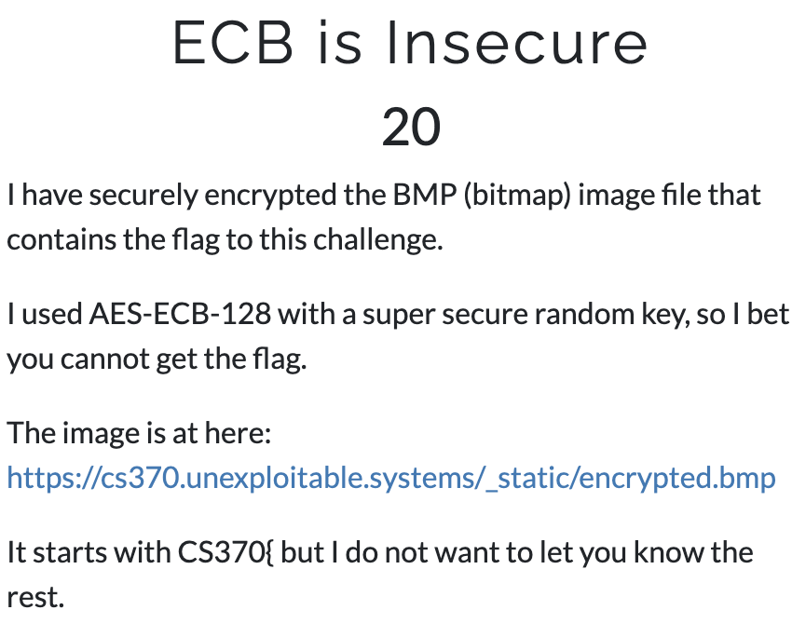

ECB Exercise
Please take a look at the ECB encrypted Image
https://cs370.unexploitable.systems/_static/encrypted.bmp

