Slide 1
CS 370 Introduction to Security
Block Cipher Modes
Yeongjin Jang

Slide 2

Recap: Block Cipher
cs370{16bytemsg}
M
0x63733337307b3136627974656d73677d
Block: a fixed sized message (16-byte here for the example)
Key: A secret between sender and receiver (short, 16-byte here for the example)
M: Plaintext message
E : Encrypted message
Block cipher
K
Key: 0xd7fe6798a7c6a9859b289ce
E
0x354a820534573738475066bd38bf1540

Slide 3

Recap: What Does the Block Cipher Do?
Generating a permutation of the numbers in
{0,1}^{n} -> {0,1}^{n}
It’s permutation, so it must be one-to-one mapping
It’s like shuffling the card
msg | Ciphertext
0 | 0xaf531b0e1
1 | 0x14a986e7a
2 | 0xad738009d
3 | 0x5ed6985c5
4 | 0xf3b8aa2e8
5 | 0xad04ec00e
… | 0x59fd94c21

Slide 4
Recap: Can encrypt arbitrary bytes..
“0123456789ABCDE0x01” (16-byte) and “\x10\x10\x10…” (16-byte)
M: ”\x10”*16
10101010101010101010101010101010
Block cipher
K
0x5ed6985c539dccf8e62cbaf5a8d563fb
E: d303fe9c04a4876930e4a5728f1eda4c

Slide 5
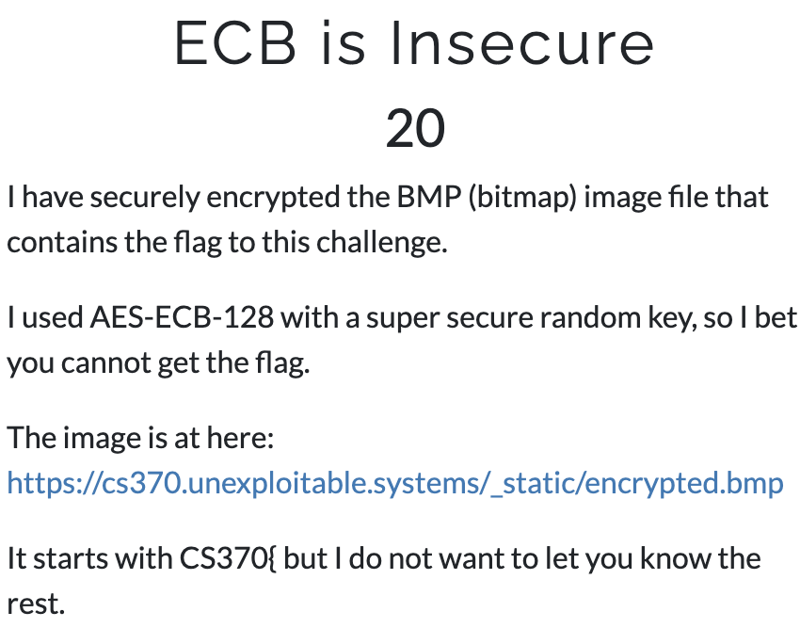

Recap: ECB is Insecure..
Please take a look at the ECB encrypted Image
https://cs370.unexploitable.systems/_static/encrypted.bmp

Slide 6
Block Cipher Modes
A way of using block cipher
A block cipher can only encrypt/decrypt a block
How can we chain this and use it to encrypt
Arbitrary length of message?
ECB / CBC / CTR

Slide 7
Electronic Code Book (ECB)
Use Block Cipher Encryption as Encryption
0000000000000
0000000000001
0000000000000
0000000000001
Block
Cipher
Block
Cipher
Block
Cipher
Block
Cipher
K
K
K
K
0101011101010
1111011101011
0101011101010
1111011101011

Slide 8
Electronic Code Book (ECB)
Use Block Cipher Decryption as Decryption
0101011101010
1111011101011
0101011101010
1111011101011
Block
Cipher⁻¹
Block
Cipher⁻¹
Block
Cipher⁻¹
Block
Cipher⁻¹
K
K
K
K
0000000000000
0000000000001
0000000000000
0000000000001

Slide 9
ECB
We can run encryption in parallel
0000000000000
0000000000001
0000000000000
0000000000001
Block
Cipher
Block
Cipher
Block
Cipher
Block
Cipher
K
K
K
K
0101011101010
1111011101011
0101011101010
1111011101011

Slide 10
ECB
We can run decryption in parallel
0101011101010
1111011101011
0101011101010
1111011101011
Block
Cipher⁻¹
Block
Cipher⁻¹
Block
Cipher⁻¹
Block
Cipher⁻¹
K
K
K
K
0000000000000
0000000000001
0000000000000
0000000000001

Slide 11
ECB Weakness
A plaintext block will be encrypted to a specific ciphertext block
0000000000000
0000000000001
Block
Cipher
Block
Cipher
K
0101011101010 is 0
K
1111011101011 is 1
0101011101010
1111011101011

Slide 12
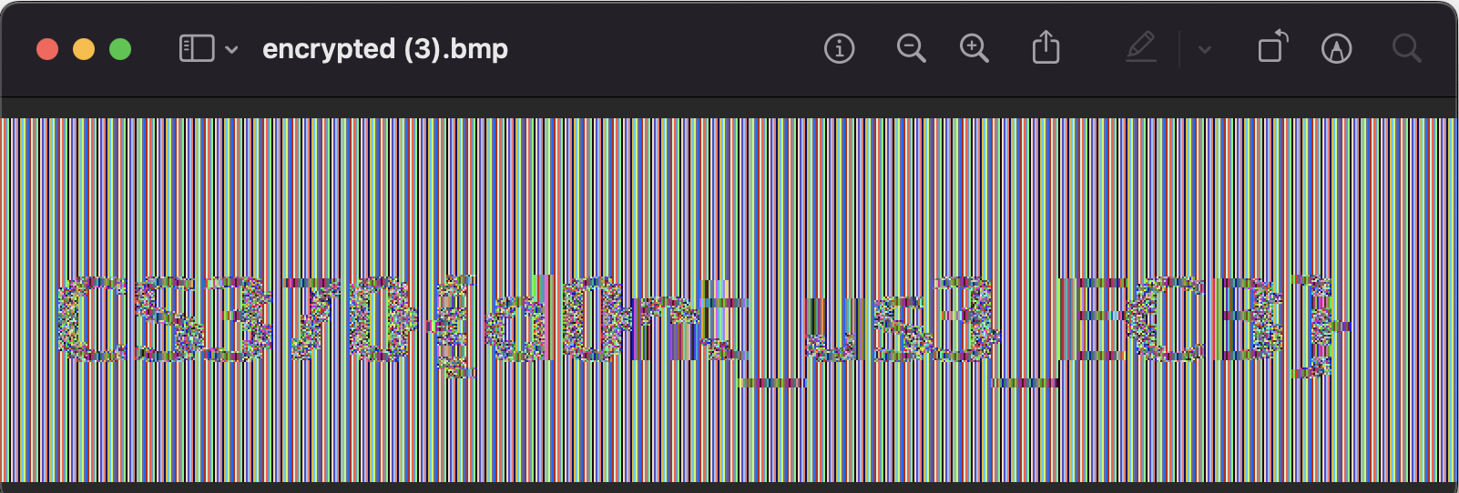
ECB-is-insecure

Slide 13
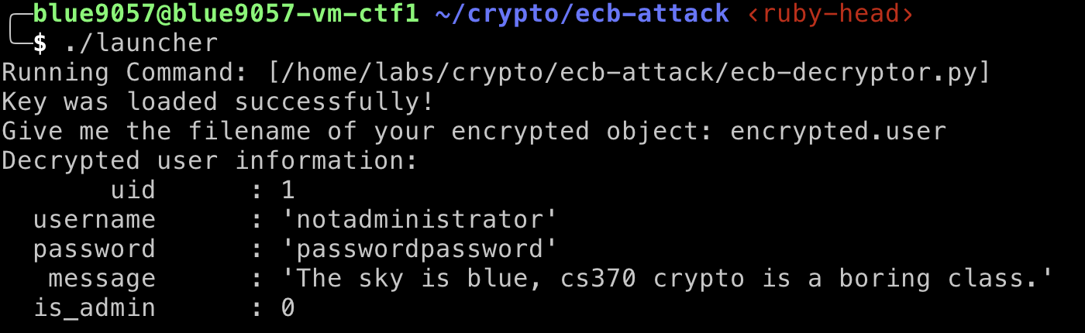
ecb-attack
uid (16-byte, an integer string)
You need to exploit the weakness of ECB mode to get 3 flags
username (16-byte, a string)
password (16-byte, a string)
Message 0 (16-byte, a string)
Message 1 (16-byte, a string)
Message 2 (16-byte, a string)
Is_admin (16-byte, an integer string)

Slide 14
ecb-attack
How to start?
fetch crypto
Run ./launcher
Type ‘encrypted.user’

Slide 15
ecb-attack
Uid = 1
Encrypted.user
The example encrypted user
username = notadministrator
password = passwordpassword
The sky is blue,
cs370 crypto is
a boring class.
is_admin = 0

Slide 16
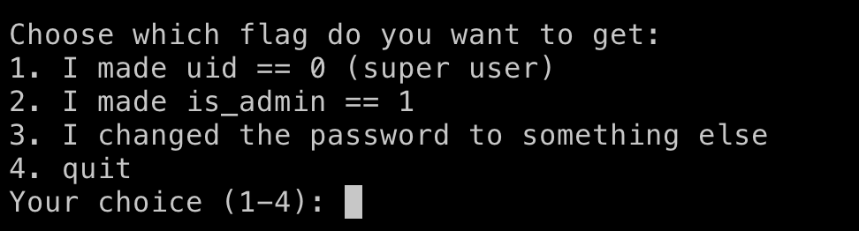
ecb-attack
Uid = 1
Create valid encrypted data…
uid == 0
is_admin == 1
password to something else
username = notadministrator
password = passwordpassword
The sky is blue,
cs370 crypto is
a boring class.
is_admin = 0

Slide 17
ecb-attack
Uid = 1
Making uid == 0
username = notadministrator
password = passwordpassword
The sky is blue,
cs370 crypto is
a boring class.
is_admin = 0

Slide 18
ecb-attack
Uid = 1
Making uid == 0
username = notadministrator
password = passwordpassword
The sky is blue,
cs370 crypto is
is_admin = 0
a boring class.
is_admin = 0

Slide 19
ecb-attack
uid = 0
Uid = 1
Making uid == 0
username = notadministrator
password = passwordpassword
The sky is blue,
cs370 crypto is
a boring class.
is_admin = 0

Slide 20
ecb-attack
uid = 0
Uid = 1
Block 0
Making uid == 0
username = notadministrator
Block 1
Block 2
password = passwordpassword
Block 3
The sky is blue,
Block 4
cs370 crypto is
a boring class.
Block 5
block[0] = block[6]
is_admin = 0
Block 6

Slide 21
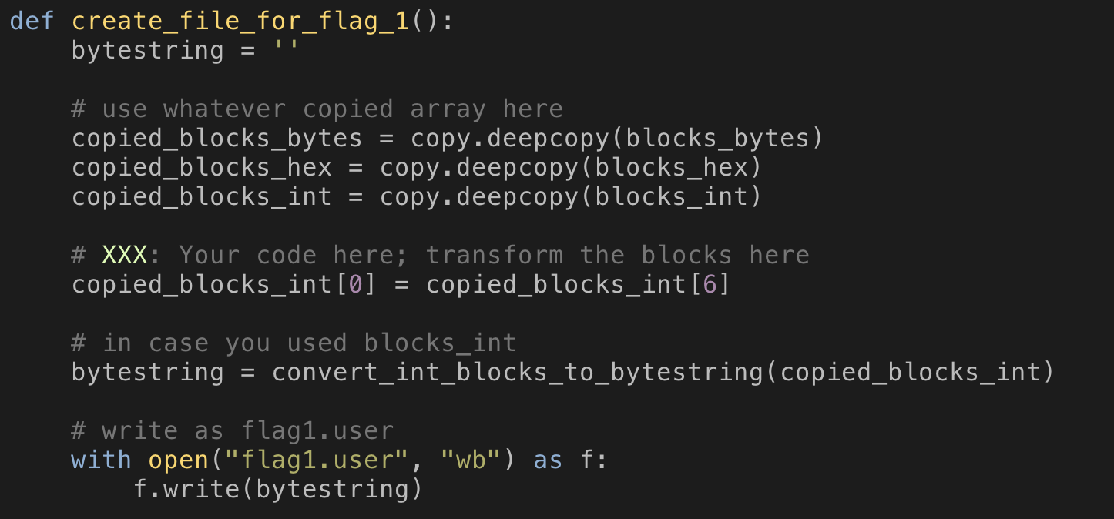
ecb-attack
In template.py. Copy this as a solution.py to start with!
The result will be stored in flag1.user
uid = 0
Uid = 1
Making uid == 0
username = notadministrator
password = passwordpassword
The sky is blue,
cs370 crypto is
a boring class.
is_admin = 0

Slide 22
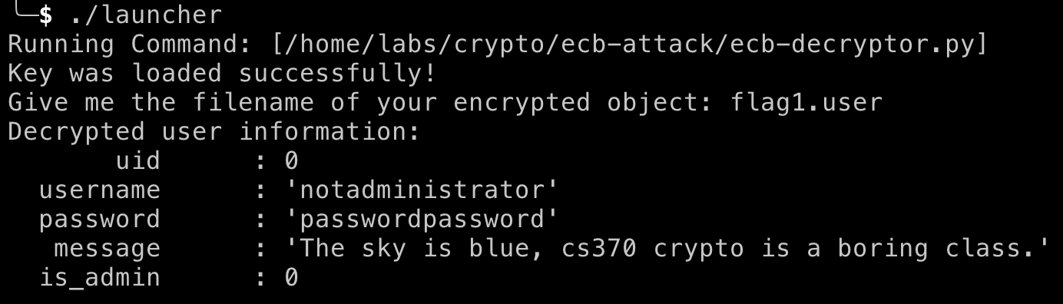
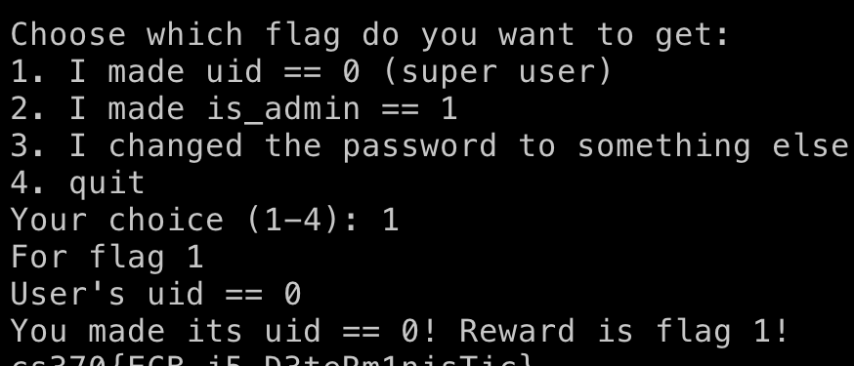
ecb-attack
Run ./launcher
Supply flag1.user as the file
uid == 0

Slide 23
ecb-attack
Uid = 1
is_admin == 1
username = notadministrator
password = passwordpassword
The sky is blue,
cs370 crypto is
a boring class.
is_admin = 0

Slide 24
ecb-attack
Uid = 1
is_admin == 1
username = notadministrator
password = passwordpassword
The sky is blue,
cs370 crypto is
Uid = 1
a boring class.
is_admin = 0

Slide 25
ecb-attack
Uid = 1
is_admin == 1
username = notadministrator
password = passwordpassword
The sky is blue,
cs370 crypto is
a boring class.
is_admin = 1

Slide 26
ecb-attack
Uid = 1
is_admin == 1
username = notadministrator
password = passwordpassword
The sky is blue,
cs370 crypto is
a boring class.
block[6] = block[0]
is_admin = 1

Slide 27
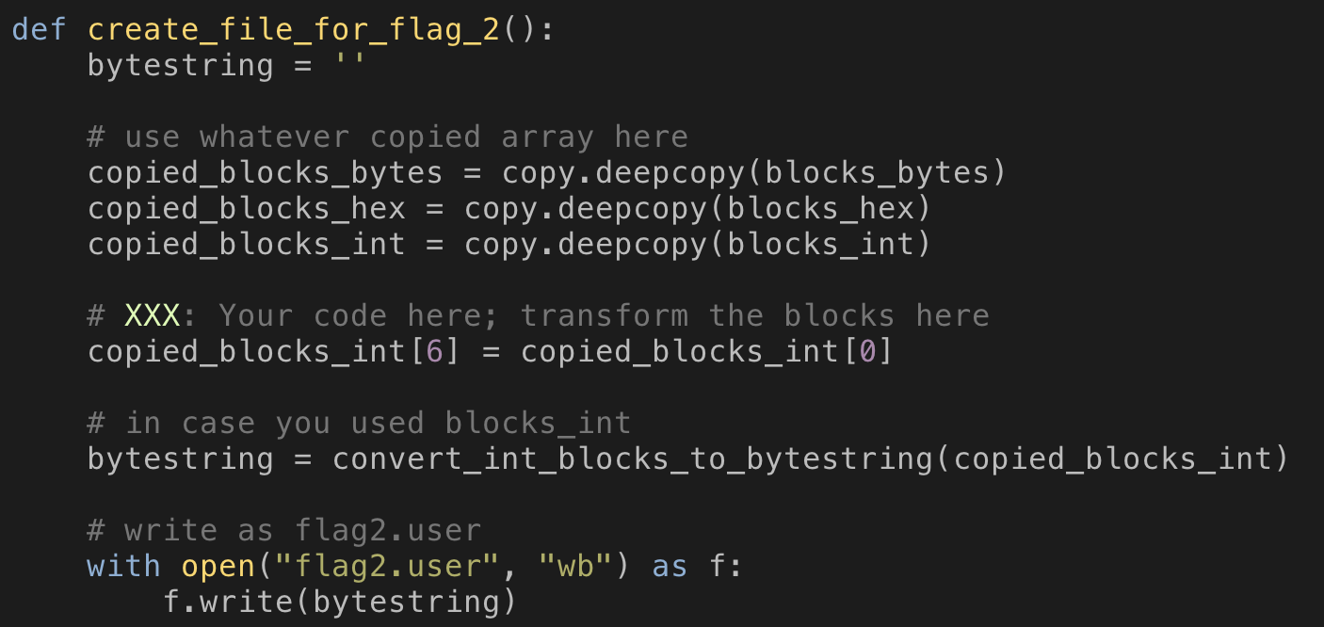
ecb-attack
In template.py. Copy this as a solution.py to start with!
The result will be stored in flag2.user
Uid = 1
is_admin == 1
username = notadministrator
password = passwordpassword
The sky is blue,
cs370 crypto is
a boring class.
is_admin = 1

Slide 28
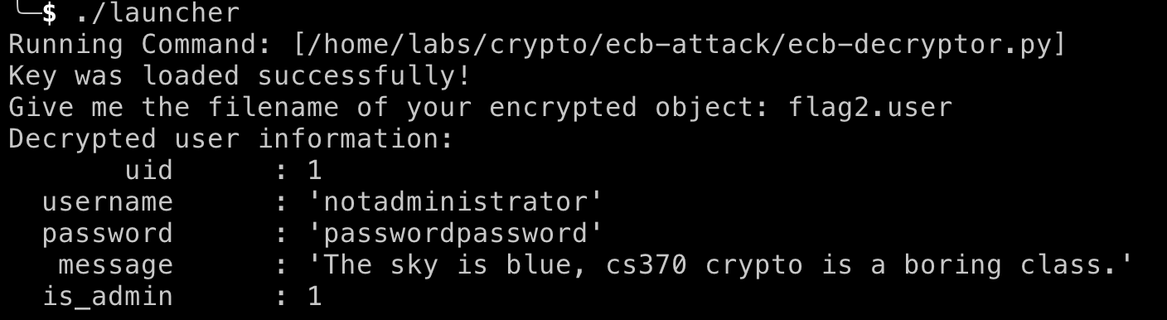
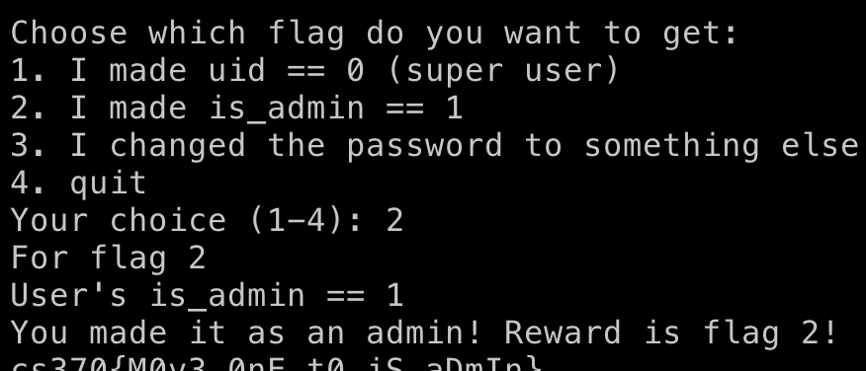
ecb-attack
Run ./launcher
Supply flag2.user as the file
is_admin == 1

Slide 29
ecb-attack
Uid = 1
change password to a different string
username = notadministrator
password = passwordpassword
The sky is blue,
cs370 crypto is
a boring class.
is_admin = 0

Slide 30
ecb-attack
Uid = 1
change password to a different string
username = notadministrator
password = passwordpassword
The sky is blue,
username = notadministrator
cs370 crypto is
a boring class.
is_admin = 0

Slide 31
ecb-attack
Uid = 1
change password to a different string
username = notadministrator
password = notadministrator
The sky is blue,
cs370 crypto is
a boring class.
is_admin = 0

Slide 32
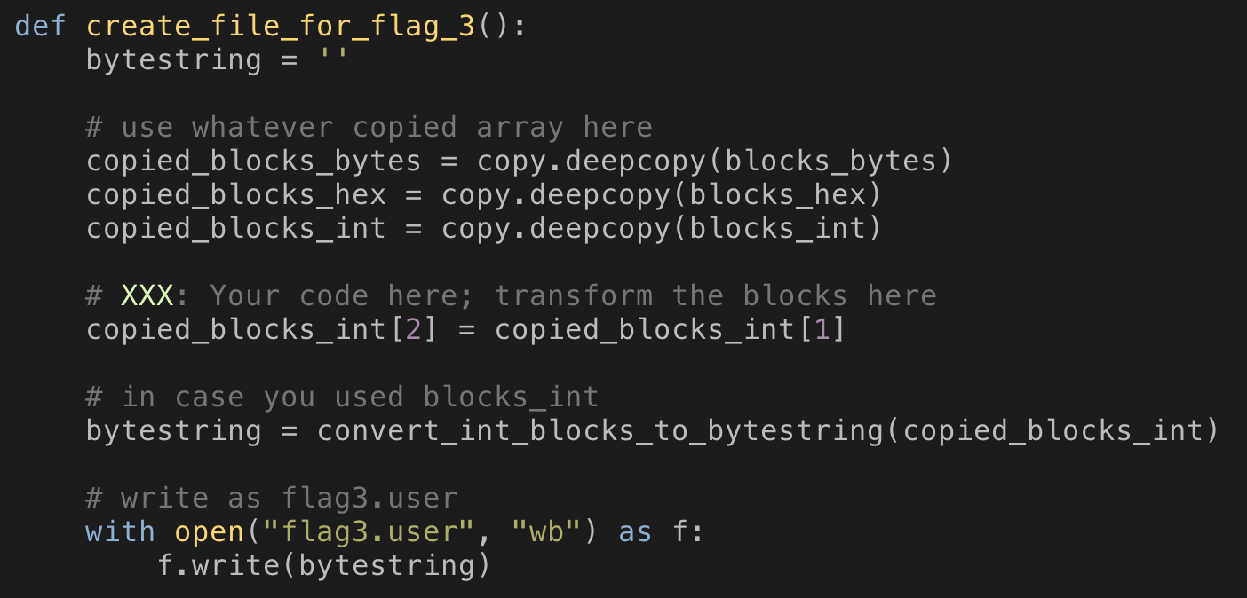
ecb-attack
In template.py. Copy this as a solution.py to start with!
The result will be stored in flag3.user
Uid = 1
change password to a different string
username = notadministrator
password = notadministrator
The sky is blue,
cs370 crypto is
a boring class.
is_admin = 0

Slide 33
ecb-attack
Uid = 1
change password to a different string
./launcher with flag3.user
Type notadministrator as password!
username = notadministrator
password = notadministrator
The sky is blue,
cs370 crypto is
a boring class.
is_admin = 0

Slide 34
ECB Weakness
A fixed plaintext <-> ciphertext mapping
How can we avoid this?
CBC Mode!

Slide 35
Cipher Block Chain (CBC)
Apply XOR between the IV (Initialization Vector) and the plaintext
Chain the previous ciphertext block to the plaintext with XOR
Run Encryption on Xor’ed data
IV ⊕ P0
C0 ⊕ P1
C1 ⊕ P2
C2 ⊕ P3
IV
0000000000000
P0
0000000000001
P1
0000000000000
P2
0000000000001
P3
⊕
⊕
⊕
⊕
101011101010
Block
Cipher
Block
Cipher
Block
Cipher
Block
Cipher
K
K
K
K
0101011101010
C0
1100011110101
C1
0001110111011
C2
1101011101110
C3

Slide 36
Cipher Block Chain (CBC)
Decrypt first, and then apply XOR
Starting with IV, XOR the previous ciphertext to the decrypted data
0101011101010
C0
1100011110101
C1
0001110111011
C2
1101011101110
C3
Block
Cipher⁻¹
Block
Cipher⁻¹
Block
Cipher⁻¹
Block
Cipher⁻¹
K
K
K
K
IV
⊕
⊕
⊕
⊕
101011101010
0000000000000
0000000000001
0000000000000
0000000000001
P0 = IV ⊕ D0
P1 = C0 ⊕ D1
P2 = C1 ⊕ D2
P3 = C2 ⊕ D3

Slide 37
CBC Benefits
ECB Weakness: 0 always encrypted in a fixed value… we can switch ciphertext to launch an attack
Let’s make each input to the block cipher looks like random
Solution:
1. Use a random IV, xor that to the plaintext; input will be random
2. If the Block Cipher is PRP, the ciphertext looks like random
3. Chain that random (ciphertext) to the next plaintext block…

Slide 38
CBC Benefits
Solution:
1. Use a random IV, xor that to the plaintext; input will be random
2. If the Block Cipher is PRP, the ciphertext looks like random
3. Chain that random (ciphertext) to the next plaintext block…
IV ⊕ P0
C0 ⊕ P1
C1 ⊕ P2
C2 ⊕ P3
IV
0000000000000
P0
0000000000001
P1
0000000000000
P2
0000000000001
P3
⊕
⊕
⊕
⊕
101011101010
Block
Cipher
Block
Cipher
Block
Cipher
Block
Cipher
K
K
K
K
0101011101010
C0
1100011110101
C1
0001110111011
C2
1101011101110
C3

Slide 39
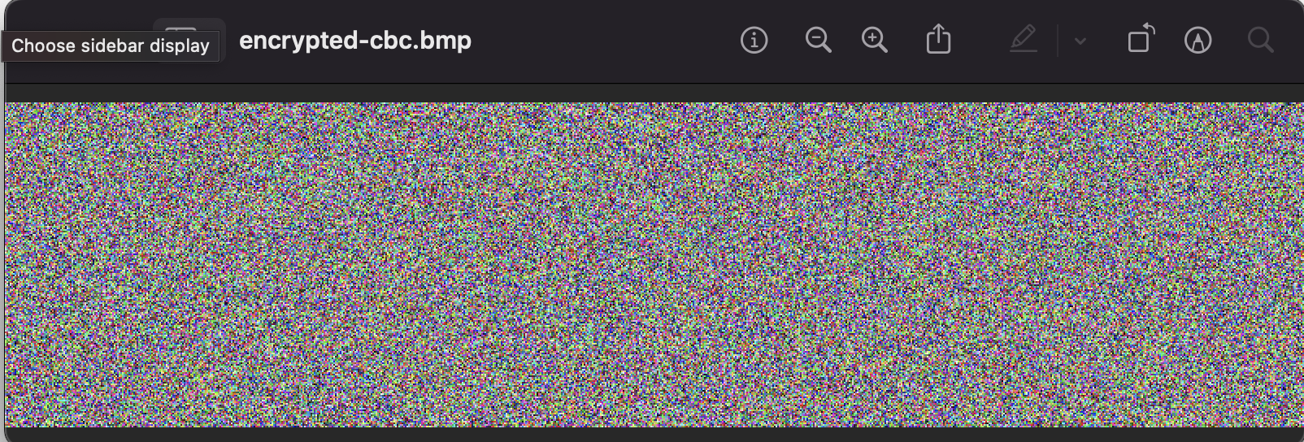
CBC-is-secure

Slide 40
CBC Drawback
We cannot parallelize encryption
We need to have a previous ciphertext block to encrypt the next block
IV ⊕ P0
C0 ⊕ P1
C1 ⊕ P2
C2 ⊕ P3
IV
0000000000000
P0
0000000000001
P1
0000000000000
P2
0000000000001
P3
⊕
⊕
⊕
⊕
101011101010
Block
Cipher
Block
Cipher
Block
Cipher
Block
Cipher
K
K
K
K
0101011101010
C0
1100011110101
C1
0001110111011
C2
1101011101110
C3

Slide 41
CBC Drawback
We can run decryption in parallel
We have all ciphertext at the start!
0101011101010
C0
1100011110101
C1
0001110111011
C2
1101011101110
C3
Block
Cipher⁻¹
Block
Cipher⁻¹
Block
Cipher⁻¹
Block
Cipher⁻¹
K
K
K
K
IV
⊕
⊕
⊕
⊕
101011101010
0000000000000
0000000000001
0000000000000
0000000000001
P0 = IV ⊕ D0
P1 = C0 ⊕ D1
P2 = C1 ⊕ D2
P3 = C2 ⊕ D3

Slide 42
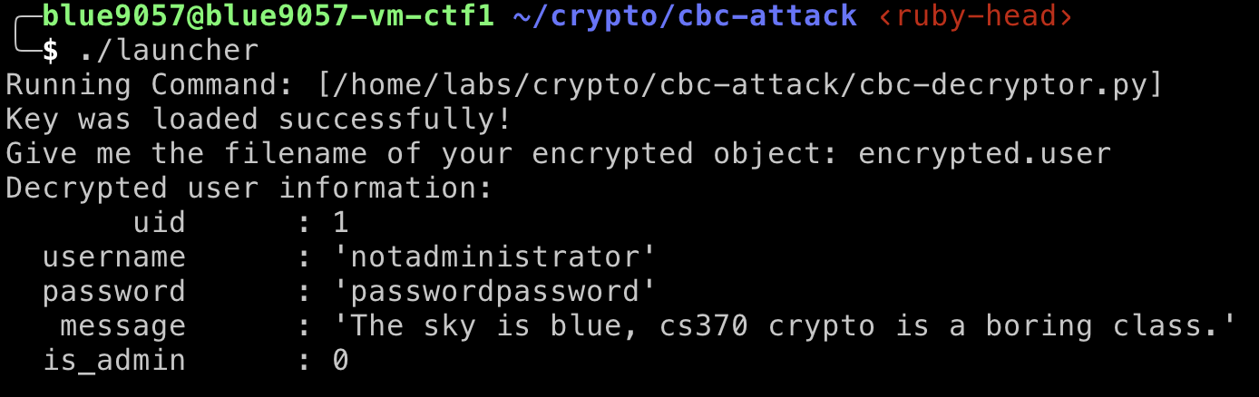
cbc-attack
Uid = 1
Encrypted.user
The example encrypted user
username = notadministrator
password = passwordpassword
The sky is blue,
cs370 crypto is
a boring class.
is_admin = 0

Slide 43
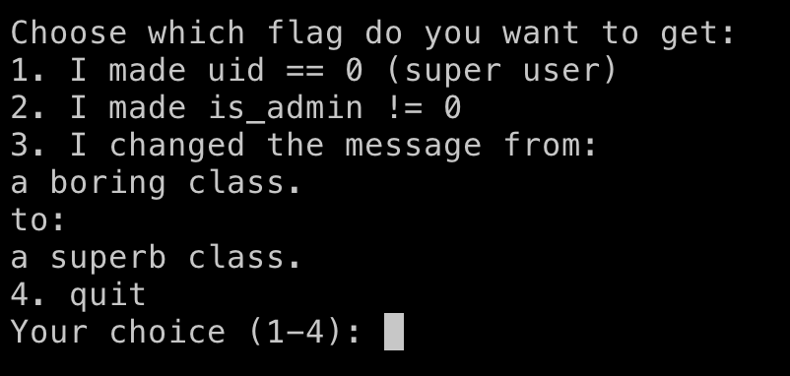
cbc-attack
Uid = 1
Encrypted.user
The example encrypted user
Need to accomplish:
username = notadministrator
password = passwordpassword
The sky is blue,
cs370 crypto is
a boring class.
is_admin = 0

Slide 44
cbc-attack
Uid = 1
uid == 0
username = notadministrator
password = passwordpassword
The sky is blue,
cs370 crypto is
a boring class.
is_admin = 0
is_admin = 0
We cannot re-use this

Slide 45
cbc-attack
uid == 0
uid = 1
C0
notadministrator
C1
passwordpassword
C2
The sky is blue,
C3
Block
Cipher⁻¹
Block
Cipher⁻¹
Block
Cipher⁻¹
Block
Cipher⁻¹
K
K
K
K
IV
⊕
⊕
⊕
⊕
101011101010
0000000000001
notadministrator
passwordpassword
The sky is blue,
P0 = IV ⊕ D0
P1 = C0 ⊕ D1
P2 = C1 ⊕ D2
P3 = C2 ⊕ D3

Slide 46
cbc-attack
This block will be decrypted as:
0000000000000001
uid == 0
uid = 1
C0
notadministrator
C1
passwordpassword
C2
The sky is blue,
C3
Block
Cipher⁻¹
Block
Cipher⁻¹
Block
Cipher⁻¹
Block
Cipher⁻¹
K
K
K
K
IV
⊕
⊕
⊕
⊕
101011101010
0000000000001
notadministrator
passwordpassword
The sky is blue,
P0 = IV ⊕ D0
P1 = C0 ⊕ D1
P2 = C1 ⊕ D2
P3 = C2 ⊕ D3

Slide 47
cbc-attack
This block will be decrypted as:
0000000000000001
uid == 0
We don’t manipulate the ciphertext
uid = 1
C0
notadministrator
C1
passwordpassword
C2
The sky is blue,
C3
Block
Cipher⁻¹
Block
Cipher⁻¹
Block
Cipher⁻¹
Block
Cipher⁻¹
K
K
K
K
IV
⊕
⊕
⊕
⊕
101011101010
0000000000001
notadministrator
passwordpassword
The sky is blue,
P0 = IV ⊕ D0
P1 = C0 ⊕ D1
P2 = C1 ⊕ D2
P3 = C2 ⊕ D3

Slide 48
cbc-attack
This block will be decrypted as:
0000000000000001
uid == 0
We don’t manipulate the ciphertext
uid = 1
C0
notadministrator
C1
passwordpassword
C2
The sky is blue,
C3
Block
Cipher⁻¹
Block
Cipher⁻¹
Block
Cipher⁻¹
Block
Cipher⁻¹
K
K
K
K
IV
⊕
⊕
⊕
⊕
101011101010
0000000000001
notadministrator
passwordpassword
The sky is blue,
P0 = IV ⊕ D0
P1 = C0 ⊕ D1
P2 = C1 ⊕ D2
P3 = C2 ⊕ D3
We manipulate IV; change the last bit from 0 to 1

Slide 49
cbc-attack
This block will be decrypted as:
0000000000000001
uid == 0
We don’t manipulate the ciphertext
uid = 1
C0
notadministrator
C1
passwordpassword
C2
The sky is blue,
C3
Block
Cipher⁻¹
Block
Cipher⁻¹
Block
Cipher⁻¹
Block
Cipher⁻¹
K
K
K
K
IV
⊕
⊕
⊕
⊕
101011101011
0000000000000
notadministrator
passwordpassword
The sky is blue,
P0 = IV ⊕ D0
P1 = C0 ⊕ D1
P2 = C1 ⊕ D2
P3 = C2 ⊕ D3
We manipulate IV; change the last bit from 0 to 1

Slide 50
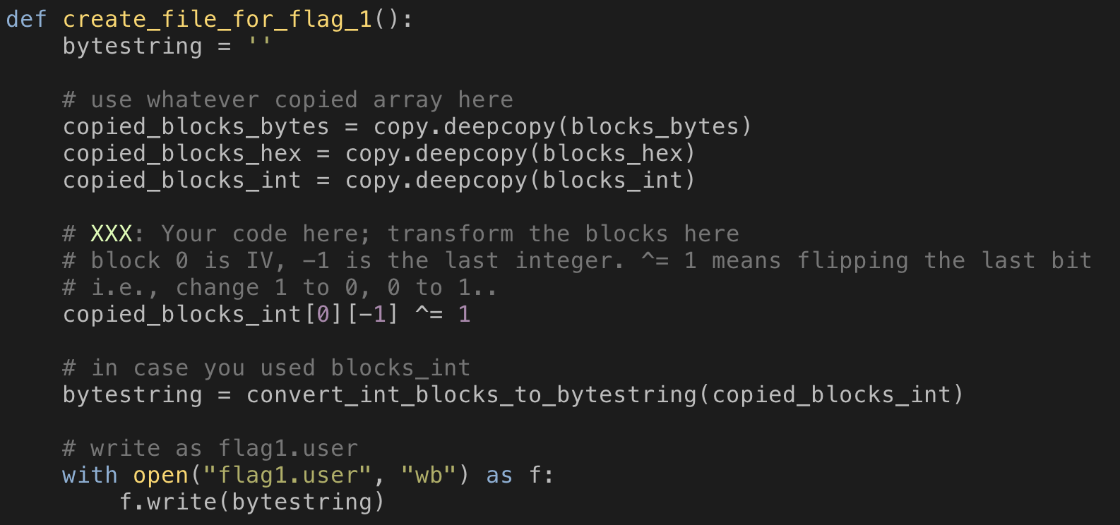
cbc-attack

Slide 51
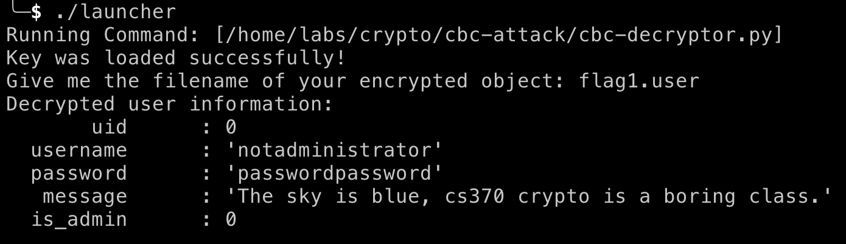
cbc-attack

Slide 52
cbc-attack
is_admin == 1
The sky is blue,
C0
cs370 crypto is
C1
a boring class
C2
is_admin=0
C3
Block
Cipher⁻¹
Block
Cipher⁻¹
Block
Cipher⁻¹
Block
Cipher⁻¹
K
K
K
K
IV
⊕
⊕
⊕
⊕
Passwordpass..
The sky is blue,
cs370 crypto is
a boring class
0000000000000000
P0 = IV ⊕ D0
P1 = C0 ⊕ D1
P2 = C1 ⊕ D2
P3 = C2 ⊕ D3

Slide 53
cbc-attack
We change this ciphertext
To change this value
is_admin == 1
Flip the last bit
The sky is blue,
C0
cs370 crypto is
C1
a boring class
C2
is_admin=0
C3
Block
Cipher⁻¹
Block
Cipher⁻¹
Block
Cipher⁻¹
Block
Cipher⁻¹
K
K
K
K
IV
⊕
⊕
⊕
⊕
Passwordpass..
The sky is blue,
cs370 crypto is
a boring class
0000000000000000
P0 = IV ⊕ D0
P1 = C0 ⊕ D1
P2 = C1 ⊕ D2
P3 = C2 ⊕ D3
Flipped at here

Slide 54
cbc-attack
We change this ciphertext
To change this value
is_admin == 1
Flip the last bit
The sky is blue,
C0
cs370 crypto is
C1
a boring class
C2
is_admin=0
C3
Block
Cipher⁻¹
Block
Cipher⁻¹
Block
Cipher⁻¹
Block
Cipher⁻¹
K
K
K
K
IV
⊕
⊕
⊕
⊕
Passwordpass..
The sky is blue,
cs370 crypto is
a boring class
0000000000000001
P0 = IV ⊕ D0
P1 = C0 ⊕ D1
P2 = C1 ⊕ D2
P3 = C2 ⊕ D3
Flipped at here

Slide 55
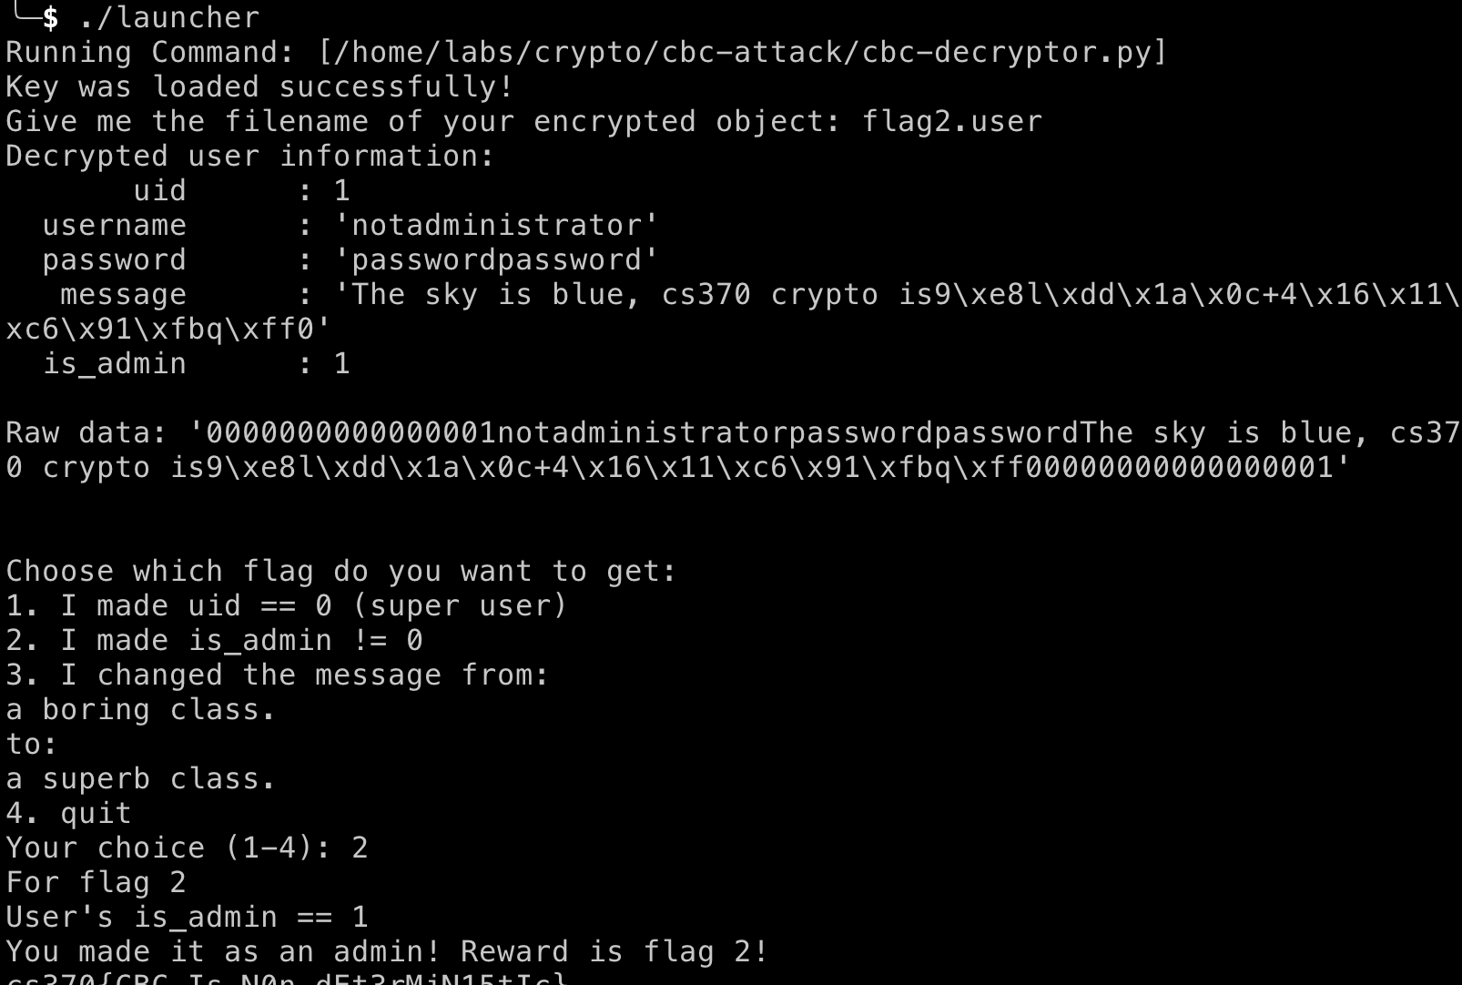
cbc-attack
is_admin == 1
We broke the plaintext of block 6
But who cares?

Slide 56
cbc-attack
is_admin == 1
We can make is_admin == 1

Slide 57
cbc-attack
Uid = 1
boring to superb?
Need to accomplish:
username = notadministrator
password = passwordpassword
The sky is blue,
cs370 crypto is
a boring class.
is_admin = 0

Slide 58
cbc-attack
boring -> superb
The sky is blue,
C0
cs370 crypto is
C1
a boring class
C2
is_admin=0
C3
Block
Cipher⁻¹
Block
Cipher⁻¹
Block
Cipher⁻¹
Block
Cipher⁻¹
K
K
K
K
IV
⊕
⊕
⊕
⊕
Passwordpass..
The sky is blue,
cs370 crypto is
a boring class
0000000000000000
P0 = IV ⊕ D0
P1 = C0 ⊕ D1
P2 = C1 ⊕ D2
P3 = C2 ⊕ D3

Slide 59
cbc-attack
We change this ciphertext
To change this value
boring -> superb
The sky is blue,
C0
cs370 crypto is
C1
a boring class
C2
is_admin=0
C3
Block
Cipher⁻¹
Block
Cipher⁻¹
Block
Cipher⁻¹
Block
Cipher⁻¹
K
K
K
K
IV
⊕
⊕
⊕
⊕
Passwordpass..
The sky is blue,
cs370 crypto is
a boring class
0000000000000000
P0 = IV ⊕ D0
P1 = C0 ⊕ D1
P2 = C1 ⊕ D2
P3 = C2 ⊕ D3

Slide 60
cbc-attack
We change this ciphertext
To change this value
boring -> superb
The sky is blue,
C0
cs370 crypto is
C1
a boring class.
C2
is_admin=0
C3
Block
Cipher⁻¹
Block
Cipher⁻¹
Block
Cipher⁻¹
Block
Cipher⁻¹
K
K
K
K
IV
⊕
⊕
⊕
⊕
Passwordpass..
The sky is blue,
cs370 crypto is
a boring class
0000000000000000
P0 = IV ⊕ D0
P1 = C0 ⊕ D1
P2 = C1 ⊕ D2
P3 = C2 ⊕ D3

Slide 61
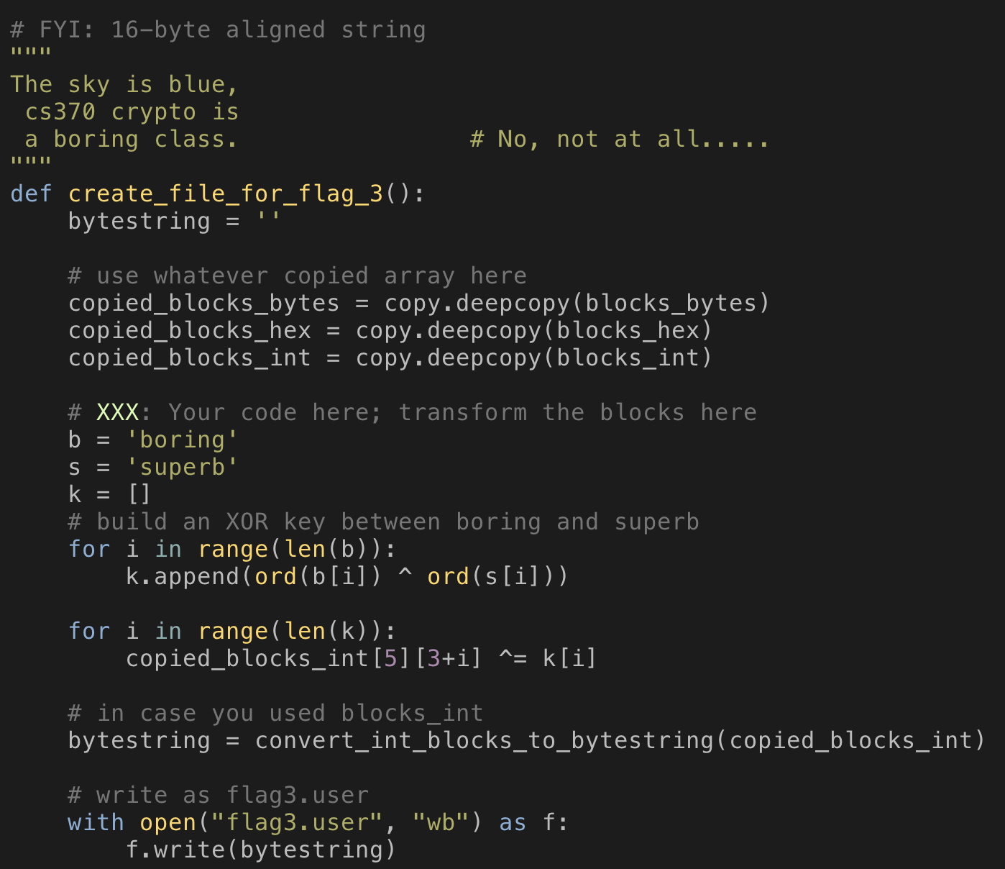
cbc-attack
boring -> superb
Build the key
Apply XOR

Slide 62
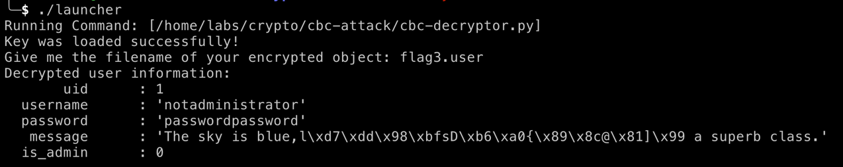
cbc-attack
boring -> superb
It smashs the block before ‘superb’ but the validator does not care..

Slide 63
ECB/CBC Drawbacks
ECB Pros: can encrypt/decrypt in parallel
ECB Cons: Attackers can easily stitch ciphertext to build plaintext
CBC Pros: can decrypt in parallel, ciphertext pattern is not fixed!
CBC Cons: Cannot encrypt in parallel
Can we have a mode that
Can en/decrypt in parallel and
Ciphertext pattern is not fixed?

Slide 64
Counter Mode
CTR (Counter mode)
Start with a random nonce || counter
It uses the block cipher as random number generator
V = Enc(nonce || counter)
Then, XOR this V to the plaintext
C = P ⊕ V

Slide 65
Counter Mode
CTR (Counter mode)
Start with a random nonce || counter
Nonce
3a88dff8
Nonce || 1
Nonce || 2
Nonce || 3
Nonce || 4
3a88dff8000001
3a88dff8000002
3a88dff8000003
3a88dff8000004
Block
Cipher
Block
Cipher
Block
Cipher
Block
Cipher
K
K
K
K
0101011101010
1100011110101
0001110111011
1101011101110
⊕
⊕
⊕
⊕
uid = 0
notadministrato
passwordpassw
The sky is blue,
010101110101
110111101101
001110101011
1101111101111

Slide 66
Counter Mode Encryption
CTR (Counter mode)
Start with a random nonce || counter
Nonce
3a88dff8
Nonce || 1
Nonce || 2
Nonce || 3
Nonce || 4
3a88dff8000001
3a88dff8000002
3a88dff8000003
3a88dff8000004
Block
Cipher
Block
Cipher
Block
Cipher
Block
Cipher
K
K
K
K
0101011101010
1100011110101
0001110111011
1101011101110
⊕
⊕
⊕
⊕
uid = 0
notadministrato
passwordpassw
The sky is blue,
010101110101
110111101101
001110101011
1101111101111

Slide 67
Counter Mode Decryption
CTR (Counter mode)
Start with a random nonce || counter
Nonce
3a88dff8
Nonce || 1
Nonce || 2
Nonce || 3
Nonce || 4
3a88dff8000001
3a88dff8000002
3a88dff8000003
3a88dff8000004
Block
Cipher
Block
Cipher
Block
Cipher
Block
Cipher
K
K
K
K
0101011101010
1100011110101
0001110111011
1101011101110
⊕
⊕
⊕
⊕
010101110101
110111101101
001110101011
1101111101111
uid = 0
notadministrato
passwordpassw
The sky is blue,

Slide 68
CTR Benefits
Can encrypt in parallel
Can decrypt in parallel
Basically, encryption and decryption are both encrypting counters
We apply XOR to the output with (plaintext/ciphertext)

Slide 69
CTR Weaknesses
Any bitflip in the ciphertext will be direct bitflip in the plaintext..

Slide 70
Challenges
ECB-attack
Hint: Moving the ciphertext to a different row!
CBC-attack
Hint: apply bitflip to the IV or previous ciphertext. That will show directly in the plaintext
CTR-attack
Hint: apply bitflip to any ciphertext. That will show directly in the plaintext
CBC-is-secure
Can you try all password to decrypt the CBC-encrypted data?
Use passwords from password-list.txt

Slide 71
Summary
ECB (Electronic Code Book)
Can run Encryption/Decryption in parallel
Leaks plaintext block patterns in ciphertext blocks
CBC (Cipher Block Chain)
Always use random number to be XOR’ed to the plaintext
No ciphertext pattern leaking
Can run decryption in parallel
Apply XOR to the-block-before will affect to the plaintext block
CTR
Always use the random nonce || counter as a block cipher input
Apply XOR to the ciphertext block will affect to the plaintext block

