Slide 1
CS 370 Introduction to Security
Message Authentication Code and
Asymmetric Encryption
Yeongjin Jang

Slide 2
Recap: Electronic Code Book
We can run encryption in parallel
0000000000000
0000000000001
0000000000000
0000000000001
Block
Cipher
Block
Cipher
Block
Cipher
Block
Cipher
K
K
K
K
0101011101010
1111011101011
0101011101010
1111011101011

Slide 3
Recap: Electronic Code Book
A specific bit error in ciphertext would result in a random error in plaintext
0000000000000
0000010000001
0000000000000
0000000000001
Block
Cipher
Block
Cipher
Block
Cipher
Block
Cipher
K
K
K
K
0101011101010
001010111011
0101011101010
1111011101011

Slide 4
Recap: Electronic Code Book
We can launch a message block substitution attack
0101011101010
1111011101011
0101011101010
1111011101011
Block
Cipher⁻¹
Block
Cipher⁻¹
Block
Cipher⁻¹
Block
Cipher⁻¹
K
K
K
K
0000000000000
0000000000001
0000000000000
0000000000001

Slide 5
Recap: Electronic Code Book
We can launch a message block substitution attack
1111011101011
0101011101010
1111011101011
0101011101010
1111011101011
Block
Cipher⁻¹
Block
Cipher⁻¹
Block
Cipher⁻¹
Block
Cipher⁻¹
K
K
K
K
0000000000001
0000000000000
0000000000001
0000000000000
0000000000001

Slide 6
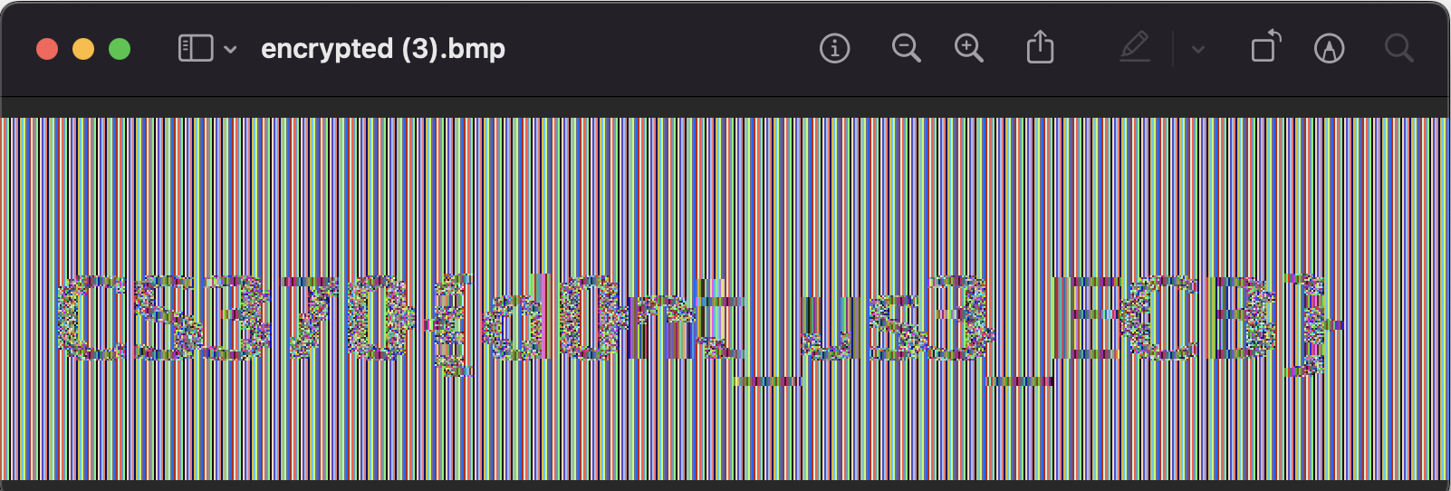
Recap: Electronic Code Book
Can encrypt in parallel
Can decrypt in parallel
Ciphertext block leaks plaintext block patterns

Slide 7
Recap: Cipher Block Chain (CBC)
Apply XOR between the IV (Initialization Vector) and the plaintext
Chain the previous ciphertext block to the plaintext with XOR
Run Encryption on Xor’ed data
IV ⊕ P0
C0 ⊕ P1
C1 ⊕ P2
C2 ⊕ P3
IV
0000000000000
P0
0000000000001
P1
0000000000000
P2
0000000000001
P3
⊕
⊕
⊕
⊕
101011101010
Block
Cipher
Block
Cipher
Block
Cipher
Block
Cipher
K
K
K
K
0101011101010
C0
1100011110101
C1
0001110111011
C2
1101011101110
C3

Slide 8
Recap: CBC Attack
A specific bit error in cipertext-n will be a specific bit error in plaintext-(n+1)
0101011101010
C0
1100011110101
C1
0001110111011
C2
1101011101110
C3
Block
Cipher⁻¹
Block
Cipher⁻¹
Block
Cipher⁻¹
Block
Cipher⁻¹
K
K
K
K
IV
⊕
⊕
⊕
⊕
101011101010
0000000000000
0000000000001
0000000000000
0000000000001
P0 = IV ⊕ D0
P1 = C0 ⊕ D1
P2 = C1 ⊕ D2
P3 = C2 ⊕ D3

Slide 9
Recap: CBC Attack
A specific bit error in cipertext-n will be a specific bit error in plaintext-(n+1)
0101011101010
C0
1100010110101
C1
0001110111011
C2
1101011101110
C3
Block
Cipher⁻¹
Block
Cipher⁻¹
Block
Cipher⁻¹
Block
Cipher⁻¹
K
K
K
K
IV
⊕
⊕
⊕
⊕
101011101010
0000000000000
0000000000001
0000001000000
0000000000001
P0 = IV ⊕ D0
P1 = C0 ⊕ D1
P2 = C1 ⊕ D2
P3 = C2 ⊕ D3

Slide 10
Recap: CBC Attack
A specific bit error in cipertext-n will be a specific bit error in plaintext-(n+1)
0101011101010
C0
1100000000101
C1
0001110111011
C2
1101011101110
C3
Block
Cipher⁻¹
Block
Cipher⁻¹
Block
Cipher⁻¹
Block
Cipher⁻¹
K
K
K
K
IV
⊕
⊕
⊕
⊕
101011101010
0000000000000
0000000000001
0000011110000
0000000000001
P0 = IV ⊕ D0
P1 = C0 ⊕ D1
P2 = C1 ⊕ D2
P3 = C2 ⊕ D3

Slide 11
Recap: Counter Mode (CTR)
CTR (Counter mode)
Start with a random nonce || counter
Nonce
3a88dff8
Nonce || 1
Nonce || 2
Nonce || 3
Nonce || 4
3a88dff8000001
3a88dff8000002
3a88dff8000003
3a88dff8000004
Block
Cipher
Block
Cipher
Block
Cipher
Block
Cipher
K
K
K
K
0101011101010
1100011110101
0001110111011
1101011101110
⊕
⊕
⊕
⊕
uid = 0
notadministrato
passwordpassw
The sky is blue,
0010101110101
110111101101
001110101011
1101111101111

Slide 12
Recap: CTR Attack
A specific bit error in cipertext-n will be a specific bit error in plaintext-n
Nonce
3a88dff8
Nonce || 1
Nonce || 2
Nonce || 3
Nonce || 4
3a88dff8000001
3a88dff8000002
3a88dff8000003
3a88dff8000004
Block
Cipher
Block
Cipher
Block
Cipher
Block
Cipher
K
K
K
K
0101011101010
1100011110101
0001110111011
1101011101110
⊕
⊕
⊕
⊕
0010101110101
110111101101
001110101011
1101111101111
0000000000000
notadministrato
passwordpassw
The sky is blue,

Slide 13
Recap: CTR Attack
A specific bit error in cipertext-n will be a specific bit error in plaintext-n
Nonce
3a88dff8
Nonce || 1
Nonce || 2
Nonce || 3
Nonce || 4
3a88dff8000001
3a88dff8000002
3a88dff8000003
3a88dff8000004
Block
Cipher
Block
Cipher
Block
Cipher
Block
Cipher
K
K
K
K
0101011101010
1100011110101
0001110111011
1101011101110
⊕
⊕
⊕
⊕
0010101110100
110111101101
001110101011
1101111101111
0000000000001
notadministrato
passwordpassw
The sky is blue,

Slide 14
Block Cipher
The block cipher itself cannot protect encrypted data modified by attackers
ECB, we can substitute blocks to known-plaintext-encrypted-block
CBC, we can apply XOR to the ciphertext that is one-block before the plaintext
CTR, we can apply XOR to the ciphertext then the result will show on the plaintext
Why?
Block Cipher gives us data confidentiality
Not data integrity

Slide 15
ecb-, cbc-, ctr-attack
Threat model
We have a verifier with the secret key
We have an encrypted user data, encrypted.user
We don’t have the key -> cannot arbitrarily generate valid encrypted file
What can we do?
Edit the ciphertext in encrypted.user
What can we achieve?
Change the plaintext at our own will

Slide 16
ecb-, cbc-, ctr-attack
Threat model
We have a verifier with the secret key
We have an encrypted user data, encrypted.user
We don’t have the key
What can we do?
Edit the ciphertext in encrypted.user <- dangerous
What can we achieve?
Change the plaintext at our own will

Slide 17
Is there any cryptographic tool that we can check the integrity of data?
What we have
Encrypted data, e.g.,
encrypted.user
What we want
Detect if the attacker has modified the file encrypted.user
What tool can we use?
Cryptographic hash!

Slide 18
An Ideal Hash Function
Suppose we have a function f(x) that
Generates a fixed length message (e.g., 32-byte)
You cannot get easily get f⁻¹(y) = x from y
A slight value change in x for f(x) = y will result in drastic change in y
So you cannot correlate any f(x’) = y’ from f(x) = y
What I will do:
f(“secret-key” + encrypted_data) = message_authentication_code

Slide 19
Create a MAC (Message Authentication Code)
What I will do:
f(“secret-key” + encrypted_data) = message_authentication_code
MAC = f(“secret-key” + )
IV
Block 0
Block 1
Put this at the end
IV
Block 0
Block 1
MAC

Slide 20
Checking a MAC
When I read the encrypted data
MAC = f(“secret-key” + )
MAC should be equal to
IV
Block 0
Block 1
MAC
IV
Block 0
Block 1
MAC

Slide 21
What Attackers Can Do?
What if they edited data?
MAC’ = f(“secret-key” + )
MAC’ !=
Suppose we have a function f(x) that
A slight value change in x for f(x) = y will result in drastic change in y
IV
Block 0
Block 1
MAC
IV
Block 0
Block 1
MAC

Slide 22
They Can Generate Valid MAC if They know the key
What if they edited data?
MAC_X = f(“secret-key” + )
But they don’t know the secret key; can’t generate it
Suppose we have a function f(x) that
You cannot get easily get f⁻¹(y) = x from y
A slight value change in x for f(x) = y will result in drastic change in y
IV
Block 0
Block 1
MAC
IV
Block 0
Block 1
IV
Block 0
Block 1
MAC_X

Slide 23
Cryptographic Hash
A hash function that generates a fingerprint of a data
SHA256(‘Hello, world’) = 03675ac53ff9cd1535ccc7dfcdfa2c458c5218371f418dc136f2d19ac1fbe8a5
With characteristics of:
One-way function
Hard to find x for given y where H(x) = y
Hard to find x’ for given x,y where x != x’, H(x) = y and H(x’) = y

Slide 24
SHA256
Secure Hash Algorithm (SHA)
SHA256 is in the SHA2 standard
Input can be any length data
Output is 256-bit, 32-byte
SHA256 is a cryptographic hash function that
It is one-way function
SHA256(‘Hello, world’) = 03675ac53ff9cd1535ccc7dfcdfa2c458c5218371f418dc136f2d19ac1fbe8a5
SHA256⁻¹(03675ac53ff9cd1535ccc7dfcdfa2c458c5218371f418 dc136f2d19ac1fbe8a5) == ???? there could be many..

Slide 25
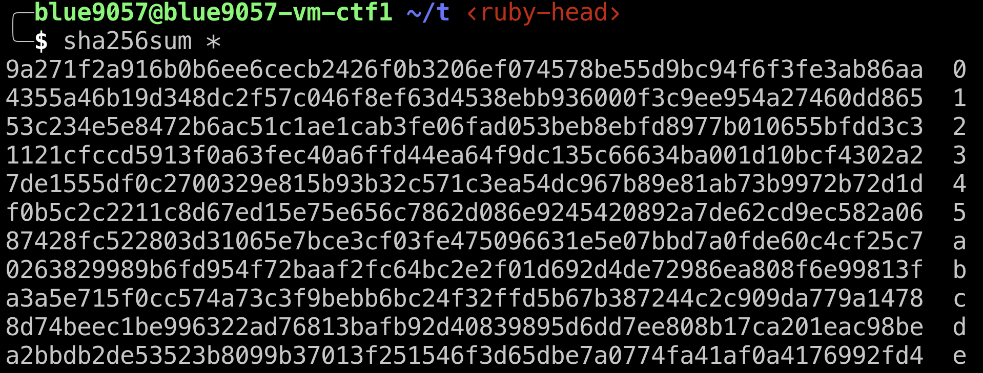
SHA256 Examples

Slide 26
SHA256
SHA256 is a cryptographic hash function that
Hard to find x for given y where H(x) = y
Find SHA256(x) for
00000000000000000000000000000000000000000f418dc136f2d19ac1fbe8a5
This task requires around the 2²⁵⁶ times of search…
Implication
If we know X, it is easy to get SHA256(X) = Y
But if we don’t know X, even if we know Y, it is hard to calculate X

Slide 27
SHA256
SHA256 is a cryptographic hash function that
Hard to find x’ for given x,y where x’ != x, H(x) = y, H(x’) = H(x)
SHA256(‘Hello, world’) = 03675ac53ff9cd1535ccc7dfcdfa2c458c5218371f418dc136f2d19ac1fbe8a5
Can you find another x’ that produces SHA256(x’) =
03675ac53ff9cd1535ccc7dfcdfa2c458c5218371f418dc136f2d19ac1fbe8a5
Other than ‘Hello, world’?
Implication
Even if we know X, Y where SHA256(X) = Y
It is hard to find SHA256(X’) = Y

Slide 28
Avalanche Effect
Even with a slight change in input, we want to have a huge change in output to not making attackers correlate output values based on their inputs…

Slide 29
Cryptographic Hash: Implications
SHA256 is a cryptographic hash that is included in the SHA2 standard
SHA256 is a one-way function and
It is hard to calculate x from y
where y = SHA256(x)
It is hard to calculate x’ from x,y
where x’ != x, SHA256(x) = y, SHA256(x’) = y
It is hard to correlate x and x’ from x, y, y’
where SHA256(x) = y, SHA256(x’) = y’

Slide 30
Cryptographic Hash: Implications
Hard to find inverse, so it is
H(“secret” + message) = hash
Hard to find the “secret” from hash
Hard to generate a valid hash without knowing the secret
From given M, h where H (“secret” + M) = h
H (“secret” + M’) = h’ without knowing the “secret”

Slide 31
How can we use this?
Hash-based Message Authentication Code (HMAC)
H = a hash function (e.g., SHA256)
HMAC = H(H(K) || M)
K: secret key
H(K): hash of the key
M: message or data

Slide 32
Encrypt Data with CBC
CBC Data (32-byte blocks)
Suppose you have a hash key = ‘asdf’
HMAC = SHA256( SHA256(‘asdf’) || encrypted_data )
= 7624e1f89ce009f8ec7e6e39781a42c0a27fa38f94db4f05f78b0f301007e06a
IV
Block 0
Block 1
IV
Block 0
Block 1
HMAC (key || IV+Block0+Block1)

Slide 33

Workflow
I encrypt data
& added HMAC!
HMAC(key||0000)
0000
HMAC

Slide 34

Workflow
I encrypt data
& added HMAC!
HMAC(key||0000)
0000
HMAC
Edit data…

Slide 35
Workflow
I encrypt data
& added HMAC!
HMAC(K||0000)
1001
HMAC
Edit data…

Slide 36
Workflow
1001
HMAC
Edit data…
Want to check if
H(K||Data) = HMAC

Slide 37
Workflow
I encrypt data
& added HMAC!
HMAC(K||0000)
1001
HMAC
Edit data…
Want to check if
H(K||Data) = HMAC
1001
H( K || 1001) !=
H( K || 0000)

Slide 38
Workflow
1001
HMAC
Edit data…
Want to check if
H(K||Data) = HMAC
1001
H( K || 1001) !=
H( K || 0000)
Reject!

Slide 39
Decrypt Data with CBC
Suppose you have a hash key = ‘asdf’
HMAC = SHA256( SHA256(‘asdf’) || encrypted_data )
= 7624e1f89ce009f8ec7e6e39781a42c0a27fa38f94db4f05f78b0f301007e06a
Suppose the attacker changed the encrypted_data
HMAC = SHA256( SHA256(‘asdf’) || encrypted_data )
= 389205904d6c7bb83fc676513911226f2be25bf1465616bb9b29587100ab1414
Mismatch with HMAC!
IV
Block 0
Block 1
HMAC (key || IV+Block0+Block1)

Slide 40
Cannot edit data because we have HMAC
Then, can attacker edit HMAC to match that to the edited ciphertext?
HMAC = SHA256( SHA256(‘key’) || edited_data)
Attackers don’t know the key
That’s why we need to use key to SHA256.
Otherwise, anyone can generate valid MAC!
Even they know SHA256(SHA256(‘key’)|| encrypted_data)
They cannot generate a valid HMAC
They cannot correlate that value from this one…

Slide 41
Summary
Block Cipher modes lets attacker play with ciphertext freely
They cannot be secure as we proved in challenges
That’s because Block Cipher protects only the data confidentiality
Data Integrity left unprotected
To protect data integrity, we can use cryptographic hash function
One way, it is hard to find an inverse of the result…
HMAC, running cryptographic hash function with key on the data can protect data integrity…

Slide 42
Summary
Encrypt-then-MAC
This is the only secure composition of using MAC with Encrypted data
You must
Encrypt the data, and supply the entire encrypted data to HMAC
No MAC-then-encrypt
Cryptanalysis exists (proven to be insecure)
Encrypted data
HMAC: H(H(key)||Encrypted data)

Slide 43
Public (Asymmetric) Key Cryptography
There is a scheme that we use different key to encryption and decryption
Why is it important? We will discuss this later about the ‘key exchange’
RSA (Rivest, Shamir, Adleman)
A public-key cryptography algorithm
Based on the difficulty of prime factorization
i.e., if the prime factorization of a large prime number is difficult, then the cryptography scheme is secure
Can be used for digital signature

Slide 44
How RSA Works?
Choose two large prime number, p and q
N = pq
φ = (p-1)(q-1)
Choose public key, say, e = 65537 (a prime), that is coprime to φ
Find de == 1 (mod φ)
d can be efficiently be computed if you know φ
Blue: public key, Red: private key
Attackers don’t know φ, to know φ, you need to factor N

Slide 45
RSA Encryption
Public key: e, N
Message: M
Me mod N

Slide 46
RSA Decryption
Private key: d
Public key: e N
Ciphertext = C = Me
ed = 1
C^{d} mod N
(Me)^{d}mod N
M^{ed} mod N
M mod N

Slide 47
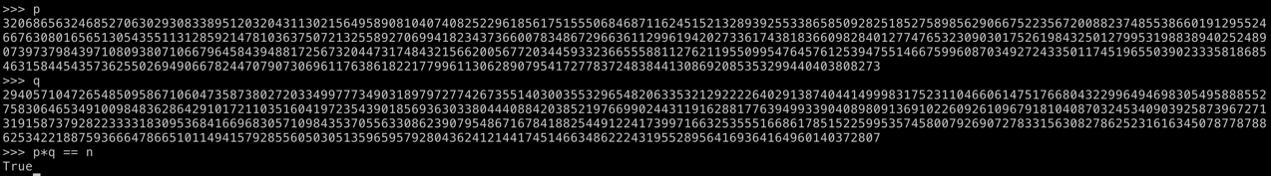
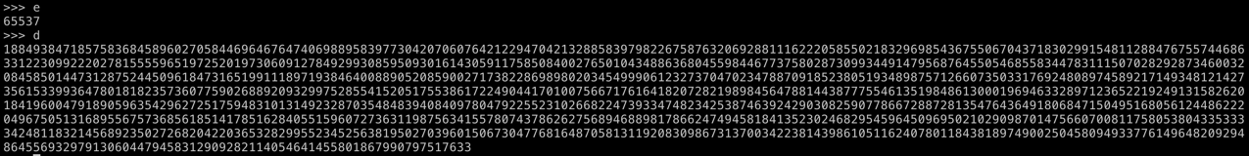
In reality: RSA-4096
N
pq = N
e,d

Slide 48
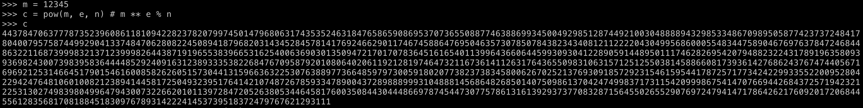
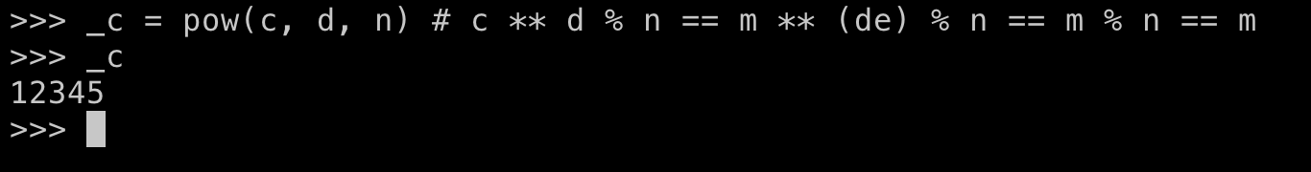
In reality: RSA-4096
Encryption
Decryption

Slide 49
Public Key Cryptography
We can use separate key for encryption and decryption
Encryption key: public key (e, N)
Decryption key: private key (d)
Attackers cannot guess the private key from the public key
In RSA, attacker must factor the prime number N = pq
In creating the key, we choose p and q as a big prime number
Factoring a multiplication of two big prime numbers is a difficult task

Slide 50
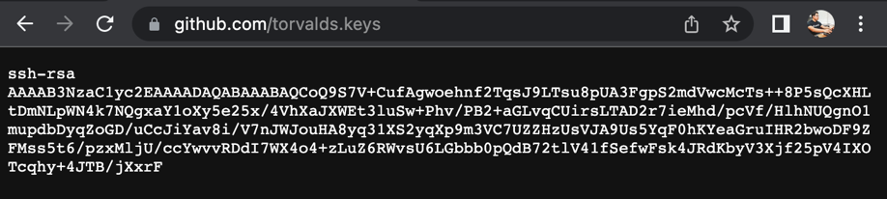
Characteristics
We use a public key for encryption
We can publicize this key
If you publish your key, anyone who can access that can encrypt message
(e, N) is public, m^{e} mod N!
Only the holder of the private key can decrypt the message
d is private, m^{ed} == m¹ == m (mod N)
Why is this important?
Let’s talk about the key exchange problem

Slide 51
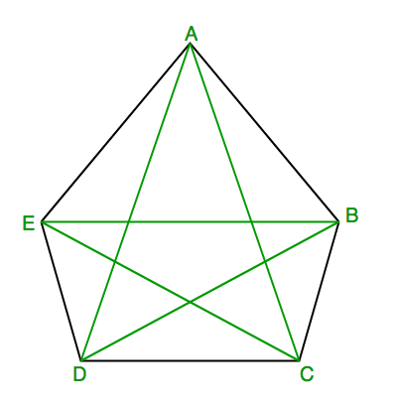
Key Exchange
Suppose we have 5 people, A, B, C, D, E
How many keys do we need to have to make them communicate securely?
E.g., if A talks to B, C or others must not see the message
But anyone should be able to talk to anyone…
A block cipher
We need 1 key for A and B can talk securely
How many keys do we need to let them communicate securely?
A-B, A-C, A-D, A-E
B-C, B-D, B-E
C-D, C-E
D-E
10 keys (5*4/2 = 10)

Slide 52
Symmetric Key Cryptography
Encryption and the decryption operations are using the same key
Block Cipher – encryption key == decryption key
You cannot share that other than 2 people
Key exchange complexity
We need 1 key per each pair of people
N (N – 1) / 2
O(N²)

Slide 53
Asymmetric Key Cryptography
Can we use a different key for the encryption and decryption?
K = k1, k2
Enc(k1, M) = C, Dec(k2, C) = M?
Preferably, can we publish the encryption key to public?
While keeping the decryption key secret
Then we need O(N) keys
Each member’s public key, that’s it.

Slide 54
Why O(N)?
We need O(N²) keys for symmetric encryption

Slide 55
Why O(N)?
Suppose each will generate public and private key
Public_A, Private_A
Public_B, Private_B
Public_C, Private_C
Public_D, Private_D
Public_E, Private_E

Slide 56
Why O(N)?
Each will have their own private key, and then,
publish all their public keys
A: Private_A
B: Private_B
C: Private_C
D: Private_D
E: Private_E
Public keys: Public_A, Public_B, Public_C, Public_D, Public_E

Slide 57
Can A Send an Encrypted message to B?
Can A send an encrypted message to B?
Yes, encrypt data using Public_B; only B (holder of Private_B) can decrypt it
Can C send an encrypted message to E?
Yes, encrypt data using Public_E; only E (holder of Private_E) can decrypt it
Can X send an encrypted message to Y?
Yes, if X knows the public key of Y
We only need to know the receiver’s public key
Sender does not matter, that’s why we have O(N)
Suppose we have N = 200, we need 19900 keys in symmetric, and we need 400 keys for asymmetric

Slide 58
RSA: Digital Signature
RSA can be used as a digital signature scheme
What is that?
In RSA, encryption is applying the public exponent to the message
Me mod N
In RSA, decryption is applying the private exponent to the message
C^{d} mod N

Slide 59
RSA: What will be the meaning of private encrypt?
Suppose A encrypts the following message with her private key
“I would like to donate $100 to OSU if I get A from CS 370”
M = 53151406333611257093956293411584759988053228938724427101859883089254119711739486837784167497839141764612450119856395995171455585519613744
C = m^{d} mod N

Slide 60
RSA: What will be the meaning of private encrypt?
M = 53151406333611257093956293411584759988053228938724427101859883089254119711739486837784167497839141764612450119856395995171455585519613744
C = m^{d} mod N
Anyone can have e. That means, anyone can decrypt C
Ce == m^{de} == m¹ == m (mod N)

Slide 61
RSA: What will be the meaning of private encrypt?
M = 53151406333611257093956293411584759988053228938724427101859883089254119711739486837784167497839141764612450119856395995171455585519613744
C = m^{d} mod N
Anyone can have e. That means, anyone can decrypt C
Ce == m^{de} == m¹ == m (mod N)
m = 53151406333611257093956293411584759988053228938724427101859883089254119711739486837784167497839141764612450119856395995171455585519613744
"I would like to donate $100 to OSU if I get A from CS 370"

Slide 62
RSA: What will be the meaning of private encrypt?
We can verify that the encrypted content C contains
The ciphertext that only the holder of private key can generate.
We all have public key, and if that is decrypted to
"I would like to donate $100 to OSU if I get A from CS 370”,
then, we know that the holder of private key ‘endorsed it’
M = 53151406333611257093956293411584759988053228938724427101859883089254119711739486837784167497839141764612450119856395995171455585519613744
C = m^{d} mod N
Anyone can have e. That means, anyone can decrypt C
Ce == m^{de} == m¹ == m (mod N)
m = 53151406333611257093956293411584759988053228938724427101859883089254119711739486837784167497839141764612450119856395995171455585519613744
"I would like to donate $100 to OSU if I get A from CS 370"

Slide 63
RSA: private_encrypt
RSA Encryption using the private key is so-called as ‘Signing’
Why?
The ciphertext will be decrypted as a plaintext using the public key
Anyone can decrypt!
But the ciphertext can only be generated with the private key
Only the private key owner can generate it!
Implication
Holder of the private key generated a ciphertext message of message M
M is signed, endorsed by the holder’s private key
(Because it can only be generated with the private key)

Slide 64
RSA Summary
Public/Private key Scheme
We can publish the public key – encryption key
We must hide the private key – decryption key
Based on the difficulty of prime factorization
You cannot correlate the private key from the public key unless
You can factor a big number (a multiple of 2 big prime numbers)
Anyone can encrypt message to the private key owner
Enc(public_key, message)
Only the private key owner can decrypt message
Dec(private_key, encrypted_message)

Slide 65
RSA Summary
Encryption with private key could be a ‘digital-signature’
Signed_message = Enc(private_key, message)
Message = Dec(public_key, signed_message)
The correctly decrypted message using public key means that the private key holder have endorsed (‘encrypted’) the data
Anyone can verify this using the public key

Slide 66
Symmetric vs. Asymmetric
Can we use symmetric key as digital signature?
A-B, A-C, A-D, A-E
B-C, B-D, B-E
C-D, C-E
D-E
If a message was encrypted with key D-E
Then either D or E generated the message -> ambiguity
Only D or E can verify that -> result is not public
They must leak the key D-E for verification -> key need to be leaked to verify

Slide 67
Symmetric vs. Asymmetric
In asymmetric key scheme
Public_A, Private_A
Public_B, Private_B
Public_C, Private_C
Public_D, Private_D
Public_E, Private_E
If a message was encrypted with Private_D
We can decrypt the data using Public_D -> generated by D -> not ambiguous
Anyone can verify this -> result is public
Does not need to leak the private key -> don’t leak the key for verification

