Slide 1
CS 370 Introduction to Security
Digital Certificates, PKI, and Diffie-Hellman Key Exchange
Yeongjin Jang

Slide 2
We Will have Asynchronous Lecture on 10/13 and 10/18
We will have Quiz 1 on 10/20
We will have Quiz Prep video on 10/18
We will have video (asynchronous, no in-person/synchronous lecture)
On 10/13
SSL/TLS

Slide 3
Recap: Block Cipher
The block cipher itself cannot protect encrypted data modified by attackers
ECB, we can substitute blocks to known-plaintext-encrypted-block
CBC, we can apply XOR to the ciphertext that is one-block before the plaintext
CTR, we can apply XOR to the ciphertext then the result will show on the plaintext
Why?
Block Cipher gives us data confidentiality
Not data integrity

Slide 4
Recap: Create a MAC (Message Authentication Code)
What I will do:
f(“secret-key” + encrypted_data) = message_authentication_code
MAC = f(“secret-key” + )
IV
Block 0
Block 1
Put this at the end
IV
Block 0
Block 1
MAC

Slide 5
Recap: Checking a MAC
When I read the encrypted data
MAC = f(“secret-key” + )
MAC should be equal to
IV
Block 0
Block 1
MAC
IV
Block 0
Block 1
MAC

Slide 6
Recap: What Attackers Can Do?
What if they edited data?
MAC’ = f(“secret-key” + )
MAC’ !=
Suppose we have a function f(x) that
A slight value change in x for f(x) = y will result in drastic change in y
IV
Block 0
Block 1
MAC
IV
Block 0
Block 1
MAC

Slide 7
Recap: Decrypt Data with CBC
Suppose you have a hash key = ‘asdf’
HMAC = SHA256( SHA256(‘asdf’) || encrypted_data )
= 7624e1f89ce009f8ec7e6e39781a42c0a27fa38f94db4f05f78b0f301007e06a
Suppose the attacker changed the encrypted_data
HMAC = SHA256( SHA256(‘asdf’) || encrypted_data )
= 389205904d6c7bb83fc676513911226f2be25bf1465616bb9b29587100ab1414
Mismatch with HMAC!
IV
Block 0
Block 1
HMAC (key || IV+Block0+Block1)

Slide 8
Recap: HMAC
Block Cipher modes lets attacker play with ciphertext freely
They cannot be secure as we proved in challenges
That’s because Block Cipher protects only the data confidentiality
Data Integrity left unprotected
To protect data integrity, we can use cryptographic hash function
One way, it is hard to find an inverse of the result…
HMAC, running cryptographic hash function with key on the data can protect data integrity…

Slide 9
Recap: RSA Summary
Public/Private key Scheme
We can publish the public key – encryption key
We must hide the private key – decryption key
Based on the difficulty of prime factorization
You cannot correlate the private key from the public key unless
You can factor a big number (a multiple of 2 big prime numbers)
Anyone can encrypt message to the private key owner
Enc(public_key, message)
Only the private key owner can decrypt message
Dec(private_key, encrypted_message)

Slide 10
Recap: RSA Summary
Encryption with private key could be a ‘digital-signature’
Signed_message = Enc(private_key, message)
Message = Dec(public_key, signed_message)
The correctly decrypted message using public key means that the private key holder have endorsed (‘encrypted’) the data
Anyone can verify this using the public key

Slide 11
Topic for Today
Digital Certificate
Use RSA as a digital signature algorithm
Proves the authenticity of the data (authentication)
Diffie-Hellman (DH) Key exchange algorithm
An algorithm to securely exchange a shared secret
The shared secret can later be used as a key for block cipher
i.e., key exchange using DH, and then, use AES-256 with the shared key
How can we make the Internet communication secure?
Digital Signature (authenticity)
Key Exchange
Block Cipher (confidentiality)
HMAC (integrity)

Slide 12
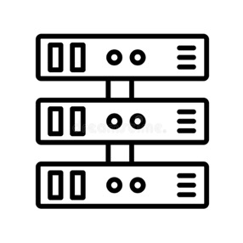


Digital Certificate
The need
Suppose the oregonstate.edu server has the public/private key
You want to connect to the website securely
Confidentiality: comes from the Block Cipher that we will use
Integrity: comes from HMAC
Where’s authenticity?
How do you know the other end is oregonstate.edu?
Plaintext
IV
Ciphertext with padding
HMAC

Slide 13
Authenticity
Can we check the other end is the one that we want to talk with?
Hey, are you oregonstate.edu?
Yes, I am oregonstate.edu!
Is there any way that we can reliably check
the other end’s authenticity?

Slide 14

Authenticity
Can we check the other end is the one that we want to talk with?
Hey, are you oregonstate.edu?
Yes, I am oregonstate.edu!
Is there any way that we can reliably check
the other end’s authenticity?

Slide 15
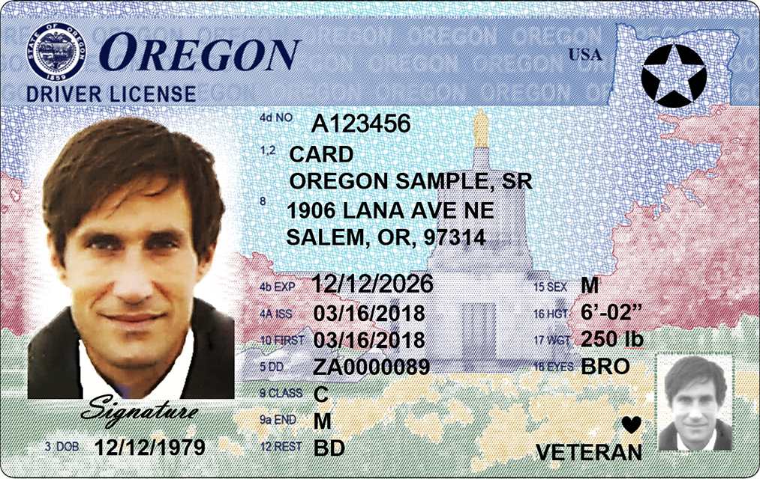



Authenticity
Can we check the other end is the one that we want to talk with?
www.oregonstate.edu
0x83823787832a87b876e67fe67e6da
Hey, are you Google?
Yes, I am!

Slide 16
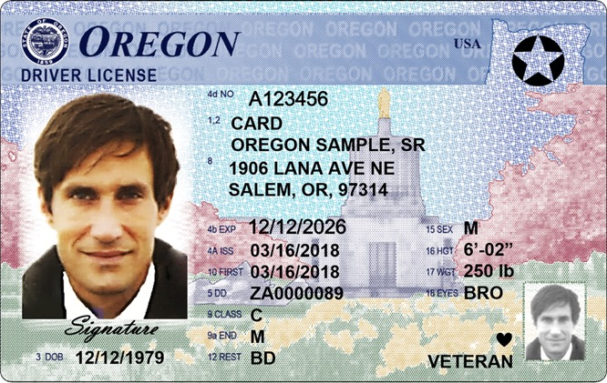


Public Key Infrastructure (PKI)
We need an identification method for the key and the real entity
We need an online ID card for crypto keys…
With RSA, we can use public key cryptosystem
We can announce the public key
Let anyone can access and verify it
How?
Where can we publish this and verify it?
PKI resolves the problem…
www.oregonstate.edu
0x83823787832a87b876
e67fe67e6da

Slide 17
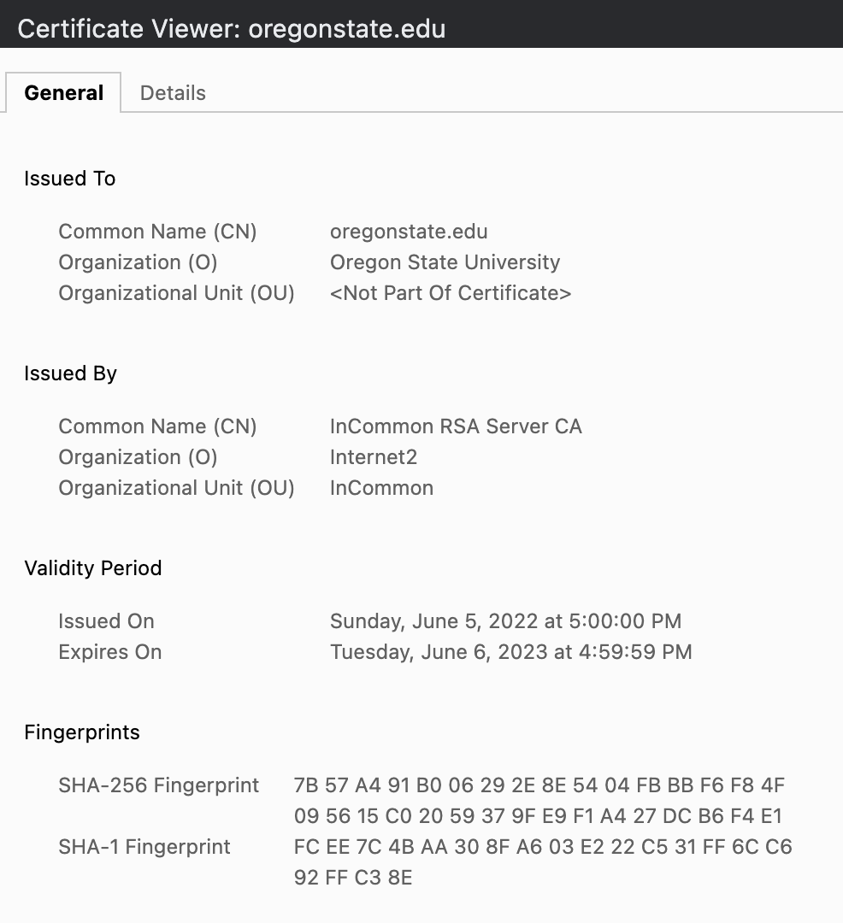
Digital Certificate
A file that contains
Entity info (CN)
Issuer info (CN)
Public key
Signature

Slide 18
Creating a Digital Certificate
1. Requester prepares a certificate request
Entity information
Public key
Signature (proving that I have the public key)
Certificate
CN: oregonstate.edu
Will use for:
*.oregonstate.edu
Public Key: 0x112233445566778899aabbccddeeff….
(beaver’s public key)
Signature: 0xaabbccddeeff00112233445566778899
(using beaver’s private key)

Slide 19
Creating a Digital Certificate
1. Requester prepares a certificate request
Entity information
Public key
Signature (proving that I have the public key)
Certificate
CN: oregonstate.edu
Will use for:
*.oregonstate.edu
Public Key: 0x112233445566778899aabbccddeeff….
(beaver’s public key)
Signature: 0xaabbccddeeff00112233445566778899
(using beaver’s private key)
Get SHA256 sum of this part
Sign it with the private key

Slide 20
Creating a Digital Certificate
1. Requester prepares a certificate request
Entity information
Public key
2. Issuer verifies the requester information, and digitally sign the cert
1) Verify the entity information
2) Get a SHA-256 fingerprint of the certificate
3) Sign the fingerprint (with issuer’s private key)
RSA_encrypt(private_key, SHA-256(certificate))

Slide 21
Creating a Digital Certificate
2. Issuer verifies the requester information, and digitally sign the cert
1) Verify the entity information
2) Get a SHA-256 fingerprint of the certificate
3) Sign the fingerprint (with issuer’s private key)
RSA_encrypt(private_key, SHA-256(certificate))
Certificate
CN: oregonstate.edu
Will use for:
*.oregonstate.edu
Public Key: 0x112233445566778899aabbccddeeff….
(beaver’s public key)
Signature: 0xffeeddccbbaa00112233445566778899
(with Issuer’s private key)
Get SHA256 sum of this part
Sign it with the private key

Slide 22
Creating a Digital Certificate
1. Requester prepares a certificate request
Entity information
Public key
2. Issuer verifies the requester information, and digitally sign the cert
1) Verify the entity information
2) Get a SHA-256 fingerprint of the certificate
3) Sign the fingerprint (with issuer’s private key)
RSA_encrypt(private_key, SHA-256(certificate))
3. Anyone with the public key can verify the result
Get issuer’s public key from their certificate

Slide 23

Digital Certificate Creation Step 1
The certificate requesting entity fills
Entity information
Public Key
Entity can be anyone
For google, its *.google.com
Can be your website address
*.unexploitable.systems
also has a certificate
CN = oregonstate.edu
Certificate
CN: oregonstate.edu
Will use for:
*.oregonstate.edu
Public Key: 0x112233445566778899aabbccddeeff….
(beaver’s public key)
Signature: 0xaabbccddeeff00112233445566778899
(with beaver’s private key)

Slide 24
Digital Certificate Creation Step 2
The issuer receives the certificate request
Verifies the entity for
Their identification
Owning the target domain name
Owning the public key
Verify the signature
Decrypt the signature with public key
It must be the same as SHA256 sum
Verification proves holding of the private key
CN = oregonstate.edu
Certificate
CN: oregonstate.edu
Will use for:
*.oregonstate.edu
Public Key: 0x112233445566778899aabbccddeeff….
(beaver’s public key)
Signature: 0xaabbccddeeff00112233445566778899
(with beaver’s private key)

Slide 25

Digital Certificate Creation Step 2
The issuer receives the certificate request
Verifies the entity for
Their identification
Owning the target domain name
etc…
Then, fill issuer information
Issuer information
Issuer public key
CN = oregonstate.edu
Certificate
CN: oregonstate.edu
Will use for:
*.oregonstate.edu
Public Key: 0x112233445566778899aabbccddeeff….
(beaver’s public key)
Issuer: InCommon RSA
Public Key: 0x22334455667788990011aabbccddeeff

Slide 26
Digital Certificate Creation Step 2
The issuer receives the certificate request
Verifies the entity for
Their identification
Owning the target domain name
etc…
Then, fill issuer information
Issuer information
Issuer public key
And then, sign the certificate
Get SHA-256 fingerprint of the certificate
Attach it as a signature!
CN = oregonstate.edu
Certificate
CN: oregonstate.edu
Will use for:
*.oregonstate.edu
Public Key: 0x112233445566778899aabbccddeeff….
(beaver’s public key)
Issuer: InCommon RSA
Public Key: 0x22334455667788990011aabbccddeeff
Signature: 0xffeeddccbbaa00112233445566778899
(InCommon RSA’s private key)

Slide 27
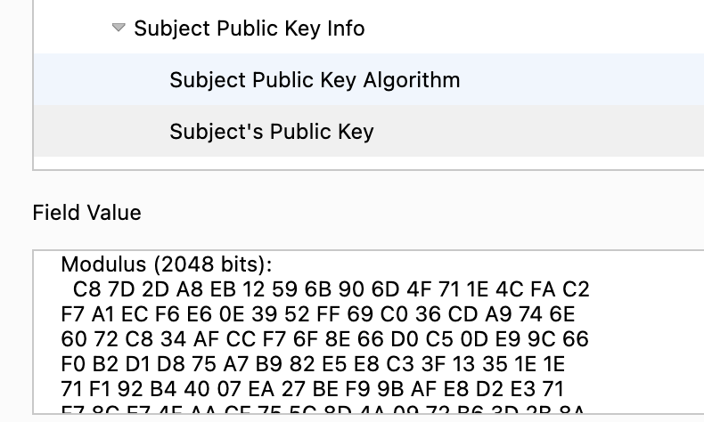
Issued Certificate
Now InCommon RSA verified
oregonstate.edu is owned by
Oregon State University
With a specific Public Key

Slide 28
Trust Chain
oregonstate.edu is owned by Oregon State University
Verified by InCommon RSA
We can verify the certificate using InCommon RSA’s public key
Where is it? It is written in InCommon RSA’s certificate
InCommon RSA, who will verify their identity?
oregonstate.edu was verified by InCommon RSA
Who will verify InCommon RSA?

Slide 29
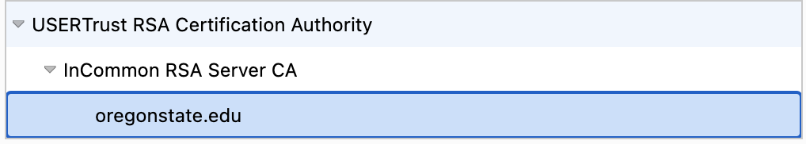
Trust Chain
oregonstate.edu
Verified by InCommon RSA Server CA
InCommon RSA Server CA
Verified by USERTrust RSA Certificate Authority
USERTrust RSA CA
Verified by self

Slide 30
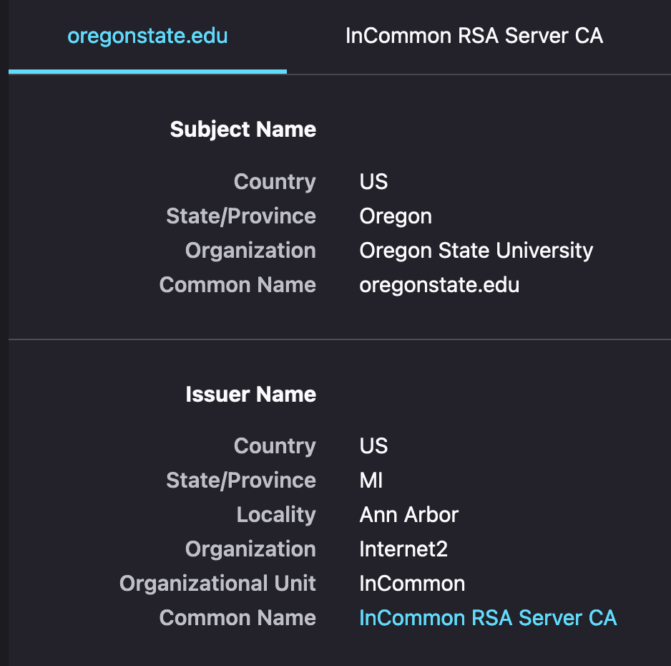
Trust Chain
oregonstate.edu
Verified by InCommon RSA Server CA
InCommon RSA Server CA
Verified by USERTrust RSA Certificate Authority
USERTrust RSA CA
Verified by self

Slide 31
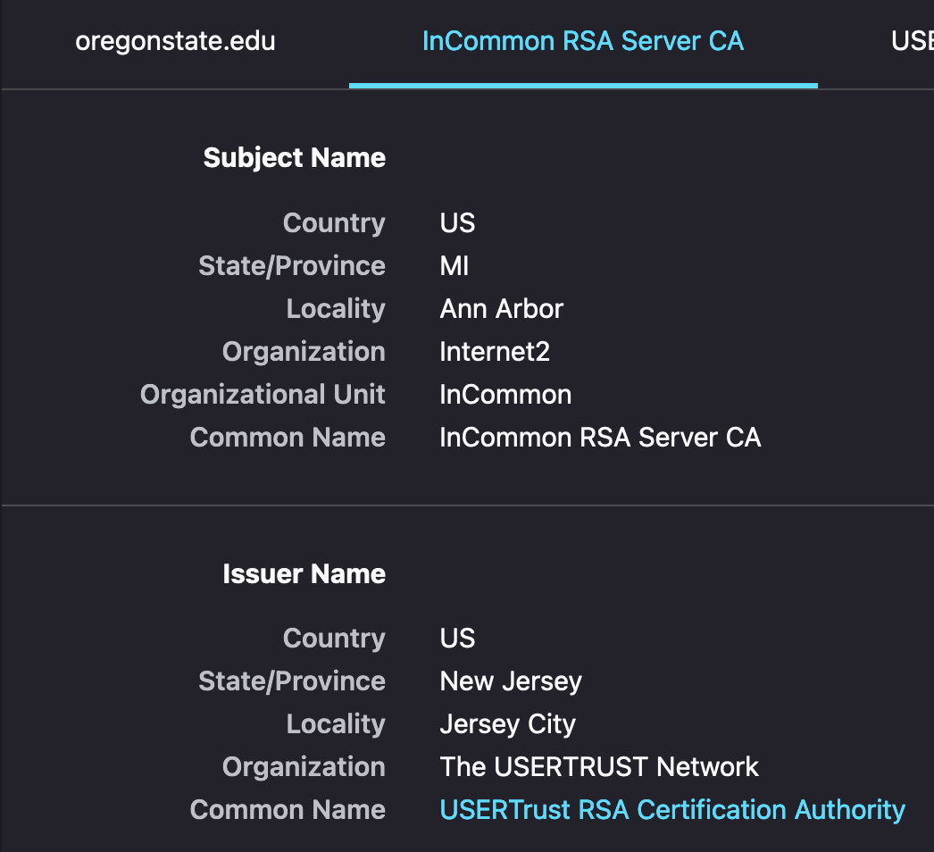
Trust Chain
oregonstate.edu
Verified by InCommon RSA Server CA
InCommon RSA Server CA
Verified by USERTrust RSA Certificate Authority
USERTrust RSA CA
Verified by self

Slide 32
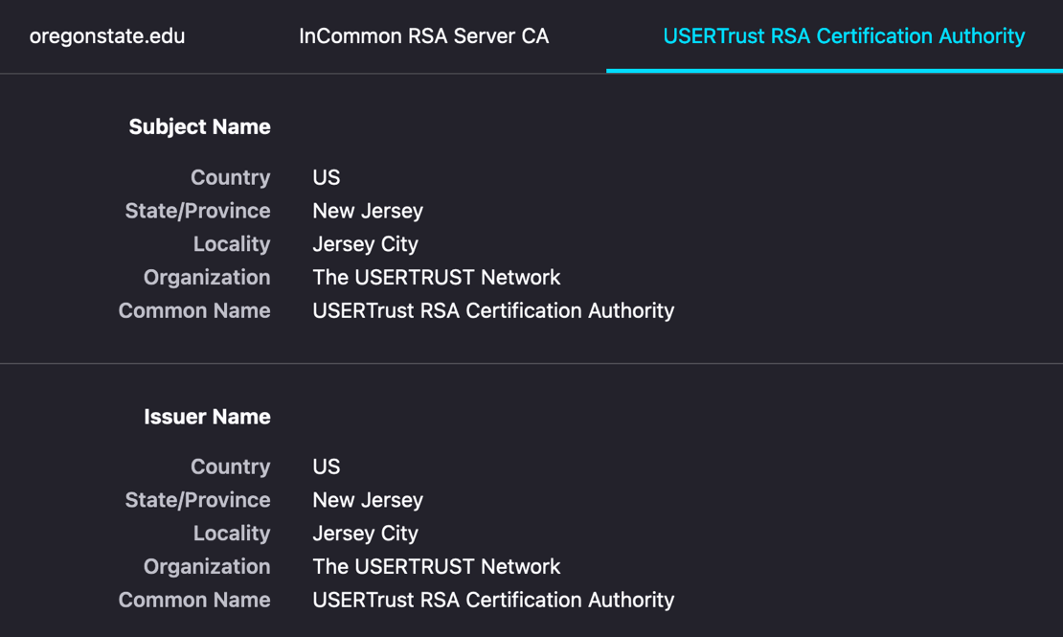
Trust Chain
oregonstate.edu
Verified by InCommon RSA Server CA
InCommon RSA Server CA
Verified by USERTrust RSA Certificate Authority
USERTrust RSA CA
Verified by itself

Slide 33
How Do We Verify Our Identity?
You as a
Student
Oregon resident
U.S. Citizen
When issuing the student ID
We verify your Oregon ID…

Slide 34
How Do We Verify Our Identity?
You as a
Student
Oregon resident
U.S. Citizen
When issuing the Oregon Driver’s License
We require either one of your birth certificate, previous Driver’s License, or U.S. passport

Slide 35
How Do We Verify Our Identity?
You as a
Student
Oregon resident
U.S. Citizen
When issuing the U.S. passport
We require your birth certificate or previously issued passport..

Slide 36
How Do We Verify Our Identity?
You as a
Student
Oregon resident
U.S. Citizen
When issuing the U.S. passport
We require your birth certificate or previously issued passport..
We need someone to verify the originality of the proving document…

Slide 37
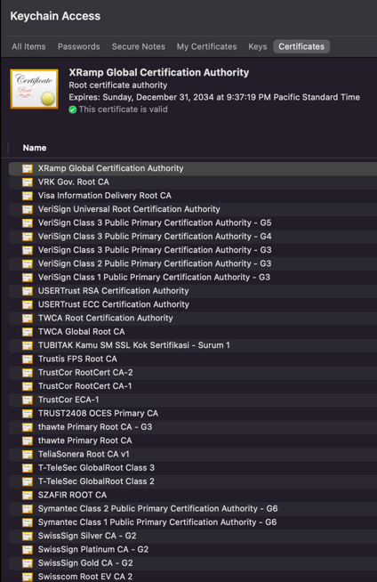
Root Certificate Authority (Root CA)
We define small set of trustworthy certificate authorities
Private companies are authorized by some jurisdiction to run the CA company
Google Trust Service (GTS CA)
DigiCert
Verisign
Etc..
We trust their self-signed certificate
Stored in almost every computer machines..

Slide 38
Public Key Infrastructure (PKI)
An Infrastructure that provides public key with certificate chain
Trust anchor: Root CA
We set a small set of entities use self-signed cert
Verify the certificate chain!
We must verify the entire chain
USERTrust
InCommon
oregonstate

Slide 39
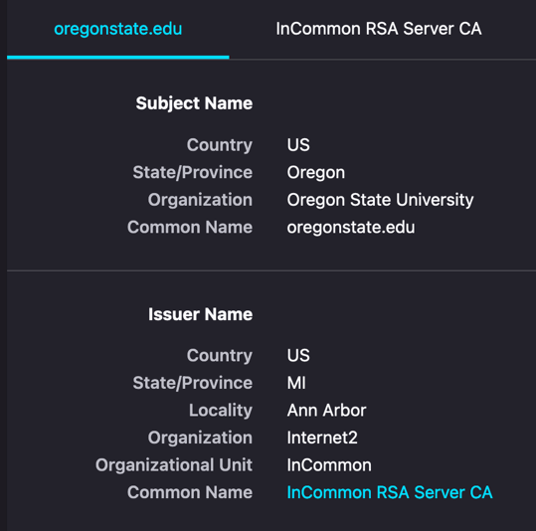
Trust Chain

Slide 40
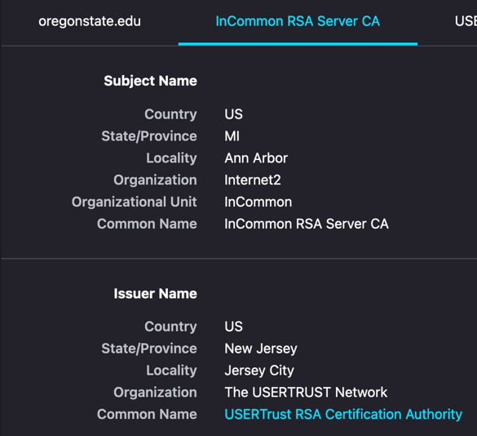
Trust Chain

Slide 41
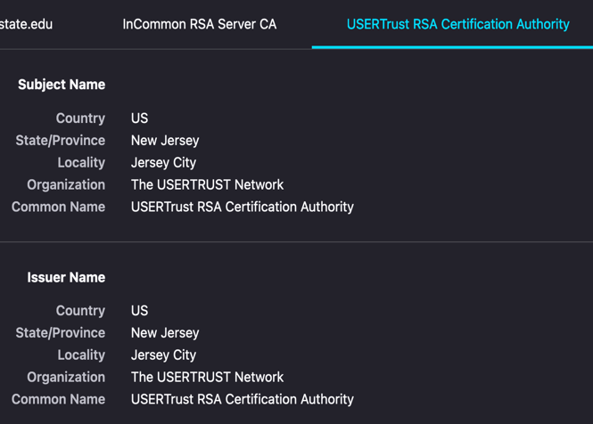
Trust Chain

Slide 42
How To Verify oregonstate.edu?
Using the digital certificate!
Hey, are you oregonstate.edu?
Give me your certificate

Slide 43



How To Verify oregonstate.edu?
Using the digital certificate!
Hey, are you oregonstate.edu?
Give me your certificate
Yes, I am oregonstate.edu!
Here’s my cert

Slide 44
How To Verify oregonstate.edu?
Using the digital certificate!
Hey, are you oregonstate.edu?
Give me your certificate
Yes, I am oregonstate.edu!
Here’s my cert
Oregonstate verified by InCommon RSA

Slide 45
How To Verify oregonstate.edu?
Using the digital certificate!
Hey, are you oregonstate.edu?
Give me your certificate
Yes, I am oregonstate.edu!
Here’s my cert
InCommon RSA verified by USERTrust RSA

Slide 46
How To Verify oregonstate.edu?
Using the digital certificate!
Hey, are you oregonstate.edu?
Give me your certificate
Yes, I am oregonstate.edu!
Here’s my cert
USERTrust RSA is self-verified (ROOT CA)

Slide 47
Summary
RSA encryption with private key can be used as digital signature
Only the private key holder can generate the message
Anyone with public key can verify this!
We use digital certificates to share public key information
Entity name, address, other information with
Public key!
Certificates are signed by other trustful entities
Verify the entity info and the public key, and then, sign the certificate!

Slide 48
Summary
A certificate need to be verified by other entity
That other entity is also need to be verified by…
Root CA is the list of trusted Certificate Authority
We accept their self-signed certificate
We must verify the entire certificate trust chain
oregonstate.edu -> InCommon RSA -> USERTrust RSA …

Slide 49
Diffie-Hellman Key Exchange
A method of securely exchanging cryptographic keys over
Public channel!
Based on the difficulty of mathematical problem of
Discrete logarithm
E.g., For given g, a, A, B where
gª mod p = A
g^{b} mod p = B
can you compute g^{ab} mod p?
Getting ab is difficult..

Slide 50
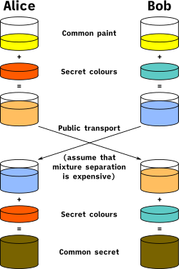
DH in Graphics
g, p
g, p
a
b
gª mod p
g^{b} mod p
g^{b} mod p
gª mod p
a
b
g^{ab} mod p
g^{ab} mod p

Slide 51
Diffie-Hellman Key Exchange
User A & User B agrees on g and p, where g and p are primes
User A secretly chooses a, send A = gª mod p
User B secretly chooses b, send B = g^{b} mod p
User A receives B, compute Bª = (g^{b})ª mod p = g^{ab} mod p
User B receives A, compute A^{b} = (gª)^{b} mod p = g^{ab} mod p
g^{ab} mod p is our secret

Slide 52
Diffie-Hellman Key Exchange
g^{ab} mod p is our secret
Attacker knows g, p, A = gª mod p and B = g^{b} mod p
A+B = (gª + g^{b}) mod p
AB = g^{(a+b)} mod p
Hard to compute g^{ab} from those values
Discrete logarithm; Can you get a from A = gª mod p

Slide 53
DH in Graphics
g, p
g, p
a
b
gª mod p
g^{b} mod p
g^{b} mod p
gª mod p
a
b
g^{ab} mod p
g^{ab} mod p

Slide 54
Example
g = 5, p = 23
A chooses a = 4
A = 5⁴ mod 23 = 625 mod 23 = 4
B chooses b = 3
B = 5³ mod 23 = 125 mod 23 = 10
B⁴ = 10⁴ mod 23 = 10000 mod 23 = 18
A³ = 4³ mod 23 = 64 mod 23 = 18
5^{(4*3)} = 5¹² mod 23 = 18

Slide 55
Diffie-Hellman Implications
Users are agreeing on two prime numbers
g, p
User A chooses any integer a, nobody knows it
User B chooses any integer b, nobody knows it
By sharing gª mod P and g^{b} mod p
Both shares g^{ab} mod P without leaking a nor b
Two entities can interactively share a secret without directly leaking the secrets to the others…

Slide 56


Diffie-Hellman Weakness: Man-in-the-middle Attack
Suppose A and B wants to share a secret
g = 5, p = 23
A chooses a = 4
A = 5⁴ mod 23 = 625 mod 23 = 4
B chooses b = 3
B = 5³ mod 23 = 125 mod 23 = 10
4
10

Slide 57
Diffie-Hellman Weakness: Man-in-the-middle Attack
Suppose C intercepts communication between A and B
A chooses a = 4
A = 5⁴ mod 23 = 625 mod 23 = 4
B chooses b = 3
B = 5³ mod 23 = 125 mod 23 = 10
C chooses c = 5
C = 55 mod 23 = 3125 mod 23 = 20
C sends 20 to both A and B
4
20
20
10

Slide 58
Diffie-Hellman Weakness: Man-in-the-middle Attack
A chooses a = 4
A = 5⁴ mod 23 = 625 mod 23 = 4
Cª = 20⁴ mod 23 = 160000 mod 23 = 12
C chooses c = 5
C = 5⁵ mod 23 = 3125 mod 23 = 20
A^{c} = 4⁵ mod 23 = 1024 mod 23 = 12
C shares a secret of 12 with A
4
20
20
10
Shared 12

Slide 59
Diffie-Hellman Weakness: Man-in-the-middle Attack
B chooses b = 3
B = 5³ mod 23 = 125 mod 23 = 10
C^{b} = 20³ mod 23 = 8000 mod 23 = 19
C chooses c = 5
C = 5⁵ mod 23 = 3125 mod 23 = 20
B^{c} = 10⁵ mod 23 = 100000 mod 23 = 19
C shares a secret of 19 with B
Shared 19
4
20
20
10
Shared 12

Slide 60
Diffie-Hellman Weakness: Man-in-the-middle Attack
Whenever A sends a message
Decrypt with 12, read it!
Encrypt with 19, send to B!
Whenever B sends a message
Decrypt with 19, read it!
Encrypt with 12, send to A!
Shared 19
4
20
20
10
Shared 12
Diffie-Hellman is susceptible to the
Man-in-the-middle attack!

Slide 61
How Can We Secure the Internet Communication?
Authentication
Get the certificate of each entity
Verify their public key
Using certificate trust chain!
Key-exchange
A computes gª mod p, and sign that with A’s private key
B computes g^{b} mod p, and sign that with B’s private key
Both can verify the identity of each and then share
g^{ab} mod p
Killed
Man-in-the-middle attack!

Slide 62
How Can We Secure the Internet Communication?
Confidentiality
Run SHA-256(‘cipher key’ + g^{ab} mod p)
Use that as the key for the block cipher
E.g., AES-256-CBC
Integrity
Run SHA-256(‘mac key’ + g^{ab} mod p)
Use that as the key for HMAC
IV
Ciphertext with padding
HMAC
A communication channel with
Authenticity
Confidentiality
Integrity
has been established!

Slide 63
Tutorials
raw-rsa
raw-dh

