Slide 1
CS 370 Introduction to Security
Quiz 1 Prep
Yeongjin Jang

Slide 2
Quiz 1 (10/20)
Released via CANVAS
You can see Quiz 1 at 8:30 am
Deadline: 10/21 11:59pm (opened for 2 days)
Duration: Unlimited, but you can finish it around 30 min
You will be given up to 3 attempts to take quiz
Open material; you may refer to
Contents at our course website: https://cs370.unexploitable.systems/cal.html
Slides
Lecture Videos
Your code for challenge assignments
Use python

Slide 3
Quiz 1 (10/20)
Released via CANVAS
You can see Quiz 1 at 8:30 am
Deadline: 10/21 11:59pm (opened for 2 days)
Duration: Unlimited, but you can finish it around 30 min
You will be given up to 3 attempts to take quiz
Open material; you may refer to
Contents at our course website: https://cs370.unexploitable.systems/cal.html
Slides
Lecture Videos
Your code for challenge assignments
Use python
Communicating with others during Quiz is
not allowed

Slide 4
Quiz 1 (10/20)
Question type: multiple choices, around 20 questions
1 pts per each question
All three weeks content will be covered in the Quiz 1
Traditional and XOR cipher
Block Cipher
Block Cipher Modes
HMAC (Hash-based message authentication code)
RSA and Asymmetric Encryption
PKI/Digital Certificates/Diffie--Hellman

Slide 5
Sample Question 1
Decipher the following string, encrypted with the CAESAR cipher

Slide 6
Sample Question 2
Which of the following description is true for the perfect secrecy?

Slide 7
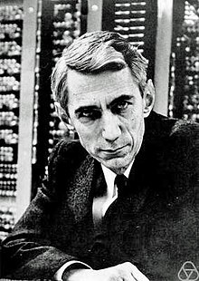
What is a Secure Cryptography?
Shannon’s Intuition
If attackers cannot distinguish a message M from
A random number R
Then it is perfectly secure
Claude Shannon (1916 ~ 2001)
A Father of Information Theory
and Modern Cryptography

Slide 8
What is a Secure Cryptography?
More formally
A message M has a distribution D
D is known to adversary (English, etc..)
Adversary observes Ciphertext C which is Enc(M)
Knowledge of adversary before observing C
Distribution of D
Knowledge of adversary after observing C
Distribution of D | C
Shannon Secrecy
Distribution of D == Distribution of D|C
Then the scheme is perfectly secure
This intuitively means
Observing many Cs does not give any information to adversary
Claude Shannon (1916 ~ 2001)
A Father of Information Theory
and Modern Cryptography

Slide 9
Definition of Perfect Secrecy
For every pair of m1, m2 in M and for all c,
Pr [k <- KG : Enc (m1, k) = c] = Pr[k <- KG: Enc(m2, k) = c]
Implications
Probability that the encryption of m1 with k resulting in c
is the same as
Probability that the encryption of m2 with k resulting in c
Adversary cannot distinguish which message the c corresponds to

Slide 10
Sample Question 3
Which of the following is correct for the XOR cipher?

Slide 11
XOR Cipher
A simple XOR Cipher is with perfect secrecy
Scheme
For a message M with length L
Get a random key K with length L
Compute ciphertext C
C = M ⊕ K

Slide 12
How is It Perfectly Secure?
Key must be selected randomly
The distribution of K is random
Ciphertext distribution is independent to the message distribution
C = M ⊕ K
No matter how you choose M, if you choose K randomly, then it’s good

Slide 13
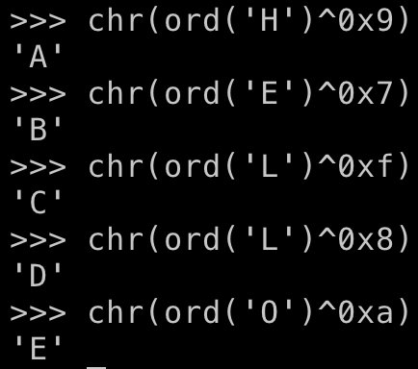
CAVEAT
Re-using the key make the scheme weak
Suppose the attacker knows
HELLO -> 0x9, 0x7, 0xf, 0x8, 0xa
They can calculate the key by

Slide 14
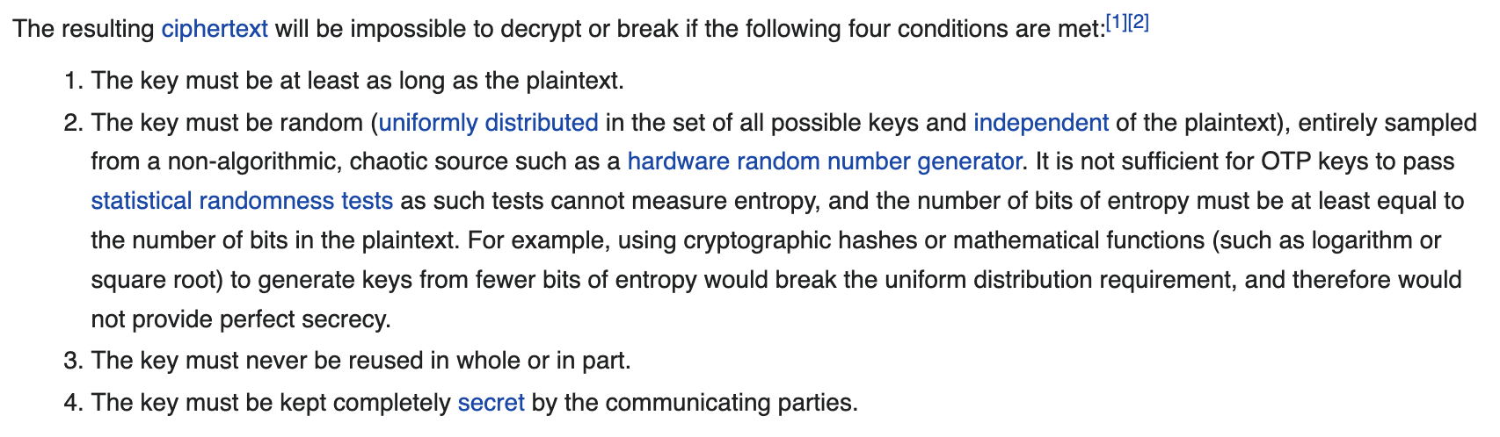
Generic Version of XOR Cipher
One-time Pad
https://en.wikipedia.org/wiki/One-time_pad

Slide 15
Sample Question 4
Stream ciphers are convenient. Why don’t we use RC4/RC5 stream ciphers?

Slide 16
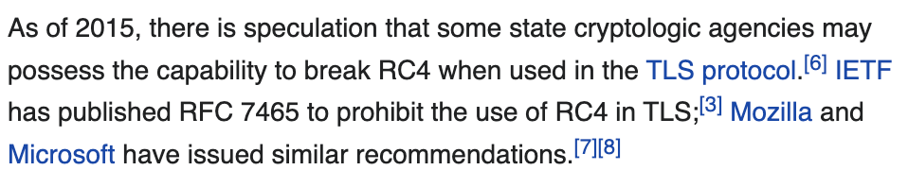
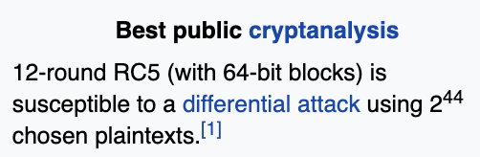
Insecure RC4/RC5
Read the Wikipedia articles for their weaknesses
https://en.wikipedia.org/wiki/RC4
https://en.wikipedia.org/wiki/RC5
RC4 RC5
Have no mathematical proof or
Have an attack against these…

Slide 17
Sample Question 5
With a block cipher, we can encrypt/decrypt a block of message. For example, in AES, a block size is 16-byte (128-bit). Then, how can we encrypt a message that is shorter than a block size, e.g., a 5-byte message?

Slide 18
Can We Encrypt Blocks That Its Size is Less Than 16 byte?
YES
We can ignore the rest of bits
How?
Via padding (add some meaningless but identifiable data)
ECB (Electronic Code Book)
A padding scheme to indicate the length of the message
Pad the length of the padding as byte for the length of the padding…

Slide 19
How ECB Works?
Suppose you want to encrypt 15 byte of data
“0123456789ABCDE” ← a 15-byte string
‘0’ ~ ‘9’ are 0x31 ~ 0x39, ’A’ ~ ‘E’ are 0x41 ~ 0x45
We need 1 byte padding to make it to be 16-byte block
Make the padding value as the length of the padding
0x1
pos | 0 | 1 | 2 | 3 | 4 | 5 | 6 | 7 | 8 | 9 | 10 | 11 | 12 | 13 | 14 | 15
val | 0x30 | 0x31 | 0x32 | 0x33 | 0x34 | 0x35 | 0x36 | 0x37 | 0x38 | 0x39 | 0x41 | 0x42 | 0x43 | 0x44 | 0x45 | 0x01

Slide 20
How ECB Works?
Suppose you want to encrypt 14 byte of data
“0123456789ABCD” ← a 14-byte string
‘0’ ~ ‘9’ are 0x31 ~ 0x39, ’A’ ~ ‘E’ are 0x41 ~ 0x45
We need 2 bytes padding to make it to be 16-byte block
Make the padding value as the length of the padding
0x2 * 2
pos | 0 | 1 | 2 | 3 | 4 | 5 | 6 | 7 | 8 | 9 | 10 | 11 | 12 | 13 | 14 | 15
val | 0x30 | 0x31 | 0x32 | 0x33 | 0x34 | 0x35 | 0x36 | 0x37 | 0x38 | 0x39 | 0x41 | 0x42 | 0x43 | 0x44 | 0x02 | 0x02

Slide 21
How ECB Works?
Suppose you want to encrypt 1 byte of data
“0” ← a 1-byte string
‘0’ ~ ‘9’ are 0x31 ~ 0x39, ’A’ ~ ‘E’ are 0x41 ~ 0x45
We need 15 bytes padding to make it to be 16-byte block
Make the padding value as the length of the padding
0xf * 15
pos | 0 | 1 | 2 | 3 | 4 | 5 | 6 | 7 | 8 | 9 | 10 | 11 | 12 | 13 | 14 | 15
val | 0x30 | 0x0f | 0x0f | 0x0f | 0x0f | 0x0f | 0x0f | 0x0f | 0x0f | 0x0f | 0x0f | 0x0f | 0x0f | 0x0f | 0x0f | 0x0f

Slide 22

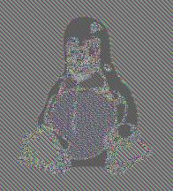
Sample Question 6
What is the reason that we can indirectly see some content of original image if we encrypt a bitmap file in ECB mode?

Slide 23
Are There Any Weaknesses in ECB?
For the same key, the same plaintext block will result in the same ciphertext
M: 10101010101010101010101010101010
Whenever an attacker observe d303fe9c04a4876930e4a5728f1eda4c
They know that it is the encryption of “\x10” * 16
(maybe the end of the message for 16-byte granularity)
E: d303fe9c04a4876930e4a5728f1eda4c

Slide 24



ECB Weakness
Suppose a message 0 is encrypted to
0x39827332…
Suppose a message 1 is encrypted to
0x5a83f874…
Suppose the attacker knows this via
Pattern analysis or something
0x5a83f874…
This is 1

Slide 25
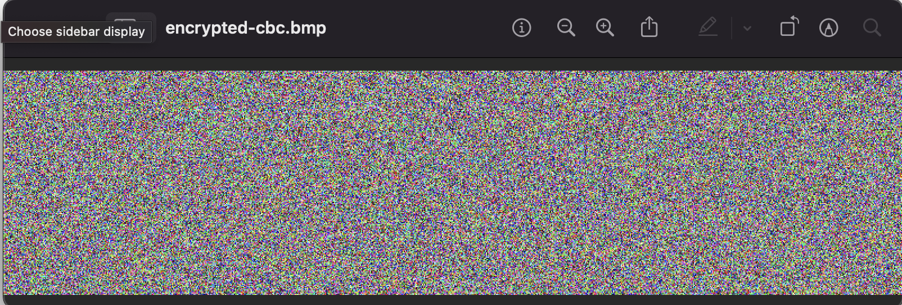
Sample Question 7
Why does CBC mode not have the same problem with ECB, in encrypting a bitmap file?

Slide 26
CBC Benefits
ECB Weakness: 0 always encrypted in a fixed value… we can switch ciphertext to launch an attack
Let’s make each input to the block cipher looks like random
Solution:
1. Use a random IV, xor that to the plaintext; input will be random
2. If the Block Cipher is PRP, the ciphertext looks like random
3. Chain that random (ciphertext) to the next plaintext block…

Slide 27
CBC Benefits
Solution:
1. Use a random IV, xor that to the plaintext; input will be random
2. If the Block Cipher is PRP, the ciphertext looks like random
3. Chain that random (ciphertext) to the next plaintext block…
IV ⊕ P0
C0 ⊕ P1
C1 ⊕ P2
C2 ⊕ P3
IV
0000000000000
P0
0000000000001
P1
0000000000000
P2
0000000000001
P3
⊕
⊕
⊕
⊕
101011101010
Block
Cipher
Block
Cipher
Block
Cipher
Block
Cipher
K
K
K
K
0101011101010
C0
1100011110101
C1
0001110111011
C2
1101011101110
C3

Slide 28
Sample Question 8
In CBC, which block do we need to apply the XOR tricks to change the plaintext marked as P2?
Choices: IV, C0, C1, C2, C3
0101011101010
C0
1100011110101
C1
0001110111011
C2
1101011101110
C3
Block
Cipher⁻¹
Block
Cipher⁻¹
Block
Cipher⁻¹
Block
Cipher⁻¹
K
K
K
K
IV
⊕
⊕
⊕
⊕
101011101010
0000000000000
0000000000001
0000000000000
0000000000001
P0 = IV ⊕ D0
P1 = C0 ⊕ D1
P2 = C1 ⊕ D2
P3 = C2 ⊕ D3

Slide 29
cbc-attack
This block will be decrypted as:
0000000000000001
uid == 0
We don’t manipulate the ciphertext
uid = 1
C0
notadministrator
C1
passwordpassword
C2
The sky is blue,
C3
Block
Cipher⁻¹
Block
Cipher⁻¹
Block
Cipher⁻¹
Block
Cipher⁻¹
K
K
K
K
IV
⊕
⊕
⊕
⊕
101011101011
0000000000000
notadministrator
passwordpassword
The sky is blue,
P0 = IV ⊕ D0
P1 = C0 ⊕ D1
P2 = C1 ⊕ D2
P3 = C2 ⊕ D3
We manipulate IV; change the last bit from 0 to 1

Slide 30
Sample Question 9
Which of the following is false for the CTR mode?

Slide 31
Counter Mode
CTR (Counter mode)
Start with a random nonce || counter
It uses the block cipher as random number generator
V = Enc(nonce || counter)
Then, XOR this V to the plaintext
C = P ⊕ V

Slide 32
Counter Mode
CTR (Counter mode)
Start with a random nonce || counter
Nonce
3a88dff8
Nonce || 1
Nonce || 2
Nonce || 3
Nonce || 4
3a88dff8000001
3a88dff8000002
3a88dff8000003
3a88dff8000004
Block
Cipher
Block
Cipher
Block
Cipher
Block
Cipher
K
K
K
K
0101011101010
1100011110101
0001110111011
1101011101110
⊕
⊕
⊕
⊕
uid = 0
notadministrato
passwordpassw
The sky is blue,
010101110101
110111101101
001110101011
1101111101111

Slide 33
Counter Mode Encryption
CTR (Counter mode)
Start with a random nonce || counter
Nonce
3a88dff8
Nonce || 1
Nonce || 2
Nonce || 3
Nonce || 4
3a88dff8000001
3a88dff8000002
3a88dff8000003
3a88dff8000004
Block
Cipher
Block
Cipher
Block
Cipher
Block
Cipher
K
K
K
K
0101011101010
1100011110101
0001110111011
1101011101110
⊕
⊕
⊕
⊕
uid = 0
notadministrato
passwordpassw
The sky is blue,
010101110101
110111101101
001110101011
1101111101111

Slide 34
Counter Mode Decryption
CTR (Counter mode)
Start with a random nonce || counter
Nonce
3a88dff8
Nonce || 1
Nonce || 2
Nonce || 3
Nonce || 4
3a88dff8000001
3a88dff8000002
3a88dff8000003
3a88dff8000004
Block
Cipher
Block
Cipher
Block
Cipher
Block
Cipher
K
K
K
K
0101011101010
1100011110101
0001110111011
1101011101110
⊕
⊕
⊕
⊕
010101110101
110111101101
001110101011
1101111101111
uid = 0
notadministrato
passwordpassw
The sky is blue,

Slide 35
CTR Benefits
Can encrypt in parallel
Can decrypt in parallel
Basically, encryption and decryption are both encrypting counters
We apply XOR to the output with (plaintext/ciphertext)

Slide 36
CTR Weaknesses
Any bitflip in the ciphertext will be direct bitflip in the plaintext..

Slide 37
Sample Question 10
Which of the following is true for the cryptographic hash function?

Slide 38
Cryptographic Hash
A hash function that generates a fingerprint of a data
SHA256(‘Hello, world’) = 03675ac53ff9cd1535ccc7dfcdfa2c458c5218371f418dc136f2d19ac1fbe8a5
With characteristics of:
One-way function
Hard to find x for given y where H(x) = y
Hard to find x’ for given x,y where x != x’, H(x) = y and H(x’) = y

Slide 39
SHA256
Secure Hash Algorithm (SHA)
SHA256 is in the SHA2 standard
Input can be any length data
Output is 256-bit, 32-byte
SHA256 is a cryptographic hash function that
It is one-way function
SHA256(‘Hello, world’) = 03675ac53ff9cd1535ccc7dfcdfa2c458c5218371f418dc136f2d19ac1fbe8a5
SHA256⁻¹(03675ac53ff9cd1535ccc7dfcdfa2c458c5218371f418 dc136f2d19ac1fbe8a5) == ???? there could be many..

Slide 40
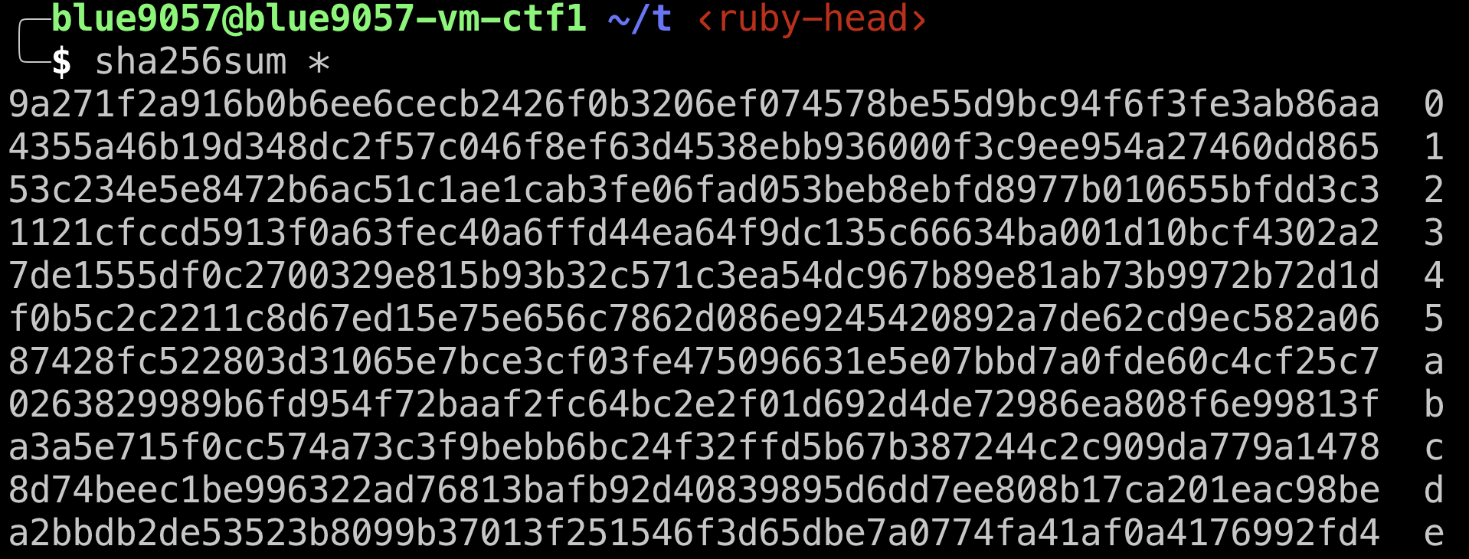
SHA256 Examples

Slide 41
SHA256
SHA256 is a cryptographic hash function that
Hard to find x for given y where H(x) = y
Find SHA256(x) for
00000000000000000000000000000000000000000f418dc136f2d19ac1fbe8a5
This task requires around the 2²⁵⁶ times of search…
Implication
If we know X, it is easy to get SHA256(X) = Y
But if we don’t know X, even if we know Y, it is hard to calculate X

Slide 42
SHA256
SHA256 is a cryptographic hash function that
Hard to find x’ for given x,y where x’ != x, H(x) = y, H(x’) = H(x)
SHA256(‘Hello, world’) = 03675ac53ff9cd1535ccc7dfcdfa2c458c5218371f418dc136f2d19ac1fbe8a5
Can you find another x’ that produces SHA256(x’) =
03675ac53ff9cd1535ccc7dfcdfa2c458c5218371f418dc136f2d19ac1fbe8a5
Other than ‘Hello, world’?
Implication
Even if we know X, Y where SHA256(X) = Y
It is hard to find SHA256(X’) = Y

Slide 43
Avalanche Effect
Even with a slight change in input, we want to have a huge change in output to not making attackers correlate output values based on their inputs…

Slide 44
Cryptographic Hash: Implications
SHA256 is a cryptographic hash that is included in the SHA2 standard
SHA256 is a one-way function and
It is hard to calculate x from y
where y = SHA256(x)
It is hard to calculate x’ from x,y
where x’ != x, SHA256(x) = y, SHA256(x’) = y
It is hard to correlate x and x’ from x, y, y’
where SHA256(x) = y, SHA256(x’) = y’

Slide 45
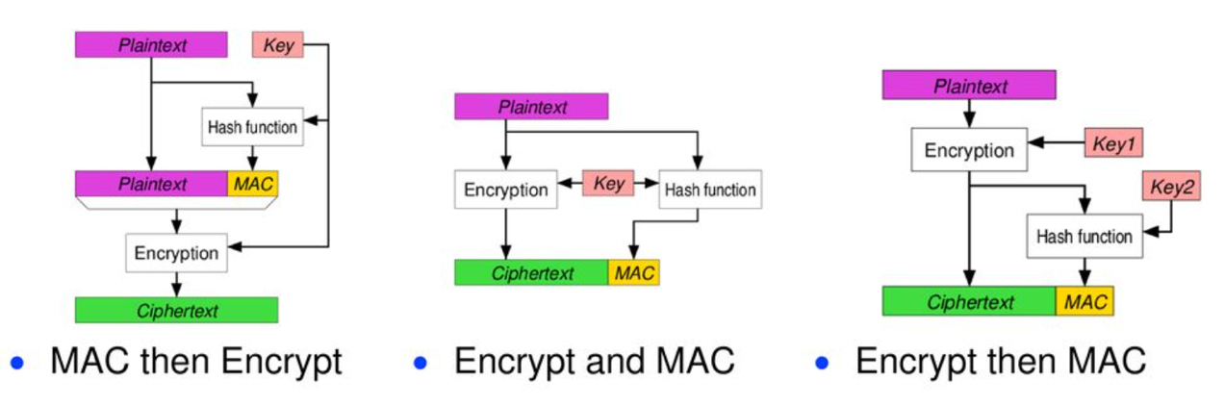
Sample Question 11
Which of the following is a secure construction of HMAC that protects the integrity of the ciphertext?

Slide 46
Summary
Encrypt-then-MAC
This is the only secure composition of using MAC with Encrypted data
You must
Encrypt the data, and supply the entire encrypted data to HMAC
No MAC-then-encrypt
Cryptanalysis exists (proven to be insecure)
Encrypted data
HMAC: H(H(key)||Encrypted data)

Slide 47
Sample Question 12
Which of the following is false for the RSA public key cryptography?

Slide 48
Public (Asymmetric) Key Cryptography
There is a scheme that we use different key to encryption and decryption
Why is it important? We will discuss this later about the ‘key exchange’
RSA (Rivest, Shamir, Adleman)
A public-key cryptography algorithm
Based on the difficulty of prime factorization
i.e., if the prime factorization of a large prime number is difficult, then the cryptography scheme is secure
Can be used for digital signature

Slide 49
How RSA Works?
Choose two large prime number, p and q
N = pq
φ = (p-1)(q-1)
Choose public key, say, e = 65537 (a prime), that is coprime to φ
Find de == 1 (mod φ)
d can be efficiently be computed if you know φ
Blue: public key, Red: private key
Attackers don’t know φ, to know φ, you need to factor N

Slide 50
RSA Encryption
Public key: e, N
Message: M
Me mod N

Slide 51
RSA Decryption
Private key: d
Public key: e N
Ciphertext = C = Me
ed = 1
C^{d} mod N
(Me)^{d}mod N
M^{ed} mod N
M mod N

Slide 52
Public Key Cryptography
We can use separate key for encryption and decryption
Encryption key: public key (e, N)
Decryption key: private key (d)
Attackers cannot guess the private key from the public key
In RSA, attacker must factor the prime number N = pq
In creating the key, we choose p and q as a big prime number
Factoring a multiplication of two big prime numbers is a difficult task

Slide 53
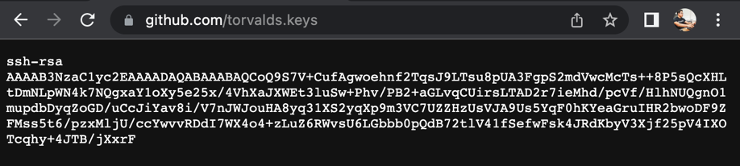
Characteristics
We use a public key for encryption
We can publicize this key
If you publish your key, anyone who can access that can encrypt message
(e, N) is public, m^{e} mod N!
Only the holder of the private key can decrypt the message
d is private, m^{ed} == m¹ == m (mod N)
Why is this important?
Let’s talk about the key exchange problem

Slide 54
RSA: Digital Signature
RSA can be used as a digital signature scheme
What is that?
In RSA, encryption is applying the public exponent to the message
Me mod N
In RSA, decryption is applying the private exponent to the message
C^{d} mod N

Slide 55
RSA: What will be the meaning of private encrypt?
Suppose A encrypts the following message with her private key
“I would like to donate $100 to OSU if I get A from CS 370”
M = 53151406333611257093956293411584759988053228938724427101859883089254119711739486837784167497839141764612450119856395995171455585519613744
C = m^{d} mod N

Slide 56
RSA: What will be the meaning of private encrypt?
M = 53151406333611257093956293411584759988053228938724427101859883089254119711739486837784167497839141764612450119856395995171455585519613744
C = m^{d} mod N
Anyone can have e. That means, anyone can decrypt C
Ce == m^{de} == m¹ == m (mod N)

Slide 57
RSA: What will be the meaning of private encrypt?
M = 53151406333611257093956293411584759988053228938724427101859883089254119711739486837784167497839141764612450119856395995171455585519613744
C = m^{d} mod N
Anyone can have e. That means, anyone can decrypt C
Ce == m^{de} == m¹ == m (mod N)
m = 53151406333611257093956293411584759988053228938724427101859883089254119711739486837784167497839141764612450119856395995171455585519613744
"I would like to donate $100 to OSU if I get A from CS 370"

Slide 58
RSA: What will be the meaning of private encrypt?
We can verify that the encrypted content C contains
The ciphertext that only the holder of private key can generate.
We all have public key, and if that is decrypted to
"I would like to donate $100 to OSU if I get A from CS 370”,
then, we know that the holder of private key ‘endorsed it’
M = 53151406333611257093956293411584759988053228938724427101859883089254119711739486837784167497839141764612450119856395995171455585519613744
C = m^{d} mod N
Anyone can have e. That means, anyone can decrypt C
Ce == m^{de} == m¹ == m (mod N)
m = 53151406333611257093956293411584759988053228938724427101859883089254119711739486837784167497839141764612450119856395995171455585519613744
"I would like to donate $100 to OSU if I get A from CS 370"

Slide 59
RSA: private_encrypt
RSA Encryption using the private key is so-called as ‘Signing’
Why?
The ciphertext will be decrypted as a plaintext using the public key
Anyone can decrypt!
But the ciphertext can only be generated with the private key
Only the private key owner can generate it!
Implication
Holder of the private key generated a ciphertext message of message M
M is signed, endorsed by the holder’s private key
(Because it can only be generated with the private key)

Slide 60
RSA Summary
Public/Private key Scheme
We can publish the public key – encryption key
We must hide the private key – decryption key
Based on the difficulty of prime factorization
You cannot correlate the private key from the public key unless
You can factor a big number (a multiple of 2 big prime numbers)
Anyone can encrypt message to the private key owner
Enc(public_key, message)
Only the private key owner can decrypt message
Dec(private_key, encrypted_message)

Slide 61
RSA Summary
Encryption with private key could be a ‘digital-signature’
Signed_message = Enc(private_key, message)
Message = Dec(public_key, signed_message)
The correctly decrypted message using public key means that the private key holder have endorsed (‘encrypted’) the data
Anyone can verify this using the public key

Slide 62
Sample Question 13
We have 10 people, and we would like to have secure and private communications among all those people (i.e., if there is users A, B, C, then the encrypted message between A and B must not be decrypted by C, while each of A and B can send encrypted messages to C).
To construct this kind of environment, how many keys do we need if we use 1) symmetric crypto and 2) asymmetric crypto?
There will be choices such as a) 100 for symmetric, 10 for asymmetric, etc…

Slide 63
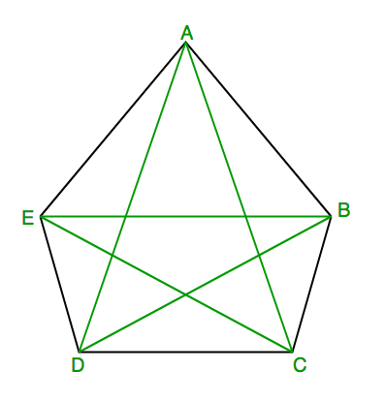
Key Exchange
Suppose we have 5 people, A, B, C, D, E
How many keys do we need to have to make them communicate securely?
E.g., if A talks to B, C or others must not see the message
But anyone should be able to talk to anyone…
A block cipher
We need 1 key for A and B can talk securely
How many keys do we need to let them communicate securely?
A-B, A-C, A-D, A-E
B-C, B-D, B-E
C-D, C-E
D-E
10 keys (5*4/2 = 10)

Slide 64
Symmetric Key Cryptography
Encryption and the decryption operations are using the same key
Block Cipher – encryption key == decryption key
You cannot share that other than 2 people
Key exchange complexity
We need 1 key per each pair of people
N (N – 1) / 2
O(N²)

Slide 65
Asymmetric Key Cryptography
Can we use a different key for the encryption and decryption?
K = k1, k2
Enc(k1, M) = C, Dec(k2, C) = M?
Preferably, can we publish the encryption key to public?
While keeping the decryption key secret
Then we need O(N) keys
Each member’s public key, that’s it.

Slide 66
Why O(N)?
We need O(N²) keys for symmetric encryption

Slide 67
Why O(N)?
Suppose each will generate public and private key
Public_A, Private_A
Public_B, Private_B
Public_C, Private_C
Public_D, Private_D
Public_E, Private_E

Slide 68
Why O(N)?
Each will have their own private key, and then,
publish all their public keys
A: Private_A
B: Private_B
C: Private_C
D: Private_D
E: Private_E
Public keys: Public_A, Public_B, Public_C, Public_D, Public_E

Slide 69
Can A Send an Encrypted message to B?
Can A send an encrypted message to B?
Yes, encrypt data using Public_B; only B (holder of Private_B) can decrypt it
Can C send an encrypted message to E?
Yes, encrypt data using Public_E; only E (holder of Private_E) can decrypt it
Can X send an encrypted message to Y?
Yes, if X knows the public key of Y
We only need to know the receiver’s public key
Sender does not matter, that’s why we have O(N)
Suppose we have N = 200, we need 19900 keys in symmetric, and we need 400 keys for asymmetric

Slide 70
Sample Question 14
Alice generated an RSA 4096-bit public/private key pair. Alice published the public key on her Twitter so that anyone can access her public key.
After that, she created a message M = “I owe Yeongjin $1,000,000”, and then, generate a hash message H = SHA256(M).
Then, she encrypts H using the RSA private key, i.e.,
S = rsa_private_encrypt(key, H)
Next, she gives S to Yeongjin, and then,
Yeongjin lend her $1,000,000. How can he do that?

Slide 71
RSA: Digital Signature
RSA can be used as a digital signature scheme
What is that?
In RSA, encryption is applying the public exponent to the message
Me mod N
In RSA, decryption is applying the private exponent to the message
C^{d} mod N

Slide 72
RSA: What will be the meaning of private encrypt?
Suppose A encrypts the following message with her private key
“I would like to donate $100 to OSU if I get A from CS 370”
M = 53151406333611257093956293411584759988053228938724427101859883089254119711739486837784167497839141764612450119856395995171455585519613744
C = m^{d} mod N

Slide 73
RSA: What will be the meaning of private encrypt?
M = 53151406333611257093956293411584759988053228938724427101859883089254119711739486837784167497839141764612450119856395995171455585519613744
C = m^{d} mod N
Anyone can have e. That means, anyone can decrypt C
Ce == m^{de} == m¹ == m (mod N)

Slide 74
RSA: What will be the meaning of private encrypt?
M = 53151406333611257093956293411584759988053228938724427101859883089254119711739486837784167497839141764612450119856395995171455585519613744
C = m^{d} mod N
Anyone can have e. That means, anyone can decrypt C
Ce == m^{de} == m¹ == m (mod N)
m = 53151406333611257093956293411584759988053228938724427101859883089254119711739486837784167497839141764612450119856395995171455585519613744
"I would like to donate $100 to OSU if I get A from CS 370"

Slide 75
RSA: What will be the meaning of private encrypt?
We can verify that the encrypted content C contains
The ciphertext that only the holder of private key can generate.
We all have public key, and if that is decrypted to
"I would like to donate $100 to OSU if I get A from CS 370”,
then, we know that the holder of private key ‘endorsed it’
M = 53151406333611257093956293411584759988053228938724427101859883089254119711739486837784167497839141764612450119856395995171455585519613744
C = m^{d} mod N
Anyone can have e. That means, anyone can decrypt C
Ce == m^{de} == m¹ == m (mod N)
m = 53151406333611257093956293411584759988053228938724427101859883089254119711739486837784167497839141764612450119856395995171455585519613744
"I would like to donate $100 to OSU if I get A from CS 370"

Slide 76
RSA: private_encrypt
RSA Encryption using the private key is so-called as ‘Signing’
Why?
The ciphertext will be decrypted as a plaintext using the public key
Anyone can decrypt!
But the ciphertext can only be generated with the private key
Only the private key owner can generate it!
Implication
Holder of the private key generated a ciphertext message of message M
M is signed, endorsed by the holder’s private key
(Because it can only be generated with the private key)

Slide 77
RSA Summary
Encryption with private key could be a ‘digital-signature’
Signed_message = Enc(private_key, message)
Message = Dec(public_key, signed_message)
The correctly decrypted message using public key means that the private key holder have endorsed (‘encrypted’) the data
Anyone can verify this using the public key

Slide 78
Sample Question 15
Which of the following describes how the Public Key Infrastructure (PKI) works?

Slide 79
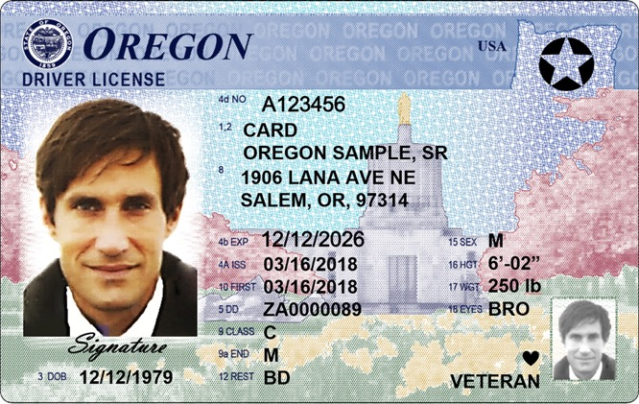


Public Key Infrastructure (PKI)
We need an identification method for the key and the real entity
We need an online ID card for crypto keys…
With RSA, we can use public key cryptosystem
We can announce the public key
Let anyone can access and verify it
How?
Where can we publish this and verify it?
PKI resolves the problem…
www.oregonstate.edu
0x83823787832a87b876
e67fe67e6da

Slide 80
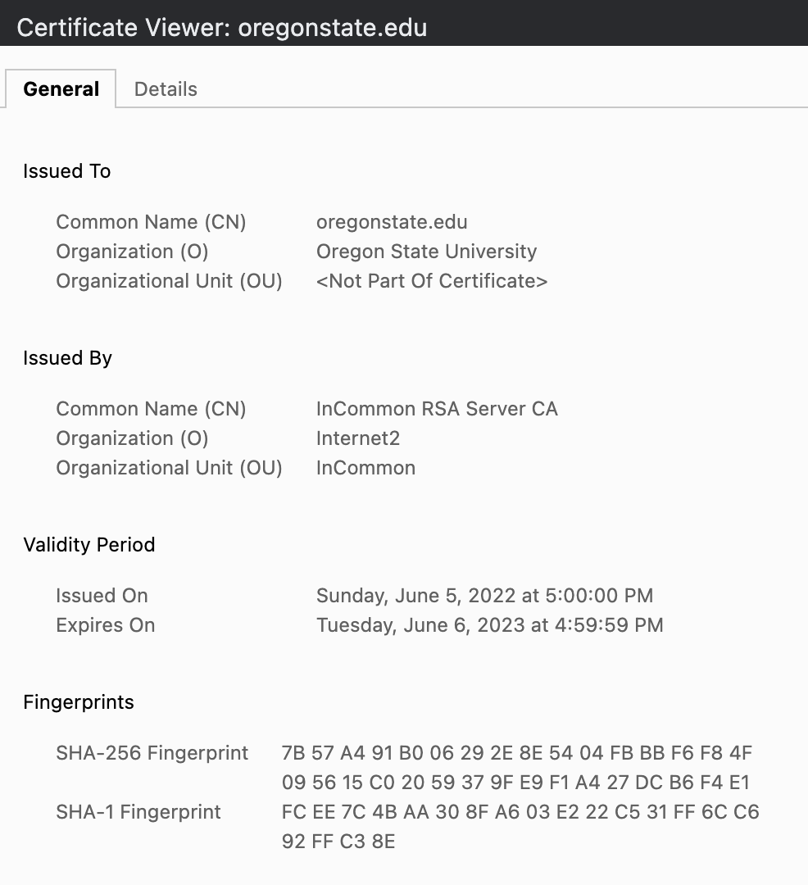
Digital Certificate
A file that contains
Entity info (CN)
Issuer info (CN)
Public key
Signature

Slide 81
Creating a Digital Certificate
1. Requester prepares a certificate request
Entity information
Public key
Signature (proving that I have the public key)
Certificate
CN: oregonstate.edu
Will use for:
*.oregonstate.edu
Public Key: 0x112233445566778899aabbccddeeff….
(beaver’s public key)
Signature: 0xaabbccddeeff00112233445566778899
(using beaver’s private key)

Slide 82
Creating a Digital Certificate
1. Requester prepares a certificate request
Entity information
Public key
Signature (proving that I have the public key)
Certificate
CN: oregonstate.edu
Will use for:
*.oregonstate.edu
Public Key: 0x112233445566778899aabbccddeeff….
(beaver’s public key)
Signature: 0xaabbccddeeff00112233445566778899
(using beaver’s private key)
Get SHA256 sum of this part
Sign it with the private key

Slide 83
Creating a Digital Certificate
1. Requester prepares a certificate request
Entity information
Public key
2. Issuer verifies the requester information, and digitally sign the cert
1) Verify the entity information
2) Get a SHA-256 fingerprint of the certificate
3) Sign the fingerprint (with issuer’s private key)
RSA_encrypt(private_key, SHA-256(certificate))

Slide 84
Creating a Digital Certificate
2. Issuer verifies the requester information, and digitally sign the cert
1) Verify the entity information
2) Get a SHA-256 fingerprint of the certificate
3) Sign the fingerprint (with issuer’s private key)
RSA_encrypt(private_key, SHA-256(certificate))
Certificate
CN: oregonstate.edu
Will use for:
*.oregonstate.edu
Public Key: 0x112233445566778899aabbccddeeff….
(beaver’s public key)
Signature: 0xffeeddccbbaa00112233445566778899
(with Issuer’s private key)
Get SHA256 sum of this part
Sign it with the private key

Slide 85
Creating a Digital Certificate
1. Requester prepares a certificate request
Entity information
Public key
2. Issuer verifies the requester information, and digitally sign the cert
1) Verify the entity information
2) Get a SHA-256 fingerprint of the certificate
3) Sign the fingerprint (with issuer’s private key)
RSA_encrypt(private_key, SHA-256(certificate))
3. Anyone with the public key can verify the result
Get issuer’s public key from their certificate

Slide 86

Digital Certificate Creation Step 1
The certificate requesting entity fills
Entity information
Public Key
Entity can be anyone
For google, its *.google.com
Can be your website address
*.unexploitable.systems
also has a certificate
CN = oregonstate.edu
Certificate
CN: oregonstate.edu
Will use for:
*.oregonstate.edu
Public Key: 0x112233445566778899aabbccddeeff….
(beaver’s public key)
Signature: 0xaabbccddeeff00112233445566778899
(with beaver’s private key)

Slide 87
Digital Certificate Creation Step 2
The issuer receives the certificate request
Verifies the entity for
Their identification
Owning the target domain name
Owning the public key
Verify the signature
Decrypt the signature with public key
It must be the same as SHA256 sum
Verification proves holding of the private key
CN = oregonstate.edu
Certificate
CN: oregonstate.edu
Will use for:
*.oregonstate.edu
Public Key: 0x112233445566778899aabbccddeeff….
(beaver’s public key)
Signature: 0xaabbccddeeff00112233445566778899
(with beaver’s private key)

Slide 88

Digital Certificate Creation Step 2
The issuer receives the certificate request
Verifies the entity for
Their identification
Owning the target domain name
etc…
Then, fill issuer information
Issuer information
Issuer public key
CN = oregonstate.edu
Certificate
CN: oregonstate.edu
Will use for:
*.oregonstate.edu
Public Key: 0x112233445566778899aabbccddeeff….
(beaver’s public key)
Issuer: InCommon RSA
Public Key: 0x22334455667788990011aabbccddeeff

Slide 89
Digital Certificate Creation Step 2
The issuer receives the certificate request
Verifies the entity for
Their identification
Owning the target domain name
etc…
Then, fill issuer information
Issuer information
Issuer public key
And then, sign the certificate
Get SHA-256 fingerprint of the certificate
Attach it as a signature!
CN = oregonstate.edu
Certificate
CN: oregonstate.edu
Will use for:
*.oregonstate.edu
Public Key: 0x112233445566778899aabbccddeeff….
(beaver’s public key)
Issuer: InCommon RSA
Public Key: 0x22334455667788990011aabbccddeeff
Signature: 0xffeeddccbbaa00112233445566778899
(InCommon RSA’s private key)

Slide 90
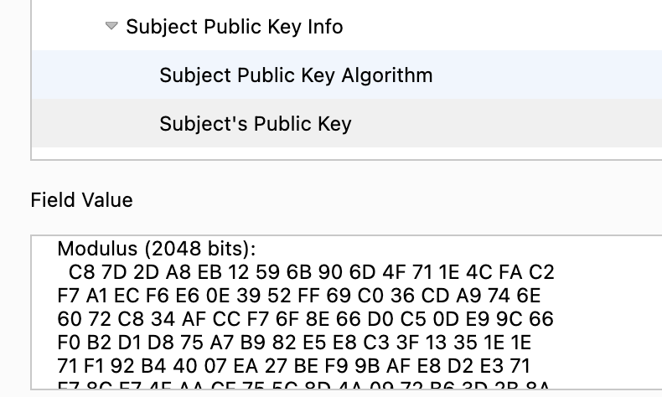
Issued Certificate
Now InCommon RSA verified
oregonstate.edu is owned by
Oregon State University
With a specific Public Key

Slide 91
Trust Chain
oregonstate.edu is owned by Oregon State University
Verified by InCommon RSA
We can verify the certificate using InCommon RSA’s public key
Where is it? It is written in InCommon RSA’s certificate
InCommon RSA, who will verify their identity?
oregonstate.edu was verified by InCommon RSA
Who will verify InCommon RSA?

Slide 92
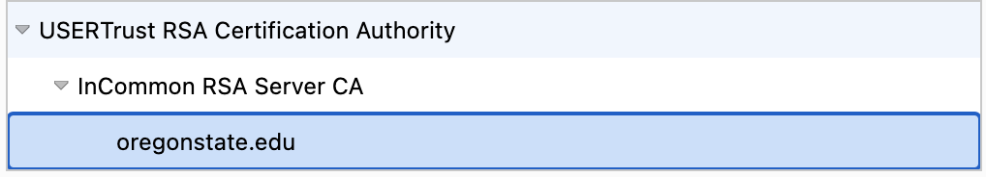
Trust Chain
oregonstate.edu
Verified by InCommon RSA Server CA
InCommon RSA Server CA
Verified by USERTrust RSA Certificate Authority
USERTrust RSA CA
Verified by self

Slide 93
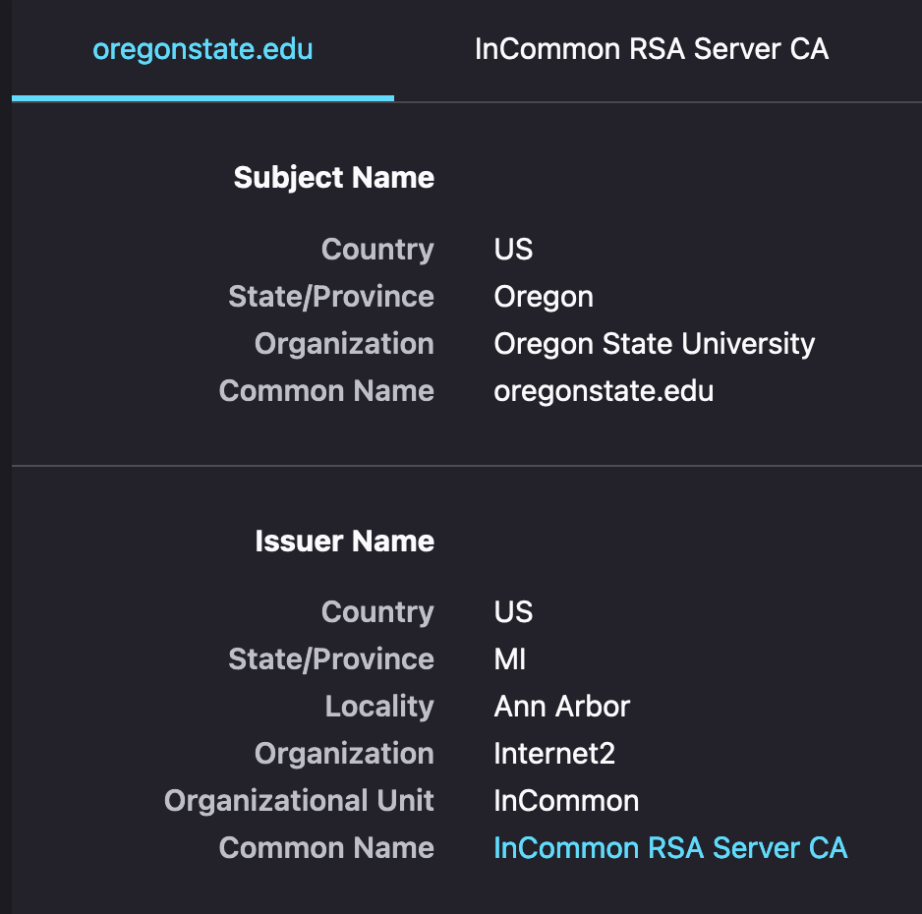
Trust Chain
oregonstate.edu
Verified by InCommon RSA Server CA
InCommon RSA Server CA
Verified by USERTrust RSA Certificate Authority
USERTrust RSA CA
Verified by self

Slide 94
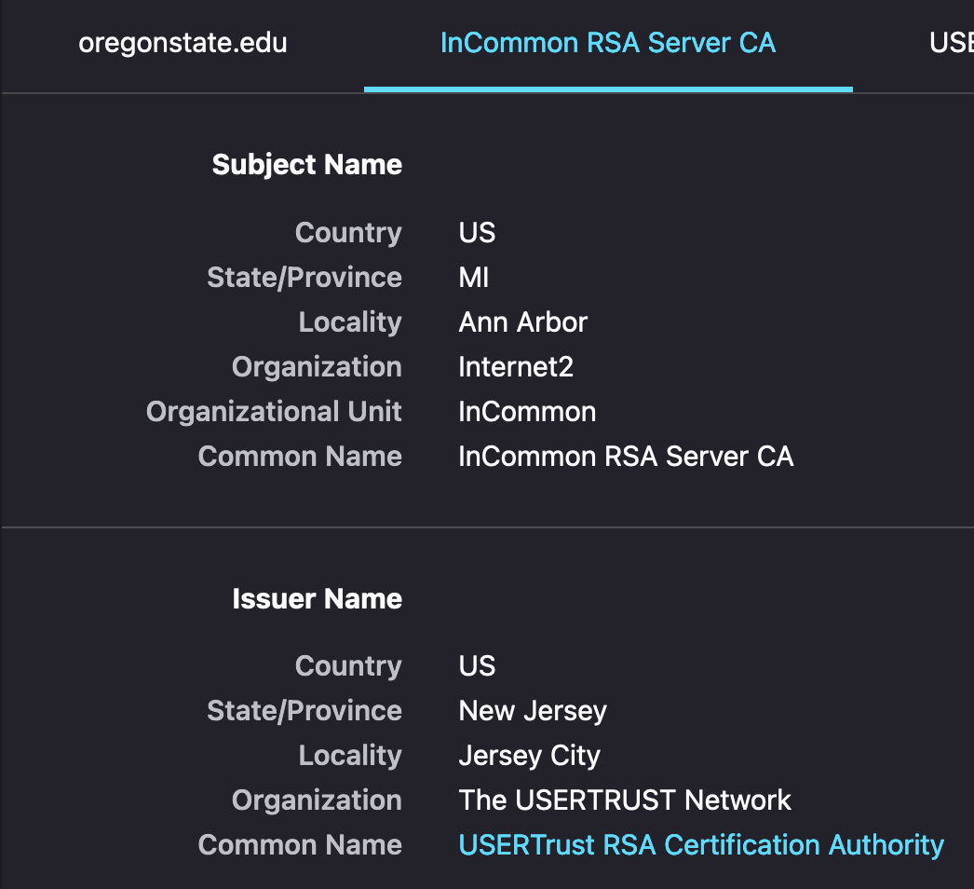
Trust Chain
oregonstate.edu
Verified by InCommon RSA Server CA
InCommon RSA Server CA
Verified by USERTrust RSA Certificate Authority
USERTrust RSA CA
Verified by self

Slide 95
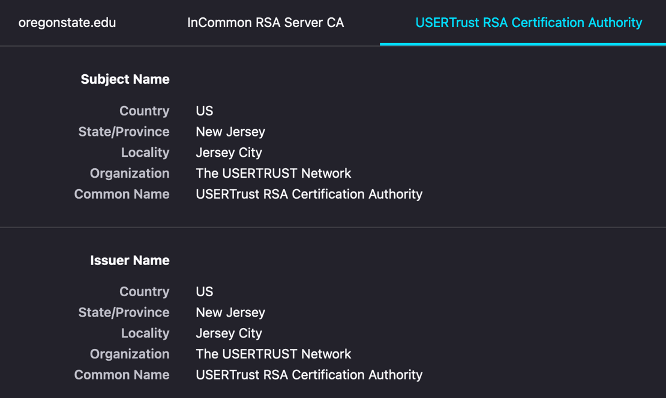
Trust Chain
oregonstate.edu
Verified by InCommon RSA Server CA
InCommon RSA Server CA
Verified by USERTrust RSA Certificate Authority
USERTrust RSA CA
Verified by itself

Slide 96
How Do We Verify Our Identity?
You as a
Student
Oregon resident
U.S. Citizen
When issuing the student ID
We verify your Oregon ID…

Slide 97
How Do We Verify Our Identity?
You as a
Student
Oregon resident
U.S. Citizen
When issuing the Oregon Driver’s License
We require either one of your birth certificate, previous Driver’s License, or U.S. passport

Slide 98
How Do We Verify Our Identity?
You as a
Student
Oregon resident
U.S. Citizen
When issuing the U.S. passport
We require your birth certificate or previously issued passport..

Slide 99
How Do We Verify Our Identity?
You as a
Student
Oregon resident
U.S. Citizen
When issuing the U.S. passport
We require your birth certificate or previously issued passport..
We need someone to verify the originality of the proving document…

Slide 100
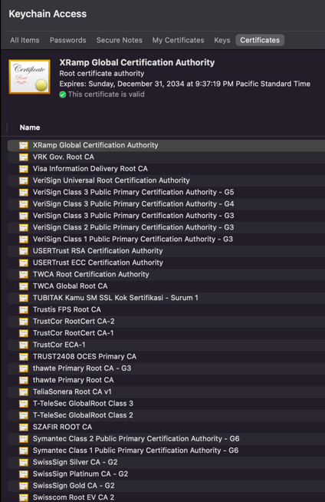
Root Certificate Authority (Root CA)
We define small set of trustworthy certificate authorities
Private companies are authorized by some jurisdiction to run the CA company
Google Trust Service (GTS CA)
DigiCert
Verisign
Etc..
We trust their self-signed certificate
Stored in almost every computer machines..

Slide 101
Public Key Infrastructure (PKI)
An Infrastructure that provides public key with certificate chain
Trust anchor: Root CA
We set a small set of entities use self-signed cert
Verify the certificate chain!
We must verify the entire chain
USERTrust
InCommon
oregonstate

Slide 102
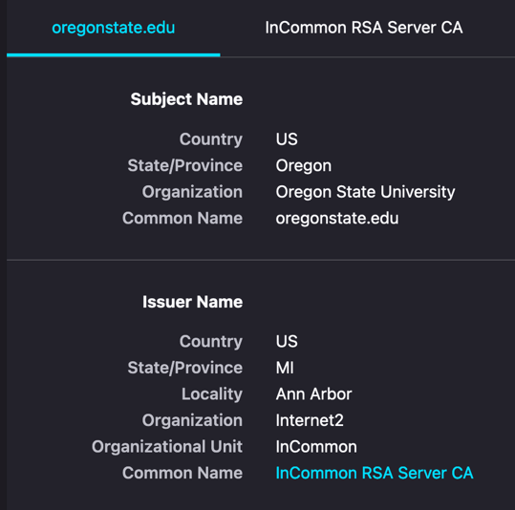
Trust Chain

Slide 103
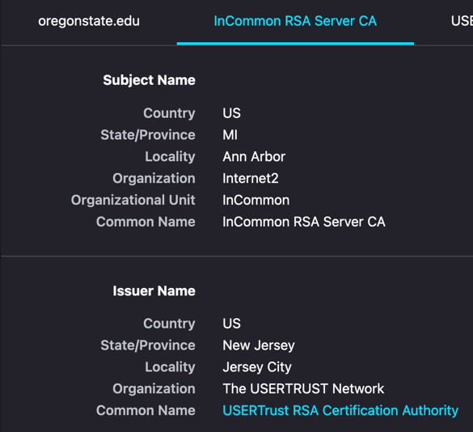
Trust Chain

Slide 104
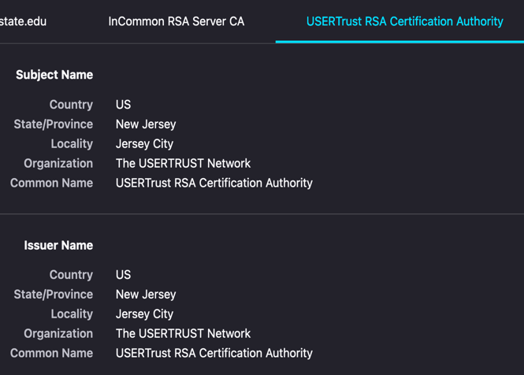
Trust Chain

Slide 105

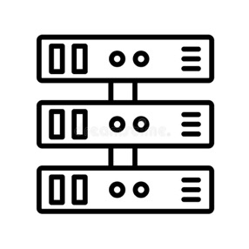

How To Verify oregonstate.edu?
Using the digital certificate!
Hey, are you oregonstate.edu?
Give me your certificate

Slide 106



How To Verify oregonstate.edu?
Using the digital certificate!
Hey, are you oregonstate.edu?
Give me your certificate
Yes, I am oregonstate.edu!
Here’s my cert

Slide 107
How To Verify oregonstate.edu?
Using the digital certificate!
Hey, are you oregonstate.edu?
Give me your certificate
Yes, I am oregonstate.edu!
Here’s my cert
Oregonstate verified by InCommon RSA

Slide 108
How To Verify oregonstate.edu?
Using the digital certificate!
Hey, are you oregonstate.edu?
Give me your certificate
Yes, I am oregonstate.edu!
Here’s my cert
InCommon RSA verified by USERTrust RSA

Slide 109
How To Verify oregonstate.edu?
Using the digital certificate!
Hey, are you oregonstate.edu?
Give me your certificate
Yes, I am oregonstate.edu!
Here’s my cert
USERTrust RSA is self-verified (ROOT CA)

Slide 110
Summary
RSA encryption with private key can be used as digital signature
Only the private key holder can generate the message
Anyone with public key can verify this!
We use digital certificates to share public key information
Entity name, address, other information with
Public key!
Certificates are signed by other trustful entities
Verify the entity info and the public key, and then, sign the certificate!

Slide 111
Summary
A certificate need to be verified by other entity
That other entity is also need to be verified by…
Root CA is the list of trusted Certificate Authority
We accept their self-signed certificate
We must verify the entire certificate trust chain
oregonstate.edu -> InCommon RSA -> USERTrust RSA …

Slide 112
Sample Question 16
Compute the secret value shared via a Diffie-Hellman key exchange

Slide 113
Example
g = 5, p = 23
A chooses a = 4
A = 5⁴ mod 23 = 625 mod 23 = 4
B chooses b = 3
B = 5³ mod 23 = 125 mod 23 = 10
B⁴ = 10⁴ mod 23 = 10000 mod 23 = 18
A³ = 4³ mod 23 = 64 mod 23 = 18
5^{(4*3)} = 5¹² mod 23 = 18

