Slide 1
CS 370 Introduction to Security
Web Security Basics and Password

Slide 2

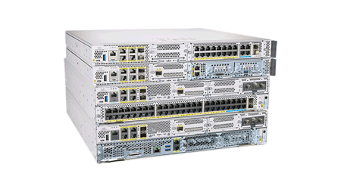
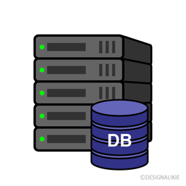

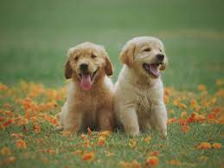
The Internet w/o SSL/TLS
Search “Dog”
Everybody in the middle knows that I searched ‘dogs’ and
they also know the search result…

Slide 3
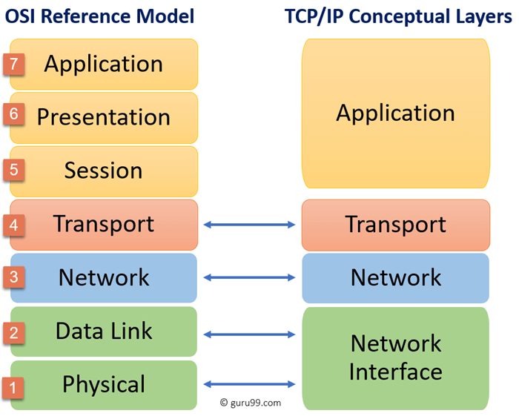
Why Transport Layer Security?
OSI vs IP Layers
TLS would like to be
Transparent to applications
If transparent,
Applications does not have to change
their behavior for adopting
security to the network protocols

Slide 4


A Web Server Example
HTTPS
TLS
TLS
Insecure Internet

Slide 5
A Web Server Example
Run TLS handshake to establish a secure channel

Slide 6
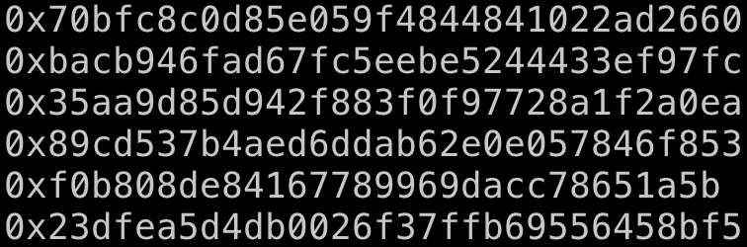

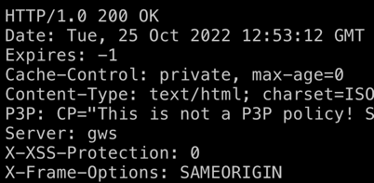
A Web Server Example
TLS
TLS
Insecure Internet

Slide 7
SSL/TLS Steps
Client
1. Client hello
6. Client Key Exchange
Shares DH material after verifying server signature for server’s DH material
7. Change Cipher Spec
8. Encrypted Handshake Message
Server
2. Server hello
3. Server Certificate
4. Server Key Exchange
5. Server Hello Done
9. Change Cipher Spec
10. Encrypted Handshake Message

Slide 8

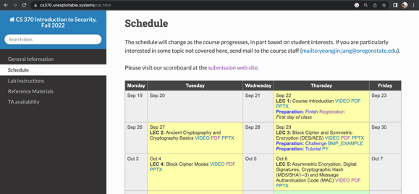
World Wide Web
A way of accessing documents (web pages) over the internet
So-called the Internet for non-techie folks
Uses HTTP as a document-delivery protocol
Request: GET /index.html HTTP/1.0\r\n
Response: 200 OK HTTP/1.0\r\n
… contents …

Slide 9
How Can We Apply Access Control On Web?
Without the protection, anyone can access the webpage via URL
URL: Uniform Resource Locator
http://cs370.unexploitable.systems
Can we apply the access control on the website?
Preferably with a password?
E.g., when accessing the website, type
ID: blue9057
Password: some password…

Slide 10
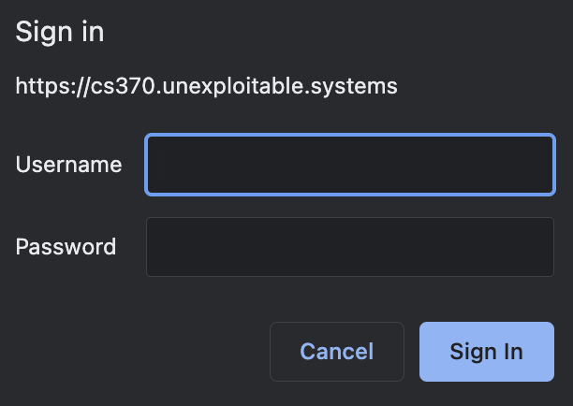
HTTP Basic Authentication
HTTP has a ‘Basic’ authentication method..
https://cs370.unexploitable.systems/_static/hidden/index.html

Slide 11
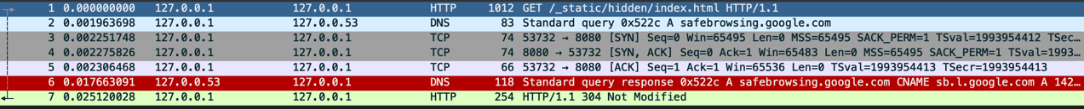
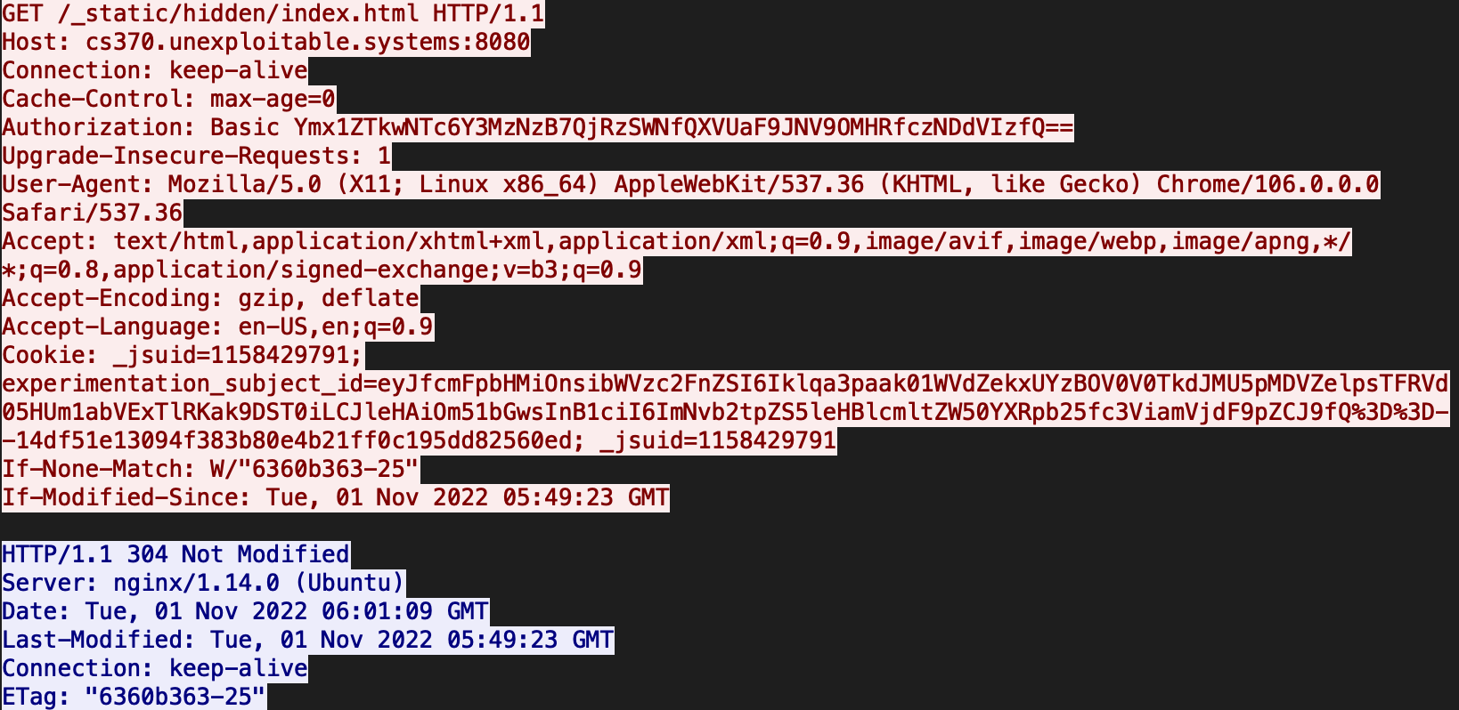
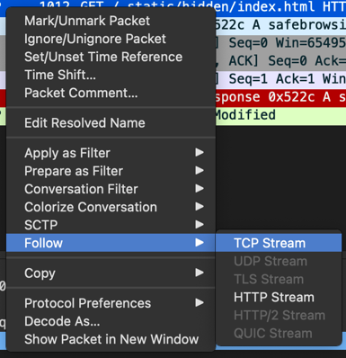
HTTP Basic Auth: Insecure
HTTP is unencrypted;
All the middlemen can see your authorization data..
HTTP – packets are in plaintext
https://cs370.unexploitable.systems/_static/http_basic.pcapng
Stream:

Slide 12
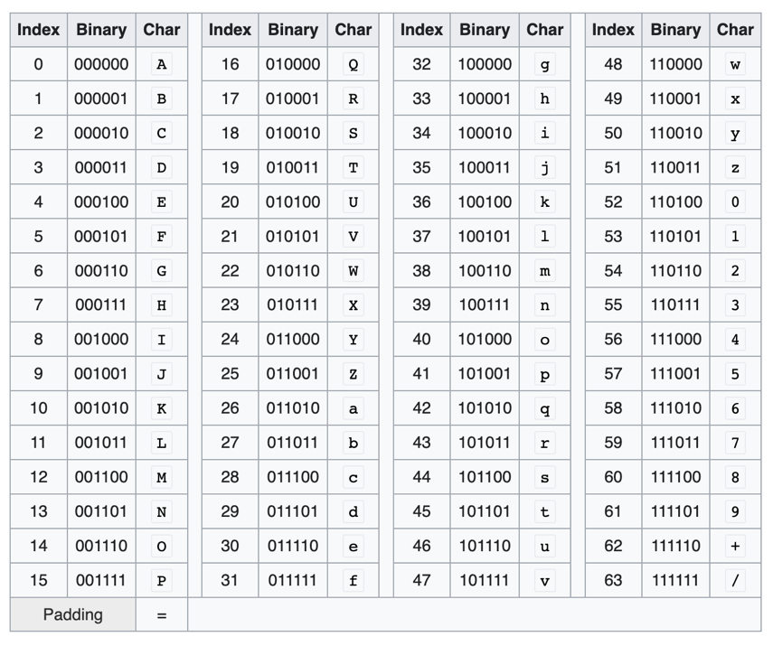

What is that string??
Base64 Encoding
Binary to Text encoding
Uses printable 64-characters
Suppose you have a string “ASD”
01000001 01010011 01000100
010000 010101 001101 000100 (6 bits)
Q V N E

Slide 13

Base64 Can Encode Binary to String!
Base64 Encoding
Binary to Text encoding
Uses printable 64-characters
Suppose you have a string “ffe0e8” (hex)
11111111 11100000 11101000
111111 111110 000011 101000 (6 bits)
/ + D o

Slide 14
Characteristics of a Base64 String
Base64 Encoding
All printable characters
Has / and + in addition to
[A-Za-z0-9]
Ymx1/ZTkwNTc6Y3MzNzB7+QjRzSWNfQXVUaF9JNV9OMHRfczNDdVIzfQ==
https://www.base64decode.net/

Slide 15
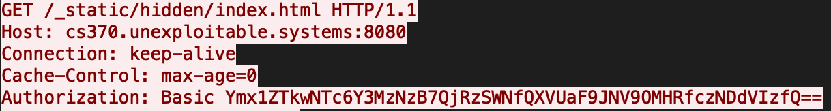
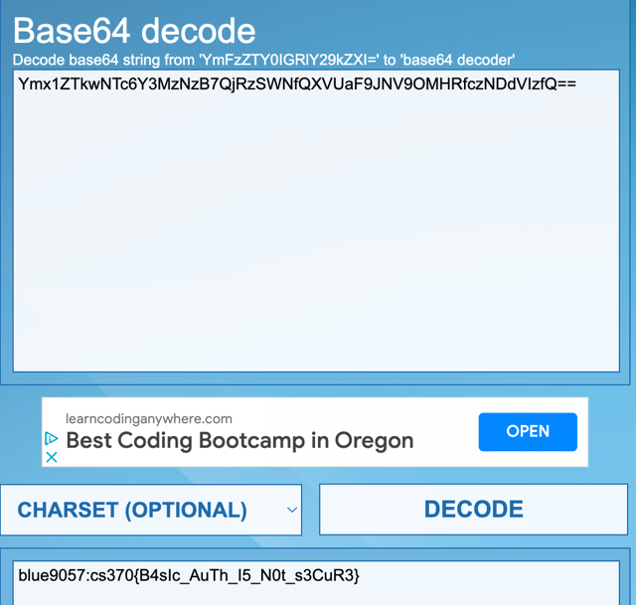
Let’s Decode the String
Ymx1ZTkwNTc6Y3MzNzB7QjRzSWNfQXVUaF9JNV9OMHRfczNDdVIzfQ==
blue9057:cs370{B4sIc_AuTh_I5_N0t_s3CuR3}
Username: blue9057
Password: cs370{B4sIc_AuTh_I5_N0t_s3CuR3}

Slide 16
Implications
We can apply HTTP basic authentication to apply
Access control on a webpage
Users are required to type the matching username and password
Otherwise, you can’t access the page
Problem
HTTP is unencrypted
base64Encode(username:password) is transmitted in
Every HTTP request…

Slide 17
Solution: Use HTTPS
HTTPS
No one other than the server/client can see the content!
TLS
TLS
Insecure Internet

Slide 18
Why Do We Use a Password?
Password is the factor of authentication that
What you know
What is the problem of this approach?
Is there any other entity that knows your password??
The server also knows your password
TLS
TLS
Insecure Internet
You as the user knows the password

Slide 19
Why is this even a problem?
Password is set based on what ‘only you know’
No one else should know the password
HTTPS basic authentication
No one else knows your password but
The server has the plaintext for the Base64 data..
Ymx1ZTkwNTc6Y3MzNzB7QjRzSWNfQXVUaF9JN
V9OMHRfczNDdVIzfQ==
blue9057:cs370{B4sIc_AuTh_I5_N0t_s3CuR3}
TLS
TLS
Insecure Internet

Slide 20
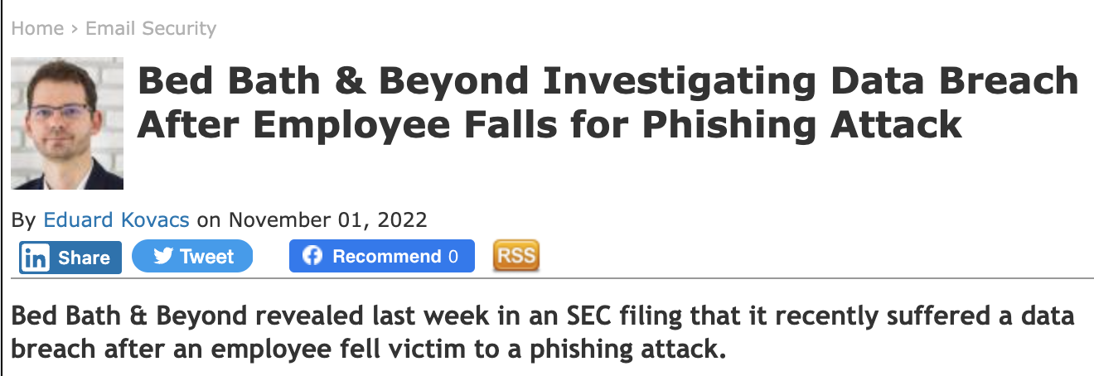
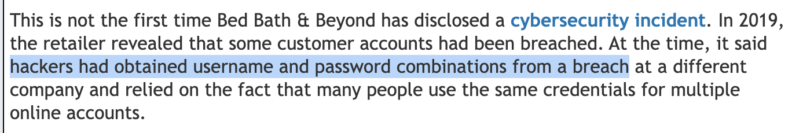
Server stores the Password
So the server knows and stores the password

Slide 21
Server stores the Password
So the server knows and stores the password
Server can be hacked
Passwords stored in the server could also be leaked
How many passwords do you have, and do you re-use the same password in multiple websites??

Slide 22
Can we hide the password from the server??
YES
How?
Instead of storing the password directly, we store
SHA256(“some_secret” + password)
E.g.,
SHA256(“some_secret” + “my-super-secure-password!@#$11”)
59636881ab9bf34263cf3f4d90f25d2b91e74e8804b802d25c8f4bc5c80846ee

Slide 23
Hashed-password
59636881ab9bf34263cf3f4d90f25d2b91e74e8804b802d25c8f4bc5c80846ee
SHA256(“some_secret” + “my-super-secure-password!@#$11”)
Can the attackers who steal the hash recover the password?
This is the same as, what is the inverse of “59636881ab9bf34263cf3f4d90f25d2b91e74e8804b802d25c8f4bc5c80846ee”
And finding an inverse of SHA256 is technically infeasible…

Slide 24
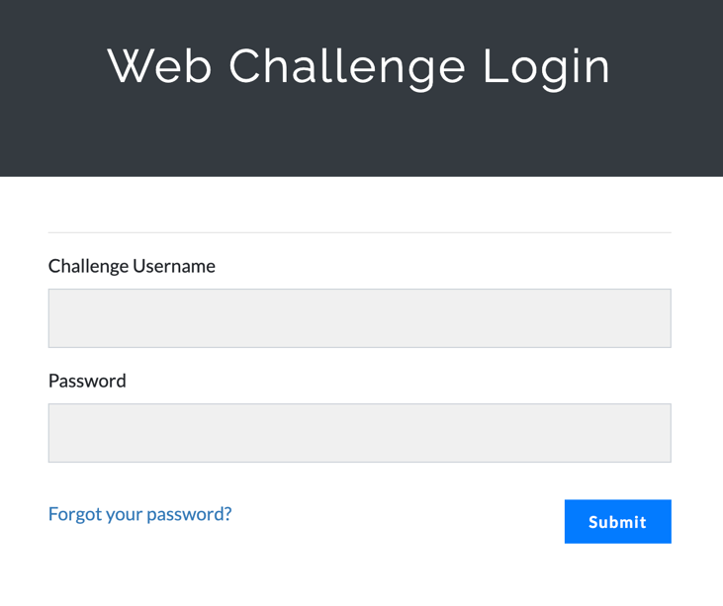
Web Server Authentication
We don’t use HTTP Basic Authentication for logging into the website
Instead, we use the login form:
How does it work?

Slide 25

Web Password Authentication
Send ID/password but the server stores hash of the password
blue9057: 59636881ab9bf34263cf3f4d90f25d2b91e74e8804b802d25c8f4bc5c80846ee
blue9057:my-super-secure-password!@#$11
Protected by TLS (HTTPS)
SHA256(“some_secret” + “my-super-secure-password!@#$11”)
= 59636881ab9bf34263cf3f4d90f25d2b91e74e8804b802d25c8f4bc5c80846ee

Slide 26
Server Logic
User submits ID and password
Query database to find a pair of
(Username, SHA256(secret + password))
Exists…

Slide 27
Database Access for Password
SQL Query (SQL examples: https://www.w3schools.com/sql/sql_examples.asp)
SELECT (username, password) FROM users WHERE username = ‘blue9057’
and password = SHA256(secret + “my-super-secure-password!@#$11”)
The user sends the plaintext password to the server
But the password is never stored in the DB
Even if the attackers know the secret, they have to inverse SHA256
To get the plaintext password

Slide 28
Caveat: SHA256 is susceptible to the Brute-force Attacks
Suppose an attacker breached into the server
They can have the database (all the password hashes)
They can have the program source code (the secret that generates hash…)
They can run the following algorithm
for strings in all_strings:
If SHA256(secret + strings) == ‘59636881ab9bf34263cf3f4d90f25d2b91e74e8804b802d25c8f4bc5c80846ee’
print(strings)

Slide 29
Caveat: SHA256 is susceptible to the Brute-force Attacks
They can run the following algorithm
for strings in all_strings:
If SHA256(secret + strings) == ‘59636881ab9bf34263cf3f4d90f25d2b91e74e8804b802d25c8f4bc5c80846ee’
print(strings)
How long should it take (theoretically) ?
~2 ** 256 seconds (seems forever)
Not true

Slide 30
Humans choose password not Randomly…
The security factor of SHA256 works correctly (2 ** 256) if
The input was chosen completely randomly
How human users choose password?
Easy to memorize and type (12345678, password)
Some familiar phrases (orangebeaverROCKS)
Add some numbers on it (password1234)
Add some special characters on in (password1234!!)

Slide 31
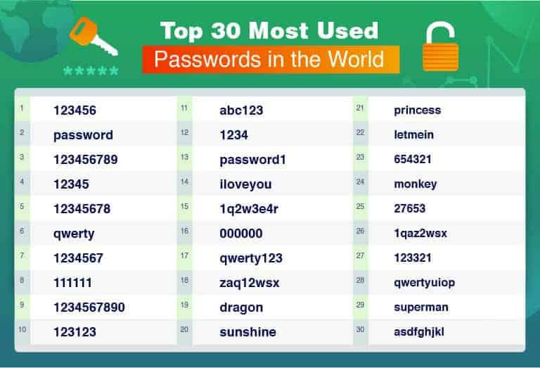

Slide 32
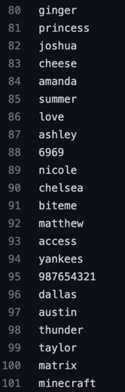
Dictionary Attack
Hackers may try popular, known password phrases first..
https://github.com/danielmiessler/SecLists/tree/master/Passwords/Common-Credentials

Slide 33
Why Do We Need Special Chars in Password?
[A-Z] * 8
26 ** 8 = 208,827,064,576
[A-Za-z] * 8
52 ** 8 = 53,459,728,531,456
[A-Za-z0-9] and special chars * 8
95 ** 8 = 6,634,204,312,890,625

Slide 34
Hash Crackers
We can run SHA256 with secret and try those passwords
[A-Za-z0-9] and special chars * 8
95 ** 8 = 6,634,204,312,890,625
6,634 trillion cases

Slide 35
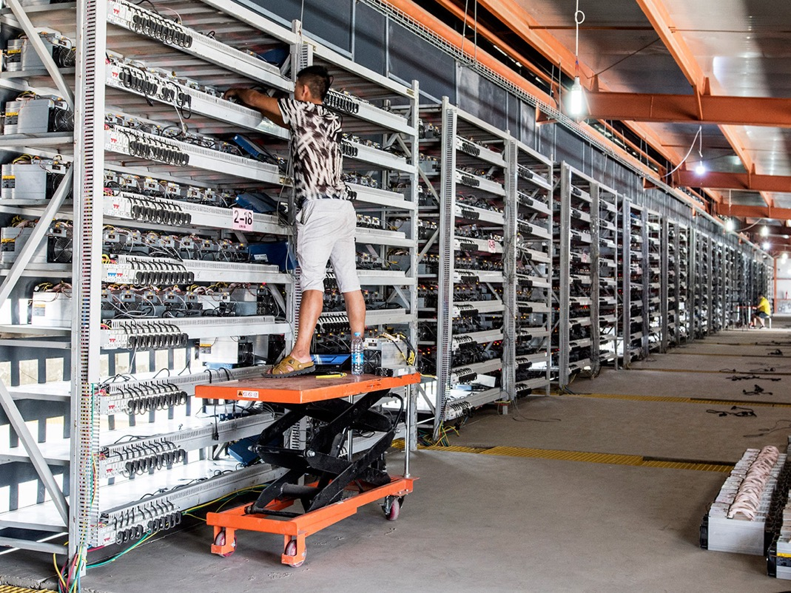
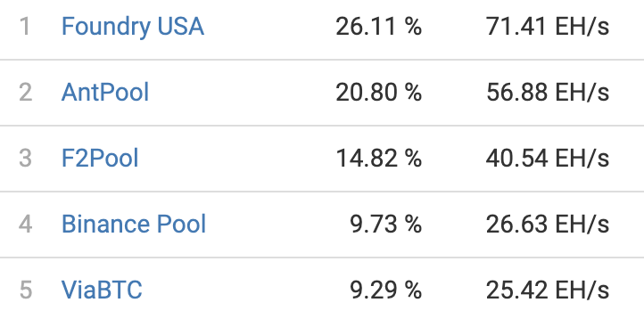
Bitcoin Miners == Hash Crackers
Using GPUs to calculate
X = transaction_data + random
SHA256(X)
The result should have 80 0s…
00000000000…..23948329793

Slide 36
Bitcoin Miners == Hash Crackers
[A-Za-z0-9] and special chars * 8
95 ** 8 = 6,634,204,312,890,625
6,634 trillion cases
6P (Peta) cases (less than 1 ms???)

Slide 37
SQL injection
SQL Query (SQL examples: https://www.w3schools.com/sql/sql_examples.asp)
SELECT (username, password) FROM users WHERE username = ‘blue9057’
and password = ’my-super-secure-password!@#$11’
What if we supply ‘or ‘a’=‘a as a password?
SELECT (username, password) FROM users WHERE username = ‘blue9057’
and password = ‘’ or ‘a’ =‘a’
SELECT (username, password) FROM users WHERE
username = ‘blue9057’ and password = ‘’ or
‘a’ =‘a’
ALWAYS TRUE!!!

Slide 38
SQL injection
What if we supply ‘or ‘a’=‘a as a password?
SELECT (username, password) FROM users WHERE username = ‘blue9057’
and password = ‘’ or ‘a’ =‘a’
We can bypass password checking logic by injecting malicious data to the database SQL query

Slide 39
SQL injection
What if we supply ’ union select (‘admin’, ‘a’) where ‘a’=‘a as a password?
SELECT (username, password) FROM users WHERE username = ‘blue9057’
and password = ‘’ union select (‘admin’, ‘a’) where ‘a’=‘a’
It will fetch none for the first select and
2nd select will return will have
Username = ‘admin’
Password = ‘a’

