Slide 1
CS 370 Introduction to Security
Codebreaker Prep

Slide 2
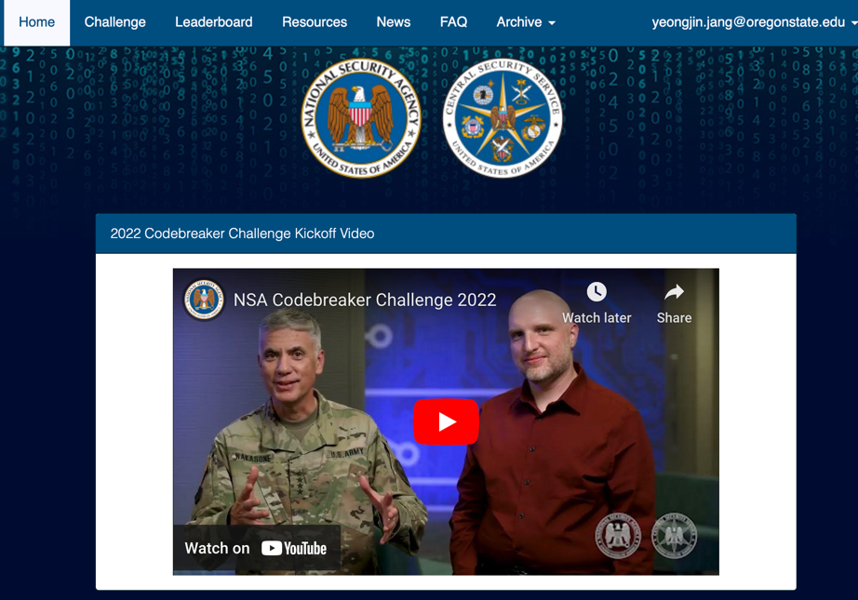
NSA Codebreaker Challenge
Annual Cybersecurity competition hosted by NSA
https://nsa-codebreaker.org/home

Slide 3
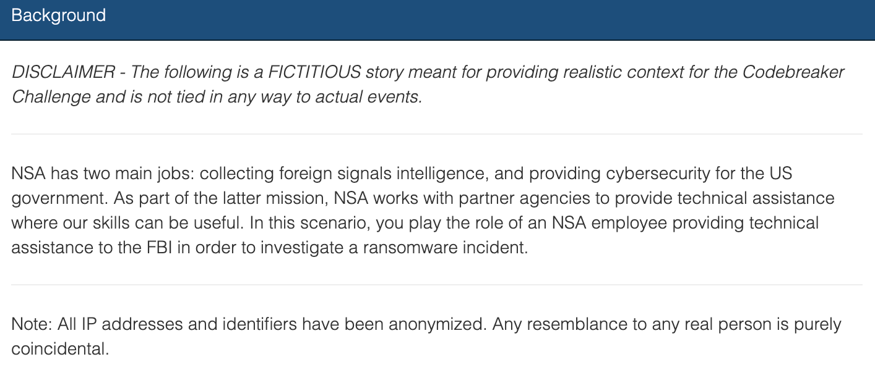
Challenge Comes with a Fake But Realistic Scenario
Assist FBI in order to investigate a ransomware incident

Slide 4
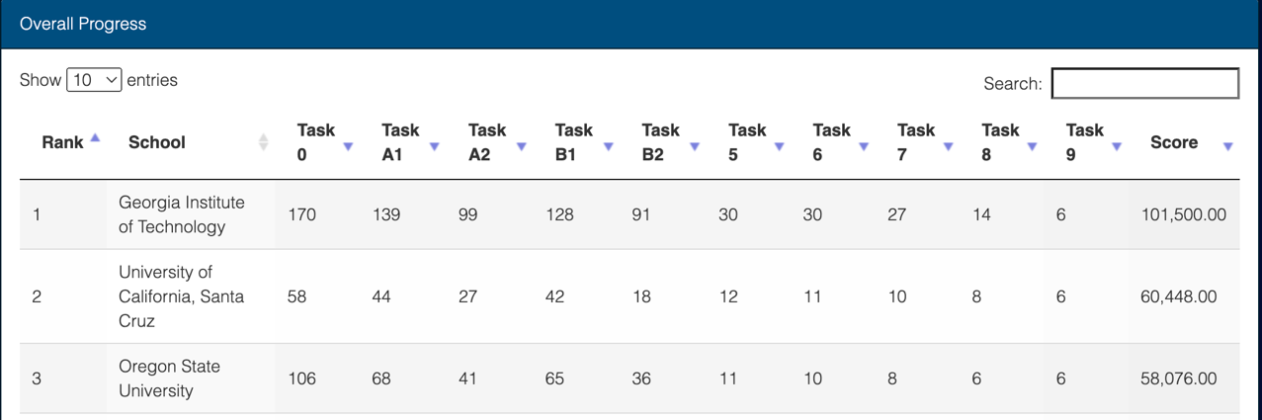
Team Effort
Oregon State University
1st place (2018), 3rd place (2019, 2020, 2021)
What about in 2022???

Slide 5
What We Include?
Task 0, Task A1, Task A2, Task B1, Task B2
Each will contribute as 4% towards your total grade points
We cannot directly teach you on how you solve codebreaker challenges
This slide/video demonstrates different but similar challenges that you can apply the technique learned from the challenge to NSA Codebreaker

Slide 6
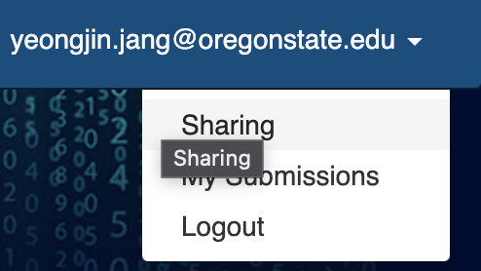
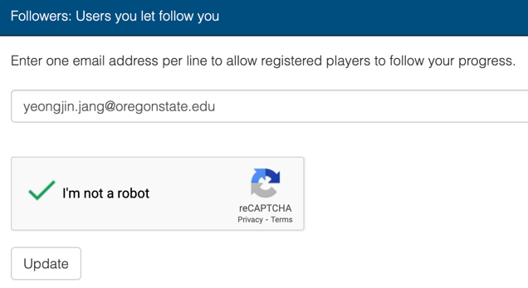
Sharing Score
Please register yourself to the NSA Codebreaker Challenge
https://nsa-codebreaker.org/home
After login, go to Sharing page
https://nsa-codebreaker.org/sharing
Add me as your follower
yeongjin.jang@oregonstate.edu

Slide 7
Tutorials
C1 – Log analysis
C2 – Packet analysis
D1 – Web application analysis
D2 – Web vulnerability analysis

Slide 8
Tutorials
C1 – Log analysis -> Solve A1!
C2 – Packet analysis -> Solve A2!
D1 – Web application analysis -> Solve B1!
D2 – Web vulnerability analysis -> Solve B2!

Slide 9
Due Date
Please solve all tutorials and the NSA codebreaker Task 0, A1, A2, B1, and B2 before 12/9 11:59 pm
There will be no later submission
I need to get your grade during 12/10~12/12

