Slide 1


Slide 2
Core Competency
Assesses the breastfeeding mother and infant for common breastfeeding difficulties and counsels and provides support and/or referrals as needed.

Slide 3
Learning Objectives
Identify consequences of unresolved breastfeeding issues (engorgement, plugged ducts, sore nipples, and low milk production) and strategies mothers can use to address them.
Name situations in which referrals are needed.

Slide 4
Solving Concerns While They Are Small
Breastfeeding challenges can usually be prevented through proper latch and milk transfer.
They can also be managed with options for solutions and support.

Slide 5

Real Life Breastfeeding Challenges
Handout 10.1: “Real-Life Breastfeeding Challenges”

Slide 6
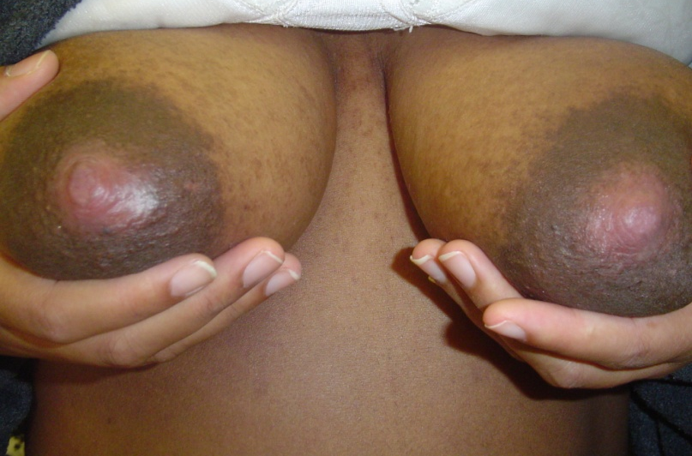
Common Concerns: Sore Nipples
Common causes
Incorrect latch or position
Baby has had other nipples
Delays between feedings
Wet nursing pads
Raynaud’s Synrome
Fungal infection
Baby’s oral structure or facial anomaly
Soaps and other products used on breasts
Incorrect breast pump use/size of flange

Slide 7
What Mom Needs to Hear
Affirmation
“What a great mom you are for sticking with it”
Information
“There are solutions that can help you feel more comfortable.”
Yield if no improvement in 24 hours
Handout 10.2: “Solutions to Share with Mothers”

Slide 8
Solutions for Sore Nipples
Before breastfeeding
Massage to bring about MER
During the feeding
Proper positioning and latch
Do not limit the feeding
After the feeding
Yield if no improvement in 24 hours

Slide 9
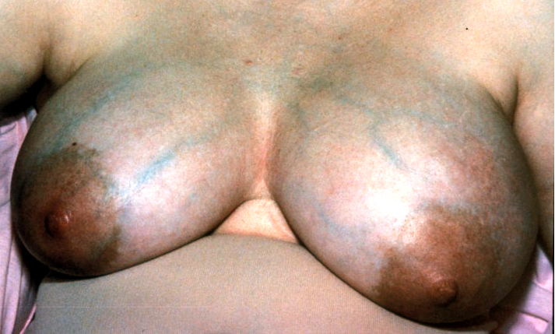
Common Concerns: ENGORGEMENT
Breast fullness is normal (extra blood and fluid)
Causes
IV fluids in hospital
Inadequate draining of the breast
Supplementation

Slide 10
The Domino Effect
Engorgement can lead to:
Diminished milk production
Reduced milk flow to baby
Diminished milk ejection reflex
Plugged ducts
Mastitis
Premature weaning

Slide 11
What Mom Needs to Hear
Affirmation
“I can see you are in a lot of pain. We can work through this.”
Information
“There are solutions for quick relief!”
How to remove excess milk
Yield if no improvement in 24 hours
Handout 10.2: “Solutions to Share with Mothers”

Slide 12
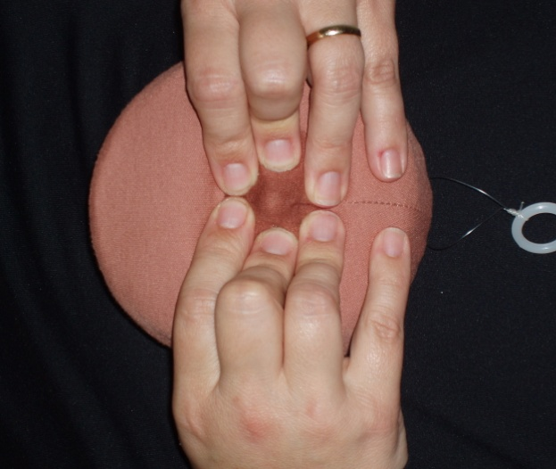
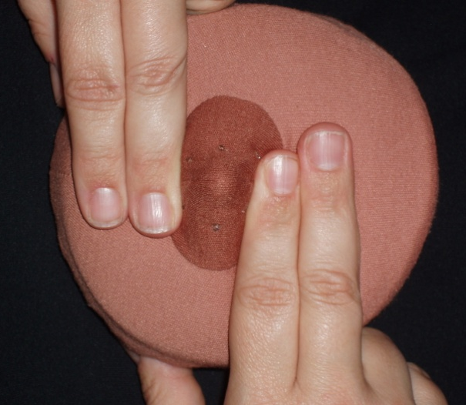
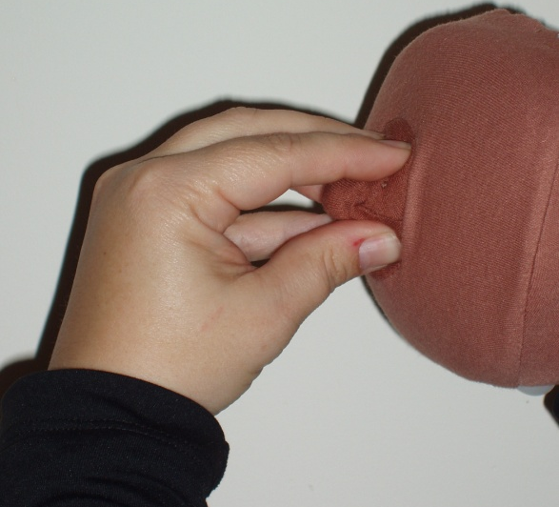
Solutions for Engorgement
Reverse Pressure Softening

Slide 13

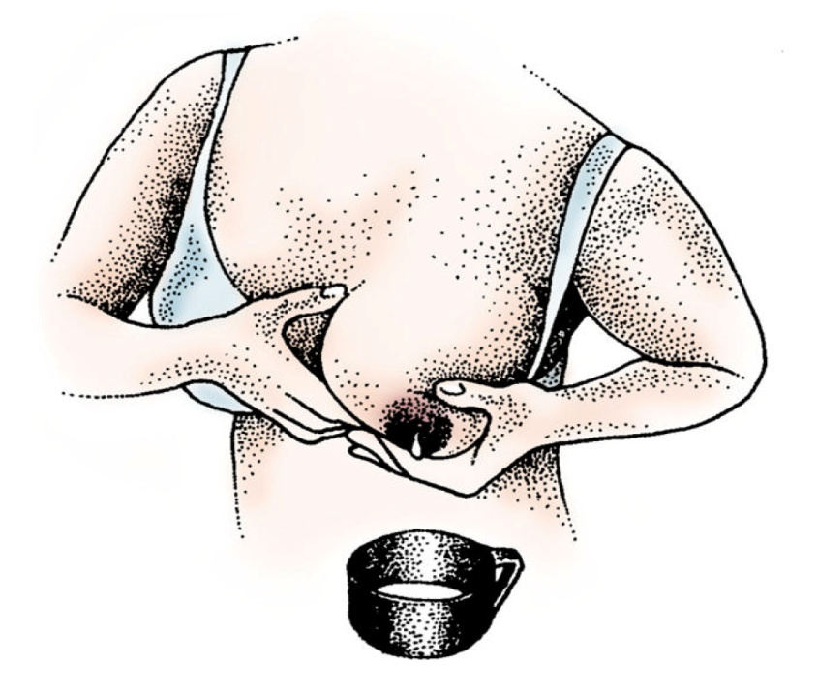
Hand Expression
Apply warm compresses
Gentle massage
Place fingers “where dark meets the light”
Bring tissue back toward chest wall and roll forward toward the nipple
Avoid squeezing the nipple
Praise every drop!

Slide 14
Common Concerns: Plugged Ducts
Causes:
Untreated engorgement
Delayed or missed feedings
Pressure against milk ducts
Purse or diaper bag strap pressing across mother’s chest
Car seat belt
Wearing a bra that is too tight

Slide 15
What Mom Needs to Hear
Affirmation
“It’s great that you called for help.”
Information
“There are strategies that can get you some comfort and quick relief.”
Yield if no improvement in 24 hours, or if mother has a hardened area that does not go down in size
Handout 10.2: “Solutions to Share with Mothers”

Slide 16
Solutions for Plugged Ducts
Warm compress on the plugged area
Gentle massage toward the nipple
Feed the baby on the breast with the plug first
Continue gently massaging the plugged area while the baby is feeding
Keep the breast well drained
Breastfeed often

Slide 17
Common Concerns: Mastitis
Mother may report:
Fever > 100.4⁰
Chills
Body aches
Painful breast(s) that may be red and hot to the touch
Baby refuses to feed on the affected breast
Handout 10.2: “Solutions to Share with Mothers”

Slide 18
What Mom Needs to Hear
Breast inflammation and infection can usually be prevented
Affirm: “I can see you are in pain. We’re going to get you some quick help so you’ll ble more comfortable.”
Yield her to her primary care physician for immediate assessment and treatment
Handout 10.2: “Solutions for Breastfeeding Mothers”

Slide 19
Solutions for Mastitis
Prevention
Rest and help with household activities
Adequate breast drainage
Proper nutrition and fluids
Promptly treat engorgement/plugged ducts
Continue breastfeeding to keep breast well drained

Slide 20
Common Concerns: Low Milk Production
Perceived vs. real low milk production
Mothers might:
Misinterpret baby’s behaviors
Feel frustrated with using a breast pump and getting little milk

Slide 21
Common Concerns: Low Milk Production
Perceived
Baby stooling well (3+ poops/day 1st 4 weeks)
Baby gaining 4-7 ozs. each week
Mom not offering supplements
Mom may be receiving negative messages
Low Milk Production
Baby is not nursing 8-12 times/24 hours
Mom’s breasts do not feel fuller before feedings
Mother giving supplements
Mother/baby are separated and milk is not being removed

Slide 22
Causes of True Low Milk Production
Replacing feedings with formula
Early introduction of solid foods
Combination birth control pills/medications
Limiting baby’s time at the breast
Surgery on the breast
Smoking
Another pregnancy

Slide 23
What Mom Needs to Hear
Affirm
“It’s normal to worry about making enough.”
Inform
Normal infant behaviors
How to know baby is getting enough
Encourage a weight check at WIC
Yield if a true low milk production
Handout 10.2: “Solutions for Breastfeeding Mothers”

Slide 24
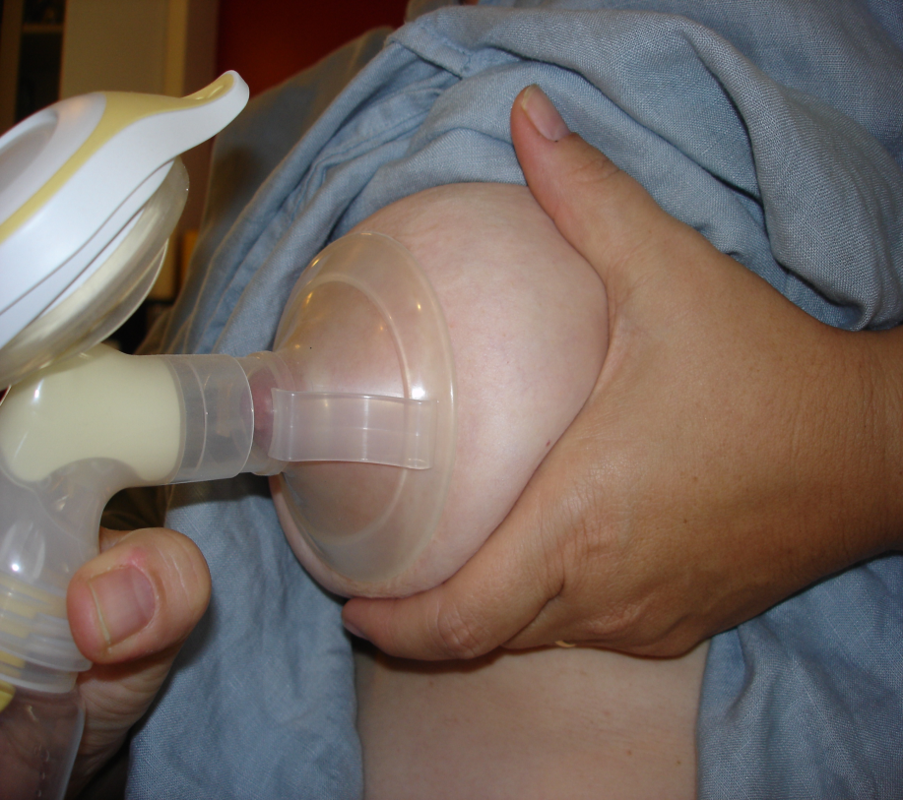
Solutions for Low Milk Production
Check baby’s position/latch
Increase number of feedings/milk expression
Skin-to-skin contact
Breast compression
Express milk when apart from baby
Handout 10.2: “Solutions to Share with Mothers”

Slide 25
Conditions That are Compatible
Hepatitis B and C
Herpes
Diabetes

Slide 26
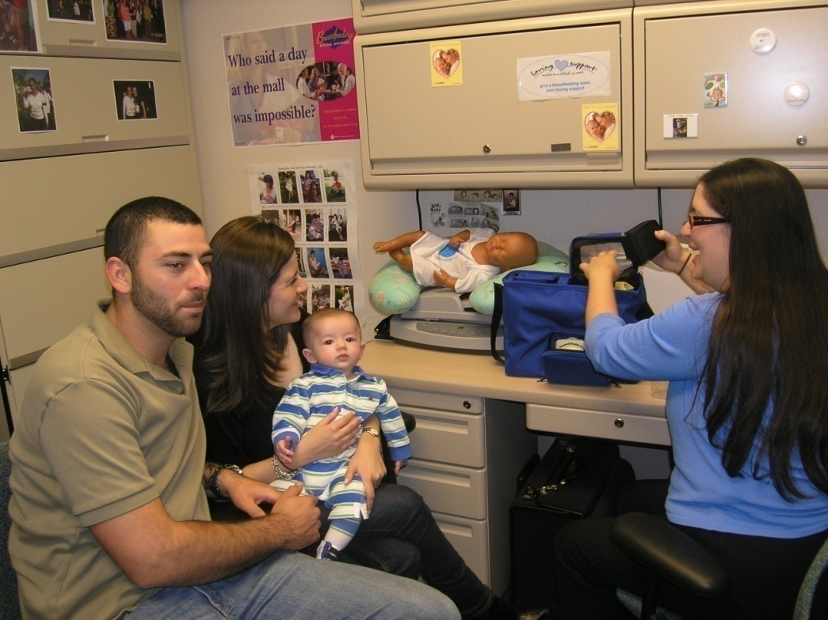
When Mothers Experience Problems
True breastfeeding problems can often be prevented
If they do occur, quick solutions and loving support make the difference
West Dade, FL WIC

Slide 27

Thinking in New Ways

Slide 28
When Mothers Request Infant Formula
Fully assess before issuing formula
Reassure her there are solutions
Explain the impact of formula on milk production
If the mother chooses to begin formula, or some formula is determined to be necessary after a careful assessment:
Issue only the smallest amount needed
Let her know that she can resume exclusive breastfeeding and WIC can help
Yield her to the WIC Designated Breastfeeding Expert

Slide 29
Application to Practice
Handout 10.3: “Application to Practice: Overcoming Challenges”

Slide 30
Summary
Common challenges that mothers face include: sore nipples, engorgement, plugged ducts, mastitis, and worried about baby getting enough.
Most common challenges can be prevented, and can be managed if they do occur.

Slide 31

Grow Your Breastfeeding Skills
“My Goals for Breastfeeding Support”
Goal-Setting Flower

