Slide 1


Slide 2
Core Competency
Recognize how personal beliefs and attitudes influence mothers’ breastfeeding decisions.

Slide 3
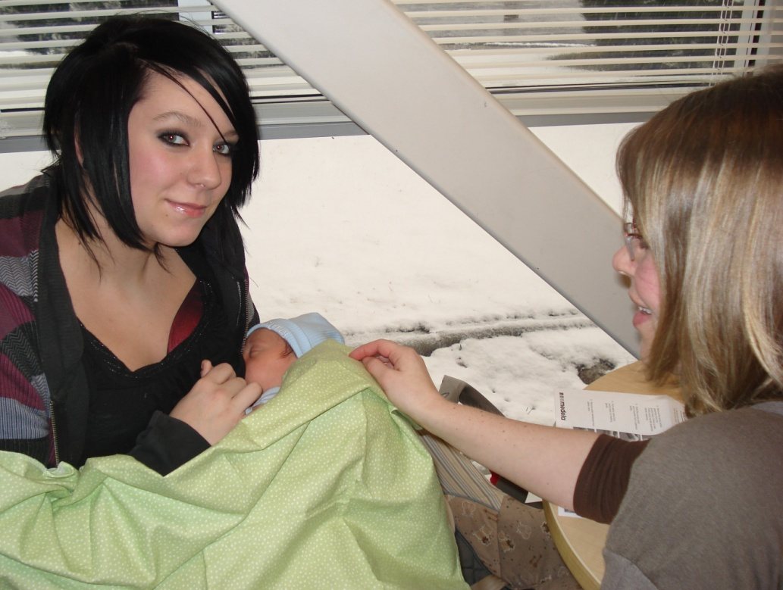
Learning Objective
Identify own personal beliefs and attitudes about breastfeeding.
Utah WIC

Slide 4
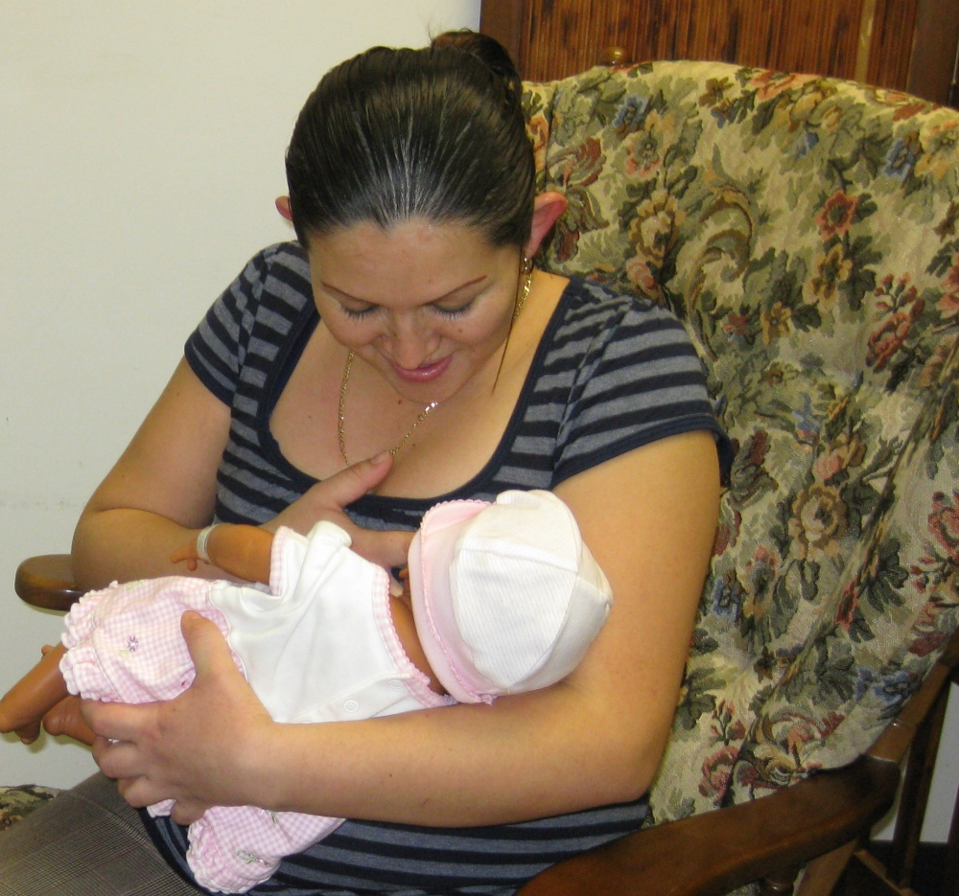
First Time for Everything
Unity Healthcare WIC, Washington, DC

Slide 5
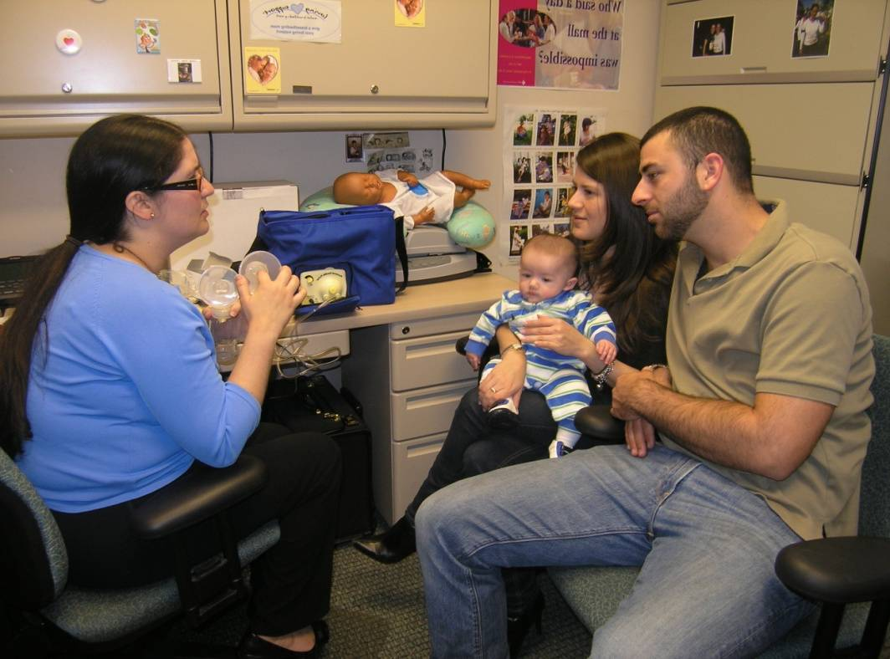
Perceptions of Breastfeeding
Feelings are part of who we are
Reflect on:
Feelings
Experiences
Beliefs
Our job: educate and support
Miami-Dade WIC, Miami, FL

Slide 6

What If?
Handout 2.1: “What If?”

Slide 7
I Don’t Want to Make Mothers Feel Guilty
Our job: Honor and support the parents’ right to choose how they feed their baby
“Breastfeeding: Another Way of Saying I Love You” (Mississippi WIC State Agency)

Slide 8
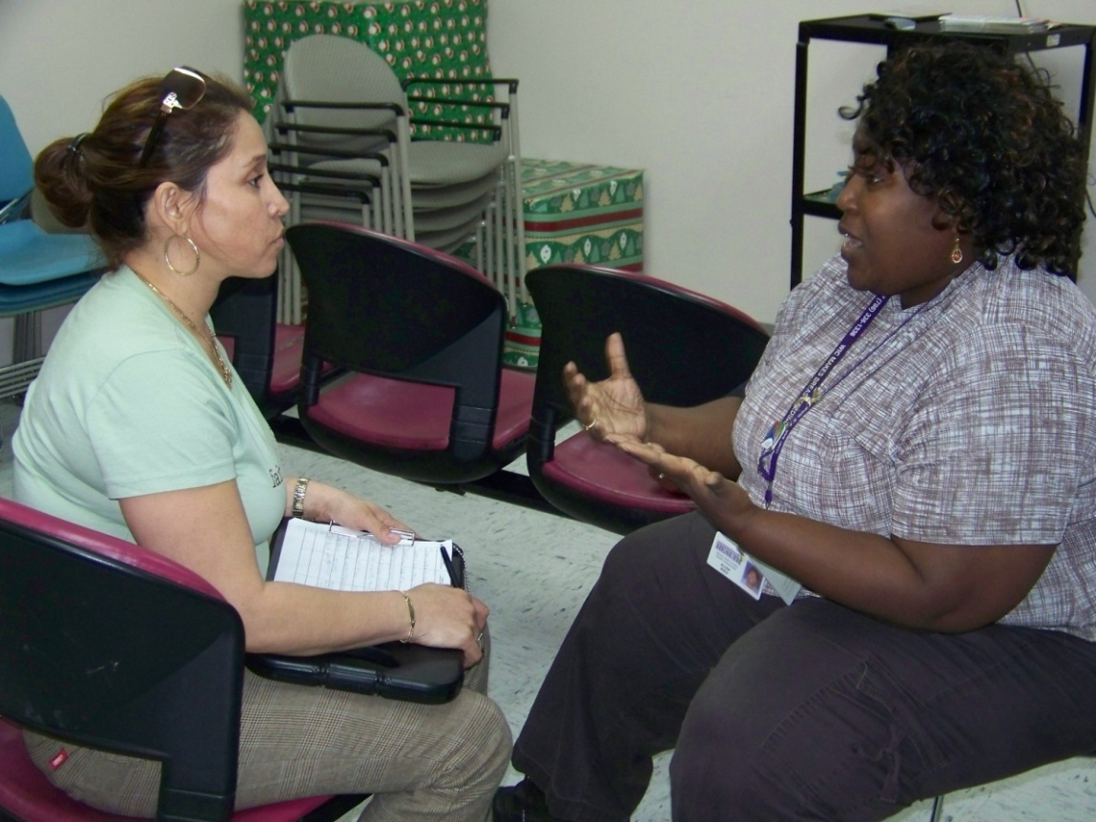
Other Feelings To Consider
Embarrassment
When participants
demand infant formula
North Miami WIC, Miami, FL

Slide 9
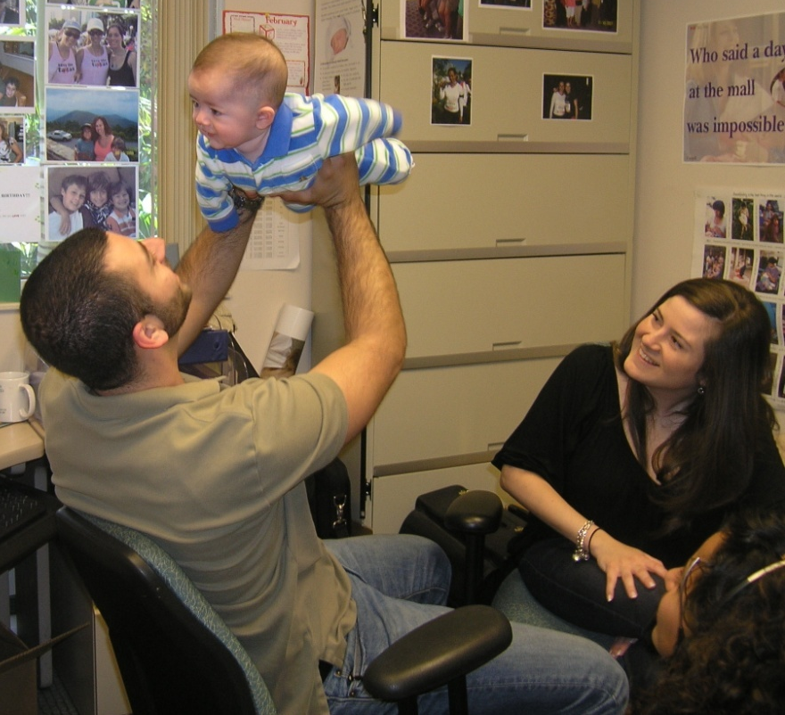
What If I’m Not an Expert?
Planting seeds
Be an expert…
in encouragement!
Miami-Dade WIC, Miami, FL

Slide 10
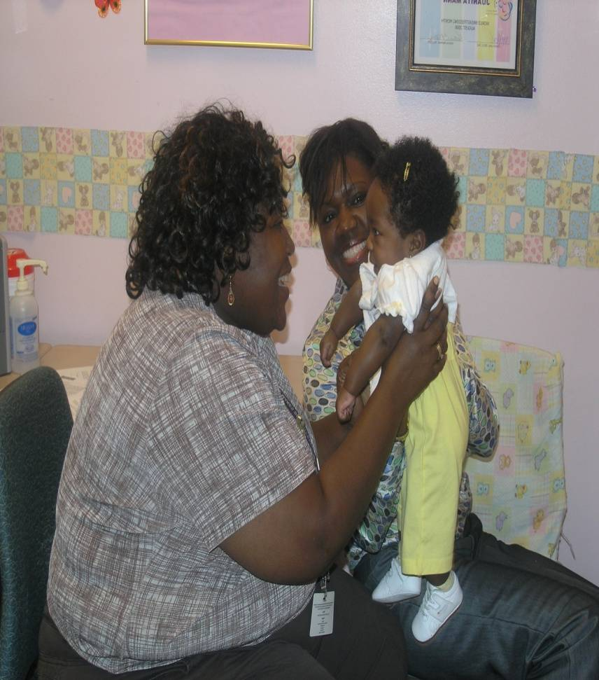
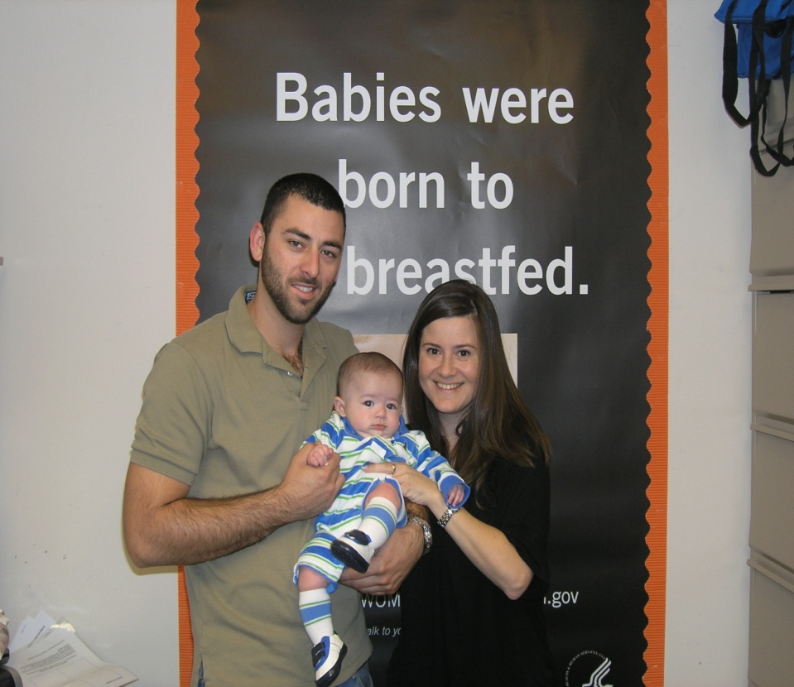
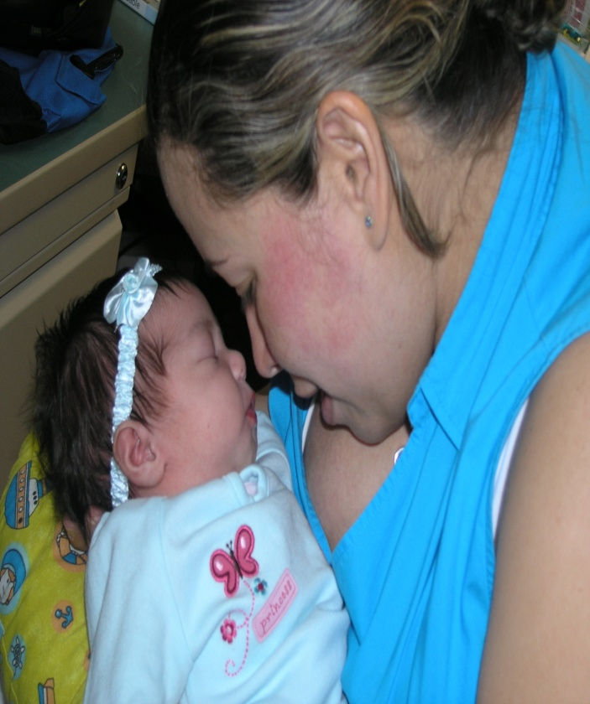
What’s Growing in Your WIC Garden?

Slide 11
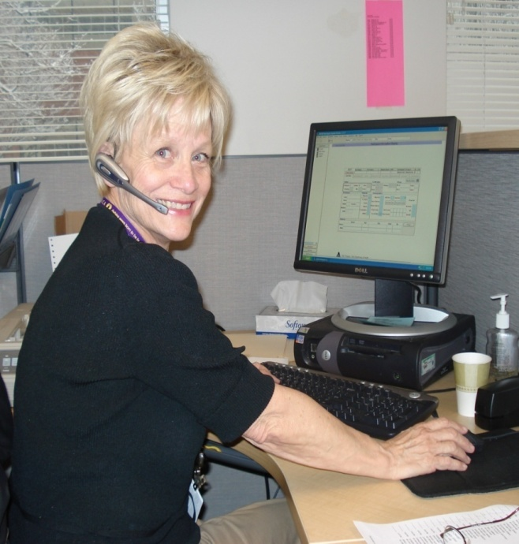
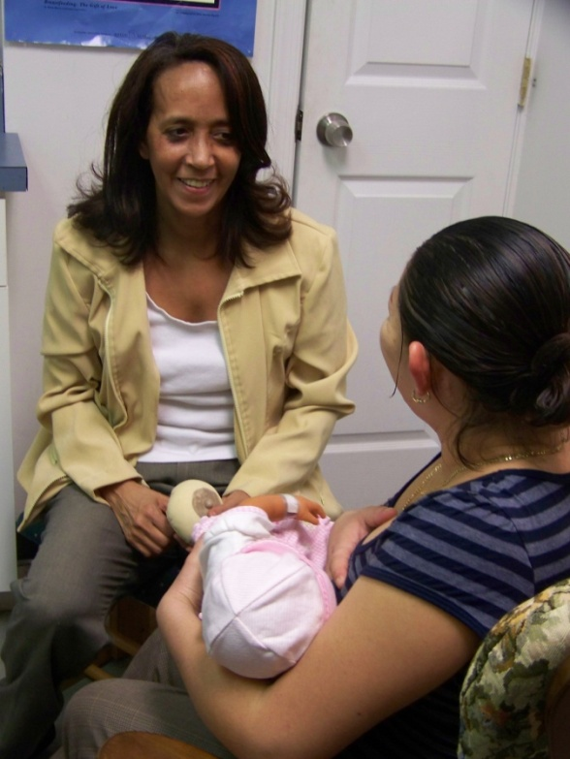
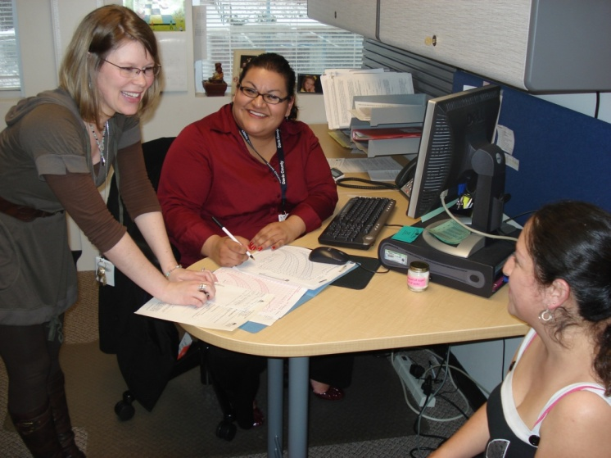
WIC Staff Make the Difference

Slide 12
Summary
As we focus on becoming more competent in helping WIC mothers with breastfeeding, an important first step is to explore our own experiences so that we can better understand where our feelings originated.

Slide 13

Grow Your Breastfeeding Skills
“My Goals for Breastfeeding Support”
Goal-Setting Flower

