Slide 1
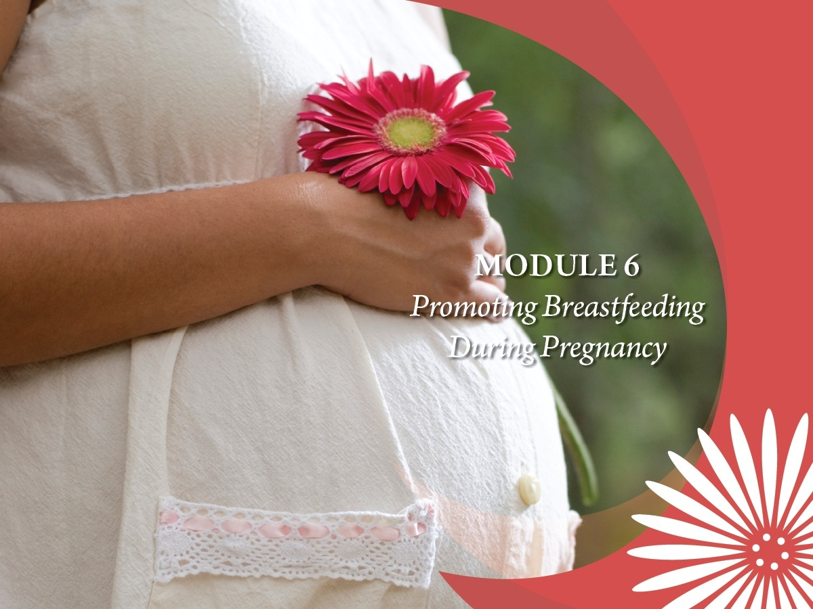

Slide 2
Core Competencies
Encourages pregnant women to breastfeed and promotes the food packages available for breastfeeding women and their infants.
Assesses a pregnant woman’s intention to breastfeed and identifies factors that affect breastfeeding success.
Provides appropriate anticipatory guidance on breastfeeding during the course of a mother’s pregnancy.

Slide 3
Learning Objectives
Describe breastfeeding anticipatory guidance for pregnant women.
State how the food packages provide incentives to help mothers make the decision to initiate and continue to breastfeed.
Explain how support during the first few weeks after delivery is critical to breastfeeding success.

Slide 4
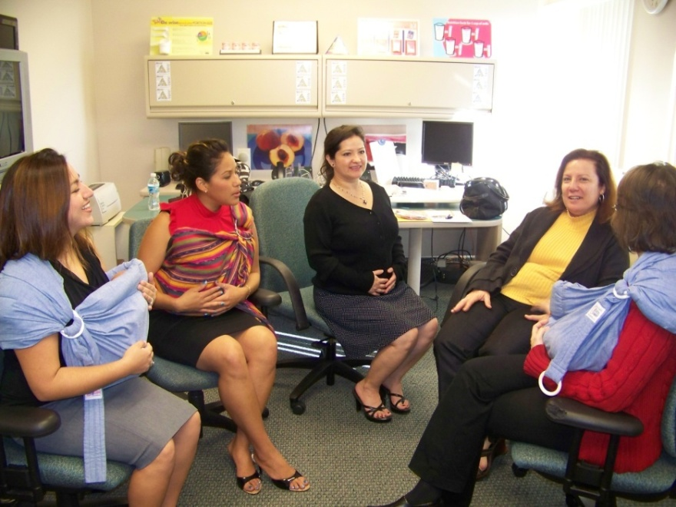
The Right Words at the Right Time
You can help increase the number of
women who breastfeed:
Increase mothers’ awareness
Increase mothers’ confidence
Help mothers know what to expect
Help mothers identify solutions to perceived barriers
Miami Dade WIC

Slide 5
Tailoring Messages
Making your messages mom-specific
Planting seeds of awareness, growing confidence
Anticipatory guidance to provide in early, mid and late pregnancy

Slide 6
Early Pregnancy
Increase awareness
Explore knowledge and beliefs about breastfeeding
Identify potential barriers
Acknowledge concerns
Refer to Peer Counselor
What have you heard about breastfeeding?

Slide 7

Health Concerns Mothers May Have
Smoking
Alcohol
Drugs

Slide 8
Anticipatory Guidance: Early Pregnancy
Explain how WIC supports her with breastfeeding
Extra WIC foods for breastfeeding mothers and babies
Certification for both mother and baby through the 1st year
Breastfeeding education classes and support group meetings
Breast pumps for certain needs
Breastfeeding Peer Counselors
Remind mothers to know their HIV status
Refer as appropriate
Yield to a peer counselor

Slide 9
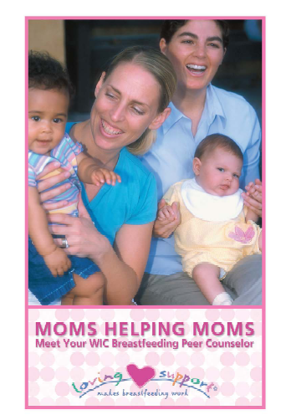

3-Step During Early Pregnancy
Open-ended questions
Affirmation
Education
Handout 6.1: “Best Practices Promoting and Supporting Breastfeeding in WIC”

Slide 10
Mid Pregnancy
Encourage attendance at a breastfeeding class
Assess questions, support, plans
Explore solutions for making breastfeeding work
How WIC supports breastfeeding, food packages
What are your plans
after the baby is born?
Who can support you
with breastfeeding?

Slide 11
Anticipatory Guidance Mid Pregnancy
Mom’s breasts are ready-to-feed!
How the breast makes milk
Why WIC does not provide formula to breastfeed babies in the first month
Combining breastfeeding and employment
Ways WIC supports breastfeeding
Who can help
Yield to WIC Designated Breastfeeding Expert
Refer as appropriate

Slide 12
Mom’s Breasts are Ready to Feed! (No Preparation Needed)
Breasts are preparing for breastfeeding
Colostrum appears around 16 weeks
Growth of glandular tissue may cause tenderness
Breast size does not impact quantity of milk
If mother has concerns about flat/inverted nipples, refer her to the WIC Designated Breastfeeding Expert

Slide 13
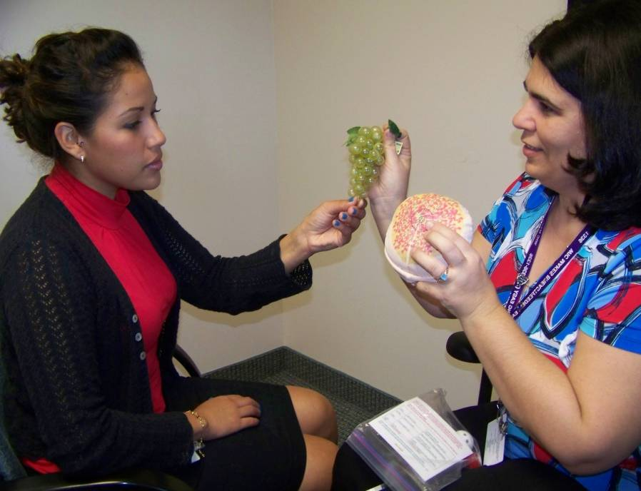
3-Step During Mid Pregnancy
Open-ended questions
Affirmation
Education
Handout 6.1: “Best Practices Promoting and Supporting Breastfeeding in WIC”
Miami Dade WIC

Slide 14
Late Pregnancy
Tell me about your plans for breastfeeding in the hospital.
What does your mother or the baby’s father think about your decision to breastfeed?
Assess how mother is preparing to breastfeed
Develop breastfeeding plan

Slide 15


Late Pregnancy: Having a Breastfeeding Plan
Getting breastfeeding off to a good start in the hospital
Sources of breastfeeding support
Plans for returning to work or school
Plans for contacting WIC after the baby is born

Slide 16
Late Pregnancy: Preparing to Breastfeed
Top Priority: Get breastfeeding off to a good start.
Attend prenatal classes.
Share goals and options with her family and support network.
Weed prevention and control – address barriers and provide doable options.

Slide 17
Anticipatory Guidance: Late Pregnancy
How supplementation affects milk production
How to know her baby is getting enough milk
Hunger signs that let her know her baby is ready to eat
Sources of breastfeeding support in the community
Practices for breastfeeding success

Slide 18
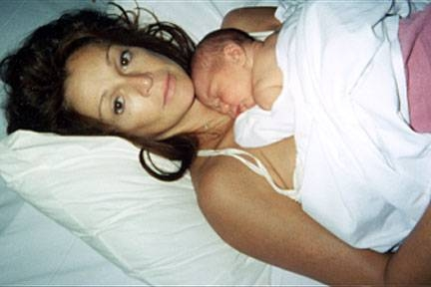
Empowering a Mother for Success
Skin-to-skin with baby
Avoid separation
Frequent feedings
(8-12 times/day)
Delay first bath
Avoid artificial smells
Delay visitors
Photo by Jeanette Panchula
Notes:
18

Slide 19
Right Before Delivery
Call to see how her pregnancy is going.
Remind her to:
Come in as soon as possible after delivery to enroll baby on WIC and get breastfeeding help if needed
Contact her Peer Counselor as soon as her baby is born
Ask the hospital nurse or IBCLC to assist her and observe a feeding
Yield to a Peer Counselor and WIC Designated Breastfeeding Expert.

Slide 20
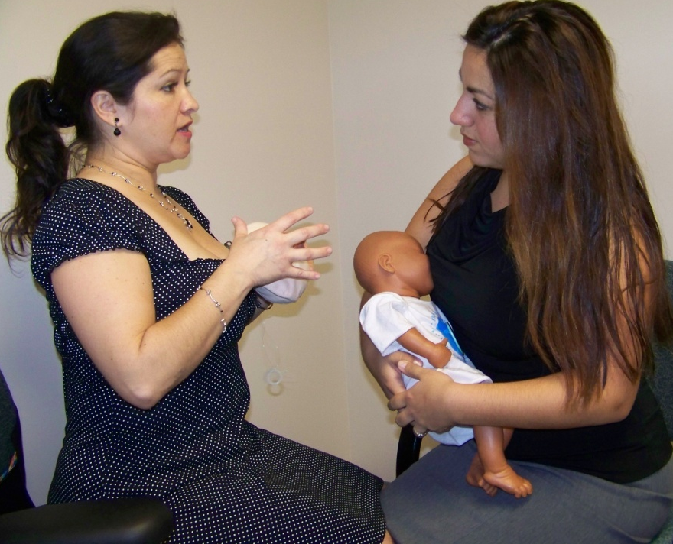
3-Step During Late Pregnancy
Open-ended questions
Affirmation
Education
Handout 6.1: “Best Practice Promoting and Supporting Breastfeeding in WIC”
Miami Dade WIC

Slide 21

Show Me!
DVD: “Show Me Video Vignettes”
Handout 6.2: “Show Me Video Vignettes: Prenatal Counseling”

Slide 22
Application To Practice
Handout 6.3: “Application To Practice: Solutions To Barriers”

Slide 23
Summary
Asking open-ended questions, affirming, then educating helps us tailor our support to meet the mother’s unique needs.
All staff can encourage women to breastfeed and provide anticipatory guidance as appropriate.
Anticipatory guidance helps a mother choose to breastfeed with confidence.

Slide 24

Grow Your Breastfeeding Skills
“My Goals for Breastfeeding Support”
Goal-Setting Flower

