Slide 1


Slide 2
Core Competencies
Helps breastfeeding mothers identify strategies for continuing to breastfeed when they must be away from their baby (i.e., returning to work or school).
Encourages mothers to continue breastfeeding and provides guidance on ways to maintain milk production.

Slide 3
Learning Objectives
Explain how a mother can maintain milk production when she is separated from her baby.
Identify common barriers to breastfeeding among women employed in unsupportive environments.
State appropriate guidelines for storing and handling breast milk.

Slide 4
WIC’s Role in Supporting Breastfeeding When Mothers and Babies are Separated
Support comes in many forms
Our most effective tools:
Affirmation, anticipatory guidance
Having a plan aids success for breastfeeding mothers who are separated from their babies

Slide 5

Mother’s Concern During Separation: Maintaining Her Milk Production
Having enough milk: Mom’s #1 worry
Help mother explore milk expression
options that fit her situation
Mom will typically need to breastfeed
or pump 8-12/day

Slide 6

Making Breastfeeding Work During Separations
Handout 9.1: “Separation Scenarios”

Slide 7
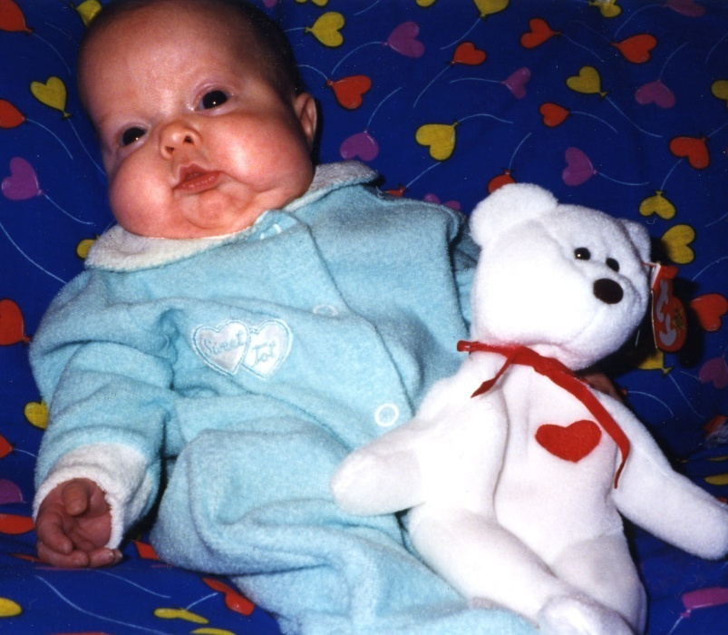
Separation: Pre-Term or Sick Baby
Mother’s milk crucial:
Immunological factors
Affects mortality and morbidity rates
Improves cognitive outcomes

Slide 8
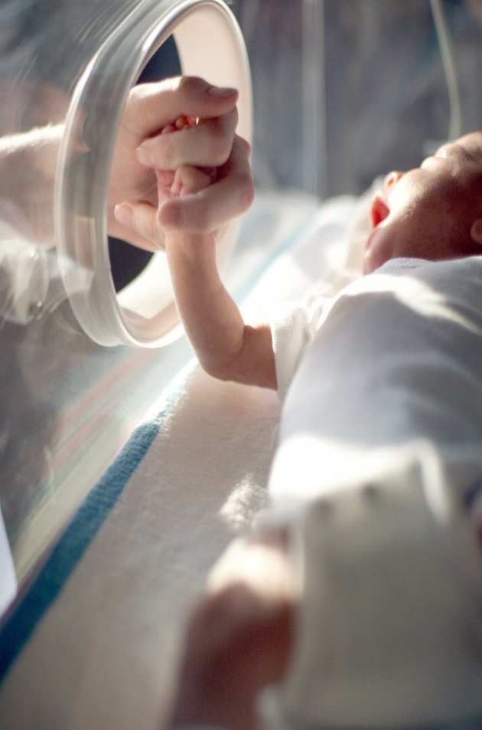

Supporting Mothers of Preterm Babies
Let mother know she is doing something for her baby no one else can
Ensure mother can express her milk and knows how to handle and store it
Refer her to staff for a pump or other services

Slide 9
Separation: Sick or Hospitalized Mother
Mother may not feel well enough to breastfeed
May worry about medications or making her baby sick
Help her avoid engorgement
Yield: WIC Designated Breastfeeding Expert

Slide 10

Separation: Occasional Outings
Short separations and exclusive breastfeeding are compatible
Hand expression: Something every mother should know
Refer: WIC Designated Breastfeeding Expert

Slide 11
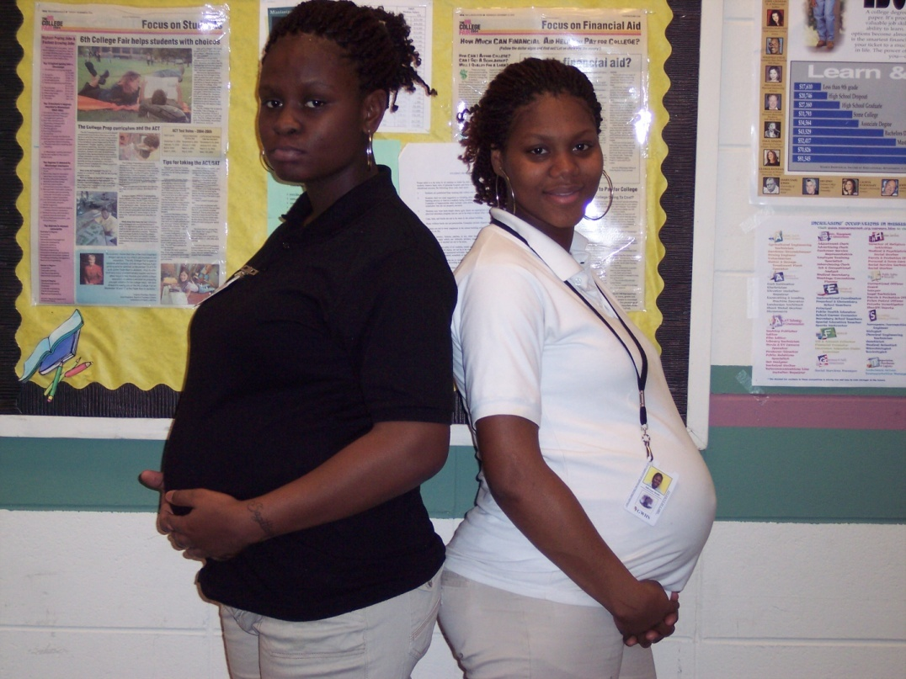
Separation: Returning to School
Tailor guidance for her situation
Yield: WIC Designated Breastfeeding Expert
Anticipatory guidance:
Place and time to express
Childcare options
Dealing with fatigue

Slide 12
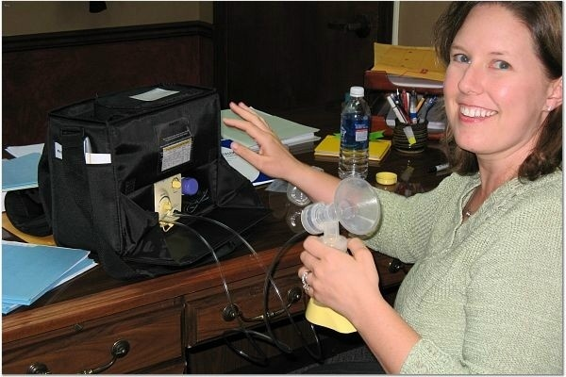
Separation: Returning to Work
Delicate balance of employment and motherhood
Help mom develop a plan for success: when/where to pump, how to feed the baby when they are apart

Slide 13

Where Do WIC Women Work?
Some workplaces are more breastfeeding-friendly than others:
Schedule
Work duties
Environment
Supervisors and co-workers
One size does not fit all—ask open-ended questions to help mother find solutions

Slide 14

All in a Day’s Work
Work Setting | Barriers | Impact on Breastfeeding | Solutions
Handout 9.2: “All in a Day’s Work”

Slide 15
Unsupportive Work Environments
Non-office job settings
Job settings with lack of personal space (cubicle work stations)
Irregular work schedules or inflexible hours
Low salaries
Child-care options may be limited

Slide 16

Turning Obstacles into Opportunities
There is no one “right” way
Present solutions as a “menu” of options
Mothers will choose what will work best for them

Slide 17
Obstacles to Opportunities: Anticipatory Guidance
Pregnancy is a good time to start thinking about options
Split shifts
Part-time
Bringing baby to work
Help her connect to support: Peer Counselor, support group

Slide 18
Obstacles to Opportunities: Mom’s Success Plan
Breastfeed exclusively the first 3-4 weeks
Delay supplementing/bottles
Let her know
Strong emotions about returning to work are normal
Continuing to breastfeed will help her reconnect with her baby at the end of the day

Slide 19

Obstacles to Opportunities: Breastfeeding and Childcare
Mothers worry that baby will not take a bottle
Encourage mother to do a “trial run” with childcare
Let mothers know about reverse cycle feeding

Slide 20
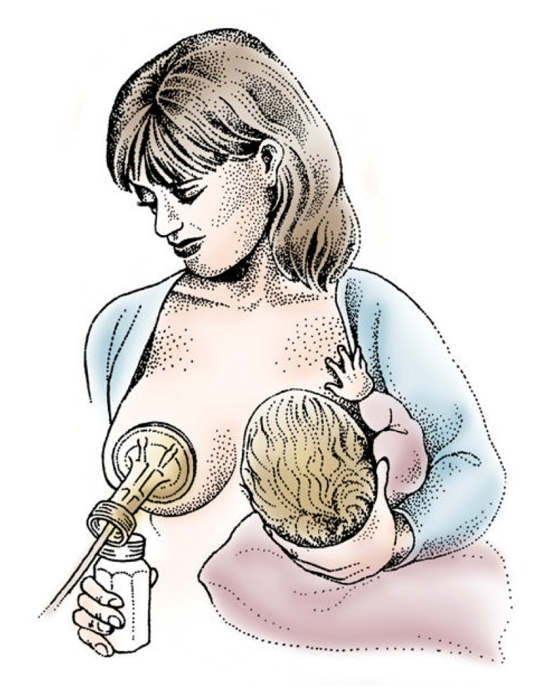
Help Mother Protect Her Milk Production
Help mom figure out when to begin expressing milk
Encourage her to express milk on a regular basis
Let her know pumping takes practice
Share relaxation pointers from other moms

Slide 21
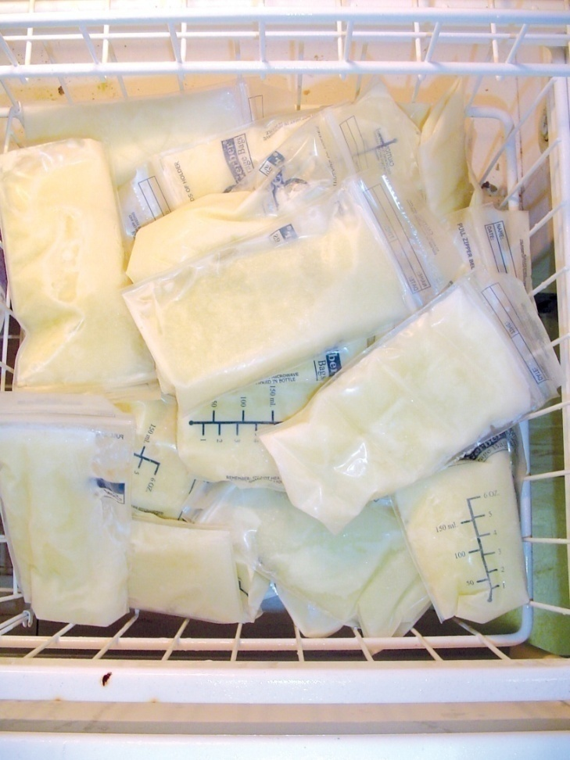
Handling Human Milk
Store in refrigerator or freezer after expressing
Freeze in small quantities
2-4 ounces typically
Smaller amounts for premature babies
Share info for milk storage
Keep milk cool when transporting

Slide 22
Storing Human Milk
American Academy of Pediatrics (AAP) recommends:
Freezing milk that will not be fed with 72 hours
Milk can be frozen for as long as 3 to 6 months

Slide 23
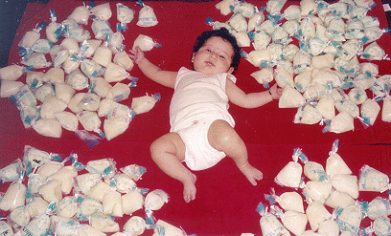
How to Thaw Frozen Milk
Thaw frozen milk under warm water
Don’t thaw milk in the microwave
Use thawed milk within 24 hours
Do not refreeze
Discard unused milk
California Public Health Foundation Enterprises

Slide 24

Success Starts at Home: WIC Supporting Breastfeeding Employees
Case Study:
California Public Health Foundation Enterprises

Slide 25

Show Me!
DVD: “Show Me Video Vignettes”
Handout 9.3: “Show Me Video Vignettes:
Talking about Breastfeeding with Working Mothers”

Slide 26
Application To Practice
Handout 9.4: “Application To Practice: Back to Work”
Handout 9.5: “Application To Practice: Hospitalized Infant”

Slide 27
Summary
Assisting mothers in coming up with a plan ahead of time helps them reach their breastfeeding goals.
Support, information, and encouragement from all WIC staff helps WIC mothers feel that they don’t have to figure it all out on their own.

Slide 28

Grow Your Breastfeeding Skills
“My Goals for Breastfeeding Support”
Goal-Setting Flower

