Slide 1
Application of Non dominated Sorting Genetic and Particle Swarm Optimization Process for solving machine loading problem in Flexible Manufacturing Systems

Slide 2
Introduction to FMS and Evolutionary algorithms
FMS stands for flexible manufacturing system. Flexibility is of two types machine flexibility and routing flexibility. FMS contain automated CNC machines , material handling and central control computer
Evolutionary algorithms are population based metaheuristic optimization algorithms. EA are inspired from nature.
EA are being used by various authors for scheduling the FMS job sequence

Slide 3
Objectives
To determine the job sequence in Flexible manufacturing system using evolutionary algorithms
To validate and develop an algorithm which will reduce the system unbalance and increase throughput and reduce the penalty cost for excluding any job

Slide 4
Problem Definition
Random FMS multiple machines and fixed tool slots
We have 8 different part types
Each part type have different number of operations.
Given data:
Here 4 machines are available.
Each machine has 8 hours of time and 5 tool slots available .
Part types are arriving randomly in a given planning period and their operation times and tool slot requirements are well known
The random FMS considered here is capable of performing operations that may be essential or optional. Essential operations are those that can be carried out on a particular machine using particular tool slots

Slide 5
Part type | Operation no. | Batch size | Unit processing time | Machine no. | Tool slots needed | Penalty cost (If not selected)
1 | 1 | 8 | 18 | 3 | 1 | 20
2 | 1 | 9 | 25 | 1 | 1 | 13
 |  |  | 25 | 4 | 1
 | 2 |  | 24 | 4 | 1
 | 3 |  | 22 | 2 | 1
3 | 1 | 13 | 26 | 4 | 2 | 15
 |  |  | 26 | 1 | 2
 | 2 |  | 11 | 3 | 3
4 | 1 | 6 | 14 | 3 | 1 | 25
 | 2 |  | 19 | 4 | 1
5 | 1 | 9 | 22 | 2 | 2 | 29
 |  |  | 22 | 3 | 2
 | 2 |  | 25 | 2 | 1
6 | 1 | 10 | 16 | 4 | 1 | 22
 | 2 |  | 7 | 4 | 1
 |  |  | 7 | 2 | 1
 |  |  | 7 | 3 | 1
 | 3 |  | 21 | 2 | 1
 |  |  | 21 | 1 | 1

Slide 6
7 | 1 | 12 | 19 | 3 | 1 | 17
 |  |  | 19 | 2 | 1
 |  |  | 19 | 4 | 1
 | 2 |  | 2 | 1 | 1
 |  |  | 13 | 3 | 1
 |  |  | 13 | 1 | 1
 | 3 |  | 23 | 4 | 1
8 | 1 | 13 | 25 | 1 | 1 | 26
 |  |  | 25 | 2 | 1
 |  |  | 25 | 3 | 1
 | 2 |  | 7 | 2 | 1
 |  |  | 1 | 1 | 1
 | 3 |  | 24 | 1 | 3
Problem adapted from Sankar and Srinivasulu(1989)

Slide 7
Mathematical Model

Slide 9
Variables Used

Slide 10
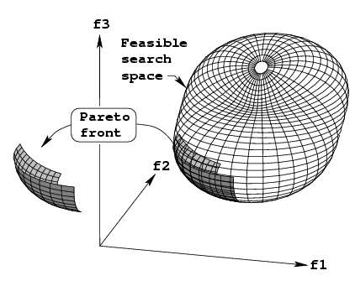
Non dominance
Dominance
A decision vector “k” is said to dominate decision vector “p” if the following two constraints satisfies:
fi(k) ≥ fi(p) For all i belongs to ( i = 1,2,…….m)
fi(k) > fi(p) for at least one i which belongs to (1,2,……m)
Pareto optimal solutions in min-min-min function
as visualized in 3 dimensions

Slide 11
Given two solutions
F(x) =
F(y) =
Normalized distance
Sharing function
where P is distance
and σ_{share} is given by
L is number of objectives
N is number of population
0 Otherwise
Niche count
where d_{pk} is the distance between p^{th} point and
k^{th} point and z(r_{i}) is the number of members
in the front with same rank ri

Slide 12
What are the extensions considered for the project?
Multi objective function is solved by assigning fitness determined by Non Dominated sorting procedure
A hybrid algorithm has been considered rather than single Genetic algorithm another algorithm Particle swarm has been added
Multiple objective has been considered with three objectives of which two are to be minimized and another is to be maximized, namely System unbalance, Penalty cost & Throughput .

Slide 13
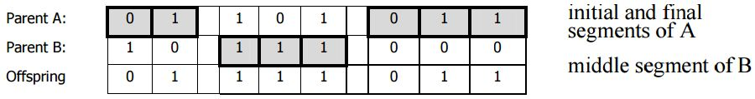
Non dominated sorting Genetic algorithm process:
Coding scheme: Pheno style coding scheme.
Feasible job sequence is coded as indicating the job sequence as two digit number
Example: Parent1: 01 05 08 02 06 09 03 07 10 04 ---→ for a 10 job sequence
Reproduction (Selection) scheme: Roulette selection
Crossover scheme : Single point or cycle crossover is considered
Example
Two point crossover
Mutation scheme:
With pheno type coding two random positions are selected and the positions are swapped
Fitness evaluation
Non dominated sorting fitness

Slide 14
NSGA Flow chart
Is Iter<Iteration size or best possible value achieved
start
No
Input all required values
Yes
stop
Iter=1
Compute new values
Mutation
Probability(pm)=0.005
Pop =pop+1
pop=1
Crossover probability(pc)=0.9
Non dominated sorting evaluation
Yes
roulette selection (update mating pool)
Is population<population size
Evaluate fitness function
No

Slide 15
Non dominated sorting Particle swarm optimization process:
is the best position of particle i and is the global best
${\text{v}}_{ij}^{t}$ is the velocity of the particle and ${\text{w}}_{\text{t}}$ is weight associated from the previous iteration
A sample representation of a job scheduling is given as below
Dimension j | 1 | 2 | 3 | 4 | 5 | 6
 | 0.11 | 1.48 | 1.21 | 0.45 | 1.08 | 0.32
 | 3.89 | 2.94 | 3.08 | -0.87 | -0.20 | 3.16
Job sequence | 1 | 6 | 4 | 5 | 3 | 2
Obtained by spv rule if initialized

Slide 16
NSPSO Flow chart
Is Iter<Iteration size or best possible value achieved
start
No
Input all required values
Yes
stop
Iter=1
Compute new values
Pop =pop+1
pop=1
Update x,v,w using the equations
Non dominated sorting evaluation
Yes
Is population<population size
Store pbest and gbest values
Evaluate fitness function
No

Slide 17
Solution Methodology Flow Diagram
Initialize
Add it to the population of PSO
Iterations=iterations +1
iterations< max iterations
Random function
If value >= 0.5
Yes
Activate PSO
PSO algorithm process
Global best from PSO
No
If value < 0.5
Stop and return Global best
Add it to the population of GA
Convert global best to job sequence
Activate GA
Iterations=iterations +1
iterations< max iterations
GA algorithm process
Yes
Convert global best to weight array
Global best from GA
No
Stop and return Global best

Slide 18
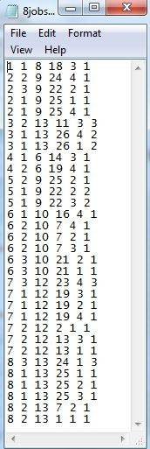
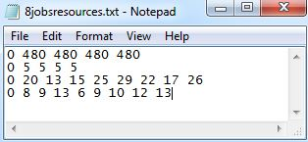
Input format
The input is provided in a text file.
Two inputs are given to the problem one being the constraints for each operation and tool slots needed
Other being Resources available for the machine
First row indicates the machine time available for each machine
Second row indicated the tool slots available on each machine
Third row indicates the penalty cost for not considering a part type
Fourth row contains the batch sizes for each part type

Slide 19
Results
Key Parameters | Notation | Value
NSGA
Population size | N | 20
Cross over probability | Pc | 0.8
Mutation probability | Pm | 0.05
Selection | - | Roulette selection
Maximum number of iterations | K | 100
NSPSO
C1,C2 | C1,C2 | 2,2 respectively
Inertial weight | W_{t} | 2
Decrement factor | β | 0.5
Non dominated Sorting
Alpha | α | 1
Sharing factor | σ | From table

Slide 20
Number of iterations

Slide 21
Number of iterations

Slide 22
Number of iterations

Slide 23
Number of iterations

Slide 24
Number of iterations

Slide 25
Number of iterations

Slide 26
Key Insights from the results
From the analysis we understand the effective data handling capability of NSGA and NSPSO algorithm. It is giving near optimal solution at population size of 20 and total generations of 50
From the graphs (Figure 1,2 and 3) in each algorithm as the number of iterations increases System unbalance and Penalty cost is minimized while throughput is maximized
From the graphs (Figure 4,5 and 6) NSGA & PSO algorithm gives more effective results. System unbalance has been reduced, throughput has been maximized and Penalty cost has been minimized.
The graphs are not always consistent in reducing a objective because we are considering Non dominated procedure for evaluation of Fitness which may result in elevation in graph although iterations increases

Slide 27
Practical Implications/ Utility of Results
We have 8 jobs with 8! Job sequences. For one order it exist (9). (6). (6). (2). (2). (2). (1). (1). (1) = 2592 machine allocations for operations. With this we have 8! Type job sequences, so combining these two gives 8! . 2592= 10^9 combinations. Hence forth exhaustive search method will be practically not applicable
Practically in FMS traditional methods are being followed in job sequencing using predetermined sequencing rules(LIFO,FIFO,SPT,CR).But it may not always guarantee in optimal solutions. But from the above analysis we can conclude that we can achieve near optimal solutions in Multi objective environment reducing the stress and helping the job operator to avoid tedious calculations.

Slide 28
Conclusion & Scope for Future Work
Here in this project we have tried to deal with multi objective problems in Manufacturing industry where large number of part types are processed on various machines. We provided a new meta-heuristic approach to handle this computational complexity involved in this project.
1. Developing a methodology for multi-objective optimization
2. Development of new solution representation scheme in linking both NSGA and PSO
3. We have introduced more complexity in this problem by consider three objectives which
differ in nature(Maximization and minimization.
Future research can be done along by including more complexity in this problem.
(Introducing travel time between the machines, increasing part types also increasing the number of objectives).
More realistic variables and constraints, such as the availability of pallets, jigs, fixtures, automatic guided vehicles (AGVs)
Consideration of multiple objective based on pareto dominance to balance conflicting constraints may give new direction in field of Meta heuristics as well as FMS

Slide 29
Key References
Berrada and Stecke, 1986 M. Berrada, K.E. Stecke, A branch and bound approach for machine load balancing in flexible manufacturing systems,Management Science, 16 (10) (1986), pp. 1316–1335
D. Powell, M. Skolnick,Using genetic algorithm in engineering design optimization with non linear constraints,S. Forrest (Ed.), Proceedings of the ICGA-93, Morgan Kaufman, San Mateo, CA (1993), pp. 967–972
M.K. Tiwari, B. Hazarika, P. Jaggi, N.K. Vidyarthi, S.K. Mukhopadhya,A heuristic solution approach to the machine loading problem of an FMS and its petri net model, International Journal of Production Research, 35 (8) (1997), pp. 2269–2284
M.K. Tiwari, N.K. Vidyarthi, Solving machine loading problems in a flexible manufacturing system using a genetic algorithm based heuristic approach, International Journal of Production Research, 38 (4) (2000), pp. 3357–3384
S. Saravana Sankar ,S. G. Ponnanbalam,C. Rajendran,A multiobjective genetic algorithm for scheduling a flexible manufacturing system,International Journal of Advanced Manufacturing Technology (2003) 22: 229–236
Sandhyarani Biswas & S. S. Mahapatra, Modified particle swarm optimization for solving machine-loading problems in flexible manufacturing systems, International Journal of Advanced Manufacturing Technology (2008) 39:931–942

