Slide 1
Using LIGGGHTS to Simulate Flexible Fibers
Matt Schramm

Slide 2
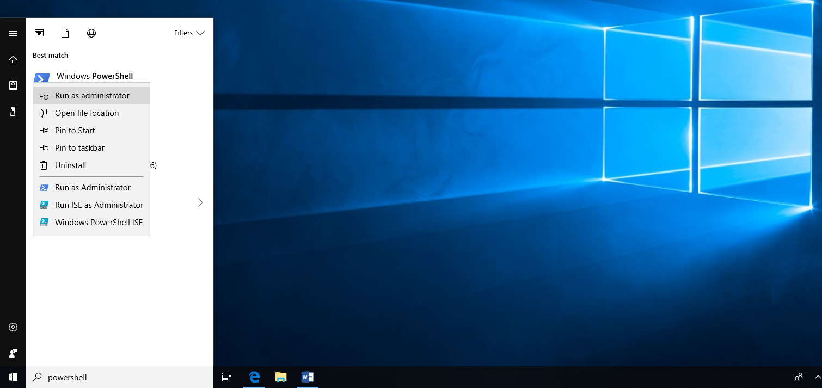
Install the Linux Subsystem for Windows 10 – Step 1
Open Powershell as an administrator

Slide 3
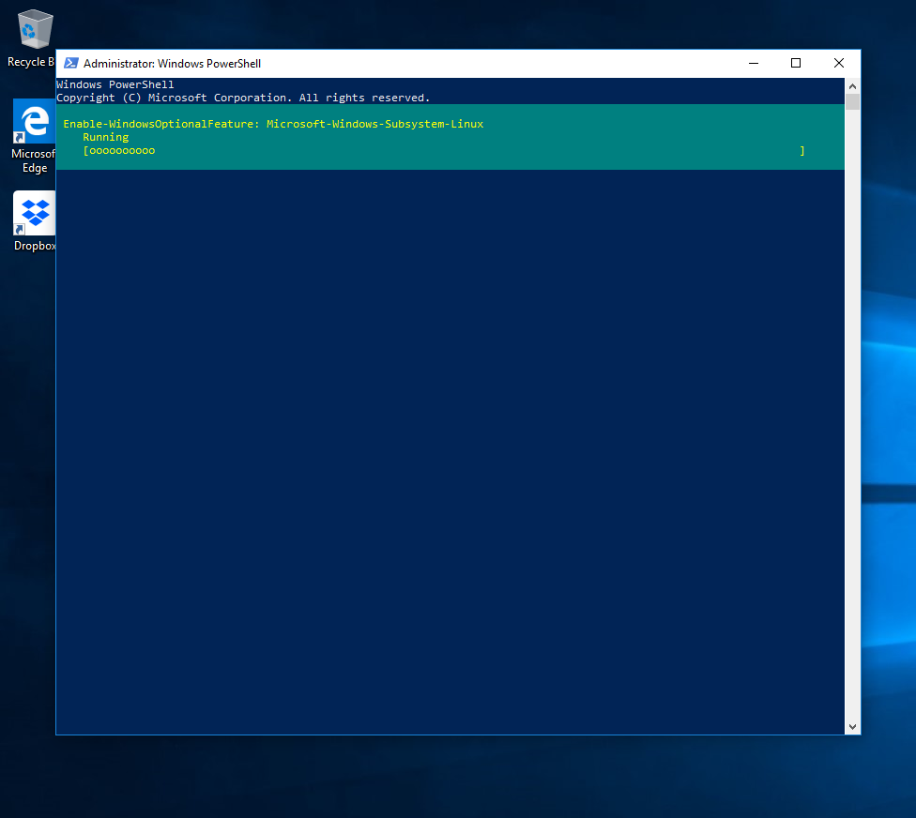
Install the Linux Subsystem for Windows 10 – Step 2
Type the command (Enable-WindowsOptionalFeature -Online -FeatureName Microsoft-Windows-Subsystem-Linux)
After Completion, restart your computer

Slide 4
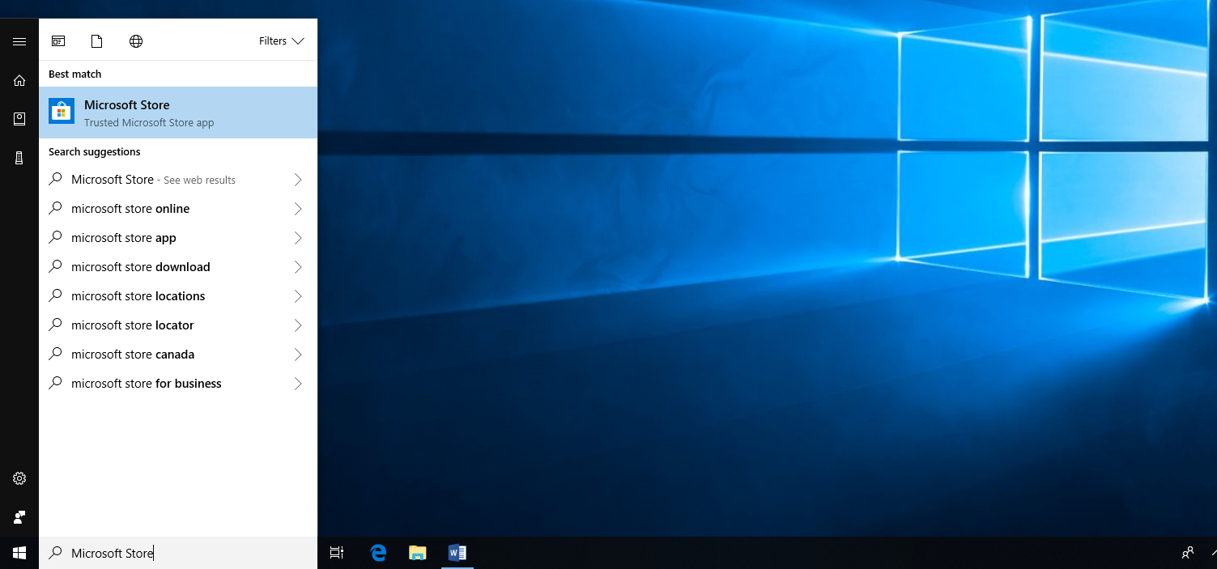
Install the Linux Subsystem for Windows 10 – Step 3
Open the Microsoft Store

Slide 5
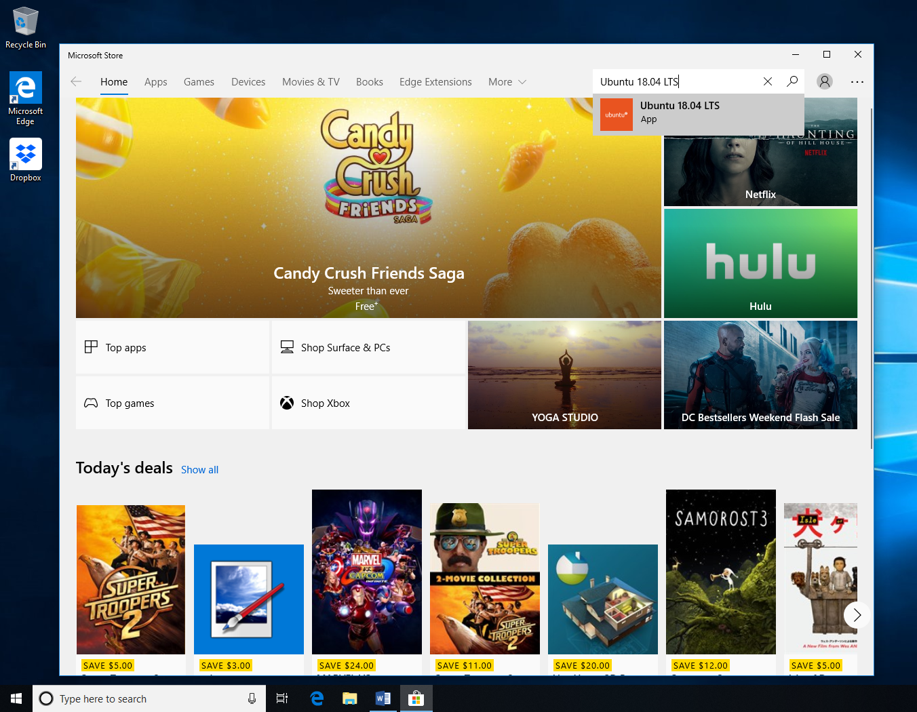
Install the Linux Subsystem for Windows 10 – Step 4
Search for Ubuntu 18.04 LTS

Slide 6
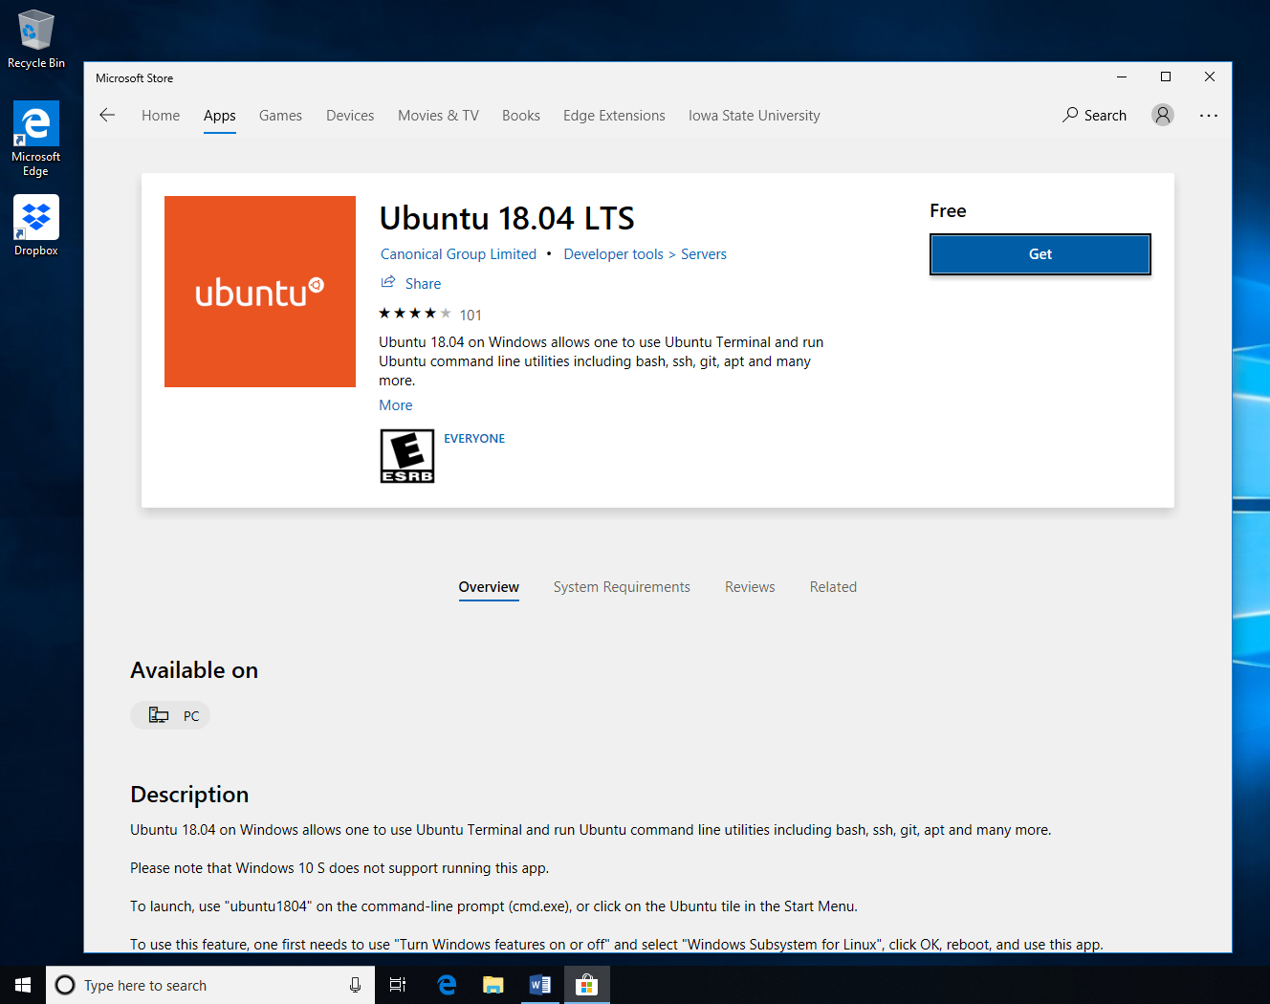
Install the Linux Subsystem for Windows 10 – Step 5
Download Ubuntu 18.04 LTS

Slide 7
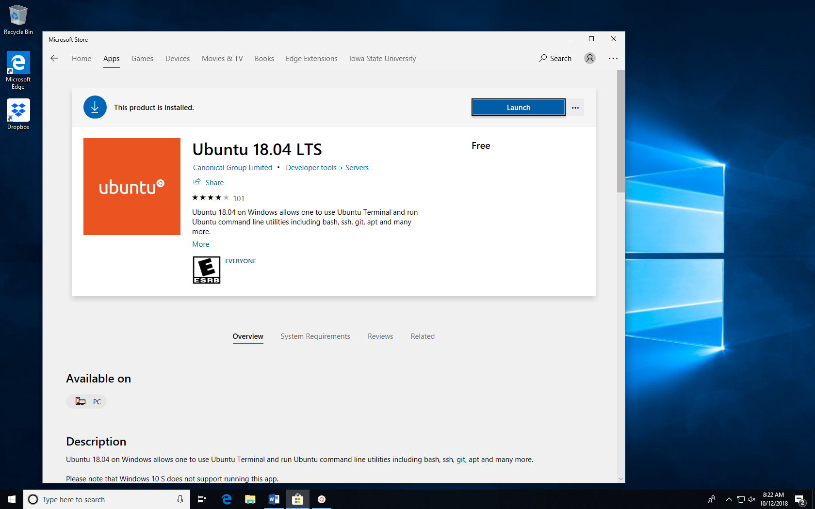
Install the Linux Subsystem for Windows 10 – Step 6
Launch Ubuntu 18.04 LTS

Slide 8
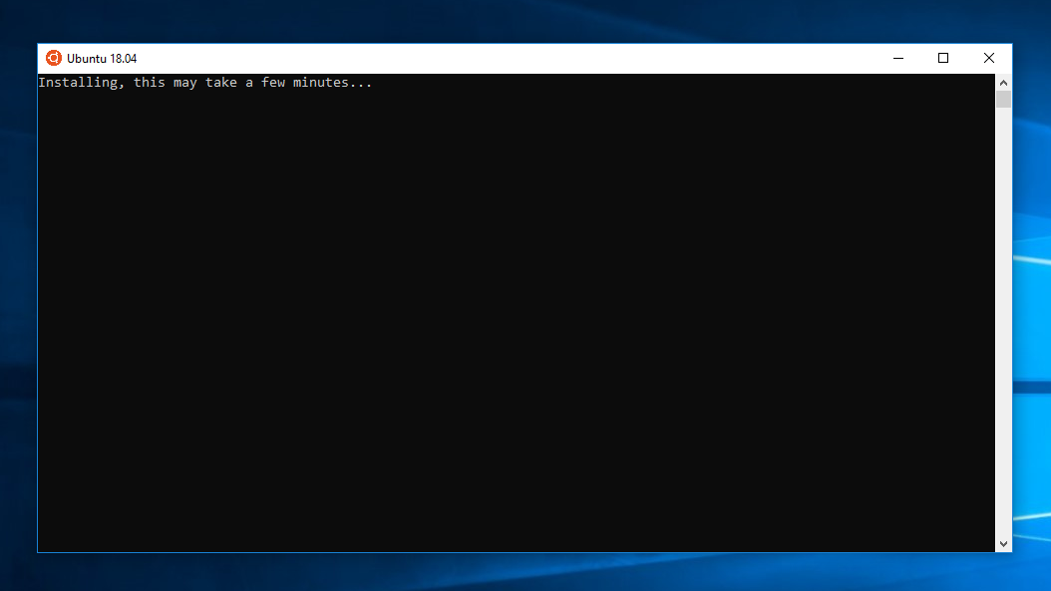
Install the Linux Subsystem for Windows 10 – Step 7
Let Ubuntu install

Slide 9
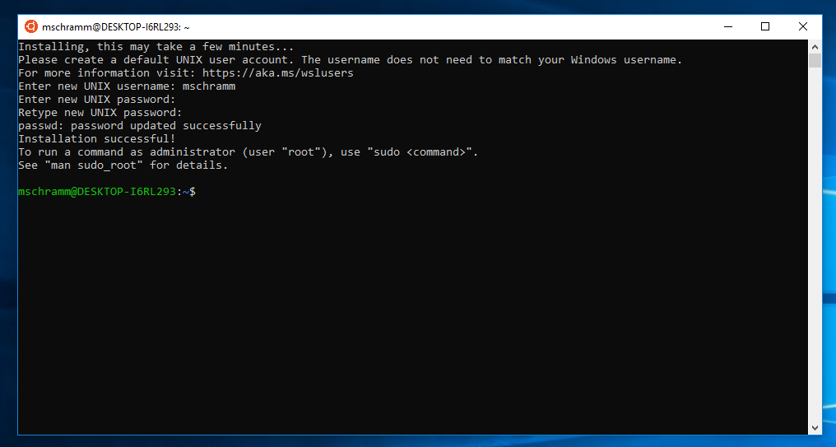
Install the Linux Subsystem for Windows 10 – Step 8
Make an account (username and password)

Slide 10
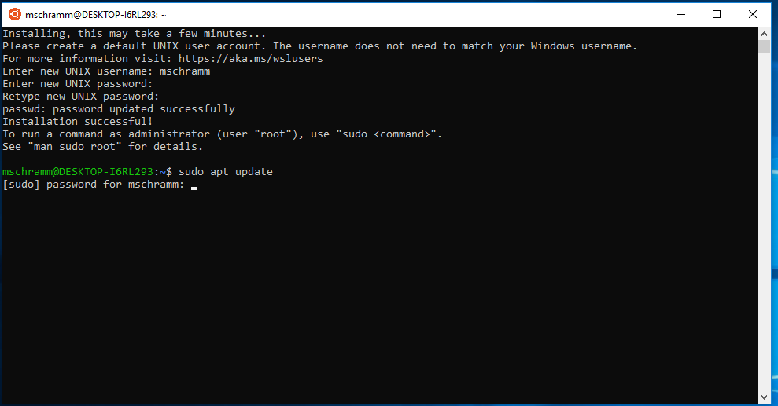
Install the Linux Subsystem for Windows 10 – Step 9
Update the subshell

Slide 11
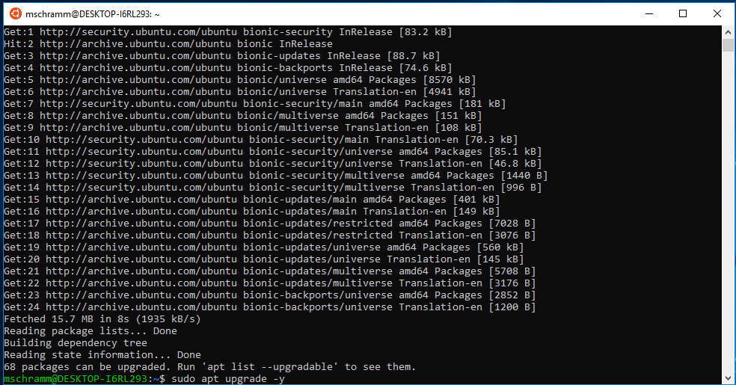
Install the Linux Subsystem for Windows 10 – Step 10
Upgrade the subshell

Slide 12
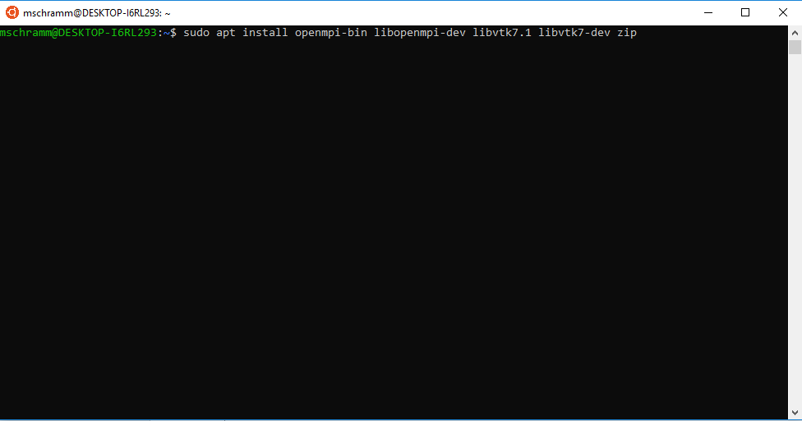
Install the Linux Subsystem for Windows 10 – Step 11
Install dependencies by running the command “sudo apt install openmpi-bin libopenmpi-dev libvtk7.1 libvtk7-dev zip” then wait…

Slide 13
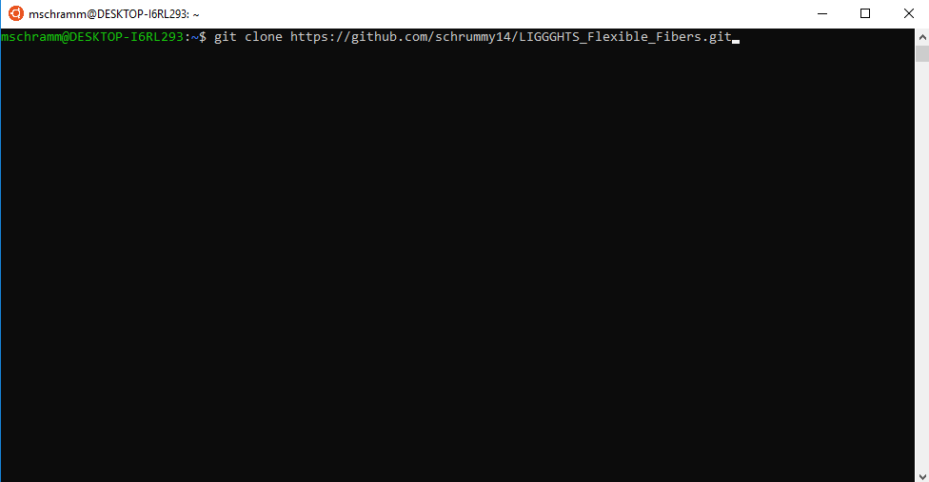
Install LIGGGHTS – Step 1
Get LIGGGHTS using git git clone https://github.com/schrummy14/LIGGGHTS_Flexible_Fibers.git

Slide 14
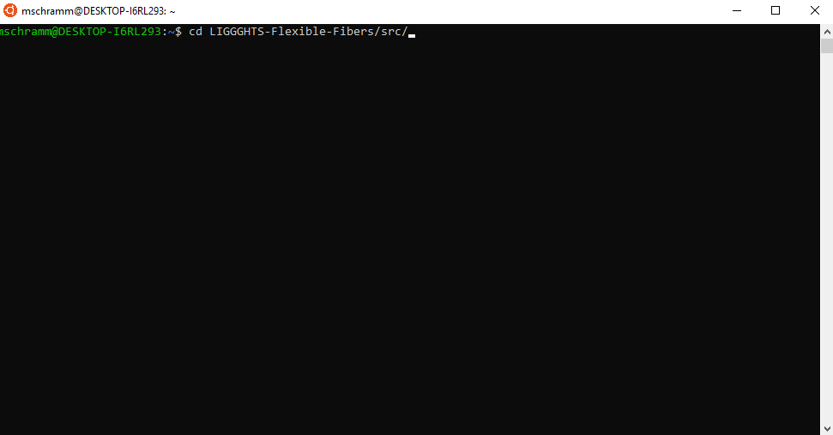
Install LIGGGHTS – Step 2
Navigate to src in LIGGGHTS “cd LIGGGHTS-Flexible-Fibers/src/”

Slide 15
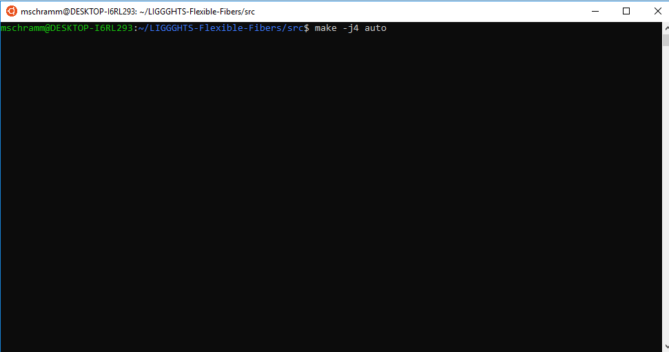
Install LIGGGHTS – Step 3
Build LIGGGHTS “make –jm auto” where m is the number of cores on your machine

Slide 16
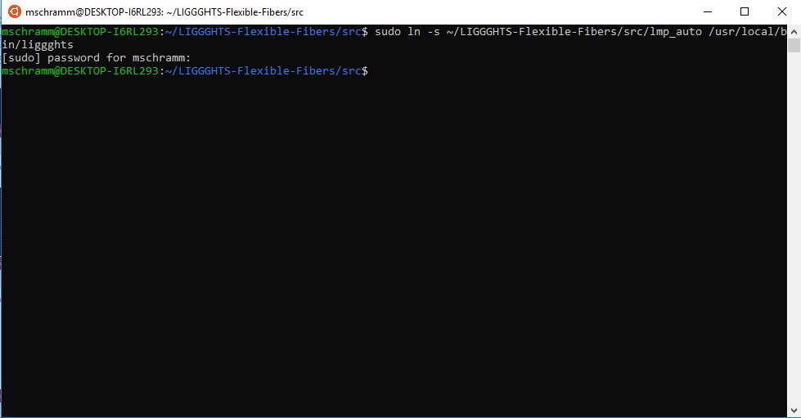
Install LIGGGHTS – Step 4
Create a symbolic link for liggghts “sudo ln –s ~/LIGGGHTS-Flexible-Fibers/src/lmp_auto /usr/local/bin/liggghts”

Slide 17
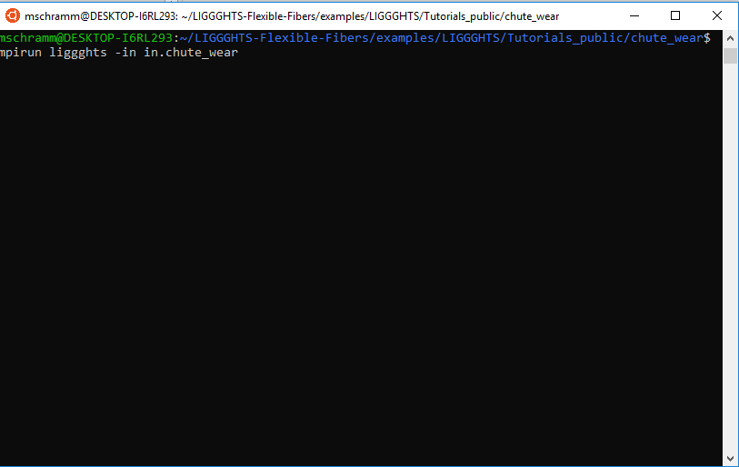
Install LIGGGHTS – Step 5
Check if install works by running an example
Type “cd ../examples/LIGGGHTS/Tutorials_public/chute_wear”
Run LIGGGHTS “mpirun liggghts –in in.chute”

Slide 18
Install Paraview 5.4.1 – Step 1
Download Paraview 5.4.1 https://www.paraview.org/paraview-downloads/download.php?submit=Download&version=v5.4&type=binary&os=Windows&downloadFile=ParaView-5.4.1-Qt5-OpenGL2-Windows-64bit.exe
Run the installer

Slide 19
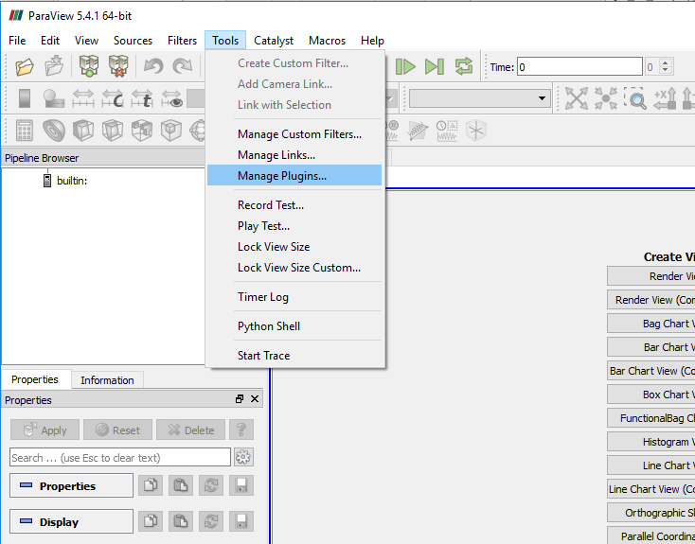
Install Paraview 5.4.1 – Step 2
Download LIGGGHTS Reader https://github.com/richti83/ParaView_Reader_for_LIGGGHTS/raw/master/pre_compiled/Windows/5.4.1/liggghts_reader.dll
Start Paraview and navigate to manage plugins

Slide 20
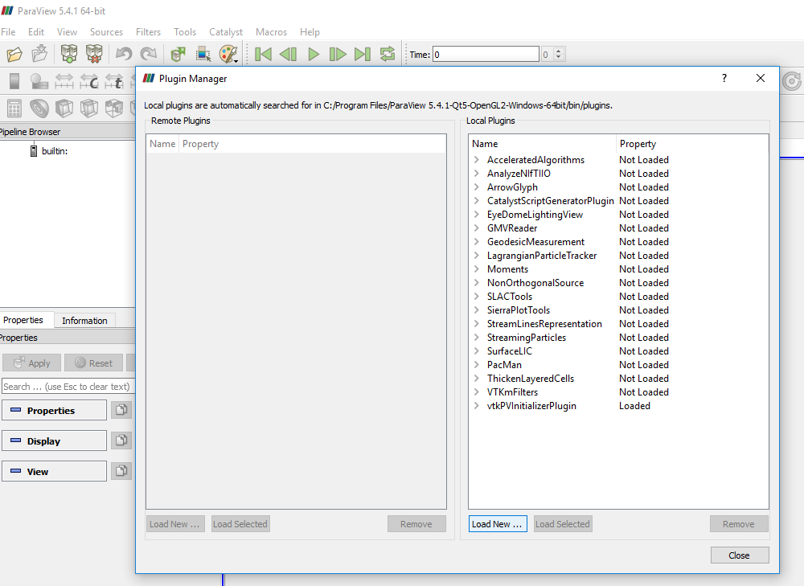
Install Paraview 5.4.1 – Step 3
Load a new plugin

Slide 21
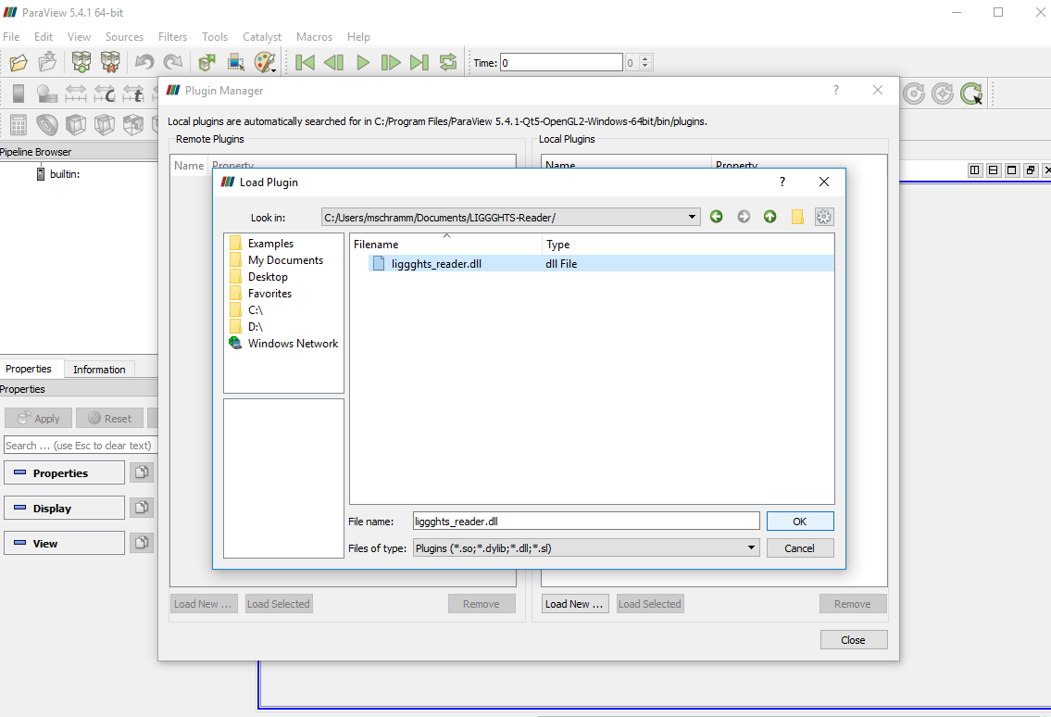
Install Paraview 5.4.1 – Step 4
Add LIGGGHTS-Reader

Slide 22
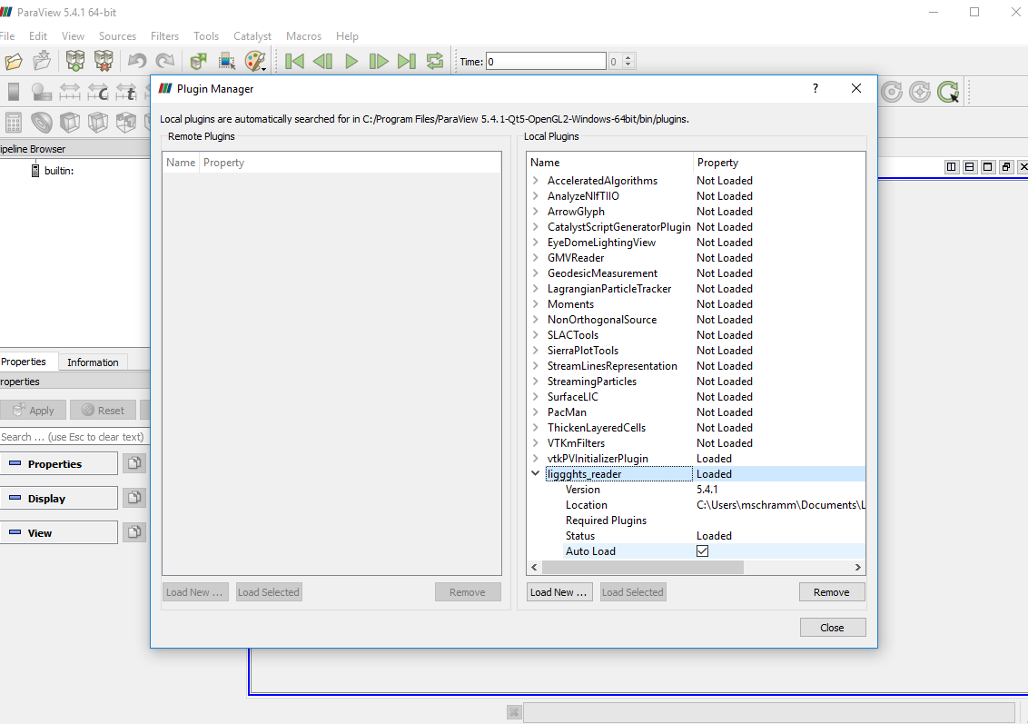
Install Paraview 5.4.1 – Step 5
Auto load the reader

Slide 23
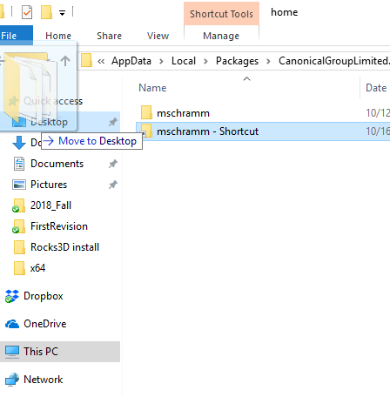
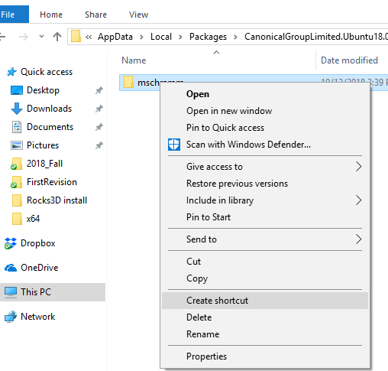
Add Shortcut to the Linux sub system
Navigate to “C:\Users\<USER_NAME>\AppData\Local\Packages\CanonicalGroupLimited.Ubuntu18.04onWindows_79rhkp1fndgsc\LocalState\rootfs\home”
Create a shortcut
Move shortcut to desktop

