Slide 1
Locale Support for Emacs
TOSSUG
Wei-Lun Chao <bluebat@member.fsf.org>
22 Apr. 2014
Notes:
Hello, everyone.
Today I would like to introduce you a project I have contributed with regard to the
"Locale Support for Emacs"

Slide 2
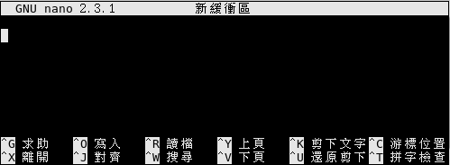
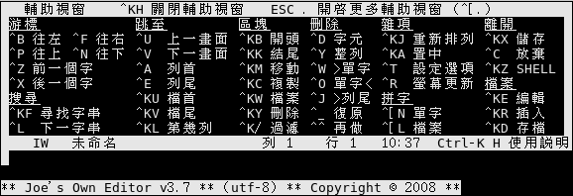
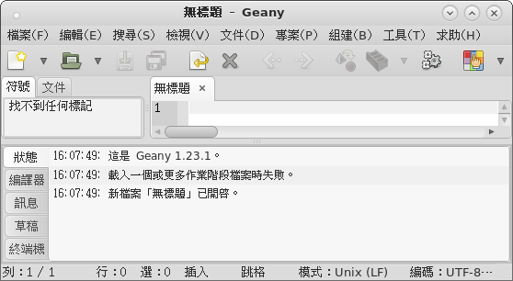
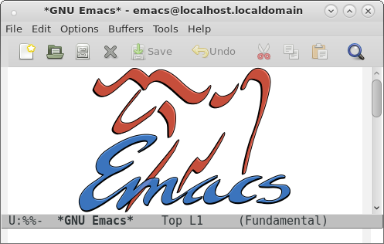

Which?
Nano
Geany
Joe
Emacs
Notes:
Which editor do you use? That's really a frequently asked question. Sorry for not including vi here.
We have nano, joe and geany. You can use them with the interface in your language.
But even without this, emacs is still one of the favorite choice.

Slide 3

Why?
Born before other GNU software
  No locale framework at that time
    No localization mechanism
      No translation
http://lists.gnu.org/archive/html/help-gnu-emacs/2007-07/msg00479.html
Notes:
So, why is there only english interface for emacs?
Most of its users are developers. That may be a part of the reason.
And ... then ... then ... then ...

Slide 4

Where?
Project:
https://github.com/bluebat/emacs-locale
forked from https://github.com/careone/emacs-locale
Original source:
http://sourceforge.net/projects/emacslocale/
Refered files:
http://www.emacswiki.org/cgi-bin/emacs/chinese-menu.el
chinese-menu-init.el by Ye Wenbin, 2006.
Notes:
The project I would like to show you is forked from the project created by careone.
You can get the original source from its souceforge site.
I have added an initial script written by Ye Wenbin for an older version of emacs.

Slide 5

How?
Getting template files from emacs-el package
e.g. /usr/share/emacs/site-lisp/locale/zh_TW/menu-bar.el
: : :
(defvar menu-bar-help-menu (make-sparse-keymap "求助"))
: : :
(defvar menu-bar-tools-menu (make-sparse-keymap "工具"))
: : :
(defvar global-buffers-menu-map (make-sparse-keymap "緩衝區"))
: : :
(defvar menu-bar-options-menu (make-sparse-keymap "選項"))
: : :
(defvar menu-bar-edit-menu (make-sparse-keymap "編輯"))
: : :
(defvar menu-bar-file-menu (make-sparse-keymap "檔案"))
: : :
Notes:
So, how does it work?
The template files are from the emacs-el package.
Actually, they are emacs lisp programs.
For example, we put a copy of the script for menu-bar in /usr/share/emacs/site-lisp/locale/zh_TW/ directory, and then translate included strings into Traditional Chinese.

Slide 6
What?
> which emacs
/usr/bin/emacs
> git clone https://github.com/bluebat/emacs-locale.git
> cd emacs-locale
> make install -n
install -d /usr/share/emacs/site-lisp/site-start.d
install -m644 locale-init.el \
/usr/share/emacs/site-lisp/site-start.d
cp -a locale /usr/share/emacs/site-lisp
install -d /usr/share/doc/emacs-locale
cp -a doc/* /usr/share/doc/emacs-locale
> make install
Notes:
Before using this, of course you must install emacs first.
After cloning from the git repository, you can type make install to install the start script, the translation files and the documents.

Slide 7
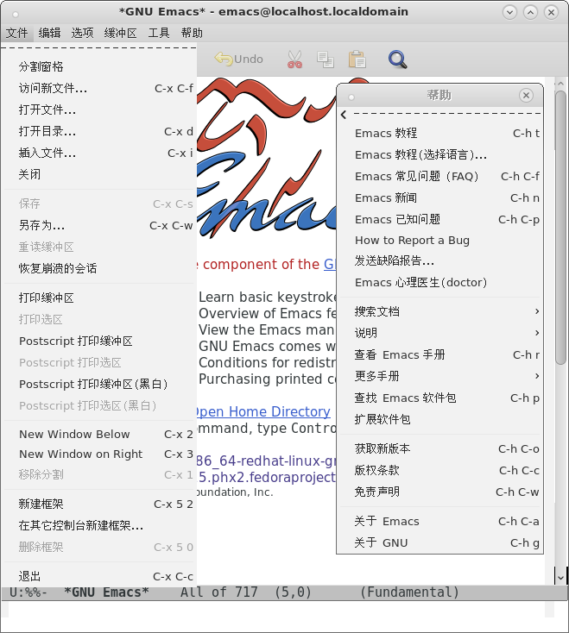
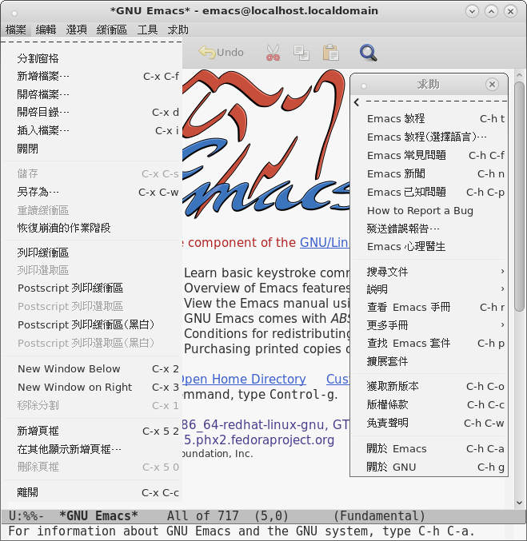

Who?
Simplified Chinese
Traditional Chinese
Notes:
Currently only with translations for Simplified Chinese and Traditional Chinese.
Is anyone interested in making a French or Japanese version of emacs?

Slide 8
Thank you!
Slides Template：資訊未來大自由 by Eric Sun
Notes:
Ok, that's all. Thanks for your listening.
You may see a short live demo.

